Slide 1
NLP Application on Identifying the Gene Phenotype
Artificial Intelligence Project
Bin Li
Chen Song
Zhenyu Zhao

Slide 2
Agenda
Why NLP in Biology
Inspiration from former work and aim of our work
Training Algorithms we use
Revise different training model
Effort to improve accuracy
Limitation and future work

Slide 3
NLP application in Biomedical Science
Traditional
Analyze medical record information to track patient’s condition
Integrate information to make a more accurate diagnosis
Precise matching and management of medication
Non-Traditional
Recognition of semantic meaning based on training on dataset
Read the semantic meaning of genes and predict mutations
Read the semantic meaning of genes and predict the phenotype

Slide 4
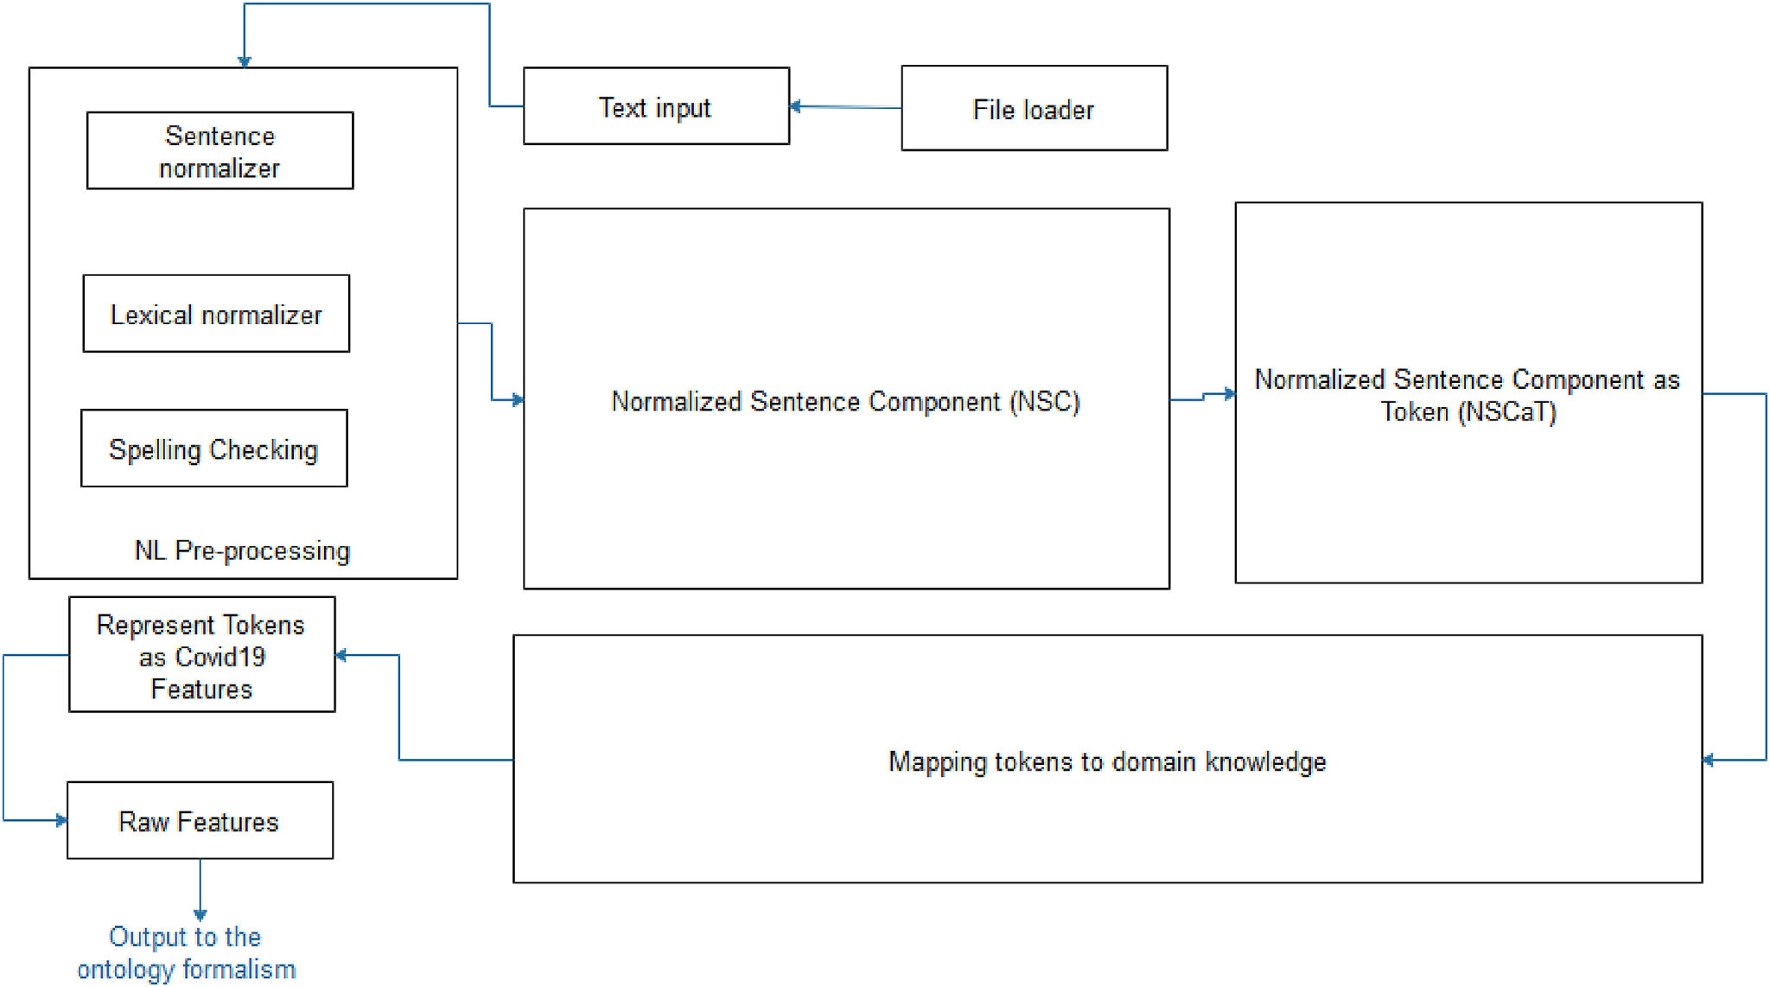
Former Work
Using NLP on detect the infectivity may help the world prepare for dangerous mutations.
Covid-19 has too many variations and some are extreme infective. Biological detection takes too long. Researchers have found that the semantic meaning of the virus is related to infectivity. The infectivity of the mutation can be predicted by reading the semantics of the text.
Training model of NLP-based Covid variant prediction

Slide 5
Why NLP Can Be a Great Tool
In the bioinformatics area, different language structures and content also imply biological meanings differently.
Great tool for Text Mining, Text classification, Text Clustering
As we know from the course, Although NLP has developed very mature. The most chatting bot does not understand the meaning of language. However in the biological applications, we don’t need the understanding of content. We use NLP as a tool, not develop NLP.

Slide 6
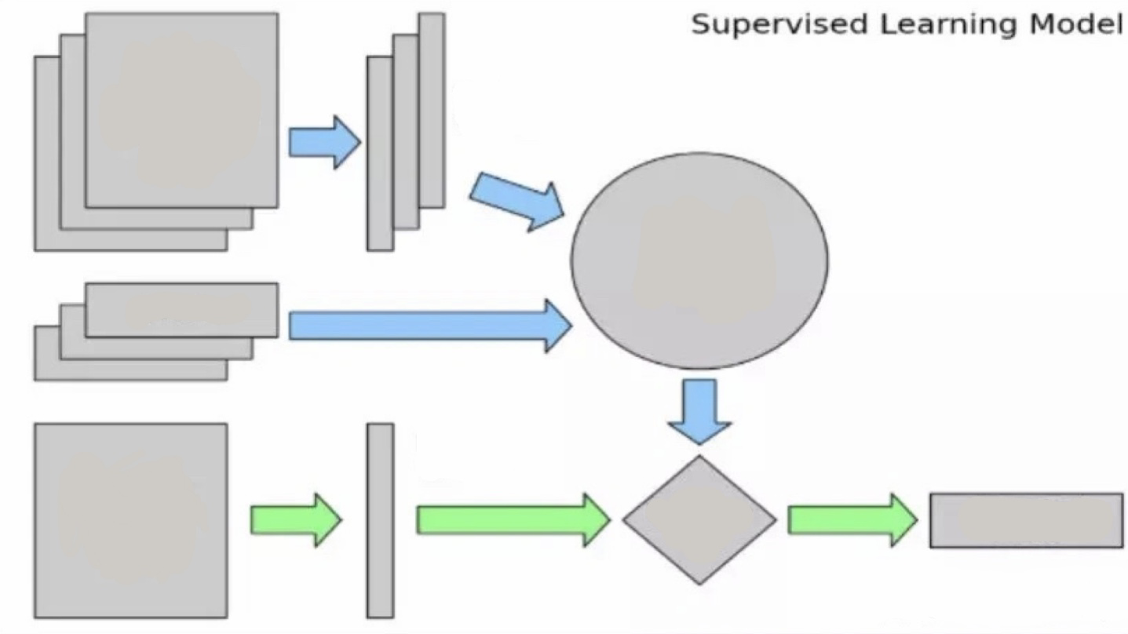
Our Project
Similar to the former work training on the semantic meaning of the current virus to predict the future mutant.
Our work training on the genotype and predict the phenotype of the unknown gene. The work is meaningful because we can know the phenotype without a comprehensive biology experiment and just read the gene's semantic information.
Training text of Genotype
Feature
Vectors
Machine
Learning
Algorithm
Labels
Feature
Vectors
New Text
Of
Genotype
Predictive
Model
Expected Label
System Model

Slide 7
Training data
Yeast Gene Data
Amount of Genotype: 28820 genetic variants
Cross Strains: Laboratory Strain (BY), encoded as -1. Vineyard Strain (RM), encoded as 1
Phenotype: represent as a continuous numerical strain
Label: phenotype measurements are greater than the statistical mean value and the rest of the samples as 0.
Goal: Find specific Phenotype in a large amount of data
Training data: 90% Test Data: 10%

Slide 8
Training Algorithm
Machine Learning Algorithm
CNN
Deep CNN(2 layers)
RCNN
CNN+LSTM
CNN+LSTM+Attention
Federate Learning
Algorithm | CNN | Deep CNN | RNN
Accuracy(%) | 78.7 | 81.83 | Too slow

Slide 9
RNN
Characters
TextRNN is good at dealing with sequence structure
RNN can extract the internal pattern among a sample
Linear regression and CNN have been used to extract relationship between samples in phenotype prediction task.
TextRNN Cell

Slide 10
Where to place the RNN (RNN: Recurrent neural network)
Using RNN at the first layer of the model
Need 50min for one epochs (more than 28,000 features in one sample)
2. Using at the latent space in a CNN/Linear model
Linear model: 73% accuracy
CNN model: 78% accuracy

Slide 11
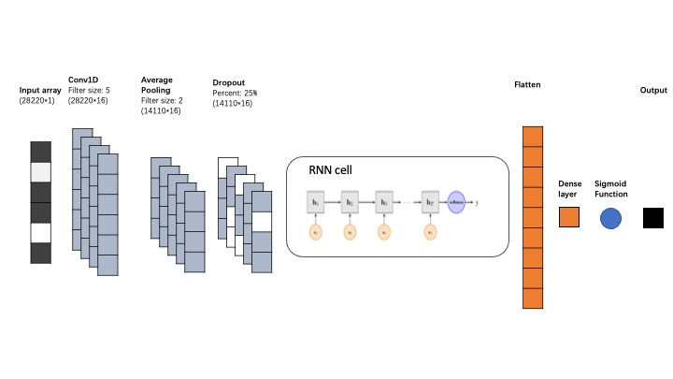

Slide 12
What RNN cell
Simple RNN: oversimple, performance is bad
GRU(Gate Recurrent Units): Performance is not very stable.
LSTM(long short term memory): Stable and Work better than the other two
(Bidirectional: calculate the information in two directions.)
Bi-LSTM: Perform best (parameter: Number of Hidden Units. 80)

Slide 13
Attention in LSTM

Slide 14
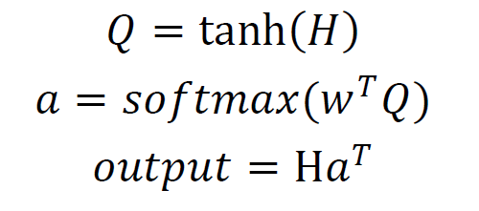
LSTM with Attention
Attention
H
summarize
Summarize: Mean(output)

Slide 15
Outcome of Training
LSTM
LSTM+Attention (Need much more time to let the parameters converge)
Accuracy
Algorithm | CNN-LSTM | CNN-LSTM+Attention
Accuracy(%) | 84.45 | 91.82

Slide 16
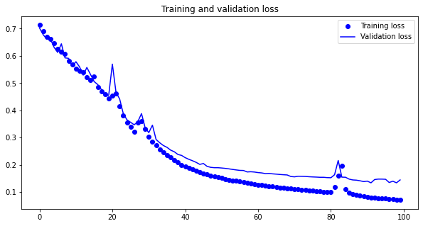
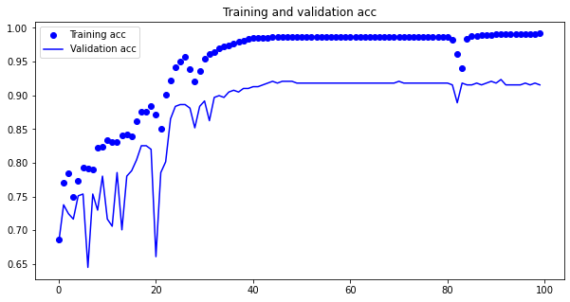
Training Time: about 600 mins on a CPU Laptop
100 epochs with adam optimizer
Keras Platform
10-Folds validation

Slide 17
Federate Learning
Motivation
Training a modern machine learning model often requires a large amount of data distributed across multiple organizations.
Data owners could be reluctant to share their data (even in the encrypted form).
It becomes highly desired to allow two or more owners to build a joint ML model while ensuring the privacy protection of the data.

Slide 18
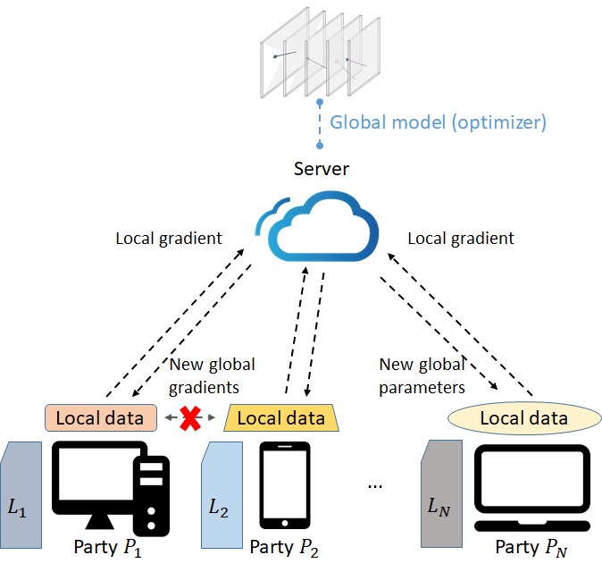
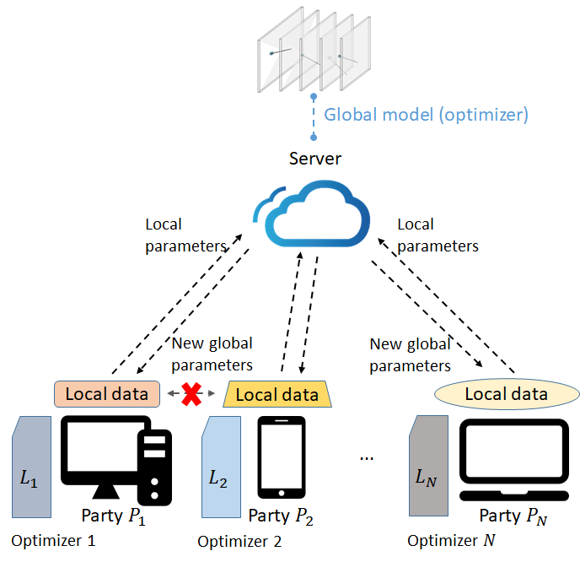
FedSGD VS. FedAVG
FedSGD
FedAVG

Slide 19
Prediction Outcome of Federate learning
Accuracy
Algorithm | FedSGD | FedAVG
Accuracy(%) | 82 | 88

Slide 20
Final result comparison and Conclusion
Comparison
Final Conclusion
The CNN-LSTM+Attention model reaches the best performance. Hard to implement on FL.
Algorithm | CNN | Deep CNN | CNN-LSTM | CNN-LSTM+Attention | Federate Learning(LSTM)
Accuracy(%) | 78.76 | 81.83 | 84.45 | 91.82 | 88.31

Slide 21
Meaning of this Project
Discover Different Language Structures’ Semantic meaning in Biological Area
Many related former works on the semantic information of the virus variants, and we discover a new area, phenotype, which has a lot of practical value.
Reach High Accuracy in Phenotype Prediction
We reach an accuracy of 91%. Although it’s not enough to replace the biological diagnosis, we get the same level of accuracy in the former work with Covid-19 variants. And it’s considered accurate in the prediction and detection model.

Slide 22
Limitation and Future Work
Accuracy Still needs to be improved
This limitation is common for current NLP-based biology diagnosis. Biodiagnostic gene technology can reach 99% accuracy, nearly 100% with advanced technology. However, NLP-based diagnosis only has around 91% accuracy, although it’s already considered reliable in the detection area. The accuracy limits the method only used for a prediction, and future biological diagnosis is needed. Also training is needed when it comes to a new phenotype.
Expectations for Future work
Scientists need to create a new structure of training system to improve accuracy. Once the accuracy reaches nearly 99%, a new era of Biological diagnosis will come.

Slide 23
Thank you

