Slide 1
Deep Learning-Based Symbolic Processing in Prolog
Mina Gabriel :)
Hanzi Xu :)
Peiyu Liang :)

Slide 2
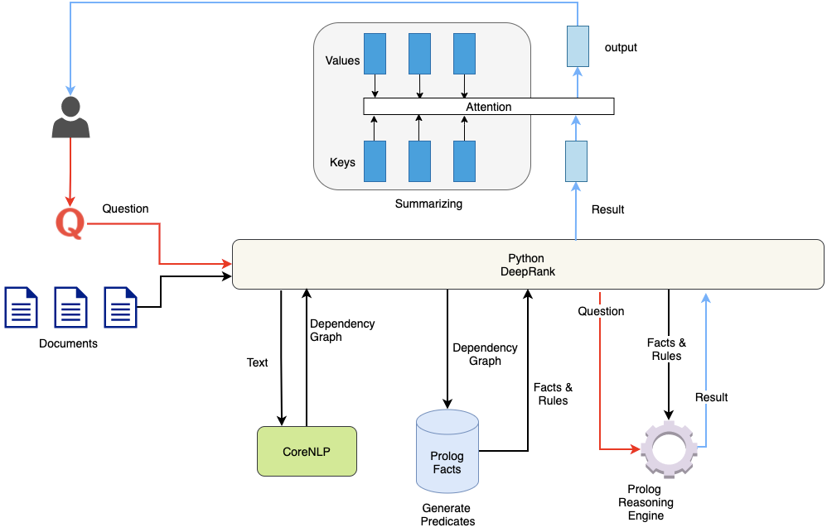
Neural to Symbolic NLP system architecture

Slide 3
Tesla Model 3 Manual
On an even larger document, like the Tesla Model 3 owner’s manual,13 digesting the document takes about 60 seconds and results in 12 MB of Prolog clauses. After that, query answering is still below 1 second.

Slide 4
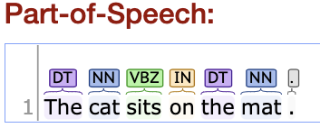
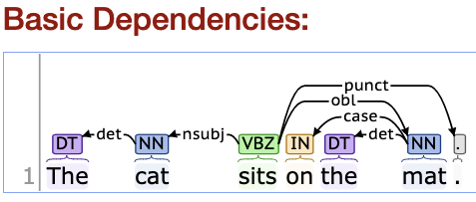
Stanford CoreNLP
Text.txt file
The cat sits on the mat.
Defines a high accurate dependency graphs.
dep(0, 'sits', 'VBZ', 'nsubj', 'cat', 'NN').
dep(0, 'cat', 'NN', 'det', 'The', 'DT').
dep(0, 'sits', 'VBZ', 'nmod', 'mat', 'NN').
dep(0, 'mat', 'NN', 'case', 'on', 'IN').
dep(0, 'mat', 'NN', 'det', 'the', 'DT').
dep(0, 'sits', 'VBZ', 'punct', '.', '.').

Slide 5
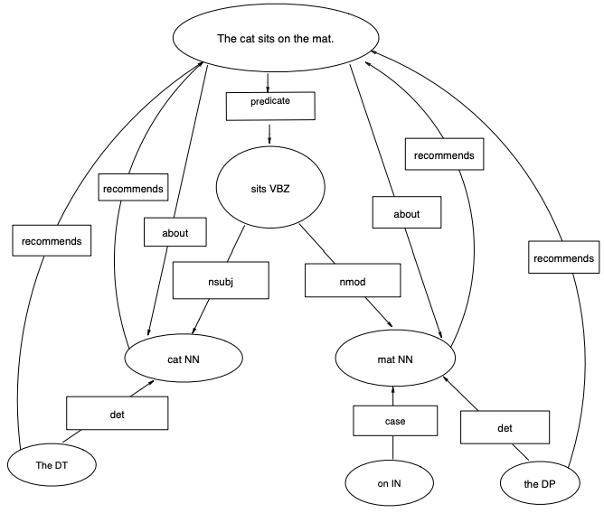
DeepRank Changes
redirect the dependency edges toward nouns
add “about” edges from the sentences they occur in.
sentences recommend verbs with predicate function.
their recommendation spreads to nouns that are predicate arguments

Slide 6
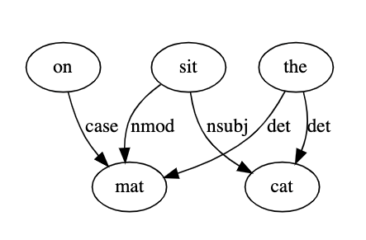
“As key phrases are centered around nouns and good summary sentences are likely to talk about important concepts, we will need to reverse some links in the dependency graph provided by the parser, to prioritize nouns and deprioritize verbs, especially auxiliary and modal ones.”
The dependency graph edges are annotated using the Universal Dependencies Treebank Tags.

Slide 7
PageRank (just to illustrate the idea!)
 | FROM
TO |  | the | cat | Sit | on | mat
 | the | 0 | 0 | 0 | 0 | 0
 | cat | 1 | 0 | 1 | 0 | 0
 | sit | 0 | 0 | 0 | 0 | 0
 | on | 0 | 0 | 0 | 0 | 0
 | mat | 1 | 0 | 1 | 1 | 0

Slide 8
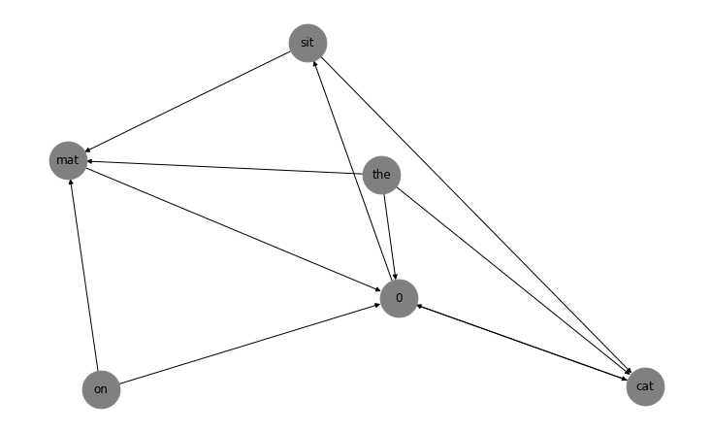
{0: 0.3748812025081476,
'cat': 0.269746898745926,
'mat': 0.12104622137883939,
'on': 0.025,
'sit': 0.1843256773670866,
'the': 0.025}

Slide 9
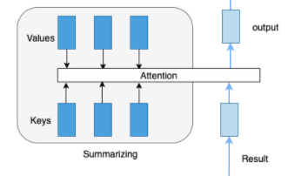
LSTM Summarization examples:

Slide 10
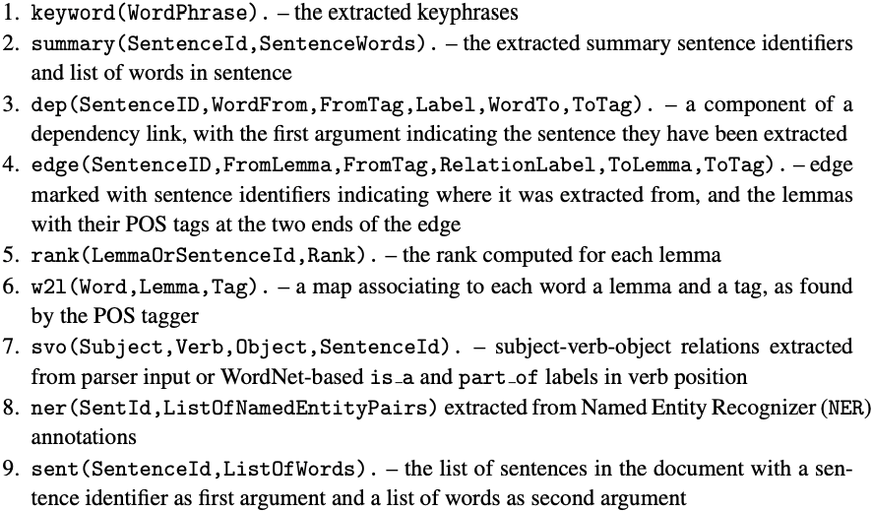
Prolog Facts Generation Process
-Use dependency graph as text representation.
-To keep the interface simple and portable to Prolog, DeepRank generate the following predicates from dependency graph in the form of Prolog-readable code, in one file per context.

Slide 11
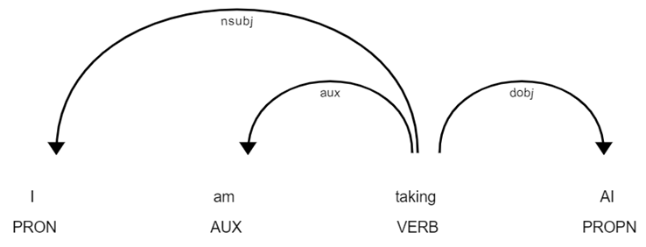
Prolog Facts Generation Process
Predicates come from linguistic knowledges of words in the sentence
Mainly based on two linguistic features: part of speech(POS) tag and syntactic dependency tag
POS tag: a particular grammatical class of word
Syntactic dependency tag: a relation between two words in a sentence
Example: “I am taking AI”

Slide 12
Prolog Facts Generation Process
DeepRank: We use:
Use another API, Spacy, to do the job for POS and dependency annotations and compare the performance.
Write our own prolog fact generation program, and improve the Prolog facts generated from the above notations

Slide 13
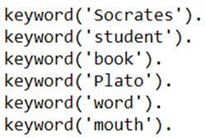
Prolog Facts Generation Process
Given this sample context:
Socrates did not write any books.
Plato is a student of Socrates.
Plato wrote books and put words into Socrates mouth.
1. Keyphrases
if the POS tag of a word is 'NOUN' or 'PROPN', this word will be kept as a keyword

Slide 14
Prolog Facts Generation Process
Given this sample context:
Socrates did not write any books.
Plato is a student of Socrates.
Plato wrote books and put words into Socrates mouth.
2. Summary
3. Sentence

Slide 15
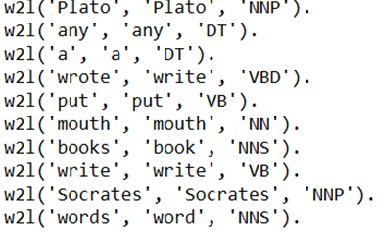
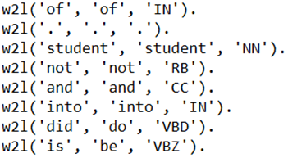
Prolog Facts Generation Process
Given this sample context:
Socrates did not write any books.
Plato is a student of Socrates.
Plato wrote books and put words into Socrates mouth.
4. Word to Lemma

Slide 16
Prolog Facts Generation Process
Given this sample context:
Socrates did not write any books.
Plato is a student of Socrates.
Plato wrote books and put words into Socrates mouth.
5. SVO
DeepRank: Ours:

Slide 17
Prolog Facts Generation Process
Given this sample context:
Socrates did not write any books.
Plato is a student of Socrates.
Plato wrote books and put words into Socrates mouth.
6. Named Entity Recognizer(NER)
Issues: ‘Socrates’ cannot be recognized as person sometime in Spacy.

Slide 18
Prolog Facts Generation Process
Given this sample context:
Socrates did not write any books.
Plato is a student of Socrates.
Plato wrote books and put words into Socrates mouth.
7. Edges
7.1 Dependency edges that already exist in the dependency relations

Slide 19
Prolog Facts Generation Process
Given this sample context:
Socrates did not write any books.
Plato is a student of Socrates.
Plato wrote books and put words into Socrates mouth.
7. Edges
7.2 Other edges that are defined by DeepRank to help with the understanding of the relations.
The recommend edge: edge from a word to the sentence (index).

Slide 20
Prolog Facts Generation Process
Given this sample context:
Socrates did not write any books.
Plato is a student of Socrates.
Plato wrote books and put words into Socrates mouth.
7. Edges
7.2 Other edges that are defined by DeepRank to help with the understanding of the relations.
The predicate edge: edge from the sentence index to the verb. DeepRank fails to extract all predicate edges when it is given a compound sentence
DeepRank: Ours:

Slide 21
Prolog Facts Generation Process
Given this sample context:
Socrates did not write any books.
Plato is a student of Socrates.
Plato wrote books and put words into Socrates mouth.
7. Edges
7.2 Other edges that are defined by DeepRank to help with the understanding of the relations.
first_in edge: the first occurrence of a noun to prioritize sentences where the concepts are likely to be defined or explained. DeepRank sometimes miss some of the first occurrence
DeepRank: Ours:

Slide 22
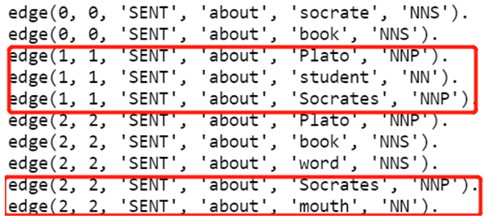
Prolog Facts Generation Process
Given this sample context:
Socrates did not write any books.
Plato is a student of Socrates.
Plato wrote books and put words into Socrates mouth.
7. Edges
7.2 Other edges that are defined by DeepRank to help with the understanding of the relations.
The about edge: from the sentence index to noun. Again, our generation will collect all about edges while DeepRank would miss almost half of them.
DeepRank: Ours:

Slide 23
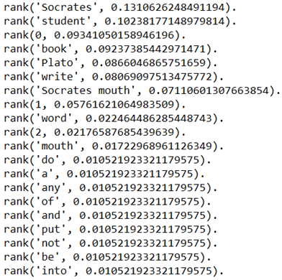
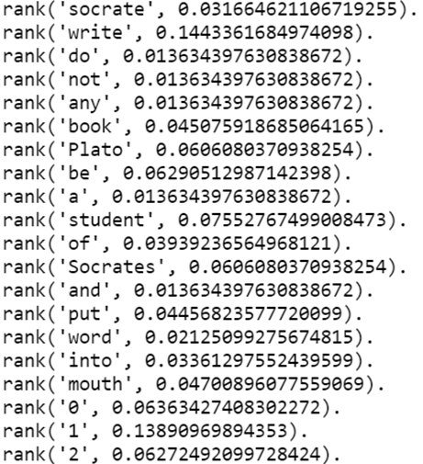
Prolog Facts Generation Process
Given this sample context:
Socrates did not write any books.
Plato is a student of Socrates.
Plato wrote books and put words into Socrates mouth.
8. Ranking DeepRank: Ours:

Slide 24
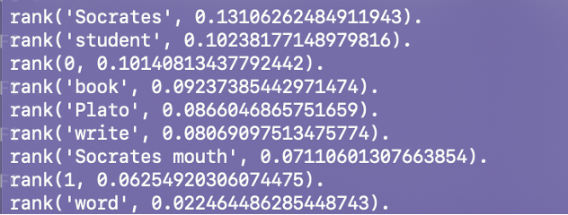
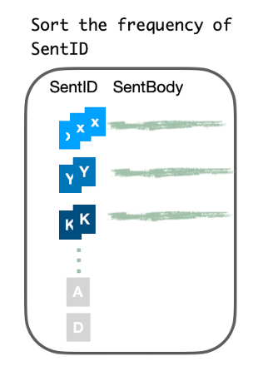
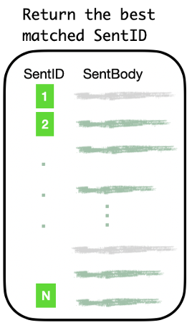
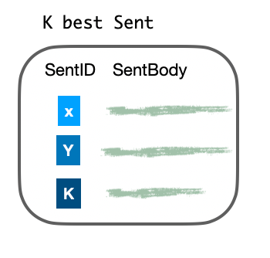
Query Answering - Using Prolog
Finding best match of:
1. NER: Name of Entity: e.g., person, location, time, etc….
2. Rank: word rank.
3. Edges.
4. SVO
[None]
[‘write’, ‘book’ ----> 1,3]
[write -> book ----> 1, 3]
[ None]
Distinct
(1, 3)
SentID
1, 3, 1,3

Slide 25
Consulting SVO & Add Negation
Default:
SVO/4 ( Subject, Verb, Object, SentID)
Weight(SVO) = （2* S + O + V） /4

