Slide 1
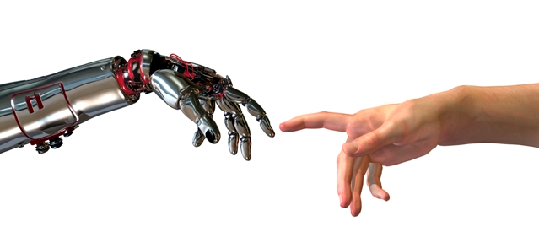
Artificial Intelligence Project
Zicong Wang, Fan Yang

Slide 2
Outline
Traditional lab
Virtual lab
Theory background
Result and feedback

Slide 3
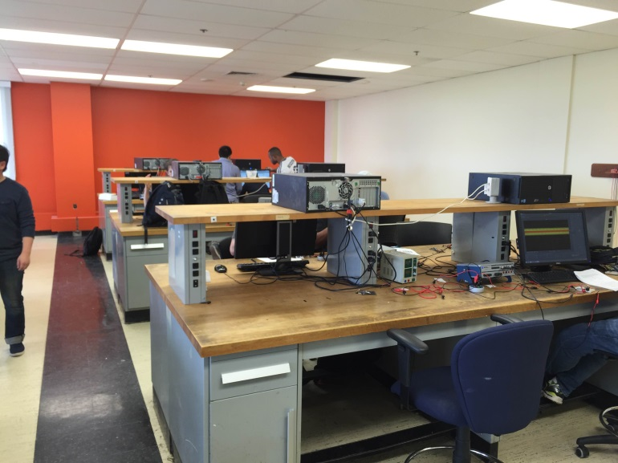
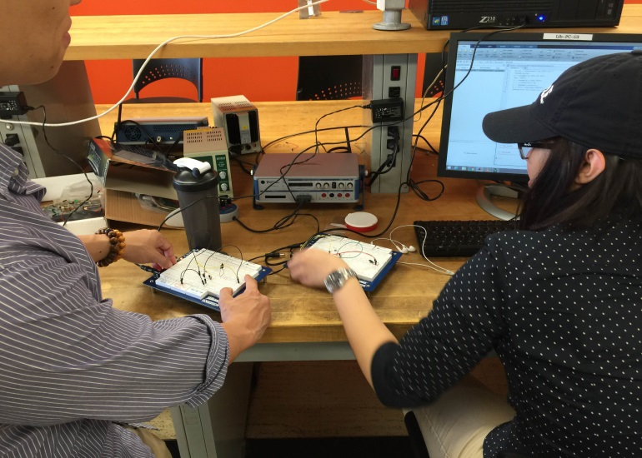
Traditional lab
TA has to be present
Student have to be present
Limited time
Limited space
Accident Error happens

Slide 4
Virtual Lab
Architecture and advantages
Flexibility of repeating lab experiment
7/24 accessibility
Effective utilization of space and equipment

Slide 5
Virtual Lab
Interface and functionality

Slide 6
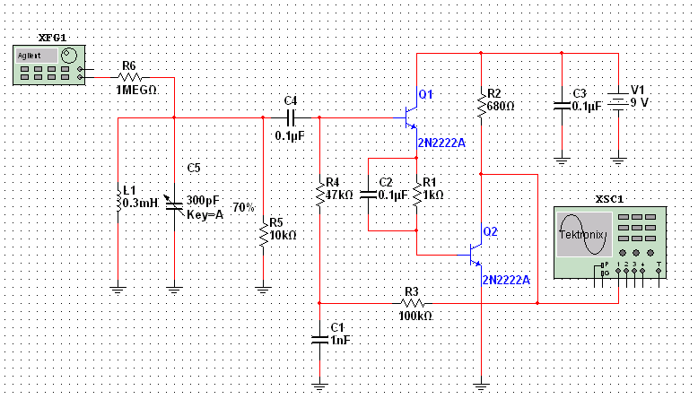
Theory Background
Circuit simulation Introduction (Multisim)

Slide 7
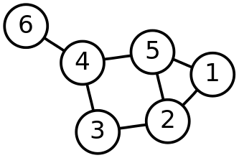
Theory Background
Graph Theory
a graph(G): G = (V, E)
A graph in this context is made up of vertices (V) and edges(E)
A graph may be undirected, meaning that there is no distinction between the two vertices associated with each edge, or its edges may be directed from one vertex to another

Slide 8
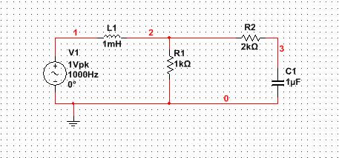
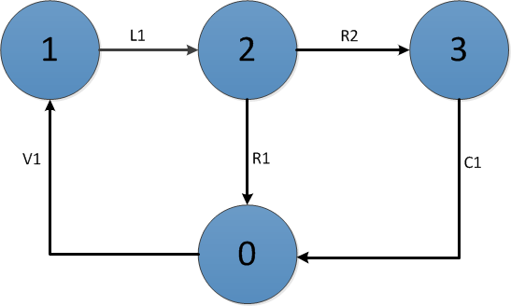
Theory Background Graph Theory Application in electrical circuit
Circuit element → edge
Node → vertice

Slide 9
Theory background Topologically equivalent circuit

Slide 10
Theory background Examples
Equivalent situation
Inequivalent situation

Slide 11
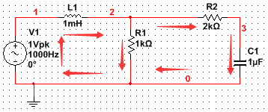
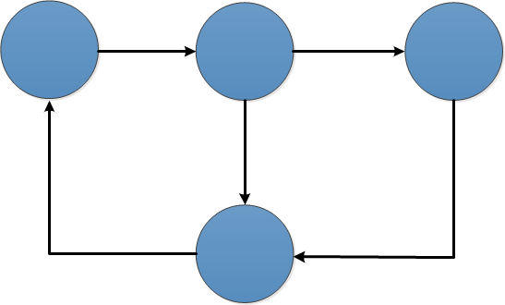
Theory background Independent Loop in State-space
Loop1: V1-L1-R1
Loop2: V1-L1-R2-C1
Loop1: V2-L2-R3
Loop2: V2-L2-C2-R4

Slide 12
Result and feedback

Slide 13
Result and feedback
Traditional teaching lab
Experiment Virtual teaching lab

Slide 14
Thank You

