Slide 1
Sudoku Solver
A CIS 5603 Course Project
By: Qizhong Mao, Baiyi Tao, Arif Aziz

Slide 2
Introduction
Sudoku (originally called Number Place) is a logic based, combinatorial number placement puzzle
Originated since 19th century
Modern Sudoku became mainstream in 1986

Slide 3
Rules
 |  |  | 1
 | 4 | 2
 | 3 | 1
2
 |  |  | 1
 | 4 | 2
 | 3 | 1
2
 |  |  | 1
 | 4 | 2
 | 3 | 1
2
 |  |  | 1
 | 4 | 2
 | 3 | 1
2
1, 2, 3, 4
1, 2, 3, 4
1, 2, 3, 4
1, 2, 3, 4

Slide 4
 |  |  | 1
 | 4 | 2
 | 3 | 1
2
3 |  |  | 1
 | 4 | 2
 | 3 | 1
2
3 |  |  | 1
1 | 4 | 2
 | 3 | 1
2
3 | 2 |  | 1
1 | 4 | 2
 | 3 | 1
2
3 | 2 | 4 | 1
1 | 4 | 2 | 3
4 | 3 | 1 | 2
2
3 | 2 | 4 | 1
1 | 4 | 2 | 3
4 | 3 | 1
2
3 | 2 | 4 | 1
1 | 4 | 2 | 3
 | 3 | 1
2
3 | 2 | 4 | 1
1 | 4 | 2
 | 3 | 1
2
3 | 2 | 4 | 1
1 | 4 | 2 | 3
4 | 3 | 1 | 2
2 | 1
3 | 2 | 4 | 1
1 | 4 | 2 | 3
4 | 3 | 1 | 2
2 | 1 | 3
3 | 2 | 4 | 1
1 | 4 | 2 | 3
4 | 3 | 1 | 2
2 | 1 | 3 | 4

Slide 5
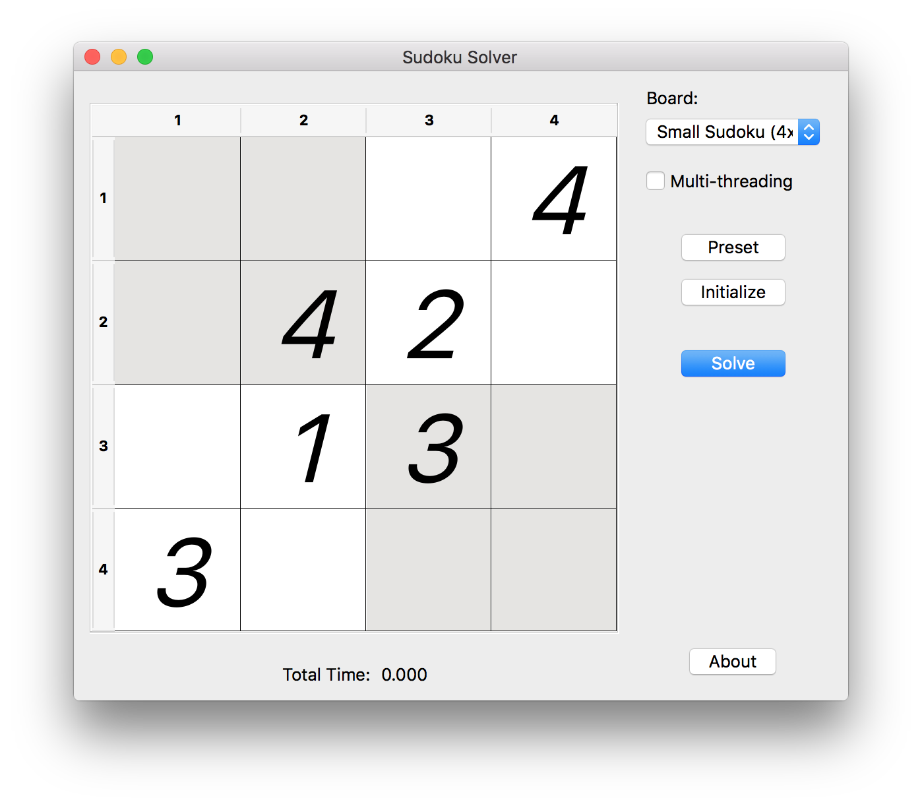
Variants
Small
Standard

Slide 6
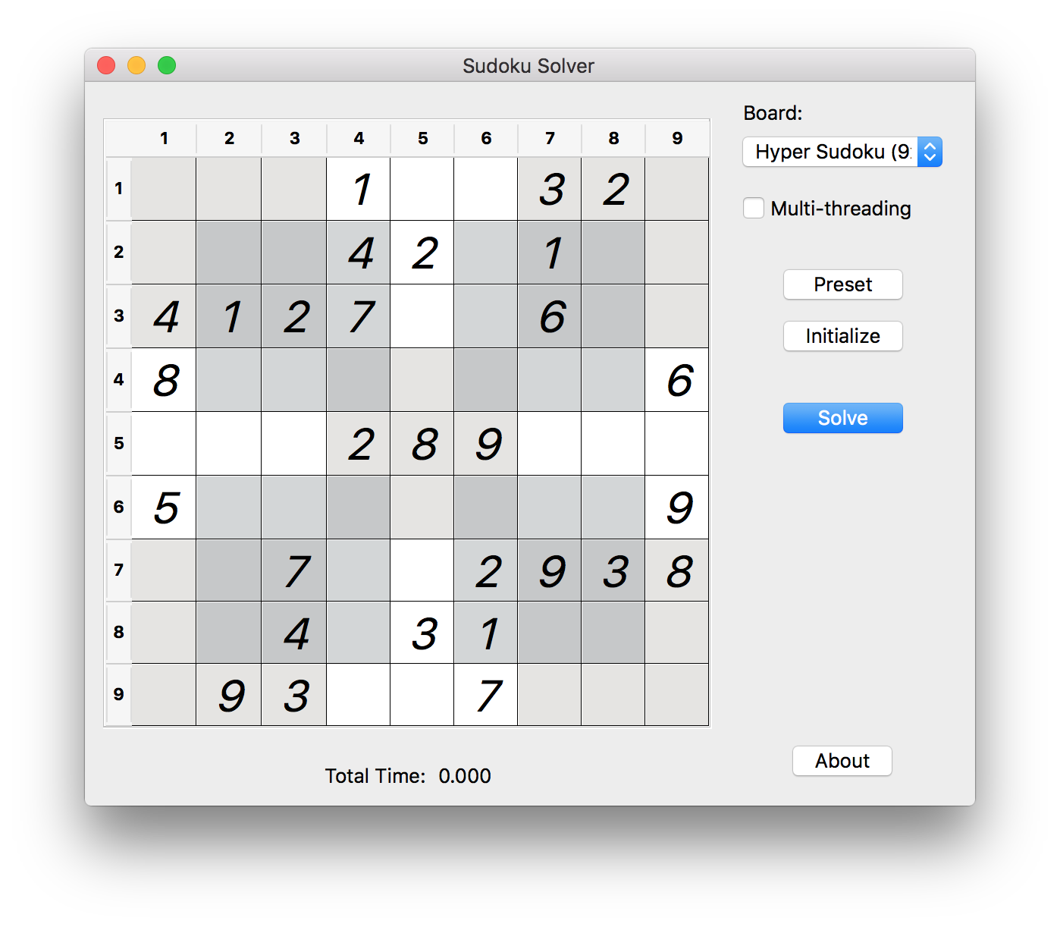
Variants
Hyper
Mini

Slide 7
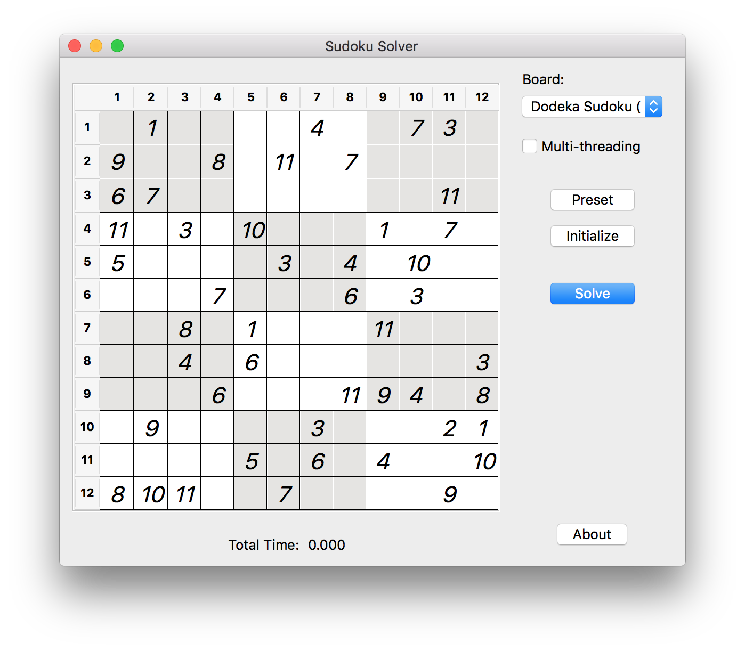
Variants
Dodeka
Jigsaw

Slide 8
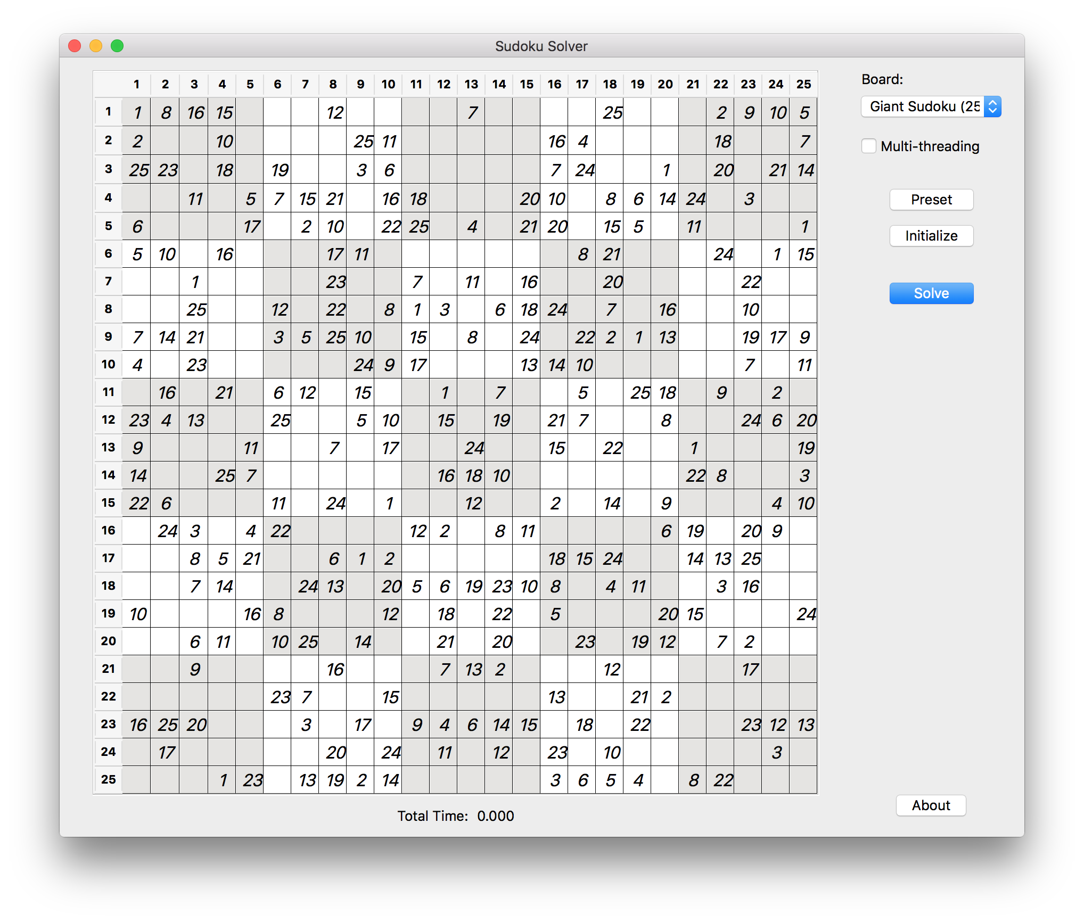
Variants
Number Place Challenger
Giant

Slide 9
Algorithm – Brute Force Search
For ever empty block, do:
Create a list of all values
Check the row, column and box(es) that contain the block
Remove the values already used in the row, column, box(es)
Assign a value from the remaining list

Slide 10
Complexity – Brute Force Search
1 | 2 | … | n-1 | n
1 | 2 | … | n-1 | n
1 | 2 | … | n-1 | n
…
1 | 2 | … | n-1 | n
1 | 2 | … | n-1 | n
…
1 | 2 | … | n-1 | n
…
1 | 2 | … | n-1 | n
1 | 2 | … | n-1 | n
…
Depth: $n^{2}$
Complexity: $O\left(\prod_{i=1}^{n^{2}}{n}\right)=O\left({\left(n^{n}\right)}^{n}\right)=O\left(n^{n^{2}}\right)$

Slide 11
Complexity – Brute Force Search
Row | Column $1$ | Column $2$ | … | Column $n−1$ | Column $n$ | Total
$$1$$ | $$n$$ | $$n−1$$ | … | $$2$$ | $$1$$ | $$n!$$
$$2$$ | $$n$$ | $$n−1$$ | … | $$2$$ | $$1$$ | $$n!$$
$$\text{…}$$ | $$n$$ | $$n−1$$ | … | $$2$$ | $$1$$ | $$n!$$
$$n−1$$ | $$n$$ | $$n−1$$ | … | $$2$$ | $$1$$ | $$n!$$
$$n$$ | $$n$$ | $$n−1$$ | … | $$2$$ | $$1$$ | $$n!$$
Complexity: $O\left(\prod_{i=1}^{n}{n!}\right)=O\left({(n!)}^{n}\right)≤O\left({\left(n^{n}\right)}^{n}\right)$

Slide 12
Algorithm – Heuristic Search
For every empty block, find all possible values
Find a block with the minimum possible values
If the block has only 1 possible value, then assign the value
If the block has more than 1 possible values, choose 1 value and assign it
If the block has no possible value, backtrack a previous block with multiple possible values, assign another value to it

Slide 13
Complexity – Heuristic Search
Best scenario: every empty block has only 1 possible value
Complexity: $O(n^{2})$
Worst scenario: an empty board
Identical to Brute Force Search

Slide 14
Complexity
$$n$$ | Complexity ($c=1$) | Complexity ($c=3$) | Complexity $O\left({(n!)}^{n}\right)$
$$4$$ | $$16$$ | $$1.30×{10}^{3}$$ | $$3.32×{10}^{5}$$
$$6$$ | $$36$$ | $$4.67×{10}^{4}$$ | $$1.39×{10}^{17}$$
$$9$$ | $$81$$ | $$1.01×{10}^{7}$$ | $$1.09×{10}^{50}$$
$$12$$ | $$144$$ | $$2.18×{10}^{9}$$ | $$1.46×{10}^{104}$$
$$16$$ | $$256$$ | $$2.82×{10}^{12}$$ | $$1.35×{10}^{213}$$
$$25$$ | $$625$$ | $$2.84×{10}^{19}$$ | $$5.84×{10}^{629}$$
$c$: The average number of available values for each cell
Complexity of ($c=3$): $O\left({(3!)}^{n}\right)=O\left(6^{n}\right)$

Slide 15
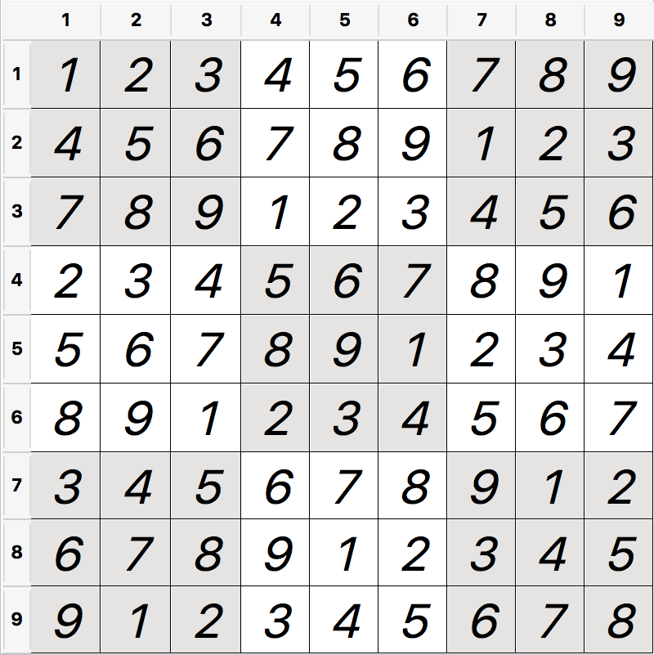
Algorithm – Empty Board
final int n = 3;
final int[][] field = new int[n*n][n*n];
for (int i = 0; i < n*n; i++)
for (int j = 0; j < n*n; j++)
field[i][j] = (i*n + i/n + j) % (n*n) + 1;

Slide 16
Application
Home page: https://github.com/autopear/Sudoku-Solver
Author: Qizhong Mao
Platform: Windows, Mac OS X, Linux, etc.
Features
Multiple embedded games
Heuristic search to solve the game
Support real-time validation
Time to solve a game
Easy to load presets
Easy to edit and save preset into file
Easy to add new game board

Slide 17
Performance Evaluation
Standard Sudoku
100 presets of easy level
Less possible values for each empty cell
100 presets of hard level
More possible values for each empty cell

Slide 18
Performance Evaluation
 | Small | Mini | Standard
Size | 4x4 | 6x6 | 9x9
Time | 5 ms | 12 ms | ∞
Solving an empty board
 | Time | CPU | Memory
Easy Level | 815 ms | 5% | 100 MB
Hard Level | 6,189 ms | 17% | 1.5 GB
Solving a standard Sudoku (9x9)

Slide 19
Performance Evaluation – Multi-threading
Multi-threading can be used for
Searching row, column, box(ex) for possible values
Retrieving empty blocks
Traversing search trees
Problems
Significant overhead for small size board
Increasing memory usage

Slide 20
Conclusion
We proposed an implementation of heuristic search method for Sudoku game
More efficient than brute force search
Capable with most Sudoku variants
A solution is guaranteed (or no solution will be given)
We studied how the number of available options affect the heuristic search
A stochastic heuristic search may be more efficient

