Slide 1
Humanoid Robot
- Emotion Reading
Final Project Presentation | CIS3203
Eunji Ha
Notes:
안녕! 내 토픽은 humanoid robot which is the most… part in AI. Today I will talk especially about emotion reading humanoid robot.

Slide 2
01
Introduction
Emotion Reading Robot?
CONTENTS
02
Principle
How?
03
Evaluation
Think more?
Notes:
This is table of contents.

Slide 3
01
Introduction
Emotion Reading Robot?
Notes:
At first, let me show a video. As you could see in the video, pepper is the latest released emotion reading robot. I will talk about the technique which are using to recognize people’s emotion. And then cover more specific info that can realize emotion recognizing robot and evaluation.

Slide 4
02
Principle
How to read human’s emotion?
Facial Expression(Visual info)-based
Speech(Voice info)-based
User’s music or text mood-based
Neural Network-based(BCI)

Slide 5
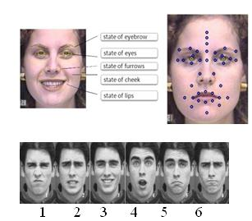
02
Principle
How to read human’s emotion?
Facial Expression(Visual info)-based

Slide 6
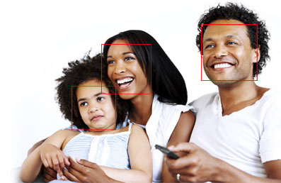
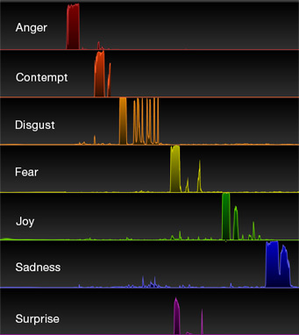
02
Principle
How to read human’s emotion?
Facial Expression(Visual info)-based
“Emotion Detection & Sentiment Analysis Glassware”
Notes:
Emotient's technology works by detecting subtle pattern changes in a person's face. The software, which can be used to measure emotion in individuals and crowds, can tell if a person is feeling positive or negative overall and zero in on more specific emotions, such as joy, sadness, surprise, anger, fear, disgust, and contempt.

Slide 7
02
Principle
How to read human’s emotion?
2. Speech(Voice info)-based
Voice Signal
Voice Feature Extraction
Voice Recognition
Emotion Recognition
Voice Detection
Preprocessing process
Data
Recognition process

Slide 8
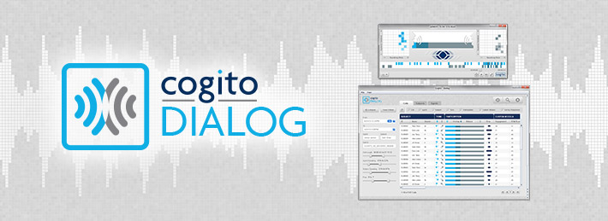
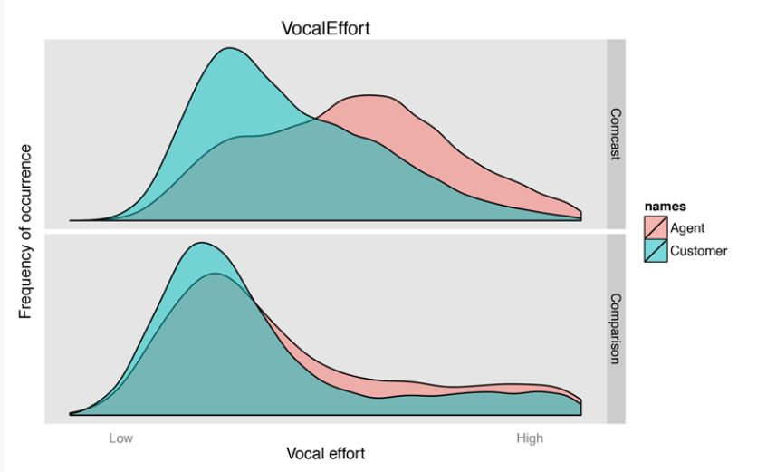
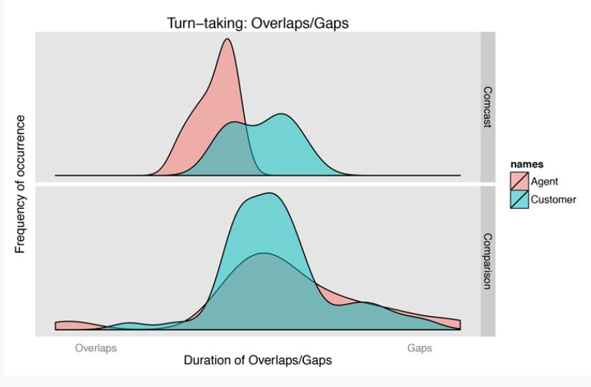
02
Principle
How to read human’s emotion?
2. Speech(Voice info)-based
Notes:
Software that listens to your voice to assess your mood gives call centre agents a dashboard that shows how the conversation is going
Vocal Effort provides a means of discriminating soft, quiet voices from loud, tense ones. Vocal Effort focuses on the frequency components of speech that are independent of volume or energy. In the below figure, distributions of Vocal Effort are plotted for agents in red and customers in green. During the Comcast call (top panel) the analysis indicates significantly higher vocal effort and an overall tenser voice for the agent, as compared to the customer.
For one of our typical “good” calls (bottom panel), the agent and customer are both highly similar in terms of their vocal effort. Also, both speakers in the “good” conversation display a vocal effort profile that matches the customer in the Comcast call, who was generally perceived as remaining quite calm during the conversation.
2. turn-taking
It is especially important to measure when we begin to start speaking relative to the person we are speaking to. Allowing too much of a gap or silence, after our speaking partner stops talking can make us seem disinterested; however, consistently leaving too short a gap or overlapping the end of our partner’s speech by too much can be perceived as rude.
3. behavior continues throughout the conversation. Had the agent noticed and modified his behavior at any of these moments, there might been a better outcome to the call.

Slide 9
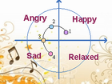
02
Principle
How to read human’s emotion?
3. User’s music or text mood-based
tunes
lylics
Notes:
Music is oftentimes referred to as a “language of emotion” and also in text we have our emotional expressions inside. Computer(Robot) analyzes these information to get our feelings.

Slide 10
02
Principle
How to read human’s emotion?
3. User’s music or text mood-based
Text
Negation Check
Emotion
Tokenization
Identify Emotion Words
Analysis of Intensity
Learning-based Methods
Hybrid Methods
Keyword spotting method
Notes:
Keyword spotting technique – Words are classified into the categories
--Whether negation is involved in it or not
2. Unlike keyword-based detection methods, learning-based methods try to detect emotions based on a previously trained classifier, which apply various theories of machine learning such as support vector machines [8] and conditional random fields [9], to determine which emotion category should the input text belongs.
3. The most significant hybrid system so far is the work of Wu, Chuang and Lin [11], that utilizes a rule-based approach to extract semantics related to specific emotions and Chinese lexicon ontology to extract attributes. These semantics and attributes are associated with emotions in the form of emotion association rules. As a result, these emotion association rules, replacing original emotion keywords, serve as the training features of their learning module based on separable mixture models. This method outperforms previous approaches, but categories of emotions are still limited.

Slide 11
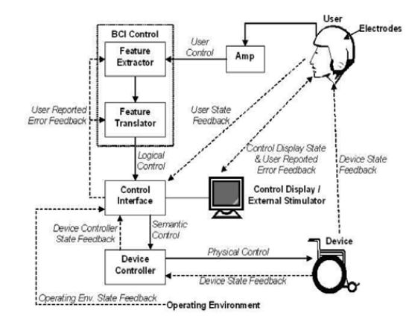
02
Principle
How to read human’s emotion?
4. Neural Network-based (BCI)
Notes:
Working of BCI
The brain signal is recorded with the help of electrodes from the user and amplified then that amplified signal is fed to the BCI control where signal processing is done i.e. feature extraction and feature translation. Now after the signal processing device command and operating protocol comes in to the action to drive the device that is a wheel chair in this case a device state feedback is also provided for further adjustment of the movement.

Slide 12
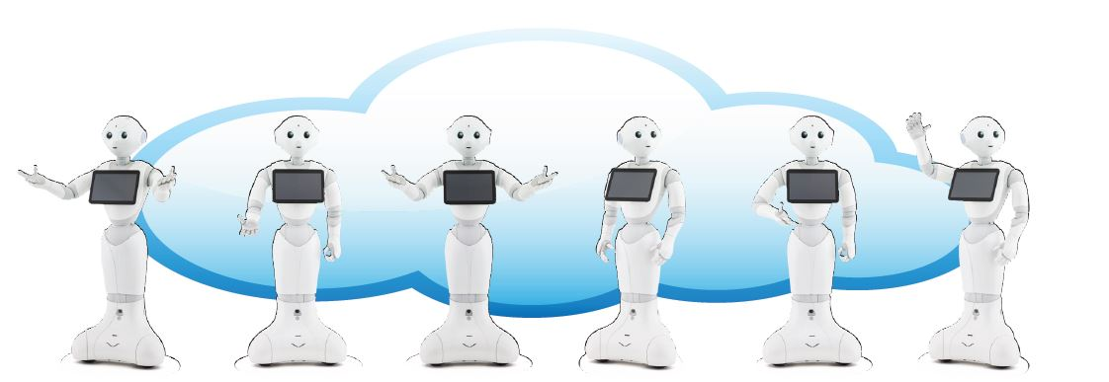
02
Principle
More technique?
Cloud System
Notes:
Now we know how the robot get human’s emotion. They are called ‘emotion engine’ which makes pepper can communicate with people not only verbally but also emotionally.
Each robot can learn from its interactions with humans and that their experiences will be uploaded to an Internet cloud database to be shared with other Peppers. This means Peppers can evolve as a collective intelligence->학습 가능함 의미!

Slide 13
03
Evaluation
Can and cannot?
I feel HAPPY!☺
♬
Notes:
So far, previous four technique which the robot recognize human’s emotion are developing all over the world. However, because they are still growing area and there are limited cost, it is hard to combine all of the methods. Those enormous amounts of data which get from various ways will help to read more human’s delicate emotion.
Also, although those technique’s evolving quickly,
Robot’s acting and speaking are expressions which are already predefined and recorded. Making robot express by themselves with its own intelligence and emotions is still challenging problems.

Slide 14
03
Evaluation
Future task?
Friend?
or
Foe?
Notes:
Also!!!
Robot’s EMOTION RECOGNITION..
can give Physical benefits + Emotional communication
But maybe can threathen human’s future life. I will finish my presentation with video which will make us think about this issue.

Slide 15
THANK YOU
915171941 Eunji Ha

