Slide 1
NearOptimalGamblingAdive
Matt Morgis
Peter Chapman
Mitch McCann
Temple University

Slide 2
Introduction
Our goal:
To build a Texas Hold’Em poker simulator that would give near perfect advice to the user.

Slide 3
How does this relate to A.I.?
Trying to simulate a human player.
Game relies on hidden information.
Many human experts can outperform modern AI implementations.
Achieving success would be a stepping stone towards solving more challenging real-world problem.

Slide 4
What is Texas Hold’Em?
Card game played with 52 cards, can have up to 7 decks.
2 – 10 players.
Each player starts with an equal amount of money.
Each player receives 2 hole cards dealt facedown.

Slide 5
Gameplay
Each hand has 4 main rounds
Preflop – 2 hole cards are dealt to each player
Flop – 3 community cards are revealed.
Turn – 1 community card is revealed.
River – The final community card is revealed.
Possible betting actions at each step
Fold
Check/Call
Bet/Raise
All-In (Jam)

Slide 6
Actions
Fold
Player sits out hand.
Check/Call
Player remains in hand without being forced to commit further money to the pot (check) or is forced to cover the current bet in order to remain in the game (call)
Bet/Raise
Bet is done when a player wants to invest further chips into the pot. Raise is a reply to a bet with a higher one.
All-In
When a player places all of their remaining money in the pot. Can be done if the amount of chips is smaller than the amount necessary to “call.”

Slide 7
Gameplay (cont.)
By the end of each hand there are 5 community cards on the table.
Each player must make the best possible poker hand using their 2 hole cards + the 5 community cards.

Slide 8
Types of Texas Hold’Em
Limit
All-in is removed from the game.
1e+18 different states.
Fixed maximum amount for the bets.
Constraints limiting the bets reduce states’ space
No-Limit
It’s possible to go All-In.
World Series of Poker and most casinos play this way.
1e+71 different game states.

Slide 9
Simplifying the Game
To simplify our analysis of the game, we used the following constraints:
2 players
1 deck
Limit game type
We wanted to determine strategies for each problem state throughout each hand instead of a general solution for the entire game.
By doing so, we would be able to give near-optimal advice and adapt as the game went on.

Slide 10
How complex is the game?
The game is “nondeterministic,” meaning entirely different outcomes are possible given the same broad states.
However, some outcomes are very unlikely (royal flush) while others are more common (community high-card).
Biggest advantage is knowing the strength (Equity Value) of the player’s two hole cards.

Slide 11
Hole Card Evaluations
Each card pair is associated with a numerical value calculated from the sample 115 million hands using data mined methods.
Computationally intensive to determine the probability of another player having a certain hand.
Also need to consider the odds your opponent will fold with a hand of a certain type.

Slide 12
Evaluating Cards Post-Flop
There is one global Hand Rank Evaluator that takes a poker hand and maps it to a unique integer representing the score of the hand.
This calculates the relative value of the 2 card hand, and takes into account Hand Strength, Hand Potential, and Effective Hand Strength.
Can drastically change throughout the course of a hand.

Slide 13
2 + 2 Algorithm
EHS = HS x (1 –NPOT) + (1 – HS) x PPOT
EHS is effective (potential) hand strength
HS is the current hand strength
NPOT is probability that the players hand deteriorates and becomes a losing hand.
PPOT is the probability that our current hand improves and becomes the winning hand.

Slide 14
2 + 2 Algorithm Continued
First published in 1998 paper “Opponent Modeling in Poker”
Since has been the basis of further research in the realm of poker artificial intelligence.
Been considered the biggest advance to Poker Game Theory.
Open source implementations available in Python, JavaScript, Objective C, Java, Bash/Shell, C.
Allowed us to focus on the betting algorithms and strategies.
Notes:
MENTION HOW THE PROMP WAS TO BUILD OFF OF OTHER

Slide 15
Sample Output of Algorithm
PokerEvaluator.evalHand(["As", "Ks", "Qs", "Js", "Ts", "3c", "5h"]);
//{ handType: 9,
// handRank: 10,
// value: 36874,
// handName: 'straight flush' }
PokerEvaluator.evalHand(["As", "Ac", "Ad", "5d", "5s"]);
//{ handType: 7,
// handRank: 148,
// value: 28820,
// handName: 'full house' }
PokerEvaluator.evalHand(["As", "Ac", "Qs"]);
//{ handType: 2,
// handRank: 441,
// value: 8633,
// handName: 'one pair' }

Slide 16
Modeling Human Opponents
Arguably the biggest challenge we faced.
Opponent’s strategy may involve bluffing.
Hand Strengths change at every stage of the game.
Modeling a realistic opponent involves modeling a human’s mistakes as well as successes (computer’s need to bluff too).

Slide 17
Opponent Human Strategies
Loose-Passive
Less dangerous players. Always call, play a lot of hands, never raise or bet.
Loose-Aggressive
Unpredictable yet exploitable. Tend to raise even with low hands.
Tight-Passive
Never raise, play few hands and when they do they call.
Tight-Aggressive
Play few hands, but when they do, they raise and raise again. Considered most dangerous category.
A good simulator would adapt its style to one of these depending on the current situation.

Slide 18
Research – Poker Strategies
Check-raise
P1 check
P2 Raise $100
P1 Raise $100 (Bet now $200)
Used to intimidate opponent
Banned in some casinos

Slide 19
Research – Poker Strategies (cont.)
Continuation Bet
Bet between 2/3 – 3/4 of the pot
Great for low level play
Semi Bluff
TABLE: 2H 4C 5D
HAND: 6S JD
Good for protection

Slide 20
Research – Poker Strategies (cont.)
Total Bluff
TABLE: 2H 4C 5D
HAND: 10S JD
No protection
Float Play
Call on the flop
Check-raise on the turn

Slide 21
Our Implementation
Boolean – Bluff
Boolean - Aggressive

Slide 22
Our Implementation (cont)
Boolean – Aggressive
x = opponentFoldsForThisRound / opponentFolds
if(x == 0 || x> 25%){
return true;
} else{
return false;
}
i.e. opponentFoldsForThisRound = 1
opponentFolds = 4
return false

Slide 23
Our Implementation (cont)
Hand Evaluation
If pre-flop
Evaluate based on starting hand percentage
Else
Evaluate Lowest Possible Hand
Evaluate Our Hand
Evaluate Highest Possible Hand
Determine percentage

Slide 24
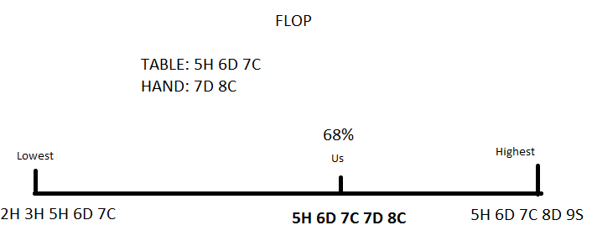
Our Implementation (cont)

Slide 25
Our Implementation (cont)
At the start of each round of betting, we set a limit on how much we would be willing to bet depending on how aggressive we want our player to be.
If playing aggressively, we will bet high in the hopes of scaring the opponent in to folding.
If playing conservatively, we only bet high if we are confident we will win.

Slide 26
Our Implementation (cont)
Example: playing aggressively hand strength = 70(%) player pot = 1000
if (playingAggressively) maxBet = 100 else maxBet = 50 advisedBet = maxBet * handStrength * player.pot / 100 / 100
advisedBet = 100 * 70 * 1000 / 100 / 100
advisedBet = 700, if we are feeling confident about a hand and are playing aggressively

Slide 27
Our Implementation (cont)
We had come up with a plan to determine the odds of success based off what kinds of hands were possible for the opponent to have.
Due to time constrictions, we had to use a more basic algorithm.

Slide 28
Basic Strength Algorithm
First, we determine the best hand the opponent could possibly have based off of the communal cards on the table.
Next, we determine the worst hand possible from the communal cards.
We give both of these hands to the emulator, and determine where our hand is relative to the two hands.

Slide 29
Finding the Best Possible Hand
To find the best possible hand, we run the community cards through a filter of the various hand types.
The filters are ordered from the strongest hand types to the weakest.
Knowing that the opponent can have any two cards in their hand (aside from what is on the table), we check every combination of 3 community cards possible.

Slide 30
Finding the Best Possible Hand (cont.)
There are several things we can find out to speed up the process:
Are there any pairs among the cards? If so, we can rule out flushes and straights.
Are the cards all of the same suit? If so, we can have a flush, but no pairs.
If there are no matches and the cards are not the same suit, we can only have Straights or Three-Of-A-Kind

Slide 31
Finding the Worst Possible Hand
Even after we find the best possible hand, that is only half of the problem. We also need the worst possible hand.
The worst possible hand anyone can have involves low cards, no matches, not a straight, and no flush.
i.e., 2 of clubs, 3 of spades, 4 of spades, 5 of spades, and 7 of spades.

Slide 32
Finding the Worst Possible Hand (cont)
The worst possible hand the AI can have will automatically contain the cards the community shares. So, we will need to avoid matches with them, as well as avoid a straight.

Slide 33
Finding the Worst Possible Hand (cont)
To start, we find if there are any matches in the community cards. If there are, we don’t have to worry about a straight.
Next, we check to see if there is a chance for a flush. If so, we must choose a suit that has not been used.
If there is a chance for a straight, we grab a card either two lower than the lowest community card, or two above if the lowest card is a 3 or 2.

Slide 34
Returning the best and worst hands
The best and worst hands are saved into 2D arrays of length 5, saving the cards value, and its suit.
Given a 5 of clubs, 6 of diamonds, and 7 of hearts
Worst hand: High card 7
[ [ 2, ‘s’], [3, ‘c’], [5, ‘c’], [6, ‘d’], [7, ‘h’] ]
Best hand: Straight, 9 high
[ [5, ‘c’], [6, ‘d’], [7, ‘h’], [8, ‘h’], [9, ‘h’] ]

Slide 35
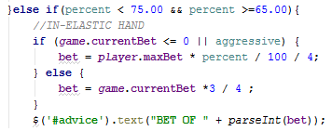
Our Implementation (cont)
Putting it all together
In-Elastic hand

Slide 36
Our Implementation (cont)
Elastic Hand

Slide 37
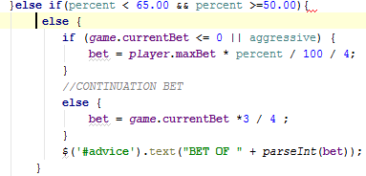
Our Implementation (cont)
Continuation Bet

Slide 38
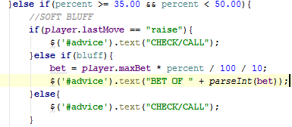
Our Implementation (cont)
Soft Bluff

Slide 39
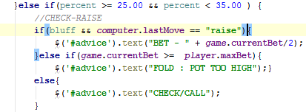
Our Implementation (cont)
Check-Raise

Slide 40
Most Recent Advances
“Texas Hold ‘Em Heads Up Poker Machine”
200 active machines across the country.
Uses knowledge gained from billions of staged rounds of poker fed through neural networks.
Results in an unpredictable player that wins almost every time.
Less than 100 players have been able to beat it in two years.
Has a “paranoid” theory and plays with the basic idea to no be exploited.

Slide 41
Other Conclusions
Human players are very good at understanding their opponent, sometimes figuring them out before the first hand is dealt.
Programs can be superior in other aspects of the game.
Still a major question of if pokerbots will be able to match all human players.

Slide 42
Retrospective
If we could start over….

