Slide 1
Connect Four AI
Robert Burns and Brett Crawford

Slide 2
Connect Four
A board with at least six rows and seven columns
Two players: one with red discs and one with black discs
Take turns inserting discs into the top of the board
A player can win by connecting four of their owns discs either horizontally, vertically, or diagonally before the other player
Perfect information, zero-sum game
Six rows by seven columns -> 4,531,985,219,092 possible game board layouts
Solved conclusion -> with perfect play, first player win

Slide 3
Specifications for our program
Graphical user interface
Variable game board sizes
At most one human player
Record all moves made and game states
Allow AI vs AI play
Allow multiple games to be played without restarting the program

Slide 4
AI Implementations
Random player
Blocker player
Minimax player
Minimax w/ weighted scores player
Minimax w/ alpha beta pruning player
Minimax w/ heuristic player
Monte Carlo method player
Monte Carlo w/ concurrency player

Slide 5
Simple AI Players
Random
Inserts discs at random into the board
Blocker
Attempts to block opponent wins
If no block move is found, inserts discs at random into the board

Slide 6
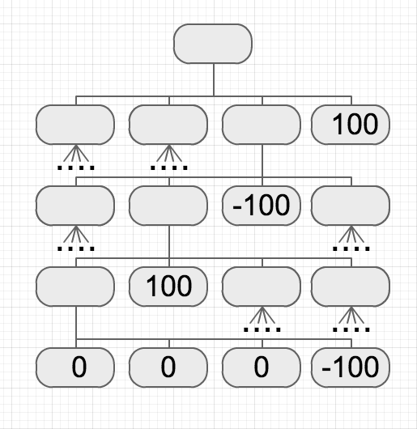
Minimax Player
Looks four moves ahead
Only wins/losses are considered
Ties in the scores of possible moves are broken at random

Slide 7
Minimax (Weighted Scores) Player
Looks four moves ahead
Only wins/losses are considered
Able to prioritize moves based on weights
Ties in the scores of possible moves are broken at random

Slide 8
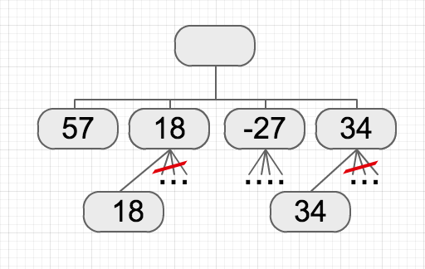
Minimax (AlphaBeta) Player
Looks five moves ahead
Only wins/losses are considered
Able to prioritize moves based on weights
Prunes away branches that would have no effect on the final decision
Ties in the scores of possible moves are broken at random
Slow in the beginning parts of games, greatly improves search time in latter parts of games

Slide 9
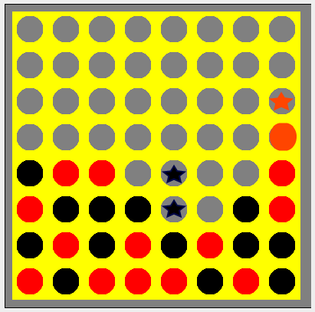
Minimax (Heuristic) Player
Looks four moves ahead
Only wins/losses are considered
Able to prioritize moves based on weights
Scores states without a win or loss (non-terminal states) based on the number of open three-in-rows sequences that each player has

Slide 10
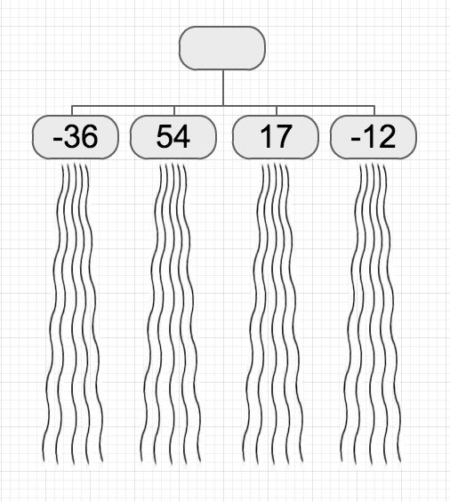
Monte Carlo Player
Considers the possible moves at a given state
For each move, simulate a given number of random games
Assigns a score [-100, 100] to each possible move based on the results of the simulated games

Slide 11
Monte Carlo (Concurrency) Player
Same as the Monte Carlo player, but uses threads to improve the computation time
In most cases, decreases the amount of time need to calculate a move a factor of one half

Slide 12
Unfinished Goals
Further optimizations of AIs
A player that utilizes all of these techniques
A player that utilizes learning techniques
Comparison of results of AI vs AI matches for all AI players to determine the best approaches

