Slide 1
Maze Runner
By: Joe Pimble and Rachel Buttimer

Slide 2

Overview
Made with LibGDX
Maze Game
Collect Coins and Race The Clock
Collect all 6 Coins and Win

Slide 3
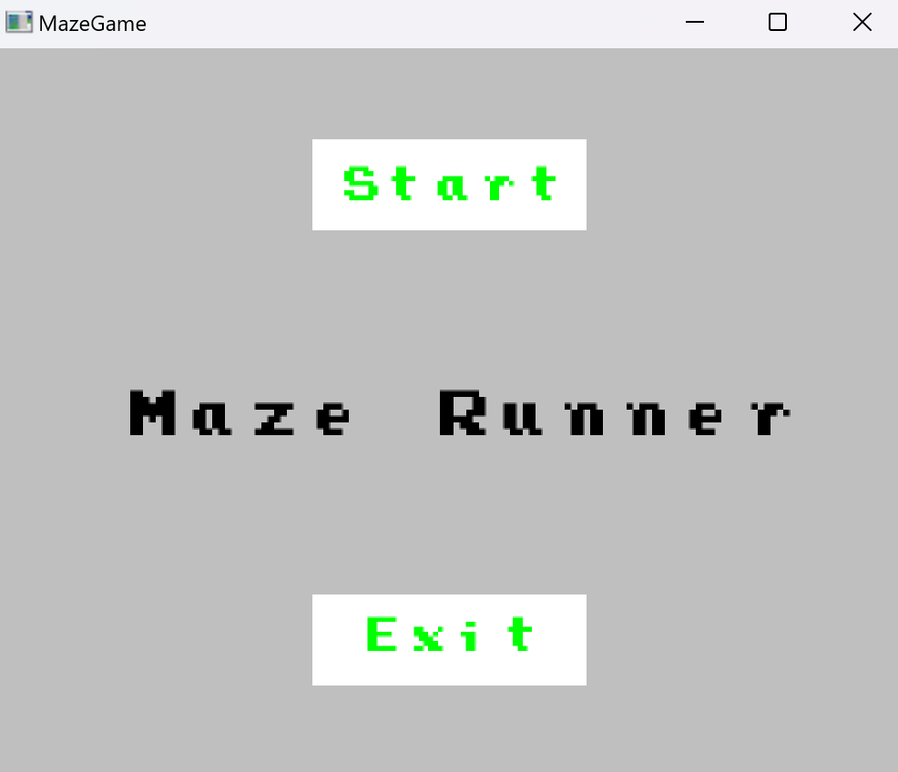
Main Menu Screen
Working Start and Exit Buttons
Highlighted Red When Hovered Over

Slide 4
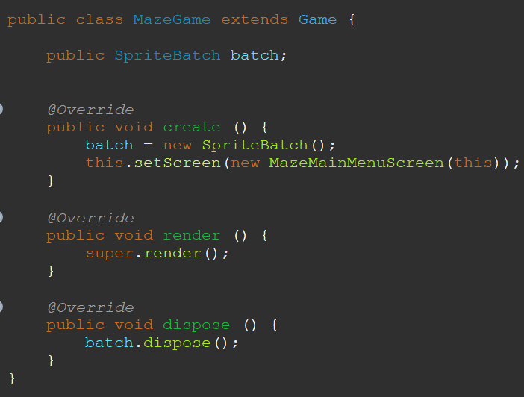
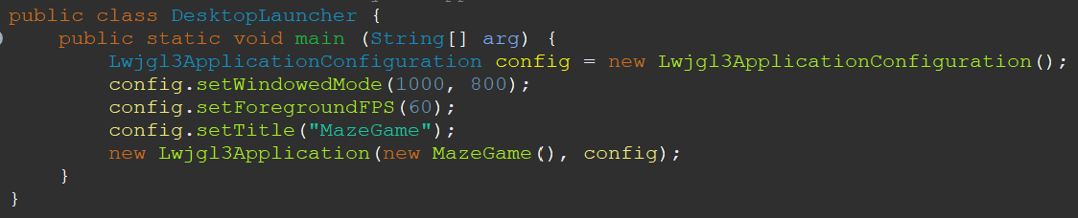
Code To Launch Game
Basic Launchers
Loads Game and Sets Size

Slide 5
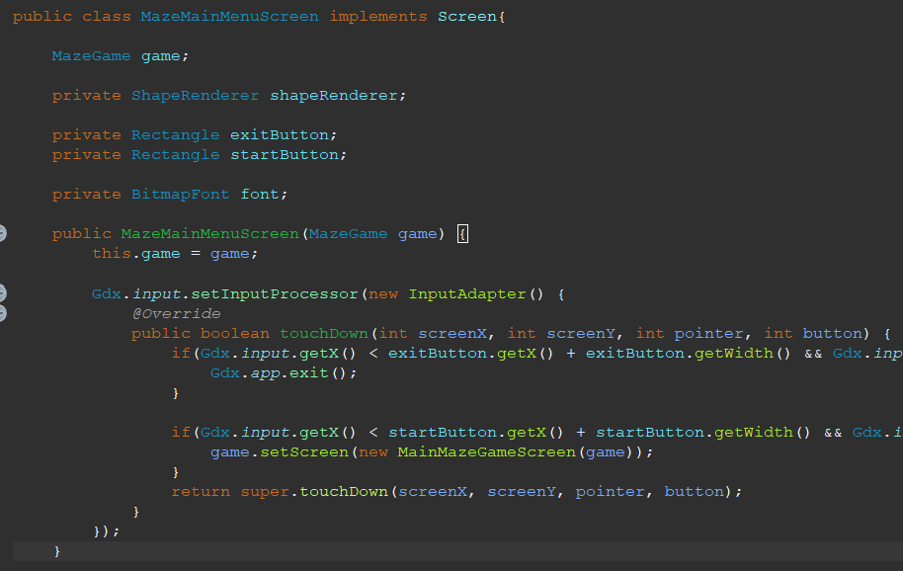
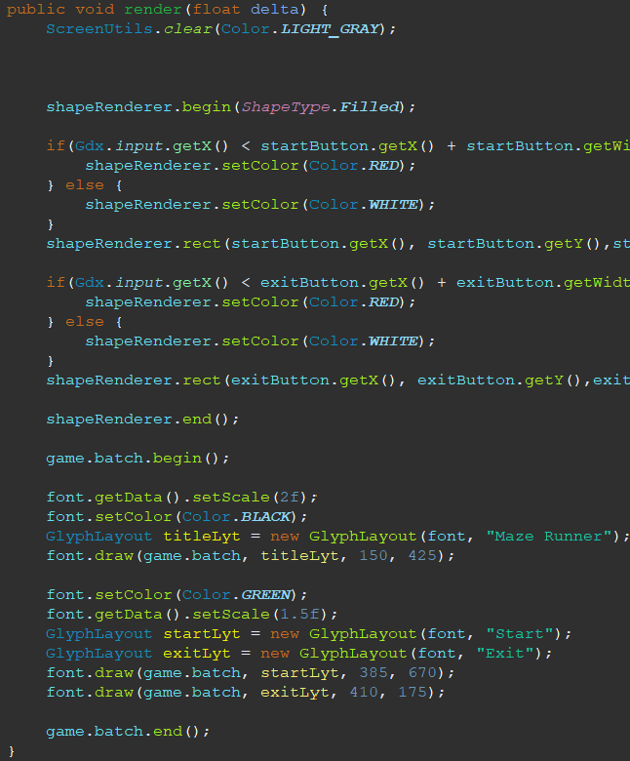
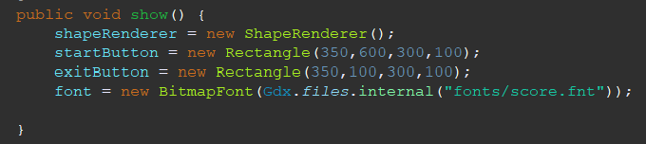
Main Menu Code
All Initializations
How Buttons Work
How Text Works

Slide 6
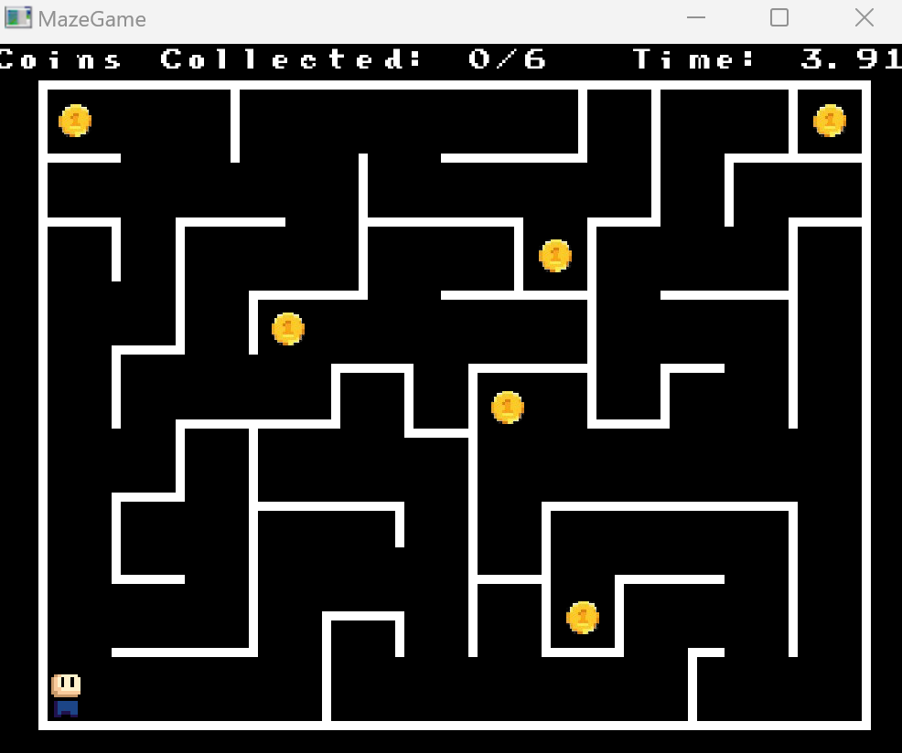
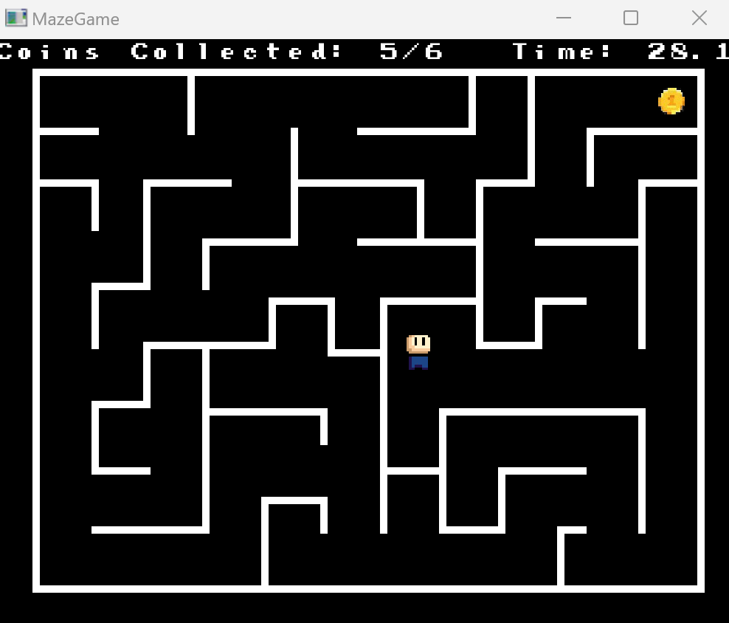
Game Screen

Slide 7
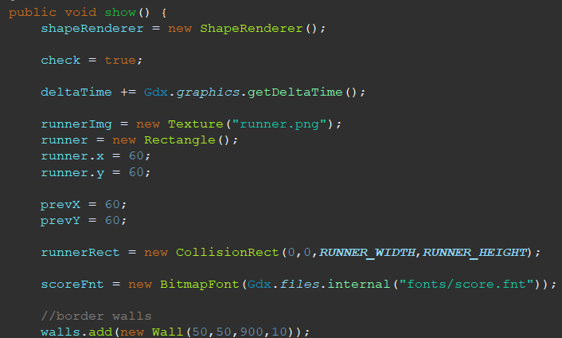
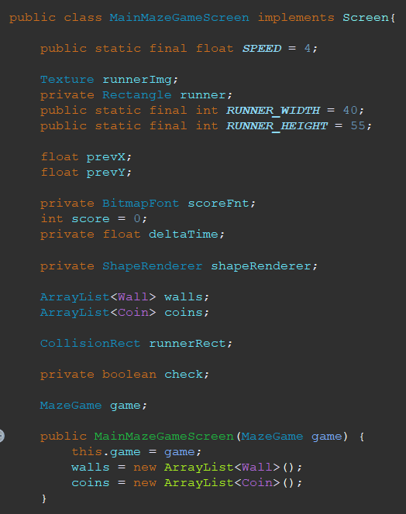
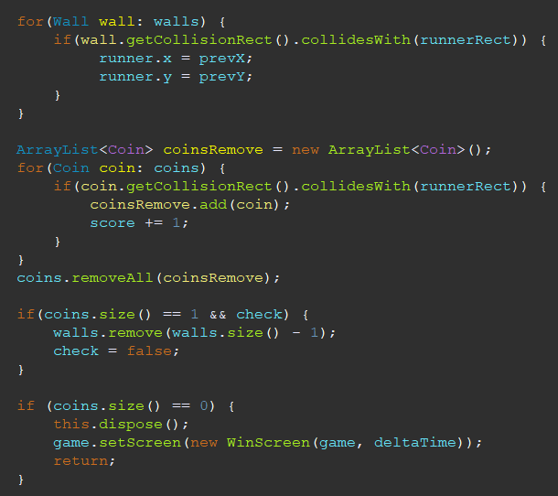
Game Screen Code Pt.1
Initializations
Coin and Wall Objects

Slide 8
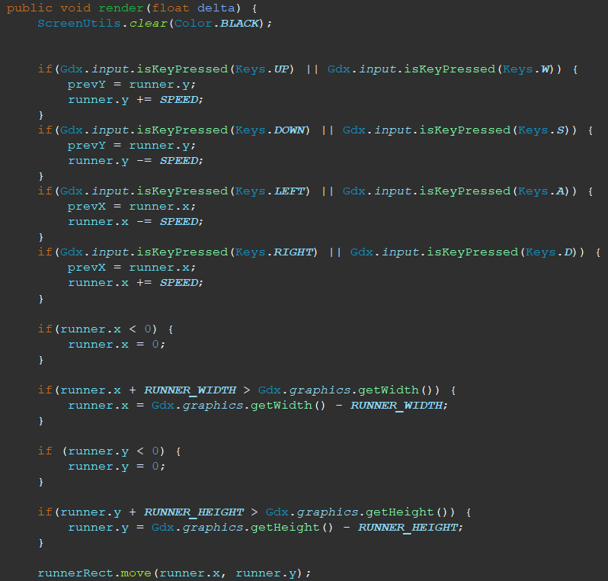
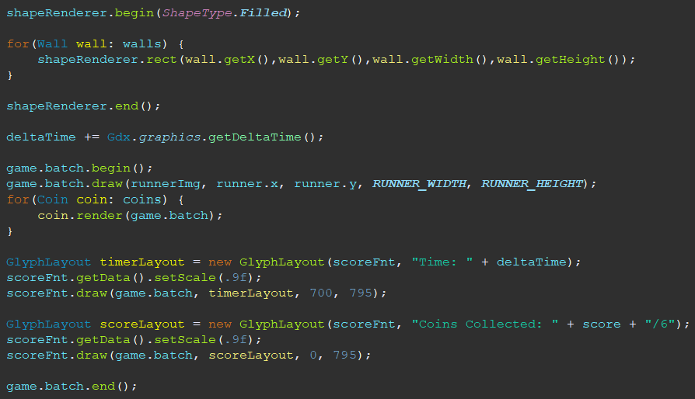
Game Screen Code Pt.2
Runner Mechanics
Drawing Walls, Coins, and Font

Slide 9
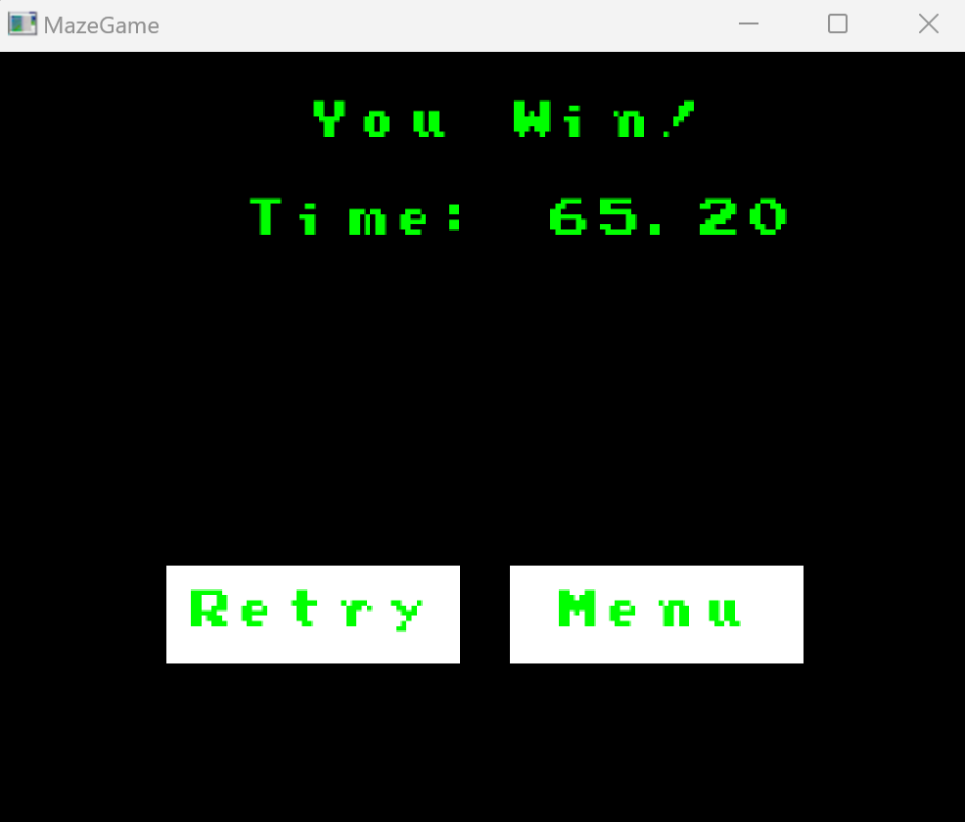
Win Screen
More Buttons
Displays Win Message and Time of Finish

Slide 10
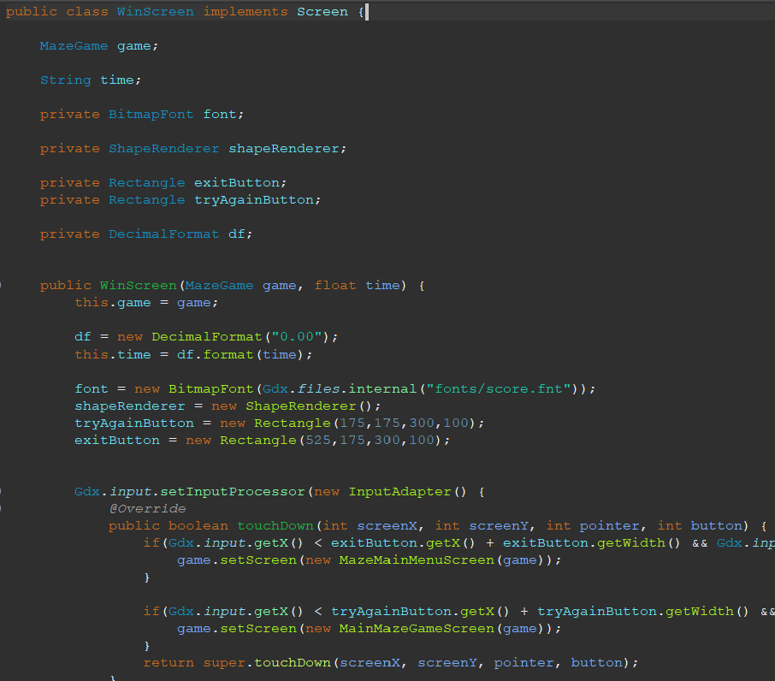
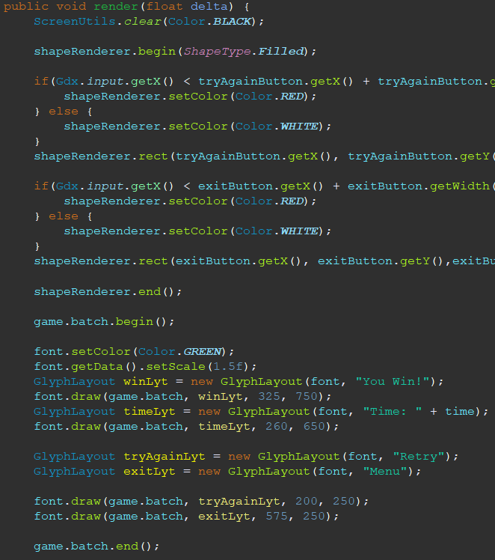
Win Screen Code
Initializations
Buttons and Text
Takes Time and Displays

Slide 11
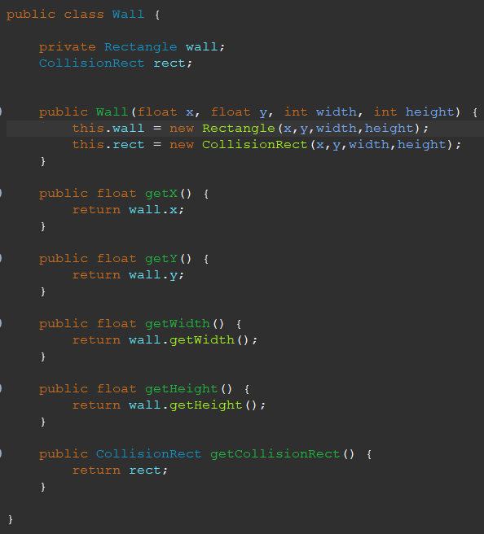
Wall Class/Object and Code
Inner-Workings of Wall
Wall Methods

Slide 12
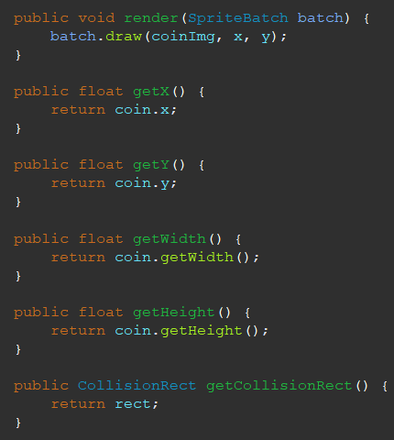
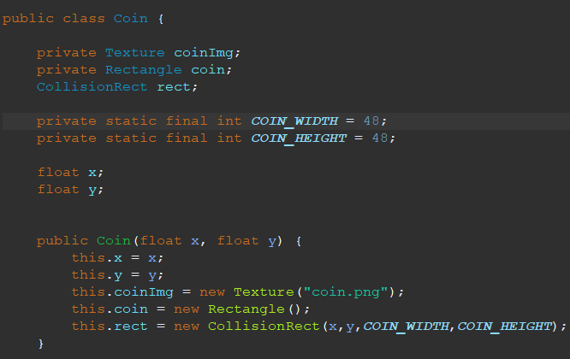
Coin Class/Object and Code
Coin Object Details
Coin Methods

Slide 13
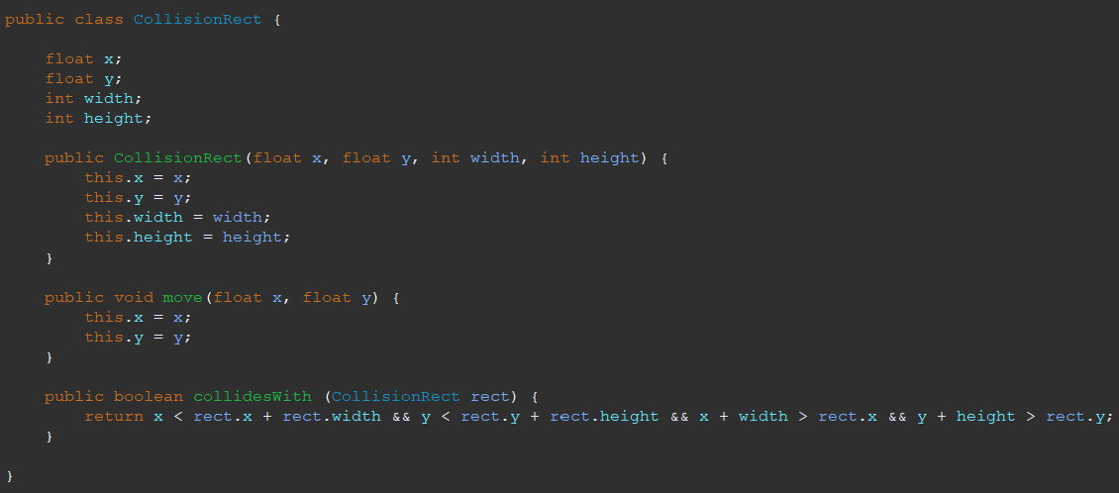
Collision Code
Collision Between Objects
Collision Methods

