Slide 1
City Simulator Game
By: Adyan, Elias, Bilal, and Zain

Slide 2
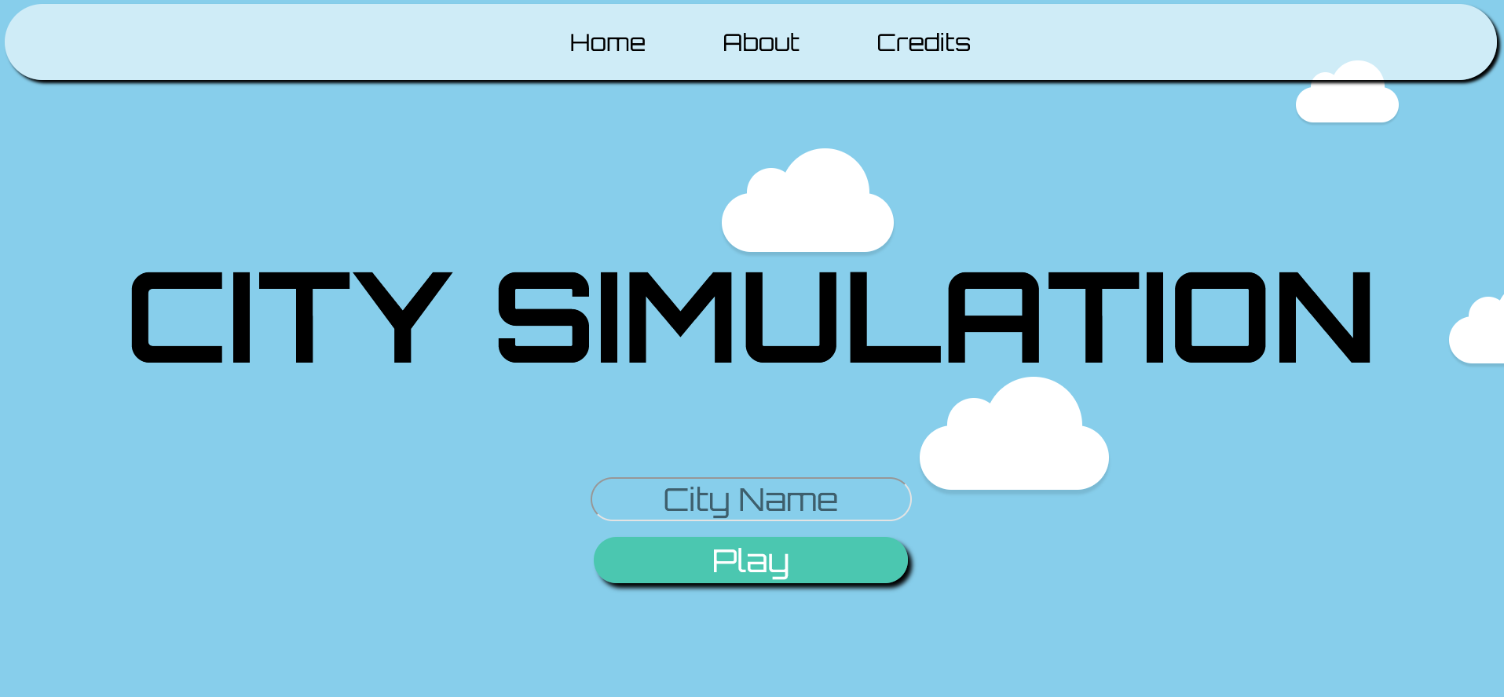
How to Play
The City Simulator Game is a game where the user is told to enter in a name for a city who then has to build it up by increasing the city’s funds. This game operates as a type of “cookie clicker” simulation where the user has to click the generator to build funds in order to buy things that will allow them to build those funds passively.
Initially, one click will net you only $1, but as you make more money, you will be able to buy cars and buildings that either passively make you more money, or multiplies how much money you can make per click. Once you, buy out the all the buildings and cars, your city will be complete, allowing you to then win the game.

Slide 3
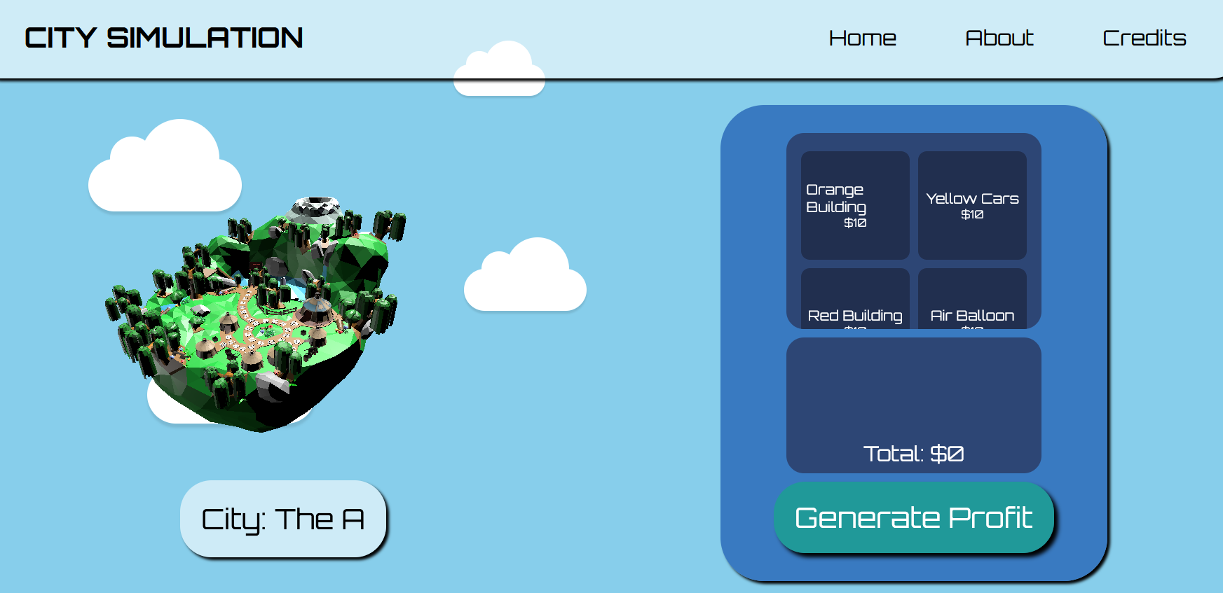
Classes/Objects
We use polymorphism to extend the super class denoted as “Prop” to our other child classes: “Building” and “Vehicle”.
The “Prop” superclass contains the programming for the name, id, and price of our objects.
The “Vehicle” and “Building” child classes retain this information as well the addition of methods that alter the accumulation of profit in the game.
Through this process, we were able to make the buildings accumulate passive profit of some amount depending on the building while vehicles give a profit multiplier, as in more money per click depending on the car.

Slide 4
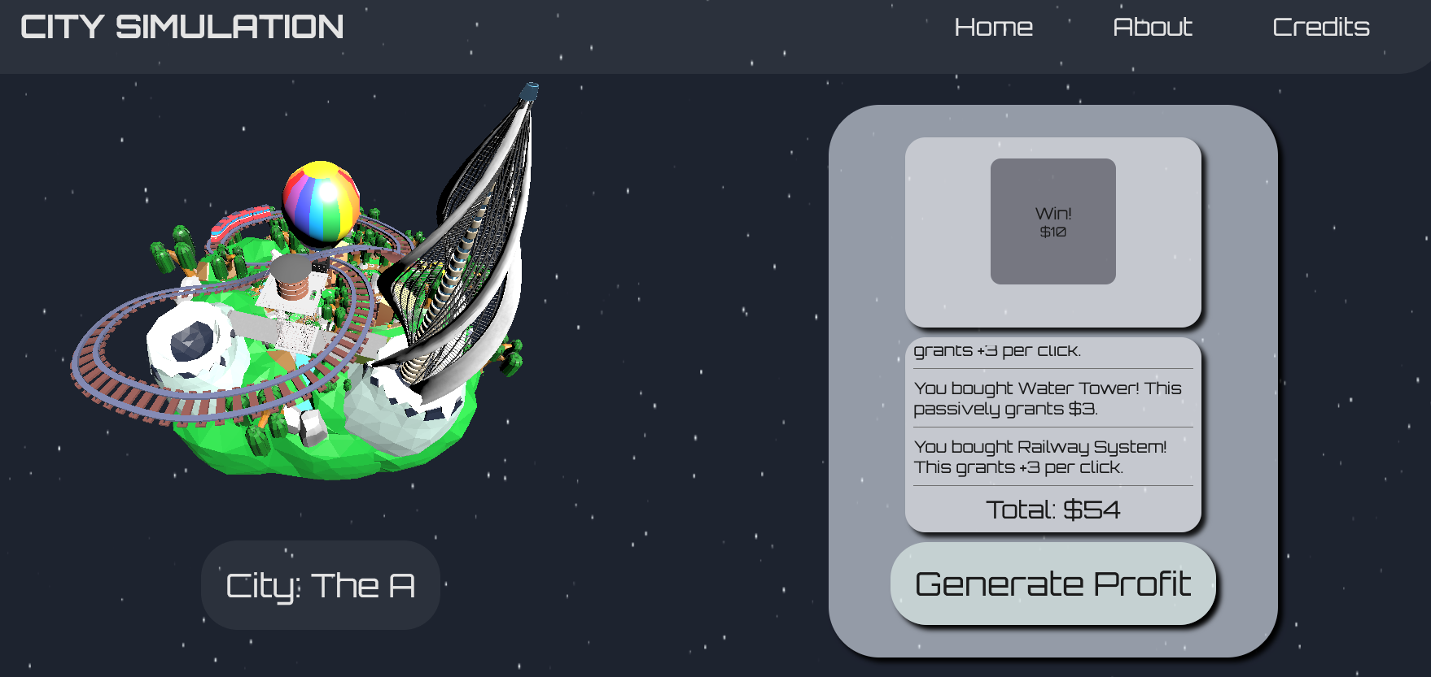
Classes
CitySimApplication
  Holds the main method
GameController
  Holds implementations of objects and ArrayLists
  Calls methods in the Money clas to update your income and current amount of money
Money
  Object that takes care of your currency in the game
    Holds your current total
    Passive income
    And multiplier for money you make from clicking
WebController
  Controls what pages/displays you are seeing as the user

Slide 5
Github Link
Github Link
Github Link
CitySim

