Slide 1
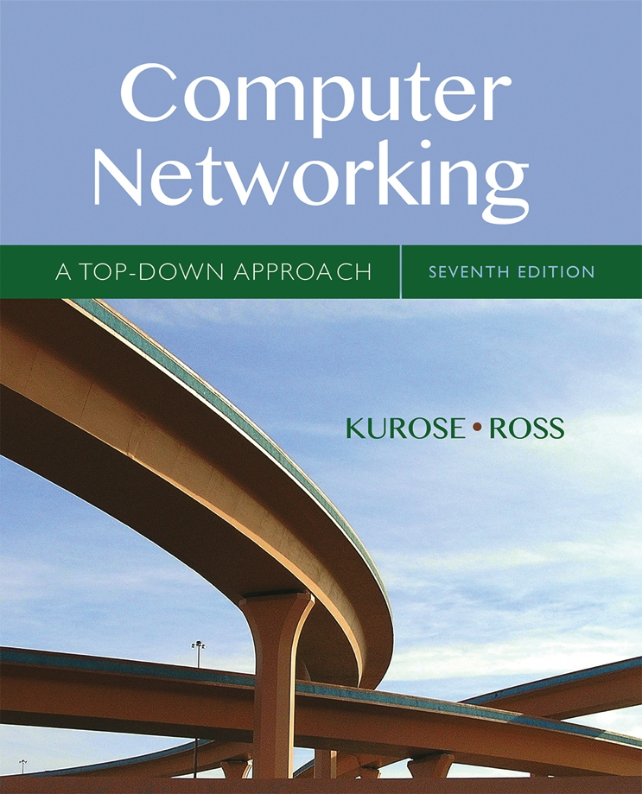

Chapter 6
The Link Layer
and LANs
A note on the use of these Powerpoint slides:
We’re making these slides freely available to all (faculty, students, readers). They’re in PowerPoint form so you see the animations; and can add, modify, and delete slides (including this one) and slide content to suit your needs. They obviously represent a lot of work on our part. In return for use, we only ask the following:
Computer Networking: A Top Down Approach
If you use these slides (e.g., in a class) that you mention their source (after all, we’d like people to use our book!)
If you post any slides on a www site, that you note that they are adapted from (or perhaps identical to) our slides, and note our copyright of this material.
Thanks and enjoy! JFK/KWR
All material copyright 1996-2016
J.F Kurose and K.W. Ross, All Rights Reserved
7th edition
Jim Kurose, Keith Ross
Pearson/Addison Wesley
April 2016

Slide 2
Link layer, LANs: outline
6.1 introduction, services
6.2 error detection, correction
6.3 multiple access protocols
6.4 LANs
  addressing, ARP
  Ethernet
  switches
  VLANS
6.5 link virtualization: MPLS
6.6 data center networking
6.7 a day in the life of a web request

Slide 3

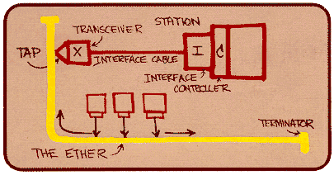
Ethernet
“dominant” wired LAN technology:
single chip, multiple speeds (e.g., Broadcom BCM5761)
first widely used LAN technology
simpler, cheap
kept up with speed race: 10 Mbps – 10 Gbps
Metcalfe’s Ethernet sketch

Slide 4



Ethernet: physical topology
bus: popular through mid 90s
  all nodes in same collision domain (can collide with each other)
star: prevails today
  active switch in center
  each “spoke” runs a (separate) Ethernet protocol (nodes do not collide with each other)
switch
star
bus: coaxial cable

Slide 5
Ethernet frame structure
sending adapter encapsulates IP datagram (or other network layer protocol packet) in Ethernet frame
preamble:
7 bytes with pattern 10101010 followed by one byte with pattern 10101011
used to synchronize receiver, sender clock rates
type
preamble
dest.
address
source
address
data (payload)
CRC

Slide 6
Ethernet frame structure (more)
addresses: 6 byte source, destination MAC addresses
  if adapter receives frame with matching destination address, or with broadcast address (e.g. ARP packet), it passes data in frame to network layer protocol
  otherwise, adapter discards frame
type: indicates higher layer protocol (mostly IP but others possible, e.g., Novell IPX, AppleTalk)
CRC: cyclic redundancy check at receiver
  error detected: frame is dropped
type
preamble
dest.
address
source
address
data (payload)
CRC

Slide 7
Ethernet: unreliable, connectionless
connectionless: no handshaking between sending and receiving NICs
unreliable: receiving NIC doesn't send acks or nacks to sending NIC
  data in dropped frames recovered only if initial sender uses higher layer rdt (e.g., TCP), otherwise dropped data lost
Ethernet’s MAC protocol: unslotted CSMA/CD with binary backoff

Slide 8
802.3 Ethernet standards: link & physical layers
many different Ethernet standards
  common MAC protocol and frame format
  different speeds: 2 Mbps, 10 Mbps, 100 Mbps, 1Gbps, 10 Gbps, 40 Gbps
  different physical layer media: fiber, cable
application
transport
network
link
physical
MAC protocol
and frame format
100BASE-TX
100BASE-T2
100BASE-FX
100BASE-T4
100BASE-SX
100BASE-BX
copper (twister
pair) physical layer
fiber physical layer

Slide 9
Link layer, LANs: outline
6.1 introduction, services
6.2 error detection, correction
6.3 multiple access protocols
6.4 LANs
  addressing, ARP
  Ethernet
  switches
  VLANS
6.5 link virtualization: MPLS
6.6 data center networking
6.7 a day in the life of a web request

Slide 10
Ethernet switch
link-layer device: takes an active role
  store, forward Ethernet frames
  examine incoming frame’s MAC address, selectively forward frame to one-or-more outgoing links when frame is to be forwarded on segment, uses CSMA/CD to access segment
transparent
  hosts are unaware of presence of switches
plug-and-play, self-learning
  switches do not need to be configured

Slide 11
Switch: multiple simultaneous transmissions
hosts have dedicated, direct connection to switch
switches buffer packets
Ethernet protocol used on each incoming link, but no collisions; full duplex
  each link is its own collision domain
switching: A-to-A’ and B-to-B’ can transmit simultaneously, without collisions
A
C’
B
6
1
2
5
4
3
B’
C
A’
switch with six interfaces
(1,2,3,4,5,6)

Slide 12
Switch forwarding table
Q: how does switch know A’ reachable via interface 4, B’ reachable via interface 5?
A
C’
B
A: each switch has a switch table, each entry:
  (MAC address of host, interface to reach host, time stamp)
  looks like a routing table!
6
1
2
5
4
3
B’
C
A’
Q: how are entries created, maintained in switch table?
  something like a routing protocol?
switch with six interfaces
(1,2,3,4,5,6)

Slide 13
Switch: self-learning
Source: A
Dest: A’
switch learns which hosts can be reached through which interfaces
  when frame received, switch “learns” location of sender: incoming LAN segment
  records sender/location pair in switch table
A
A A’
C’
B
6
1
2
5
4
3
B’
C
A’
MAC addr interface TTL
A
1
60
Switch table
(initially empty)

Slide 14
Switch: frame filtering/forwarding
when frame received at switch:
  1. record incoming link, MAC address of sending host
  2. index switch table using MAC destination address
  3. if entry found for destination
  then {
  if destination on segment from which frame arrived
  then drop frame
  else forward frame on interface indicated by entry
  }
  else flood /* forward on all interfaces except arriving
  interface */

Slide 15
Self-learning, forwarding: example
Source: A
Dest: A’
A
A A’
frame destination, A’, location unknown:
flood
C’
B
destination A location known:
6
1
2
A A’
A A’
A A’
A A’
selectively send
on just one link
A A’
5
4
3
B’
C
A’ A
A’
MAC addr interface TTL
A
1
60
switch table
(initially empty)
A’
4
60

Slide 16

Interconnecting switches
self-learning switches can be connected together:
S₄
S₁
S₃
A
S₂
F
I
B
C
D
E
G
H
Q: sending from A to G - how does S₁ know to forward frame destined to G via S₄ and S₃?
A: self learning! (works exactly the same as in single-switch case!)

Slide 17
Self-learning multi-switch example
Suppose C sends frame to I, I responds to C
S₄
S₁
S₃
A
S₂
F
I
B
C
D
E
G
H
Q: show switch tables and packet forwarding in S₁, S₂, S₃, S₄

Slide 18
Institutional network
mail server
to external
network
router
web server
IP subnet

Slide 19
Switches vs. routers
application
transport
network
link
physical
both are store-and-forward:
routers: network-layer devices (examine network-layer headers)
switches: link-layer devices (examine link-layer headers)
both have forwarding tables:
routers: compute tables using routing algorithms, IP addresses
switches: learn forwarding table using flooding, learning, MAC addresses
datagram
frame
link
physical
frame
switch
network
link
physical
datagram
frame
application
transport
network
link
physical

