Slide 1
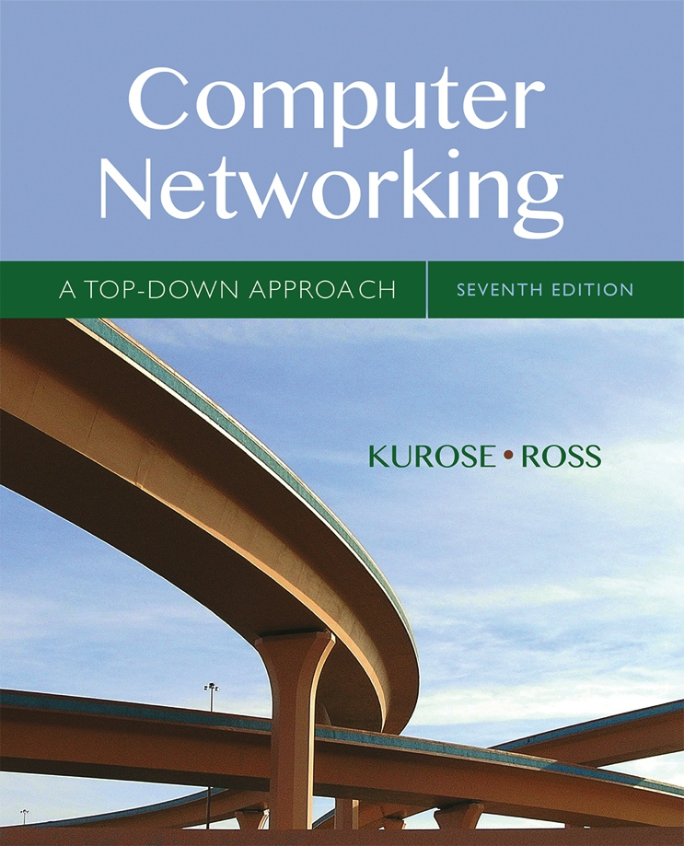

Chapter 5
Network Layer:
The Control Plane
A note on the use of these Powerpoint slides:
We’re making these slides freely available to all (faculty, students, readers). They’re in PowerPoint form so you see the animations; and can add, modify, and delete slides (including this one) and slide content to suit your needs. They obviously represent a lot of work on our part. In return for use, we only ask the following:
Computer Networking: A Top Down Approach
If you use these slides (e.g., in a class) that you mention their source (after all, we’d like people to use our book!)
If you post any slides on a www site, that you note that they are adapted from (or perhaps identical to) our slides, and note our copyright of this material.
Thanks and enjoy! JFK/KWR
All material copyright 1996-2016
J.F Kurose and K.W. Ross, All Rights Reserved
7th edition
Jim Kurose, Keith Ross
Pearson/Addison Wesley
April 2016

Slide 2
Chapter 5: outline
5.1 introduction
5.2 routing protocols
link state
distance vector
5.3 intra-AS routing in the Internet: OSPF
5.4 routing among the ISPs: BGP
5.5 The SDN control plane
5.6 ICMP: The Internet Control Message Protocol
5.7 Network management and SNMP

Slide 3
Internet inter-AS routing: BGP
BGP (Border Gateway Protocol): the de facto inter-domain routing protocol
  “glue that holds the Internet together”
BGP provides each AS a means to:
  eBGP: obtain subnet reachability information from neighboring ASes
  iBGP: propagate reachability information to all AS-internal routers.
  determine “good” routes to other networks based on reachability information and policy
allows subnet to advertise its existence to rest of Internet: “I am here”

Slide 4
eBGP, iBGP connections
2b
∂
2a
2c
1b
3b
2d
∂
1a
1c
3a
3c
AS 2
1d
3d
AS 1
eBGP connectivity
AS 3
iBGP connectivity
1c
gateway routers run both eBGP and iBGP protools

Slide 5
BGP basics
BGP session: two BGP routers (“peers”) exchange BGP messages over semi-permanent TCP connection:
  advertising paths to different destination network prefixes (BGP is a “path vector” protocol)
when AS3 gateway router 3a advertises path AS3,X to AS2 gateway router 2c:
  AS3 promises to AS2 it will forward datagrams towards X
AS 3
3b
AS 1
1b
3a
3c
1a
1c
AS 2
2b
3d
X
1d
2a
2c
BGP advertisement:
AS3, X
2d

Slide 6
Path attributes and BGP routes
advertised prefix includes BGP attributes
  prefix + attributes = “route”
two important attributes:
  AS-PATH: list of ASes through which prefix advertisement has passed
  NEXT-HOP: indicates specific internal-AS router to next-hop AS
Policy-based routing:
  gateway receiving route advertisement uses import policy to accept/decline path (e.g., never route through AS Y).
  AS policy also determines whether to advertise path to other other neighboring ASes

Slide 7
BGP path advertisement
AS3
3b
AS1
1b
3a
3c
1a
1c
AS2
2b
3d
X
1d
AS3,X
AS2,AS3,X
2a
2c
2d
AS2 router 2c receives path advertisement AS3,X (via eBGP) from AS3 router 3a
Based on AS2 policy, AS2 router 2c accepts path AS3,X, propagates (via iBGP) to all AS2 routers
Based on AS2 policy, AS2 router 2a advertises (via eBGP) path AS2, AS3, X to AS1 router 1c

Slide 8
BGP path advertisement
AS3
3b
AS1
1b
AS3,X
3a
3c
1a
1c
AS2
2b
3d
X
1d
AS3,X
AS2,AS3,X
2a
2c
2d
gateway router may learn about multiple paths to destination:
AS1 gateway router 1c learns path AS2,AS3,X from 2a
AS1 gateway router 1c learns path AS3,X from 3a
Based on policy, AS1 gateway router 1c chooses path AS3,X, and advertises path within AS1 via iBGP

Slide 9
BGP messages
BGP messages exchanged between peers over TCP connection
BGP messages:
  OPEN: opens TCP connection to remote BGP peer and authenticates sending BGP peer
  UPDATE: advertises new path (or withdraws old)
  KEEPALIVE: keeps connection alive in absence of UPDATES; also ACKs OPEN request
  NOTIFICATION: reports errors in previous msg; also used to close connection

Slide 10
BGP, OSPF, forwarding table entries
Q: how does router set forwarding table entry to distant prefix?
AS3
3b
AS1
1b
AS3,X
1
AS3,X
3a
3c
1a
2
1c
local link interfaces
at 1a, 1d
AS2
2b
3d
X
2
1d
1
AS3,X
AS2,AS3,X
2a
2c
physical link
2d
dest
interface
recall: 1a, 1b, 1c learn about dest X via iBGP from 1c: “path to X goes through 1c”
…
…
…
…
X
1
1d: OSPF intra-domain routing: to get to 1c, forward over outgoing local interface 1

Slide 11
BGP, OSPF, forwarding table entries
Q: how does router set forwarding table entry to distant prefix?
AS3
3b
AS1
1b
1
3a
3c
1a
2
1c
AS2
2b
3d
X
1d
2a
2c
2d
dest
interface
recall: 1a, 1b, 1c learn about dest X via iBGP from 1c: “path to X goes through 1c”
…
…
…
…
X
2
1d: OSPF intra-domain routing: to get to 1c, forward over outgoing local interface 1
1a: OSPF intra-domain routing: to get to 1c, forward over outgoing local interface 2

Slide 12
BGP route selection
router may learn about more than one route to destination AS, selects route based on:
  local preference value attribute: policy decision
  shortest AS-PATH
  closest NEXT-HOP router: hot potato routing
  additional criteria

Slide 13
Hot Potato Routing
AS3
3b
AS1
1b
3a
3c
1a
1c
AS2
2b
3d
X
1d
112
152
AS3,X
AS1,AS3,X
2a
263
2c
201
OSPF link weights
2d
2d learns (via iBGP) it can route to X via 2a or 2c
hot potato routing: choose local gateway that has least intra-domain cost (e.g., 2d chooses 2a, even though more AS hops to X): don’t worry about inter-domain cost!

Slide 14
BGP: achieving policy via advertisements
legend:
provider
B
network
X
W
A
customer
C
network:
Y
Suppose an ISP only wants to route traffic to/from its customer networks (does not want to carry transit traffic between other ISPs)
A advertises path Aw to B and to C
B chooses not to advertise BAw to C:
  B gets no “revenue” for routing CBAw, since none of C, A, w are B’s customers
  C does not learn about CBAw path
C will route CAw (not using B) to get to w

Slide 15
BGP: achieving policy via advertisements
legend:
provider
B
network
X
W
A
customer
C
network:
Y
Suppose an ISP only wants to route traffic to/from its customer networks (does not want to carry transit traffic between other ISPs)
A,B,C are provider networks
X,W,Y are customer (of provider networks)
X is dual-homed: attached to two networks
policy to enforce: X does not want to route from B to C via X
  .. so X will not advertise to B a route to C

Slide 16
Why different Intra-, Inter-AS routing ?
policy:
inter-AS: admin wants control over how its traffic routed, who routes through its net.
intra-AS: single admin, so no policy decisions needed
scale:
hierarchical routing saves table size, reduced update traffic
performance:
intra-AS: can focus on performance
inter-AS: policy may dominate over performance

Slide 17
Chapter 5: outline
5.1 introduction
5.2 routing protocols
link state
distance vector
5.3 intra-AS routing in the Internet: OSPF
5.4 routing among the ISPs: BGP
5.5 The SDN control plane
5.6 ICMP: The Internet Control Message Protocol
5.7 Network management and SNMP

Slide 18
Software defined networking (SDN)
Internet network layer: historically has been implemented via distributed, per-router approach
  monolithic router contains switching hardware, runs proprietary implementation of Internet standard protocols (IP, RIP, IS-IS, OSPF, BGP) in proprietary router OS (e.g., Cisco IOS)
  different “middleboxes” for different network layer functions: firewalls, load balancers, NAT boxes, ..
~2005: renewed interest in rethinking network control plane

Slide 19

Recall: per-router control plane
Individual routing algorithm components in each and every router interact with each other in control plane to compute forwarding tables
Routing
Algorithm
control
plane
data
plane

Slide 20
Recall: logically centralized control plane
A distinct (typically remote) controller interacts with local control agents (CAs) in routers to compute forwarding tables
Remote Controller
control
plane
data
plane
CA
CA
CA
CA
CA

Slide 21
Software defined networking (SDN)
Why a logically centralized control plane?
easier network management: avoid router misconfigurations, greater flexibility of traffic flows
table-based forwarding (recall OpenFlow API) allows “programming” routers
  centralized “programming” easier: compute tables centrally and distribute
  distributed “programming: more difficult: compute tables as result of distributed algorithm (protocol) implemented in each and every router
open (non-proprietary) implementation of control plane

Slide 22

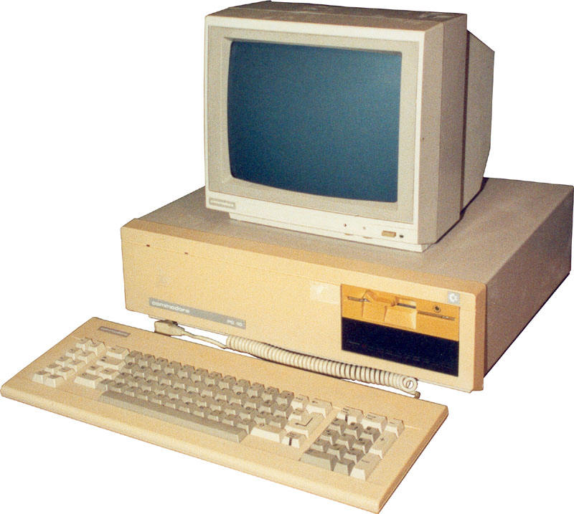
Analogy: mainframe to PC evolution*
App
App
App
App
App
App
App
App
App
App
App
Specialized
Applications
Open Interface
Specialized
Operating
System
Windows
(OS)
Linux
Mac
OS
or
or
Specialized
Hardware
Open Interface
Microprocessor
Vertically integrated
Closed, proprietary
Slow innovation
Small industry
Horizontal
Open interfaces
Rapid innovation
Huge industry
* Slide courtesy: N. McKeown

