Slide 1
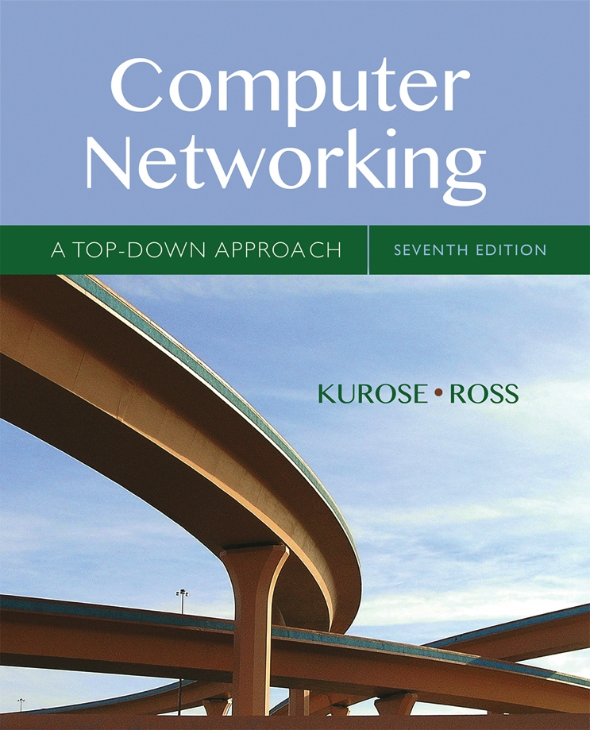

Chapter 5
Network Layer:
The Control Plane
A note on the use of these Powerpoint slides:
We’re making these slides freely available to all (faculty, students, readers). They’re in PowerPoint form so you see the animations; and can add, modify, and delete slides (including this one) and slide content to suit your needs. They obviously represent a lot of work on our part. In return for use, we only ask the following:
Computer Networking: A Top Down Approach
If you use these slides (e.g., in a class) that you mention their source (after all, we’d like people to use our book!)
If you post any slides on a www site, that you note that they are adapted from (or perhaps identical to) our slides, and note our copyright of this material.
Thanks and enjoy! JFK/KWR
All material copyright 1996-2016
J.F Kurose and K.W. Ross, All Rights Reserved
7th edition
Jim Kurose, Keith Ross
Pearson/Addison Wesley
April 2016

Slide 2
Chapter 5: outline
5.1 introduction
5.2 routing protocols
link state
distance vector
5.3 intra-AS routing in the Internet: OSPF
5.4 routing among the ISPs: BGP
5.5 The SDN control plane
5.6 ICMP: The Internet Control Message Protocol
5.7 Network management and SNMP

Slide 3
Distance vector algorithm
Bellman-Ford equation (dynamic programming)
let
d_{x}(y) := cost of least-cost path from x to y
then
d_{x}(y) = min {c(x,v) + d_{v}(y) }
v
cost from neighbor v to destination y
cost to neighbor v
min taken over all neighbors v of x

Slide 4
Bellman-Ford example
5
clearly, d_{v}(z) = 5, d_{x}(z) = 3, d_{w}(z) = 3
v
3
w
2
5
u
z
B-F equation says:
2
1
3
1
2
d_{u}(z) = min { c(u,v) + d_{v}(z),
c(u,x) + d_{x}(z),
c(u,w) + d_{w}(z) }
= min {2 + 5,
1 + 3,
5 + 3} = 4
x
y
1
node achieving minimum is next
hop in shortest path, used in forwarding table

Slide 5
Distance vector algorithm
D_{x}(y) = estimate of least cost from x to y
  x maintains distance vector D_{x} = [D_{x}(y): y є N ]
node x:
  knows cost to each neighbor v: c(x,v)
  maintains its neighbors’ distance vectors. For each neighbor v, x maintains
  D_{v} = [D_{v}(y): y є N ]

Slide 6
Distance vector algorithm
key idea:
from time-to-time, each node sends its own distance vector estimate to neighbors
when x receives new DV estimate from neighbor, it updates its own DV using B-F equation:
D_{x}(y) ← min_{v}{c(x,v) + D_{v}(y)} for each node y ∊ N
under minor, natural conditions, the estimate D_{x}(y) converge to the actual least cost d_{x}(y)

Slide 7
Distance vector algorithm
iterative, asynchronous: each local iteration caused by:
local link cost change
DV update message from neighbor
distributed:
each node notifies neighbors only when its DV changes
  neighbors then notify their neighbors if necessary
each node:
wait for (change in local link cost or msg from neighbor)
recompute estimates
if DV to any dest has changed, notify neighbors

Slide 8
D_{x}(z) = min{c(x,y) +
D_{y}(z), c(x,z) + D_{z}(z)}
= min{2+1 , 7+0} = 3
D_{x}(y) = min{c(x,y) + D_{y}(y), c(x,z) + D_{z}(y)}
= min{2+0 , 7+1} = 2
node x
table
cost to
cost to
x y z
x y z
x
0 2 7
x
0
2
3
y
y
2 0 1
from
∞
∞
∞
from
z
∞
∞
∞
z
7 1 0
node y
table
cost to
x y z
y
2
1
x
∞
∞
z
∞
2 0 1
x
from
y
7
z
∞
∞
∞
node z
table
cost to
x y z
x
∞ ∞ ∞
from
y
∞
∞
∞
z
7
1
0
time

Slide 9
D_{x}(z) = min{c(x,y) +
D_{y}(z), c(x,z) + D_{z}(z)}
= min{2+1 , 7+0} = 3
D_{x}(y) = min{c(x,y) + D_{y}(y), c(x,z) + D_{z}(y)}
= min{2+0 , 7+1} = 2
node x
table
cost to
cost to
cost to
x y z
x y z
x y z
x
0 2 7
x
0
2
3
x
0 2 3
y
y
2 0 1
from
∞
∞
∞
from
y
2 0 1
z
z
from
∞
∞
∞
7 1 0
z
3 1 0
node y
table
cost to
cost to
cost to
x y z
x y z
x y z
y
2
1
x
∞
∞
x
0 2 7
∞
2 0 1
x
0 2 3
x
z
from
y
y
2 0 1
y
7
from
from
2 0 1
z
∞
∞
∞
z
7 1 0
z
3 1 0
node z
table
cost to
cost to
cost to
x y z
x y z
x y z
x
∞ ∞ ∞
x
0 2 7
x
0 2 3
y
y
2 0 1
from
y
∞
∞
from
2 0 1
from
∞
z
z
3 1 0
z
3 1 0
7
1
0
time
time

Slide 10
Distance vector: link cost changes
link cost changes:
node detects local link cost change
updates routing info, recalculates
distance vector
if DV changes, notify neighbors
1
y
4
1
x
z
50
“good
news
travels
fast”
t₀ : y detects link-cost change, updates its DV, informs its neighbors.
t₁ : z receives update from y, updates its table, computes new least cost to x , sends its neighbors its DV.
t₂ : y receives z’s update, updates its distance table. y’s least costs do not change, so y does not send a message to z.
* Check out the online interactive exercises for more examples: http://gaia.cs.umass.edu/kurose_ross/interactive/

Slide 11
Distance vector: link cost changes
link cost changes:
node detects local link cost change
bad news travels slow - “count to infinity” problem!
44 iterations before algorithm stabilizes: see text
60
y
4
1
x
z
50
poisoned reverse:
If Z routes through Y to get to X :
  Z tells Y its (Z’s) distance to X is infinite (so Y won’t route to X via Z)
will this completely solve count to infinity problem?

Slide 12
Comparison of LS and DV algorithms
message complexity
LS: with n nodes, E links, O(nE) msgs sent
DV: exchange between neighbors only
  convergence time varies
speed of convergence
LS: O(n²) algorithm requires O(nE) msgs
  may have oscillations
DV: convergence time varies
  may be routing loops
  count-to-infinity problem
robustness: what happens if router malfunctions?
LS:
  node can advertise incorrect link cost
  each node computes only its own table
DV:
  DV node can advertise incorrect path cost
  each node’s table used by others
    error propagate thru network

Slide 13
Chapter 5: outline
5.1 introduction
5.2 routing protocols
link state
distance vector
5.3 intra-AS routing in the Internet: OSPF
5.4 routing among the ISPs: BGP
5.5 The SDN control plane
5.6 ICMP: The Internet Control Message Protocol
5.7 Network management and SNMP

Slide 14
Making routing scalable
our routing study thus far - idealized
all routers identical
network “flat”
… not true in practice
scale: with billions of destinations:
can’t store all destinations in routing tables!
routing table exchange would swamp links!
administrative autonomy
internet = network of networks
each network admin may want to control routing in its own network

Slide 15
Internet approach to scalable routing
aggregate routers into regions known as “autonomous systems” (AS) (a.k.a. “domains”)
intra-AS routing
routing among hosts, routers in same AS (“network”)
all routers in AS must run same intra-domain protocol
routers in different AS can run different intra-domain routing protocol
gateway router: at “edge” of its own AS, has link(s) to router(s) in other AS’es
inter-AS routing
routing among AS’es
gateways perform inter-domain routing (as well as intra-domain routing)

Slide 16
Interconnected ASes
3c
3a
2c
3b
AS3
2a
1c
2b
AS2
1a
1b
1d
AS1
forwarding table configured by both intra- and inter-AS routing algorithm
  intra-AS routing determine entries for destinations within AS
  inter-AS & intra-AS determine entries for external destinations
Intra-AS
Routing
algorithm
Inter-AS
Routing
algorithm
Forwarding
table

Slide 17
Inter-AS tasks
suppose router in AS1 receives datagram destined outside of AS1:
  router should forward packet to gateway router, but which one?
AS1 must:
learn which dests are reachable through AS2, which through AS3
propagate this reachability info to all routers in AS1
job of inter-AS routing!
3c
3a
3b
AS3
2c
other
networks
1c
2a
other
networks
1a
2b
1b
AS2
AS1
1d

Slide 18
Intra-AS Routing
also known as interior gateway protocols (IGP)
most common intra-AS routing protocols:
  RIP: Routing Information Protocol
  OSPF: Open Shortest Path First (IS-IS protocol essentially same as OSPF)
  IGRP: Interior Gateway Routing Protocol (Cisco proprietary for decades, until 2016)

Slide 19
OSPF (Open Shortest Path First)
“open”: publicly available
uses link-state algorithm
  link state packet dissemination
  topology map at each node
  route computation using Dijkstra’s algorithm
router floods OSPF link-state advertisements to all other routers in entire AS
  carried in OSPF messages directly over IP (rather than TCP or UDP
  link state: for each attached link
IS-IS routing protocol: nearly identical to OSPF

Slide 20
OSPF “advanced” features
security: all OSPF messages authenticated (to prevent malicious intrusion)
multiple same-cost paths allowed (only one path in RIP)
for each link, multiple cost metrics for different TOS (e.g., satellite link cost set low for best effort ToS; high for real-time ToS)
integrated uni- and multi-cast support:
  Multicast OSPF (MOSPF) uses same topology data base as OSPF
hierarchical OSPF in large domains.

Slide 21
Hierarchical OSPF
boundary router
backbone router
backbone
area
border
routers
area 3
internal
routers
area 1
area 2

Slide 22
Hierarchical OSPF
two-level hierarchy: local area, backbone.
  link-state advertisements only in area
  each nodes has detailed area topology; only know direction (shortest path) to nets in other areas.
area border routers: “summarize” distances to nets in own area, advertise to other Area Border routers.
backbone routers: run OSPF routing limited to backbone.
boundary routers: connect to other AS’es.

Slide 23
Chapter 5: outline
5.1 introduction
5.2 routing protocols
link state
distance vector
5.3 intra-AS routing in the Internet: OSPF
5.4 routing among the ISPs: BGP
5.5 The SDN control plane
5.6 ICMP: The Internet Control Message Protocol
5.7 Network management and SNMP

