Slide 1
Lecture 12 – Chapter 6
Link Layer and LANs
CIS 5617, Spring 2020
Anduo Wang
Based on Slides created by JFK/KWR
7th edition
Jim Kurose, Keith Ross
Pearson/Addison Wesley
April 2016

Slide 2
Chapter 6: Link layer and LANs
our goals:
understand principles behind link layer services:
  error detection, correction
  sharing a broadcast channel: multiple access
  link layer addressing
  local area networks: Ethernet, VLANs
instantiation, implementation of various link layer technologies

Slide 3
Link layer, LANs: outline
6.1 introduction, services
6.2 error detection, correction
6.3 multiple access protocols
6.4 LANs
  addressing, ARP
  Ethernet
  switches
  VLANS
6.5 link virtualization: MPLS

Slide 4

















Link layer: introduction
terminology:
hosts and routers: nodes
communication channels that connect adjacent nodes along communication path: links
  wired links
  wireless links
  LANs
layer-2 packet: frame, encapsulates datagram
data-link layer has responsibility of
transferring datagram from one node
to physically adjacent node over a link

Slide 5
Link layer services
framing, link access:
  encapsulate datagram into frame, adding header, trailer
  channel access if shared medium
  “MAC” addresses used in frame headers to identify source, destination
    different from IP address!
reliable delivery between adjacent nodes
  we learned how to do this already (chapter 3)!
  seldom used on low bit-error link (fiber, some twisted pair)
  wireless links: high error rates
    Q: why both link-level and end-end reliability?

Slide 6
Link layer services (more)
flow control:
  pacing between adjacent sending and receiving nodes
error detection:
  errors caused by signal attenuation, noise.
  receiver detects presence of errors:
    signals sender for retransmission or drops frame
error correction:
  receiver identifies and corrects bit error(s) without resorting to retransmission
half-duplex and full-duplex
  with half duplex, nodes at both ends of link can transmit, but not at same time

Slide 7
Link layer, LANs: outline
6.1 introduction, services
6.2 error detection, correction
6.3 multiple access protocols
6.4 LANs
  addressing, ARP
  Ethernet
  switches
  VLANS
6.5 link virtualization: MPLS
6.6 data center networking
6.7 a day in the life of a web request

Slide 8
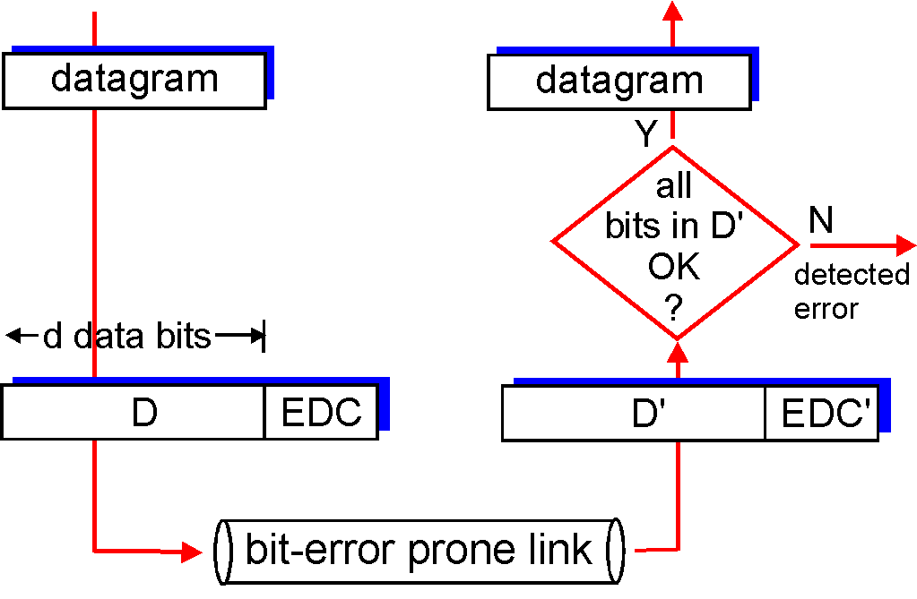
Error detection
EDC= Error Detection and Correction bits (redundancy)
D = Data protected by error checking, may include header fields
Error detection not 100% reliable!
  protocol may miss some errors, but rarely
  larger EDC field yields better detection and correction
otherwise

Slide 9
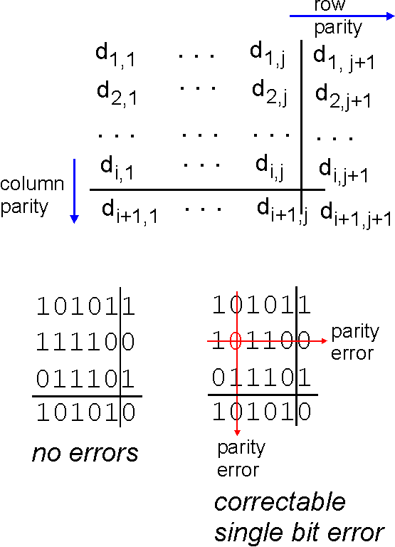
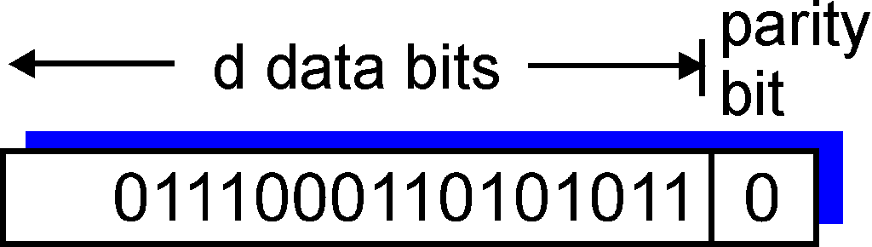
Parity checking
single bit parity:
detect single bit errors
two-dimensional bit parity:
detect and correct single bit errors
0
0
* Check out the online interactive exercises for more examples: http://gaia.cs.umass.edu/kurose_ross/interactive/

Slide 10
Link layer, LANs: outline
6.1 introduction, services
6.2 error detection, correction
6.3 multiple access protocols
6.4 LANs
  addressing, ARP
  Ethernet
  switches
  VLANS
6.5 link virtualization: MPLS

Slide 11




Multiple access links, protocols
two types of “links”:
point-to-point
  PPP for dial-up access
  point-to-point link between Ethernet switch, host
broadcast (shared wire or medium)
  old-fashioned Ethernet
  upstream HFC
  802.11 wireless LAN
shared wire (e.g.,
cabled Ethernet)
shared RF
(e.g., 802.11 WiFi)
shared RF
(satellite)
humans at a
cocktail party
(shared air, acoustical)

Slide 12
Multiple access protocols
single shared broadcast channel
two or more simultaneous transmissions by nodes: interference
  collision if node receives two or more signals at the same time
multiple access protocol
distributed algorithm that determines how nodes share channel, i.e., determine when node can transmit
communication about channel sharing must use channel itself!
  no out-of-band channel for coordination

Slide 13
An ideal multiple access protocol
given: broadcast channel of rate R bps
desiderata:
  1. when one node wants to transmit, it can send at rate R.
  2. when M nodes want to transmit, each can send at average rate R/M
  3. fully decentralized:
    no special node to coordinate transmissions
    no synchronization of clocks, slots
  4. simple

Slide 14
MAC protocols: taxonomy
three broad classes:
channel partitioning
  divide channel into smaller “pieces” (time slots, frequency, code)
  allocate piece to node for exclusive use
random access
  channel not divided, allow collisions
  “recover” from collisions
“taking turns”
  nodes take turns, but nodes with more to send can take longer turns

Slide 15
Summary of MAC protocols
channel partitioning, by time, frequency or code
  Time Division, Frequency Division
random access (dynamic),
  ALOHA, S-ALOHA, CSMA, CSMA/CD
  carrier sensing: easy in some technologies (wire), hard in others (wireless)
  CSMA/CD used in Ethernet
  CSMA/CA used in 802.11
taking turns
  polling from central site, token passing
  Bluetooth, FDDI, token ring

Slide 16
Link layer, LANs: outline
6.1 introduction, services
6.2 error detection, correction
6.3 multiple access protocols
6.4 LANs
  addressing, ARP
  Ethernet
  switches
  VLANS
6.5 link virtualization: MPLS
6.6 data center networking
6.7 a day in the life of a web request

Slide 17
MAC addresses and ARP
32-bit IP address:
  network-layer address for interface
  used for layer 3 (network layer) forwarding
MAC (or LAN or physical or Ethernet) address:
  function: used ‘locally” to get frame from one interface to another physically-connected interface (same network, in IP-addressing sense)
  48 bit MAC address (for most LANs) burned in NIC ROM, also sometimes software settable
  e.g.: 1A-2F-BB-76-09-AD
hexadecimal (base 16) notation
(each “numeral” represents 4 bits)

Slide 18

LAN addresses and ARP
each adapter on LAN has unique LAN address
1A-2F-BB-76-09-AD
LAN
(wired or
wireless)
adapter
71-65-F7-2B-08-53
58-23-D7-FA-20-B0
0C-C4-11-6F-E3-98

Slide 19
LAN addresses (more)
MAC address allocation administered by IEEE
manufacturer buys portion of MAC address space (to assure uniqueness)
analogy:
  MAC address: like Social Security Number
  IP address: like postal address
MAC flat address ➜ portability
  can move LAN card from one LAN to another
IP hierarchical address not portable
  address depends on IP subnet to which node is attached

Slide 20


ARP: address resolution protocol
Question: how to determine
interface’s MAC address, knowing its IP address?
ARP table: each IP node (host, router) on LAN has table
  IP/MAC address mappings for some LAN nodes:
< IP address; MAC address; TTL>
  TTL (Time To Live): time after which address mapping will be forgotten (typically 20 min)
137.196.7.78
1A-2F-BB-76-09-AD
137.196.7.23
137.196.7.14
LAN
71-65-F7-2B-08-53
58-23-D7-FA-20-B0
0C-C4-11-6F-E3-98
137.196.7.88

Slide 21
ARP protocol: same LAN
A wants to send datagram to B
  B’s MAC address not in A’s ARP table.
A broadcasts ARP query packet, containing B's IP address
  destination MAC address = FF-FF-FF-FF-FF-FF
  all nodes on LAN receive ARP query
B receives ARP packet, replies to A with its (B's) MAC address
  frame sent to A’s MAC address (unicast)
A caches (saves) IP-to-MAC address pair in its ARP table until information becomes old (times out)
  soft state: information that times out (goes away) unless refreshed
ARP is “plug-and-play”:
  nodes create their ARP tables without intervention from net administrator

Slide 22
Addressing: routing to another LAN
walkthrough: send datagram from A to B via R
  focus on addressing – at IP (datagram) and MAC layer (frame)
  assume A knows B’s IP address
  assume A knows IP address of first hop router, R (how?)
  assume A knows R’s MAC address (how?)
A
B
R
111.111.111.111
222.222.222.222
74-29-9C-E8-FF-55
49-BD-D2-C7-56-2A
222.222.222.220
1A-23-F9-CD-06-9B
111.111.111.112
111.111.111.110
222.222.222.221
CC-49-DE-D0-AB-7D
E6-E9-00-17-BB-4B
88-B2-2F-54-1A-0F

Slide 23
Addressing: routing to another LAN
A creates IP datagram with IP source A, destination B
A creates link-layer frame with R's MAC address as destination address, frame contains A-to-B IP datagram
MAC src: 74-29-9C-E8-FF-55
MAC dest: E6-E9-00-17-BB-4B
IP
Eth
Phy
IP src: 111.111.111.111
IP dest: 222.222.222.222
A
B
R
111.111.111.111
222.222.222.222
74-29-9C-E8-FF-55
49-BD-D2-C7-56-2A
222.222.222.220
1A-23-F9-CD-06-9B
111.111.111.112
111.111.111.110
222.222.222.221
CC-49-DE-D0-AB-7D
E6-E9-00-17-BB-4B
88-B2-2F-54-1A-0F

Slide 24
Addressing: routing to another LAN
frame sent from A to R
frame received at R, datagram removed, passed up to IP
MAC src: 74-29-9C-E8-FF-55
MAC dest: E6-E9-00-17-BB-4B
IP src: 111.111.111.111
IP dest: 222.222.222.222
IP
Eth
Phy
IP src: 111.111.111.111
IP dest: 222.222.222.222
IP
Eth
Phy
A
B
R
111.111.111.111
222.222.222.222
74-29-9C-E8-FF-55
49-BD-D2-C7-56-2A
222.222.222.220
1A-23-F9-CD-06-9B
111.111.111.112
111.111.111.110
222.222.222.221
CC-49-DE-D0-AB-7D
E6-E9-00-17-BB-4B
88-B2-2F-54-1A-0F

Slide 25
Addressing: routing to another LAN
R forwards datagram with IP source A, destination B
R creates link-layer frame with B's MAC address as destination address, frame contains A-to-B IP datagram
MAC src: 1A-23-F9-CD-06-9B
MAC dest: 49-BD-D2-C7-56-2A
IP
Eth
Phy
IP
Eth
Phy
IP src: 111.111.111.111
IP dest: 222.222.222.222
A
B
R
111.111.111.111
222.222.222.222
74-29-9C-E8-FF-55
49-BD-D2-C7-56-2A
222.222.222.220
1A-23-F9-CD-06-9B
111.111.111.112
111.111.111.110
222.222.222.221
CC-49-DE-D0-AB-7D
E6-E9-00-17-BB-4B
88-B2-2F-54-1A-0F

Slide 26
Addressing: routing to another LAN
R forwards datagram with IP source A, destination B
R creates link-layer frame with B's MAC address as destination address, frame contains A-to-B IP datagram
MAC src: 1A-23-F9-CD-06-9B
MAC dest: 49-BD-D2-C7-56-2A
IP
Eth
Phy
IP
Eth
Phy
IP src: 111.111.111.111
IP dest: 222.222.222.222
A
B
R
111.111.111.111
222.222.222.222
74-29-9C-E8-FF-55
49-BD-D2-C7-56-2A
222.222.222.220
1A-23-F9-CD-06-9B
111.111.111.112
111.111.111.110
222.222.222.221
CC-49-DE-D0-AB-7D
E6-E9-00-17-BB-4B
88-B2-2F-54-1A-0F

Slide 27
Addressing: routing to another LAN
R forwards datagram with IP source A, destination B
R creates link-layer frame with B's MAC address as dest, frame contains A-to-B IP datagram
MAC src: 1A-23-F9-CD-06-9B
MAC dest: 49-BD-D2-C7-56-2A
IP src: 111.111.111.111
IP dest: 222.222.222.222
IP
Eth
Phy
A
B
R
111.111.111.111
222.222.222.222
74-29-9C-E8-FF-55
49-BD-D2-C7-56-2A
222.222.222.220
1A-23-F9-CD-06-9B
111.111.111.112
111.111.111.110
222.222.222.221
CC-49-DE-D0-AB-7D
E6-E9-00-17-BB-4B
88-B2-2F-54-1A-0F
* Check out the online interactive exercises for more examples: http://gaia.cs.umass.edu/kurose_ross/interactive/

Slide 28
Link layer, LANs: outline
6.1 introduction, services
6.2 error detection, correction
6.3 multiple access protocols
6.4 LANs
  addressing, ARP
  Ethernet
  switches
  VLANS
6.5 link virtualization: MPLS

Slide 29

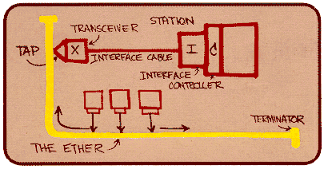
Ethernet
“dominant” wired LAN technology:
single chip, multiple speeds (e.g., Broadcom BCM5761)
first widely used LAN technology
simpler, cheap
kept up with speed race: 10 Mbps – 10 Gbps
Metcalfe’s Ethernet sketch

Slide 30

Ethernet: physical topology
bus: popular through mid 90s
  all nodes in same collision domain (can collide with each other)
star: prevails today
  active switch in center
  each “spoke” runs a (separate) Ethernet protocol (nodes do not collide with each other)
switch
star
bus: coaxial cable

Slide 31
Ethernet: unreliable, connectionless
connectionless: no handshaking between sending and receiving NICs
unreliable: receiving NIC doesn't send acks or nacks to sending NIC
  data in dropped frames recovered only if initial sender uses higher layer rdt (e.g., TCP), otherwise dropped data lost
Ethernet’s MAC protocol: unslotted CSMA/CD with binary backoff

Slide 32
Link layer, LANs: outline
6.1 introduction, services
6.2 error detection, correction
6.3 multiple access protocols
6.4 LANs
  addressing, ARP
  Ethernet
  switches
  VLANS
6.5 link virtualization: MPLS

Slide 33
Ethernet switch
link-layer device: takes an active role
  store, forward Ethernet frames
  examine incoming frame’s MAC address, selectively forward frame to one-or-more outgoing links when frame is to be forwarded on segment, uses CSMA/CD to access segment
transparent
  hosts are unaware of presence of switches
plug-and-play, self-learning
  switches do not need to be configured

Slide 34
Switch: multiple simultaneous transmissions
hosts have dedicated, direct connection to switch
switches buffer packets
Ethernet protocol used on each incoming link, but no collisions; full duplex
  each link is its own collision domain
switching: A-to-A’ and B-to-B’ can transmit simultaneously, without collisions
A
C’
B
6
1
2
5
4
3
B’
C
A’
switch with six interfaces
(1,2,3,4,5,6)

Slide 35
Switch forwarding table
Q: how does switch know A’ reachable via interface 4, B’ reachable via interface 5?
A
C’
B
A: each switch has a switch table, each entry:
  (MAC address of host, interface to reach host, time stamp)
  looks like a routing table!
6
1
2
5
4
3
B’
C
A’
Q: how are entries created, maintained in switch table?
  something like a routing protocol?
switch with six interfaces
(1,2,3,4,5,6)

Slide 36
Switch: self-learning
Source: A
Dest: A’
switch learns which hosts can be reached through which interfaces
  when frame received, switch “learns” location of sender: incoming LAN segment
  records sender/location pair in switch table
A
A A’
C’
B
6
1
2
5
4
3
B’
C
A’
MAC addr interface TTL
A
1
60
Switch table
(initially empty)

Slide 37
Switch: frame filtering/forwarding
when frame received at switch:
  1. record incoming link, MAC address of sending host
  2. index switch table using MAC destination address
  3. if entry found for destination
  then {
  if destination on segment from which frame arrived
  then drop frame
  else forward frame on interface indicated by entry
  }
  else flood /* forward on all interfaces except arriving
  interface */

Slide 38
Self-learning, forwarding: example
Source: A
Dest: A’
A
A A’
frame destination, A’, location unknown:
flood
C’
B
destination A location known:
6
1
2
A A’
A A’
A A’
A A’
selectively send
on just one link
A A’
5
4
3
B’
C
A’ A
A’
MAC addr interface TTL
A
1
60
switch table
(initially empty)
A’
4
60

Slide 39

Interconnecting switches
self-learning switches can be connected together:
S₄
S₁
S₃
A
S₂
F
I
B
C
D
E
G
H
Q: sending from A to G - how does S₁ know to forward frame destined to G via S₄ and S₃?
A: self learning! (works exactly the same as in single-switch case!)

Slide 40
Self-learning multi-switch example
Suppose C sends frame to I, I responds to C
S₄
S₁
S₃
A
S₂
F
I
B
C
D
E
G
H
Q: show switch tables and packet forwarding in S₁, S₂, S₃, S₄

Slide 41
Institutional network
mail server
to external
network
router
web server
IP subnet

Slide 42
Switches vs. routers
application
transport
network
link
physical
both are store-and-forward:
routers: network-layer devices (examine network-layer headers)
switches: link-layer devices (examine link-layer headers)
both have forwarding tables:
routers: compute tables using routing algorithms, IP addresses
switches: learn forwarding table using flooding, learning, MAC addresses
datagram
frame
link
physical
frame
switch
network
link
physical
datagram
frame
application
transport
network
link
physical

Slide 43
Link layer, LANs: outline
6.1 introduction, services
6.2 error detection, correction
6.3 multiple access protocols
6.4 LANs
  addressing, ARP
  Ethernet
  switches
  VLANS
6.5 link virtualization: MPLS

Slide 44


VLANs: motivation
consider:
CS user moves office to EE, but wants connect to CS switch?
single broadcast domain:
  all layer-2 broadcast traffic (ARP, DHCP, unknown location of destination MAC address) must cross entire LAN
  security/privacy, efficiency issues
Computer
Science
Computer
Engineering
Electrical
Engineering

Slide 45
VLANs
port-based VLAN: switch ports grouped (by switch management software) so that single physical switch ……
Virtual Local
Area Network
1
7
9
15
2
8
10
16
switch(es) supporting VLAN capabilities can be configured to define multiple virtual LANS over single physical LAN infrastructure.
…
…
Electrical Engineering
(VLAN ports 1-8)
Computer Science
(VLAN ports 9-15)
… operates as multiple virtual switches
1
7
9
15
2
8
10
16
…
…
Electrical Engineering
(VLAN ports 1-8)
Computer Science
(VLAN ports 9-16)

Slide 46
Port-based VLAN
router
traffic isolation: frames to/from ports 1-8 can only reach ports 1-8
  can also define VLAN based on MAC addresses of endpoints, rather than switch port
1
7
9
15
2
8
10
16
dynamic membership: ports can be dynamically assigned among VLANs
…
…
Electrical Engineering
(VLAN ports 1-8)
Computer Science
(VLAN ports 9-15)
forwarding between VLANS: done via routing (just as with separate switches)
  in practice vendors sell combined switches plus routers

Slide 47
Link layer, LANs: outline
6.1 introduction, services
6.2 error detection, correction
6.3 multiple access protocols
6.4 LANs
  addressing, ARP
  Ethernet
  switches
  VLANS
6.5 link virtualization: MPLS

Slide 48
Multiprotocol label switching (MPLS)
initial goal: high-speed IP forwarding using fixed length label (instead of IP address)
  fast lookup using fixed length identifier (rather than shortest prefix matching)
  borrowing ideas from Virtual Circuit (VC) approach
  but IP datagram still keeps IP address!
PPP or Ethernet
header
IP header
remainder of link-layer frame
MPLS header
label
Exp
S
TTL
20
3
1
5

Slide 49
MPLS capable routers
a.k.a. label-switched router
forward packets to outgoing interface based only on label value (don’t inspect IP address)
  MPLS forwarding table distinct from IP forwarding tables
flexibility: MPLS forwarding decisions can differ from those of IP
  use destination and source addresses to route flows to same destination differently (traffic engineering)
  re-route flows quickly if link fails: pre-computed backup paths (useful for VoIP)

Slide 50
MPLS versus IP paths
R6
D
R4
R3
R5
A
R2
IP routing: path to destination determined by destination address alone
IP router

Slide 51
MPLS versus IP paths
entry router (R4) can use different MPLS routes to A based, e.g., on source address
R6
D
R4
R3
R5
A
R2
IP routing: path to destination determined by destination address alone
IP-only
router
MPLS routing: path to destination can be based on source and destination address
  fast reroute: precompute backup routes in case of link failure
MPLS and
IP router

Slide 52
MPLS signaling
modify OSPF, IS-IS link-state flooding protocols to carry info used by MPLS routing,
  e.g., link bandwidth, amount of “reserved” link bandwidth
entry MPLS router uses RSVP-TE signaling protocol to set up MPLS forwarding at downstream routers
R6
RSVP-TE
D
R4
R5
modified
link state
flooding
A

Slide 53
MPLS forwarding tables
in out out
label label dest interface
10 A 0
in out out
label label dest interface
12 D 0
8 A 1
10 6 A 1
12 9 D 0
R6
0
0
D
1
1
R4
R3
R5
0
0
A
R2
in out out
label label dest interface
R1
in out out
label label dest interface
6 - A 0
8 6 A 0

Slide 54
Link layer, LANs: outline
6.1 introduction, services
6.2 error detection, correction
6.3 multiple access protocols
6.4 LANs
  addressing, ARP
  Ethernet
  switches
  VLANS
6.5 link virtualization: MPLS

