Slide 1
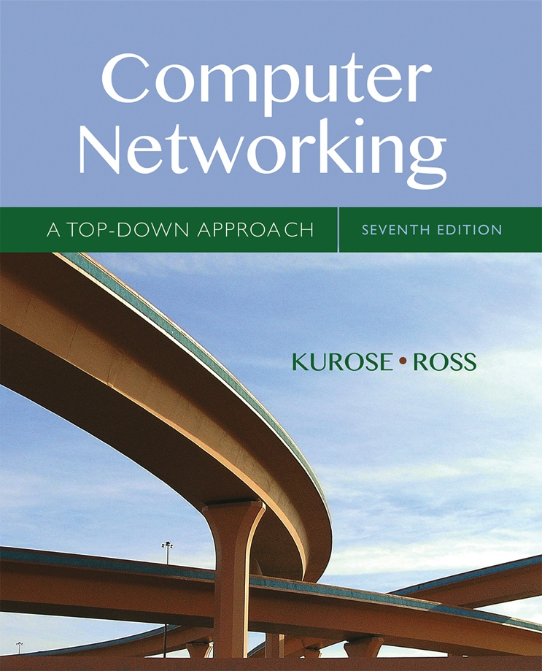

Chapter 6
The Link Layer
and LANs
A note on the use of these Powerpoint slides:
We’re making these slides freely available to all (faculty, students, readers). They’re in PowerPoint form so you see the animations; and can add, modify, and delete slides (including this one) and slide content to suit your needs. They obviously represent a lot of work on our part. In return for use, we only ask the following:
Computer Networking: A Top Down Approach
If you use these slides (e.g., in a class) that you mention their source (after all, we’d like people to use our book!)
If you post any slides on a www site, that you note that they are adapted from (or perhaps identical to) our slides, and note our copyright of this material.
Thanks and enjoy! JFK/KWR
All material copyright 1996-2016
J.F Kurose and K.W. Ross, All Rights Reserved
7th edition
Jim Kurose, Keith Ross
Pearson/Addison Wesley
April 2016

Slide 2
Chapter 6: Link layer and LANs
our goals:
understand principles behind link layer services:
  error detection, correction
  sharing a broadcast channel: multiple access
  link layer addressing
  local area networks: Ethernet, VLANs
instantiation, implementation of various link layer technologies

Slide 3
Link layer, LANs: outline
6.1 introduction, services
6.2 error detection, correction
6.3 multiple access protocols
6.4 LANs
  addressing, ARP
  Ethernet
  switches
  VLANS
6.5 link virtualization: MPLS
6.6 data center networking
6.7 a day in the life of a web request

Slide 4

















Link layer: introduction
terminology:
hosts and routers: nodes
communication channels that connect adjacent nodes along communication path: links
  wired links
  wireless links
  LANs
layer-2 packet: frame, encapsulates datagram
data-link layer has responsibility of
transferring datagram from one node
to physically adjacent node over a link

Slide 5
Link layer: context
datagram transferred by different link protocols over different links:
  e.g., Ethernet on first link, frame relay on intermediate links, 802.11 on last link
each link protocol provides different services
  e.g., may or may not provide rdt over link
transportation analogy:
trip from Princeton to Lausanne
  limo: Princeton to JFK
  plane: JFK to Geneva
  train: Geneva to Lausanne
tourist = datagram
transport segment = communication link
transportation mode = link layer protocol
travel agent = routing algorithm

Slide 6
Link layer services
framing, link access:
  encapsulate datagram into frame, adding header, trailer
  channel access if shared medium
  “MAC” addresses used in frame headers to identify source, destination
    different from IP address!
reliable delivery between adjacent nodes
  we learned how to do this already (chapter 3)!
  seldom used on low bit-error link (fiber, some twisted pair)
  wireless links: high error rates
    Q: why both link-level and end-end reliability?

Slide 7
Link layer services (more)
flow control:
  pacing between adjacent sending and receiving nodes
error detection:
  errors caused by signal attenuation, noise.
  receiver detects presence of errors:
    signals sender for retransmission or drops frame
error correction:
  receiver identifies and corrects bit error(s) without resorting to retransmission
half-duplex and full-duplex
  with half duplex, nodes at both ends of link can transmit, but not at same time

Slide 8
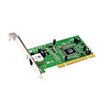
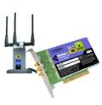

Where is the link layer implemented?
in each and every host
link layer implemented in “adaptor” (aka network interface card NIC) or on a chip
  Ethernet card, 802.11 card; Ethernet chipset
  implements link, physical layer
attaches into host’s system buses
combination of hardware, software, firmware
application
transport
network
link
cpu
memory
link
physical
host
bus
(e.g., PCI)
controller
physical
transmission
network adapter
card

Slide 9
Adaptors communicating
datagram
datagram
controller
controller
sending host
receiving host
datagram
frame
sending side:
  encapsulates datagram in frame
  adds error checking bits, rdt, flow control, etc.
receiving side
  looks for errors, rdt, flow control, etc.
  extracts datagram, passes to upper layer at receiving side

Slide 10
Link layer, LANs: outline
6.1 introduction, services
6.2 error detection, correction
6.3 multiple access protocols
6.4 LANs
  addressing, ARP
  Ethernet
  switches
  VLANS
6.5 link virtualization: MPLS
6.6 data center networking
6.7 a day in the life of a web request

Slide 11
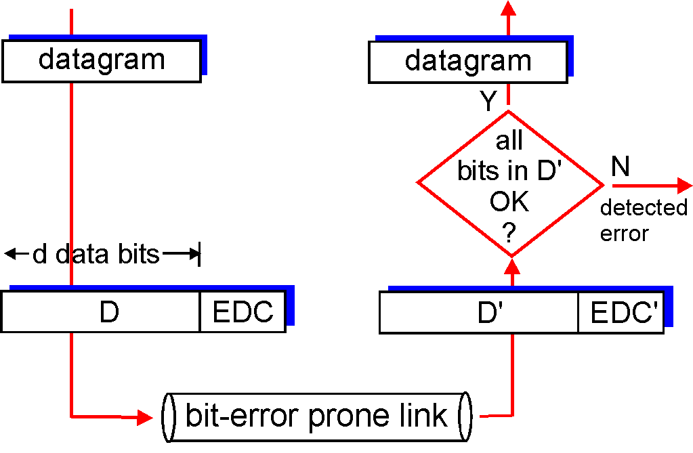
Error detection
EDC= Error Detection and Correction bits (redundancy)
D = Data protected by error checking, may include header fields
Error detection not 100% reliable!
  protocol may miss some errors, but rarely
  larger EDC field yields better detection and correction
otherwise

Slide 12
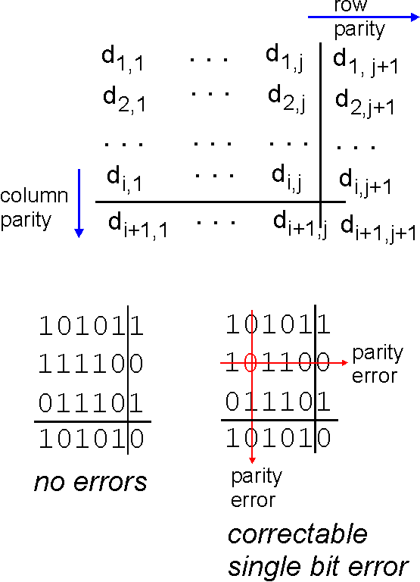
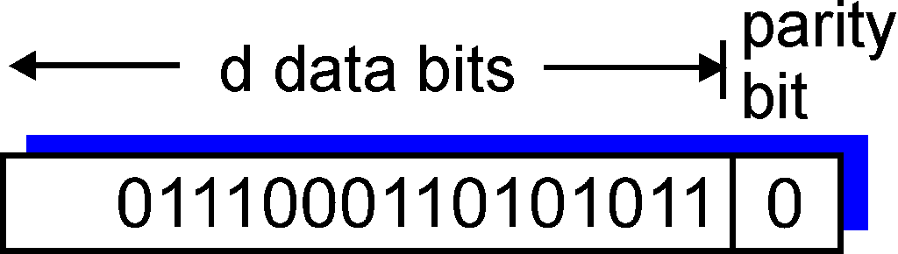
Parity checking
single bit parity:
detect single bit errors
two-dimensional bit parity:
detect and correct single bit errors
0
0
* Check out the online interactive exercises for more examples: http://gaia.cs.umass.edu/kurose_ross/interactive/

Slide 13
Internet checksum (review)
goal: detect “errors” (e.g., flipped bits) in transmitted packet (note: used at transport layer only)
sender:
treat segment contents as sequence of 16-bit integers
checksum: addition (1’s complement sum) of segment contents
sender puts checksum value into UDP checksum field
receiver:
compute checksum of received segment
check if computed checksum equals checksum field value:
  NO - error detected
  YES - no error detected. But maybe errors nonetheless?

Slide 14
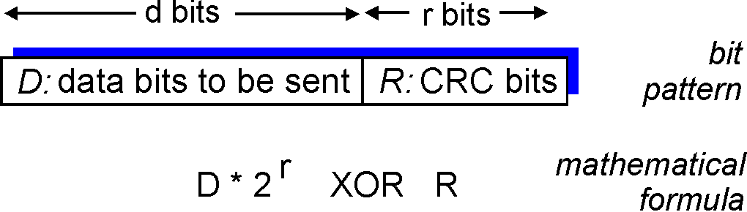
Cyclic redundancy check
more powerful error-detection coding
view data bits, D, as a binary number
choose r+1 bit pattern (generator), G
goal: choose r CRC bits, R, such that
  <D,R> exactly divisible by G (modulo 2)
  receiver knows G, divides <D,R> by G. If non-zero remainder: error detected!
  can detect all burst errors less than r+1 bits
widely used in practice (Ethernet, 802.11 WiFi, ATM)

Slide 15
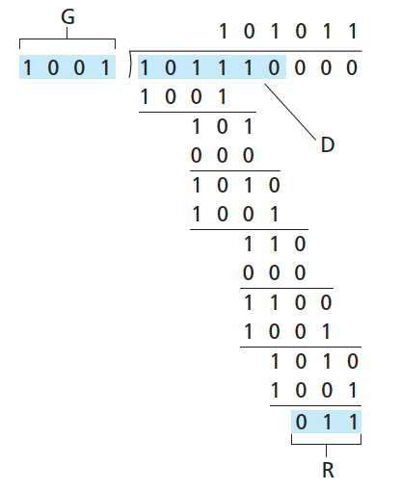
CRC example
want:
  D.2^{r} XOR R = nG
equivalently:
  D.2^{r} = nG XOR R
equivalently:
if we divide D.2^{r} by G, want remainder R to satisfy:
D.2^{r}
G
R = remainder[ ]
* Check out the online interactive exercises for more examples: http://gaia.cs.umass.edu/kurose_ross/interactive/

Slide 16
Link layer, LANs: outline
6.1 introduction, services
6.2 error detection, correction
6.3 multiple access protocols
6.4 LANs
  addressing, ARP
  Ethernet
  switches
  VLANS
6.5 link virtualization: MPLS
6.6 data center networking
6.7 a day in the life of a web request

Slide 17




Multiple access links, protocols
two types of “links”:
point-to-point
  PPP for dial-up access
  point-to-point link between Ethernet switch, host
broadcast (shared wire or medium)
  old-fashioned Ethernet
  upstream HFC
  802.11 wireless LAN
shared wire (e.g.,
cabled Ethernet)
shared RF
(e.g., 802.11 WiFi)
shared RF
(satellite)
humans at a
cocktail party
(shared air, acoustical)

Slide 18
Multiple access protocols
single shared broadcast channel
two or more simultaneous transmissions by nodes: interference
  collision if node receives two or more signals at the same time
multiple access protocol
distributed algorithm that determines how nodes share channel, i.e., determine when node can transmit
communication about channel sharing must use channel itself!
  no out-of-band channel for coordination

Slide 19
An ideal multiple access protocol
given: broadcast channel of rate R bps
desiderata:
  1. when one node wants to transmit, it can send at rate R.
  2. when M nodes want to transmit, each can send at average rate R/M
  3. fully decentralized:
    no special node to coordinate transmissions
    no synchronization of clocks, slots
  4. simple

Slide 20
MAC protocols: taxonomy
three broad classes:
channel partitioning
  divide channel into smaller “pieces” (time slots, frequency, code)
  allocate piece to node for exclusive use
random access
  channel not divided, allow collisions
  “recover” from collisions
“taking turns”
  nodes take turns, but nodes with more to send can take longer turns

