Slide 1
CIS 5512 - Operating Systems
Synchronization and Deadlock
Professor Qiang Zeng

Slide 2
Previous class
Restroom problem
Bar problem
Enforcing execution order
Single-slot producer-consumer problem
Multi-slot producer-consumer problem

Slide 3
Barrier Problem

Slide 4
Barrier problem
Goal: given a number, N, of processes, each process has to wait at some point of its program until all processes reach the point
Implement the API Barrier(), which is called by each process
  The N-1 processes block until the last one calls it

Slide 5
Solution
Barrier() {
down(mutex)
count += 1
if (count == n)
for (i = 0; i < n; ++i)
up(barrier)
up(mutex)
down(barrier)
}
Notes:
Little book 3.6.6

Slide 6
Another solution
Is it possible that two processes both arrive here and find “count == n”
A: It is possible. But extra up() operations will not cause errors. Certainly, you can move the “if” statement into mutex-guarded region

Slide 7
Readers-Writers Problem

Slide 8
Readers-Writers Problem
Problem statement:
  Reader threads only read the object
  Writer threads modify the object
  Writers must have exclusive access to the object
  Unlimited number of readers can access the object
Occurs frequently in real systems, e.g.,
  Online airline reservation system
  Multithreaded caching Web proxy

Slide 9
Solution
Shared:
int readcnt; /* Initially = 0 */
semaphore r, whole; /* Initially = 1 */
Writers:
void writer(void)
{
while (1) {
down(whole);
/* Critical section */
/* Writing here */
up(whole);
}
}

Slide 10
Solution
What if the “whole” lock is already acquired by the writer, and the first reader comes in?
Readers:
void reader(void)
{
while (1) {
/*Increment readcnt*/
down(r); /*Only one reader a time*/
readcnt++;
if (readcnt == 1) /* First reader in */
down(whole); /* Lock out writers */
up(r);
/* Read; mutliple readers may be here */
/*Decrement readcnt*/
down(r);
readcnt--;
if (readcnt == 0) /* Last out */
up(whole); /* Let in writers */
up(r);
}
}

Slide 11
Previous class…
What is a binary semaphore? A binary semaphore can only be used as a mutex?
A mutex is a lock for mutual exclusion. A binary semaphore can be used
as a mutex for mutual exclusion
for synchronization of concurrent use of resources
for enforcing the order of operations of processes

Slide 12
Summary of the uses of Semaphore
Mutual exclusion (using binary semaphores)
Synchronizing the use of shared resources, e.g.,
  The single-slot restroom problem
  The bar problem
  The producer-consumer problem
  The counter of the semaphore should be initialized to the # of resources available
Enforcing order, e.g.,
  Operation O1 in Process P1 has to occur after O2 in P2

Slide 13
Relations between Condition Variable & Monitor
A Monitor may contain zero or more CVs
  Very often, procedures in Monitor rely on CVs to implement complex synchronization
  Recall that a CV has to be used with a lock; a Monitor can provide the lock, so you do not have to explicitly use a lock for employing a CV in a Monitor
The use of CVs is not limited to Monitors
  E.g., Pthread library provides CVs but not Monitors

Slide 14
Condition variable VS Semaphore
A CV has to work with a lock (e.g., the lock provided by a monitor), while a Semaphore does not
Condition Variables allow broadcast() operation, while Semaphores do not
A Semaphore has a counter and a wait queue, while a Condition Variable only has a wait queue
  You need to initialize the counter when using a Semaphore. A Condition Variable has no notion of “the number of resources”
  If there are no processes in the wait queue
    The up() operation of a semaphore will increment the counter
    The signal() operation of a CV will have no effect (i.e., the “signal” gets lost)

Slide 15
Deadlock
A set of processes is deadlocked when each process in the set is blocked awaiting an event that can only be triggered by another blocked process in the set
Some Slides Courtesy of Dr. William Stallings
Notes:
Deadlock can be defined as the permanent blocking of a set of processes that either compete for system resources or communicate with each other. A set of processes is deadlocked when each process in the set is blocked awaiting an event (typically the freeing up of some requested resource) that can only be triggered by another blocked process in the set. Deadlock is permanent because none of the events is ever triggered. Unlike other problems in concurrent process management, there is no efficient solution in the general case.

Slide 16

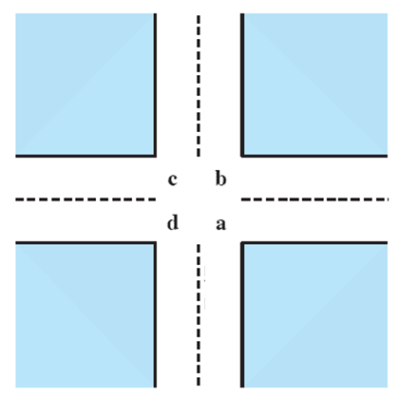
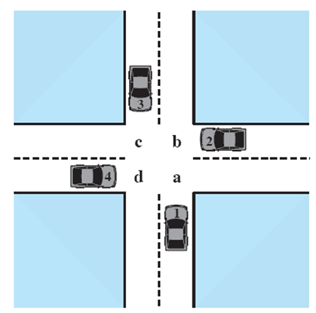



Potential Deadlock
I need quad C and D
I need quad B and C
I need quad A and B
I need quad D and A
Notes:
Animated Slide
Click 1 Cars approach intersection
Then Cars announce their resource needs
All deadlocks involve conflicting needs for resources by two or more processes. A common example is the traffic deadlock. Figure 6.1a shows a situation in which four cars have arrived at a four-way stop intersection at approximately the same time. The four quadrants of the intersection are the resources over which control is needed. In particular, if all four cars wish to go straight through the intersection, the resource requirements are as follows:
• Car 1, traveling north, needs quadrants a and b.
• Car 2 needs quadrants b and c.
• Car 3 needs quadrants c and d.
• Car 4 needs quadrants d and a.
The typical rule of the road in the United States is that a car at a four-way stop should defer to a car immediately to its right. This rule works if there are only two or three cars at the intersection. For example, if only the northbound and westbound cars arrive at the intersection, the northbound car will wait and the westbound car proceeds. However, if all four cars arrive at about the same time, each will refrain from entering the intersection, this causes a potential deadlock. The deadlock is only potential, not actual, because the necessary resources are available for any of the cars to proceed. If one car eventually does proceed, it can do so.

Slide 17
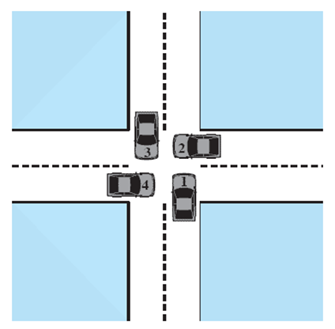
Actual Deadlock
HALT until D is free
HALT until C is free
HALT until B is free
HALT until A is free
Notes:
Animated Slide
Click 1 Cars move to deadlock
Then Cars announce their resource need
However, if all four cars ignore the rules and proceed (cautiously) into the intersection at the same time, then each car seizes one resource (one quadrant) but cannot proceed because the required second resource has already been seized by another car. This is an actual deadlock.

Slide 18
Resource Categories
Reusable
can be safely used by only one process at a time and is not depleted by that use
processors, I/O channels, main and secondary memory, devices, and data structures such as files, databases, and semaphores
Consumable
one that can be created (produced) and destroyed (consumed)
interrupts, signals, messages, and information in I/O buffers
Notes:
Two general categories of resources can be distinguished: reusable and consumable. A reusable resource is one that can be safely used by only one process at a time and is not depleted by that use. Processes obtain resource units that they later release for reuse by other processes. Examples of reusable resources include processors; I/O channels; main and secondary memory; devices; and data structures such as files, databases, and semaphores.
A consumable resource is one that can be created (produced) and destroyed (consumed). Examples of consumable resources are interrupts, signals, messages, and information in I/O buffers.

Slide 19
Example of Deadlock: Memory Request
Space is available for allocation of 200Kbytes, and the following sequence of events occur:
Deadlock occurs if both processes progress to their second request
P1
P2
. . .
. . .
Request 80 Kbytes;
Request 70 Kbytes;
. . .
. . .
Request 60 Kbytes;
Request 80 Kbytes;
Notes:
Another example of deadlock with a reusable resource has to do with requests for main memory. Suppose the space available for allocation is 200 Kbytes, and the following sequence of requests occurs: (see diagram)
Deadlock occurs if both processes progress to their second request. If the amount of memory to be requested is not known ahead of time, it is difficult to deal with this type of deadlock by means of system design constraints. The best way to deal with this particular problem is, in effect, to eliminate the possibility by using virtual memory, which is discussed in Chapter 8 .

Slide 20
Example of Deadlock: waiting for messages
Consider a pair of processes, in which each process attempts to receive a message from the other process and then send a message to the other process:
S1 = 1; s2 = 1;
P1:
P(s1)
V(s2)
P2:
P(s2)
V(s1)
Notes:
As an example of deadlock involving consumable resources, consider the following pair of processes, in which each process attempts to receive a message
from the other process and then send a message to the other process: (see diagram)
Deadlock occurs if the Receive is blocking (i.e., the receiving process is blocked until the message is received). Once again, a design error is the cause of the deadlock. Such errors may be quite subtle and difficult to detect. Furthermore, it may take a rare combination of events to cause the deadlock; thus a program could be in use for a considerable period of time, even years, before the deadlock actually occurs.

Slide 21
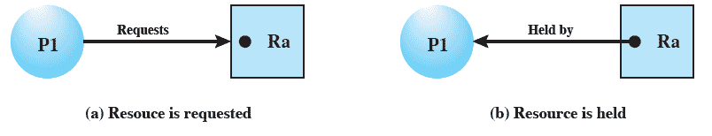
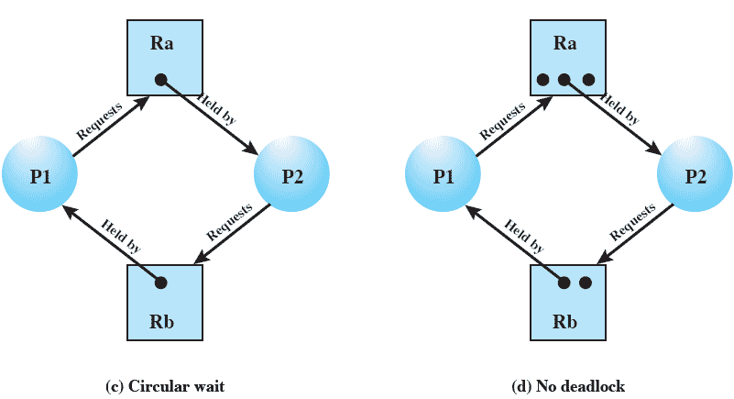
Resource Allocation Graph
There is a circle in the graph, which indicates deadlock
Notes:
A useful tool in characterizing the allocation of resources to processes is the resource allocation graph , introduced by Holt [HOLT72]. The resource allocation graph is a directed graph that depicts a state of the system of resources and processes, with each process and each resource represented by a node. A graph edge directed from a process to a resource indicates a resource that has been requested by the process but not yet granted ( Figure 6.5a ). Within a resource node, a dot is shown for each instance of that resource. Examples of resource types that may have multiple instances are I/O devices that are allocated by a resource management module in the OS. A graph edge directed from a reusable resource node dot to a process indicates a request that has been granted ( Figure 6.5b ); that is, the process has been assigned one unit of that resource. A graph edge directed from a consumable
resource node dot to a process indicates that the process is the producer of that
resource.
Figure 6.5c shows an example deadlock. There is only one unit each of resources Ra and Rb. Process P1 holds Rb and requests Ra, while P2 holds Ra but requests Rb. Figure 6.5d has the same topology as Figure 6.5c , but there is no deadlock because multiple units of each resource are available.

Slide 22
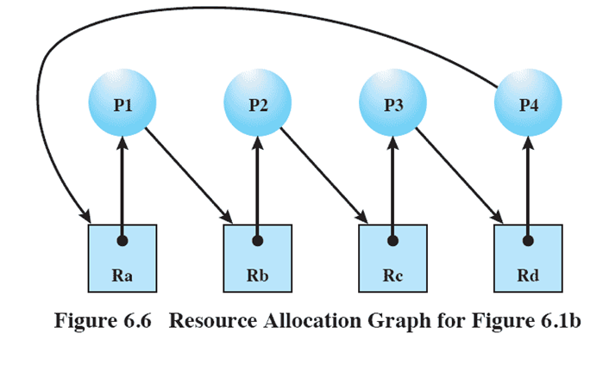
Resource Allocation Graph describing the traffic jam
Notes:
The resource allocation graph of Figure 6.6 corresponds to the deadlock situation in Figure 6.1b . Note that in this case, we do not have a simple situation in which two processes each have one resource the other needs. Rather, in this case, there is a circular chain of processes and resources that results in deadlock.

Slide 23
Conditions for Deadlock
Mutual Exclusion
A process cannot access a resource that has been allocated to another process
Hold-and-Wait
a process may hold allocated resources while awaiting assignment of others
No Pre-emption
no resource can be forcibly removed from a process holding it
Circular Wait
a closed chain of processes exists, such that each process holds at least one resource needed by the next process in the chain
Notes:
Three conditions of policy must be present for a deadlock to be possible:
1. Mutual exclusion . Only one process may use a resource at a time. No process may access a resource unit that has been allocated to another process.
2. Hold and wait . A process may hold allocated resources while awaiting assignment of other resources.
3. No preemption . No resource can be forcibly removed from a process holding it.
In many ways these conditions are quite desirable. For example, mutual exclusion is needed to ensure consistency of results and the integrity of a database. Similarly, preemption should not be done arbitrarily. For example, when data resources are involved, preemption must be supported by a rollback recovery mechanism, which restores a process and its resources to a suitable previous state from which the process can eventually repeat its actions.
The first three conditions are necessary but not sufficient for a deadlock to exist. For deadlock to actually take place, a fourth condition is required:
4. Circular wait . A closed chain of processes exists, such that each process holds at least one resource needed by the next process in the chain (e.g., Figure 6.5c
and Figure 6.6 ).
The fourth condition is, actually, a potential consequence of the first three. That is, given that the first three conditions exist, a sequence of events may occur that lead to an unresolvable circular wait. The unresolvable circular wait is in fact the definition of deadlock. The circular wait listed as condition 4 is unresolvable because the first three conditions hold. Thus, the four conditions, taken together, constitute necessary and sufficient conditions for deadlock.

Slide 24
Dealing with Deadlock
Three general approaches exist for dealing with deadlock:
Prevent Deadlock
adopt a policy that eliminates one of the conditions
Avoid Deadlock
make the appropriate dynamic choices based on the current state of resource allocation
Detect Deadlock
attempt to detect the presence of deadlock and take action to recover
Notes:
Three general approaches exist for dealing with deadlock. First, one can prevent deadlock by adopting a policy that eliminates one of the conditions (conditions 1 through 4). Second, one can avoid deadlock by making the appropriate dynamic choices based on the current state of resource allocation. Third, one can attempt to detect the presence of deadlock (conditions 1 through 4 hold) and take action to recover.

Slide 25
Deadlock Condition Prevention
Mutual Exclusion
Avoiding mutual exclusion is not realistic
Hold and Wait
Countermeasure: require that a process request all required resources at once; blocking the process until all requests can be granted simultaneously
Notes:
Mutual Exclusion
In general, the first of the four listed conditions cannot be disallowed. If access to a resource requires mutual exclusion, then mutual exclusion must be supported by the OS. Some resources, such as files, may allow multiple accesses for reads but only exclusive access for writes. Even in this case, deadlock can occur if more than one process requires write permission.
Hold and Wait
The hold-and-wait condition can be prevented by requiring that a process request all of its required resources at one time and blocking the process until all requests can be granted simultaneously. This approach is inefficient in two ways. First, a process may be held up for a long time waiting for all of its resource requests to be filled, when in fact it could have proceeded with only some of the resources. Second, resources allocated to a process may remain unused for a considerable period, during which time they are denied to other processes. Another problem is that a process may not know in advance all of the resources that it will require.
There is also the practical problem created by the use of modular programming or a multithreaded structure for an application. An application would need to be aware of all resources that will be requested at all levels or in all modules to make the simultaneous request.

Slide 26
Deadlock Condition Prevention
No Preemption
  Countermeasure: if a process holding certain resources is denied a further request, that process must release its original resources and request them again
Circular Wait
  Countermeasure: define a linear ordering of resource numbers; if a process has been allocated a resource of number R , then it may subsequently request only those resources of numbers following R in the ordering.
  Why does this work?
    Think about the Resource Allocation Graph
Notes:
No Preemption
This condition can be prevented in several ways. First, if a process holding certain resources is denied a further request, that process must release its original resources and, if necessary, request them again together with the additional resource. Alternatively, if a process requests a resource that is currently held by another process, the OS may preempt the second process and require it to release its resources. This latter scheme would prevent deadlock only if no two processes possessed the same priority.
This approach is practical only when applied to resources whose state can be easily saved and restored later, as is the case with a processor.
Circular Wait
The circular-wait condition can be prevented by defining a linear ordering of resource types. If a process has been allocated resources of type R , then it may subsequently request only those resources of types following R in the ordering. To see that this strategy works, let us associate an index with each resource type. Then resource R i precedes R j in the ordering if i < j . Now suppose that two processes, A and B, are deadlocked because A has acquired R i and requested R j , and B has acquired R j and requested R i . This condition is impossible because it implies i < j and j < i .
As with hold-and-wait prevention, circular-wait prevention may be inefficient, slowing down processes and denying resource access unnecessarily.

Slide 27
Deadlock Avoidance
Deadlock prevention breaks one of the deadlock conditions through rules, which are defined before execution, while deadlock avoidance is enforced during execution
A decision is made dynamically whether the current resource allocation request will lead to an unsafe state
Requires knowledge of future process requests
We will examine some examples
Notes:
An approach to solving the deadlock problem that differs subtly from deadlock prevention is deadlock avoidance. 2 In deadlock prevention , we constrain resource requests to prevent at least one of the four conditions of deadlock. This is either done indirectly, by preventing one of the three necessary policy conditions (mutual exclusion, hold and wait, no preemption), or directly, by preventing circular wait. This leads to inefficient use of resources and inefficient execution of processes. Deadlock avoidance , on the other hand, allows the three necessary conditions but makes judicious choices to assure that the deadlock point is never reached. As such, avoidance allows more concurrency than prevention. With deadlock avoidance, a decision is made dynamically whether the current resource allocation request will, if granted, potentially lead to a deadlock. Deadlock avoidance thus requires knowledge
of future process resource requests.

Slide 28
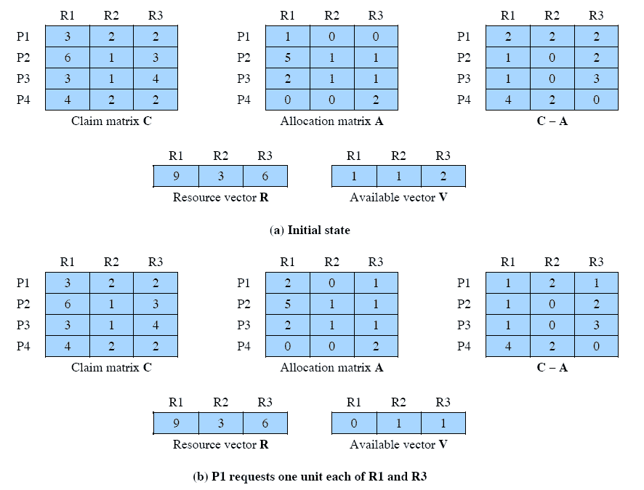
Example
State of a system consisting of 4 processes and 3 resources
Allocations have been made as follows

Slide 29
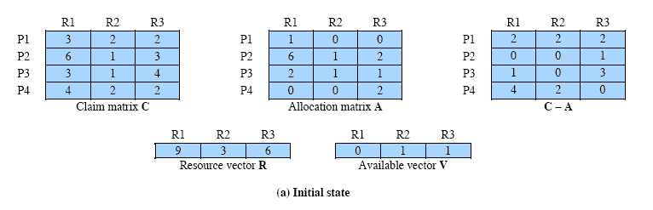
Determination of a Safe State
P2 requests one of R1 and one unit of R3
Should this request be granted?
Banker’s algorithm: assume this request is granted, then check whether the resulted state is safe
A state is safe if there is at least one sequence of resource allocations that satisfies all the processes’ needs
Is this a safe state?
Notes:
Animation: Callouts explain resource parts of figure
The following example illustrates these concepts. Figure 6.7a shows the state of a system consisting of four processes and three resources. The total amount of resources R1, R2, and R3 are 9, 3, and 6 units, respectively. In the current state allocations have been made to the four processes, leaving 1 unit of R2 and 1 unit of R3 available. Is this a safe state? To answer this question, we ask an intermediate question: Can any of the four processes be run to completion with the resources available? That is, can the difference between the maximum requirement and current allocation for any process be met with the available resources? In terms of the matrices and vectors introduced earlier, the condition to be met
for process i is:
Cij - Aij … Vj, for all j

Slide 30
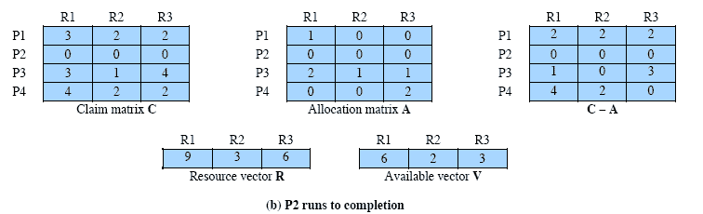
P2 Runs to Completion
Old Available vector (0, 1, 1) + Resources released by P2 (6, 1, 2) =
Updated available vector(6, 2, 3)
Notes:
Clearly, this is not possible for P1, which has only 1 unit of R1 and requires 2 more units of R1, 2 units of R2, and 2 units of R3. However, by assigning one unit of R3 to process P2, P2 has its maximum required resources allocated and can run to completion. Let us assume that this is accomplished. When P2 completes, its resources can be returned to the pool of available resources. The resulting state is shown in Figure 6.7b . Now we can ask again if any of the remaining processes can be completed. In this case, each of the remaining processes could be completed.

Slide 31
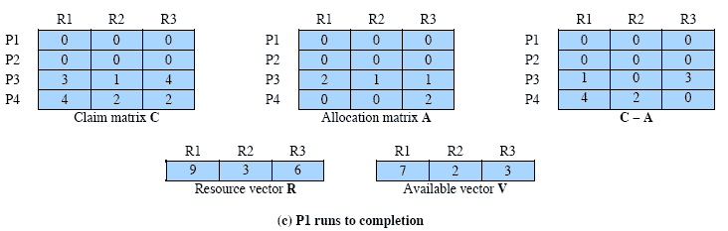
P1 Runs to Completion
Old Available vector (6, 2, 3) + Resources Released by P1 (1, 0, 0) =
Updated available vector(7, 2, 3)
Notes:
Suppose we choose P1, allocate the required resources, complete P1, and return all of P1’s resources to the available pool. We are left in the state shown in Figure 6.7c .

Slide 32
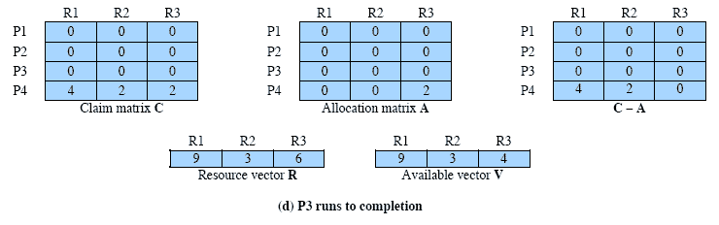
P3 Runs to Completion
Thus, the state defined originally is safe
Notes:
Next, we can complete P3, resulting in the state of Figure 6.7d . Finally, we can complete P4. At this point, all of the processes have been run to completion. Thus, the state defined by Figure 6.7a is a safe state.
These concepts suggest the following deadlock avoidance strategy, which ensures that the system of processes and resources is always in a safe state. When a process makes a request for a set of resources, assume that the request is granted, update the system state accordingly, and then determine if the result is a safe state. If so, grant the request and, if not, block the process until it is safe to grant the request.

Slide 33
Determination of an Unsafe State
P1 requests for one more R1 and one more R3
The request should not be granted, because it leads to an unsafe state
Notes:
Consider the state defined in Figure 6.8a . Suppose P2 makes a request for one additional unit of R1 and one additional unit of R3. If we assume the request is granted, then the resulting state is that of Figure 6.7a . We have already seen that this is a safe state; therefore, it is safe to grant the request. Now let us return to the state of Figure 6.8a and suppose that P1 makes the request for one additional unit each of R1 and R3; if we assume that the request is granted, we are left in the state of Figure 6.8b . Is this a safe state? The answer is no, because each process will need at least one additional unit of R1, and there are none available. Thus, on the basis of deadlock avoidance, the request by P1 should be denied and P1 should be blocked.
It is important to point out that Figure 6.8b is not a deadlocked state. It merely has the potential for deadlock. It is possible, for example, that if P1 were run from this state it would subsequently release one unit of R1 and one unit of R3 prior to needing these resources again. If that happened, the system would return to a safe state. Thus, the deadlock avoidance strategy does not predict deadlock with certainty; it merely anticipates the possibility of deadlock and assures that there is never such a possibility.

Slide 34
Deadlock detection
Notes:
The resource allocation graph of Figure 6.6 corresponds to the deadlock situation in Figure 6.1b . Note that in this case, we do not have a simple situation in which two processes each have one resource the other needs. Rather, in this case, there is a circular chain of processes and resources that results in deadlock.

Slide 35
Recovery strategies
  Kill one deadlocked process at a time and release its resources
  Kill all deadlocked processes
  Steal one resource at a time
  Roll back all or one of the processes to a checkpoint that occurred before they requested any resources, then continue
    Difficult to prevent indefinite postponement
Notes:
Once deadlock has been detected, some strategy is needed for recovery. The following are possible approaches, listed in order of increasing sophistication:
1. Abort all deadlocked processes. This is, believe it or not, one of the most common, if not the most common, solution adopted in operating systems.
2. Back up each deadlocked process to some previously defined checkpoint, and restart all processes. This requires that rollback and restart mechanisms be built
in to the system. The risk in this approach is that the original deadlock may recur. However, the nondeterminancy of concurrent processing may ensure that this does not happen.
3. Successively abort deadlocked processes until deadlock no longer exists. The order in which processes are selected for abortion should be on the basis of some criterion of minimum cost. After each abortion, the detection algorithm must be reinvoked to see whether deadlock still exists.
4. Successively preempt resources until deadlock no longer exists. As in (3), a costbased selection should be used, and reinvocation of the detection algorithm is required after each preemption. A process that has a resource preempted from it must be rolled back to a point prior to its acquisition of that resource.
For (3) and (4), the selection criteria could be one of the following. Choose the process with the
• least amount of processor time consumed so far
• least amount of output produced so far
• most estimated time remaining
least total resources allocated so far
• lowest priority
Some of these quantities are easier to measure than others. Estimated time remaining is particularly suspect. Also, other than by means of the priority measure, there is no indication of the “cost” to the user, as opposed to the cost to the system as a whole.

Slide 36
Recovery by killing processes

Slide 37
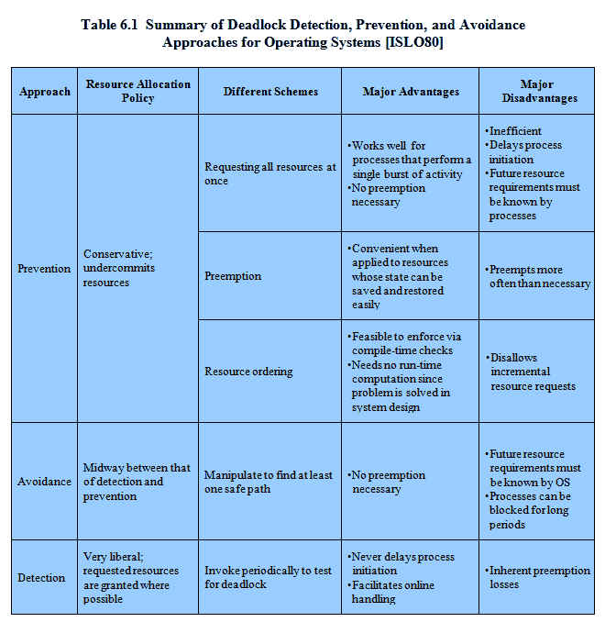
Notes:
As Table 6.1 suggests, there are strengths and weaknesses to all of the strategies for dealing with deadlock. Rather than attempting to design an OS facility that employs only one of these strategies, it might be more efficient to use different strategies in different situations.

Slide 38




Dining Philosophers: failed solution with deadlock
# define N 5
void philosopher (int i) {
while (TRUE) {
think();
take_fork(i);
take_fork((i+1)%N);
eat(); /* yummy */
put_fork(i);
put_fork((i+1)%N);
}
}

Slide 39
Dining Philosophers: failed solution with deadlock
# define N 5
void philosopher (int i) {
while (TRUE) {
think();
take_fork(i);
take_fork((i+1)%N);
eat(); /* yummy */
put_fork(i);
put_fork((i+1)%N);
}
}

Slide 40
Dining Philosophers: failed solution with deadlock
# define N 5
void philosopher (int i) {
while (TRUE) {
think();
take_fork(i);
take_fork((i+1)%N);
eat(); /* yummy */
put_fork(i);
put_fork((i+1)%N);
}
}

Slide 41
Dining Philosophers solution with numbered resources
Instead, number resources
First request lower numbered fork
# define N 5
void philosopher (int i) {
while (TRUE) {
think();
take_fork(LOWER(i));
take_fork(HIGHER(i));
eat(); /* yummy */
put_fork(LOWER(i));
put_fork(HIGHER(i));
}
}
1
5
2
4
3

Slide 42
Dining Philosophers solution with numbered resources
Instead, number resources...
Then request higher numbered fork
# define N 5
void philosopher (int i) {
while (TRUE) {
think();
take_fork(LOWER(i));
take_fork(HIGHER(i));
eat(); /* yummy */
put_fork(LOWER(i));
put_fork(HIGHER(i));
}
}
1
5
2
4
3

Slide 43
Dining Philosophers solution with numbered resources
Instead, number resources...
Then request higher numbered fork
# define N 5
void philosopher (int i) {
while (TRUE) {
think();
take_fork(LOWER(i));
take_fork(HIGHER(i));
eat(); /* yummy */
put_fork(LOWER(i));
put_fork(HIGHER(i));
}
}
1
5
2
4
3

Slide 44
Dining Philosophers solution with numbered resources
Instead, number resources...
One philosopher can eat!
# define N 5
void philosopher (int i) {
while (TRUE) {
think();
take_fork(LOWER(i));
take_fork(HIGHER(i));
eat(); /* yummy */
put_fork(LOWER(i));
put_fork(HIGHER(i));
}
}
1
5
2
4
3

Slide 45
Summary
Uses of semaphores
Deadlock
Dealing with deadlock:
  Prevention
  Avoidance
  Detection
Notes:
Chapter 6 summary.

