Slide 1

EchoSense
A Reinforcement Learning Approach to Adaptive Information Prioritization
Nahom Tamene

Slide 2
Problem Statement & Motivation
Current assistive technologies provide generic, one-size-fits-all descriptions
Information overload: too much irrelevant data
No personalization or learning from user feedback
SOLUTION
Adaptive system that learns user preferences
Prioritizes most relevant information in real-time

Slide 3
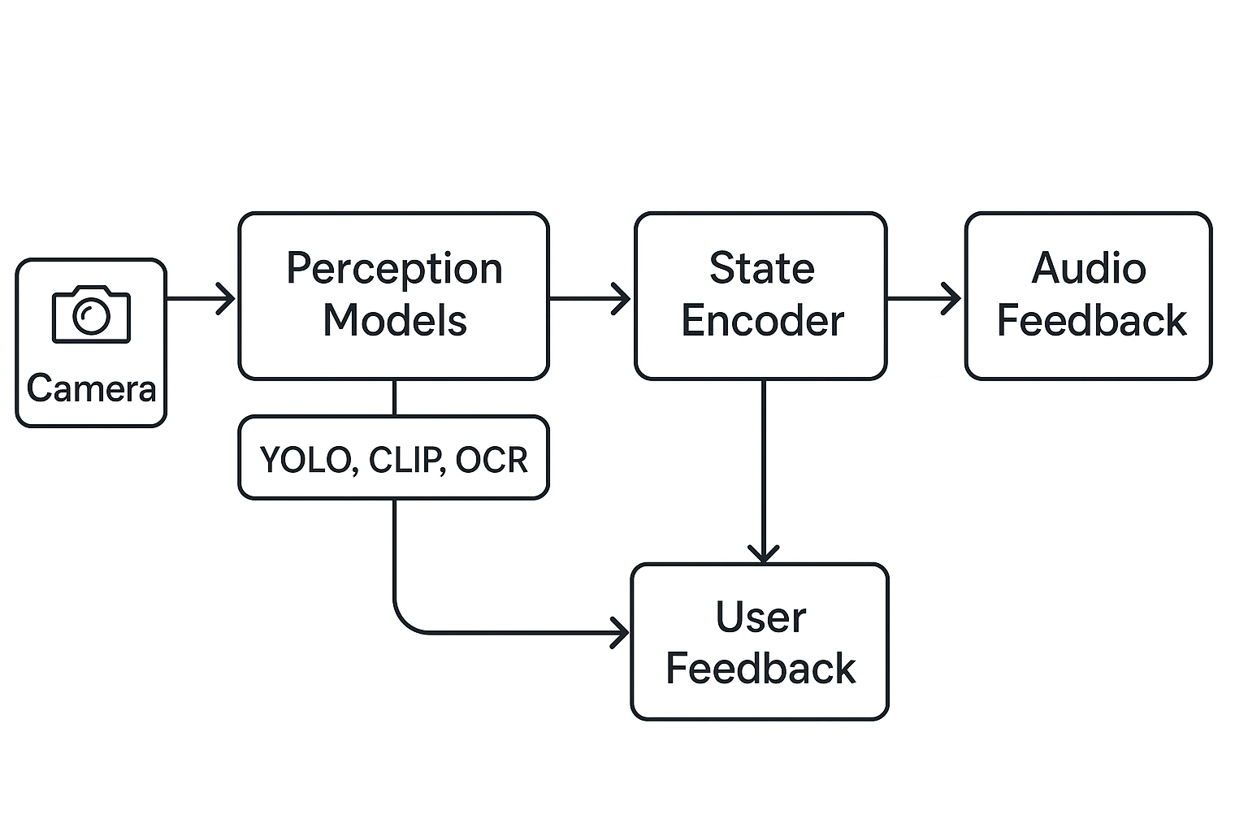
System architecture
Frozen Perception Layer
Adaptive Decision Layer
User Interface Layer

Slide 4
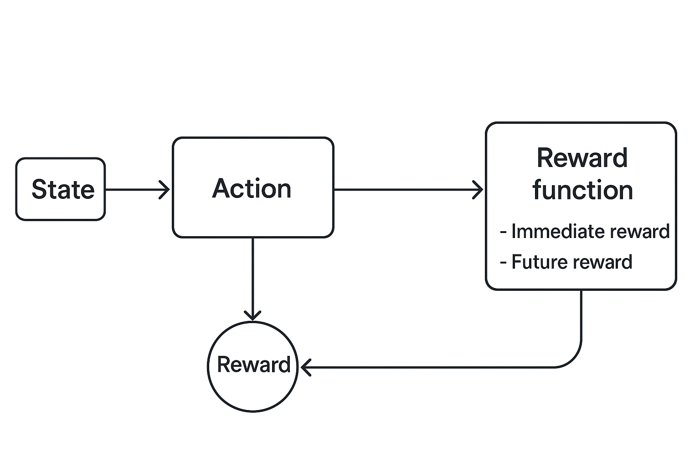
Methodology (Reinforcement Learning Framework)
Visual features (object detections, scene embeddings, text)
Context (time, location, session duration)
User history (recent feedback, preferences, satisfaction)

Slide 5
IMPLEMENTATION
Modular architecture: Perception, RL, UI components
Real-time processing: 2 FPS with GPU acceleration support
PyQt6 GUI with camera feed and feedback interface
Baseline rule-based system for comparison

Slide 6
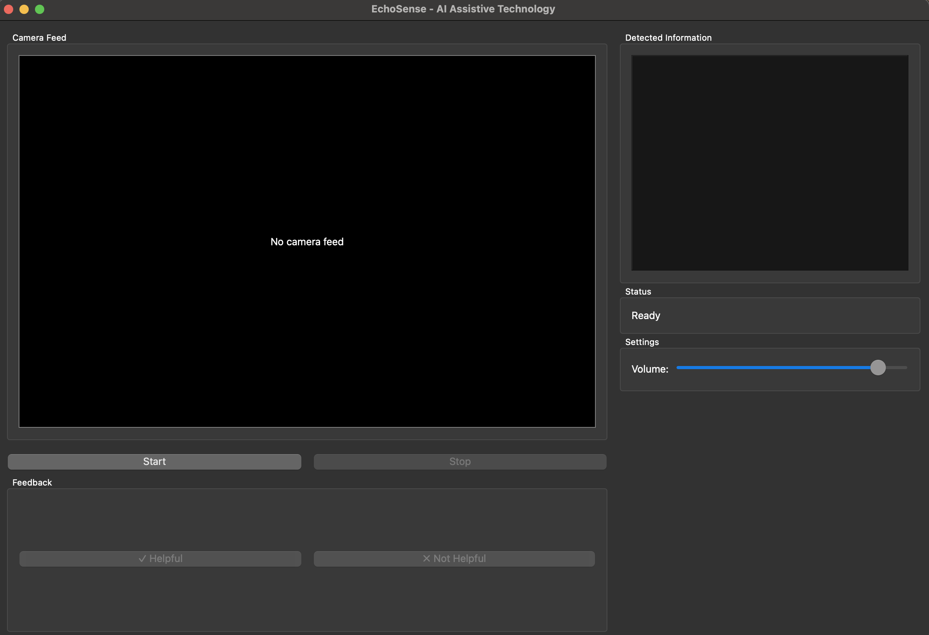

Slide 7
Next steps
Complete RL agent implementation
Comparative evaluation: baseline vs. RL
Future work
Mobile deployment
Integration with navigation systems

Slide 8
Thank you

