Slide 1

is high in a
TEMPLE
U N I V E R S I T Y
Department of Computer & Information Sciences
Bi-level Optimization for Model Pruning in
Decentralized Environments
Presenter: Heng Liang
Qi Chen
TEMPLE
U N I V E R S I T Y

Slide 2
Index
Problem & Motivation
Preliminary
Method
Experiments Setup
Results

Slide 3
Problem & Motivation
Modern neural networks are becoming increasingly large, and many studies apply model pruning to reduce their size and complexity.
Problem
Existing pruning methods are heuristic — they prune model parameters directly without being jointly optimized with training.
Existing pruning methods are designed for centralized training — they cannot handle decentralized settings with client heterogeneity and non-IID data.
Motivation
To replace heuristic pruning with a principled, optimization-driven approach, we adopt bi-level optimization to jointly learn the pruning mask and model parameters for decentralized training.

Slide 4
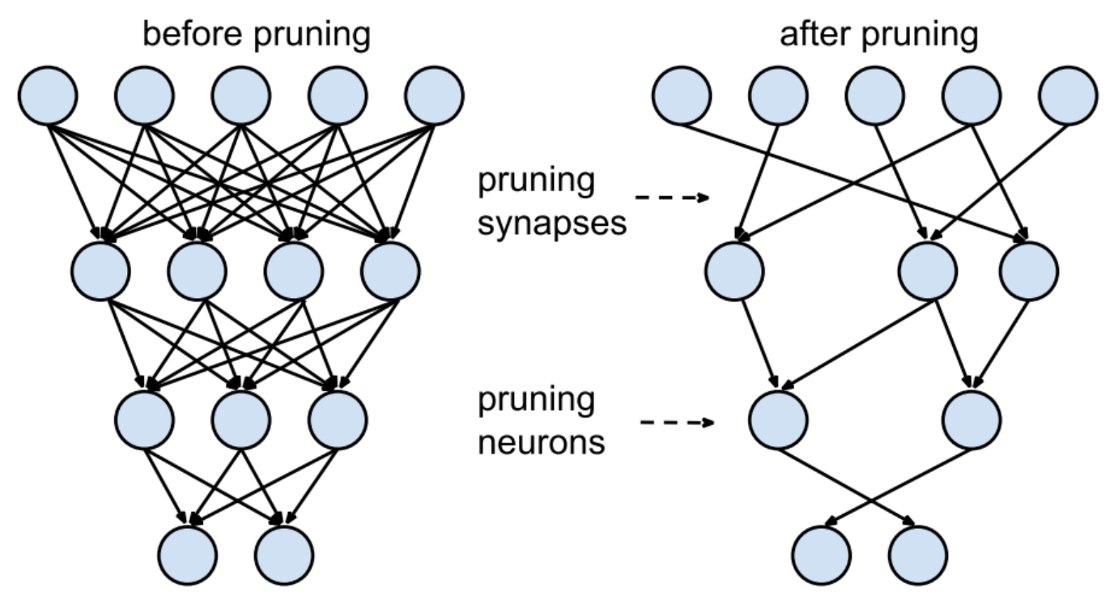

Preliminary —— Model Pruning
What is Model Pruning？
Remove unimportant weights/channels to reduce model size & computation
Common approaches are heuristic (e.g., magnitude pruning)
Typically performed after training → not jointly optimized
Basic Form
y: model weights
x: pruning mask (0/1)
x ⊙ y：pruned model
Why it matters here
Smaller model → lower communication cost in decentralized learning
But heuristic pruning often harms accuracy & stability

Slide 5


Preliminary —— Bi-level Optimization
What is Bi-level Optimization
An optimization framework with two nested problems:
Upper level (structure)
Optimize pruning mask x to improve global performance.
Lower level (parameters)
Train model weights y under a fixed mask x.
Why it fits pruning
Pruning = decide “what structure to keep”
Training = decide “how to fit the data”
Bi-level naturally couples these two → principled joint optimization, not heuristic

Slide 6
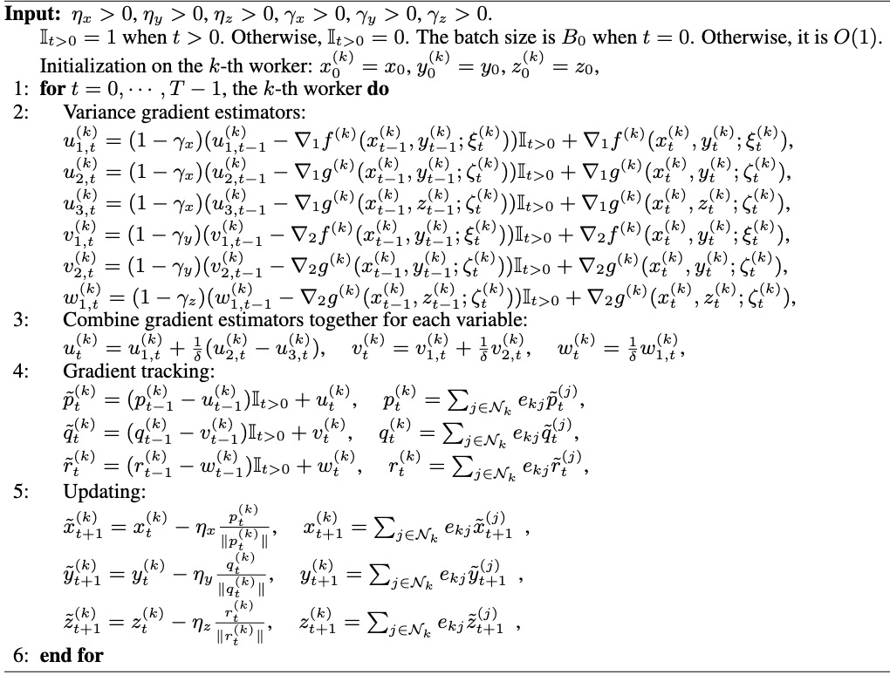
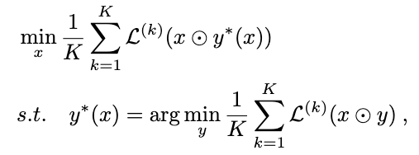
Method
Upper-level problem(pruning parameters):
Lower-level problem(model parameters):
x : pruning parameter (same dimension as model parameter y), acts as a gate vector deciding which weights are kept
y : model parameter, trained given a fixed pruning mask x
⊙ : element-wise product (apply mask x to the model parameters y)
K : number of decentralized workers / clients

Slide 7
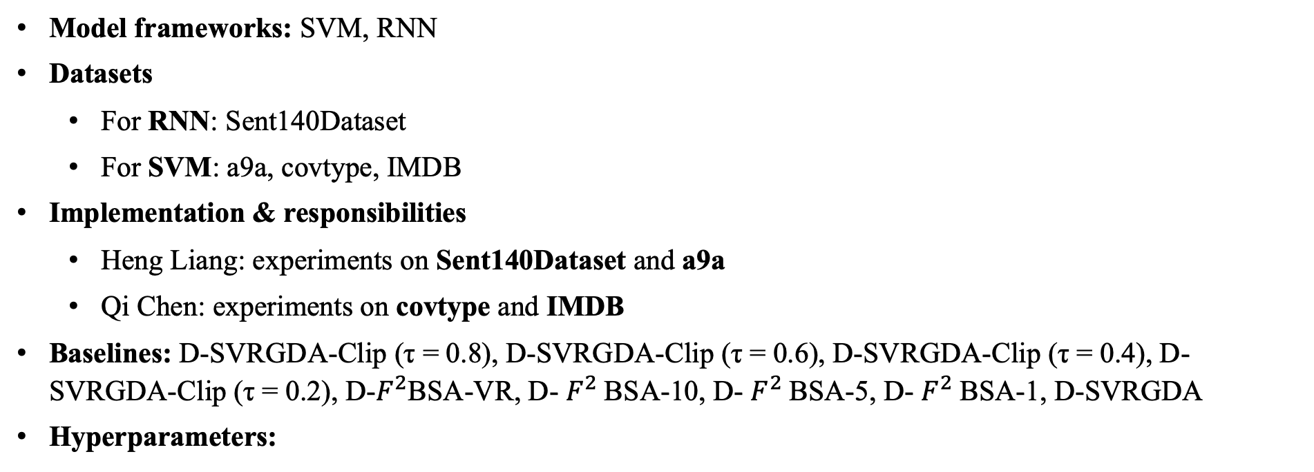
Experiment Setup
Model frameworks: SVM, RNN
Datasets
  For RNN: Sent140Dataset
  For SVM: a9a, covtype, IMDB
Implementation & responsibilities
  Heng Liang: experiments on Sent140Dataset and a9a
  Qi Chen: experiments on covtype and IMDB
Baselines: D-SVRGDA-Clip (τ = 0.8), D-SVRGDA-Clip (τ = 0.6), D-SVRGDA-Clip (τ = 0.4), D-SVRGDA-Clip (τ = 0.2), D-$F^{2}$BSA-VR, D- $F^{2}$BSA-10, D- $F^{2}$BSA-5, D- $F^{2}$BSA-1, D-SVRGDA
Hyperparameters:
Model | Batchsize | hidden feature | learning rate | rho | momentum | pruning rate
SVM | 32 | 20 | 0.001 | 0.1 | 0.9 | 20%
RNN | 16 | 128 | 0.001 | 0.1 | 0.9 | 20%

Slide 8
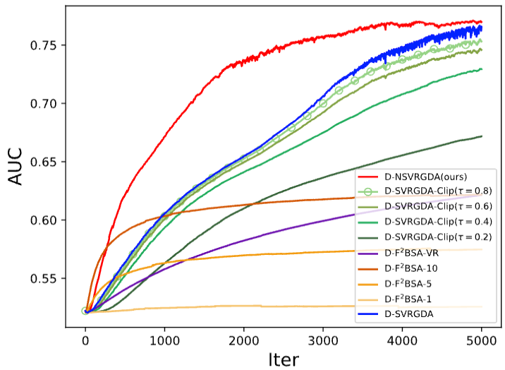
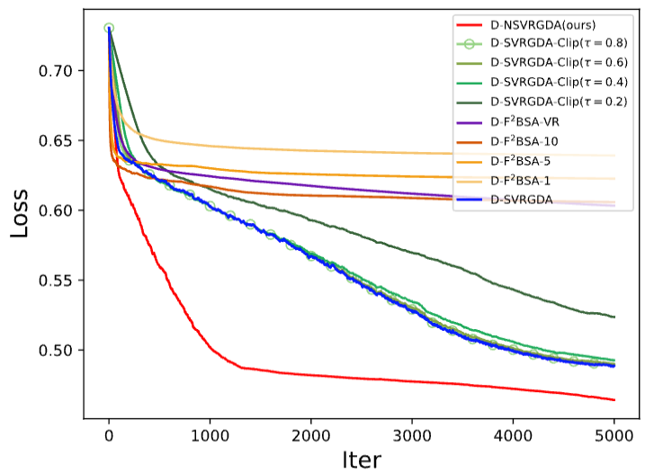
Results: RNN
Our method consistently achieves the highest AUC throughout training and the best final AUC among all methods
Our method shows much faster loss decrease and converges to a lower final loss than all baselines

Slide 9
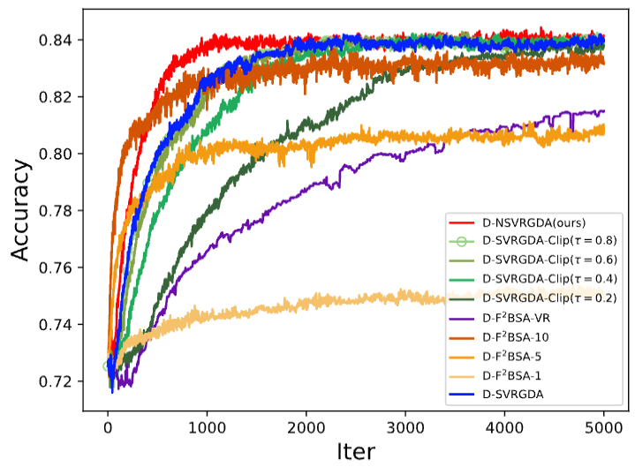
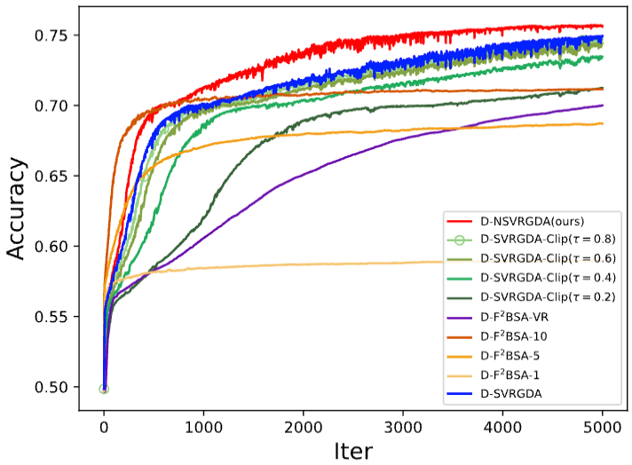
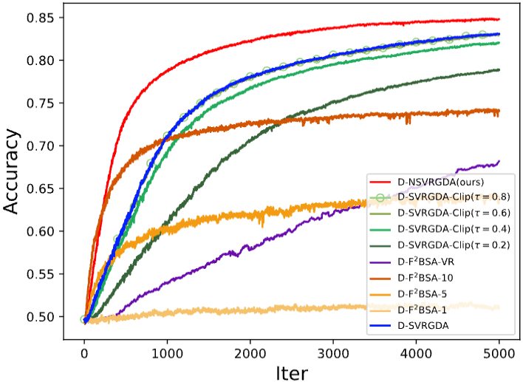
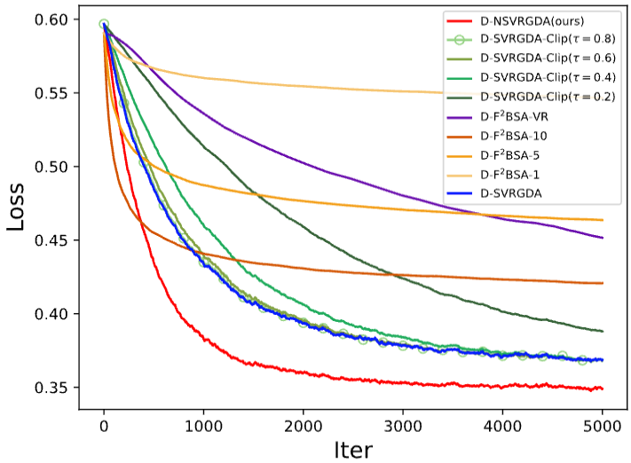
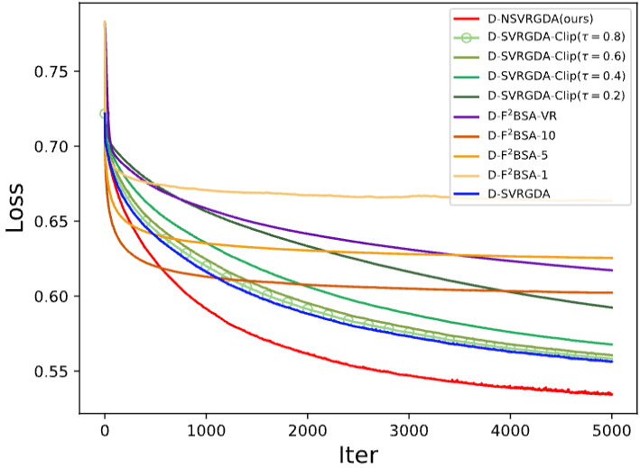
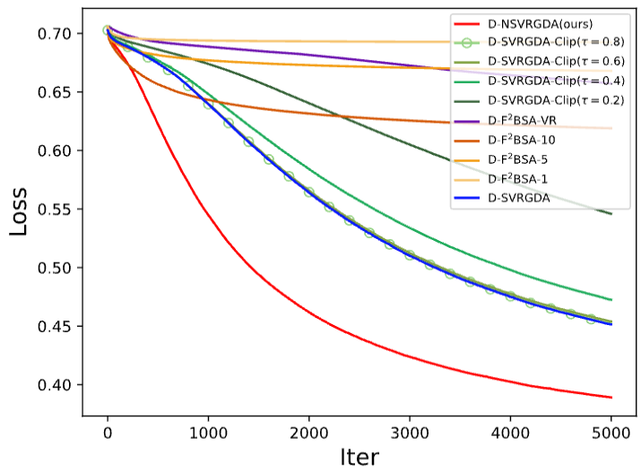
Results: SVM
a9a
covtype
IMDB

Slide 10
Conclusion
We proposed a bi-level model pruning algorithm for distributed systems and evaluated it on two model families, SVM and RNN, over four datasets, achieving faster convergence and better performance than the baselines.
We also conducted preliminary experiments on a CNN(ResNet-18) with CIFAR-10; the current results still leave room for improvement, possibly because the larger model size poses additional challenges for algorithmic stability. We are continuing to tune and refine our method in this setting.

Slide 11
TEMPLE
is high in a
U N I V E R S I T Y
Department of Computer & Information Sciences
T h a n k s !
Presenter: Heng Liang
Qi Chen
TEMPLE
U N I V E R S I T Y

