Slide 1
CIS 5601:
Bayesian Knowledge Graph
Amitai Goldmeer
CIS 5601: Bayesian Knowledge Graph
12/4/2025
Amitai Goldmeer

Slide 2
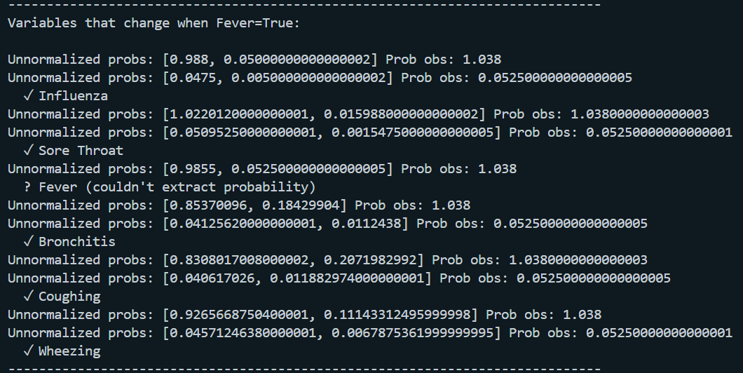
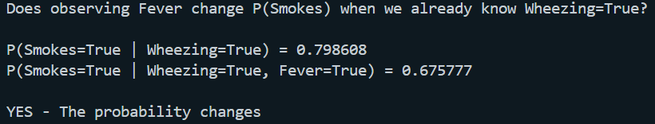
Review: Bayesian Network
Amitai Goldmeer
CIS 5601: Bayesian Knowledge Graph
12/4/2025
Bayesian Networks must be Directed Acyclic Graphs (DAGs)
Each edge is a conditional probability
  P(Symptom | Disease)
Probabilities update according to Bayes’s Rule when new evidence added to network
Probabilities are globally connected
  A change in one node can influence all dependent nodes in the network
Best used for causal inference
  Also good for structured probabilistic reasoning
We used these during an assignment to create a Bayesian Network surrounding the symptoms related to certain medical diagnoses

Slide 3
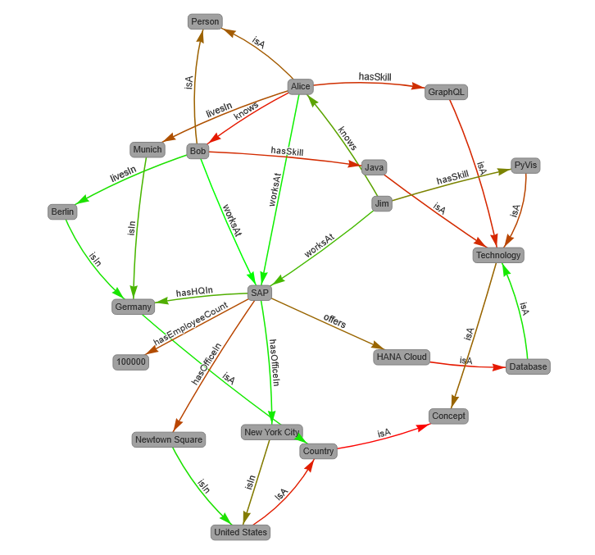
Review: Knowledge Graphs
Amitai Goldmeer
CIS 5601: Bayesian Knowledge Graph
12/4/2025
Knowledge Graphs are a form of knowledge representation in AI systems
Entities as nodes, relationships as edges
They are a form of computational system, where system knowledge is represented within data structures
  Knowledge graphs are graph-typed data models which store interlinked descriptions of entities, linked by the underlying relationships
The subject / predicate / object ‘triple’ model is a common way of representing this data
Data storage, semantic search & retrieval
Knowledge graphs have varied usage in AI, including being used instead of Vector Stores for data storage and retrieval for LLMs

Slide 4
Bayesian Knowledge Graph
Amitai Goldmeer
CIS 5601: Bayesian Knowledge Graph
12/4/2025
Goal: Combine the structured belief-updating capabilities of Bayesian Networks with flexible structure of Knowledge Graphs
Use ‘subject / predicate / object’ triples with confidence values
Each relationship (edge) has a belief score instead of conditional probability
Use Bayesian Network Principles
  Edge confidence
  Node reliability
Allow for the combination of evidence from multiple source to inform final belief scores
Difference from Bayesian Network:
Graph which allows cycles
Supports multiple relationships between the same nodes
Does not use conditional probability
  Utilizes belief estimates
Inference is local (edge-based) instead of global
Nodes gain reliability the more that high confidence evidence goes through them
  Based on amount of evidence, and quality
Track the trustworthiness of certain predicates (does this evidence type perform better)?

Slide 5
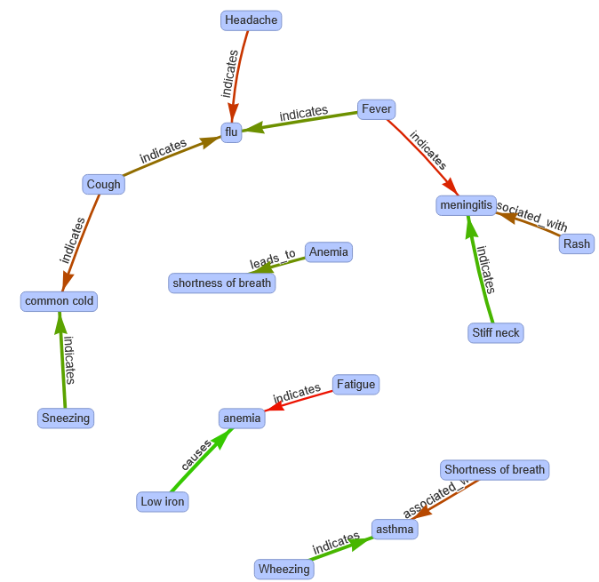
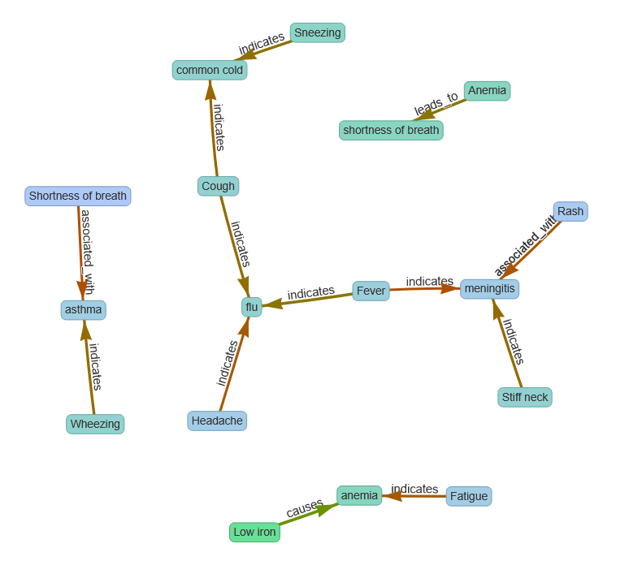
Bayesian Knowledge Graph
Amitai Goldmeer
CIS 5601: Bayesian Knowledge Graph
12/4/2025
Result:
Graph that blends the freedom of knowledge graphs with the statistical basis of Bayesian Systems
Great for
  Noisy relational data
  Mixed evidence across sources
  Graphs with cycles
  Graph / datasets with uncertain knowledge
  Belief Updating System

