Slide 1

is high in a
TEMPLE
U N I V E R S I T Y
Department of Computer & Information Sciences
Applying Reinforcement Learning
to Game Playing
Presenter: Saiyun Dong
saiyun.dong@temple.edu
TEMPLE
U N I V E R S I T Y

Slide 2
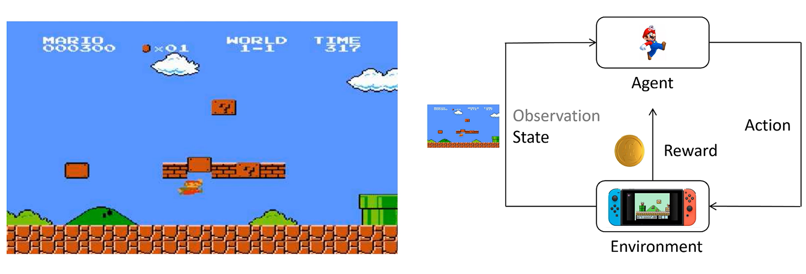
Background
Reinforcement Learning

Slide 3
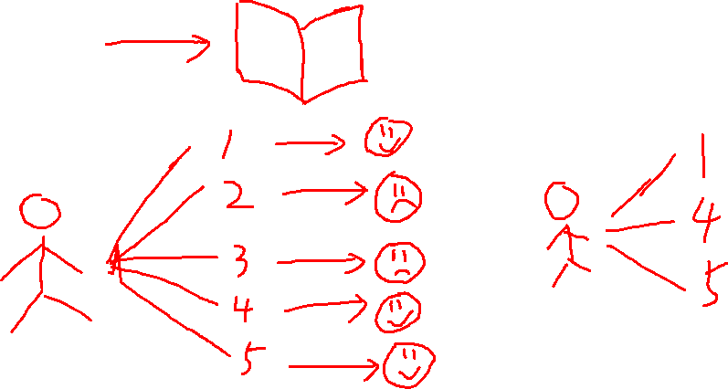

Background
Reinforcement Learning
Notes:
Reinforcement learning means our agent will explore various situations, and if the reward for a situation is high, it will do more of that action, otherwise it will reduce the frequency of that action.

Slide 4
Index
Deep Q-learning(DQN)
Proximal Policy Optimization(PPO)
Result
Difficulties & Improvements

Slide 5


Deep Q-learning(DQN)
State
Action
 | Up(1) | Down(2) | Left(3) | Right(4)
1 | Q(1, 1) | Q(1, 2) | Q(1, 3) | Q(1, 4)
2 | Q(2, 1) | Q(2, 2) | Q(2, 3) | Q(2, 4)
…
25 | Q(25, 1) | Q(25, 2) | Q(25, 3) | Q(25, 4)
① Initialize the table, set all Q (s, a) to 0;
② Randomly select the initial state and action, iterate through the Bellman equation, continuously update the value function in the table;
③ Loop until the algorithm converges, and finally obtain the value of each state and action in the table;
④ After training, when the intelligent agent makes decisions, it selects the action corresponding to the highest Q-function value for each state.

Slide 6



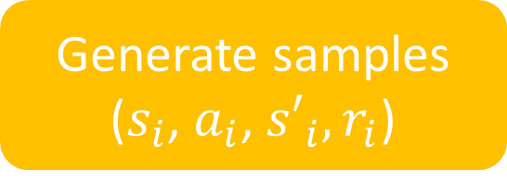
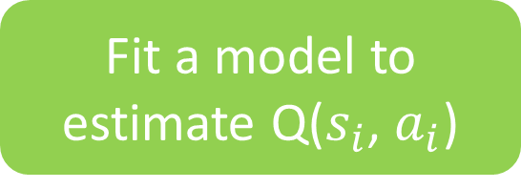
Deep Q-learning(DQN)
Fit a model to
estimate Q($s_{i}$, $a_{i}$)
Generate samples
($s_{i}$, $a_{i}$, ${s′}_{i},r_{i}$)
Target :
Improve the policy
Loss =

Slide 7
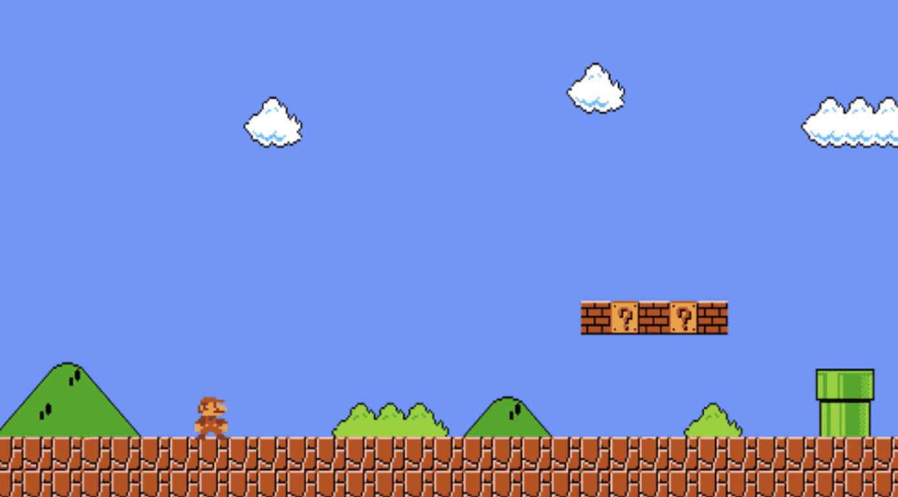
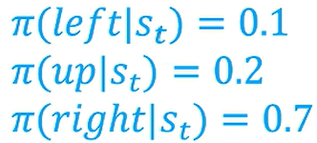
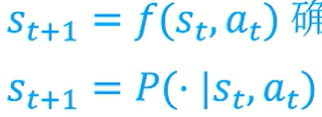
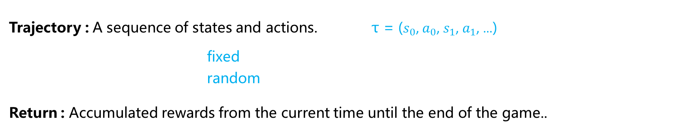
Proximal Policy Optimization(PPO)
Action Space : Selectable actions {left, up, right}
Policy : The strategy function takes State as input and outputs
the probability distribution of Action.
Trajectory : A sequence of states and actions. τ = ($s_{0}$, $a_{0}$, $s_{1}$, $a_{1}$, …)
fixed
random
Return : Accumulated rewards from the current time until the end of the game..

Slide 8
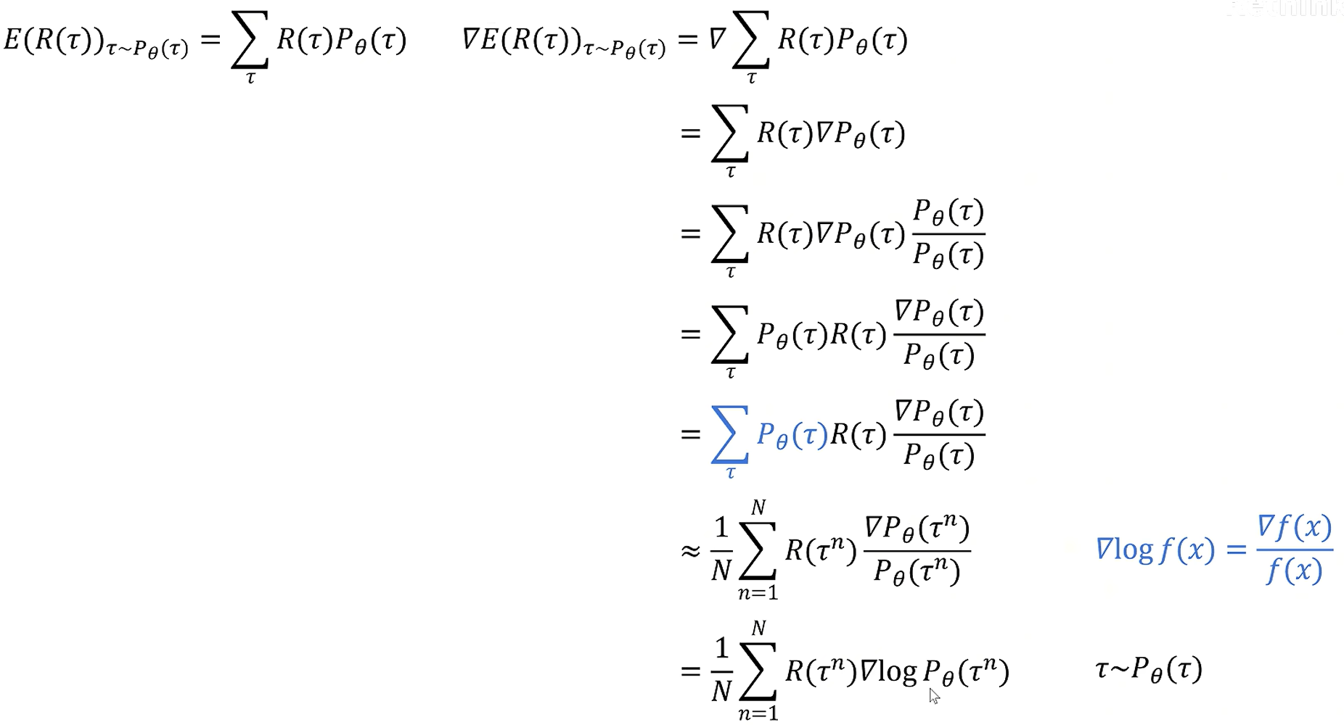
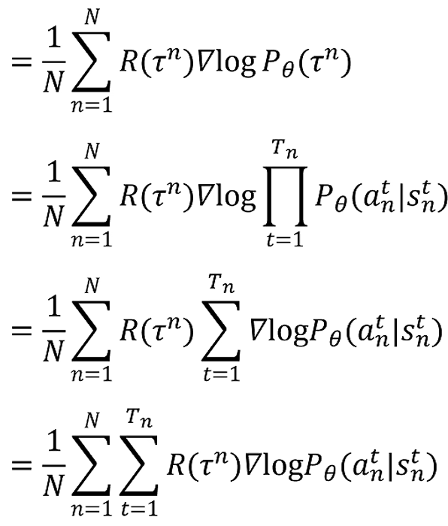
Proximal Policy Optimization(PPO)
Goal of PPO : Train a Policy network π to obtain the highest expected Return among all Trajectories.
Policy Gradient
Notes:
the first part is the total reward obtained by the trajectory, and the second part is the probability of making an action based on the current state at each step.

Slide 9
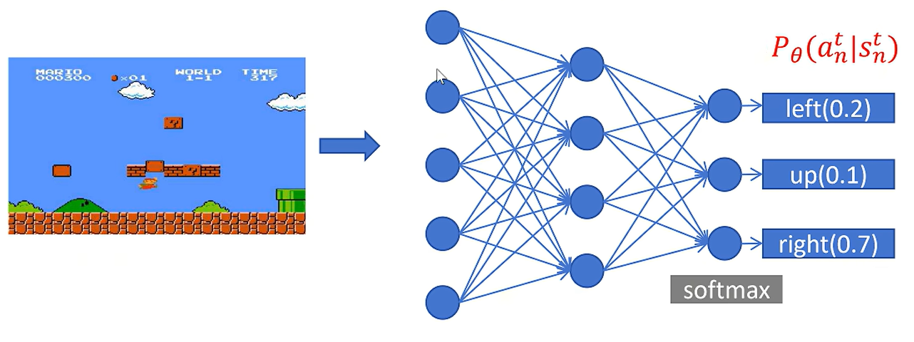

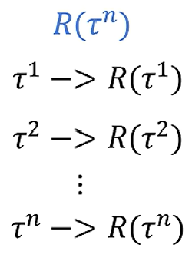
Proximal Policy Optimization(PPO)
Loss =
Data
Run model;
Collect data
Train model;
Update parameters
Model
On Policy
Notes:
By play the game many rounds, we collected the blue part.
This graph is an On Policy strategy. But there is a problem. This means that we run and train the same model. We need the agent to play many rounds of the game before we can start training. However, we know that playing a single round of the game is very time-consuming.

Slide 10
Proximal Policy Optimization(PPO)
Data
Run reference model;
Collect data
Run model;
Collect data
Train model;
Update parameters
Data
Train model;
Update parameters
Model
On Policy
Off Policy
Notes:
To solve this problem, we can make the data collection model and the training model not the same. We can use a reference model to collect data.

Slide 11
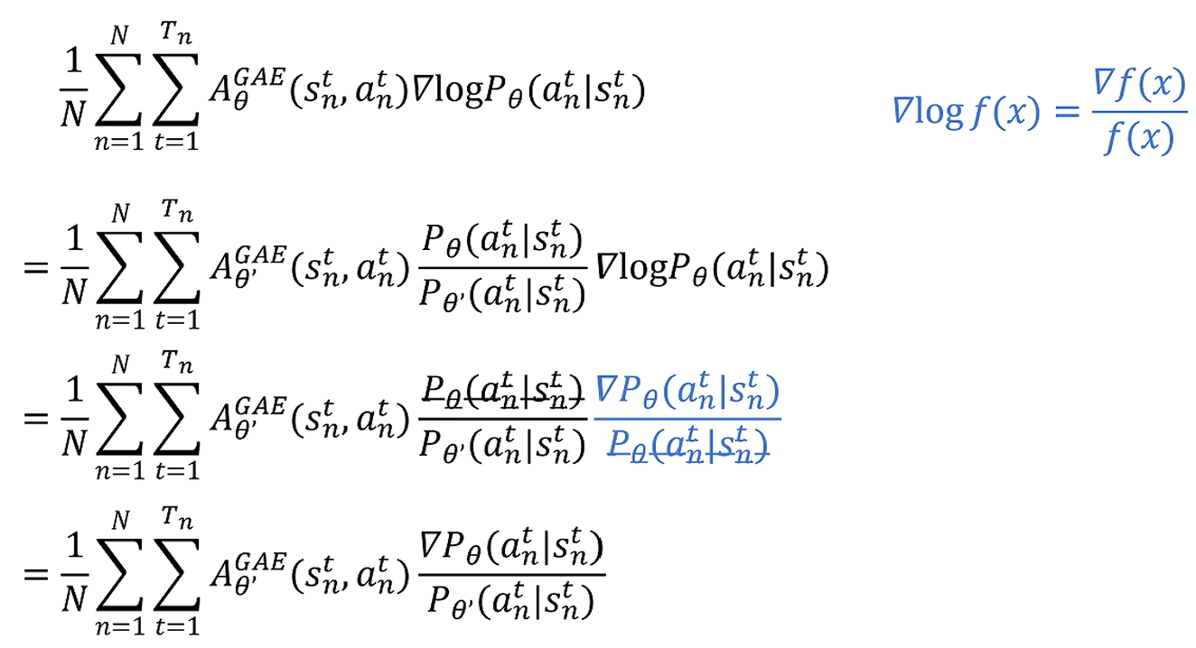
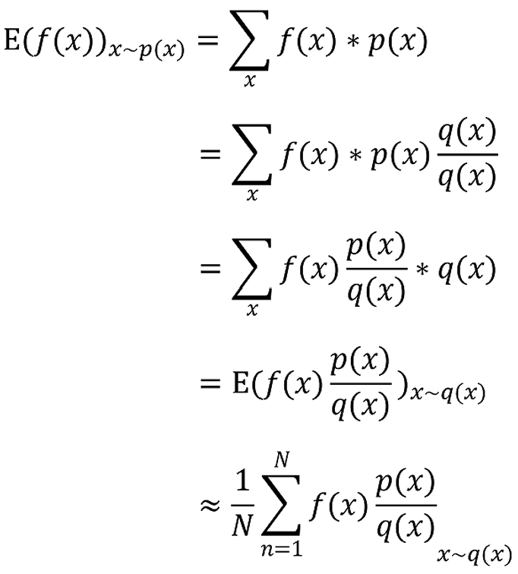
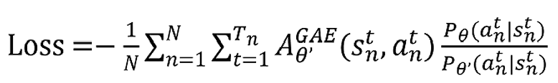
Proximal Policy Optimization(PPO)
Importance Sampling
Notes:
We can use importance sampling to let the distribution θ' approximate the original distribution θ.

Slide 12
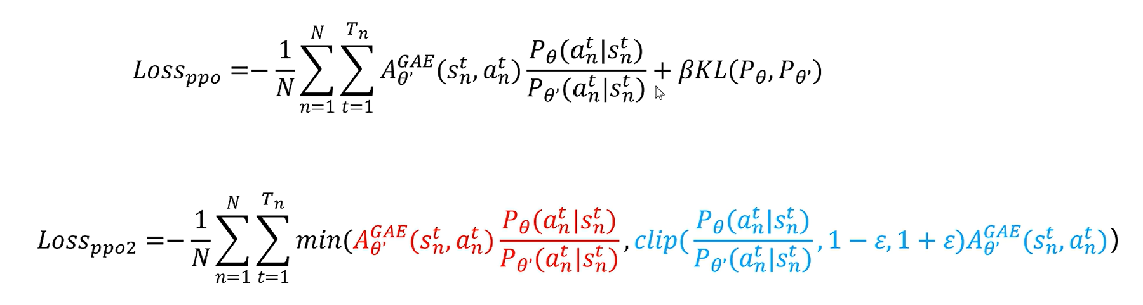
Proximal Policy Optimization(PPO)
Notes:
And we also need to add a restriction so that the two distributions cannot differ too much. PPO generally has these two loss functions.
In fact, this θ is just the previous iteration of the current model.

Slide 13

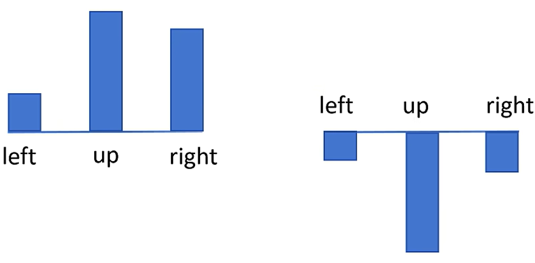
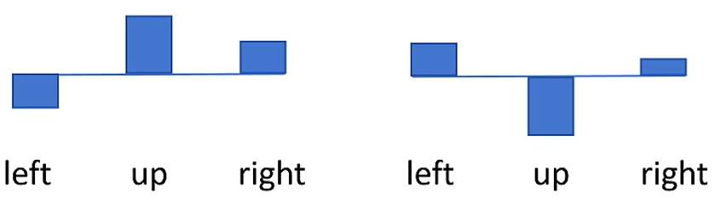

Proximal Policy Optimization(PPO)
Advantage Function
means expected return in state s (state value function)
How much advantage can Action A bring compared to other actions in State S.

Slide 14
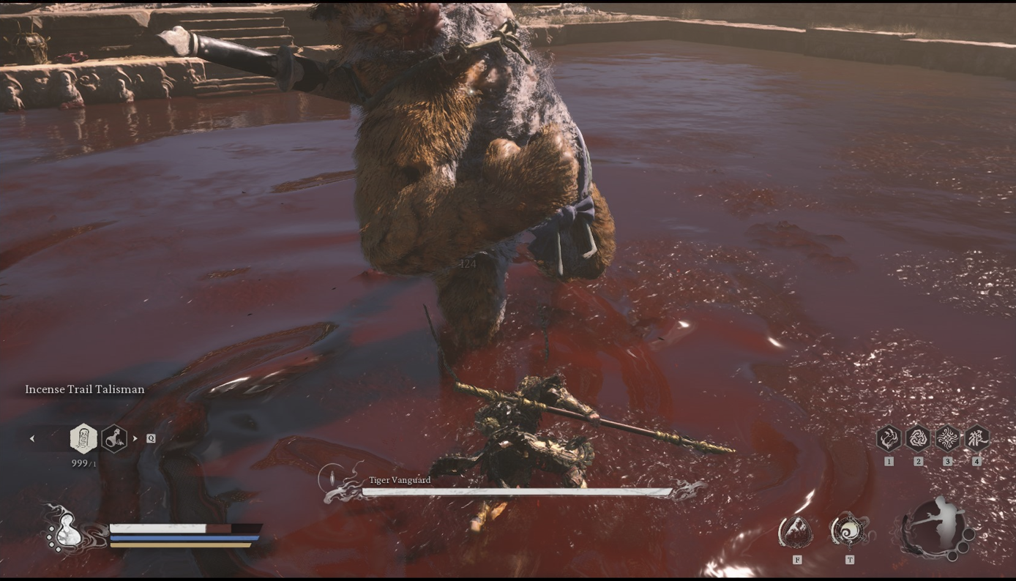
Experiment and Results
Multi-Input Policy：
Image Features
Backbone: resnet/YOLO/…
Agent State
Vector: (Health, Mana, Stamina, …)

Slide 15
Experiment and Results
Result of PPO

Slide 16
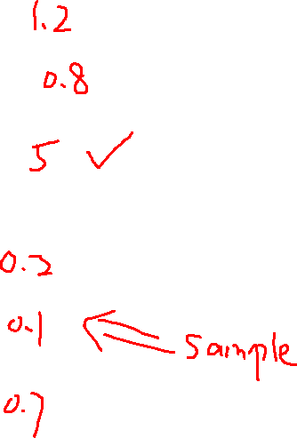
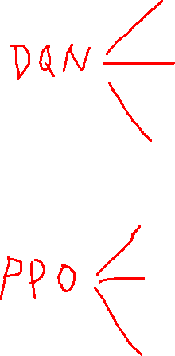

Result Analysis
Notes:
PPO performs better than DQN.
Because DQN is somewhat a greedy algorithm. We will definitely choose the action with the highest Q value. Therefore, in a complex environments, it is easy to focus only on local optimal solutions.
But PPO directly learns a probability distribution. Therefore, there is more randomness and exploration. And due to its constraint on the entire trajectory, its prediction of actions is more holistic. It can learn to give up short-term reward and gain more long-term reward.

Slide 17
Result Analysis
Difficulties
Due to the various delays, pre-inputs, and animation effects that large games often have, it is difficult to accurately capture the moment when the action ends. (After pressing a button, the game requires a certain amount of time to input commands. Or the game need to play an animation to show the state change. So the information you captured on the screen is likely not the next state. Therefore, you receive a incorrect reward.)
The game and network must run on the same computer(because of real-timely). Unable to use remote server. Therefore, it will cause a shortage of computing resource.
Highly dependent on the setting of reward. Sometimes it is difficult to make reasonable conditional judgments.
The replay time is too long, and training the network is very time-consuming. You can’t do anything else on your computer during training.

Slide 18
Result Analysis
Improvements
Use the sound of game as input to the network. (Intelligent agents will respond accordingly when they hear certain sounds).
Use each frame refreshed by the game as the action input time. This can make the particles in the action space finer, and the intelligent agent can learn combination skills, cancel skills to dodge, etc.
Use a better visual backbone.(3D pose estimation, behavior recognition, e.g. OpenPose)

Slide 19
TEMPLE
is high in a
U N I V E R S I T Y
Department of Computer & Information Sciences
T h a n k s !
Presenter: Saiyun Dong
TEMPLE
U N I V E R S I T Y

