Slide 1
Multi Instance Learning with Deep AUC Maximization on Medical Task Classification
Xinwen Zhang

Slide 2
Multi-instance learning
Training set consists of bags and bag labels , each bag contains multiple instances
A bag is positive if at least one of the instances in that bag is positive.
Weakly supervised learning: training with incomplete labels

Slide 3
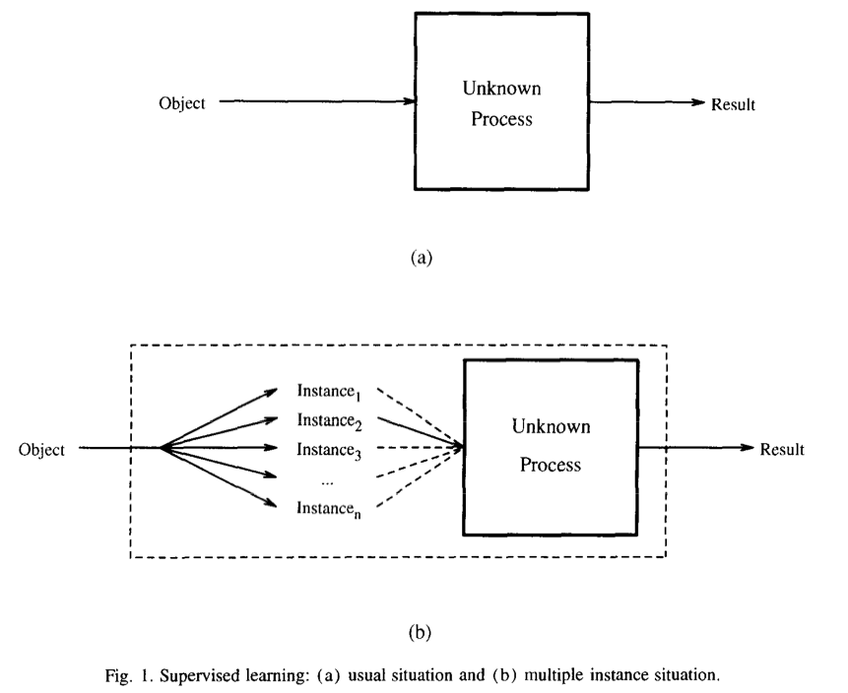
Multi-instance learning
[1] Solving the multiple instance problem with axis-parallel rectangles. Artificial intelligence, 89(1-2):31–71, 1997a.

Slide 4
Methodology: Update AUC Score
Metrics: AUC Score(Area under the ROC Curve)
Decoupling the pairwise structure into min-max formulation: [Ying et al.,2016]
[1] Ying et al, 2016. Stochastic online auc maximization, NIPS.
[2] Yuan et al, 2021. Large-scale Robust Deep AUC Maximization: A New Surrogate Loss and Empirical Studies on Medical Image Classification, IEEE.

Slide 5
Experiment
Dataset: MUSK (molecule) 1 / 2
47 positive bags, and 45 negative bags / 39 positive bags, and 63 negative bag
Average bag: 5.17 / 64.69
Bag batch size: 8
Instance batch size: 4
5-fold Cross-validation

Slide 6
Experiment
Pooling method
Max Pooling
Smoothed-max Pooling
Mean Pooling
Attention-based Pooling

Slide 7
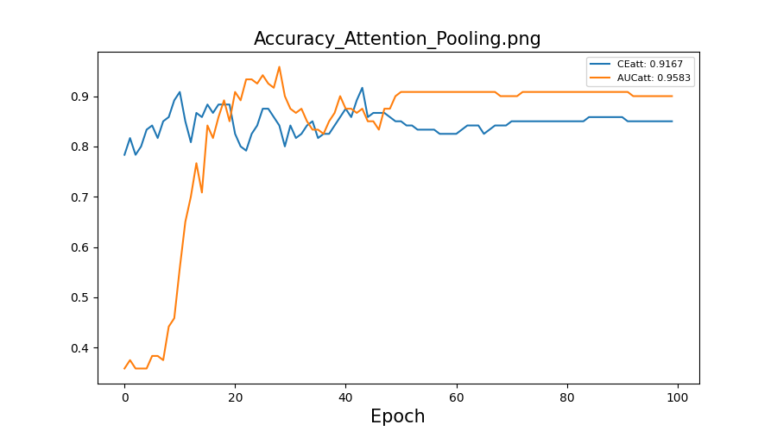
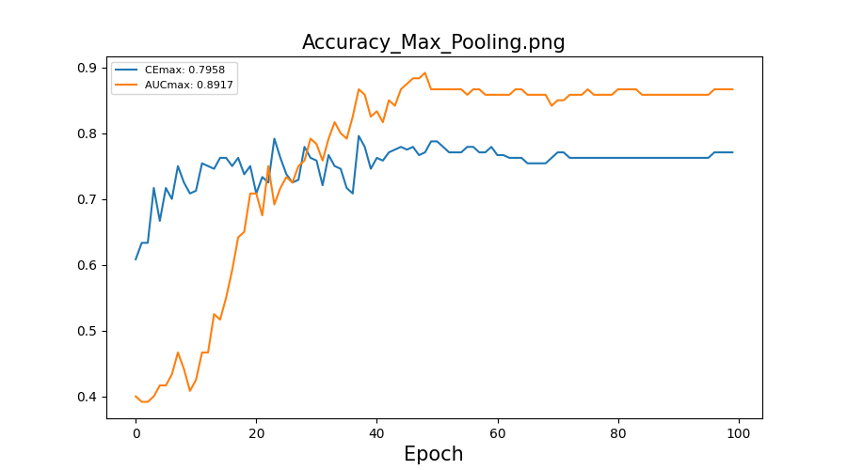
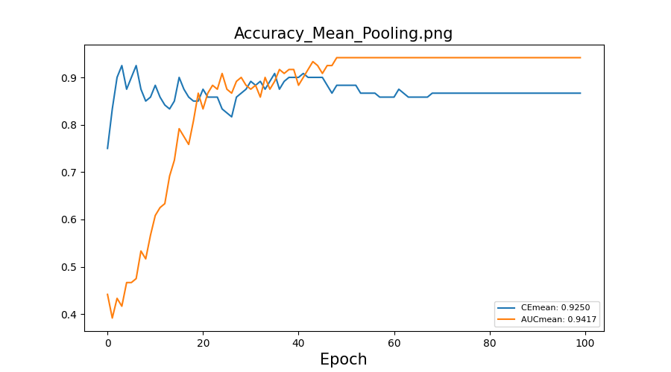
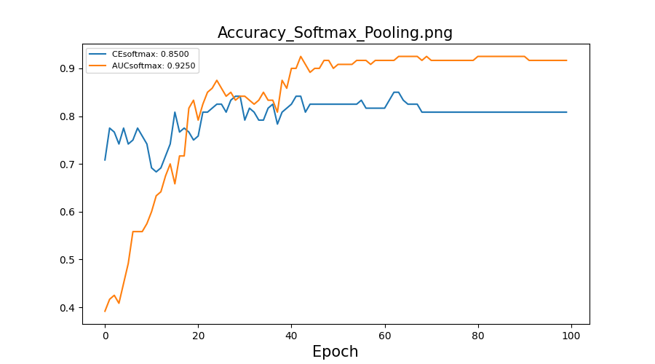
Experimental Result: MUSK1

Slide 8
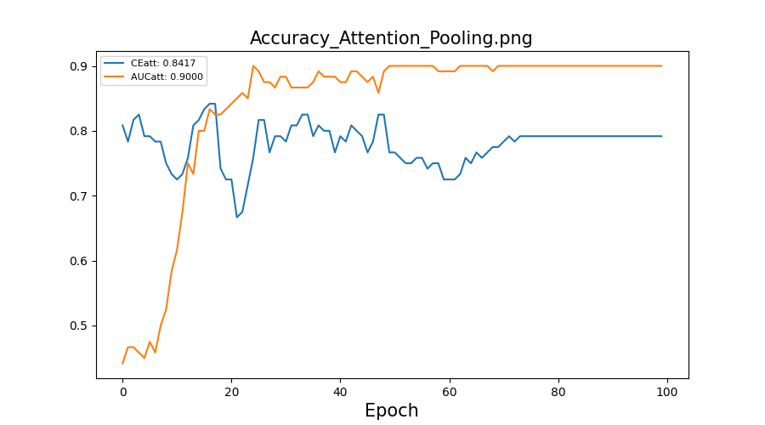
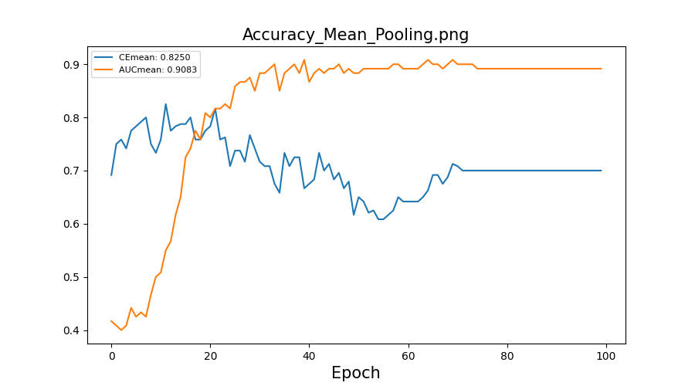
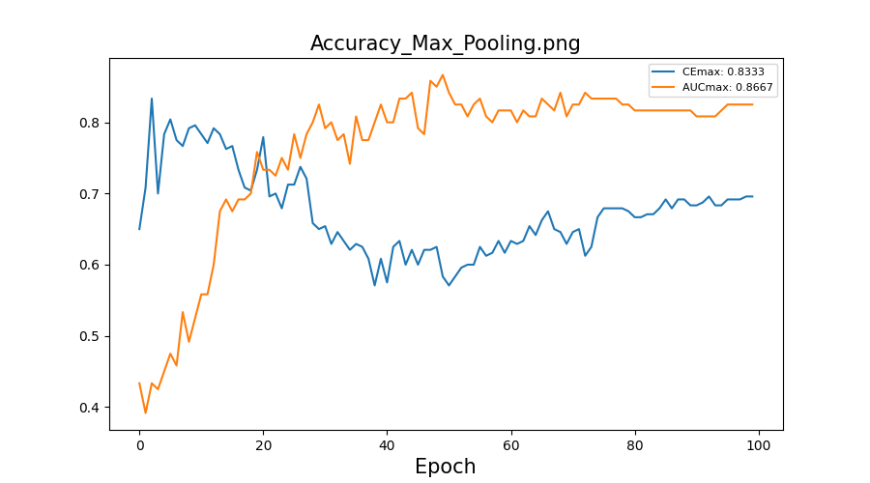
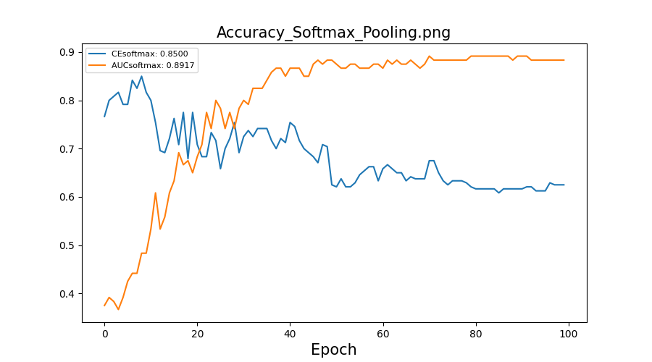
Experimental Result: MUSK2

Slide 9
THANKS!

