Slide 1
Computer Vision for AAC
Cindy Zastudil

Slide 2
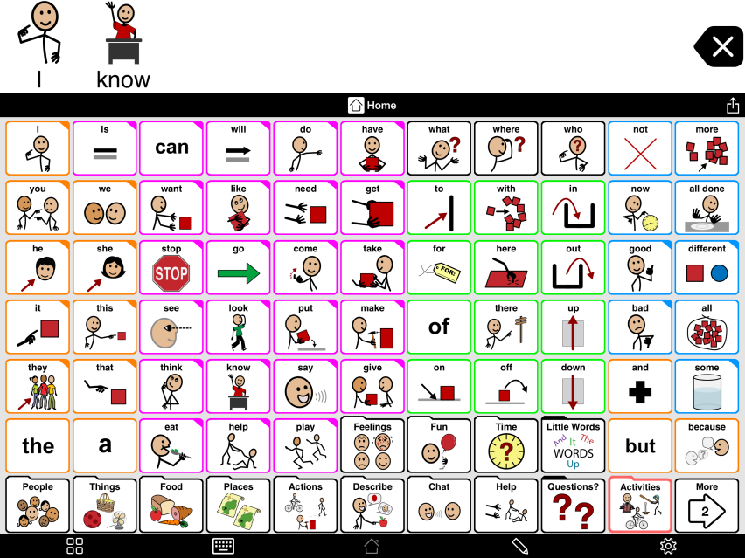
Background & Motivation
AAC devices are used by many people with difficulties in verbal communication
Popular devices, like grid displays, can be too rigid and complex for active communication [1]
Image Source: https://www.assistiveware.com/blog/new-to-proloquo2go-training
Notes:
AAC devices - or Augmentative and Alternative Communication devices are used by many people who experience difficulties in communicating verbally.
The conditions that cause this can vary widely, from Autism Spectrum Disorder, aphasia, ALS, and a variety of other cognitive and physical conditions.
The form AAC can take can vary widely as well, from low- to no-tech (e.g., using or pointing to physical photos or pointing/gesturing at things or people) to high-tech (e.g., text to speech functionality or mobile applications). A very common form of AAC device is an application on some sort of computer (e.g., phone, tablet, laptop, etc.) which contains a grid display with buttons that users can press to assemble a sentence which can then either be read by a communication partner or spoken aloud by the software such as is shown on this slide.
While these devices can be immensely helpful for those who require AAC to communicate, they suffer from a number of disadvantages which negatively impact both the experience of the AAC user and their communication partner(s).
One such disadvantage is that these grid displays are often fixed, and it's tedious or hard to modify the buttons, change the text, change the buttons' icons, and more.
Additionally, since they are fixed, users often have to flip through multiple pages of buttons to complete a simple sentence which impacts their ability to actively participate in communication.
With a communication rate of approximately 10 words/per minute, it can be very hard for AAC users, especially beginners to effectively use these tools

Slide 3
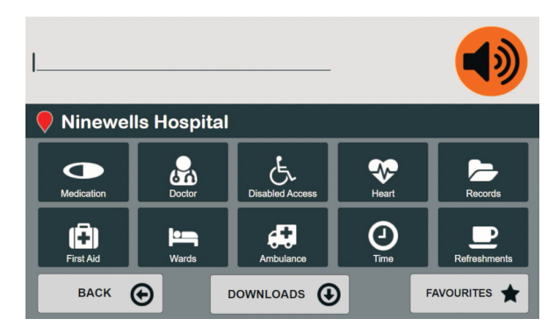
Related Work
Notes:
Work from McKillop in 2018 delivered a prototype of a tool which developed a context-aware keyboard with older AAC users in mind
This prototype was based on location data, with no artificial intelligence or machine learning agent involved
This project’s work, however, focuses on beginning communicators, around ages 3-7 as a way to scaffold their use of AAC devices by introducing simpler, more “informed” devices

Slide 4
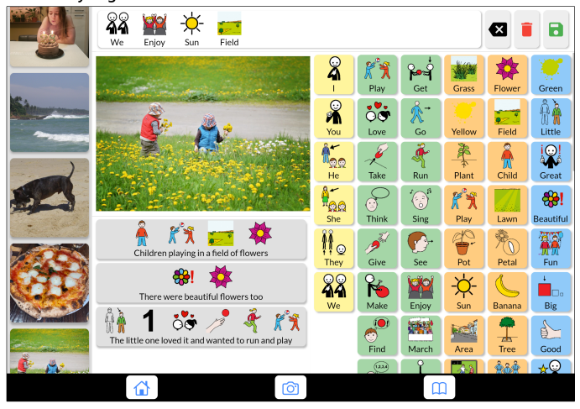
Related Work
Notes:
ClickAAC, a system developed by Vargas, Dai, and Moffat in 2022, focuses on automatically generating descriptive and narrative communication options, as shown in this screenshot
In contrast to this work, this project focuses primarily on generating objects and actions from a provided photo in order to provide a manageable amount of communication options, as well as more agency over their communication options

Slide 5
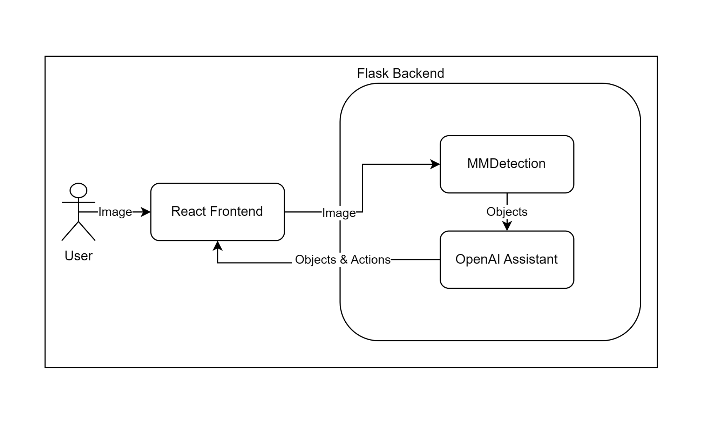
My Approach - System Overview
Notes:
An end user access the React Frontend and uploads an image
The React Frontend then sends the image to a Python Flask backend
In the backend, object detection is performed by the open-source mmdetection library, I will explain more details in a bit
Then, once objects are recognized, they are sent to an OpenAI assistant I created which generates appropriate actions for the objects provided
Finally, the resulting objects and actions are displayed in the react frontend for the user to communicate with

Slide 6
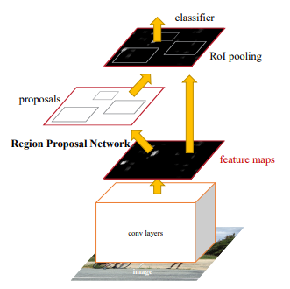
My Approach - Underlying Systems
Notes:
The MMDetection library is primarily an object detection library based on PyTorch and has a plethora of different models implement with a variety of datasets (https://github.com/open-mmlab/mmdetection/tree/main)
From the MMDetection library I used the Faster R-CNN model trained on the OpenImages dataset
The OpenImages dataset contains 600 object classes in 1.9 million images - https://storage.googleapis.com/openimages/web/factsfigures_v6.html
I chose this dataset because it had the most relevant classes included in the dataset
Here is a description of the model used (https://github.com/open-mmlab/mmdetection/tree/main/configs/openimages)
This model runs an image though convolutional layers before running it through a region proposal network
An RPN is a fully convolutional network that predicts object bounds and objectness scores at each position.
I chose this model because through a process of trial and error it performed the best out of models supporting the OpenImages dataset

Slide 7
My Approach - Underlying Systems
Image Source: https://platform.openai.com/docs/assistants/how-it-works
Notes:
The objects detected are then sent to an OpenAI assistant
Here is how those work based off of a simple example
The code interpreter is enabled and the prompt used was
“You are generating actions for an augmentative and alternative communication (AAC) device. Output ONLY a Python list 5 single word actions a young child (3-7) may use with a given object. Python list:”

Slide 8
Demonstration
Notes:
Here is a brief demonstration of the app I built:
The user uploads a photo from their device
Then after a bit of latency, which I’ll discuss later, the detected objects and suggested activities are returned to the frontend
The user can then use those words, along with the core vocabulary which is always displayed, in order to construct their sentences or communication

Slide 9
Limitations & Future Work
Limitations:
Latency
Limits in classes
Existing issues with object recognition
LLM-specific issues:
Latency
Servers overwhelmed
Formatting/consistency issues
Future Work:
User testing
Fine tuned object recognition models and LLMs for activity suggestion
Notes:
There are a number of limitations which I believe are important to discuss:
Latency of inference impacted user experience, performance would need to be improved for an actual system rather than a prototype
There were also limits in classes
Models should be fine-tuned, more specific classes for this particular application
but dataset collection is hard
Existing issues with object recognition - smaller objects hard to detect, give sample image on which it doesn’t perform well
LLM issues
Latency & servers being overwhelmed caused significant issues in testing and performance
Servers overwhelmed
There were significant formatting issues where it didn’t consistently return the same type of response which caused errors to occurs
In terms of future work:
User testing should be done with actual end users as well as speech language pathologists to determine the efficacy, benefits, and potential harms of this tool
Fine tuned object recognition models and LLMs for activity suggestion should be developed and leveraged

Slide 10
Thank you!

Slide 11
References
[1] Conor McKillop. 2018. Designing a Context Aware AAC Solution. In Proceedings of the 20th International ACM SIGACCESS Conference on Computers and Accessibility (ASSETS '18).
[2] Mauricio Fontana de Vargas, Jiamin Dai, and Karyn Moffatt. 2022. AAC with Automated Vocabulary from Photographs: Insights from School and Speech-Language Therapy Settings. In Proceedings of the 24th International ACM SIGACCESS Conference on Computers and Accessibility (ASSETS '22).
[3] Conor McKillop. 2018. Designing a Context Aware AAC Solution. In Proceedings of the 20th International ACM SIGACCESS Conference on Computers and Accessibility (ASSETS '18).
[4] Ren, Shaoqing, et al. "Faster r-cnn: Towards real-time object detection with region proposal networks." Advances in neural information processing systems 28 (2015).

