Slide 1
Artificial Intelligence: Using Deep Reinforcement Learning to Play “Snake”
BY: Saf Rahman

Slide 2
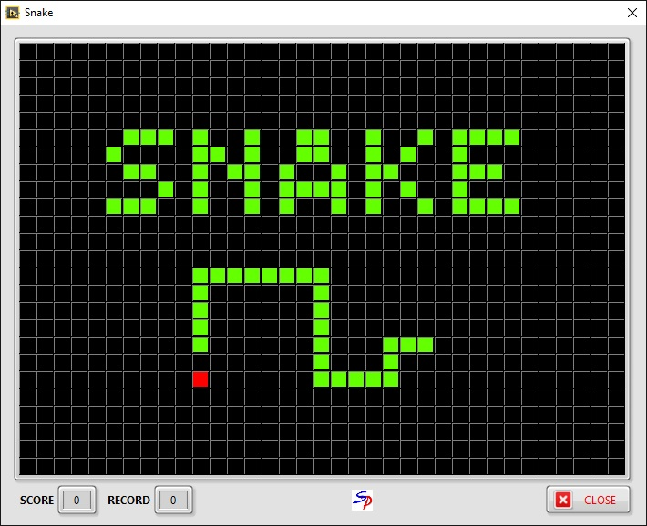
What is Snake?
Single Player Game
Survival game
Goal is to get the highest score
Increase score by eating food
As you eat food the snake grows
The snake loses if it runs into a wall or itself

Slide 3
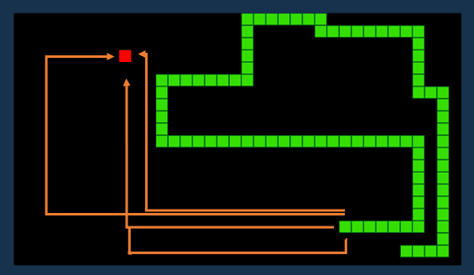
General Analysis
There is a limit to how large the snake can be depending on the size of the board
There are l*w places on the board
Food can appear in any random location
There are multiple solutions that work for a given level, as the size of the snake grows, the number of working solutions decreases
Starts with infinitely many solutions to reach the food. To prevent infinite loops I added a clause that ends the game after a certain amount of turns that pass if no food is found.

Slide 4
Deep Reinforcement learning
As we know, reinforcement learning is most like how humans learn in that the program learns from feedback is given after certain actions
I thought this problem would be suitable for this type of learning since it would be relatively easy to provide feedback given certain actions from the snake
Supervised and unsupervised learning don’t work as well since there aren’t necessarily correct answers at each step in order to train the snake.

Slide 5
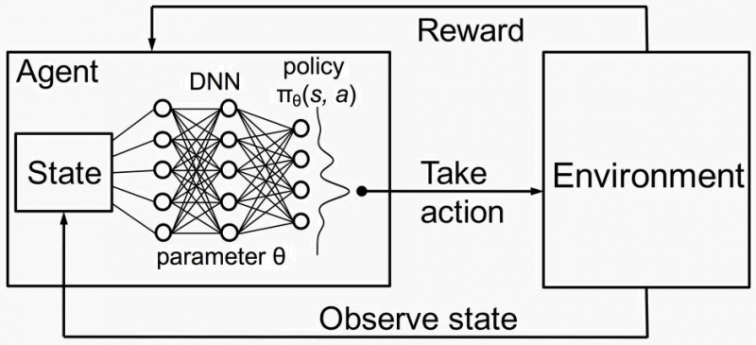
Deep Reinforcement learning

Slide 6
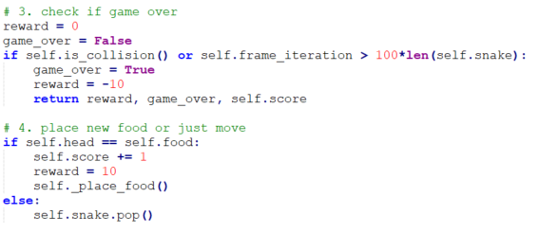
Rewards
Eating the food
Should we reward for going closer or farther away from food or only when it gets it?
Hitting the wall
Running into itself
Staying Alive
Should time alive matter?

Slide 7
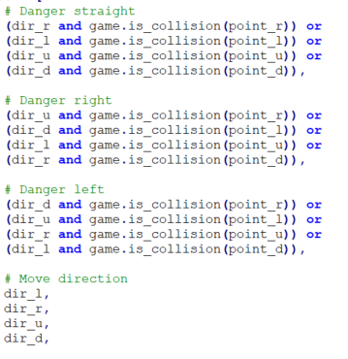
Information Given
Location of food
Two options: Give the direction of the food
Give the coordinates of the food
Location of wall
Two options: How far the wall is from all directions
Whether or not there is a wall directly in front or to the side

Slide 8
Hyper Parameters of Neural Network
Single hidden layer
Adding additional hidden layers didn’t improve performance in my experience
Adding a second layer didn’t hinder performance but didn’t improve it either – it just wasted more resources
Number of neurons in the layer = 512
Input size is 11 output is 3
Input layer considers the 4 movement directions, 4 cardinal directions of food relative to the head of the snake, and 3 potential collisions with walls
Output layer is related to the 3 directions that the snake head must choose from (left, right, straight)

Slide 9
Hyper Parameters of Neural Network (cont.)
Activation function: ReLu
Most popular activation function
Also tried sigmoid and Tanh but this proved superior performance. The vanishing gradient problem was not an issue but nonetheless it still worked better
Batch size
Tested powers of 2 from 32 to 1024
Learning rate = 0.0001
There isn’t traditional overfitting but there is the issue of Exploration vs exploitation
Used a random variable epsilon to force a random move, this value decreased overtime to reduce the number of random moves as the model learned more

Slide 10
Limitations
Performance was capped at around 50 points
The snake learns to search for the food and avoid obstacles around the head but not necessarily avoid trapping itself since it doesn’t keep track of where the rest of its body is
Coming up with a system to give the agent more information about where everything is on the board might be useful to keep track of the rest of the snake

Slide 11
Future Experimentation
Increase the size of the board every ‘n’ turns to see how that impacts the score
Add obstacles in addition to the walls and snake body to see how the trained model will perform
Add multiple pieces of food for the snake to potentially eat
Add “poison” that decreases score instead of increasing or causing the game to end

Slide 12
Thank You!

Slide 13
References
https://towardsdatascience.com/snake-played-by-a-deep-reinforcement-learning-agent-53f2c4331d36
https://machinelearningmastery.com/choose-an-activation-function-for-deep-learning/#:~:text=ReLU%20Hidden%20Layer%20Activation%20Function,function%20used%20for%20hidden%20layers.
https://arxiv.org/pdf/1811.03378.pdf
``Multilayer feedforward networks are universal approximators" eserved@d = *@let@token - Kur Hornik, Maxwell Stinchcombe and Halber White (1989) eserved@d = *@let@token (cmu.edu)
Learning to Play: Reinforcement Learning and Games | Semantic Scholar

