Slide 1
Creating 3D “Flyers” Using Genetic Algorithms
By: Christian Hahm and Kathryn Piper
CIS 5603 - Artificial Intelligence
Final Project Report

Slide 2
Genetic Algorithms
Evolutionary computation inspired by Darwin’s “natural selection” to automatically generate increasingly optimal solutions for a task with a defined fitness function.
Our Goal:
Use a genetic algorithm for a population of 3D “Flyers” which evolve to fly higher throughout the generations
Notes:
Genetic algorithm is a type of evolutionary computation which is inspired by Darwin’s “natural selection” to automatically generate increasingly optimal solutions for a task with a defined fitness function. Each candidate is a solution to the problem and has a set of “genes” or attributes that impact how well it solves the problem. The genetic algorithm consists of a loop where the best-performing candidates in the population, determined by a fitness function,“reproduce” introducing new offspring and potentially better candidates. The Genetic Algorithm hopes to introduce better ‘fit’ candidates through reproduction of the best performing candidates from the previous generation. So, over many generations the algorithm hopes to produce candidates that have optimized for to solve the problem.
For this project we implemented a Genetic Algorithm on a population of 3D flyers that evolve to fly higher through the generations.

Slide 3
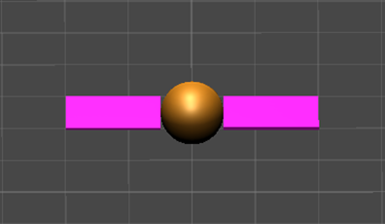
The Flyers
Each Flyer consists of a spherical Body with two rectangular-prism Wings (a Left and Right Wing), and are expected to have the following attributes:
Left/Right Wing Length (Wing area is proportional to the Wing’s flapping force)
Left/Right Wing Width (Wing area is proportional to the Wing’s flapping force)
Left/Right Wing Thickness (proportional to the Wing’s flapping frequency)
Body Diameter (proportional to the # of flaps a Flyer can perform in its lifetime)

Slide 4
Evolutionary Algorithm Details
16 Flyers per generation. Top 4 survive to the next generation and interbreed to produce 12 offspring
Each gene is a float in range (0.0,4.0]
Mutation Rate 20% - up from the initial plan of 10% to increase genetic diversity - every gene has a 20% chance of getting a uniform random value

Slide 5
Crossover
Single-Point
Two-Point
Uniform
Parent #1 Parent #2
Offspring #1 Offspring #2
Offspring #1 Offspring #2
Offspring #1 Offspring #2
?

Slide 6
Flyer Statistics We Collected
Data Collected For:
3 types of crossover; 3 trials per crossover
25 generations per trial
Attribute values of every flyer
Score ranking (#1 to #16) per generation
Allowing us to calculate:
Average attribute values for each generation
High score per generation
Attributes of the Best Flyer in Each Trial

Slide 7
First Generation (#1)
Completely random population; wide variety of gene values
Some Flyers perform well, others cannot even lift off the ground
Sets the baseline score for future generations to beat

Slide 8
Final Generation (#25)
Population becomes homogeneous, high score has been achieved
Not much room for improvement, a certain combination of optimal traits will continue to dominate the population
However, the high 20% rate of random mutations may lead to lucky improvements and healthy gene diversity

Slide 9
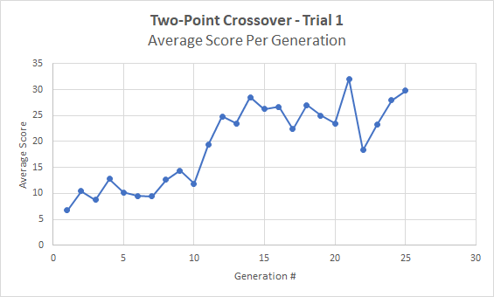
Results: Genetic Algorithm leads to increasing scores
The average score per Flyer increases drastically over the generations, providing us with parameters for high-scoring Flyers
Due to the nature of the algorithm, the species produces higher-scorers (on average) with every passing generation to some upper limit (limited by the fitness function and simulation)
Every trial shows this increasing trend. Our results show that Genetic Algorithm is a good and automated way to find parameters for a model you are optimizing

Slide 10
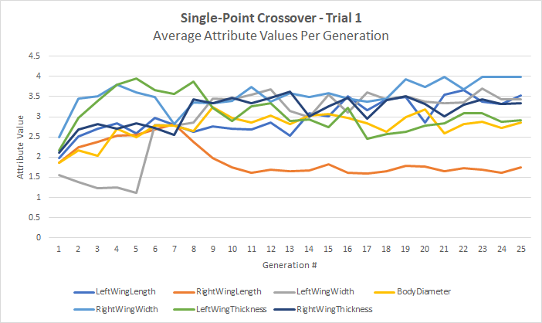
Results: Attribute Values
In every trial, the flyers evolved to have one wing dramatically shorter than the other, with the shorter wing length stabilizing around [1.5,2.0]
The smaller wing’s frequent flapping force probably helps keep the body pointed upward; the other larger wing provides the force necessary to get off the ground
All other attribute values tended towards higher values in the range [3.0,3.5]

Slide 11
Which Crossover method produced the overall best Flyer?
Drumroll...

Slide 12
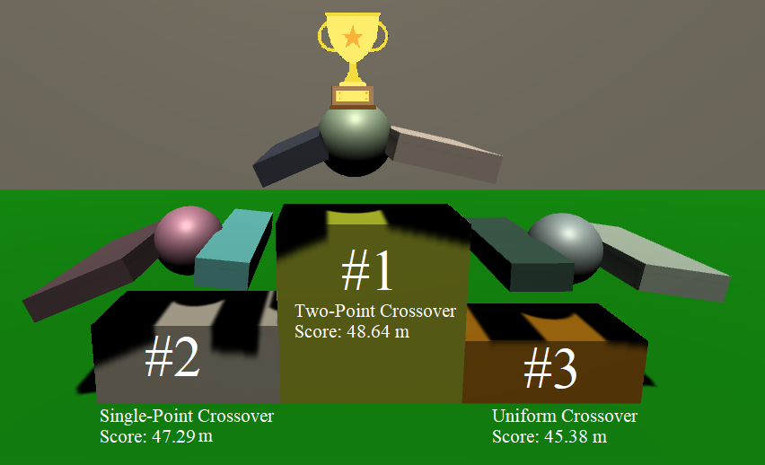
Overall Best Flyer: Two-Point Crossover

Slide 13
Results
Best Flyer Genetic Attribute Values from each Trial
Crossover | Trial | LW Length | RW Length | LW Width | Body Diameter | RW Width | LW Thickness | RW Thickness | Score (meters)
Single-Point | Trial 1 | 3.960963 | 1.672601 | 3.808132 | 3.023949 | 3.996559 | 3.079279 | 3.635968 | 47.28957
Single-Point | Trial 2 | 2.546351 | 3.026479 | 3.288517 | 2.883121 | 3.760251 | 3.025312 | 2.574933 | 45.70729
Single-Point | Trial 3 | 1.237751 | 3.838802 | 3.26551 | 2.755591 | 2.714379 | 3.803769 | 3.029102 | 38.07222
Two-point | Trial 1 | 2.53915 | 3.672182 | 3.686303 | 2.827985 | 3.090761 | 3.893079 | 3.453083 | 43.557
Two-point | Trial 2 | 1.619304 | 2.967868 | 3.961496 | 2.74494 | 3.511518 | 3.739878 | 2.856245 | 42.98876
Two-point | Trial 3 | 2.282935 | 3.598958 | 3.829222 | 3.606087 | 3.510516 | 2.643354 | 3.431449 | 48.64305
Uniform | Trial 1 | 2.389143 | 3.237123 | 3.252407 | 2.454668 | 3.681267 | 2.195402 | 2.232904 | 44.09472
Uniform | Trial 2 | 2.066612 | 3.048501 | 3.530656 | 3.340074 | 3.545026 | 3.830632 | 3.551865 | 45.38079
Uniform | Trial 3 | 1.637495 | 3.931123 | 3.315953 | 2.900353 | 3.325307 | 3.811975 | 3.298044 | 42.74664

Slide 14
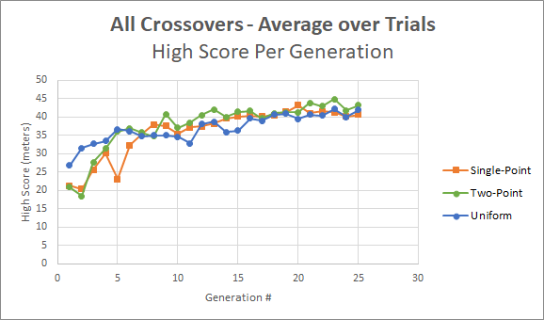
Which Crossover was most efficient?
Single-Point Crossover and Two-Point Crossover performed about equally well; both methods work well for genetic algorithm
Uniform Crossover consistently trended lower than the other 2 crossover methods, despite starting with much better Flyers on average
All methods eventually led to approximately the same high-scoring population by Generation #25; the crossover method does not seem too important if it runs for a sufficiently large number of generations
Average best Flyer height over all 3 trials:
Single-Point: 43.689 meters
Two-Point: 45.063 meters
Uniform: 44.074 meters
Since Two-Point Crossover had the best Top Flyers on average, AND produced the best Flyer overall, we recommend Two-Point Crossover as the best crossover method for genetic algorithm

Slide 15
References
1. Matsunaga, Rafael. Genetic Walkers. Rednuht. https://rednuht.org/genetic_walkers/
2. Tomasz D. Gwiazda, Genetic Algorithms Reference Vol.1 Crossover for single-objective numerical optimization problems, Tomasz Gwiazda, Lomianki, 2006
3. Holland, John Henry. Adaptation in natural and artificial systems: an introductory analysis with applications to biology, control, and artificial intelligence. MIT press, 1992.

