Slide 1
Comparing NLP Feature Extraction Models in Patient Mortality Prediction
Elizabeth Garrison, Sai Shi, and Tanuja Sajja

Slide 2
Overview
Background
Methods
Results
Examples
Discussion

Slide 3
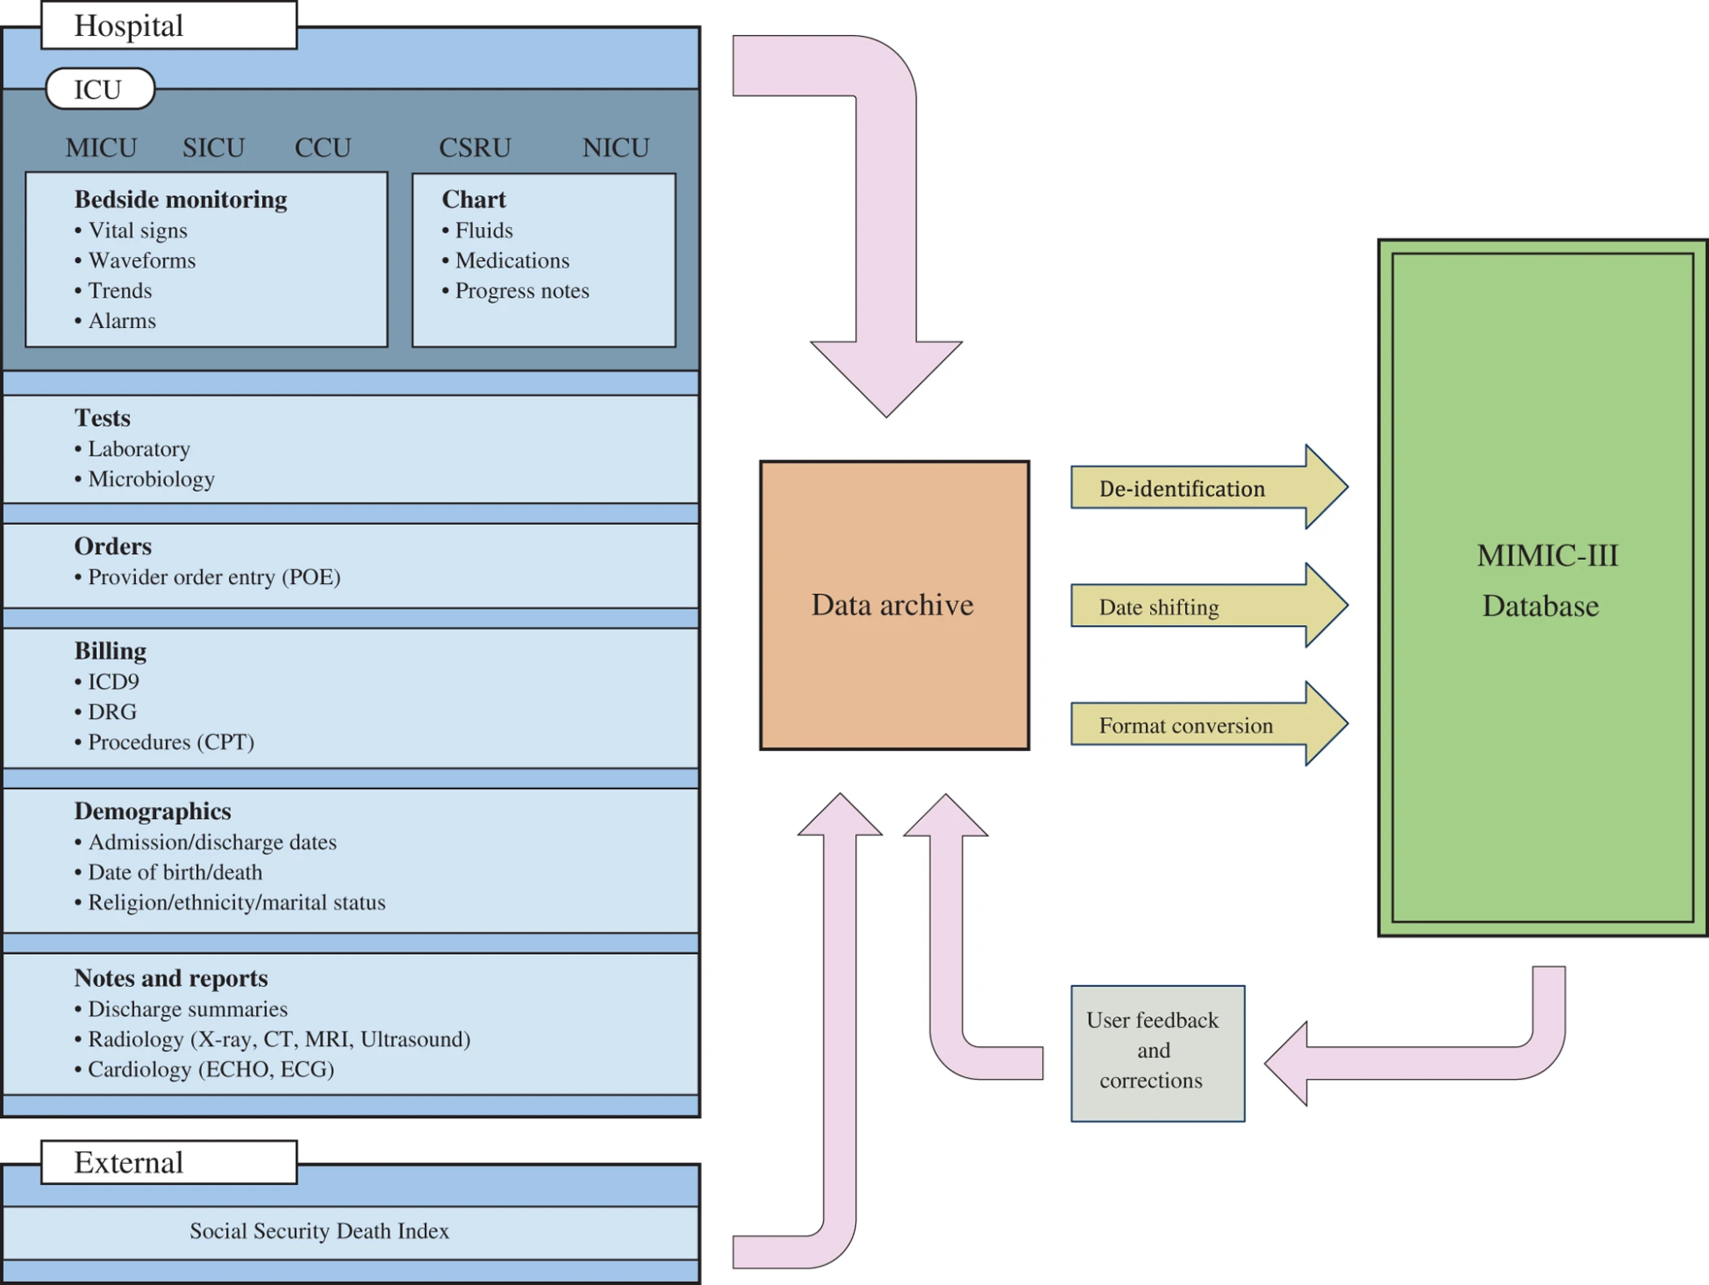
MIMIC III
Rise in electronic health records has the potential to provide insights to understanding diseases.
MIMIC-III is a freely available database that contains de-identified health-related data associated with forty thousand patients who stayed in critical care units of the Beth Israel Deaconess Medical Center between 2001 and 2012.
Alistar E.W et al, Nature 2016

Slide 4
Natural Language Processing
Natural language processing is an interdisciplinary subfield of computer science and linguistics
One of the main uses of NLP is to support the automation of tasks in sectors of work that require human coding
NLP models such as bag of words, TF-IDF and Bidirectional LSTM can be used to extract features from the clinical notes to build models that better support the medical field and patient care
https://www.cybiant.com/wp-content/uploads/2020/01/CKC-Natural-Language-Processing.png

Slide 5
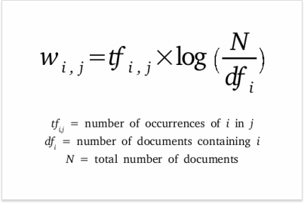
SVM with BoW and TF-IDF
SVM:
Initially used for binary classification, but can be applied to non-linear classification
SVM with target-dependent and target-independent feature engineering methods have been proven to be effective in many NLP tasks
Bag of Words:
A model that is used to extract specific features such as the number of times a word occurs in a text and stores these features to be used by other machine learning algorithms
TF-IDF:
Assigns a statistical weight to each word based on its relevance in the text.
Higher weight is assigned to words that appear frequently in a single document, but lower weights are assigned to words that appear in a set of multiple documents - the final score of a word is the product of the two numbers.
These scores are used by other machine learning algorithms

Slide 6
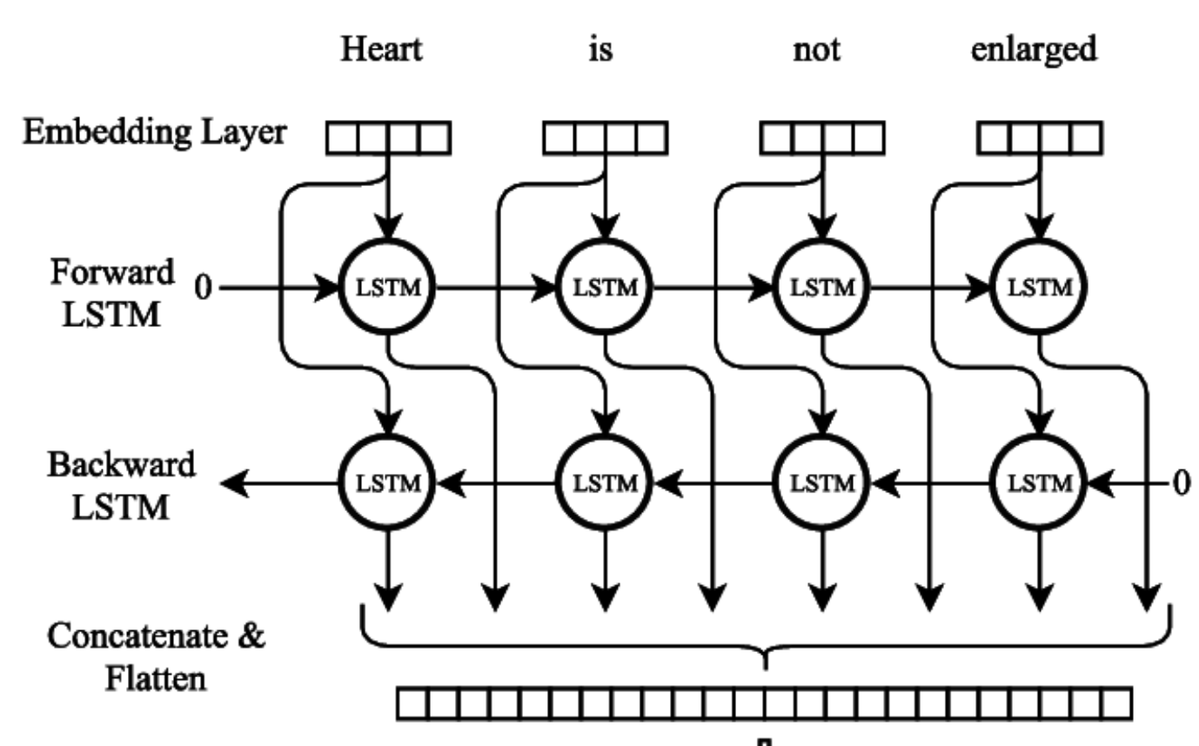
LSTM and BiLSTM
LSTM:
A type of RNN that can preserve information for long durations of time and recall that information to predict based on context
At each time step LSTM takes 3 pieces of information
Current input data
Short term memory from the last cell (hidden state)
Long term memory
BiLSTM:
Is able to use information from the past and the future based on context
Runs both forward and backward at the same time, increasing the amount of information available to the network
Cornegruta S. et al, 2016 “BiLSTM”

Slide 7
Methods: Data Preprocessing
Dataframe:
Imported MIMIC-III .csv file “Patient Clinical Notes” to Pandas dataframe.
Removed all features except Subject id, Clinical Notes, and mortality label.
Shuffled data and randomly sampled 10,000 examples.
Remove Stopwords:
Used NLTK package to remove stopwords
Added additional stopwords of “Admission,” “Discharge,” and “Date”

Slide 8
Methods: Models
One word ‘attends’ to other words in the same sentence differently
Problem with fixed-length context vector: incapability of remembering long sentences
Self-attention model: allow inputs to interact with each other and find out who they should pay more attention to
Very useful in many NLP tasks: Transformer model
Image source: https://lilianweng.github.io/lil-log/2018/06/24/attention-attention.html

Slide 9
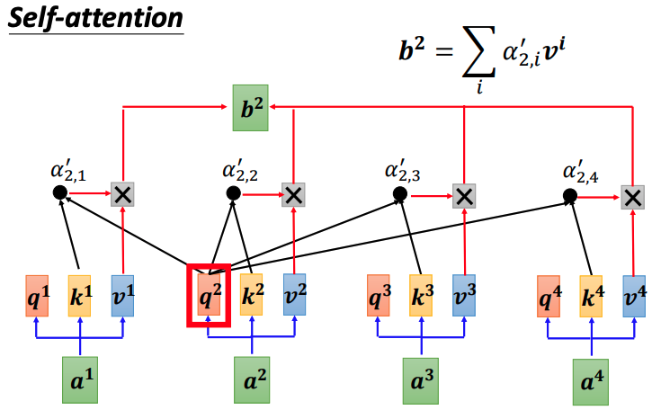
Methods: Models
Components: key, value and query
Scaled dot-product attention
Extract information based on attention scores
Parallel computation
Image source: https://speech.ee.ntu.edu.tw/~hylee/ml/ml2021-course-data/self_v7.pdf

Slide 10
Results
Models | Accuracy | Precision | Recall | F1
BoW + SVM | 0.73 | 0.69 | 0.68 | 0.68
TF-IDF + SVM | 0.75 | 0.69 | 0.71 | 0.70
LSTM (scratch) | 0.71 | 0.66 | 0.65 | 0.65
LSTM (GloVe) | 0.73 | 0.66 | 0.78 | 0.71
LSTM (Fasttext) | 0.73 | 0.66 | 0.75 | 0.70
BiLSTM (GloVe) | 0.72 | 0.64 | 0.81 | 0.71
BiLSTM (Fasttext) | 0.73 | 0.68 | 0.67 | 0.68
BiLSTM + Attention | 0.75 | 0.71 | 0.80 | 0.75

Slide 11
Examples from Model Prediction
In the following examples, we show where the best model matched a ground truth and prediction of mortality.
Each example highlights in light to dark blue by importance in relation to the classification of mortality.
Dark blue indicates where there is more attention in relation to classification.

Slide 12
Examples from Model Prediction
assessment noted cv remains fib despite amiodorone lopressor planned cardioversion today bp stable slight edema started lasix po qd car enzymes rising 5 sets ho aware pt started heparin ecg done denies chest pain along res ls clear dim prod cough nc 4 5l po2 62 neuro intact turns assist cooperative gi ice chips last night tolerated well npo midnight denies nausea abs soft hypo bs dressing intact gu 40 60 h amber heme hct 37 obvious signs bleeding lines lines intact plan cardioversion
Attention: edema (swelling caused by excess fluid trapped in your body's tissues), 5l po2 (blood oxygen, less than 40 is severe), ecg, cardioversion is a medical procedure that restores a normal heart rhythm in people with certain types of abnormal heartbeats (arrhythmias).

Slide 13
Examples from Model Prediction
Liver wants repeat liver u No recs EEG showed encephalopthy triphasic waves seizure Neuro new recs Bladder pressure rechecked 24 19 HCT stable n
Attention: liver, EEG, pressure, ecephalopthy (damage or disease that affects the brain), seizure.

Slide 14
Examples from Model Prediction
follow repair ventral hernia PA lateral upright chest radiograph compared 2163 6 26 The heart size normal Mediastinal contours position width unremarkable The right atrium IVC stent demonstrated unchanged position The lungs clear There change right small pleural effusion pleural thickening Calcified granuloma right upper lobe noted
Attention: pleural effusion, “water on the lungs,” pleural thickening, calcified granuloma--infection of lung

Slide 15
Examples from Model Prediction
history Respiratory failure acute ARDS Doctor Last Name 11 Assessment Rr 30 Lung sounds diminished thru crackles left upper lobe Hr 120 130
Attention: Respiratory, ARDS (Acute respiratory distress syndrome), lung, diminished

Slide 16
Discussion
Overall, the BiLSTM Attention model performed the best.
Limitations: Resource limitations in using a larger sample size to improve model performance.
Future research: Test other word embedding techniques that are domain specific to the medical field.
Conclusions: Through NLP, we may be able to build systems where clinical notes are reviewed in real time, to alert physicians to potential risk of mortality in patients.

Slide 17
References
1] Singh, A. K., Guntu, M., Bhimireddy, A. R., Gichoya, J. W., & Purkayastha, S. (2020). Multi-label natural language processing to identify diagnosis and procedure codes from MIMIC-III inpatient notes. arXiv preprint arXiv:2003.07507.
[2] F. Hasan, A. Roy and S. Pan, "Integrating Text Embedding with Traditional NLP Features for Clinical Relation Extraction," 2020 IEEE 32nd International Conference on Tools with Artificial Intelligence (ICTAI), Baltimore, MD, USA, 2020, pp. 418-425, doi: 10.1109/ICTAI50040.2020.00072.
[3] MIMIC-III, a freely accessible critical care database. Johnson AEW, Pollard TJ, Shen L, Lehman LH, Feng M, Ghassemi M, Moody B, Szolovits P, Celi LA, and Mark RG. Scientific Data (2016). DOI: 10.1038/sdata.2016.35. Available at: http://www.nature.com/articles/sdata201635 (Links to an external site.)
[4] Cornegruta, Savelie & Bakewell, Robert & Withey, Samuel & Montana, Giovanni. (2016). Modelling Radiological Language with Bidirectional Long Short-Term Memory Networks. 17-27. 10.18653/v1/W16-6103.
[5] Chalapathy, Raghavendra, Ehsan Zare Borzeshi, and Massimo Piccardi. "Bidirectional LSTM-CRF for clinical concept extraction." arXiv preprint arXiv:1611.08373 (2016).
[6] Liu, Gang, and Jiabao Guo. "Bidirectional LSTM with attention mechanism and convolutional layer for text classification." Neurocomputing 337 (2019): 325-338.
[7] Prakash M Nadkarni, Lucila Ohno-Machado, Wendy W Chapman, Natural language processing: an introduction, Journal of the American Medical Informatics Association, Volume 18, Issue 5, September 2011, Pages 544–551, https://doi.org/10.1136/amiajnl-2011-000464
Image references:
MIMIC-III, a freely accessible critical care database. Johnson AEW, Pollard TJ, Shen L, Lehman LH, Feng M, Ghassemi M, Moody B, Szolovits P, Celi LA, and Mark RG. Scientific Data (2016). DOI: 10.1038/sdata.2016.35. Available at: http://www.nature.com/articles/sdata201635 (Links to an external site.)
Cornegruta, Savelie & Bakewell, Robert & Withey, Samuel & Montana, Giovanni. (2016). Modelling Radiological Language with Bidirectional Long Short-Term Memory Networks. 17-27. 10.18653/v1/W16-6103.
https://www.cybiant.com/resources/natural-language-processing/?v=7516fd43adaa
Cybiant “Natiral Language Processing”. https://www.cybiant.com/resources/natural-language-processing/?v=7516fd43adaa

