Slide 1
Stock Market prediction with Machine learning algorithms
Olivia Chen

Slide 2
Introduction
The Stock Market is full of uncertainty, expectations
market for the trading
one of the most important sources for companies to raise money
allows businesses to go public, or raise additional capital for expansion
Predicting stock performance is a very large and profitable area of study
Which algorithm will perform best?

Slide 3
DatA
SPDR S&P 500 Trust ETF (SPY) from Yahoo Finance
Time Period: 2016-01-01 → 2021-01-01
Train & Split
Total | 1259
Train(70%) | 881
Test(30%) | 378

Slide 4
Linear Regression
A basic and commonly used type of predictive analysis
Data contain only one independent variable X which represents the “date” and the dependent variable we are trying to predict is the “stock price”
To fit a line to the data points, which then represents an estimated relationship between X and Y.

Slide 5
Linear Regression
Fomula:
$$Y= β0+β1X$$
_{where:}
Y is the predicted value of the dependent variable
$β0$ _{is the Y-intercept}
$β1$ _{is the slope}
X is the value of the independent variable

Slide 6
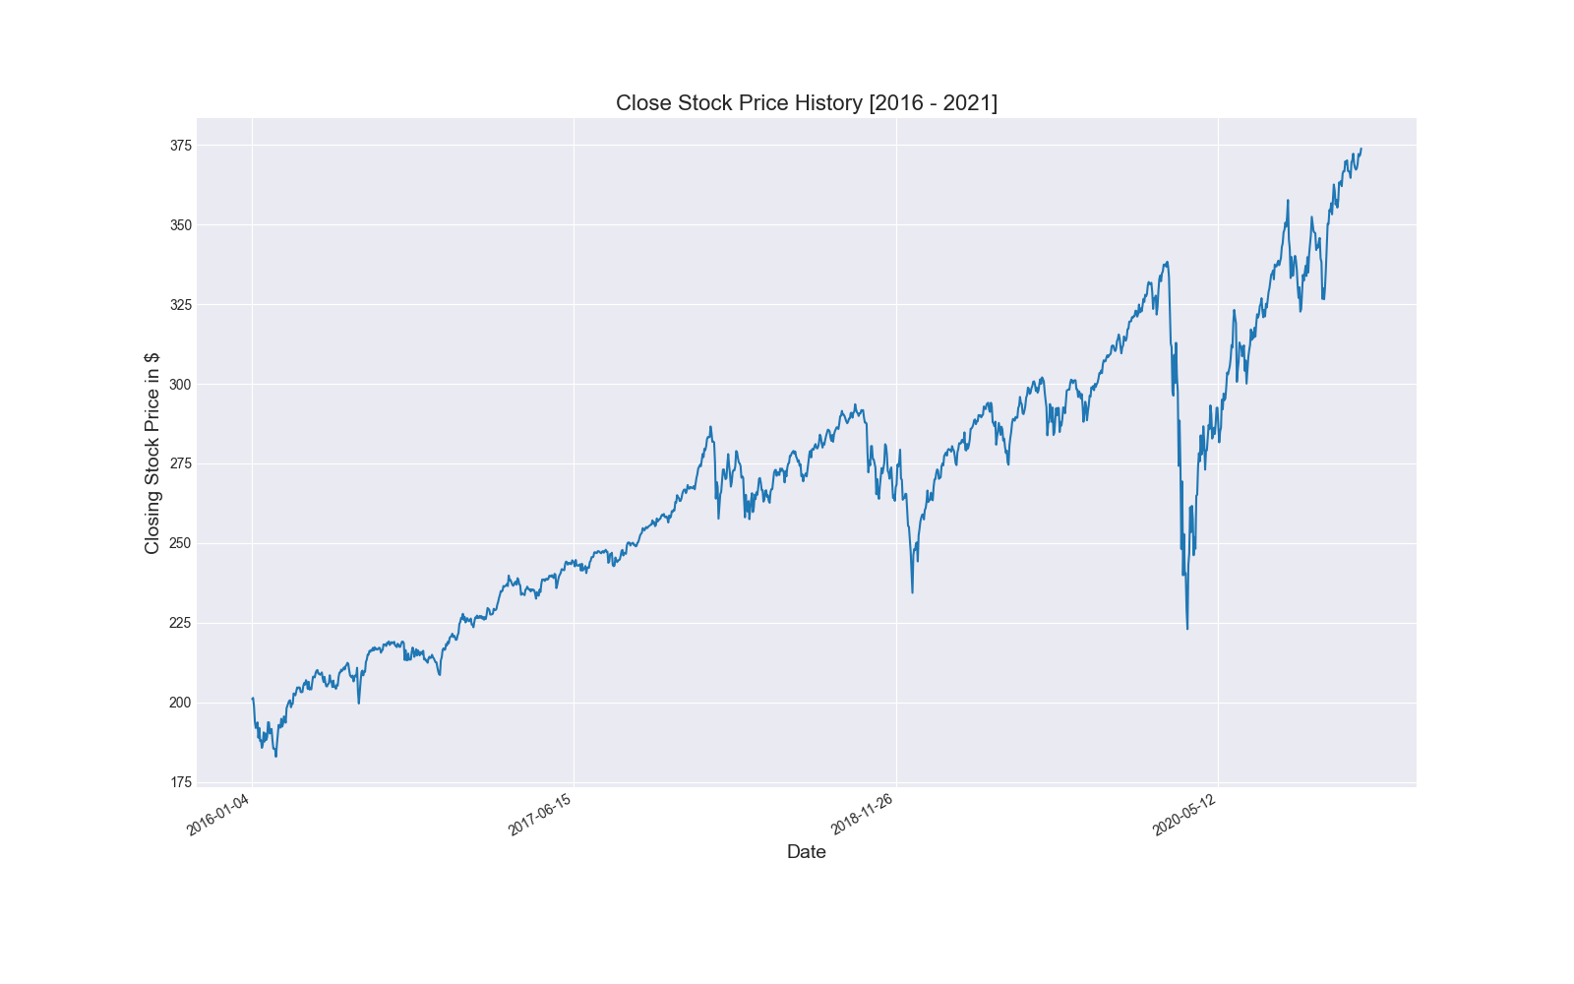
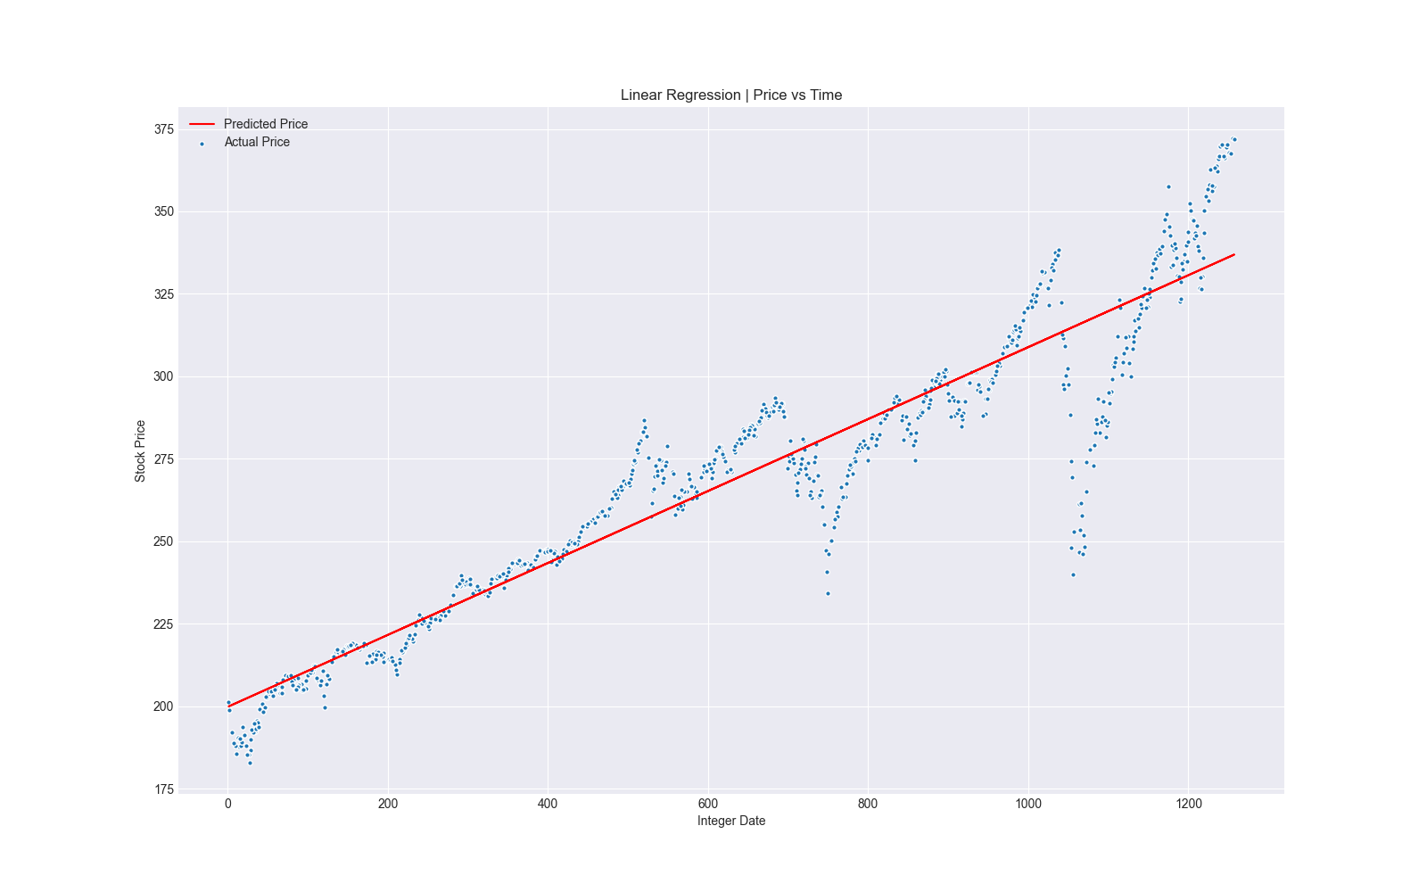
Linear Regression

Slide 7
Naïve Bayes Algorithm
a machine learning algorithm that uses the Bayes’ theorem with strong independence assumptions between the features to procure results.
Formula:
$P\left(Y | X\right)=\frac{P\left(Y\right)P(X|Y) }{P(X)}$
where:
P(Y|X) = probability of data with vector X in class Y
P(Y) = initial probability of class Y
P(|Y) = probability X based on the condition of hypothesis H
P(X) = probability X

Slide 8
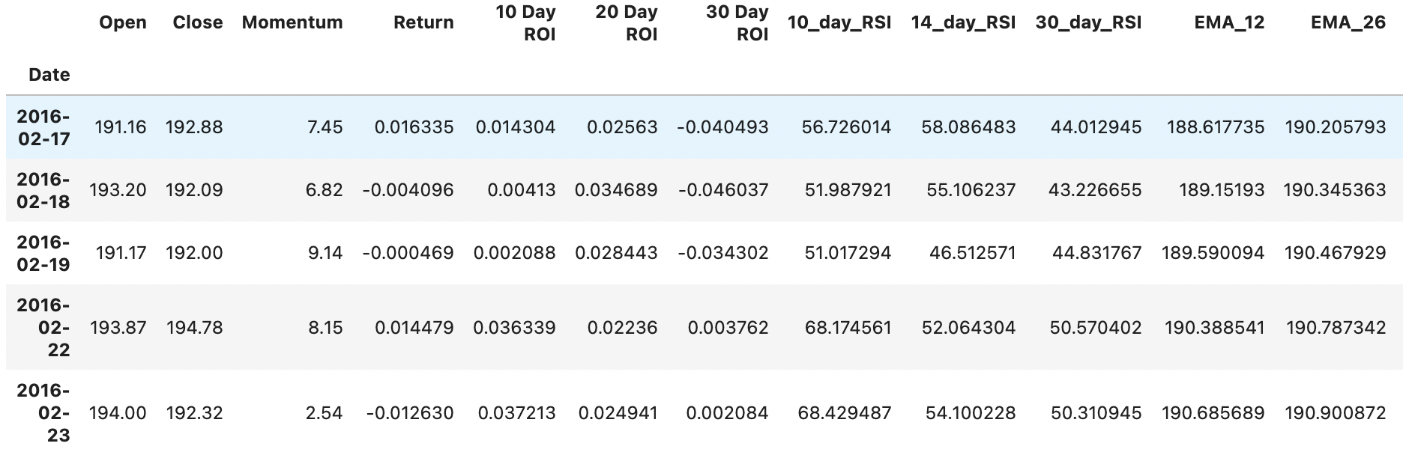
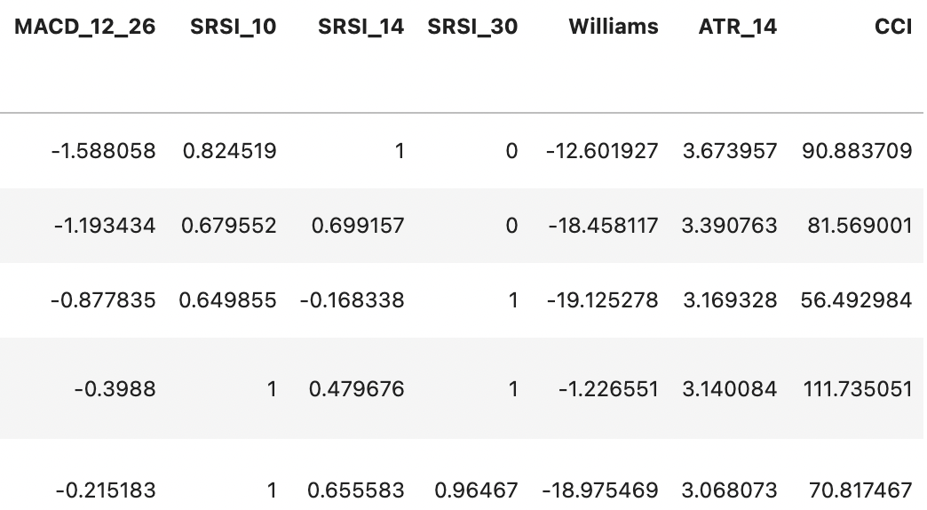
Naïve Bayes Algorithm
Features:
Open
Close
momentum
Return on investment (ROI) [10, 20, 30]
Relative strength index (RSI) [10, 14, 30]
Exponential moving average (EMA) [12, 26]
Moving average convergence divergence (MACD)
Stochastic relative strength index [10, 14, 30]
William %R
True range
Average true range
Commodify channel index
Classify
1 -> If $\frac{Close −Open}{Open} 100$ >.3
else 0
% Accuracy: 55.98

Slide 9
K Nearest neighbor
A simplest algorithms used in Machine Learning for regression and classification problem.
The prediction of stock market closing price is computed using kNN as follows:
Determine the number of nearest neighbors, k.
Compute the distance between the training samples and the query record.
Sort all training records according to the distance values.
Use a majority vote for the class labels of k nearest neighbors, and assign it as a prediction value of the query record.

Slide 10
K Nearest neighbor
K | Train_data Accuracy | Test_data Accuracy
2 | 0.74 | 0.47
5 | 0.69 | 0.55
10 | 0.63 | 0.54
15 | 0.59 | 0.57
20 | 0.59 | 0.53
25 | 0.57 | 0.54
30 | 0.56 | 0.51

Slide 11
LSTM
Special case of Recurrent Neural Networks (RNN) introduced by Hochreiter & Schmihuber
Designed to avoid the long-term dependency problem of RNN
The key to LSTMs is the cell state
LSTM has ability to add or remove information from cell state using gates
Gates are used to optionally let information through to cell.

Slide 12
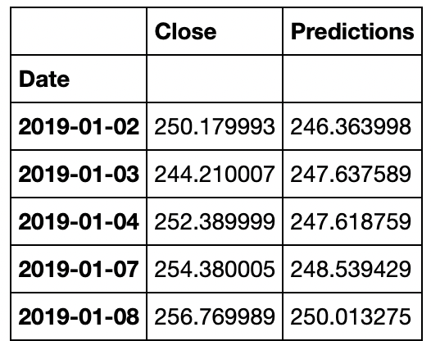
LSTM
Epochs : 10
RMSE: 8.214
Root Mean Square Error: the standard deviation of the prediction errors.

Slide 13
Conclusion
Stock Market can be completely random and unpredictable.
It is difficult to predict stock market price with machine learning algorithms. The
Accuracy of all algorithms is about 50%-70%.
ML cannot provide the accuracy we expect.
The tested algorithm is not sensitive enough to correctly predicting future prices.

