Slide 1
Robot Navigation
AI Project
Asmaa Sehnouni
Jasmine Dsouza
Supervised by :Dr. Pei Wang

Slide 2
Agenda
Introduction
Group
The Problem
Introduction to navigation problem
Input file
Random inputs
Solutions
Breadth First Algorithm
Genetic Programming
Obstacles
Comparison between different solutions
Conclusion

Slide 3
Introduction
Asmaa Sehnouni
Exchange graduate student from Pierre and Marie Curie University (France)
Jasmine V Dsouza
Masters Computer Science (Temple University)

Slide 4
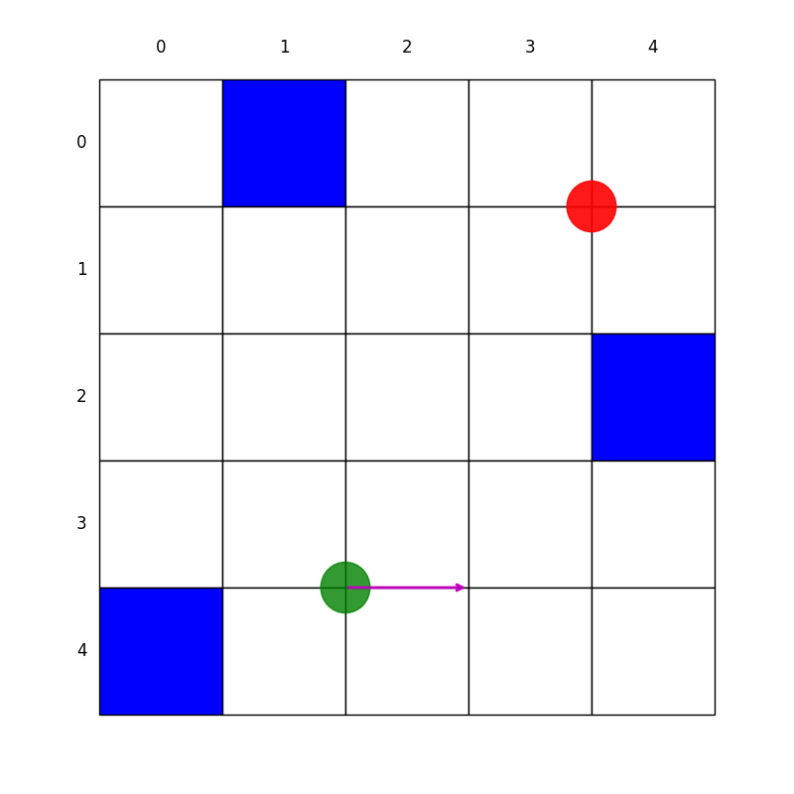
The Problem
Description:
Matrix with different obstacles, start point, end point and initial direction of robot.
The goal is to find the shortest path between the start point and end point avoiding the obstacles.

Slide 5
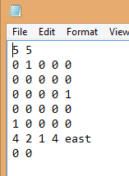
Input File
We can have a specific matrix defined in a file:
First line: number of rows and columns
The line : 4 2 1 4 “east” defines : (4,2) coordinate of the
start point , (1,4) coordinate of the end point , “east” the start
direction.
The last line : defines end of the file
In the middle is the matrix where:
0 defines space that can be travelled by robot
1 defines an obstacle

Slide 6
Input File

Slide 7
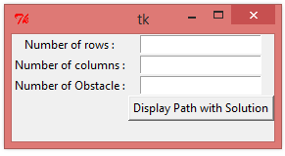
Random inputs
We can generate a random matrix:
Choose the number of rows
Choose the number of columns
Choose the number of obstacles
From this user provided information, we will generate a random matrix with random places of obstacles and random start point, end point and direction.

Slide 8
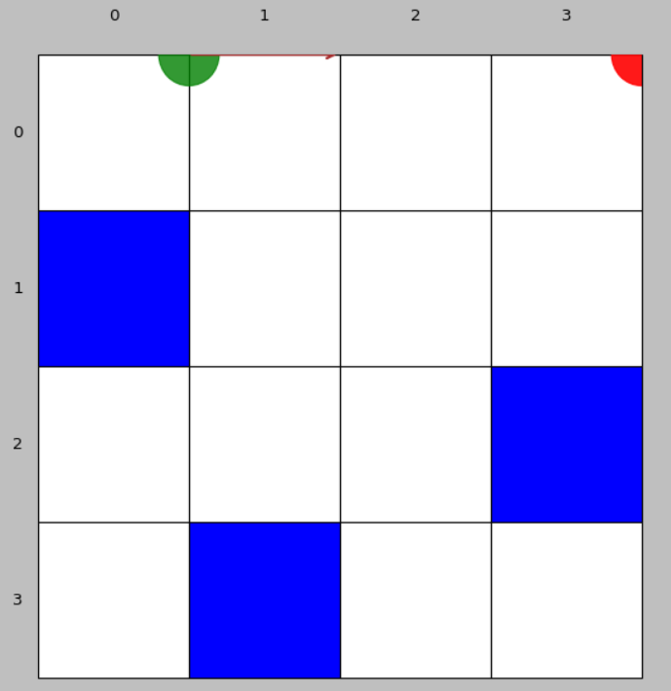
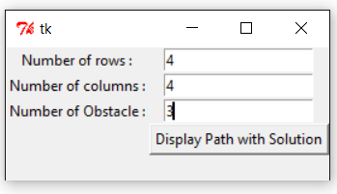
Random

Slide 9
Solution
Breadth First Algorithm :
We generate a graph that has as a root the start point.
Once done we explore all possible solutions taking in consideration obstacles and the time.
The path is showed in a graph and written in a file called : “Solution”.

Slide 10
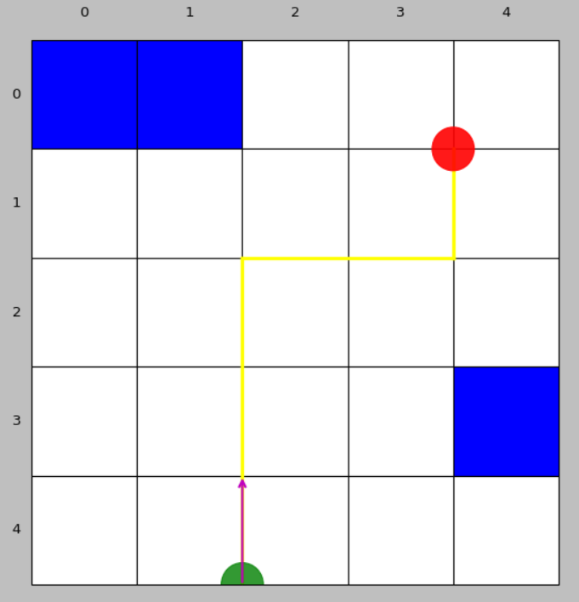
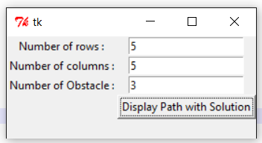
Solution

Slide 11
Demonstration
Input File:
https://www.youtube.com/watch?v=3mE25v6721c

Slide 12
Alternate Solution
Genetic Programming
We solved for a certain start and end point, and obstacle locations.
We randomly generate different individuals that in our case represent the path
Then, in our population we give to each random individual, a value (fitness function) to evaluate it
Hence, we choose the best individuals for each generation and create using them new individuals for the NEXT generation.
After 100 iterations of population we can evaluate our random path, which matches the correct path.

Slide 13
Demonstration
Genetic Programming
https://www.youtube.com/watch?v=iRBynTJXi10

Slide 14
Obstacles
Breadth First Algorithm :
How to generate the graph
How to choose the short path
Genetic Algorithm :
How to evaluate the individuals (fitness function)
How to generate the new Child

Slide 15
Comparison between Solutions
Breadth First Algorithm:
Easy to program, understand
Quick solution
Guaranteed Solution
Genetic Algorithm:
Take time
Not guaranteed solution
Not easy to understand

Slide 16
Conclusion
A navigation path is a common problem.
It can be solved using different solutions: Breath First Algorithm , A* Algorithm and Genetic programming
The quick solution is to use Breath First Algorithm
This kind of exercises is used to solve robotic path and GPS.

Slide 17
Thank You!

