Slide 1
Evolutionary Algorithms
Guilherme Oliveira

Slide 2
What is it about ?
Population based optimization algorithms
Reproduction
Mutation
Recombination
Selection

Slide 3
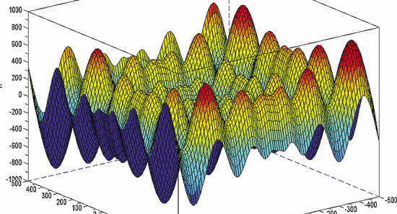
Example of what it can do
Goal is to minimize Schwefel’s function

Slide 4
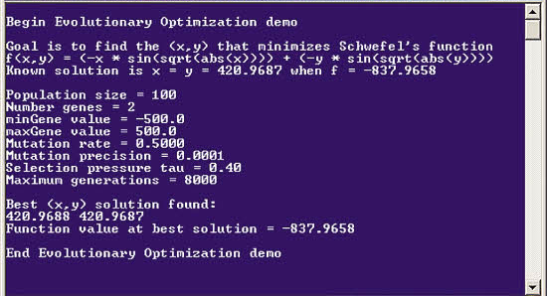
Example of what it can do

Slide 5
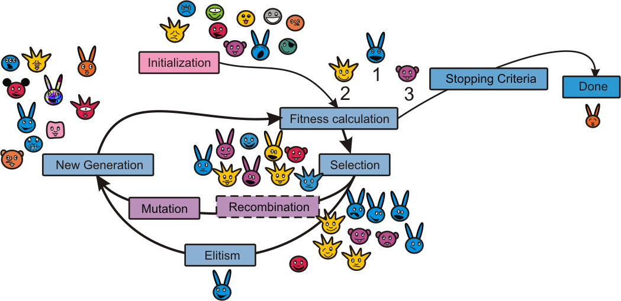
How ?

Slide 6
Inner topics
Genetic Algorithm
Genetic Programming
Evolutionary Programming
Gene Expression Programming
Evolution Strategy
Differential Evolution
And more

Slide 7
How is it related to AI ?
Broad state space
Decision making

Slide 8
Project Progress
Studies
EA
biology
Writing almost done
Discussion about EA
Discussion about biology
Relation between them
Related work
Came up with my own opinion, about to be concluded

Slide 9
Difficulties of the project
Extensive topic
Complex codes in prolog
Complex math relation

Slide 10
What I’ve learned
EA
Different approach to solve generic problems
New technique to find approximated solutions
Knowledge about the existence of algorithms to solve real problems that simulates life’s behavior

Slide 11
Final Consideration
I expect to finish my work on time

Slide 12
Presentations images & information sources
http://en.wikipedia.org/wiki/Evolutionary_algorithm#Evolutionary_algorithm_type
http://msdn.microsoft.com/en-us/magazine/jj133825.aspx
http://physiol.gu.se/maberg/figures/EAalgorithmPedagogical.png

