Slide 1
Math for Neural Networks
Lecture Notes prepared by Longin Jan Latecki
Revised by Pei Wang

Slide 2
Sources
Deep Learning Course by Mitesh M. Khapra, Indian Institute of Technology, Madras, http://www.cse.iitm.ac.in/~miteshk/CS6910.html
Akshay L Chandra. Perceptron Learning Algorithm: A Graphical Explanation Of Why It Works. Towards Data Science
https://pabloinsente.github.io/the-multilayer-perceptron
Deep Learning, Chapter 6, Goodfellow et al., 2016
Alex Pang (Temple Univ)
Other Internet sources
Other readings: The Illustrated Transformer

Slide 3
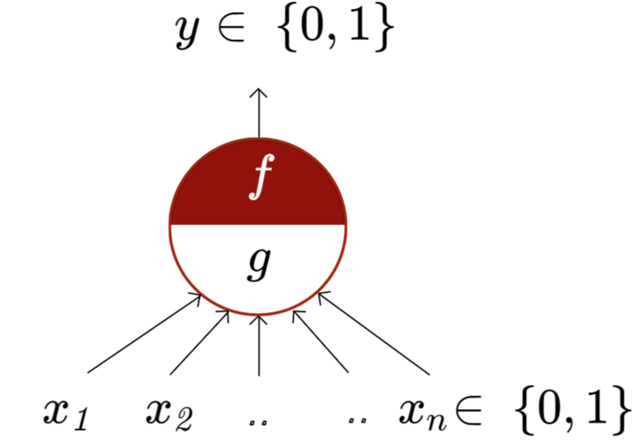
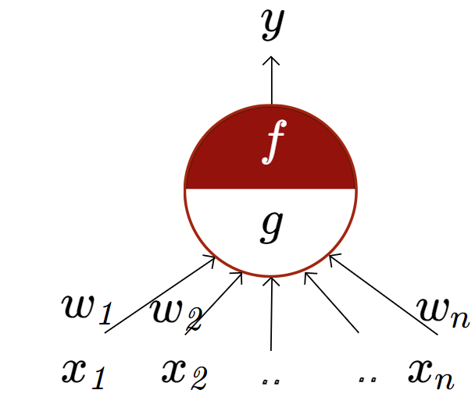
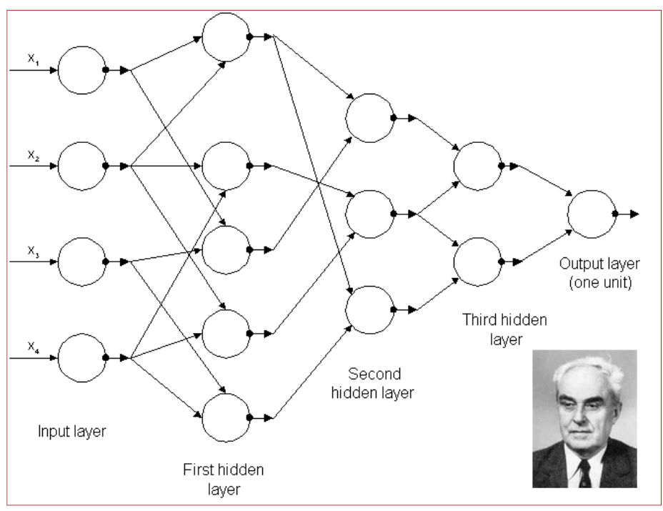
Artificial Neuron
McCulloch Pitts Neuron
McCulloch (neuroscientist) and Pitts (logician) proposed a highly simplified model of the neuron (1943).
“The perceptron may eventually be able to learn, make decisions, and translate languages” -Frank Rosenblatt, 1957-8
First generation Multilayer Perceptrons published by A. Ivakhnenko and V. G. Lapa in 1966.

Slide 4
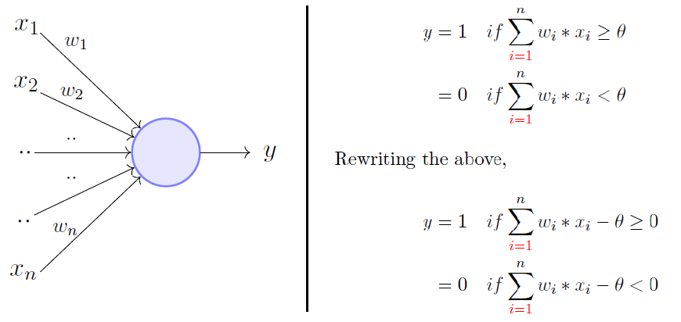
Perceptron
The perceptron model is a more general computational model than McCulloch-Pitts neuron.
It takes an input, aggregates it (weighted sum), and returns one only if the aggregated sum is more than some threshold otherwise, it returns zero.
A single perceptron can only be used to implement linearly separable functions.
It takes both real and Boolean inputs and associates a set of weights to them.

Slide 5
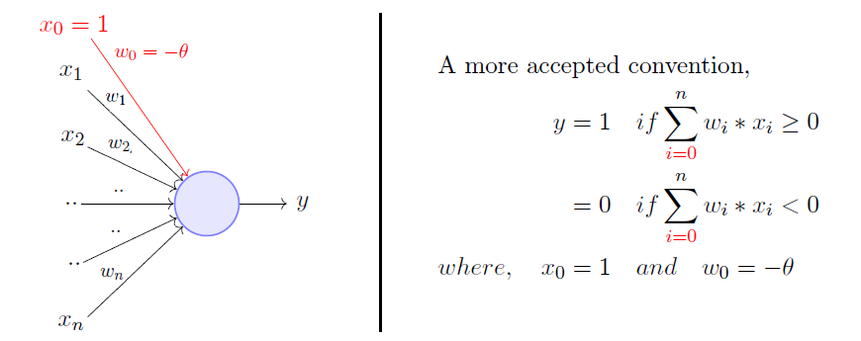
Rewriting the threshold (called bias) and making it a constant input with a variable weight, we get:
A perceptron will fire if the weighted sum of its inputs is greater than the threshold (−w₀).
Minsky and Papert proposed a more principled way of learning the weights using a set of examples (data). After weights are learned, we get the function.

Slide 6
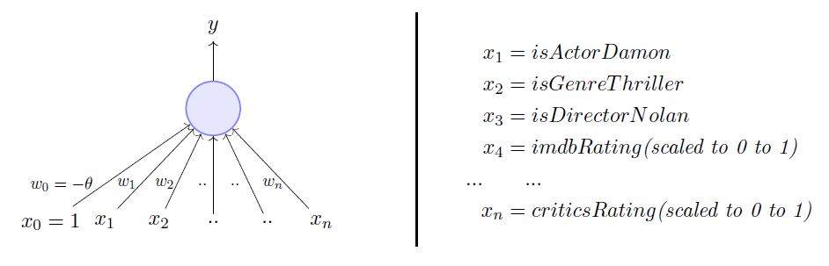
Predicting whether one would like to watch a movie or not: binary decision
The weights (including the bias w₀) are learned from data: [<vector of observations>_{k}, <label>_{k}]
for k = 1, …, N, where <label>_{k}= 0 or 1 depending on whether the viewer watched movie k before.
For perceptron, we assume that the data is linearly separable and we want a perceptron to learn how to make this decision.
A different set of weights is learned for each viewer. For example:
A movie buff may have a very low bias θ=0 and may watch any movie irrespective of the genre, actor, or director. On the other hand, a selective viewer may only watch thrillers starring Matt Damon and directed by Nolan, e.g., θ=3.

Slide 7
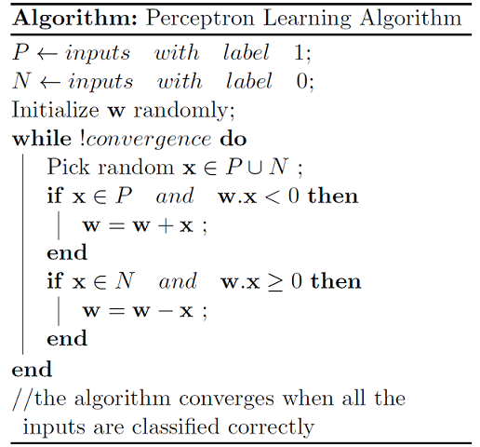
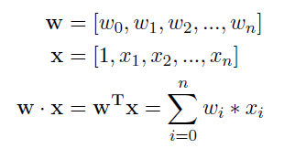
Stochastic Gradient Descent Version
1. Initialize weights (and bias) randomly
2. For each training example:
a. Calculate the predicted output:
ŷ = sign(w · x)
b. Update weights if the prediction is incorrect:
w = w + β (y – ŷ) · x
3. Repeat step 2 until convergence
or max iterations are reached,
where y is 1 or -1, ŷ is the predicted label,
and β is the learning rate, which we set to β = ½.
-1;
We switched the labels from 1 or 0 to 1 or -1.
The perceptron learning algorithm is a simple supervised learning algorithm for binary classification.

Slide 8
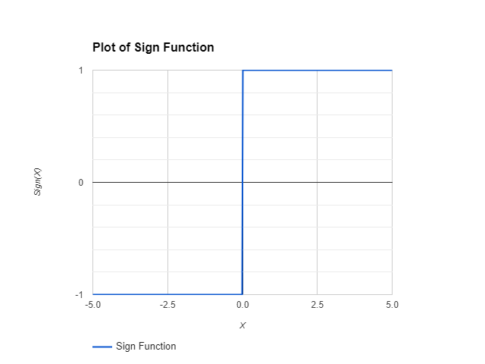
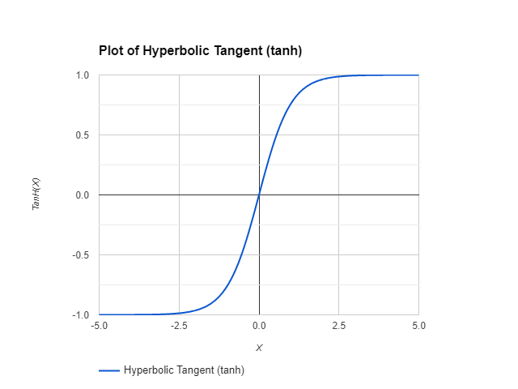
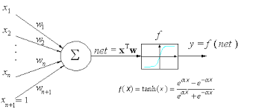
Perceptron Learning Algorithm → Single Layer Neural Network (NN)
If we replace the sign function (step function) with tanh (or other nonlinear function)
as an activation function,
we obtain a single-layer neural network
from the perceptron.
We switched the labels
from 1 or 0 to 1 or -1.

Slide 9
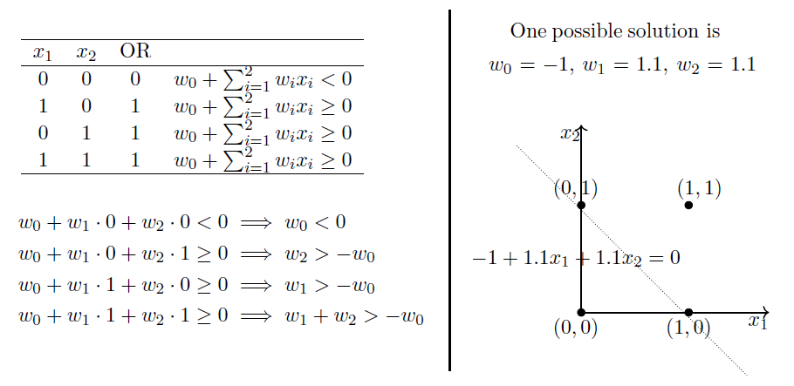
OR Function Using A Perceptron

Slide 10
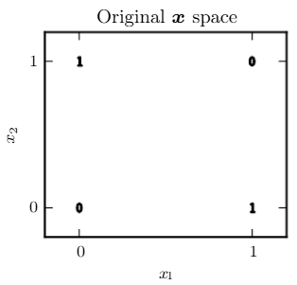
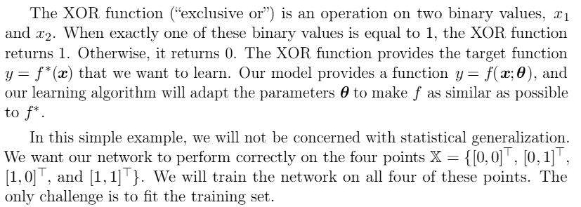
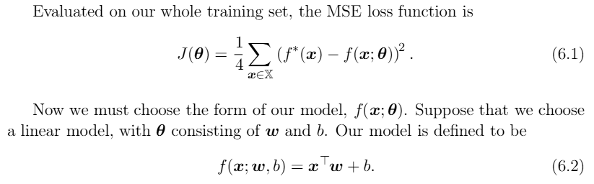

Learning XOR (exclusive or)
Does not work since our data is not linearly separable.

Slide 11
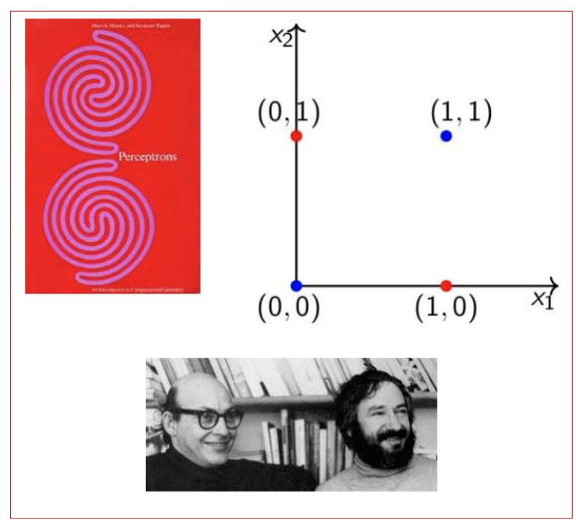
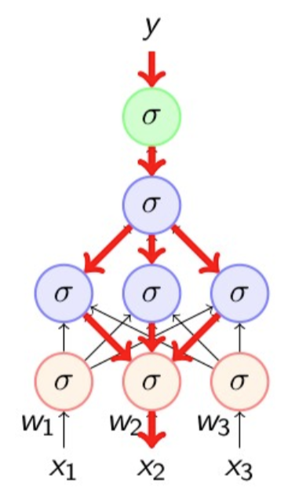
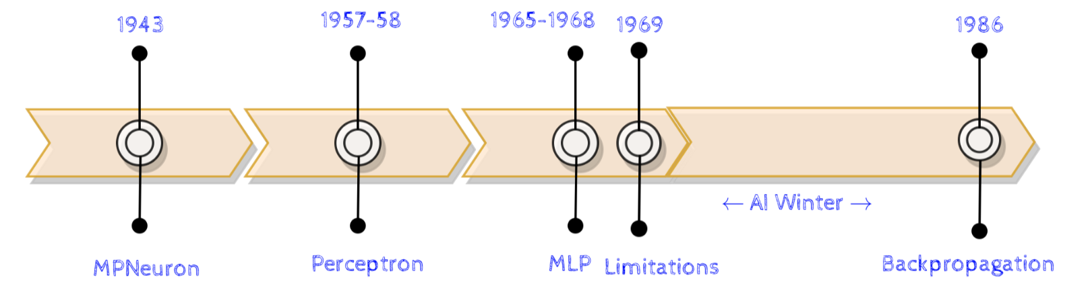
Perceptron Limitations
In book “Perceptrons” 1969, Minsky and Papert outlined the limits of what perceptrons could do and killed them.
Backpropagation
Discovered and rediscovered several times throughout 1960’s and 1970’s
Werbos (1982) first used it in the context of artificial neural networks
Eventually popularized by the work of Rumelhart et. al. (David Rumelhart, Geoffrey Hinton, and Ronald Williams) in 1986. More info.

Slide 12
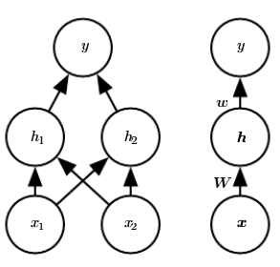
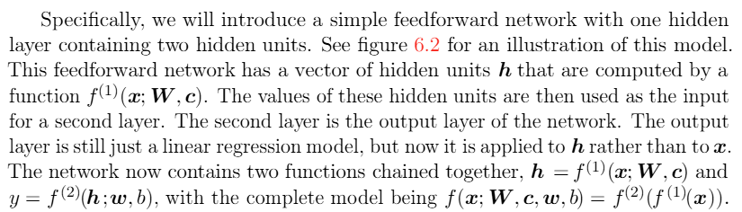
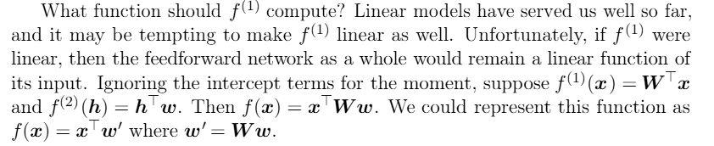





How about we add another network layer?
$f^{(1)}=W^{T}x+c$
$$f^{\left(2\right)}=h^{T}w+b$$

Slide 13
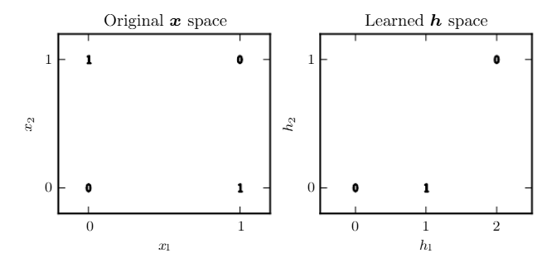
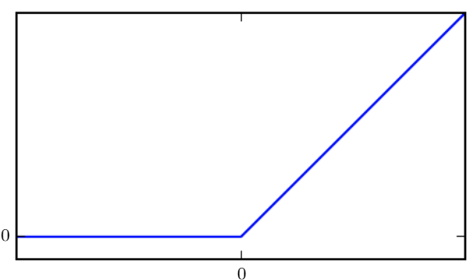




One way to solve this problem is to use a model that learns a diﬀerent feature space in which a linear model is able to separate the data.
for network parameters on the next slide
We use the rectiﬁed linear unit (ReLU) as g:
$f^{\left(1\right)}(x)=W^{T}x+c$
$f^{\left(1\right)}(x)={g(W}^{T}x+c)$
$$f^{\left(2\right)}\left(x\right)=w^{T}h+b$$

Slide 14
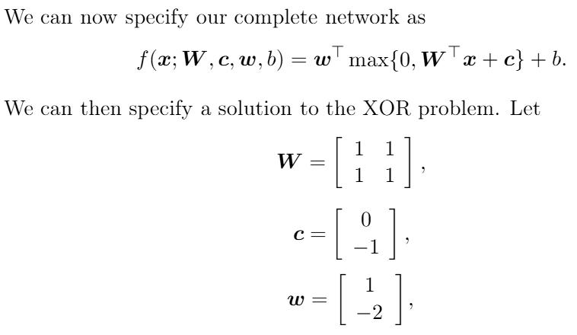

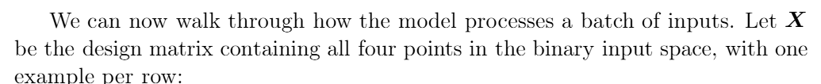


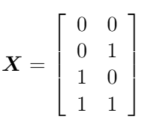
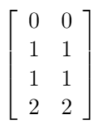
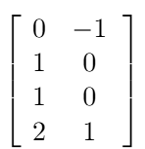
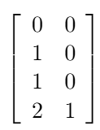







Slide 15
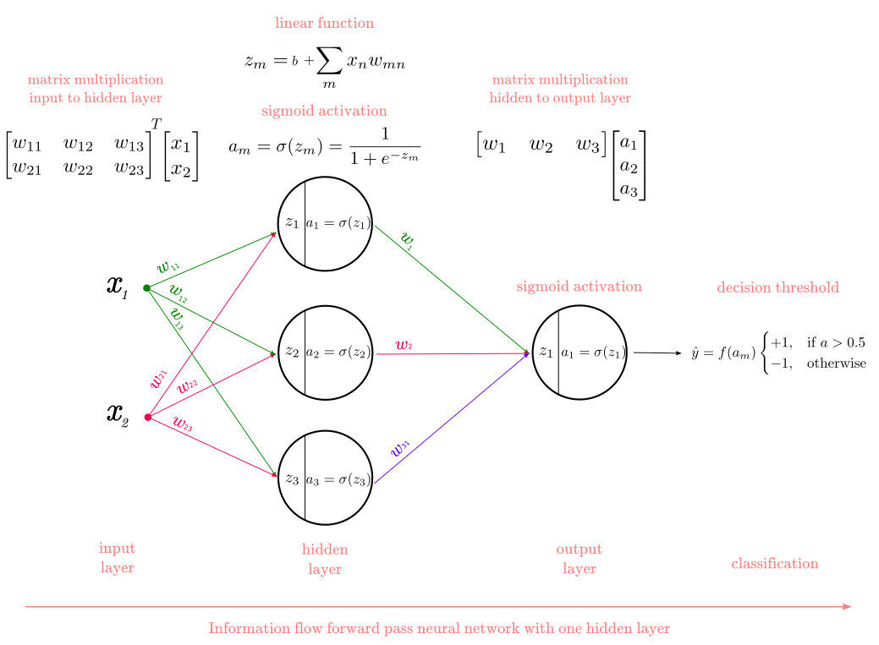
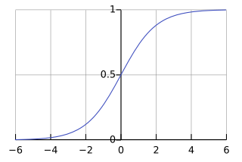

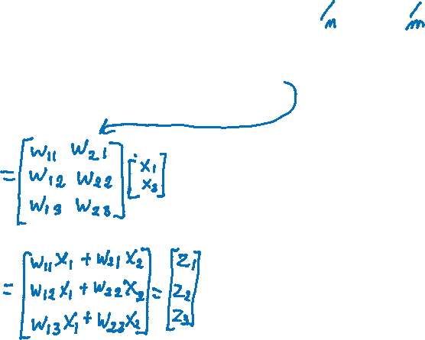

Slide 16
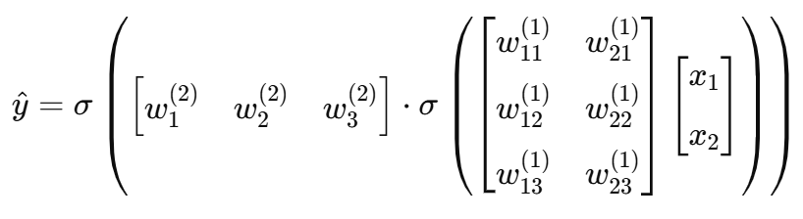

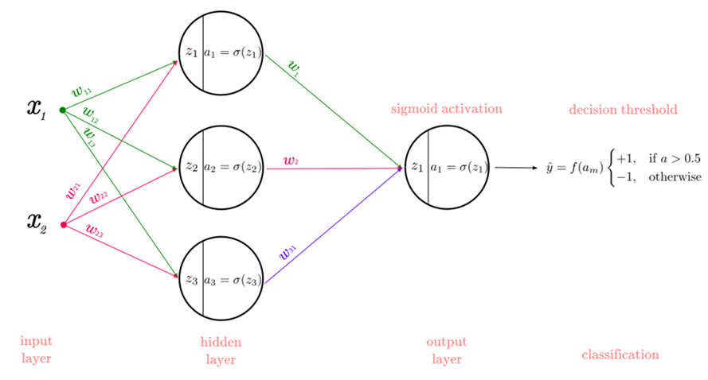
Forward pass in one formula

Slide 17
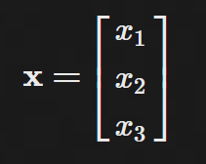
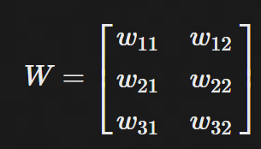
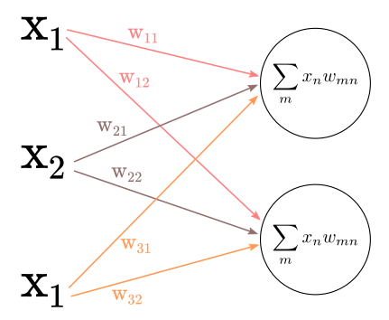
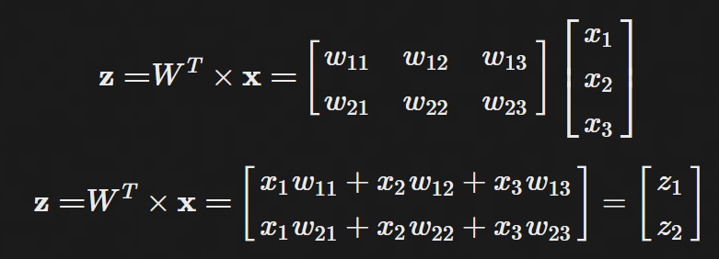

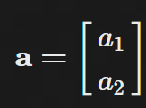

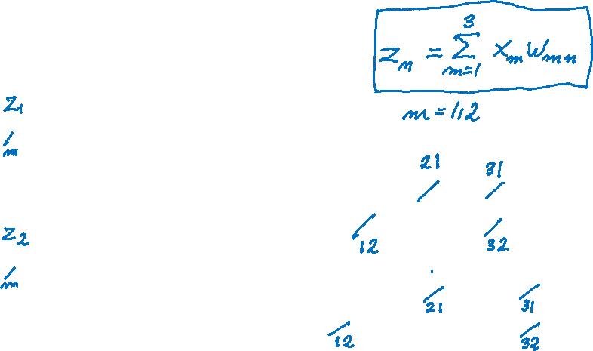

we have 3 input units connecting to hidden 2 units we have 3x2 weight matrix:
$$σ\left(z\right)=a$$
$$σ\left(z\right)=ReLU or \frac{1}{1+e^{−z}}$$

Slide 18
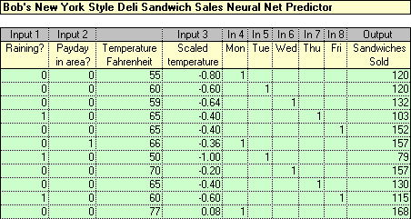
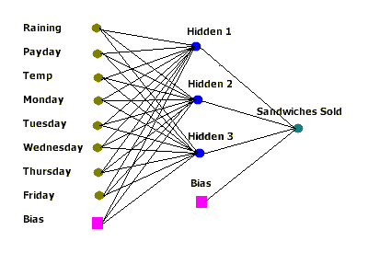

NN Example
The loss function for one data point is
Loss = (predicted_value – true_value)^2,
where true_value = # Sandwiches Sold
How many weights?

Slide 19
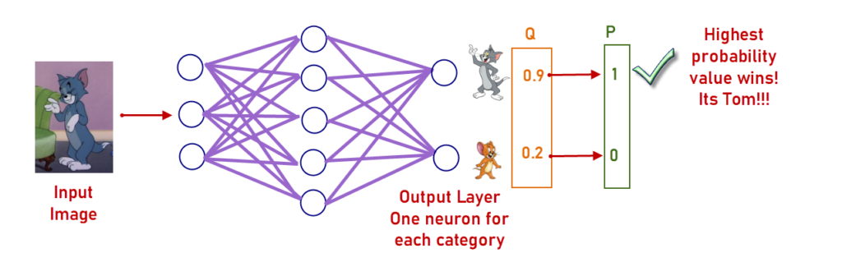
Each output can represent a class probability

Slide 20
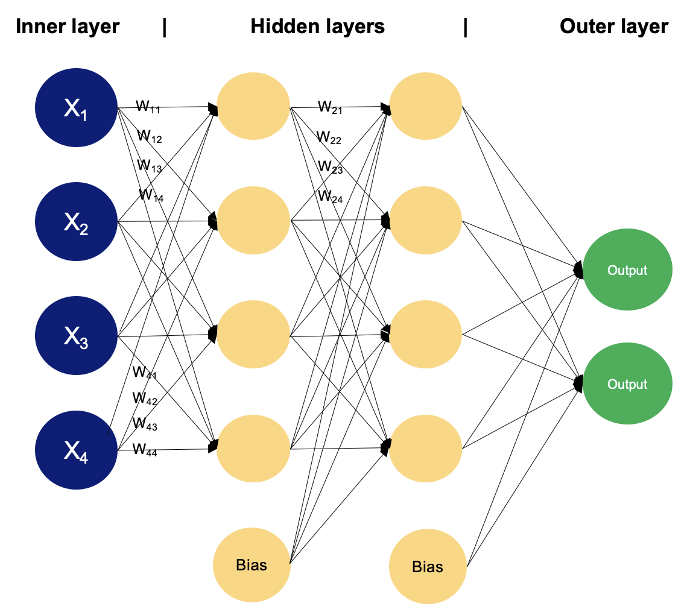
Multilayer Perceptron or Neural Network (NN)

Slide 21
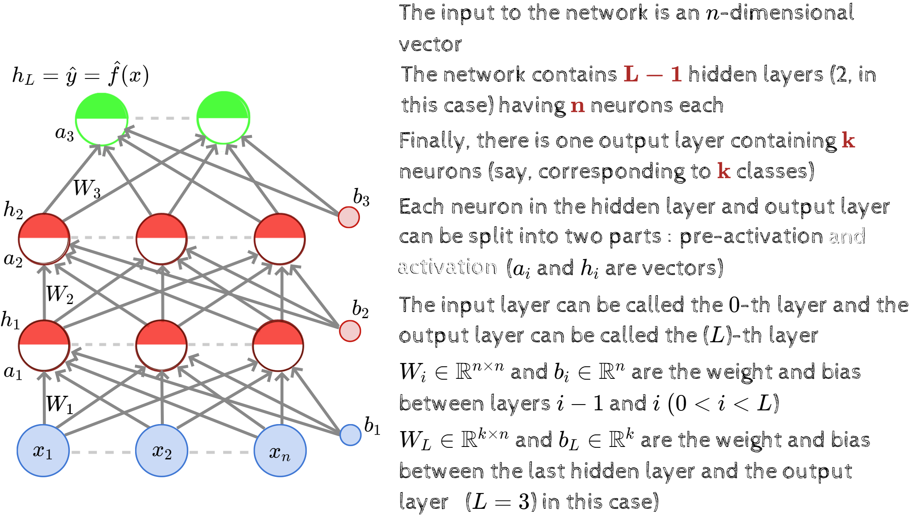

Slide 22
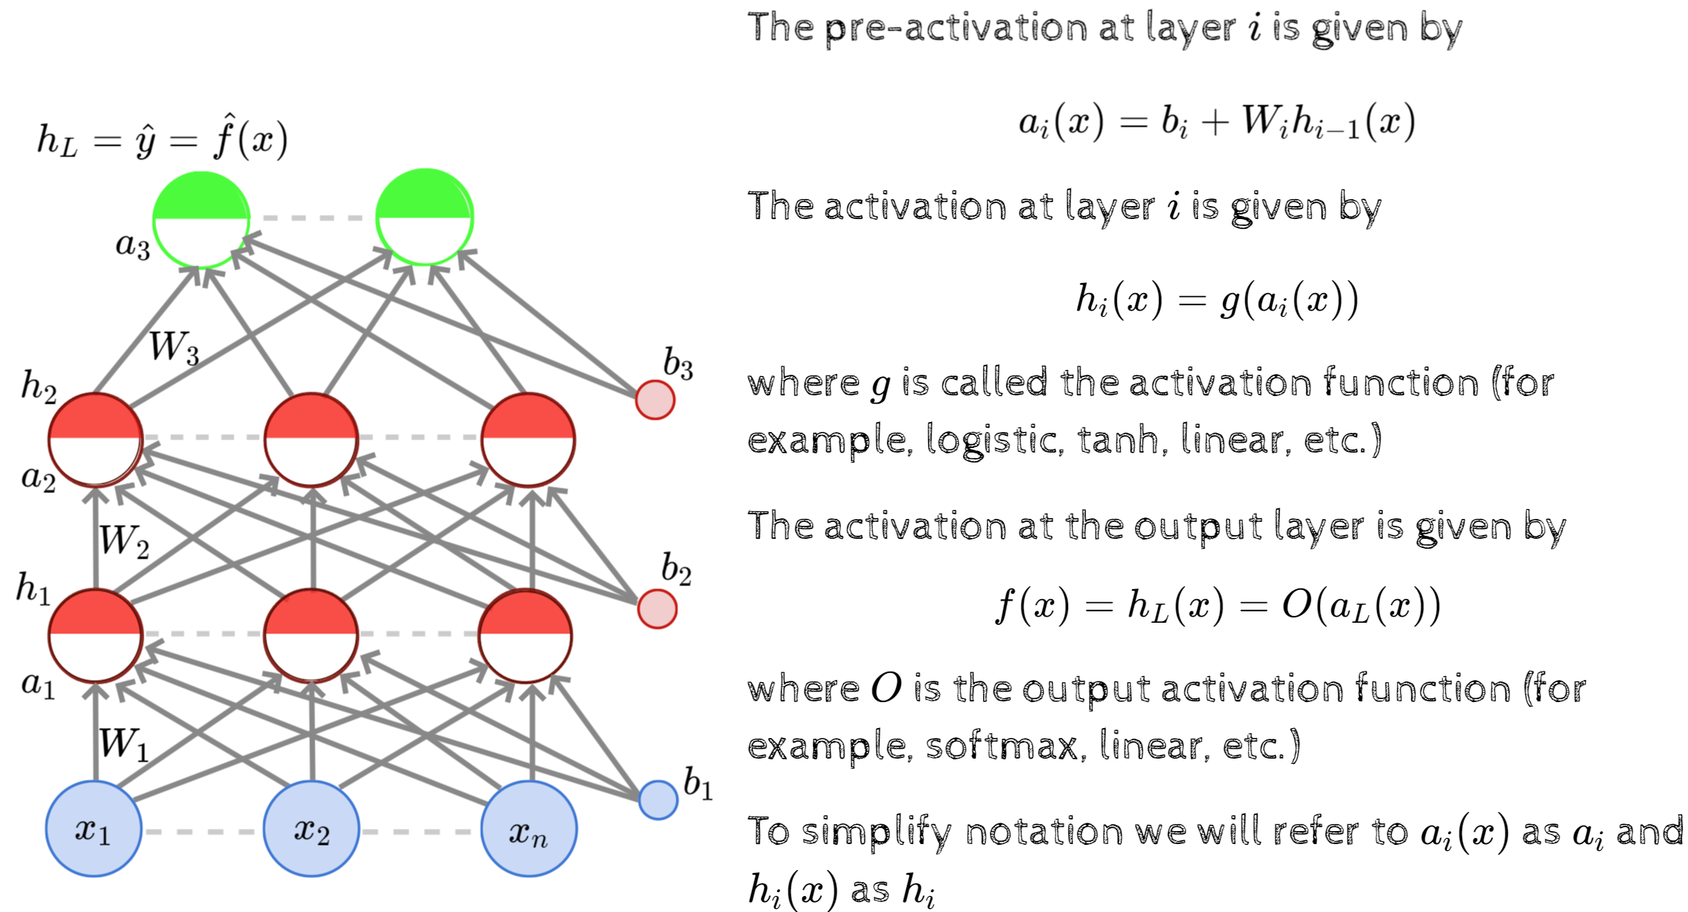

Slide 23
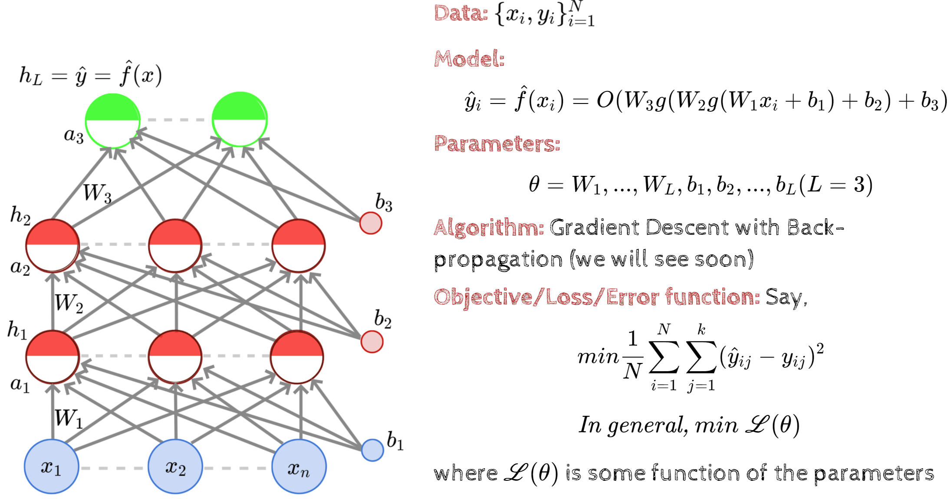

Slide 24
Backpropagation
Convolutional Neural Network (CNN)
Matrix Multiplication in CPU and GPU

Slide 25
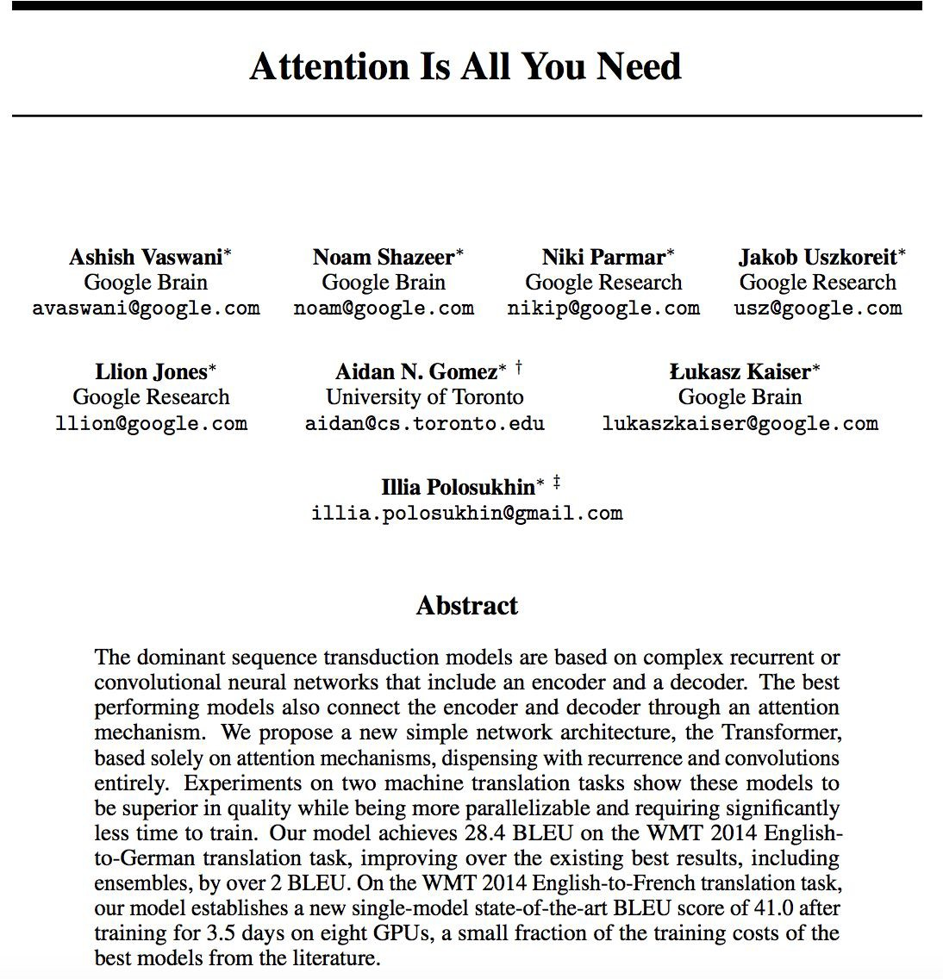
GenerativeTransformers 2017
Why now?
Big data
Fast algorithm for training
Compute Power (GPU)
Transformers as a new Neural Network Architecture

