Slide 1
Chapter 3
Operations on Matrices
Fundamentals of Matrix Algebra By Gregory Hartman
Lecture Notes prepared by Longin Jan Latecki
Revised by Pei Wang

Slide 2
3.1 The Matrix Transpose

Slide 3
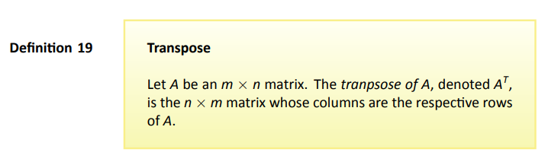



Example 60

Slide 4
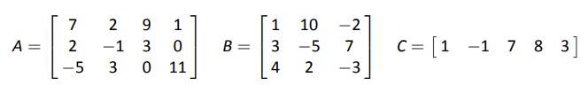
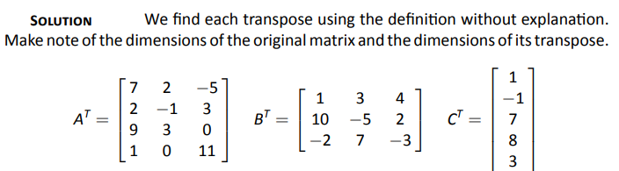
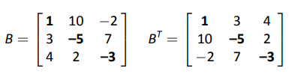
Example 61
Problem
Solution
Note
Page 4

Slide 5
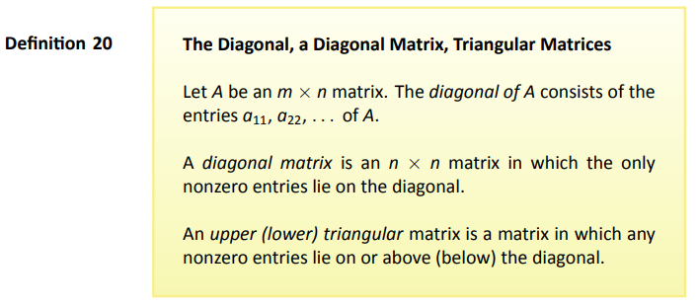
Definition
Page 5

Slide 6
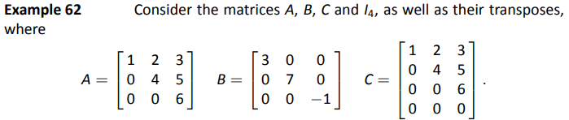
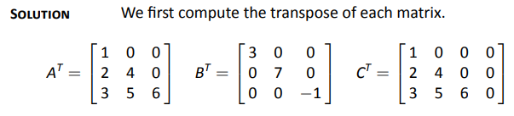
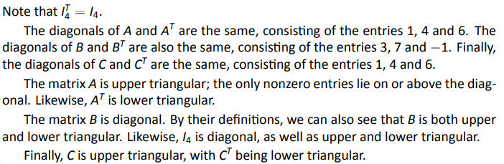
Example 62
Problem
Solution

Slide 7
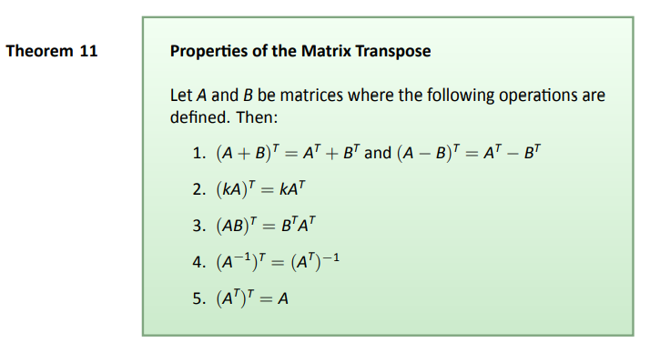
Theorem 11

Slide 8
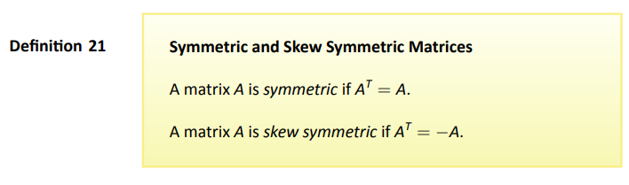
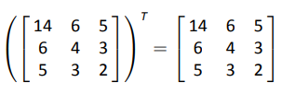

In both cases, A must be a square matrix.
Example
So why is AA^{T} symmetric?

Slide 9
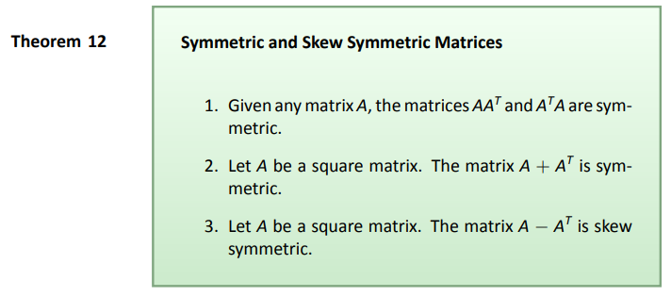
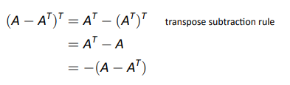
Theorem
Proof

Slide 10

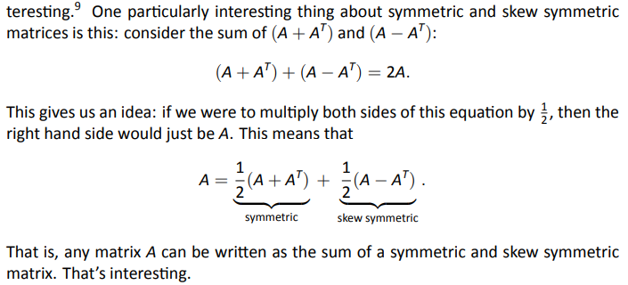
Interesting Thought
square

Slide 11
3.2 The Matrix Trace

Slide 12
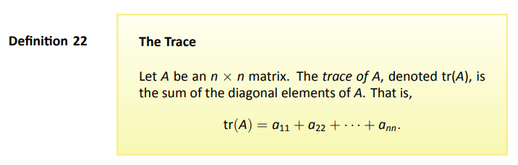
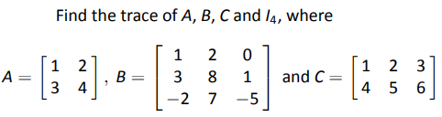


Example 67

Slide 13
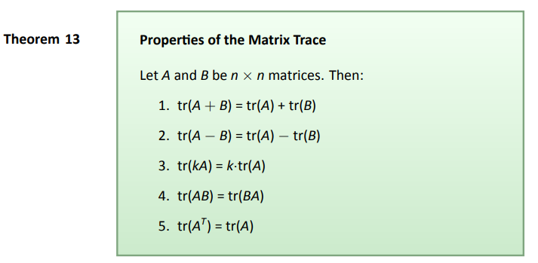
Theorem

Slide 14
3.3 The Determinant

Slide 15

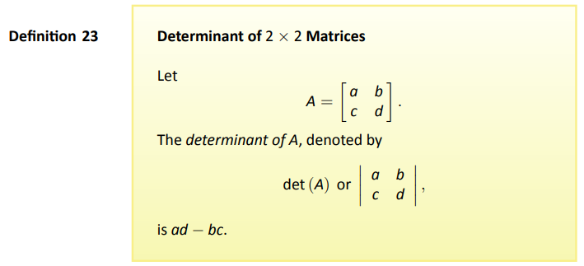
Definition

Slide 16
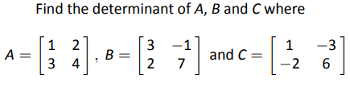
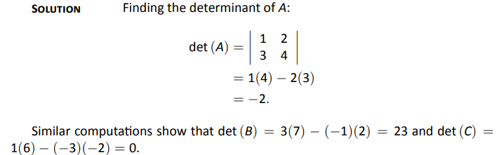
Example 68
Problem
Solution

Slide 17
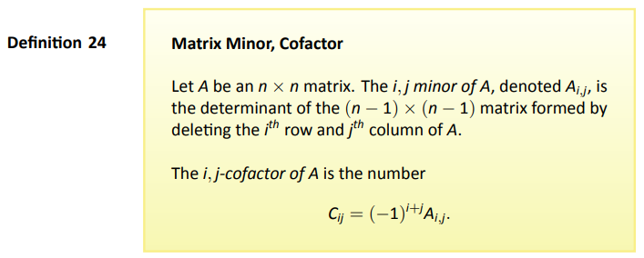
Definition

Slide 18
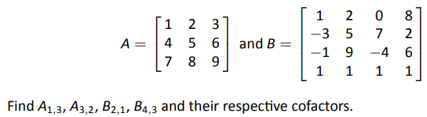
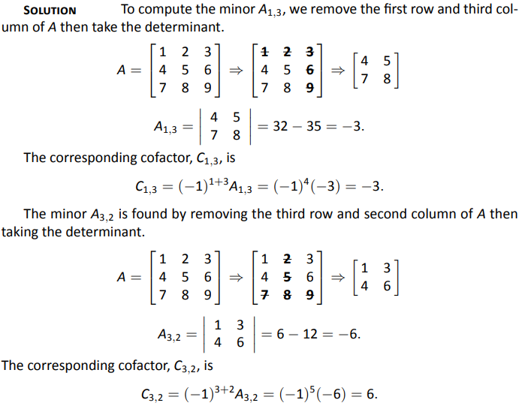
Example 69

Slide 19
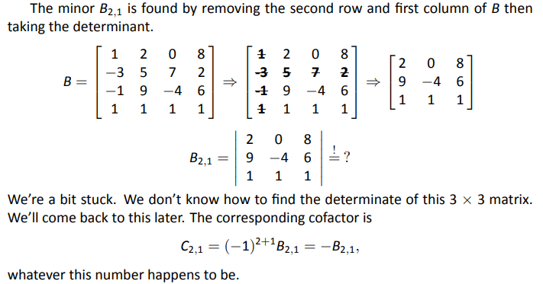
Example 69
Solution

Slide 20
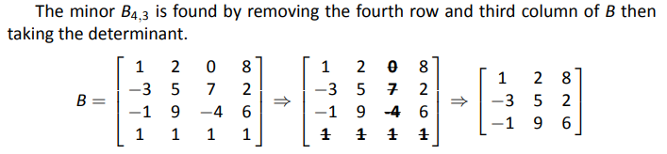
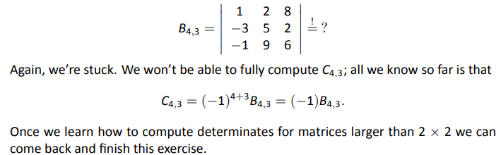
Example 69
Solution

Slide 21
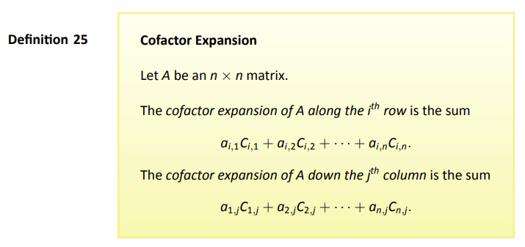
Definition

Slide 22
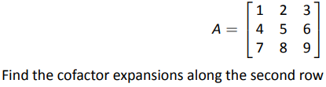

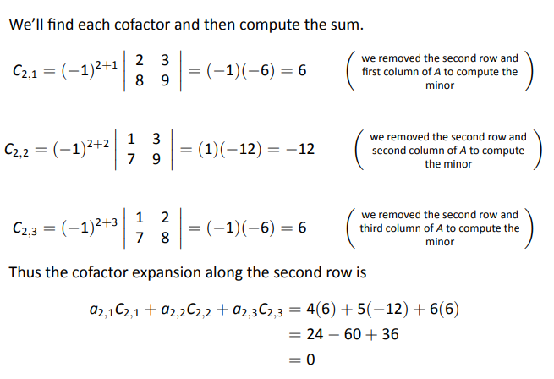
Example 70
Problem
Solution

Slide 23
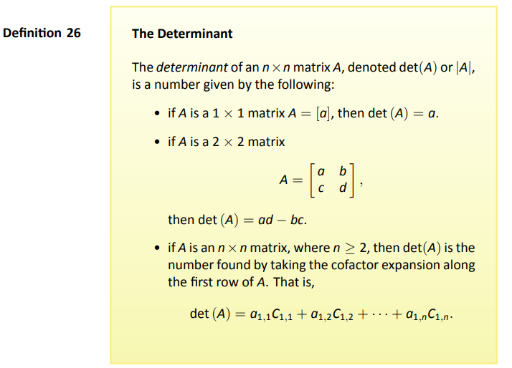
Definition

Slide 24
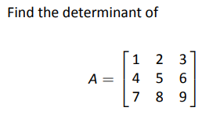
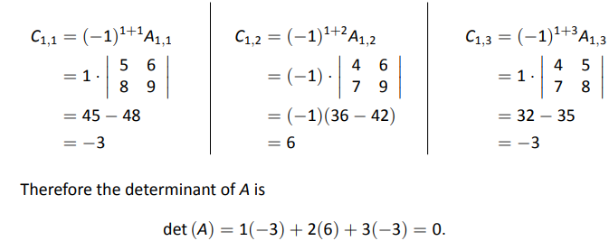
Example 71
Problem
Solution

Slide 25
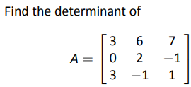
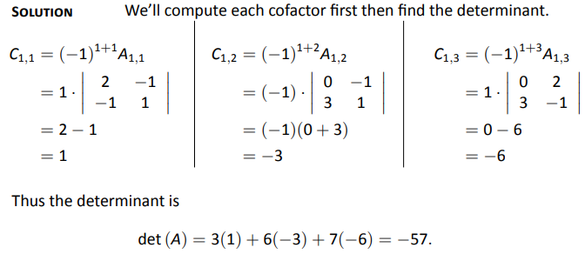
Example 72
Problem
Solution

Slide 26
3.4 Properties of the Determinant

Slide 27
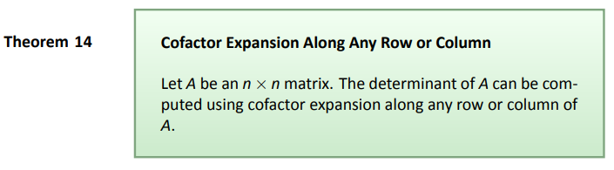
Theorem

Slide 28
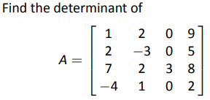

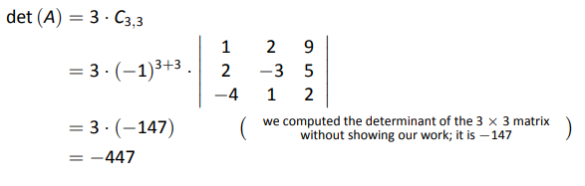
Example 74
Problem
Solution

Slide 29
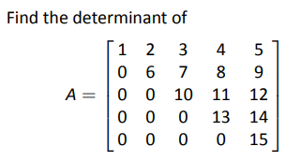
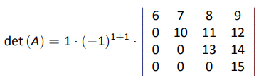


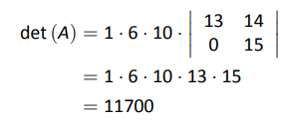
Example 75
Problem
Solution
We chose the first column.
We again use cofactor expansion
along the first column. This cofactor
expansion is

Slide 30
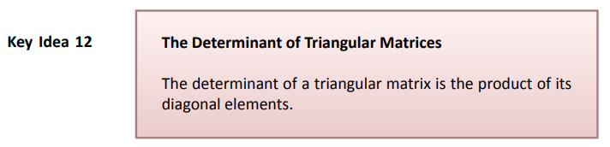

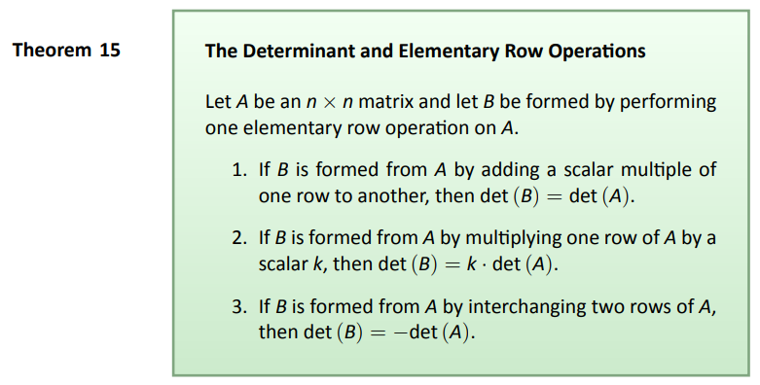

Slide 31
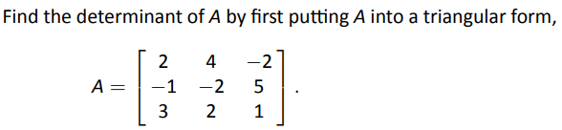



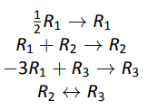
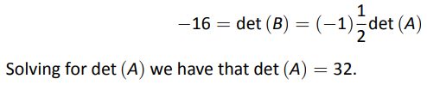
Example 78
Problem
Solution

Slide 32
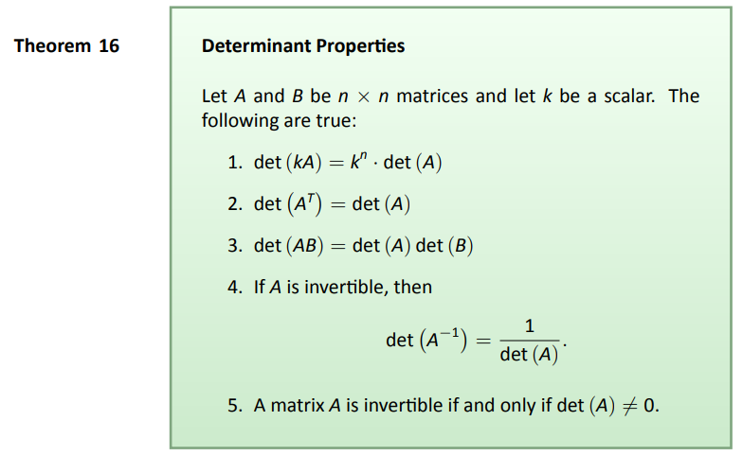
Theorem

Slide 33
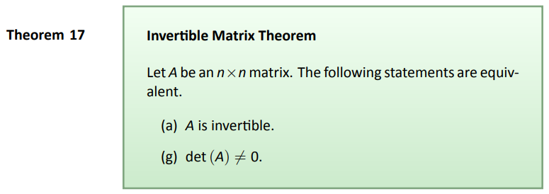
Theorem

Slide 34
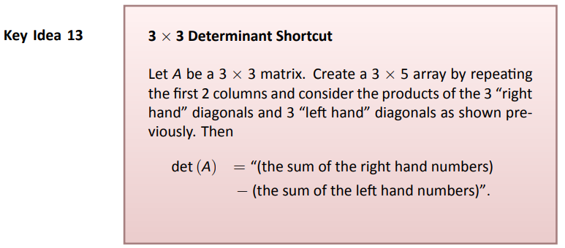
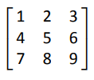

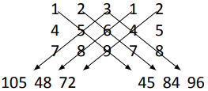

Rule of Sarrus: 3 X 3 Determinant Computing Shortcut
The determinant of the 3x3 matrix
is the sum of the products along the red diagonals
minus the sum of the products along the blue diagonals.

Slide 35


Example 81
Problem
Solution

Slide 36

Use Gaussian elimination and cofactor expansion to find the determinant of this matrix:

