Slide 1
Chapter 2 Matrix Arithmetic
Fundamentals of Matrix Algebra By Gregory Hartman
Lecture Notes prepared by Longin Jan Latecki
Revised by Pei Wang

Slide 2
2.1 Matrix Addition and Scalar Multiplication

Slide 3
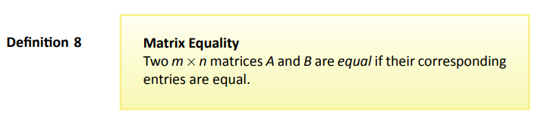
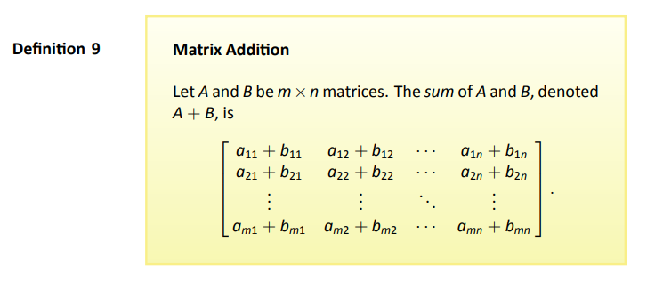
Definitions

Slide 4
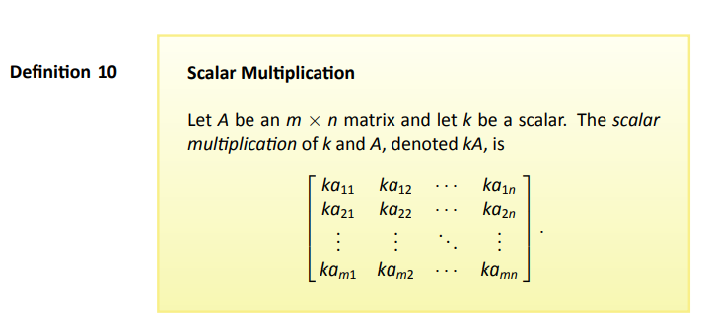
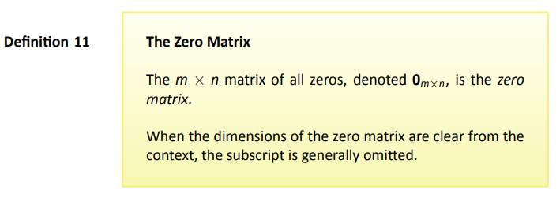
Definitions
Page 4

Slide 5
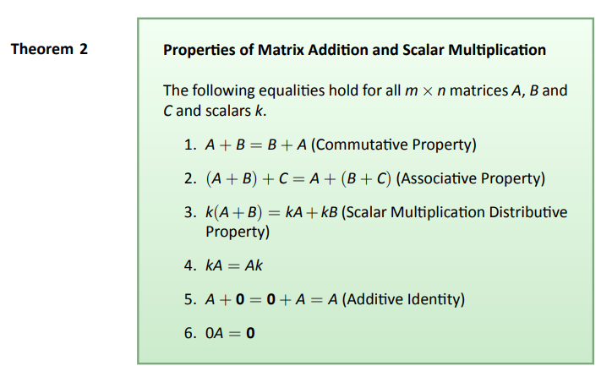
Theorem
Page 5

Slide 6
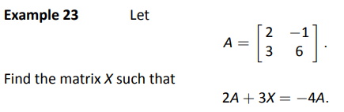
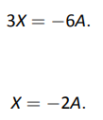


Slide 7
2.2 Matrix Multiplation

Slide 8
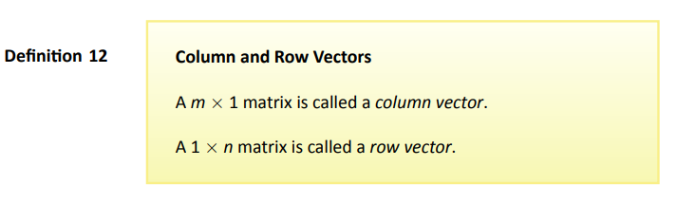
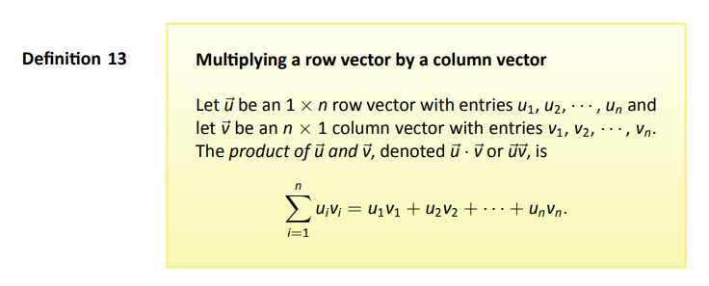
Definitions

Slide 9
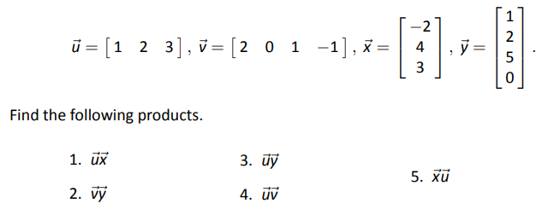

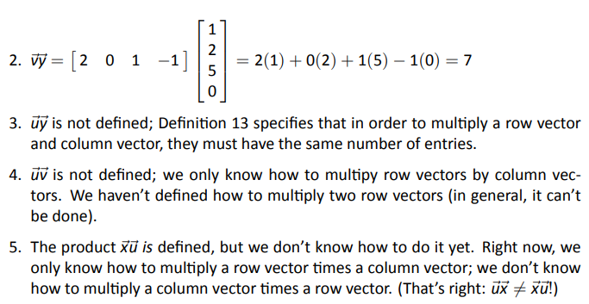
Example 24

Slide 10
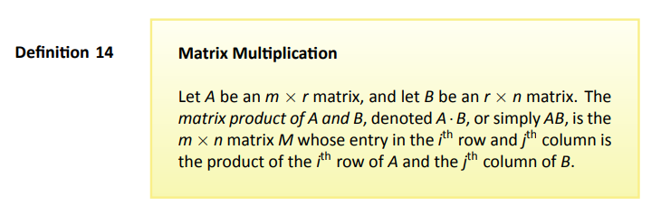
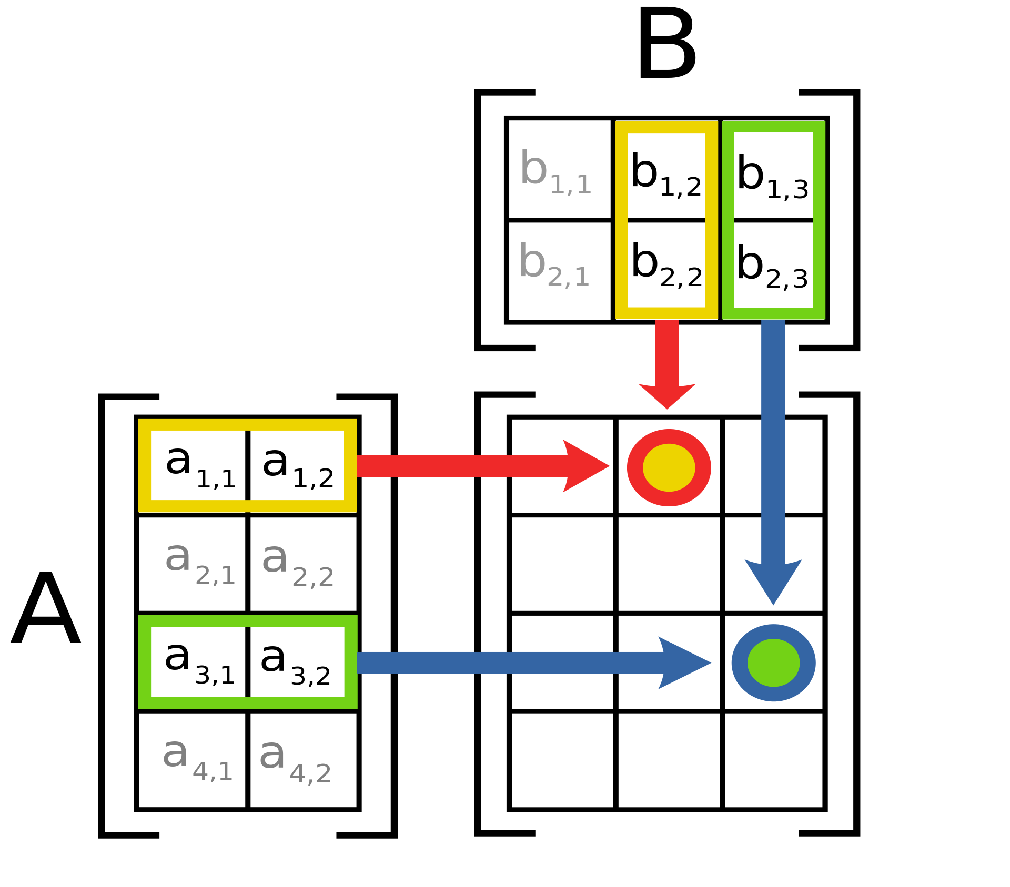
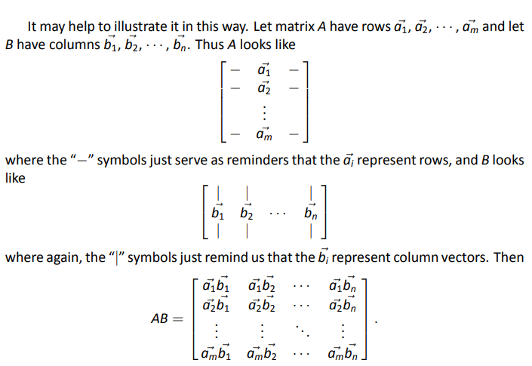
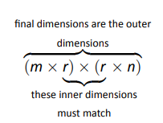
Important

Slide 11





Example 25
……….

Slide 12
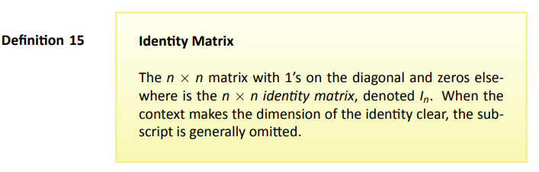
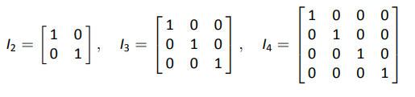
Definition
Examples

Slide 13
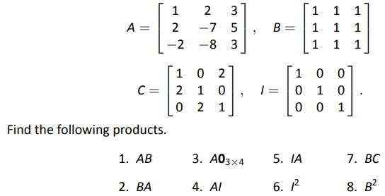
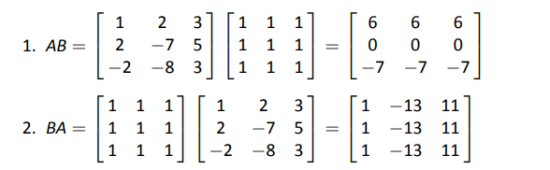

Example 29

Slide 14
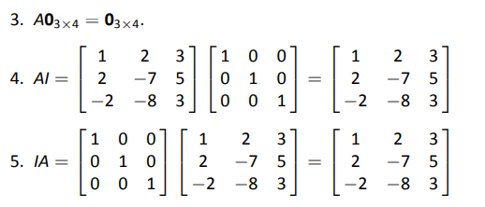
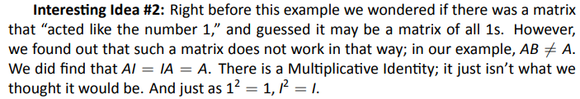
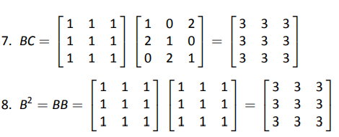
Example 29 : Solution (cont)

Slide 15
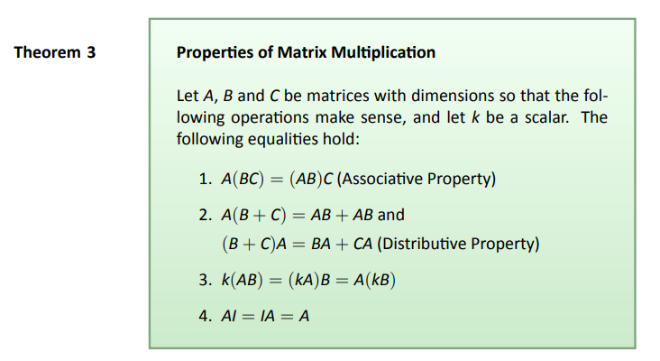
Theorem

Slide 16
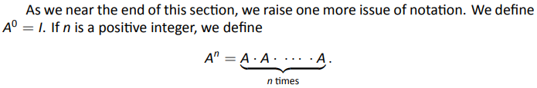
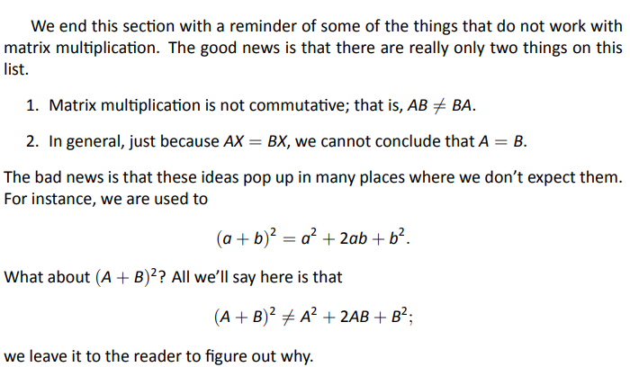
Final Thoughts

Slide 17
Elementary Row Operations as Matrix Multiplication

Slide 18
We performed three types of elementary row operations on a matrix A of dimension m-by-n:
Row addition: adding a scalar multiple of one row to another, and replace the later row with the sum
Row multiplication: multiplying all entries of a row by a non-zero constant
Row switching: interchanging the position of two rows.
The elementary row operations can be implemented by multiplying matrix A from left with an elementary matrix E of dimension m-by-m: E⋅A. For this we will use three types of elementary matrices E obtained from the identity matrix.

Slide 19
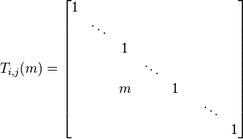
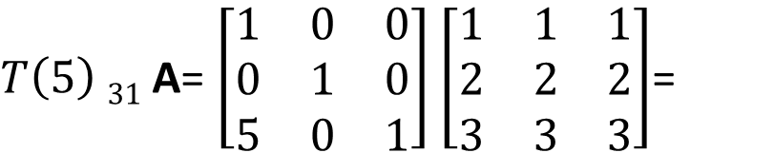
1. Row-addition transformations
The corresponding elementary matrix is the identity matrix but with an m in the (i,j) position.
$T\left(5\right) 31$ A= $\left[\begin{matrix}1 & 0 & 0 \\ 0 & 1 & 0 \\ 5 & 0 & 1\end{matrix}\right]$ $\left[\begin{matrix}1 & 1 & 1 \\ 2 & 2 & 2 \\ 3 & 3 & 3\end{matrix}\right]$=
So, T_{i,j}(m)⋅A is the matrix produced from A by adding m times row j to row i.

Slide 20
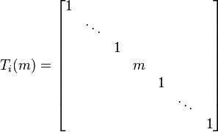
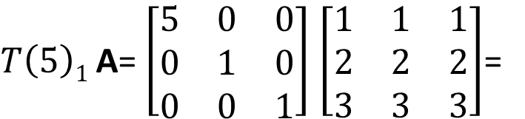
2. Row-multiplying transformations
The corresponding elementary matrix is a diagonal matrix, with diagonal entries 1 everywhere except in the i-th position, where it is m:
$T\left(5\right)1$A= $\left[\begin{matrix}5 & 0 & 0 \\ 0 & 1 & 0 \\ 0 & 0 & 1\end{matrix}\right]$ $\left[\begin{matrix}1 & 1 & 1 \\ 2 & 2 & 2 \\ 3 & 3 & 3\end{matrix}\right]$=
So, T_{i}(m)⋅A is the matrix produced from A by multiplying row i by m.

Slide 21
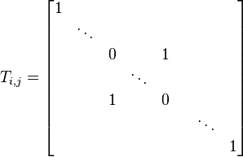
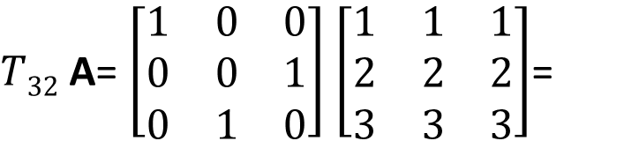
3. Row-switching transformations
The corresponding elementary matrix is obtained by swapping row i and row j of the identity matrix:
$T32$ A= $\left[\begin{matrix}1 & 0 & 0 \\ 0 & 0 & 1 \\ 0 & 1 & 0\end{matrix}\right]$ $\left[\begin{matrix}1 & 1 & 1 \\ 2 & 2 & 2 \\ 3 & 3 & 3\end{matrix}\right]$=
So T_{ij}⋅A is the matrix produced by exchanging row i and row j of A.

Slide 22
2.3 Visualizing Matrix Arithmetic in 2D

Slide 23

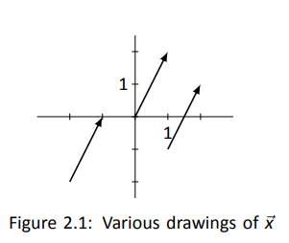
Graphing a Vector
A vector is a one-column matrix

Slide 24
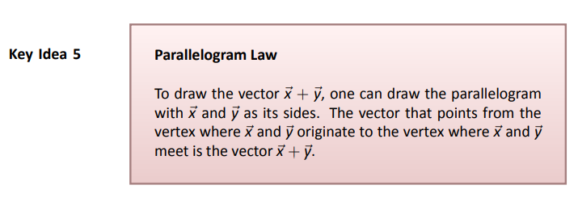
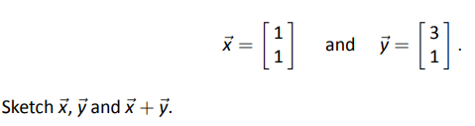

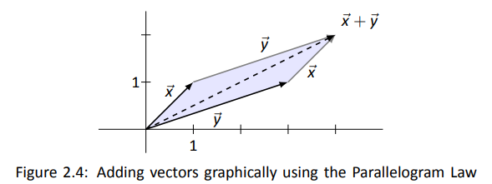
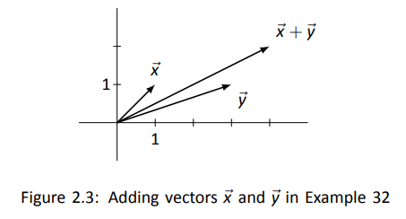
Example 32
Problem
Solution

Slide 25
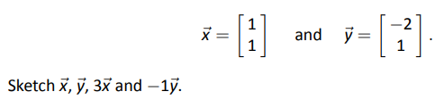

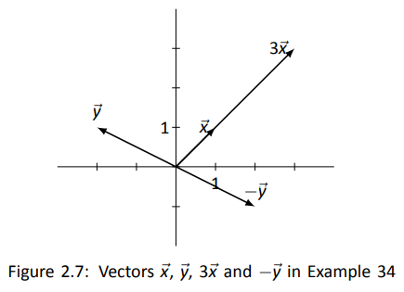
Example 34
Problem
Solution

Slide 26
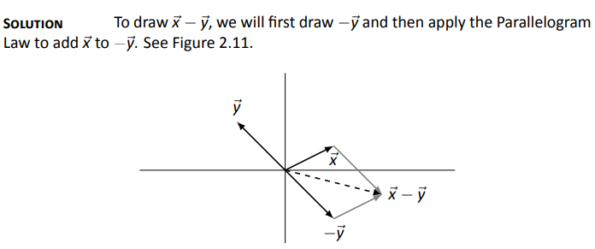
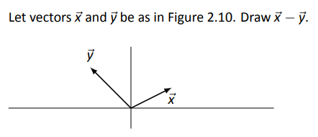
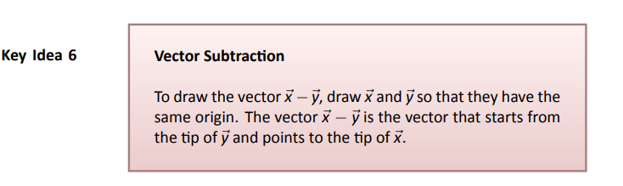
Example 36
Problem

Slide 27
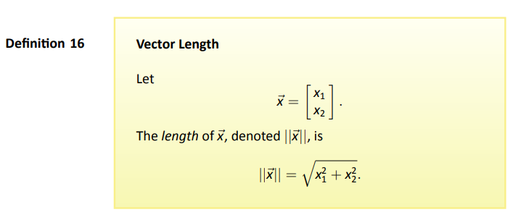
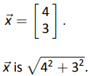
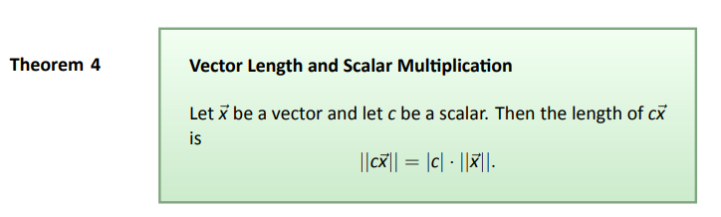

Slide 28
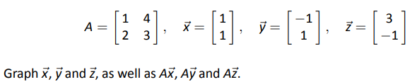
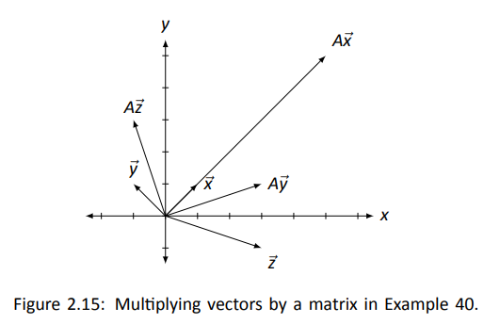
Example 40
Problem
Solution
Different matrices affect the length and direction of vectors in different ways.

Slide 29
2.4 Vector Solutions to Linear Systems

Slide 30
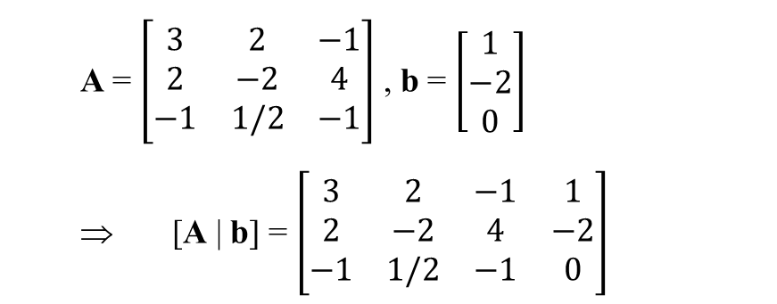
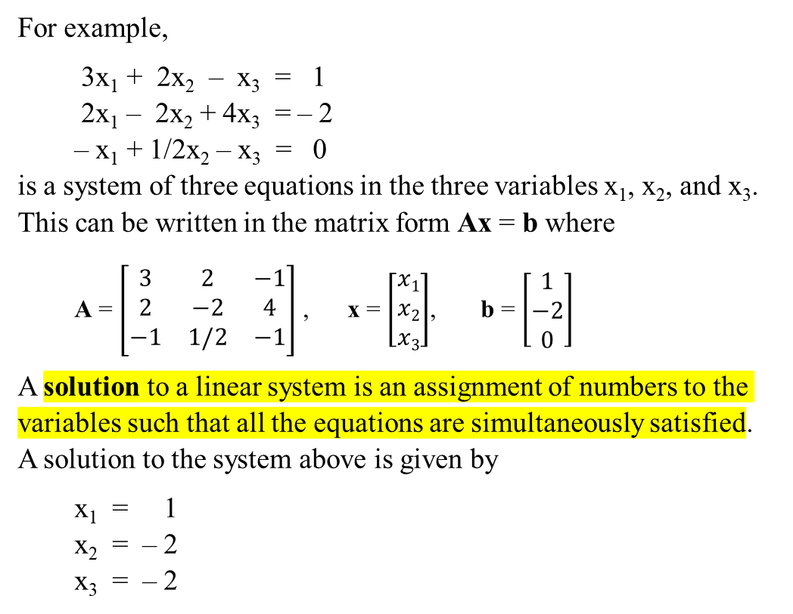
Summary
Given a system of linear equations represented in the matrix form as Ax = b, its augmented matrix is obtained by concatenating m-by-1 column vector b to m-by-n A and creating m-by-(n+1) augmented matrix [A | b]:
For example,
3x₁ + 2x₂ – x₃ = 1
2x₁ – 2x₂ + 4x₃ = – 2
– x₁ + 1/2x₂ – x₃ = 0
is a system of three equations in the three variables x₁, x₂, and x₃. This can be written in the matrix form Ax = b where
A = $\left[\begin{matrix}3 & 2 & −1 \\ 2 & −2 & 4 \\ −1 & 1/2 & −1\end{matrix}\right]$ , x = $\left[\begin{matrix}x1 \\ x2 \\ x3\end{matrix}\right]$, b = $\left[\begin{matrix}1 \\ −2 \\ 0\end{matrix}\right]$
A solution to a linear system is an assignment of numbers to the variables such that all the equations are simultaneously satisfied. A solution to the system above is given by
x₁ = 1
x₂ = – 2
x₃ = – 2
A = $\left[\begin{matrix}3 & 2 & −1 \\ 2 & −2 & 4 \\ −1 & 1/2 & −1\end{matrix}\right]$ , b = $\left[\begin{matrix}1 \\ −2 \\ 0\end{matrix}\right]$
⇒ [A | b] = $\left[\begin{matrix}3 & 2 & −1 & 1 \\ 2 & −2 & 4 & −2 \\ −1 & 1/2 & −1 & 0\end{matrix}\right]$
We can then solve the Ax = b,
by applying Gaussian elimination to [A | b],
and transforming it into a reduced row echelon form.

Slide 31
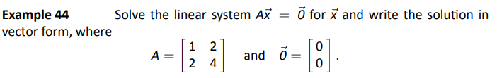

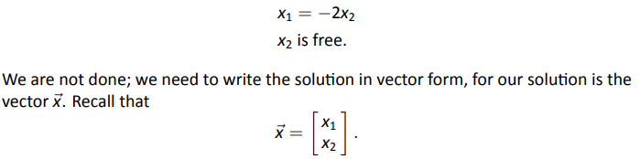



Example 44
Problem
Solution

Slide 32



Example 44 (cont)

Slide 33










Example 46
Problem
Solution
1.
2.

Slide 34


The term homogeneous comes from two Greek words; homo meaning “same” and genus meaning “type.”

Slide 35







Determining How Many Solutions
Recall earlier example
Solutions
Recall earlier notation

Slide 36


Key Idea

Slide 37





Example 47
Problem
Solution
First, we solve for
We pull apart this
vector into two
vectors: one with “x₃”
stuff, and the other with “x₄” stuff.

Slide 38



Example 47 (cont)
Problem
Solution
Next we solve for
Again, we pull apart this
vector, but this time we
break it into three
vectors: one with “x₃”
stuff, one with “x₄” stuff,
and one with just
constants.

Slide 39



Example 49
Problem
Solution
First, we solve for

Slide 40






Example 50
Problem
Solution
Next we solve for
First, we solve for

Slide 41
2.5 Solving Matrix Equations AX = B

Slide 42






Overview of (new) Problem Solving Method

Slide 43



Example 51

Slide 44

Why Does This Work?

Slide 45




Why Does This Work? (cont)

Slide 46

Key Idea

Slide 47
2.6 The Matrix Inverse

Slide 48

Inverse 101

Slide 49





Example 53
Problem
Solution
We also have:
This means that AX = I = XA

Slide 50



Example 54

Slide 51

Key Idea

Slide 52




Slide 53

Theorem

Slide 54


What if A⁻¹ exists?
Can more than one solution exist?

Slide 55

Theorem (we just proved)

Slide 56



Example 57
Problem
Solution

Slide 57
2.7 Properties of Matrix Inverse

Slide 58



Slide 59


