Slide 1
Probability and Statistics for Computer Scientists Third Edition, By Michael Baron Section 11.1: Least squares estimation CIS 2033. Computational Probability and Statistics Pei Wang

Slide 2
Regression models
A regression model relates a response (or dependent) variable Y to one or several predictors (or independent) variables X⁽¹⁾, …, X^{(k)}
Regression of Y on X⁽¹⁾, …, X^{(k)} is the conditional expectation
G(x⁽¹⁾, …, x^{(k)}) = E[Y | X⁽¹⁾ = x⁽¹⁾, …, X^{(k)} = x^{(k)}]
We only consider the cases of k = 1, that is,
G(x) = E[Y | X = x]

Slide 3
Regression example: linear

Slide 4
Regression example: non-linear

Slide 5
Overfitting a model
Overfitting a model: to fit a regression line too closely to the observed data often lead to poor predictions

Slide 6
Linear regression
The simple linear regression model for a bivariate dataset (x₁, y₁), . . . , (x_{n}, y_{n}) is
Y_{i} = α + βx_{i} + Z_{i}, for i = 1, . . ., n,
where Z₁, . . . , Z_{n} are independent random variables with zero expectation
The ith residual r_{i} is the distance between the ith point and the estimated regression line:

Slide 7
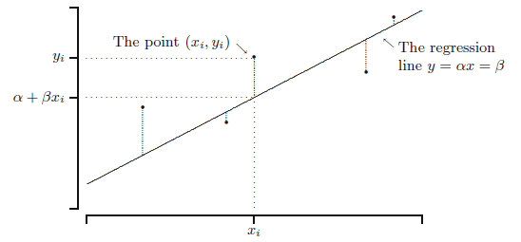
Method of least squares
Choose α and β to minimize the total residual
+

Slide 8
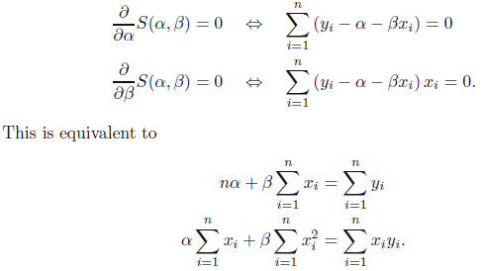
Parameters estimation (1)
To get α and β from (x₁, y₁), . . . , (x_{n}, y_{n}):

Slide 9
Parameters estimation (2)
Solve the previous equations:
Both estimators are unbiased

Slide 10
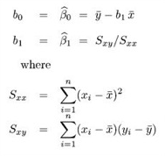
Parameters estimation (3)
Another equivalent method to estimate the parameters in y = b₀ + b₁x is to let

Slide 11
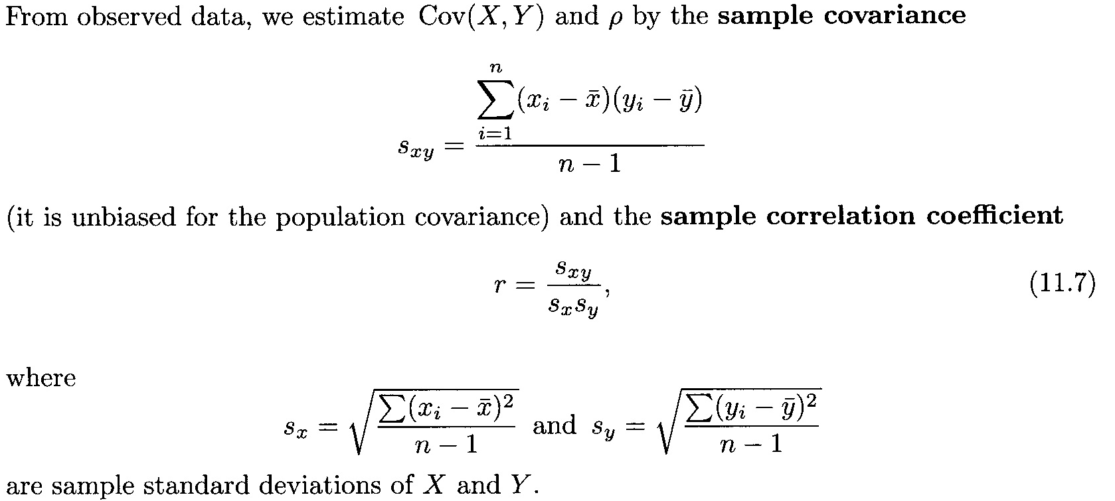
Regression and correlation

Slide 12
Regression and correlation (2)
The estimated slope (β or b₁) is proportional
to the sample regression coefficient r
β > 0: X and Y are positively correlated
β < 0: X and Y are negatively correlated
β = 0: Y is a constant, uncorrelated to X

Slide 13
Summary
1. Linear regression
2. The method of least squares
3. Regression and correlation

