Slide 1
Probability and Statistics for Computer Scientists Third Edition, By Michael Baron Section 5.2: Simulation of Random Variables CIS 2033. Computational Probability and Statistics Pei Wang

Slide 2
Introduction 🫨
Tangrui (Tory) Li
B.E. AI (2019), M.S. AI (2021), Ph. D AI candidate
tuo90515@temple.edu
Office hour
1:00 PM – 2:00 PM SERC 307, Wednesday/Thursday

Slide 3
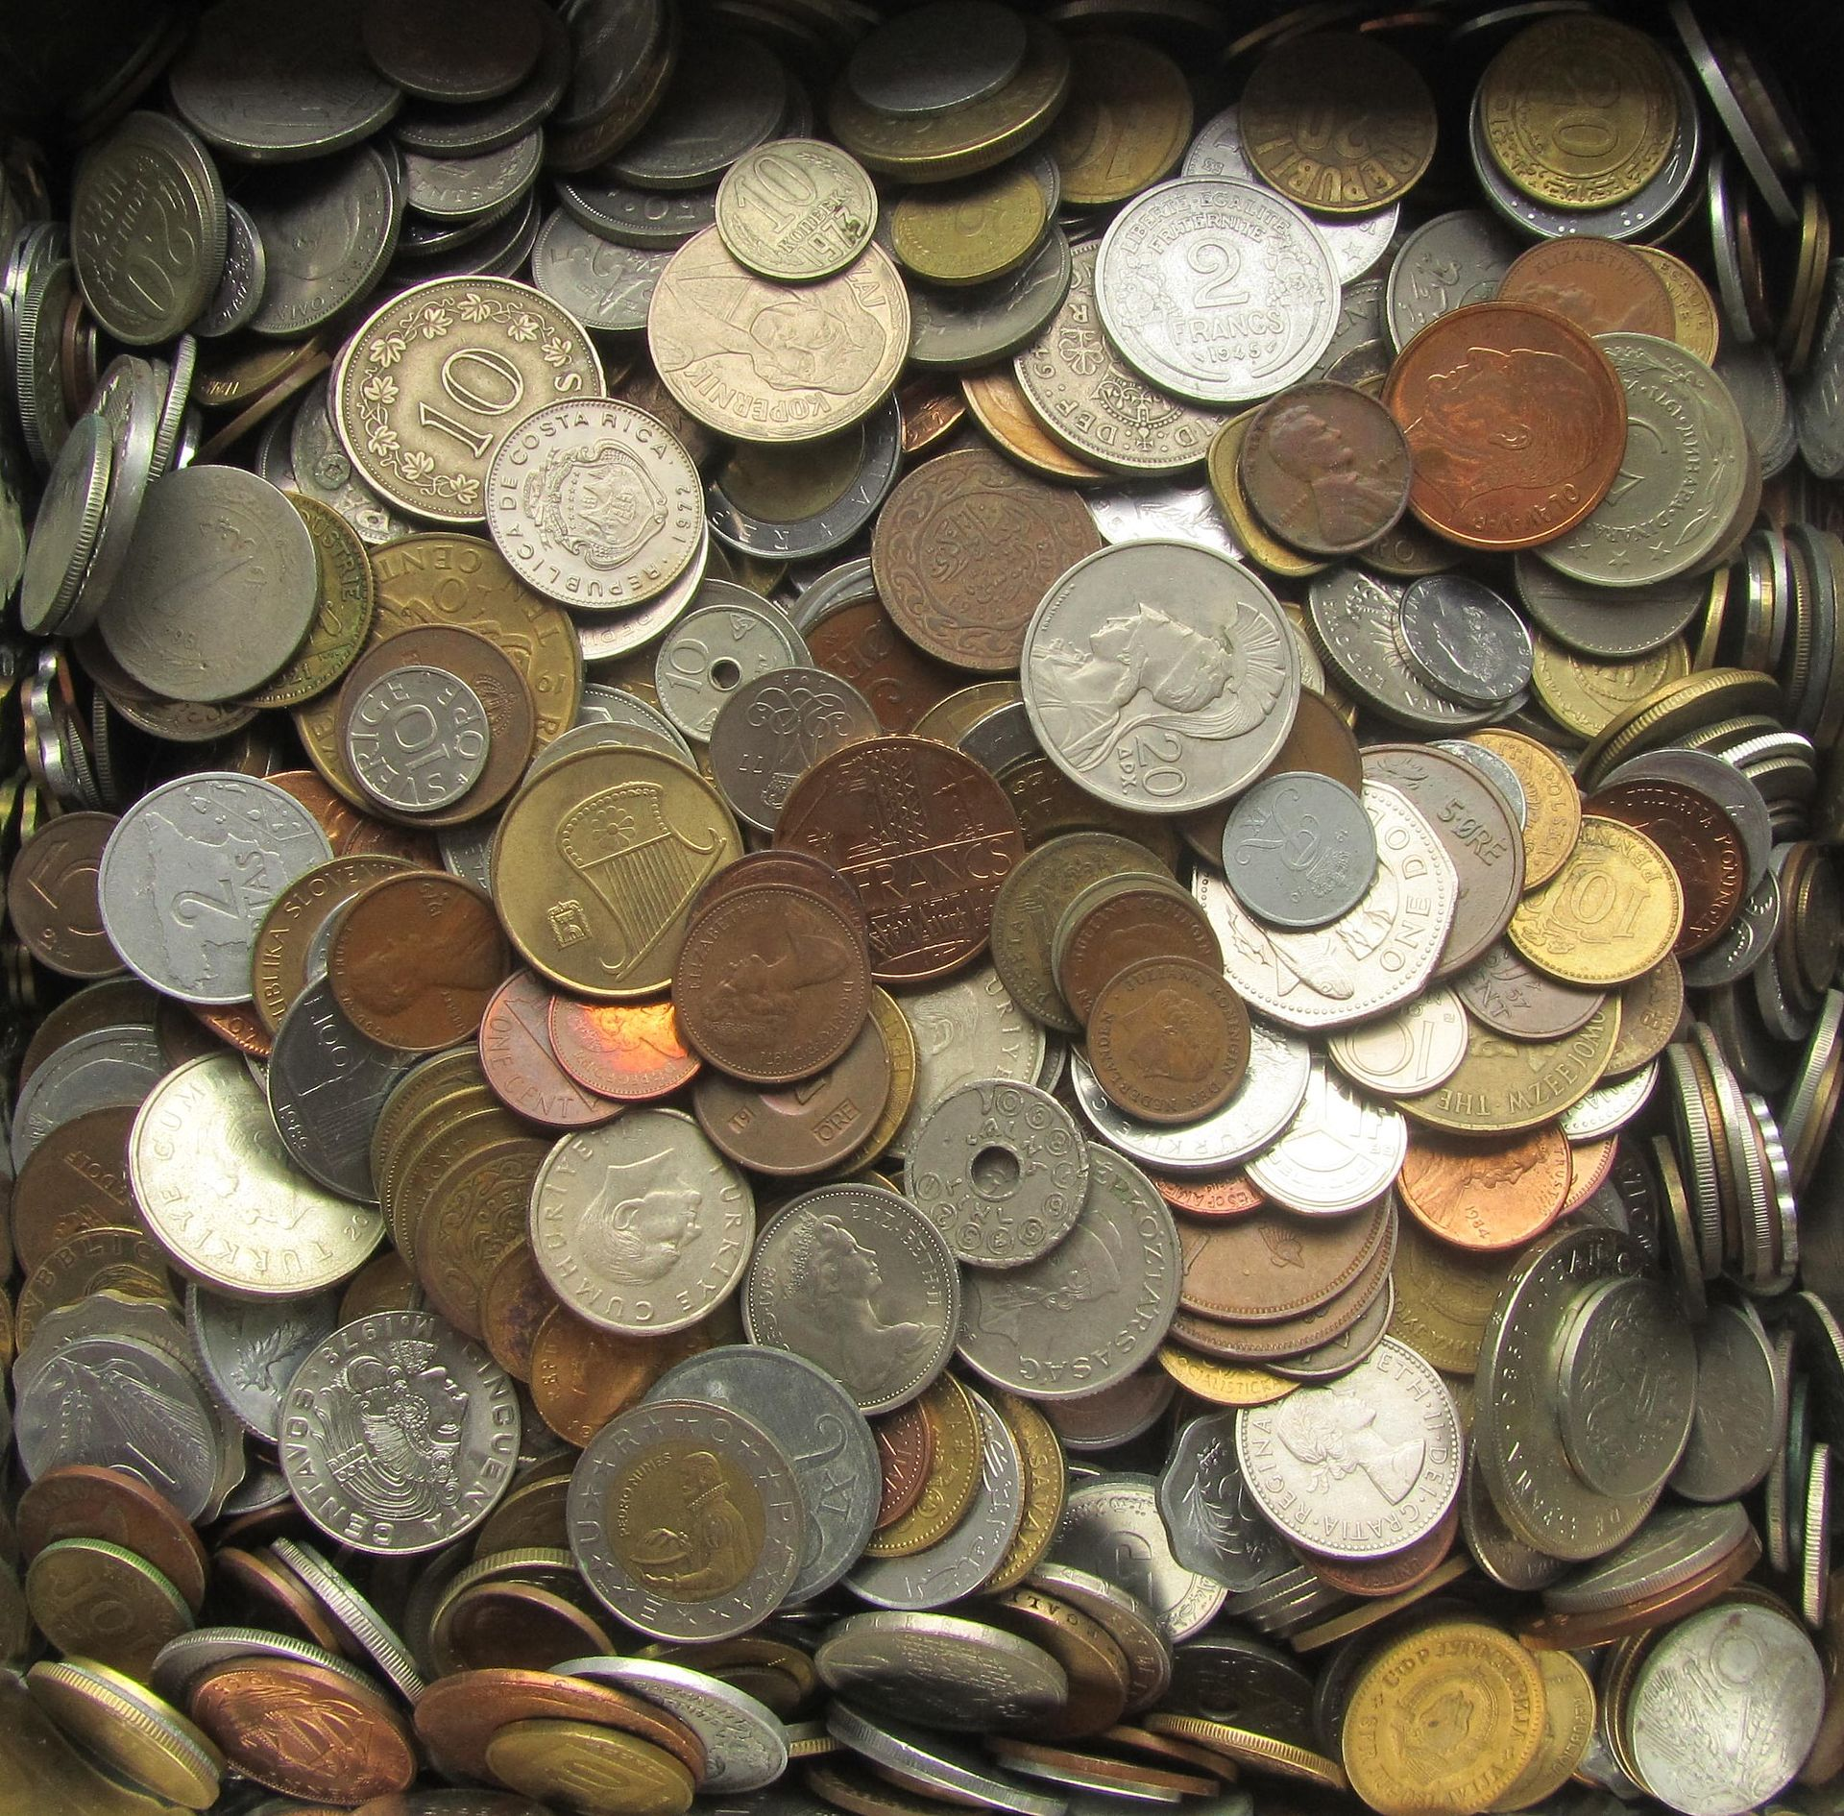
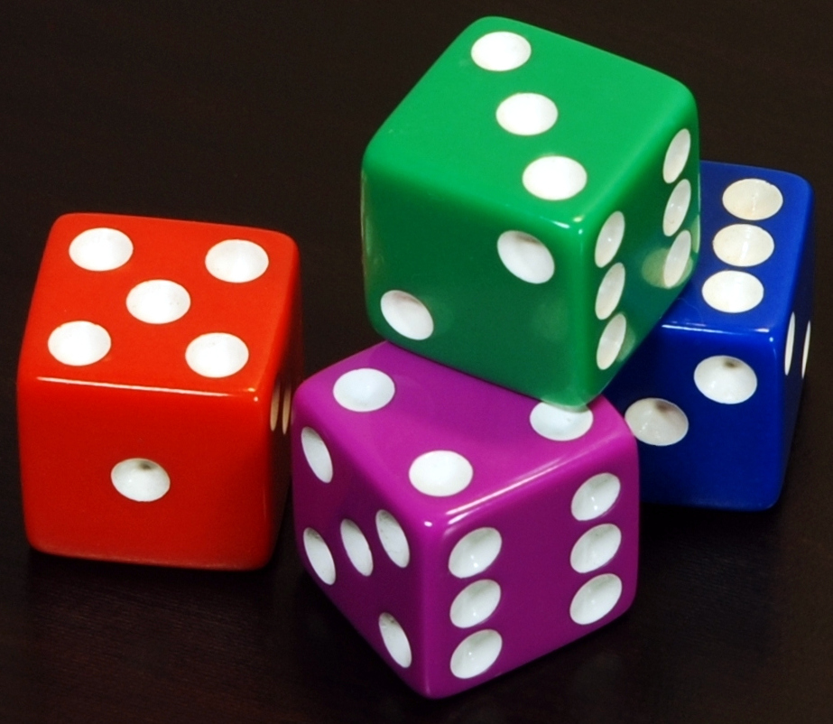
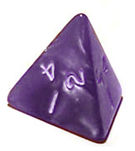
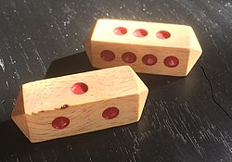
Simulation
Use one distribution to simulate another.
Quiz:
Can you simulate a fair coin with a fair 6-sided dice?
Can you simulate a fair 4-sided dice with a fair coin?
Can you simulate a fair 6-sided dice with a fair coin?
Reject 2 of the 8 possibilities.

Slide 4
Simulation
Use one distribution to simulate another.
Quiz:
Can you simulate a fair coin with an unfair coin?
Make it more concrete? heads (1/3), tails (2/3)
HH(1/9), HT(2/9), TH(2/9), TT(4/9)
Reject TT and HH, then mark HT as head, TH as tail.

Slide 5
Simulation
Why we want to do such simulations?
Coin?
Dice?
The accessibility of distributions are different, as well in sampling.

Slide 6

PDF vs. CDF
PDF: Probability Density (Mass) Function, represented as $p,f$
CDF: Cumulative Distribution Function, represented as $P,F$
$p\left(1\right)=0.5$?
$F\left(1\right)=0.5$?
It is CDF to be practically used to generate data.
But CDF might be hard to get, thus we need to find alternatives.

Slide 7
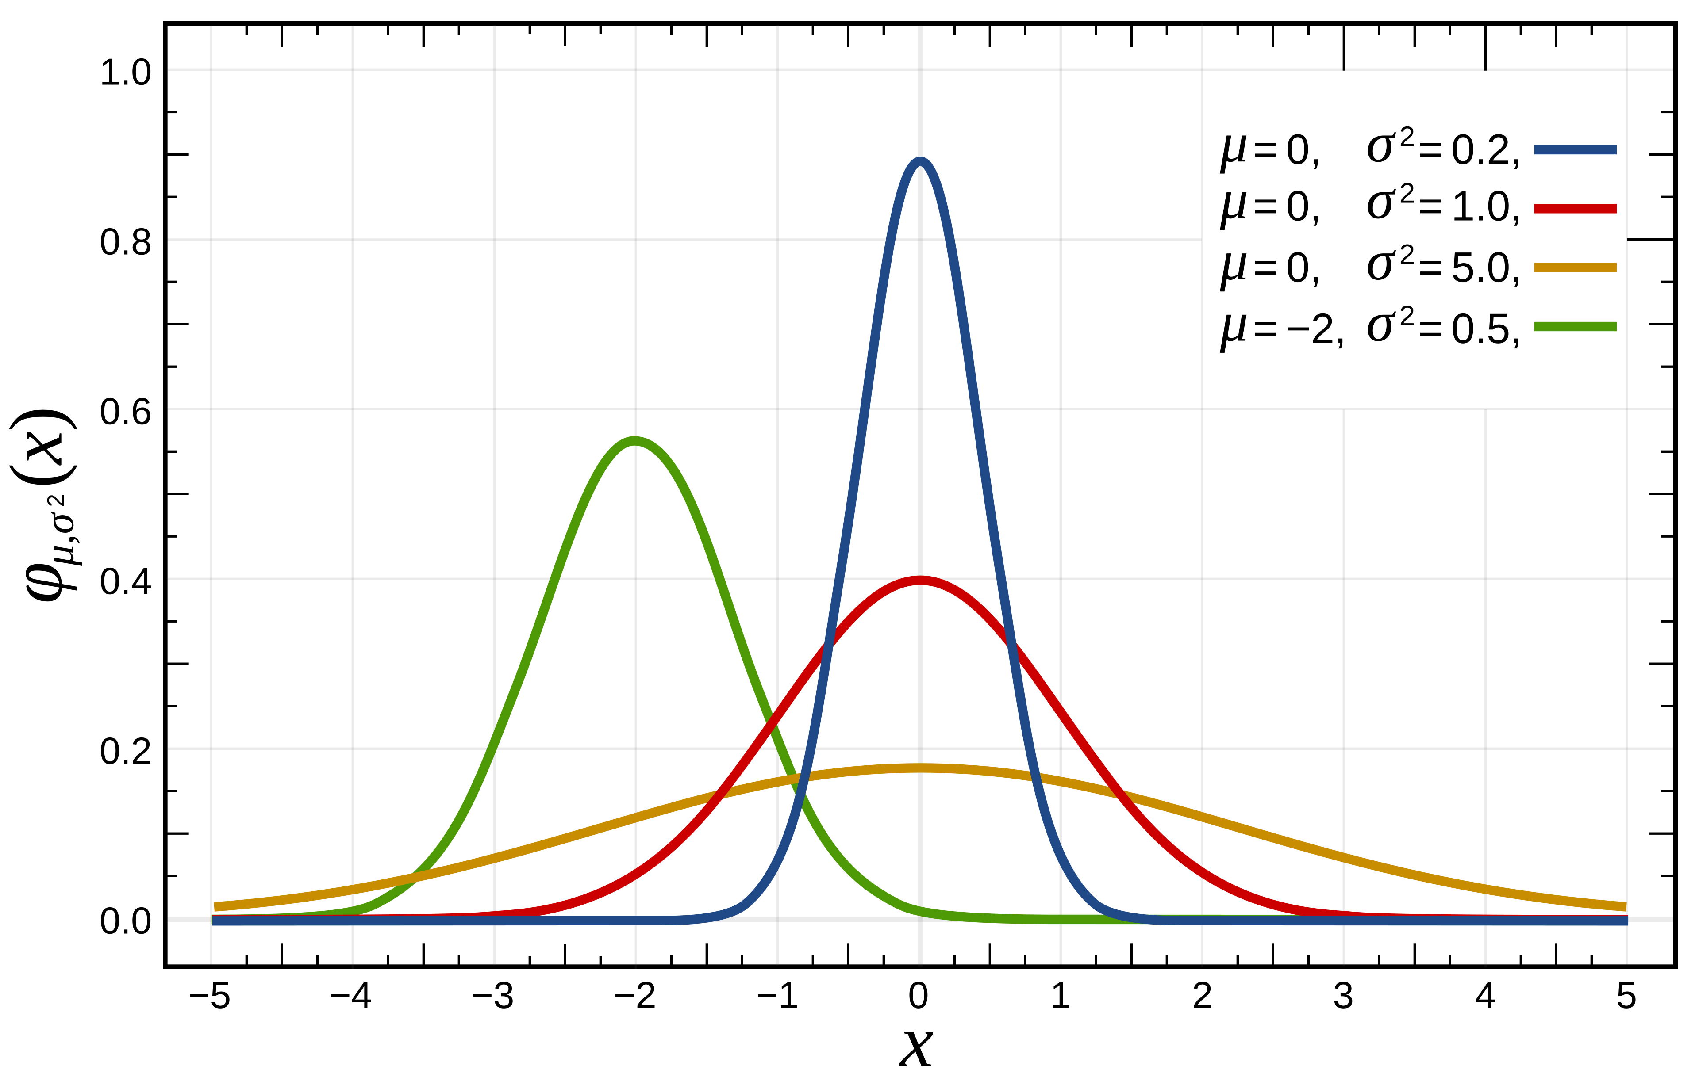
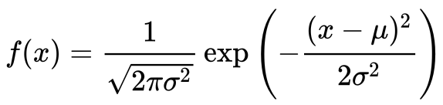
Gaussian (Normal) Distribution
PDF

Slide 8
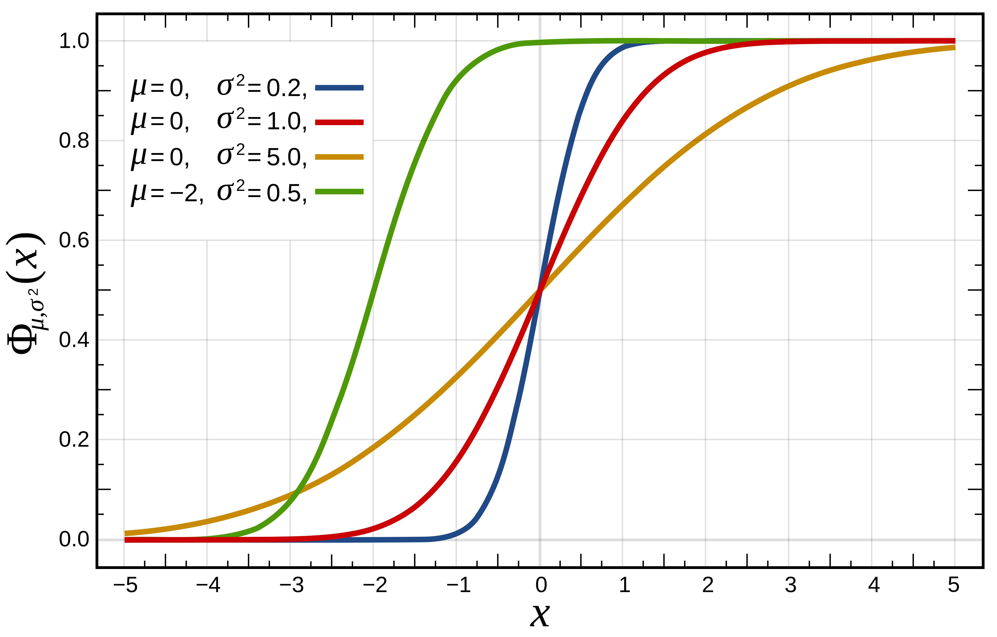
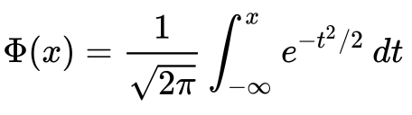
Gaussian (Normal) Distribution
CDF

Slide 9
Python’s random.norm()?
You must be lying. Python can get correct data in a flash.
Indeed.
But you will need to know Box-Muller Transform and Ziggurat Sampling, which are not easy.
Today we will only cover the basic methods without those modern solutions.

Slide 10
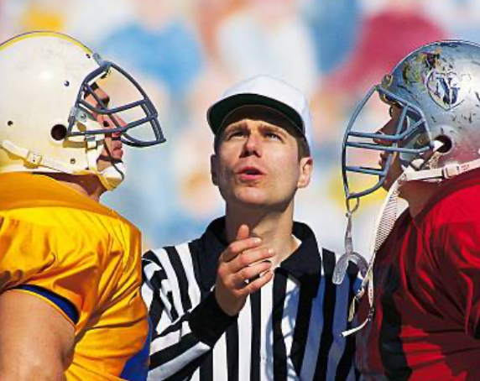
Simulation
Simulation: to use a model to study what would happen in the real world
Monte Carlo methods: computer simulations involving random numbers
Such a method requires values of a random variable with a certain distribution
Simulation is from Model (p, f, or F) to Data

Slide 11
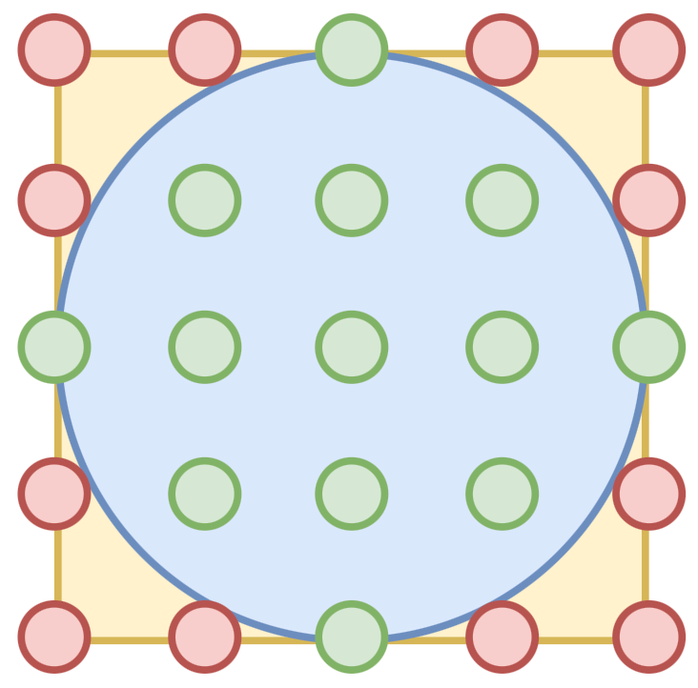
Monte Carlo
Calculate the area of the circle. Given the area of the box.

Slide 12
Random number generator
A device that generates numbers that can be seen as the realization of a random variable
Examples:
A fair coin is Ber(0.5)
A fair die generates {1,2,3,4,5,6} evenly
A table of random numbers
A program that generates random values

Slide 13
Turn one distribution into another
How to generate random numbers of one distribution from those of another?
To simulate a fair coin with a fair die
To simulate an even distribution on {a,b,c,d} with a fair coin
To simulate a fair die with a fair coin
To simulate a fair coin with a unfair coin

Slide 14
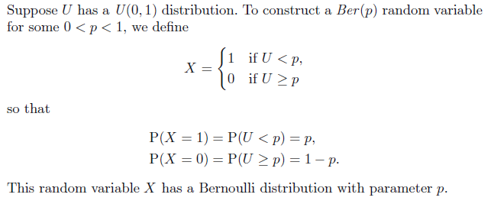
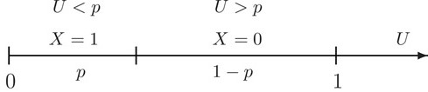
To get Ber(p) from U(0,1)

Slide 15
Pseudocode
Pseudocode describes an algorithm in a semi-formal format
Example:
Ber(p)
u = U(0, 1)
if (u < p)
return 1
return 0

Slide 16
To generate Bin
How many successes in n experiments?
Bin(n, p) can be generated using a for-loop to sum n Ber(p)
Pseudocode:
Bin(n, p)
count = 0
for(n)
count = count + Ber(p)
return count

Slide 17
To generate Geo
To get a success, how many experiments do I need?
Geo(p) can be generated using a while-loop to count the number of Ber(p) until the first 1 is obtained
Pseudocode:
Geo(p)
count = 1
while (Ber(p) == 0)
count++
return count

Slide 18
To generate NegBin
Until you get n successes.
NegBin(n, p) can be generated using a while-loop to count the number of Ber(p) until the nth 1 is obtained, or a for-loop to sum n Geo(p)
Pseudocode:
NegBin(n, p)
count = 0
for(n)
count = count + Geo(p)
return count

Slide 19
To simulate discrete variable
A random variable Y has outcomes 1, 3, and 4 with the following probabilities:
P(Y = 1) = 3/5
P(Y = 3) = 1/5
P(Y = 4) = 1/5
How to generate Y from a U(0, 1)?
3 4
0.6 0.2 0.2
0
1

Slide 20
To simulate discrete variable (2)
a | 1 | 3 | 4
p(a) | 0.6 | 0.2 | 0.2
F(a) | 0.6 | 0.8 | 1
u = U(0, 1)
if (u < 0.6)
return 1
if (u < 0.8)
return 3
return 4

Slide 21

Inverse Transform Sampling
Getting tired of treating every simulation as a puzzle?
Is there a universal method to simulate any distributions?
Methodology:
The range of a CDF is always from 0 to 1.
The range of a uniform distribution is also from 0 to 1.
CDF is monotonic (non-decreasing).
Map a uniform distribution using $F^{−1}$.

Slide 22
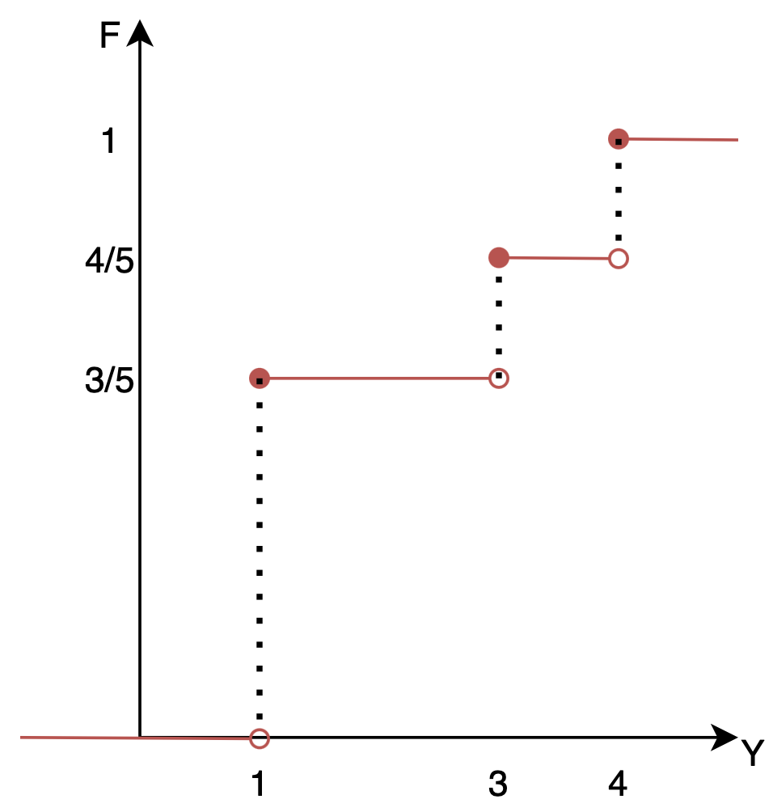
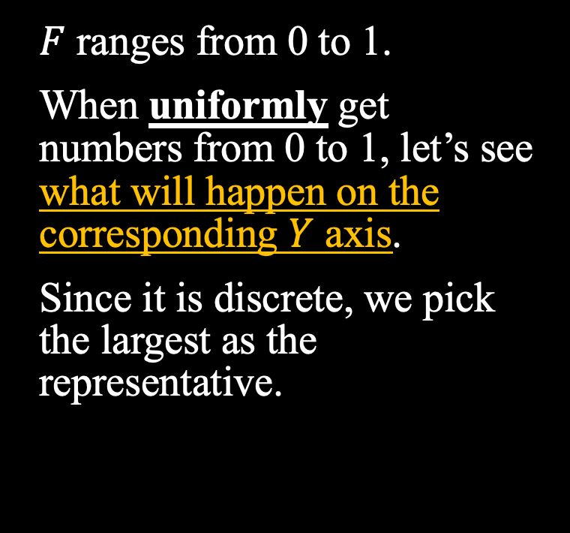
a | 1 | 3 | 4
p(a) | 0.6 | 0.2 | 0.2
F(a) | 0.6 | 0.8 | 1
5/9
2/9
2/9
🫨
$F$ ranges from 0 to 1.
When uniformly get numbers from 0 to 1, let’s see what will happen on the corresponding $Y$ axis.
Since it is discrete, we pick the largest as the representative.
4
4
3
3
1
1
1
1
1

Slide 23
To simulate discrete variable (3)
Algorithm:
1. Divide [0, 1] according to F(a), that is,
2. Get u = U(0, 1)
3. Generate a_{i} (the ith value) when u is in A_{i}

Slide 24
To simulate discrete variable (4)
u

Slide 25
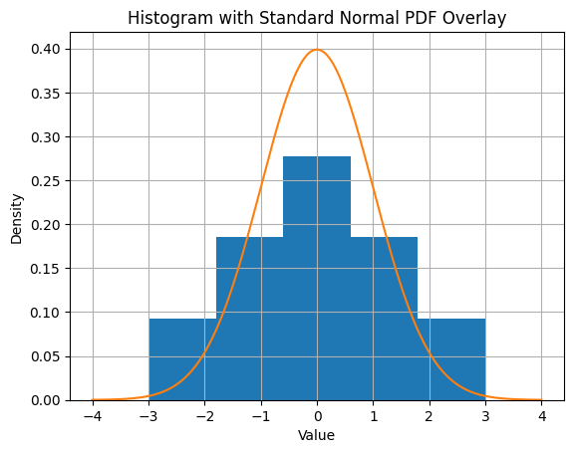
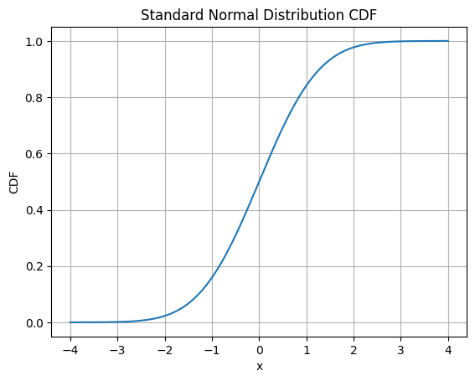
Continuous Situation
🫨
Will this be simpler for continuous situations?
Yes. Let’s revisit the Gaussian distribution.
1.1
3
0.8
0.3
0
-0.4
-0.8
-1.2
-3

Slide 26
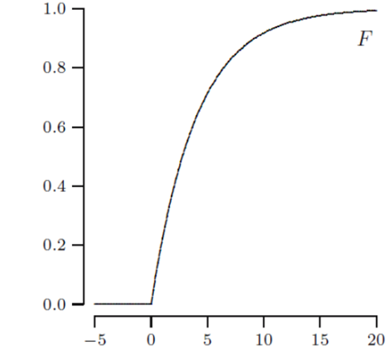
The inverse function of cdf
For a continuous random variable X, if its cdf F strictly increases, the inverse function F⁻¹ exists
F(5)
F⁻¹(0.8)

Slide 27
To simulate continuous variable
When F⁻¹ is applied on U that is U(0, 1), event U ≤ F(a) corresponds to event F⁻¹(U) ≤ a
So P(F⁻¹(U) ≤ a) = P(U ≤ F(a)) = F(a)
Therefore, X can be simulated by F⁻¹(U)
To obtain the formula of F⁻¹, solve the equation F(y) = u for y
E.g. If y = 4x – 5, then x = (y + 5) / 4

Slide 28
To simulate U(a, b)
As stated in Ch. 4:
If X is U(a, b), then Y = (X – a) / (b – a) is U(0, 1)
The inverse function is used to simulate U(a, b)
u = U(0, 1)
return u * (b – a) + a

Slide 29
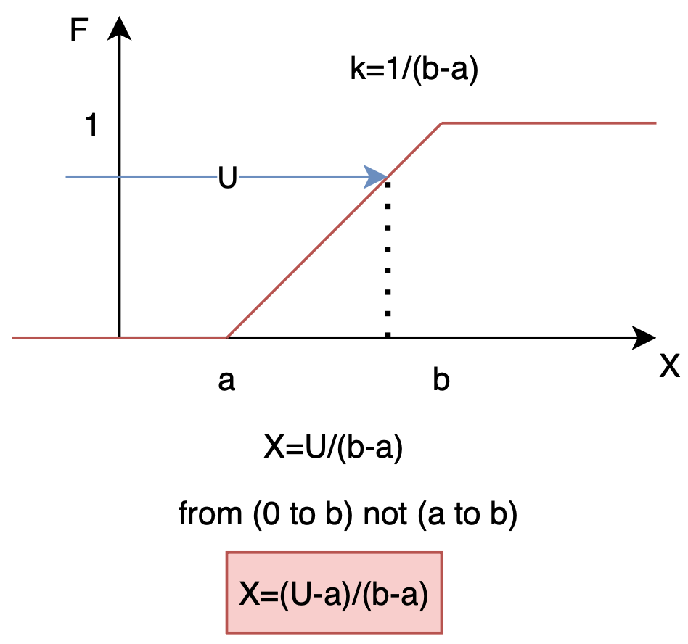

Slide 30
To simulate Exp(λ)
If u = F(y) = 1 − e^{−λy}, then y = −(1/λ) ln(1 − u)
Since 1 − U is also uniform (U), it can be replaced by U, so the simulation function is −(1/λ)ln(u)
Pseudocode:
u = U(0, 1)
return −(1/λ)ln(u)

Slide 31
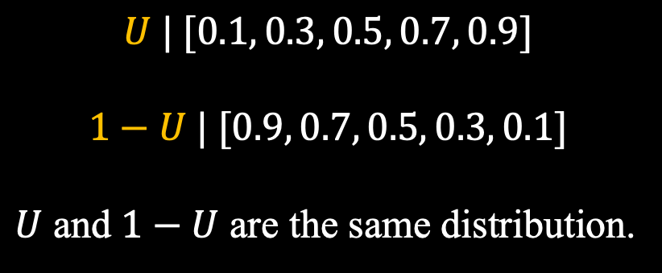
$$U | [0.1, 0.3, 0.5, 0.7, 0.9]$$
$$1−U | [0.9, 0.7, 0.5, 0.3, 0.1]$$
$U$ and $1−U$ are the same distribution.

Slide 32
To simulate arbitrary variable
The previous solution still works even if the random variable is partly discrete and partly continuous:
If F has a jump at b, then P(X = b) is the height of the jump
If F is flat at [b, c], then P(X = a) is 0 for any a in [b, c], and F⁻¹ can be made to take any value in [b, c]

Slide 33
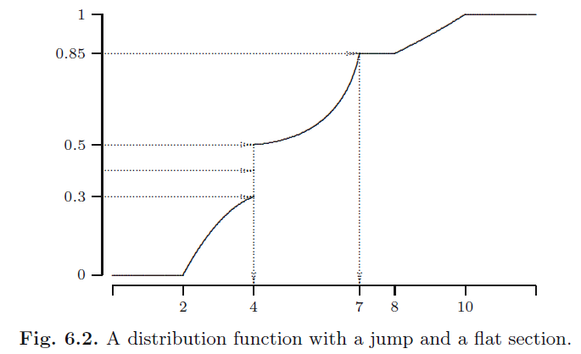
To simulate arbitrary variable (2)

Slide 34
Rejection method
For a continuous random variable, if the cdf F(a) is not available, but the pdf f(a) is, then the latter can be used to generate its values
Generating points (X, Y) in a region including f(a), while X and Y are both uniform. Among the points “under f(a)”, i.e., Y < f(X), the X values roughly have the density function f(a)
This is an example of Monte Carlo method

Slide 35
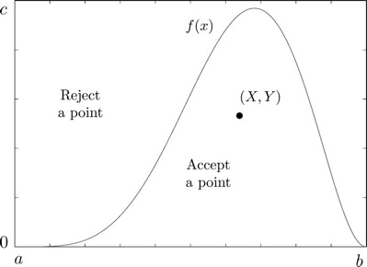
Rejection method (2)

Slide 36
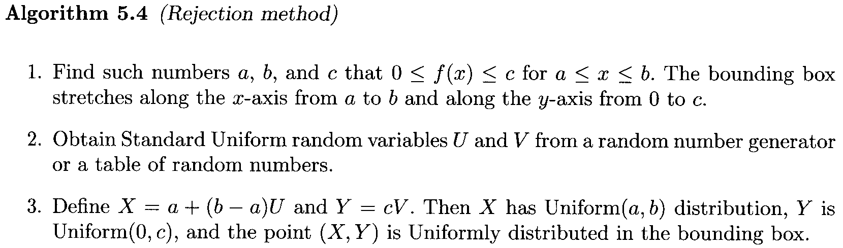
Rejection method (3)

Slide 37
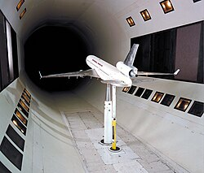

Recap
Simulation:
There is a model.
The model is for representing the world.
$→$ generating data.
Generating data from different distributions has different difficulties.
wind tunnel
for aerodynamic experiments

Slide 38
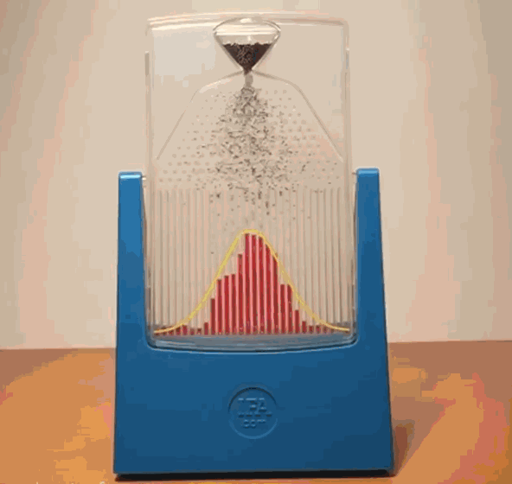
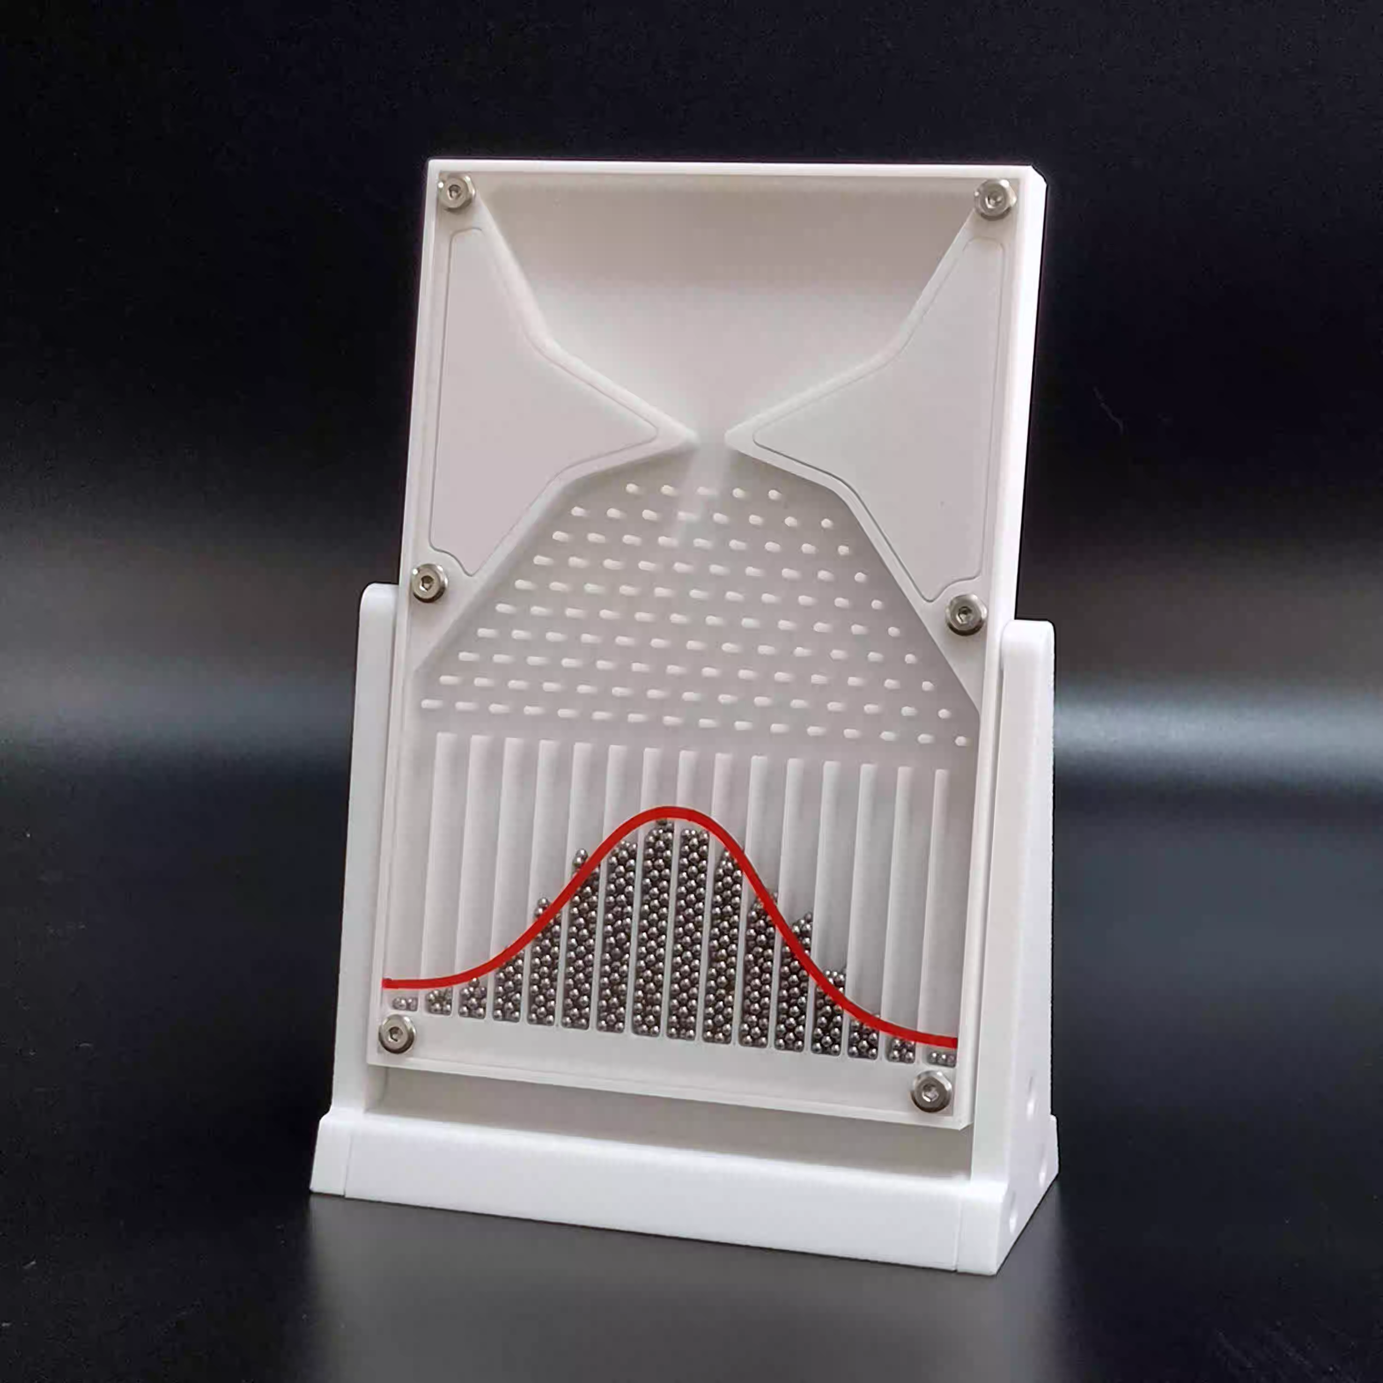
Recap
Example:
Generating data from a Bernoulli distribution. [tossing a coin]
Generating data from a normal distribution. [BMT, ZS]
Assumption: the distribution is given. (people create it for some purpose)
One of the simplest distribution: uniform distribution from 0 to 1.
Can we get data from any distributions according to its cdf using the uniform distribution from 0 to 1?

Slide 39
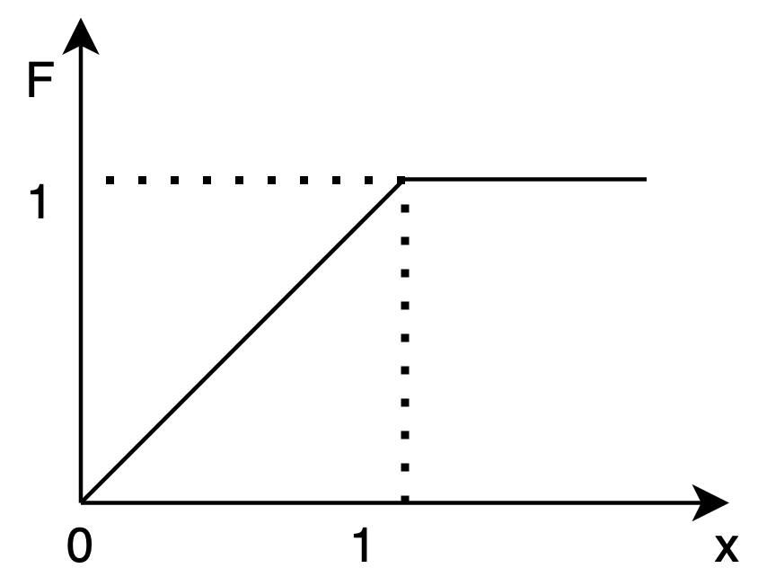




Recap
Method:
For $u$ from $U\left(0,1\right)$.
Find $x=F^{−1}(u)$.
The cdf of $U\left(0,1\right)$
$$u$$
$$x$$
0
0
0.1
0.1
0.2
0.2
0.3
0.3
0.4
0.4
0.5
0.5
0.6
0.6
0.7
0.7
0.8
0.8
0.9
0.9
1
1

Slide 40
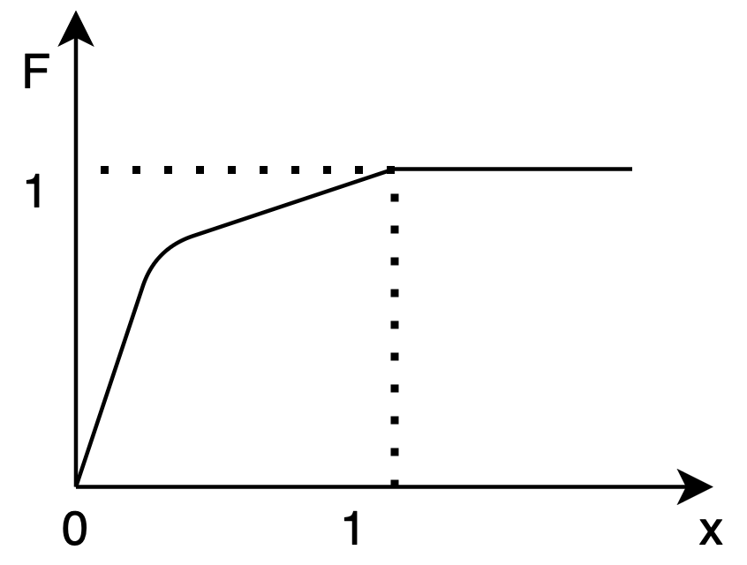
Recap
Method:
For $u$ from $U\left(0,1\right)$.
Find $x=F^{−1}(u)$.
$$u$$
$$x$$
0
0
0.1
0.01
0.2
0.05
0.3
0.1
0.4
0.15
0.5
0.2
0.6
0.25
0.7
0.3
0.8
0.4
0.9
0.7
1
1

Slide 41
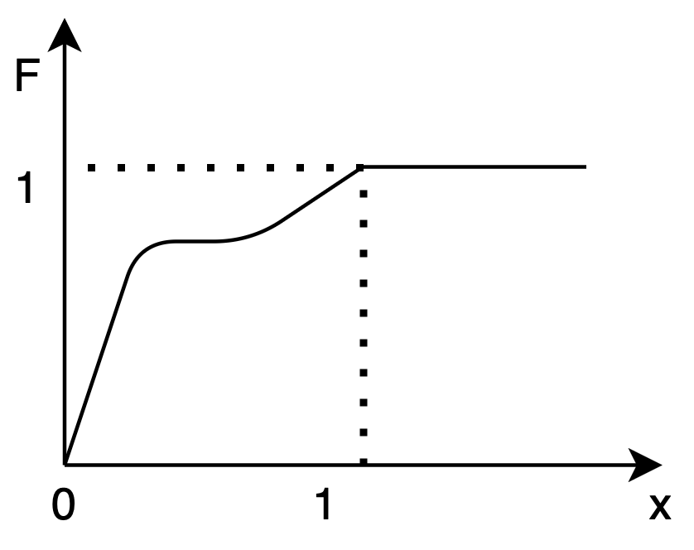




Recap
Method:
For $u$ from $U\left(0,1\right)$.
Find $x=F^{−1}(u)$.
Plateau (flat)
Any possible values from $a$ to $b$ will work.
$$a$$
$$b$$

Slide 42
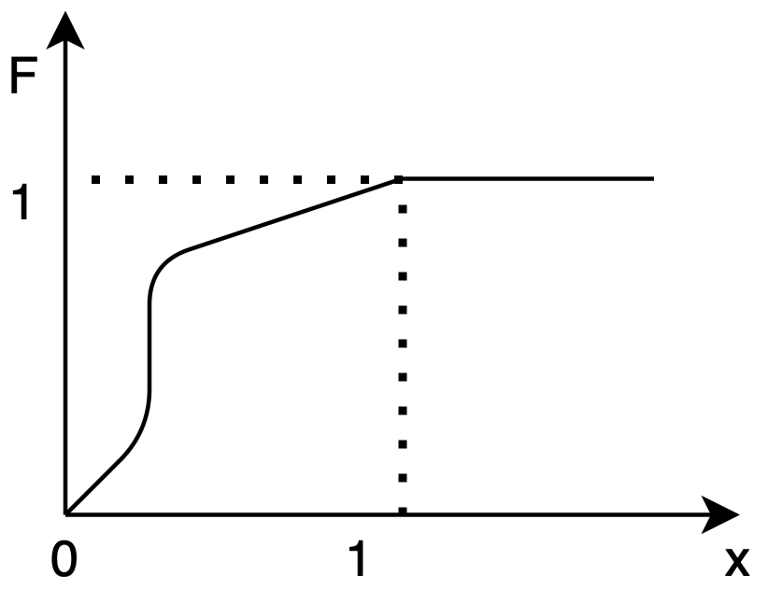





Recap
Method:
For $u$ from $U\left(0,1\right)$.
Find $x=F^{−1}(u)$.
Jump
$β−α$, that proportion are for $a$ only.
$p\left(a\right)=β−α$
$$β$$
$$α$$
$$a$$

Slide 43
Recap
If we could have a function of CDF, as well as its inverse function, the above process will be easy.
But CDF is usually hard to get.

Slide 44
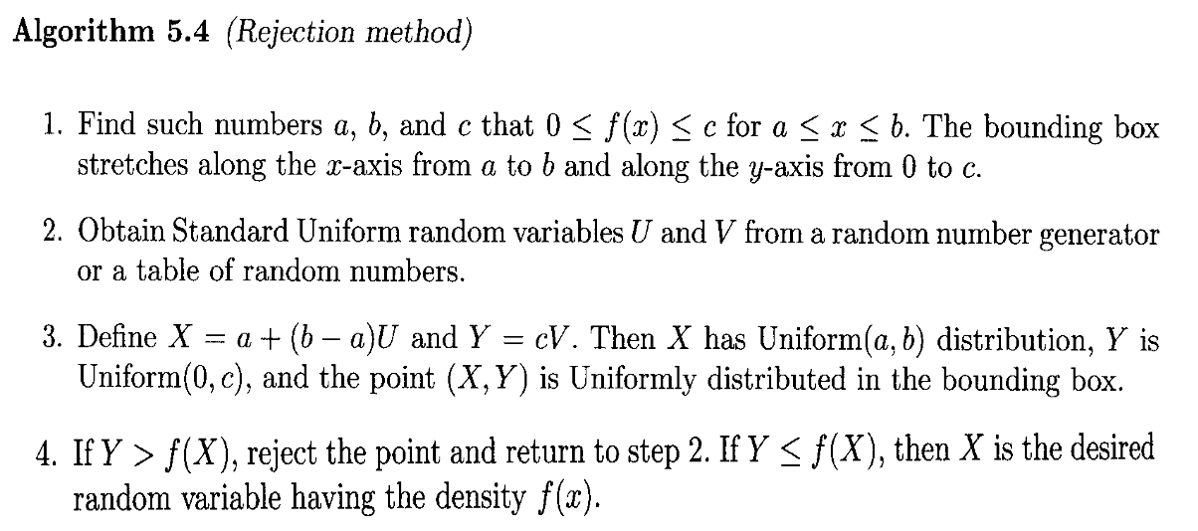










Recap
$$U\sim U\left(0,1\right),V\sim U\left(0,1\right)$$
Monte Carlo.
- Rejection.
$$X\sim U(a,b)$$
$$Y\sim U(0,c)$$
PDF, since it is using lower case
$$f(x)$$
$$c$$
$$Y\sim U(0,c)$$
$$x$$
$$a$$
$$b$$
$$X\sim U(a,b)$$

Slide 45
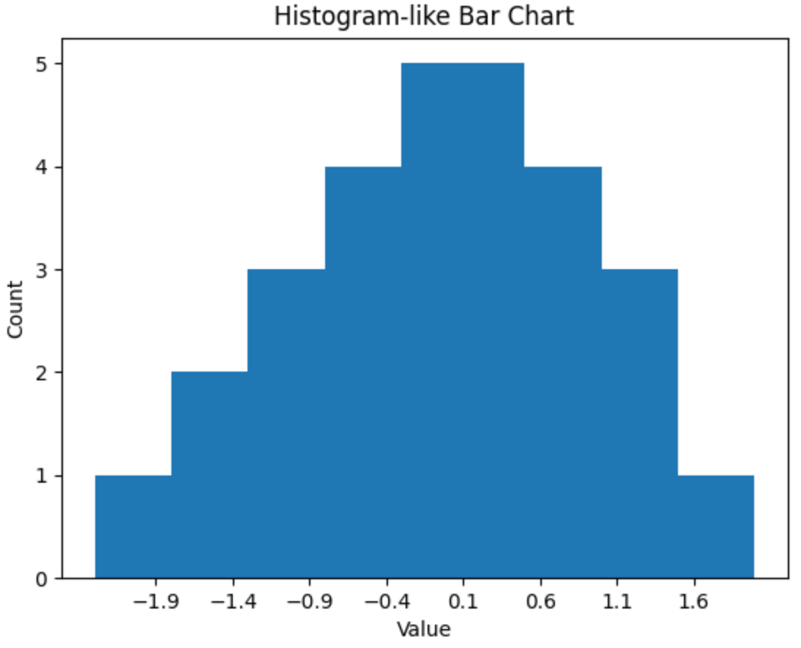
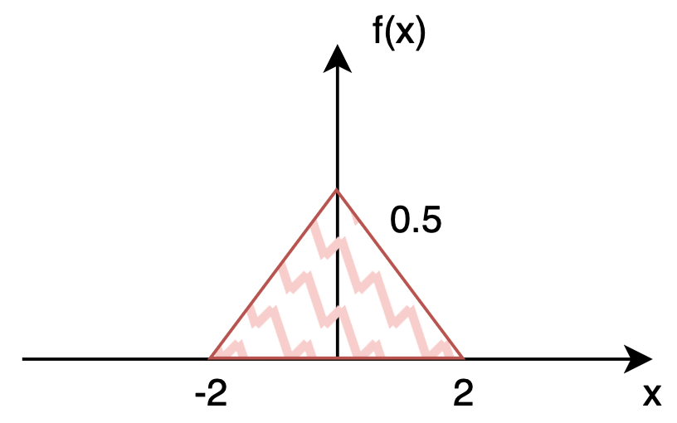









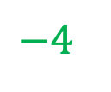

Example
🫨
$$−4$$
$$3$$
$$1$$
$$−1.9 (1)$$
$$−1.4 (2)$$
$$−0.9 (3)$$
$$−0.4 (4)$$
$$0.1 (5)$$
$$0.6 (4)$$
$$1.1 (3)$$
$$1.6 (1)$$

Slide 46
Simulation example
People waiting to get water from a pump. Let T_{i} be the inter-arrival time between the ith customer and the previous one, so
Customers arrival: T₁, T₁+T₂, T₁+T₂+T₃, ...
Their service times: S₁, S₂, S₃, ...
The pump capacity v is a model parameter to be determined, and S_{i} = R_{i} / v for all i, where R_{i} is the demand of the ith customer.

Slide 47
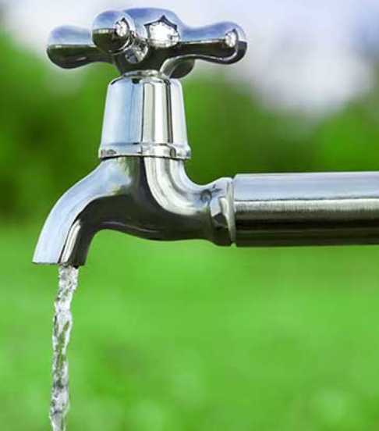


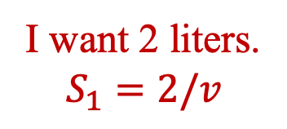
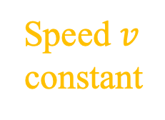


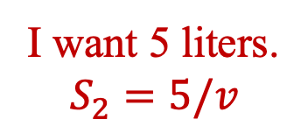
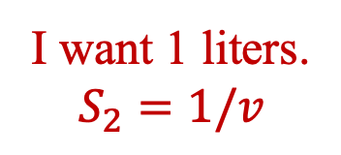
I want 1 liters.
$$S_{2}=1/v$$
Speed $v$
constant
I want 2 liters.
$$S_{1}=2/v$$
I want 5 liters.
$$S_{2}=5/v$$
$$T_{2}$$
$$T_{1}$$
How long should I wait?

Slide 48
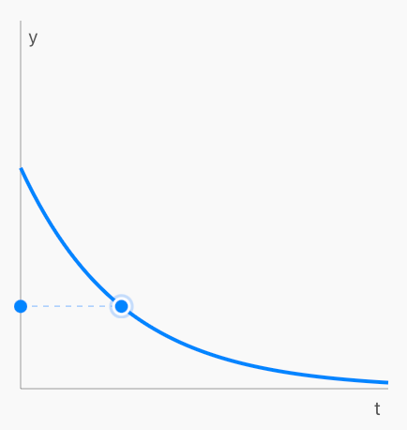
Simulation example (2)
An analysis of the situation leads to the following assumptions:
Inter-arrival times: every T_{i} has an Exp(0.5) distribution (minutes)
Service requirement: every R_{i} has a U(2, 5) distribution (liters)

Slide 49
Simulation example (3)
Let W_{i} be the waiting time of the ith customer:
W_{i} = max{W_{i-1} + S_{i-1} − T_{i}, 0}.

Slide 50




$$S=R/v$$
$$R\sim U(2,5)$$
$$T\sim Exp(0.5)$$
$$W_{0}=0$$
$$W_{i}=max⁡\{W_{i−1}+S_{i−1}−T_{i}, 0\}$$
The waiting time of the previous guy.
The service time of the previous guy.
The arrival time of this guy.

Slide 51
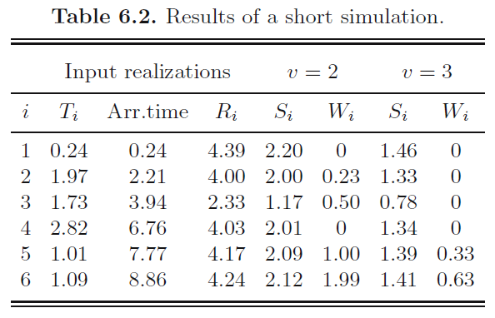
Simulation example (4)

Slide 52
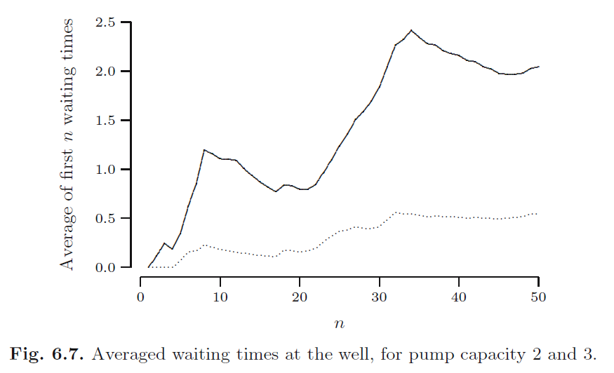
Simulation example (5)

Slide 53
Simulation example (6)
When the pump capacity is 2 (liters/minute),
the average waiting time is around 2.0 (minutes)
When the pump capacity is 3 (liters/minute)
the average waiting time is around 0.5 (minutes)

Slide 54
Summary
1. Using a coin to simulate a discrete random variable with N equally probable values
2. Using U(0, 1) to simulate a random variable
Ber, Bin, Geo, NegBin
Given p(x), f(x), or F(x)
3. Use case of problem-solving by simulation

