Slide 1

Representation Learning for Visual Tasks: A Study of Attention and Information Selection
Vivek Trivedy - Dissertation Defense
Advisor: Dr. Longin Jan Latecki
Committee: Dr. Mindy Shi, Dr. Richard Souvenir, Dr. Yiwei Chen

Slide 2
Agenda
Background & Motivation
Information Aggregation Across Examples (CNN2Graph, DMCAC)
Attention as Information Selection (Registers)
Directly Optimizing Attention for Objectness (OFA)
Conclusion & Future Work

Slide 3
Section 1: Background & Motivation

Slide 4

Why Visual Representation Learning?
Perceiving the visual world is fundamental to modern AI applications like autonomous navigation, medicine, and large-scale content retrieval.
At its core is visual representation learning: transforming raw pixels into compact, structured, and semantically meaningful embeddings for downstream tasks
Dataset
Neural Network
Classification
sample
Internal
Representation
Retrieval
Downstream Tasks

Slide 5
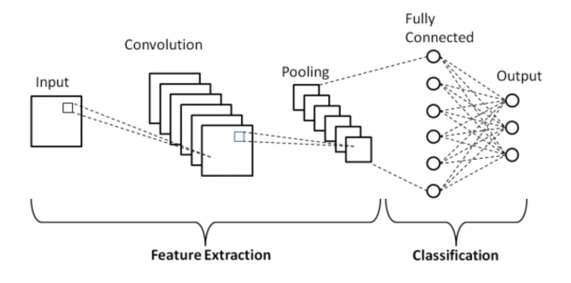
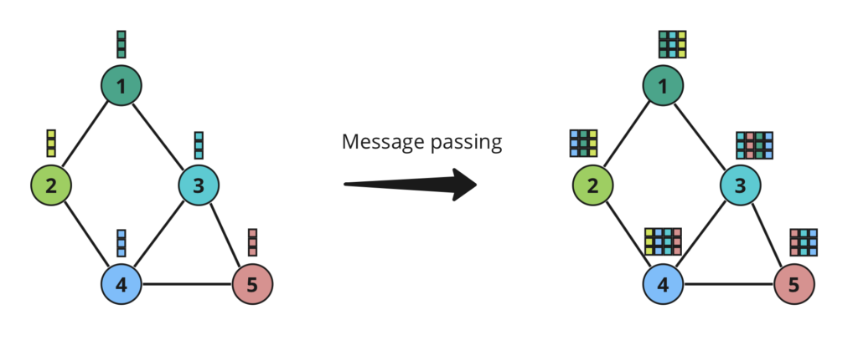
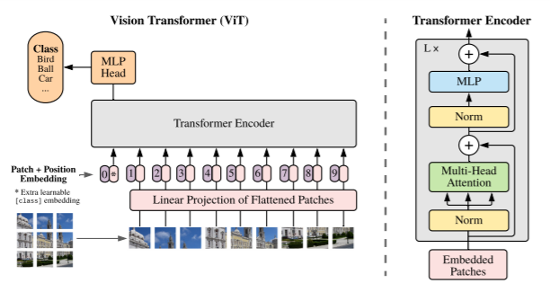
Architectures & Motivation
CNNs
GNNs
ViTs
These architectures point to 2 areas of interest across our work
  How does information get aggregated within/across images?
  What is the mechanism for selecting and upweighting “important” information?

Slide 6
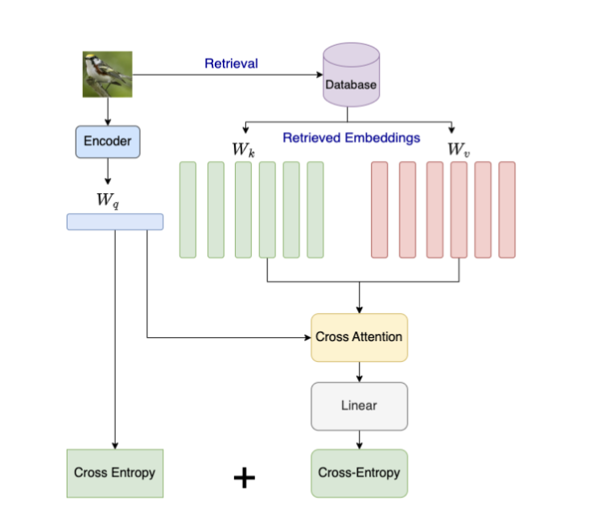
The Study & Use of Attention Mechanisms
Across our work we experiment with limiting and expanding the context of self-attention and cross-attention
Limit self-attention within images to focus on “important parts” (Registers & OFA)
Allow images to attend to other signals outside their pixels by cleverly constructing batches and training

Slide 7
Section 2: Information Aggregation Across Examples

Slide 8
Moving Beyond Independent Examples
Observation: Processing images independently (i.i.d.) overlooks contextual information and inter-example relationships within datasets
Question: "How can we enrich an image's representation with information gleaned from its surrounding context (dataset structure or database neighbors)?"
Our Solutions:
CNN2Graph: Using static dataset context for classification.
DMCAC: Using dynamic database context for retrieval.

Slide 9
CNN2Graph
WACV 2023
Goal: Improve classification by incorporating dataset-level class structure inductively and end-to-end
How: We pick n examples per class to serve as anchors and we also learn a set of proxies for each class → “selected/learned class representatives
Intuition: This creates a bipartite graph where the examples in a mini-batch attend over the anchors and proxies

Slide 10
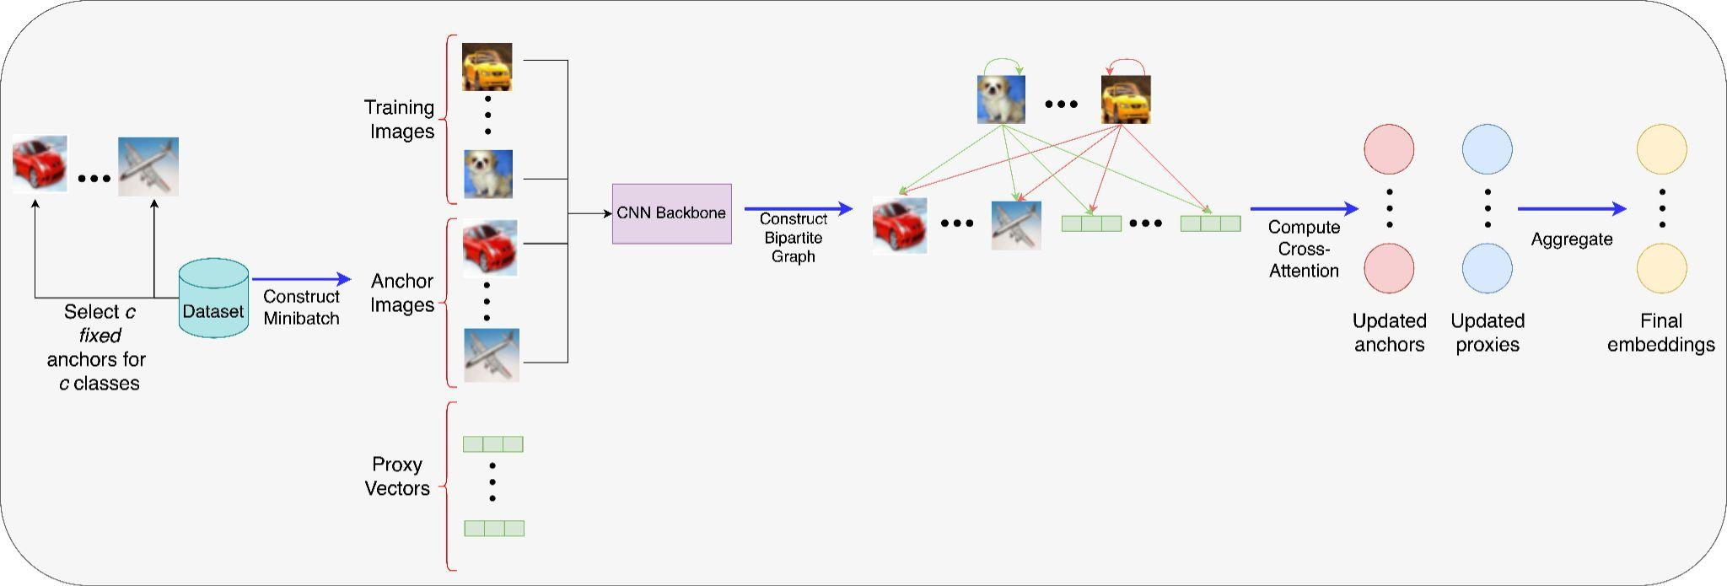
How the Forward Pass Works

Slide 11
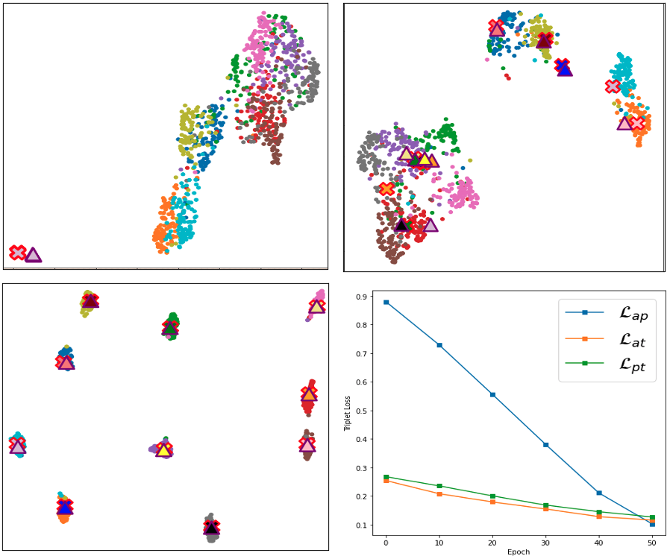
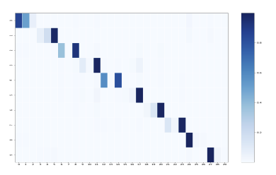
Visual Results
Anchors/Proxies Cluster w/ classes
Anchors (3 chosen) attend to correct classes on CIFAR-10

Slide 12
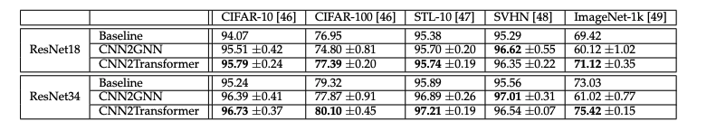
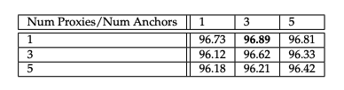
Empirical Results

Slide 13
DMCAC
IJCAI 2024
Problem: "Most retrieval methods train disconnected from the target database, leading to suboptimal alignment."
Goal: Condition representation learning on interactions with the target database during training.
Insight: When a query retrieves over a database, it produces a distribution. If we augment a query n times, they should produce similar distributions!

Slide 14
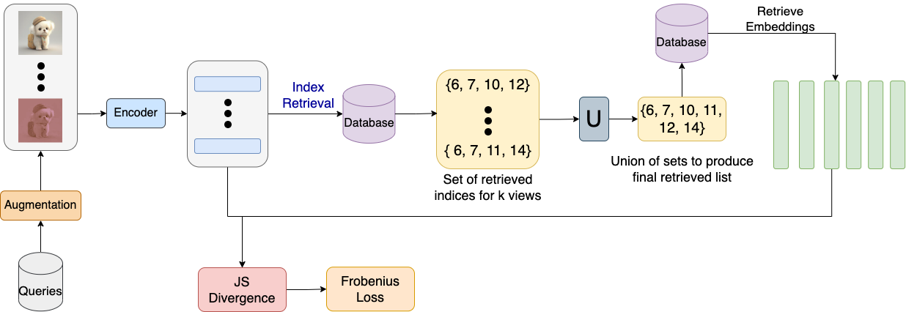
How Minimizing Divergence Works
We can produce n distributions for n augmented queries over a database
Minimize the divergence between every pairwise distribution

Slide 15
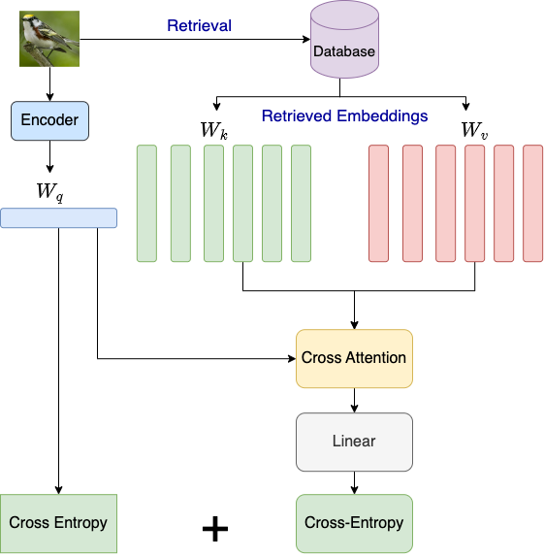
Cross-Attention Classification
Intuition: Cross-Attention is like projecting the query to database basis space
A good representation should be able to classify this new query embedding in db space

Slide 16
Conclusions
For large databases, you can use our approach with “approximate retrieval” with very little retrieval degradation
To make training stable, both divergence minimization and cross-attention classification are needed. We suffer from representation collapse without having both
Overall Takeaway: Using context across examples via cross-attention—whether static dataset structure (CNN2Graph) or dynamic database interactions (DMCAC)—yields richer, more task-aligned representations."

Slide 17
Section 3: Attention as Information Selection

Slide 18
Can we Identify which Tokens are Important?
Hypothesis: What if in retrieval, we used more than the CLS token? Could we get better representations with more tokens?
Problem: It is difficult to reliably find relevant tokens if attention maps are messy
Solution: We can use register tokens to automatically find regions of interest for better retrieval

Slide 19
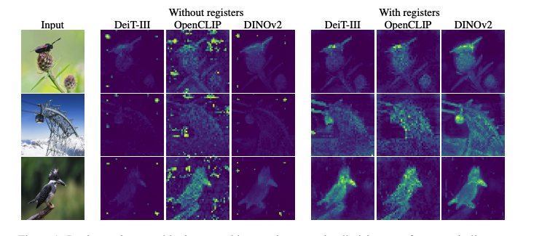
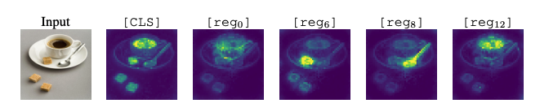
Why Use Registers?

Slide 20
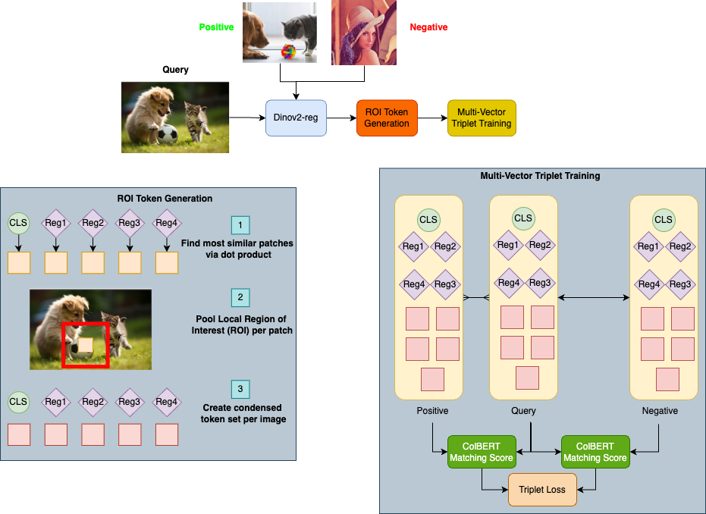
Registers to Find Regions of Interest
ICCV 2025
(under review)
Registers give us a way of identifying important regions via similarity scores
We adapt classical retrieval to use a multi-vector retrieval approach (common in NLP), but with a curated set of high signal tokens

Slide 21
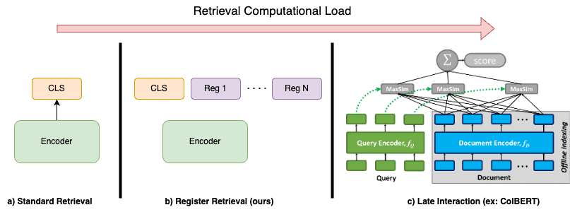
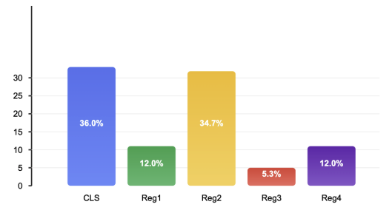
Thinking About Efficiency
We use far fewer tokens for retrieval than picking all patch tokens
We can do this because we find that often the CLS token of a class (COCO dog class) is most similar to a register token

Slide 22
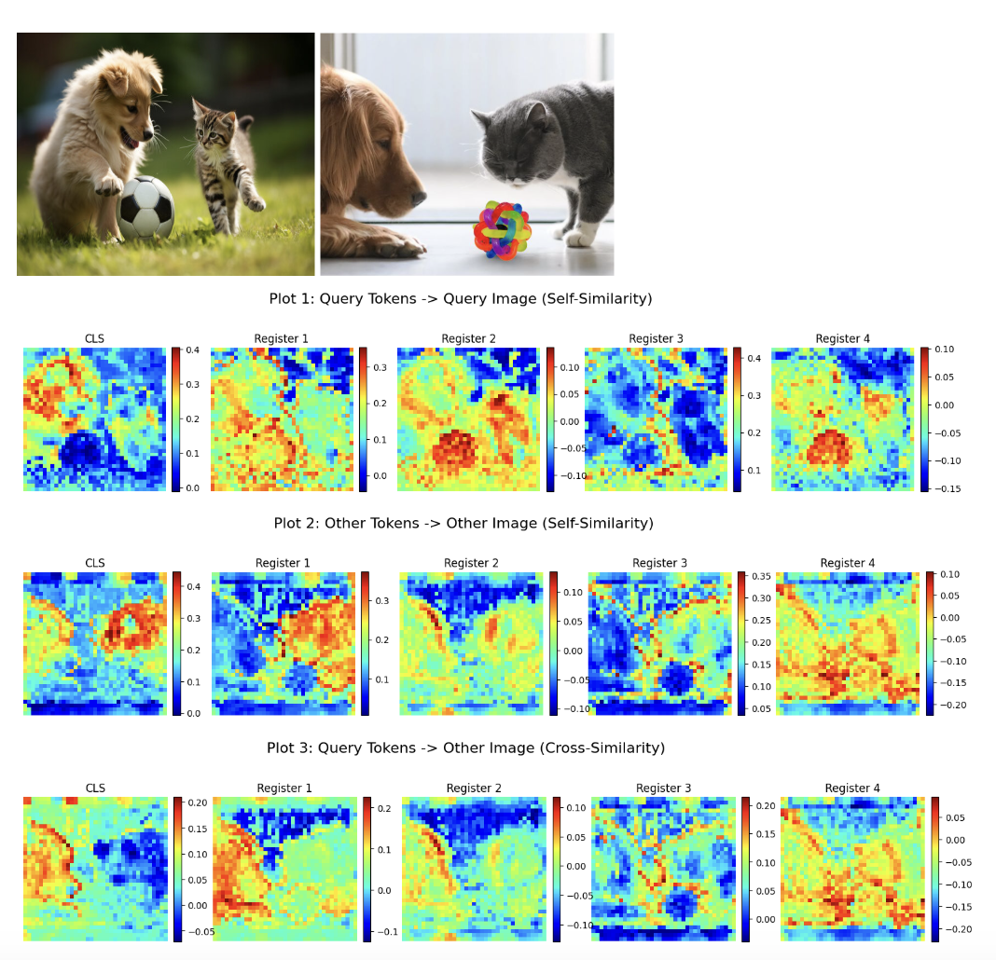
Visualizing Similarity
We qualitatively evaluate how our “bag of tokens” finds patterns within an image (rows 1,2) and across images (row 3)
We find that although the patterns aren’t totally consistent, there appears to be particular semantic activations for our tokens across images

Slide 23
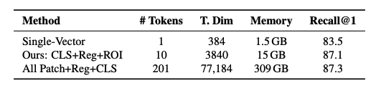
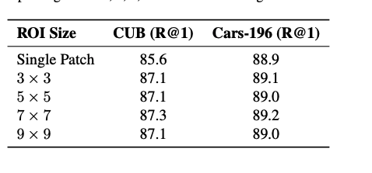
Conclusions
On CUB-200, we show that our approach has very similar results to using all tokens but with 20x memory savings
We also show relative stability depending on our ROI size, but we want explore this multi-scaleness more
Careful token selection + multi-vector training improves retrieval performance dramatically

Slide 24
Section 4: Directly Optimizing Attention for Objectness

Slide 25
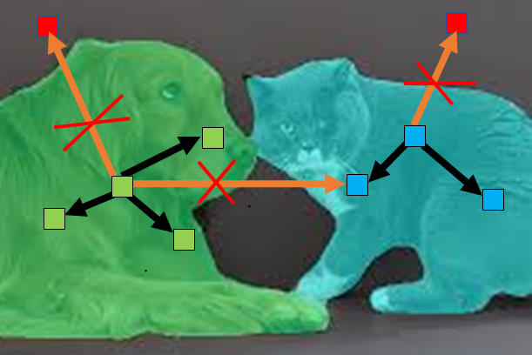
Object Focused Attention
ICPR 2024
Problem: ViTs can learn 'shortcuts' relying on spurious correlations (e.g., background texture) rather than intrinsic object properties (shape)
Hypothesis: Can we explicitly control the ViT's self-attention mechanism during training to force focus on semantically relevant object regions?

Slide 26
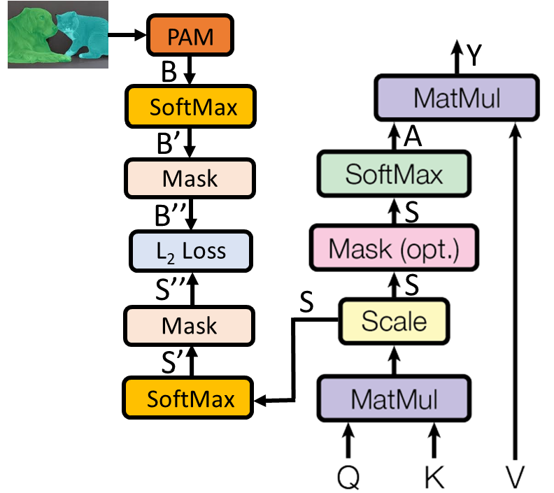
How OFA Works
We use segmentation masks to figure out which patches are part of the same object to define a Patch Attention Matrix (PAM)
We compute an auxillary L2 loss between the PAM and observed attention to encourage patches to focus on “correct objects”

Slide 27
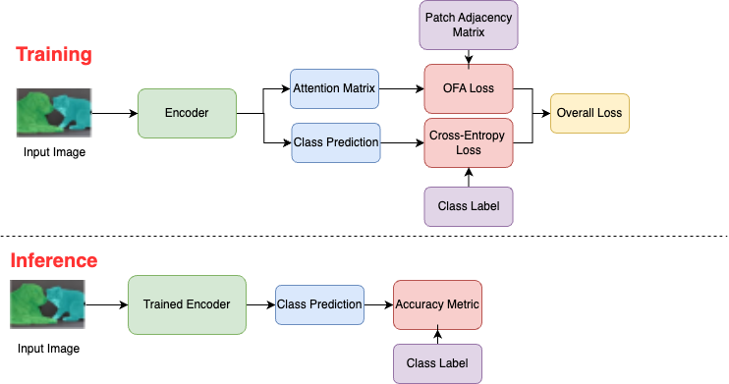
No Additional Inference Time Costs

Slide 28
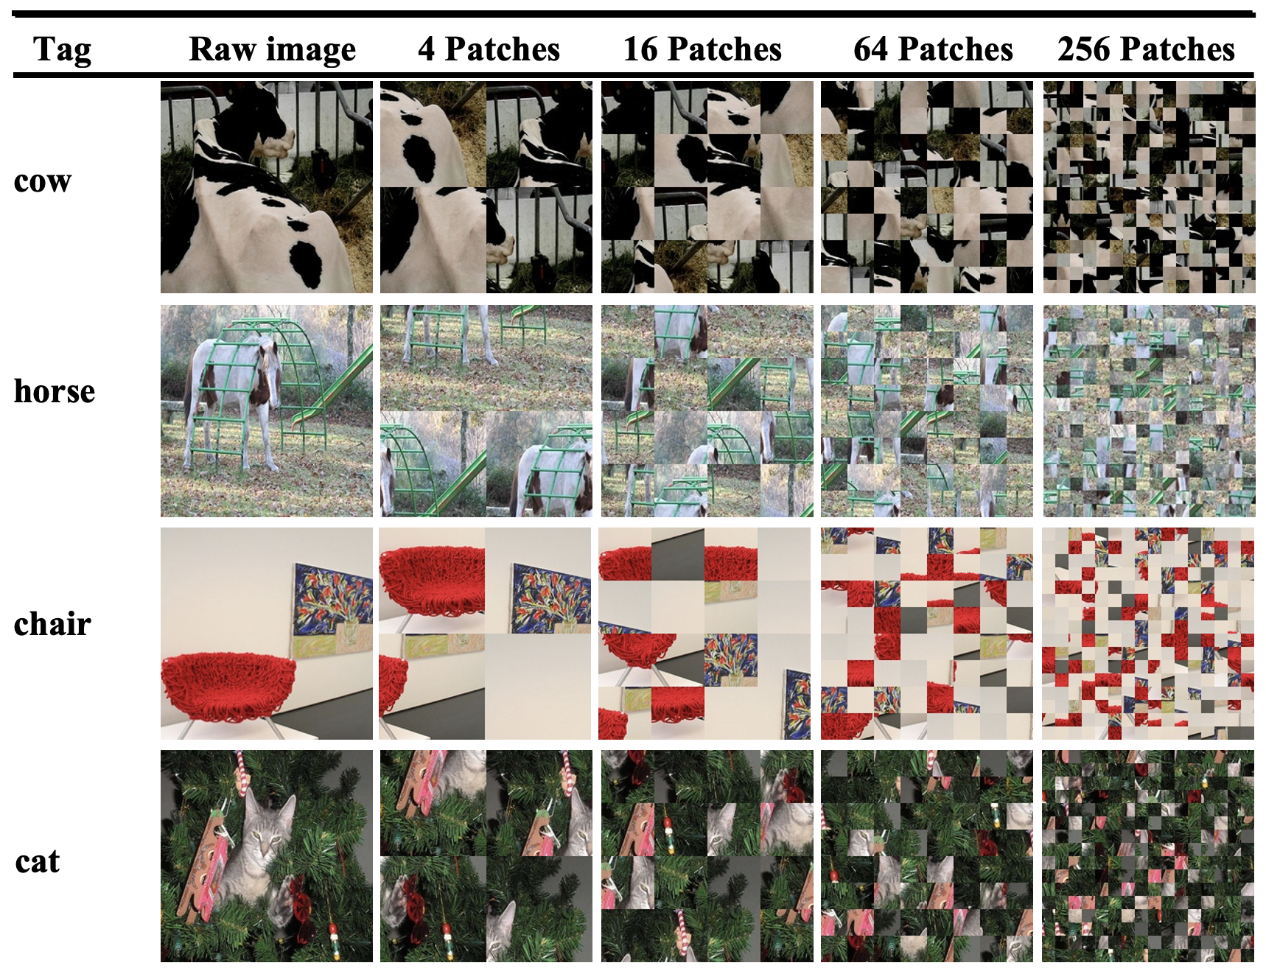
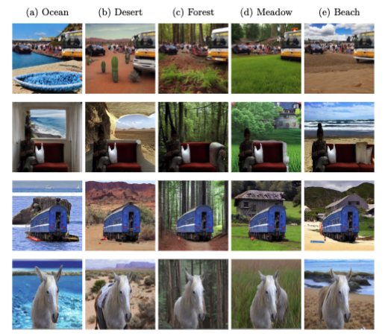

Synthetic Datasets
We create 2 synthetic benchmarks - patch shuffling and adversarial inpainting (COCO) to test if OFA focuses on objects
We find that OFA’s degradation is much reduced compared to standard ViTs (inpainting table below for Recall@1)

Slide 29
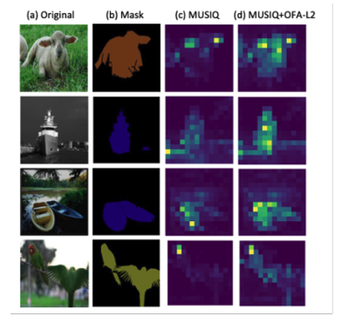
Conclusions
Adding OFA creates qualitatively and quantitatively better retrieval performance
Explicitly controlling attenion during training mitigates shortcut learning, improve OOD robustness, and creates more semantically grounded representations without added inference cost.

Slide 30
Section 5: Conclusions and Future Work

Slide 31
Tying it Together
We improved representations by making attention aware of context across examples:
CNN2Graph Integrated static dataset structure.
DMCAC Conditioned on dynamic database interactions.
We improved representations by enabling attention to efficiently capture detail within images:
Used internal signals (registers) for efficient multi-vector features
We improved representations by explicitly controlling attention's focus:
OFA guided self-attention towards objects to reduce shortcuts

Slide 32
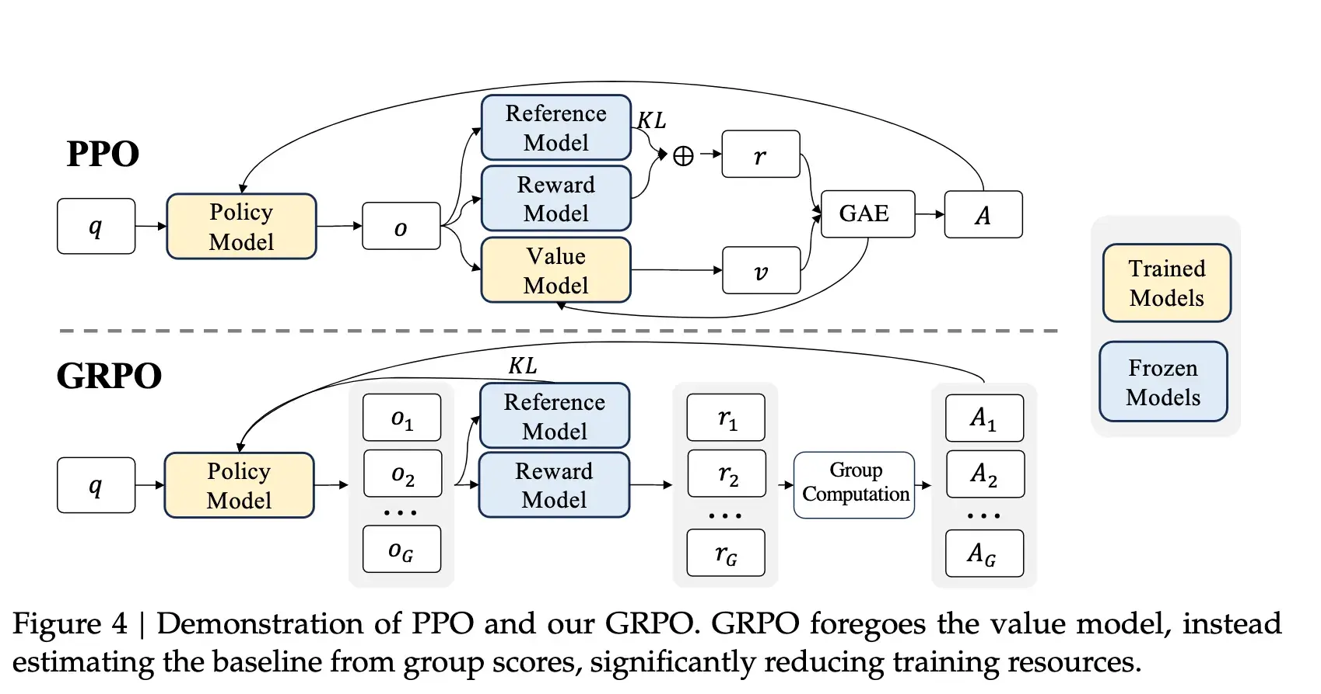
Future Directions
Experiment if registers can automatically discover multi-resolution and multi-scale tasks. Test on coarse and fine-grained visual recognition
What attention patterns does Reinforcement Learning (GRPO) learn and correct during chain-of-thought?
  Does chain of thought help visual reasoning?
  Do VLMs suffer from perception problems

Slide 33
Thank You!
Questions?

Slide 34
Publications
Trivedy, Vivek, and Longin Jan Latecki. "CNN2Graph: Building Graphs for Image Classification." Proceedings of the IEEE/CVF Winter Conference on Applications of Computer Vision. 2023.
Trivedy, Vivek & Latecki, Longin. (2024). Image Retrieval with Self-Supervised Divergence Minimization and Cross-Attention Classification. International Joint Conference on Artificial Intelligence. 1344-1352. 10.24963/ijcai.2024/149.
Trivedy, Vivek, and Longin Jan Latecki. ”Learning Object Focused Attention." Proceedings of the International Conference on Pattern Recognition. 2024
Trivedy, Vivek, and Longin Jan Latecki. ”Augmenting the CLS Token with Region of Interest Tokens for Efficient Multi-Vector Image Retrieval." International Conference on Computer Vision 2025 (Under Review)

Slide 35
References
L. -F. Dong, Y. -Z. Gan, X. -L. Mao, Y. -B. Yang and C. Shen, "Learning Deep Representations Using Convolutional Auto-Encoders with Symmetric Skip Connections," 2018 IEEE International Conference on Acoustics, Speech and Signal Processing (ICASSP), 2018, pp. 3006-3010, doi: 10.1109/ICASSP.2018.8462085.
Alexey Dosovitskiy, Lucas Beyer, Alexander Kolesnikov, Dirk Weissenborn, Xiaohua Zhai, Thomas Unterthiner, Mostafa Dehghani, Matthias Minderer, Georg Heigold, Sylvain Gelly, Jakob Uszkoreit, Neil Houlsby: “An Image is Worth 16x16 Words: Transformers for Image Recognition at Scale”, 2020
Kaiming He, Xinlei Chen, Saining Xie, Yanghao Li, Piotr Dollár, Ross Girshick: “Masked Autoencoders Are Scalable Vision Learners”, 2021; [http://arxiv.org/abs/2111.06377 arXiv:2111.06377]. * William L. Hamilton, Rex Ying, Jure Leskovec: “Inductive Representation Learning on Large Graphs”, 2017; [http://arxiv.org/abs/1706.02216 arXiv:1706.02216].
Caron, Mathilde, et al. "Emerging properties in self-supervised vision transformers." Proceedings of the IEEE/CVF international conference on computer vision. 2021.
Chen, Ting, et al. "A simple framework for contrastive learning of visual representations." International conference on machine learning. PMLR, 2020.
Keyulu Xu, Weihua Hu, Jure Leskovec, Stefanie Jegelka: “How Powerful are Graph Neural Networks?”, 2018; [http://arxiv.org/abs/1810.00826 arXiv:1810.00826].
Petar Veličković, Guillem Cucurull, Arantxa Casanova, Adriana Romero, Pietro Liò, Yoshua Bengio: “Graph Attention Networks”, 2017; [http://arxiv.org/abs/1710.10903 arXiv:1710.10903].
Yang Hu, Haoxuan You, Zhecan Wang, Zhicheng Wang, Erjin Zhou, Yue Gao: “Graph-MLP: Node Classification without Message Passing in Graph”, 2021; [http://arxiv.org/abs/2106.04051 arXiv:2106.04051].
Adrian Arnaiz-Rodriguez, Ahmed Begga, Francisco Escolano, Nuria Oliver: “DiffWire: Inductive Graph Rewiring via the Lovász Bound”, 2022; [http://arxiv.org/abs/2206.07369 arXiv:2206.07369].
Jake Topping, Francesco Di Giovanni, Benjamin Paul Chamberlain, Xiaowen Dong, Michael M. Bronstein: “Understanding over-squashing and bottlenecks on graphs via curvature”, 2021; [http://arxiv.org/abs/2111.14522 arXiv:2111.14522].
Ashish Vaswani, Noam Shazeer, Niki Parmar, Jakob Uszkoreit, Llion Jones, Aidan N. Gomez, Lukasz Kaiser, Illia Polosukhin: “Attention Is All You Need”, 2017; [http://arxiv.org/abs/1706.03762 arXiv:1706.03762].
Darcet, Timothée, et al. "Vision transformers need registers." arXiv preprint arXiv:2309.16588 (2023).
Mathilde Caron, Ishan Misra, Julien Mairal, Priya Goyal, Piotr Bojanowski, Armand Joulin: “Unsupervised Learning of Visual Features by Contrasting Cluster Assignments”, 2020; [http://arxiv.org/abs/2006.09882 arXiv:2006.09882].
* Anees Kazi, Luca Cosmo, Seyed-Ahmad Ahmadi, Nassir Navab, Michael Bronstein: “Differentiable Graph Module (DGM) for Graph Convolutional Networks”, 2020, IEEE Transactions on Pattern Analysis and Machine Intelligence (2022); [http://arxiv.org/abs/2002.04999 arXiv:2002.04999]. DOI: [https://dx.doi.org/10.1109/TPAMI.2022.3170249 10.1109/TPAMI.2022.3170249].

Slide 36
References (continued)
Sainbayar Sukhbaatar, Arthur Szlam, Jason Weston, Rob Fergus: “End-To-End Memory Networks”, 2015; [http://arxiv.org/abs/1503.08895 arXiv:1503.08895]
Róbert Csordás, Jürgen Schmidhuber: “Improving Differentiable Neural Computers Through Memory Masking, De-allocation, and Link Distribution Sharpness Control”, 2019; [http://arxiv.org/abs/1904.10278 arXiv:1904.10278].
Shaked Brody, Uri Alon, Eran Yahav: “How Attentive are Graph Attention Networks?”, 2021; [http://arxiv.org/abs/2105.14491 arXiv:2105.14491].
Alex Graves, Greg Wayne, Ivo Danihelka: “Neural Turing Machines”, 2014; [http://arxiv.org/abs/1410.5401 arXiv:1410.5401].
Rahmanzadehgervi, Pooyan, et al. "Vision language models are blind." Proceedings of the Asian Conference on Computer Vision. 2024.

Slide 37
Industrial Publications
MapMyCells(RRID:SCR_024672)

Slide 38
Appendix

Slide 39
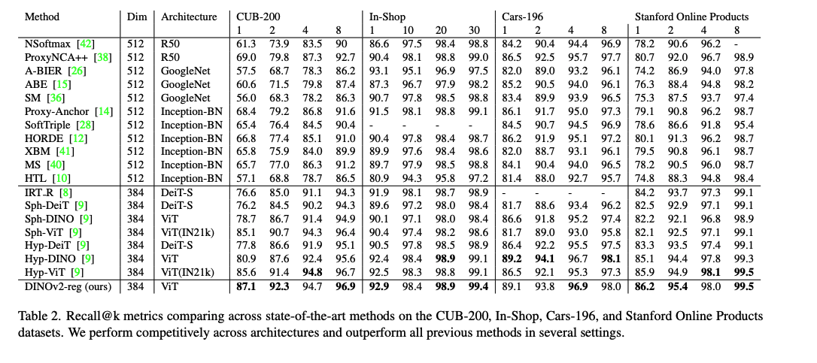
Registers Main Table

Slide 40
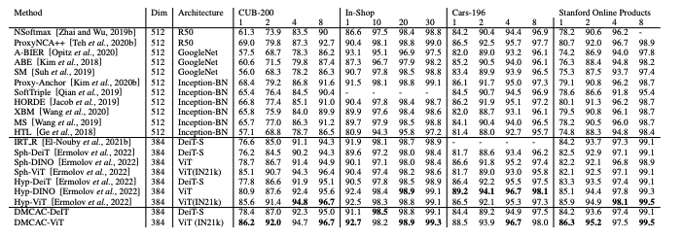
DMCAC Table

Slide 41
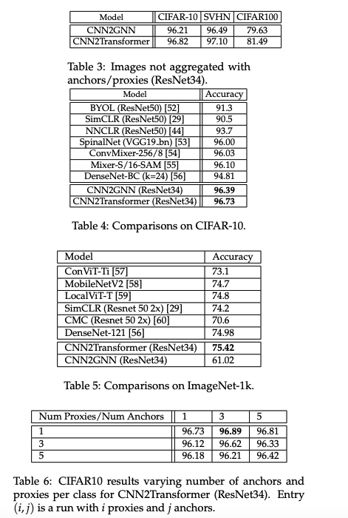
CNN2Graph Tables

Slide 42
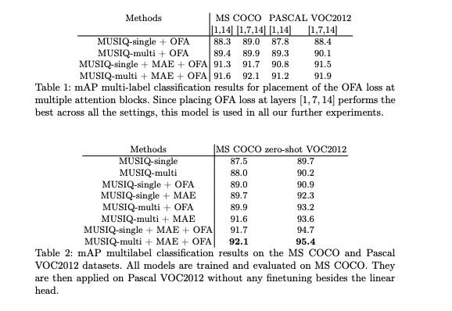
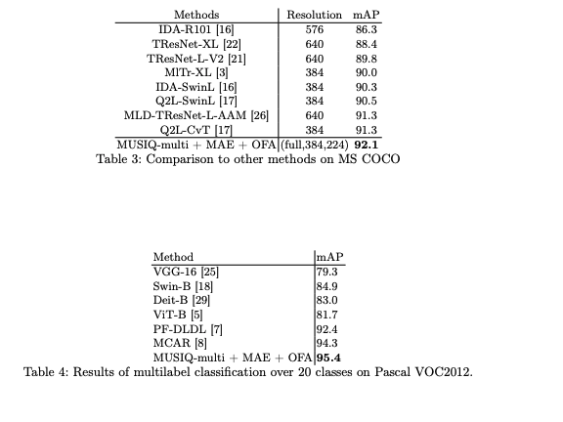
OFA Tables

