Slide 1
INTRODUCTION TO
Vision
Transformers
How an image becomes a sequence—and how self-attention reasons over it
Longin Jan Latecki, latecki@temple.edu
01
Notes:
Open by asking: if a Transformer expects a sequence, what should count as a ‘word’ in an image? Preview the answer: fixed-size patches become tokens.
[Sources]
https://arxiv.org/abs/2010.11929

Slide 2
VISION TRANSFORMERS
By the end, you can trace every tensor through a ViT
01
02
03
04
Tokenize
Attend
Transform
Predict
Convert H×W pixels into N patch tokens.
Explain Q, K, V and scaled dot-product attention.
Read the pre-norm residual block equations.
Connect the [CLS] representation to class logits.
2017 — “Attention Is All You Need”
Vaswani et al. introduced the Transformer and multi-head self-attention
2020 — “An Image Is Worth 16×16 Words: Transformers for Image Recognition at Scale” (ViT)
Dosovitskiy et al. divided images into patches, treated the patches as tokens, and processed them with a standard Transformer encoder.
02
Notes:
Use these outcomes to frame the lecture. The equations will always be tied to tensor meaning and shape.
[Sources]
https://arxiv.org/abs/2010.11929

Slide 3
Core Components of a Vision Transformer
Patch Embedding: The model splits an input image into a grid of non-overlapping square blocks (e.g., 16 × 16 pixels), flattens each block into a 1D vector, and projects it via a linear layer into a fixed-size embedding dimension.
[CLS] Token: A learnable vector prepended to the patch sequence that interacts with all other patches via attention, ultimately holding the global image representation for final classification.
Positional Embedding: Learnable 1D vectors added to the patch embeddings to retain and inject spatial awareness, telling the model where each patch sits in the original image grid.
Transformer Encoder Blocks: Stacks of repeating layers containing Layer Normalization (LayerNorm), Multi-Head Self-Attention (MSA) to measure semantic relationships across distant patches, and Multi-Layer Perceptrons (MLP/FFN) with residual connections.
MLP Head: A final dense/linear classification layer that maps the processed [CLS] token output to the final class prediction probabilities

Slide 4

https://medium.com/analytics-vidhya/illustrated-vision-transformers-165f4d0c3dd1

Slide 5
VISION TRANSFORMERS
ViT changes the visual primitive
CNN
ViT
Local kernels scan neighboring pixels
Hierarchy grows the receptive field
Translation structure is built in
Patches form a token sequence
Attention connects every token directly
Position must be added explicitly
same input → class probabilities
03
Notes:
Anchor new material in what students know. Both architectures map an image to class probabilities; their inductive biases and internal operations differ.
[Sources]
https://arxiv.org/abs/2010.11929

Slide 6
VISION TRANSFORMERS
Transformer foundations
Vision Transformer (ViT)
A closer look at the Transformer mechanics used inside the ViT encoder
04
Notes:
Anchor new material in what students know. Both architectures map an image to class probabilities; their inductive biases and internal operations differ.
[Sources]
https://arxiv.org/abs/2010.11929
[Sources]
- User-provided ViT_v1.pptx, slide 1.

Slide 7
VISION TRANSFORMERS
A ViT feeds image-patch tokens to a Transformer encoder
Image
Patch + project
Add [CLS] + position
L × encoder block
Linear classifier
pixels
N vectors
N+1 tokens
contextual tokens
C logits
image → patches → token sequence → Transformer → class
The whole lecture in one line
05
Notes:
Walk left to right. Emphasize that the Transformer encoder is standard; the key adaptation is turning a 2-D image into a 1-D token sequence.
[Sources]
https://arxiv.org/abs/2010.11929

Slide 8
VISION TRANSFORMERS
ViT uses the Transformer encoder
ENCODER
Input tokens
Maps an input token sequence to a contextual token sequence.
Stacks self-attention and MLP sublayers with residual paths and normalization.
ViT uses the final [CLS] token for classification.
LN → MSA
+ residual
LN → MLP
+ residual
DECODER
Useful when generating a different output sequence—for example, translation. It is not required for standard ViT classification.
Contextual tokens
06
Notes:
Connect the generic Transformer to ViT. Classification needs an encoder stack; the autoregressive decoder is a different use case.
[Sources]
C:/Web/Courses/CIS5590-Fall26/Temp/ViT_v1.pptx
https://arxiv.org/abs/2010.11929
https://arxiv.org/abs/1706.03762

Slide 9
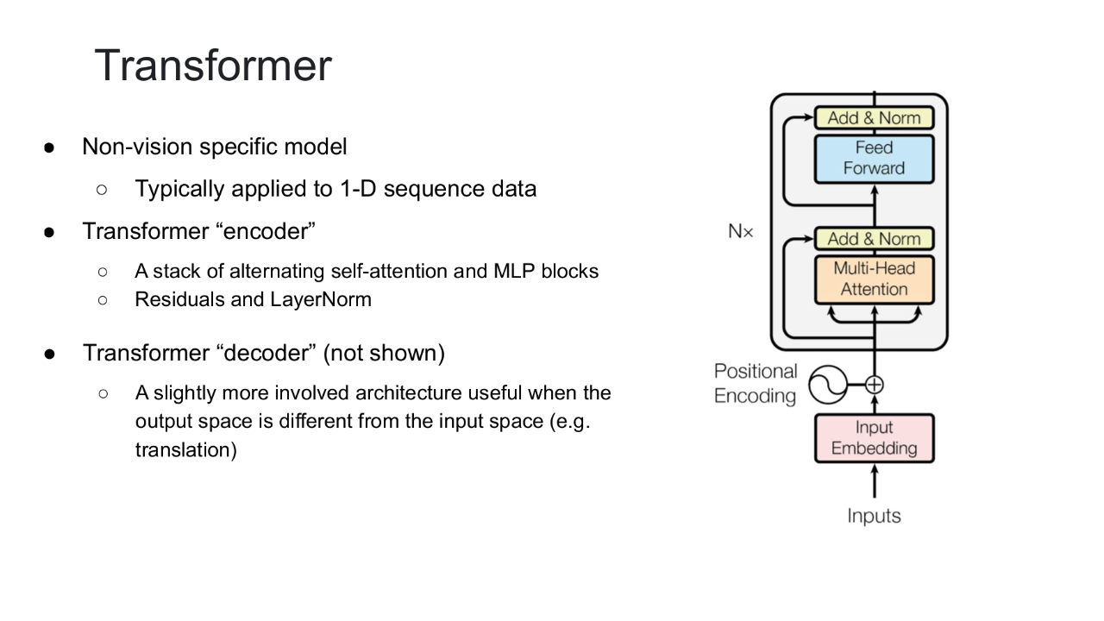
VISION TRANSFORMERS
Transformer encoders build context in layers
07
Notes:
Anchor new material in what students know. Both architectures map an image to class probabilities; their inductive biases and internal operations differ.
[Sources]
https://arxiv.org/abs/2010.11929
[Sources]
- User-provided ViT_v1.pptx, slide 2.

Slide 10
VISION TRANSFORMERS
Patch size controls sequence length—and attention cost
N = HW / P²
Worked example
224 × 224 image, P = 16
H×W image, P×P non-overlapping patches
224 / 16 = 14 patches per side
N number of patch tokens
H, W image height and width
P patch side length
N = 14 × 14 = 196 patch tokens
After [CLS]: sequence length = 197
Halving P roughly quadruples N—and makes global attention ≈16× larger.
08
Notes:
Derive N geometrically. Then connect sequence length to quadratic attention. Ask students what happens when P changes from 16 to 8.
[Sources]
https://arxiv.org/abs/2010.11929

Slide 11
VISION TRANSFORMERS
Each patch becomes a D-dimensional token
flatten
linear projection E
xₚⁱ ∈ ℝᴾ²ᶜ
xₚⁱ E ∈ ℝᴰ
P × P × C
E ∈ ℝ⁽ᴾ²ᶜ⁾×ᴰ
The same learned projection is applied to every patch
09
Notes:
The subscript p means patch. Flattening preserves the numbers but removes the 2-D arrangement; E learns a D-dimensional token representation.
[Sources]
https://arxiv.org/abs/2010.11929

Slide 12
VISION TRANSFORMERS
The input is [CLS] plus positioned patch tokens
z₀ = [ x_class ; xₚ¹E ; ··· ; xₚᴺE ] + E_pos
z₀ ∈ ℝ⁽ᴺ⁺¹⁾×ᴰ
[CLS]
patch 1
patch 2
···
patch N
+
pos 0
pos 1
pos 2
pos 3
pos 4
[CLS] is a learned vector that gathers information for classification.
E_pos has one learned D-vector for every sequence position.
Semicolons mean concatenate along the token axis.
10
Notes:
Explain the sequence from left to right. Clarify that x_class and E_pos are learned parameters, while patch tokens depend on the input image.
[Sources]
https://arxiv.org/abs/2010.11929

Slide 13
VISION TRANSFORMERS
Position makes token order visible to attention
Same patch content, different location
x1
x2
x3
x4
x5
x6
+
p1
p2
p3
p4
p5
p6
Without position
learned E_pos
tokenᵢ = patch_embeddingᵢ + position_embeddingᵢ
Location becomes part of the token representation
11
Notes:
Attention alone treats inputs as a set. Positional embeddings let the network distinguish, for example, an eye patch near the top from a similar texture elsewhere.
[Sources]
https://arxiv.org/abs/2010.11929

Slide 14
VISION TRANSFORMERS
VISION TRANSFORMERS
Position can be learned or fixed
Position can be learned or fixed
Learned positions
Fixed sinusoidal positions
One trainable D-vector per sequence position.
Added to patch and [CLS] embeddings.
This is the original ViT choice.
PE(pos, 2i) = sin(pos / 10000^(2i/d_model))
PE(pos, 2i+1) = cos(pos / 10000^(2i/d_model))
tokenᵢ = embeddingᵢ + E_posᵢ
learned E_pos
Same dimension D as the token embedding.
Feature pairs use different spatial frequencies.
Both methods inject order by addition—not concatenation.
12
Notes:
The source deck adds the fixed sinusoidal alternative. Clarify that the original ViT uses learned positional embeddings, while the original Transformer introduced sine/cosine encodings.
[Sources]
C:/Web/Courses/CIS5590-Fall26/Temp/ViT_v1.pptx
https://arxiv.org/abs/2010.11929
https://arxiv.org/abs/1706.03762

Slide 15
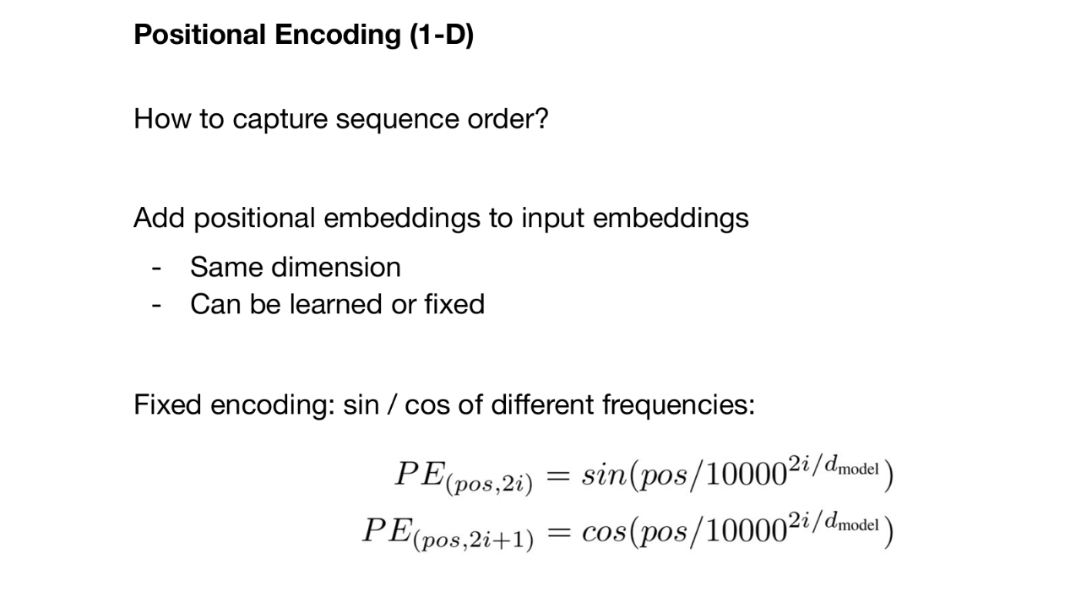
VISION TRANSFORMERS
Position encodings preserve sequence order
13
Notes:
Anchor new material in what students know. Both architectures map an image to class probabilities; their inductive biases and internal operations differ.
[Sources]
https://arxiv.org/abs/2010.11929
[Sources]
- User-provided ViT_v1.pptx, slide 8.

Slide 16
VISION TRANSFORMERS
A block mixes tokens, then features
Input zₗ₋₁
LN → MSA
Residual add
LN → MLP
Residual add zₗ
MSA = Multi-Head
Self-Attention
MLP transforms features within each token
mixes across tokens
pre-norm: normalize → transform → add the shortcut
14
Notes:
Introduce the two sublayers before diving into equations. MSA communicates across spatial locations; the MLP operates independently at each token position.
[Sources]
https://arxiv.org/abs/2010.11929

Slide 17
VISION TRANSFORMERS
Layer normalization acts on each token
For one token x ∈ ℝᴰ
What LN does
1 Computes μ and σ² across the D features of one token
2 Normalizes those features to a common scale
3 Learns a scale γ and shift β for each feature
μ = (1/D) Σⱼ xⱼ σ² = (1/D) Σⱼ (xⱼ − μ)²
LN(x)ⱼ = γⱼ · (xⱼ − μ) / √(σ² + ε) + βⱼ
Unlike BatchNorm, LN does not use statistics from other examples in the mini-batch.
Pre-norm ViT block: apply LN before MSA, then apply LN again before the MLP.
15
Notes:
Layer normalization computes normalization statistics within one example; for a ViT token, that means across its D feature dimensions.
γ and β are learned feature-wise parameters; ε provides numerical stability.
[Sources]
- Ba, J. L., Kiros, J. R., & Hinton, G. E. (2016). Layer Normalization. https://arxiv.org/abs/1607.06450
- User-provided integrated Vision Transformers deck, source slide 14, for the pre-norm placement shown in this lecture.

Slide 18
VISION TRANSFORMERS
Q, K, and V are three learned views of X
Q = XW_Q K = XW_K V = XW_V
For one attention head: X ∈ ℝᵀ×ᴰ, Q,K ∈ ℝᵀ×ᵈᵏ, V ∈ ℝᵀ×ᵈᵛ
Query Q
Key K
Value V
What am I looking for?
What do I contain?
What information can I send?
W_Q
W_K
W_V
16
Notes:
Use a retrieval analogy: a query is matched against keys; the resulting weights blend values. T=N+1 is the sequence length.
[Sources]
https://arxiv.org/abs/2010.11929
https://arxiv.org/abs/1706.03762

Slide 19
VISION TRANSFORMERS
VISION TRANSFORMERS
Attention mixes values
Attention mixes values
Attention(Q,K,V) = softmax( QKᵀ / √dₖ ) V
Output shape: T × dᵥ
1
Compare
2
Scale
3
Normalize
4
Aggregate
QKᵀ produces every query–key similarity.
Divide by √dₖ to keep logits numerically controlled.
softmax makes each row nonnegative and sum to 1.
Multiply by V to form weighted value mixtures.
17
Notes:
Read the equation as four verbs. The scale factor comes from the Transformer paper: large dot products can push softmax into small-gradient regions.
[Sources]
https://arxiv.org/abs/2010.11929
https://arxiv.org/abs/1706.03762

Slide 20
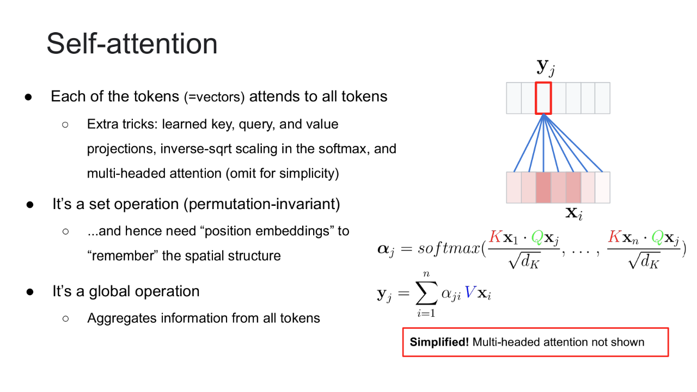
VISION TRANSFORMERS
Self-attention gathers global context
18
Notes:
Anchor new material in what students know. Both architectures map an image to class probabilities; their inductive biases and internal operations differ.
[Sources]
https://arxiv.org/abs/2010.11929
[Sources]
- User-provided ViT_v1.pptx, slide 3.

Slide 21
VISION TRANSFORMERS
One attention row is one weighted sum
αⱼᵢ = exp(qⱼ·kᵢ / √dₖ) / Σᵣ exp(qⱼ·kᵣ / √dₖ)
attention from output position j to source position i
yⱼ = Σᵢ αⱼᵢ vᵢ
new representation at token position j
v₁
v₂
v₃
…
v_T
yⱼ
αⱼ1
αⱼ2
αⱼ3
αⱼT
The matrix formula computes this operation for every j simultaneously.
19
Notes:
Translate between the scalar and matrix views. For a fixed query position j, softmax produces weights across every source position i, and the values are averaged with those weights.
[Sources]
C:/Web/Courses/CIS5590-Fall26/Temp/ViT_v1.pptx
https://arxiv.org/abs/1706.03762

Slide 22
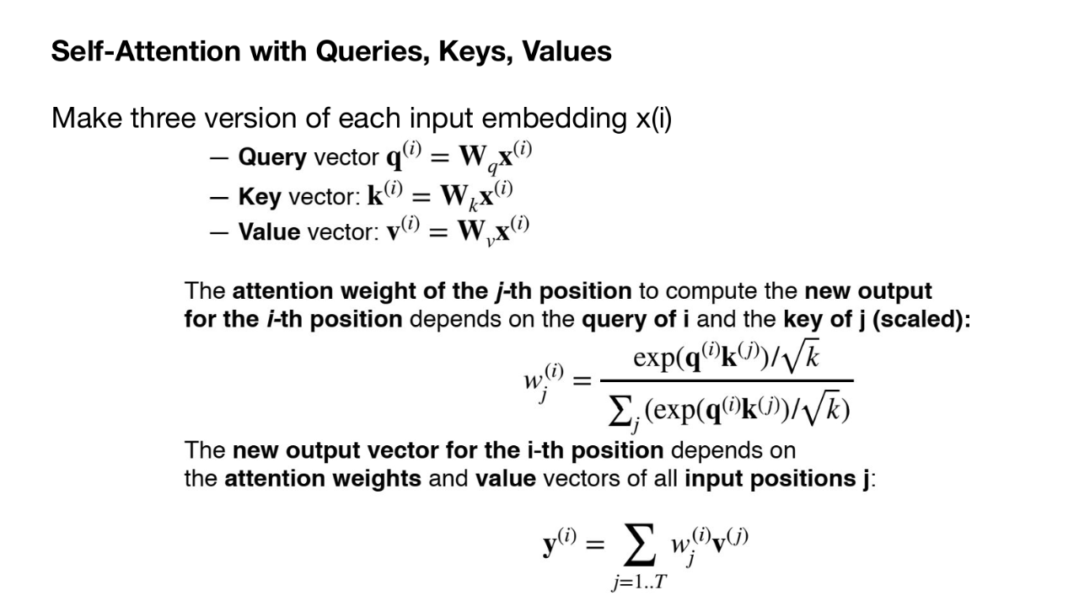
VISION TRANSFORMERS
Queries, keys, and values define attention weights
20
Notes:
Anchor new material in what students know. Both architectures map an image to class probabilities; their inductive biases and internal operations differ.
[Sources]
https://arxiv.org/abs/2010.11929
[Sources]
- User-provided ViT_v1.pptx, slide 4.

Slide 23
VISION TRANSFORMERS
Each token learns where to look
Query: [CLS]
[CLS]
sky
bird
branch
0.10
0.15
0.55
0.20
0.4
0.8
2.1
1.2
weights sum to 1.00
scaled scores
softmax
output_[CLS] = 0.10v_cls + 0.15v_sky + 0.55v_bird + 0.20v_branch
The output is a weighted sum of value vectors
21
Notes:
This is illustrative, not computed from a trained model. Stress that each query gets its own attention distribution and therefore its own value mixture.
[Sources]
https://arxiv.org/abs/1706.03762

Slide 24
VISION TRANSFORMERS
VISION TRANSFORMERS
QKᵀ forms a T × T attention map
QKᵀ forms a T × T attention map
softmax row-wise
Q
Kᵀ
QKᵀ
V
H
dₖ × T
T × dₖ
T × T
T × dᵥ
T × dᵥ
Each row of the attention map is nonnegative and sums to 1.
H = softmax(QKᵀ / √dₖ) V
22
Notes:
Use the shapes to check matrix multiplication. QK^T creates all T-by-T token interactions; row-wise softmax converts each query row into a distribution; multiplication by V returns one output per token.
[Sources]
C:/Web/Courses/CIS5590-Fall26/Temp/ViT_v1.pptx
https://arxiv.org/abs/1706.03762

Slide 25
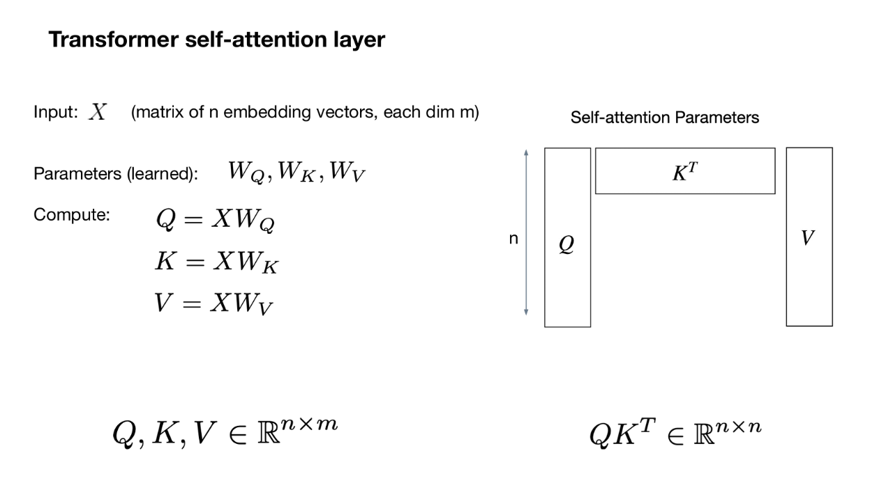
VISION TRANSFORMERS
QKᵀ produces pairwise attention scores
23
Notes:
Anchor new material in what students know. Both architectures map an image to class probabilities; their inductive biases and internal operations differ.
[Sources]
https://arxiv.org/abs/2010.11929
[Sources]
- User-provided ViT_v1.pptx, slide 5.

Slide 26
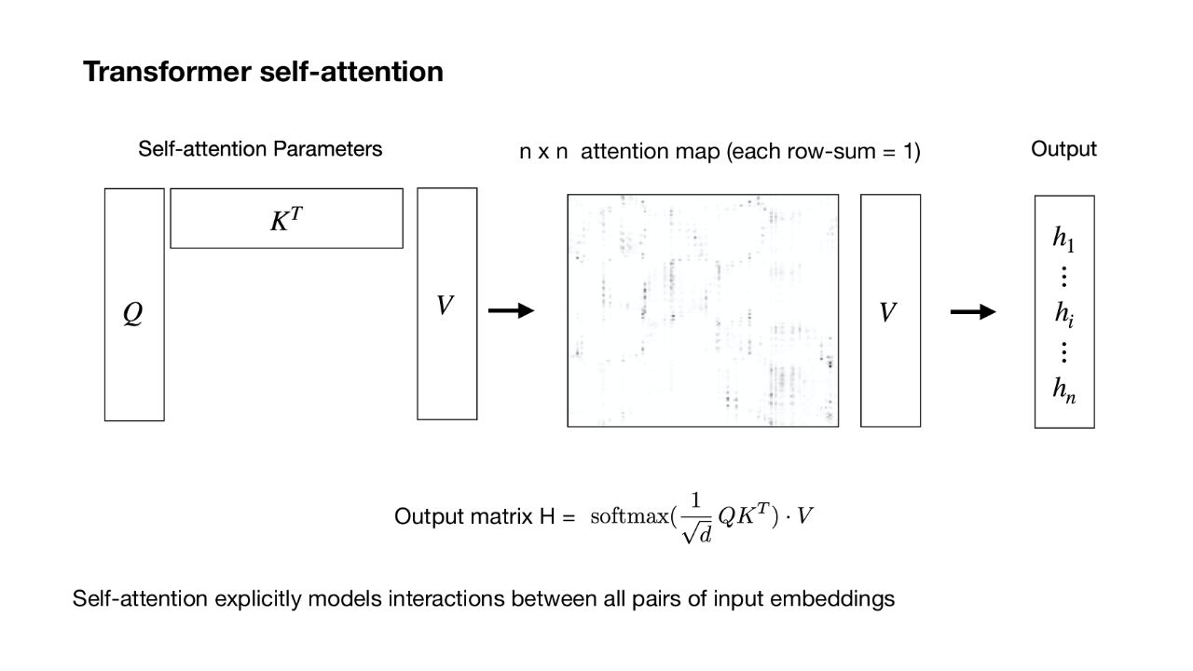
VISION TRANSFORMERS
Softmax turns scores into a weighted value mixture
24
Notes:
Anchor new material in what students know. Both architectures map an image to class probabilities; their inductive biases and internal operations differ.
[Sources]
https://arxiv.org/abs/2010.11929
[Sources]
- User-provided ViT_v1.pptx, slide 6.

Slide 27
VISION TRANSFORMERS
Multiple heads learn relationships in parallel
headᵢ = Attention(XW_Qⁱ, XW_Kⁱ, XW_Vⁱ)
head 1: shape
MSA(X) = Concat(head₁, …, headₕ) W_O
head 2: texture
head 3: parts
If dₖ = D/h, concatenation restores width D.
W_O lets the model remix information across heads.
Head interpretations are possibilities, not guaranteed semantics.
head h: context
25
Notes:
Explain dimension bookkeeping. Each head usually works in a smaller subspace; concatenation plus W_O returns to the model dimension.
[Sources]
https://arxiv.org/abs/2010.11929
https://arxiv.org/abs/1706.03762

Slide 28
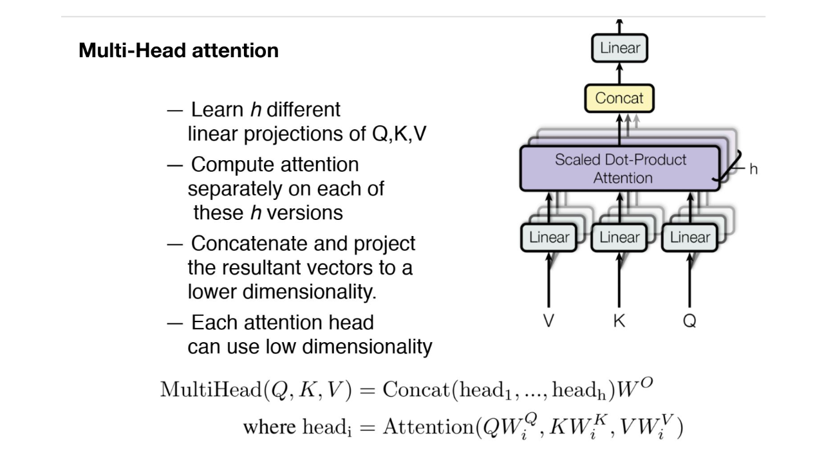
VISION TRANSFORMERS
Why use multiple attention heads?
26
Notes:
Anchor new material in what students know. Both architectures map an image to class probabilities; their inductive biases and internal operations differ.
[Sources]
https://arxiv.org/abs/2010.11929
[Sources]
- User-provided ViT_v1.pptx, slide 7.

Slide 29
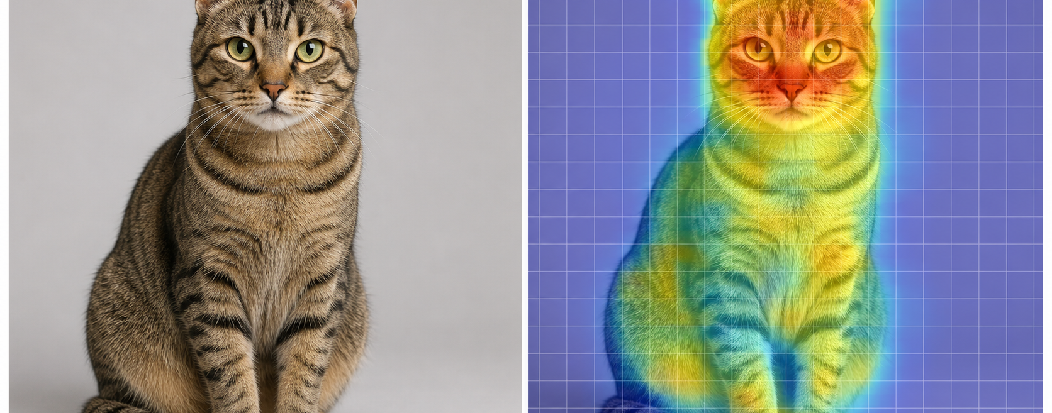
VISION TRANSFORMERS
Where [CLS] attends to predict “cat”
INPUT IMAGE
[CLS] ATTENTION MAP · PREDICTED CLASS: CAT
Illustrative: brighter patches indicate stronger [CLS] attention; actual maps vary by model, layer, and head.
01
Notes:
The [CLS] token aggregates information from image-patch tokens. In this conceptual example, attention is strongest around the cat's eyes, ears, and muzzle—regions that can support a cat classification.
This is an illustrative visualization, not attention exported from a specific trained model, layer, or head.
[Sources]
- AI-generated visual created with OpenAI ImageGen for this slide; prompt and provenance are recorded in source-notes.txt.

Slide 30
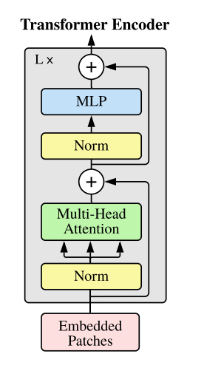
VISION TRANSFORMERS
Residual paths let each sublayer add a refinement
z′ₗ = MSA( LN(zₗ₋₁) ) + zₗ₋₁
attention sublayer + shortcut
zₗ = MLP( LN(z′ₗ) ) + z′ₗ
feature sublayer + shortcut
LN stabilizes each token’s feature scale before the sublayer.
Residual addition creates a direct information and gradient path.
ℓ indexes the encoder block; shapes stay (N+1) × D.
27
Notes:
Point out the primes: z′ is the intermediate state after attention; z is the block output after the MLP. ViT uses pre-layer normalization.
[Sources]
https://arxiv.org/abs/2010.11929

Slide 31
VISION TRANSFORMERS
The MLP expands and compresses each token
MLP(x) = W₂ GELU(W₁x + b₁) + b₂
Typical hidden width D_mlp ≈ 4D
x ∈ ℝᴰ
W₁x+b₁ ∈ ℝᴰᵐˡᵖ
GELU activation
W₂(·)+b₂ ∈ ℝᴰ
Same weights for every token; no token-to-token mixing happens here.
28
Notes:
Contrast with attention. Attention mixes across the token dimension; the MLP mixes across the feature dimension within each token.
[Sources]
https://arxiv.org/abs/2010.11929

Slide 32

VISION TRANSFORMERS
The final [CLS] state becomes the image representation
[CLS] zᴸ⁰
y = LN(zᴸ⁰)
logits = W_head y + b
C logits
MEANING
EXAMPLE
The superscript c selects the c-th softmax value—the model-assigned probability that the image belongs to class c.
[cat, dog, bird], logits [2.0, 1.0, 0.1]
→ softmax ≈ [0.66, 0.24, 0.10]
So p(cat | image) ≈ 0.66; predict cat.
29
Notes:
The superscript 0 denotes the first token position, occupied by [CLS]. For classification, only this final token is passed to the head.
[Sources]
https://arxiv.org/abs/2010.11929
Example calculation: exp([2.0, 1.0, 0.1]) normalized by its sum gives approximately [0.659, 0.242, 0.099], rounded on-slide to [0.66, 0.24, 0.10].

Slide 33
VISION TRANSFORMERS
Cross-entropy trains every ViT projection
ℒ_CE = − Σᶜ y_c log p_c
image
cross-entropy for one labeled image
↓
ViT parameters θ
Backpropagation updates patch projection, position embeddings, Q/K/V, MLPs, and classifier.
The original ViT result depended strongly on large-scale pretraining, then fine-tuning.
Augmentation and regularization matter because ViT has weaker built-in locality than a CNN.
↓
prediction p
↺ gradient of ℒ
30
Notes:
The cross-entropy formula is standard. Keep the emphasis on end-to-end learning and the data regime highlighted by the original ViT paper.
[Sources]
https://arxiv.org/abs/2010.11929

Slide 34
DENSE PREDICTION WITH VISION TRANSFORMERS
What is the segmentation head in a ViT?
THE SEGMENTATION HEAD
ViT patch
tokens
Reshape tokens
to a 2-D grid
Linear D → K
(or 1 × 1 conv)
Upsample
to image size
Pixel-wise
class mask
N × D; discard [CLS]
h × w × D
h × w × K logits
H × W × K logits
argmax → H × W
segmentation head = reshape + Linear(D → K) + upsample
For every patch token zᵢ ∈ ℝᴰ: logitsᵢ = Wₛₑg zᵢ + b, where Wₛₑg ∈ ℝᴷˣᴰ
01
Notes:
The segmentation head is the task-specific decoder after the ViT encoder. It uses the spatial patch tokens and normally discards the image-level [CLS] token.
In the simplest linear head, reshape the N patch tokens into an h × w × D feature grid. A shared Linear(D → K)—equivalent to a 1 × 1 convolution—produces K class logits at every patch location. Bilinear interpolation upsamples those logits to H × W, and argmax selects the class at each pixel.
More sophisticated decoders can fuse multiple encoder layers or use mask-transformer decoding, but the attachment point remains the spatial token features.
[Sources]
- Strudel, R., Garcia, R., Laptev, I., & Schmid, C. (2021). Segmenter: Transformer for Semantic Segmentation. https://arxiv.org/abs/2105.05633
- Zheng, S. et al. (2020). Rethinking Semantic Segmentation from a Sequence-to-Sequence Perspective with Transformers. https://arxiv.org/abs/2012.15840

Slide 35
VISION TRANSFORMERS
Attention cost grows quadratically
attention scores: QKᵀ ∈ ℝᵀ×ᵀ
T = N + 1
memory / interaction cost ∝ O(T²)
Smaller patches increase spatial detail but rapidly increase T.
This motivates hierarchical, local, sparse, or windowed variants.
every row attends across all columns
31
Notes:
Connect back to slide 5. Strict compute includes projection terms too, but the T×T score matrix explains the main scaling issue for long sequences.
[Sources]
https://arxiv.org/abs/1706.03762
https://arxiv.org/abs/2010.11929

Slide 36
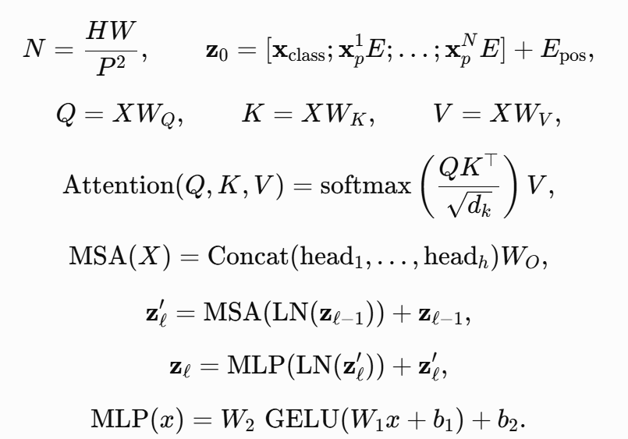
The formulas together:

Slide 37
VISION TRANSFORMERS
Tensor shapes make ViTs easier to debug
Object
Shape for batch B
Image
B × C × H × W
Patch tokens
B × N × D
Input z₀
B × (N+1) × D
Q, K, V per head
B × h × (N+1) × dₖ
Attention map
B × h × (N+1) × (N+1)
Block output zₗ
B × (N+1) × D
Class logits
B × C_classes
33
Notes:
Use this as a checkpoint. Ask students to identify which dimension attention mixes: the token dimension N+1.
[Sources]
https://arxiv.org/abs/2010.11929
https://arxiv.org/abs/1706.03762

Slide 38
VISION TRANSFORMERS
Check your mental model before we close
1. For 384×384 images with P=16, what is N?
2. Why divide QKᵀ by √dₖ?
3. Which sublayer mixes tokens? Which mixes features?
4. Why does ViT need positional embeddings?
Answers: 576 • control softmax scale • MSA / MLP • attention alone has no order
34
Notes:
Give students two minutes individually, then compare answers in pairs. The first answer is (384/16)^2 = 24^2 = 576.
[Sources]
https://arxiv.org/abs/2010.11929
https://arxiv.org/abs/1706.03762

Slide 39
VISION TRANSFORMERS
A ViT is an image-to-sequence model
1
Patchify turns spatial resolution into sequence length.
2
Position tells attention where each patch came from.
3
QKᵀ chooses relationships; V carries the information.
4
MSA mixes tokens; MLP mixes features; residuals preserve the path.
5
[CLS] summarizes the final sequence for classification.
pixels → tokens → contextual tokens → prediction
35
Notes:
Close by returning to the opening question: the ‘words’ are learned patch embeddings. Invite students to use the formula sheet for review.
[Sources]
https://arxiv.org/abs/2010.11929
https://arxiv.org/abs/1706.03762

