Slide 1
Larage Language Models (VLMs)
Based on The Illustrated Transformer
The Illustrated Transformer – Jay Alammar – Visualizing machine learning one concept at a time.
Assembled by Longin Jan Latecki, latecki@temple.edu

Slide 2
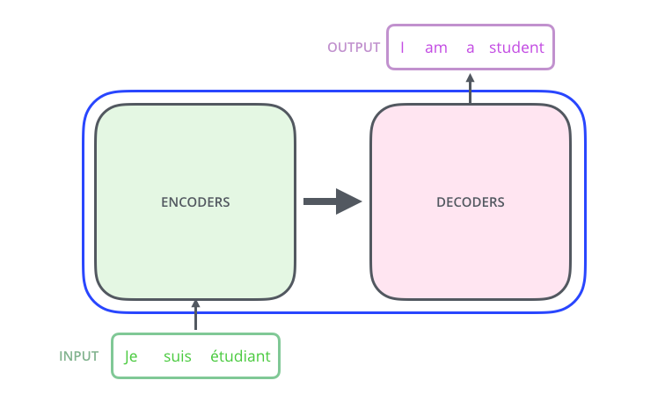

Slide 3
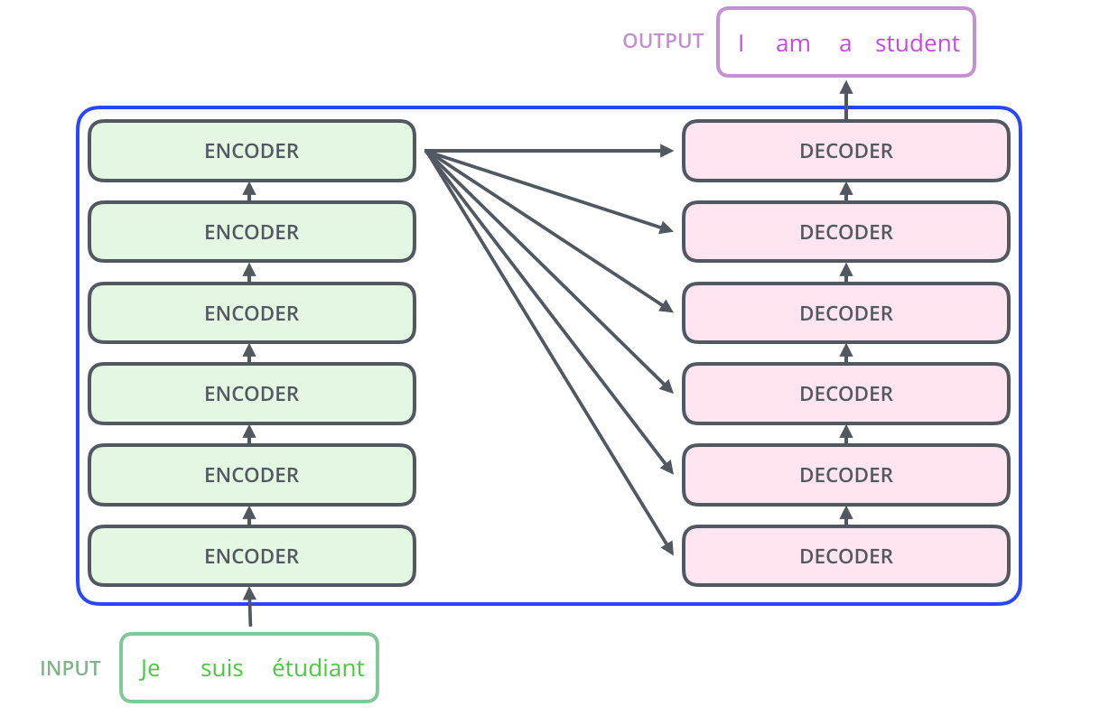

Each word is embedded into a vector of size 512.

Slide 4
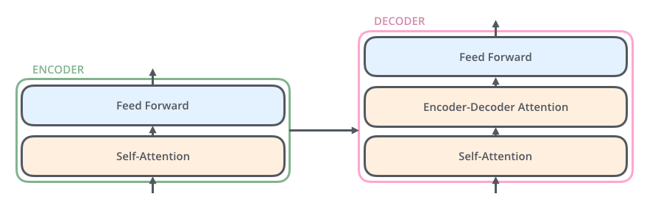

Slide 5
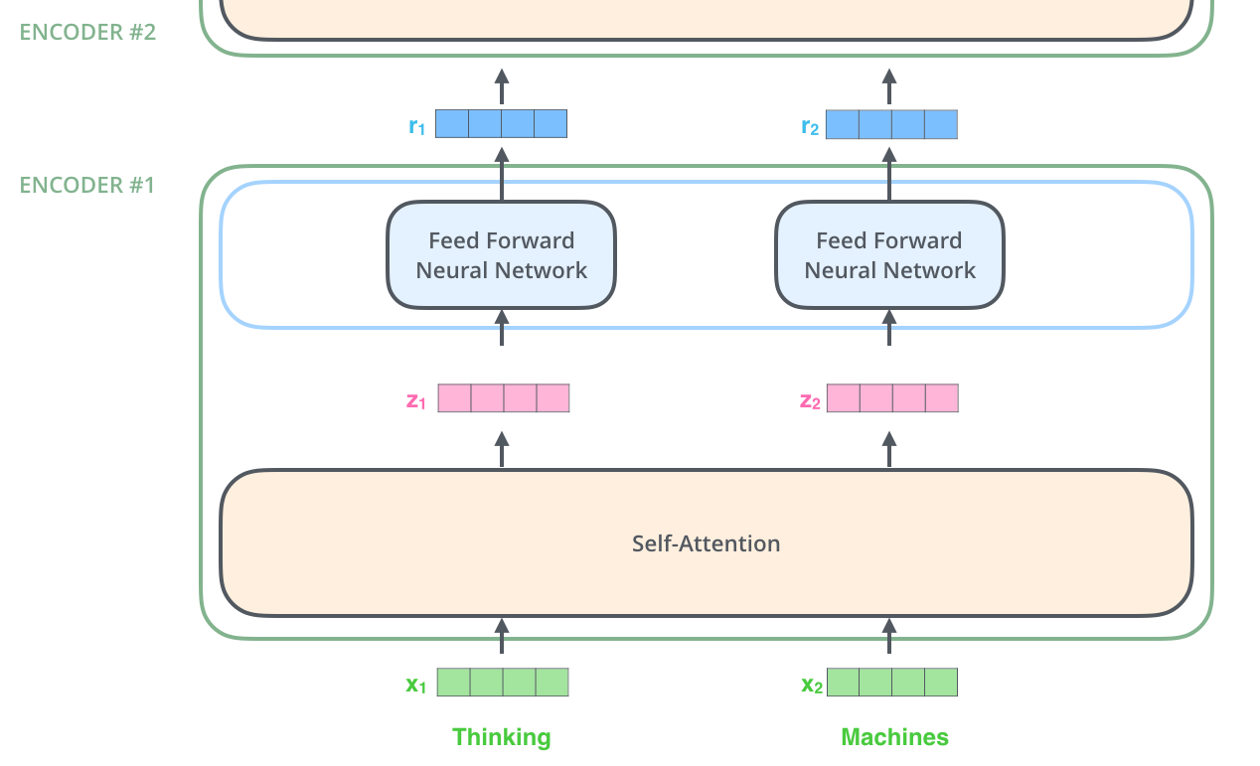

Slide 6
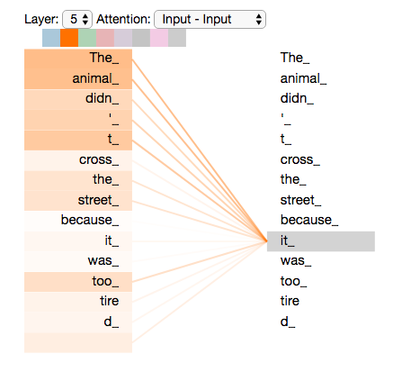

Slide 7
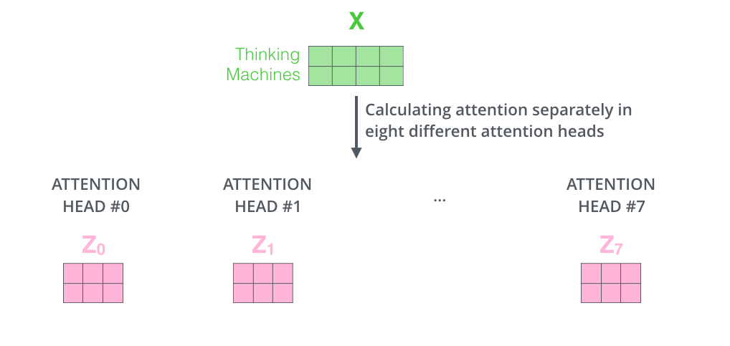

Slide 8
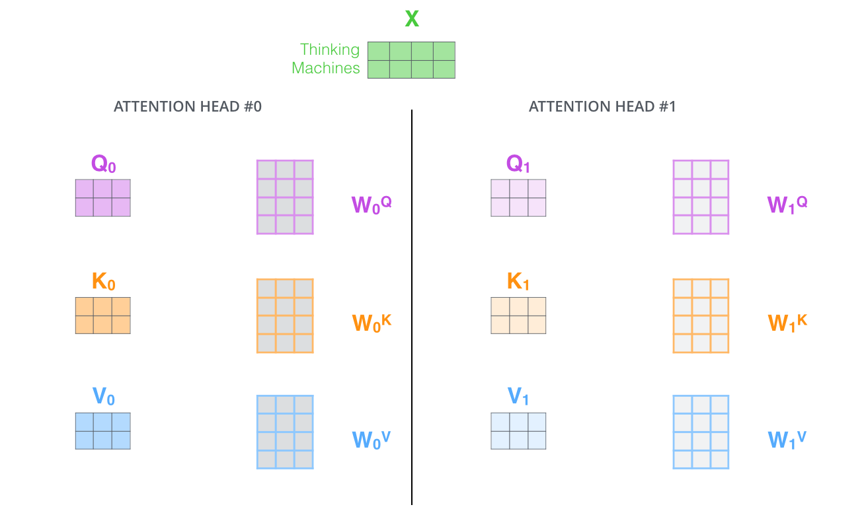

Slide 9
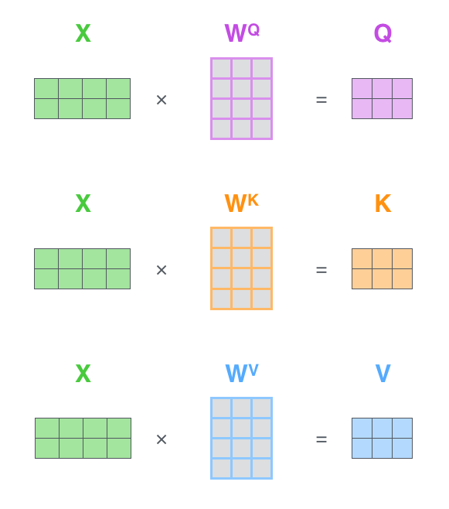
Attention Module
Matrix Notation

Slide 10
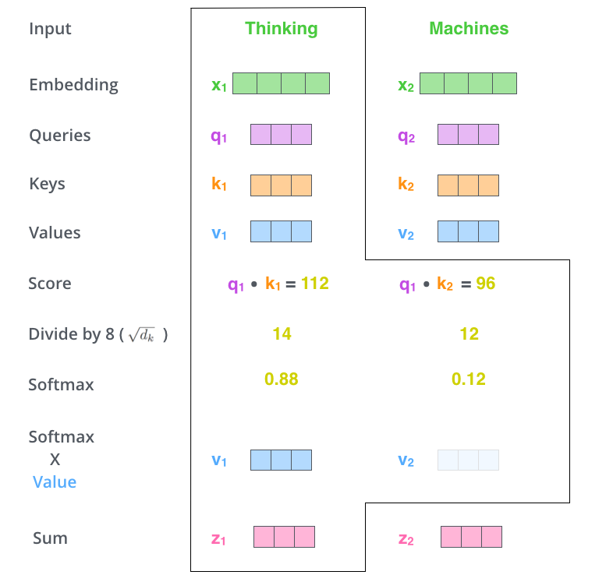
Attention Module

Slide 11
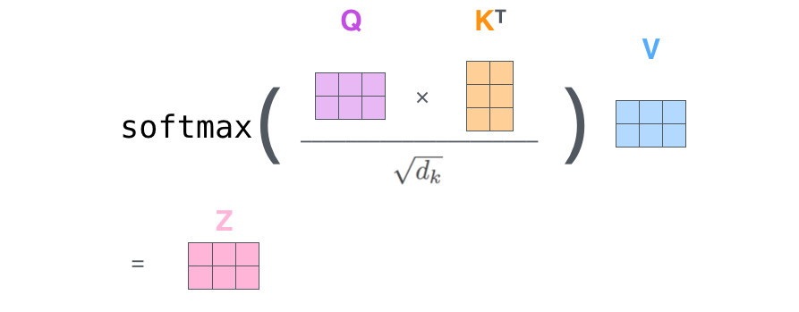

Slide 12
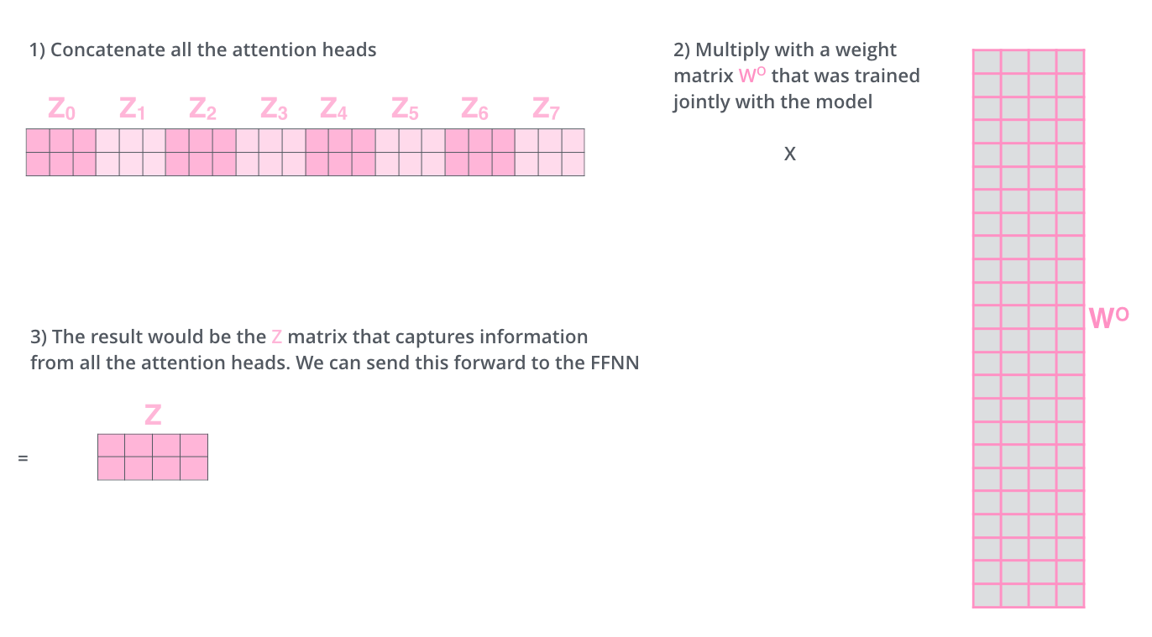

Slide 13
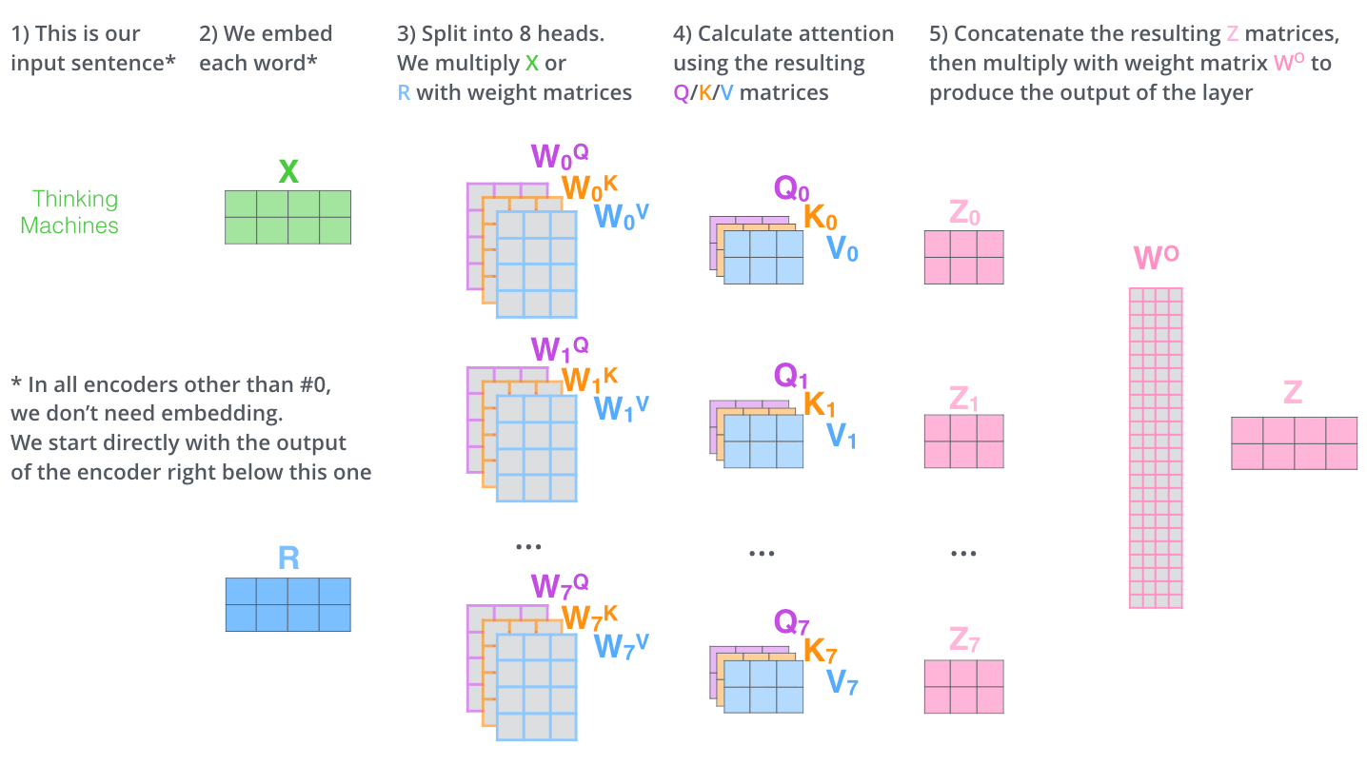

Slide 14
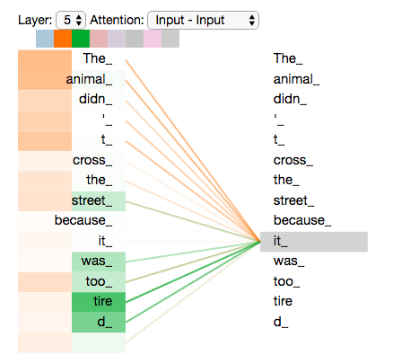
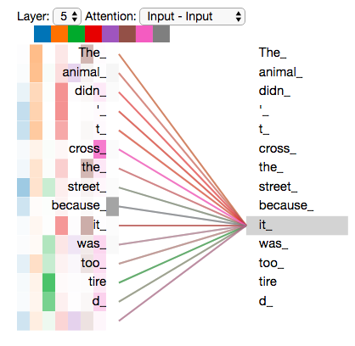
Attention of one head and of 8 heads.

Slide 15
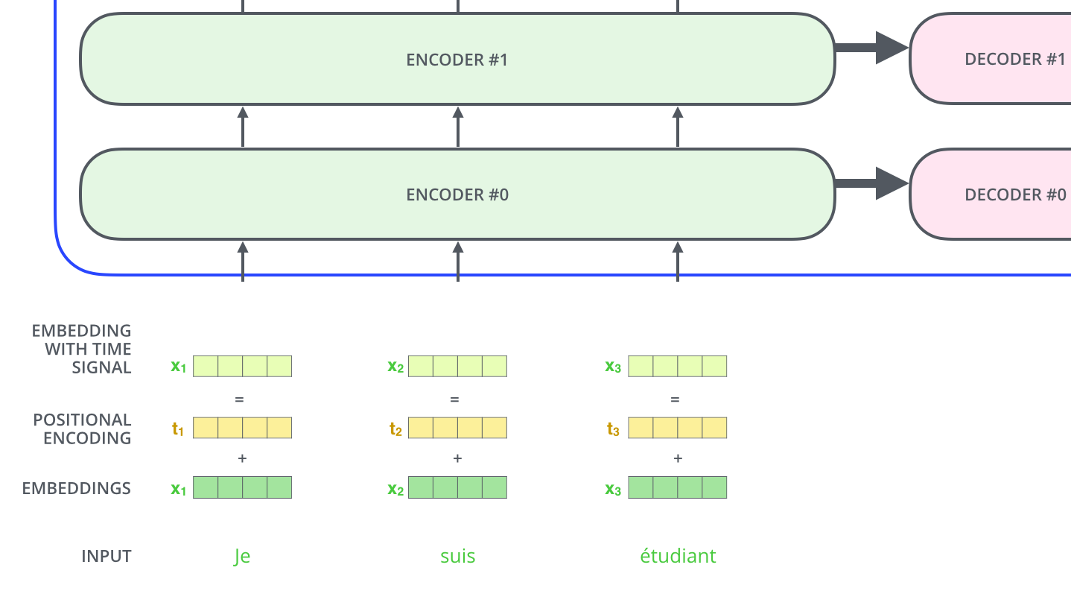

Slide 16
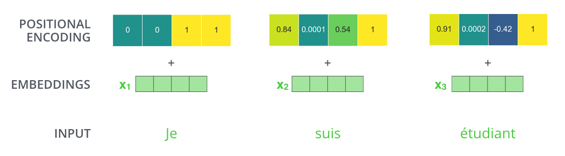

Slide 17
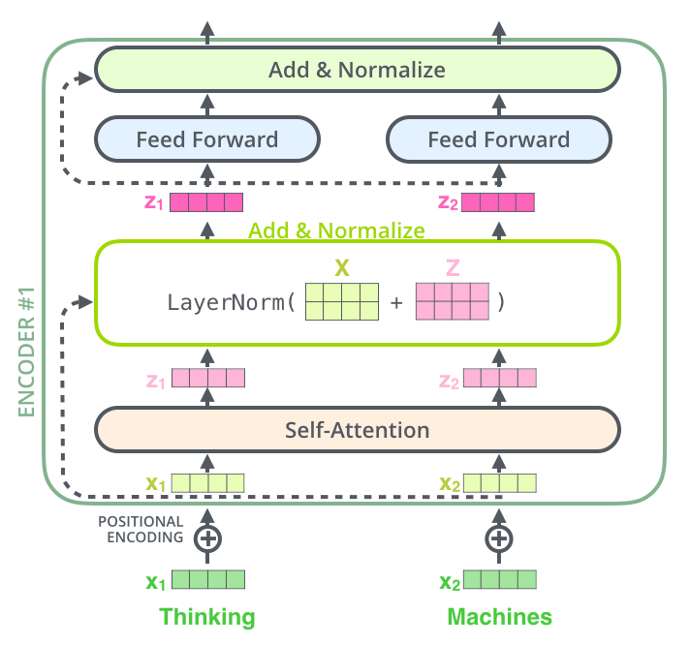
The Residuals

Slide 18
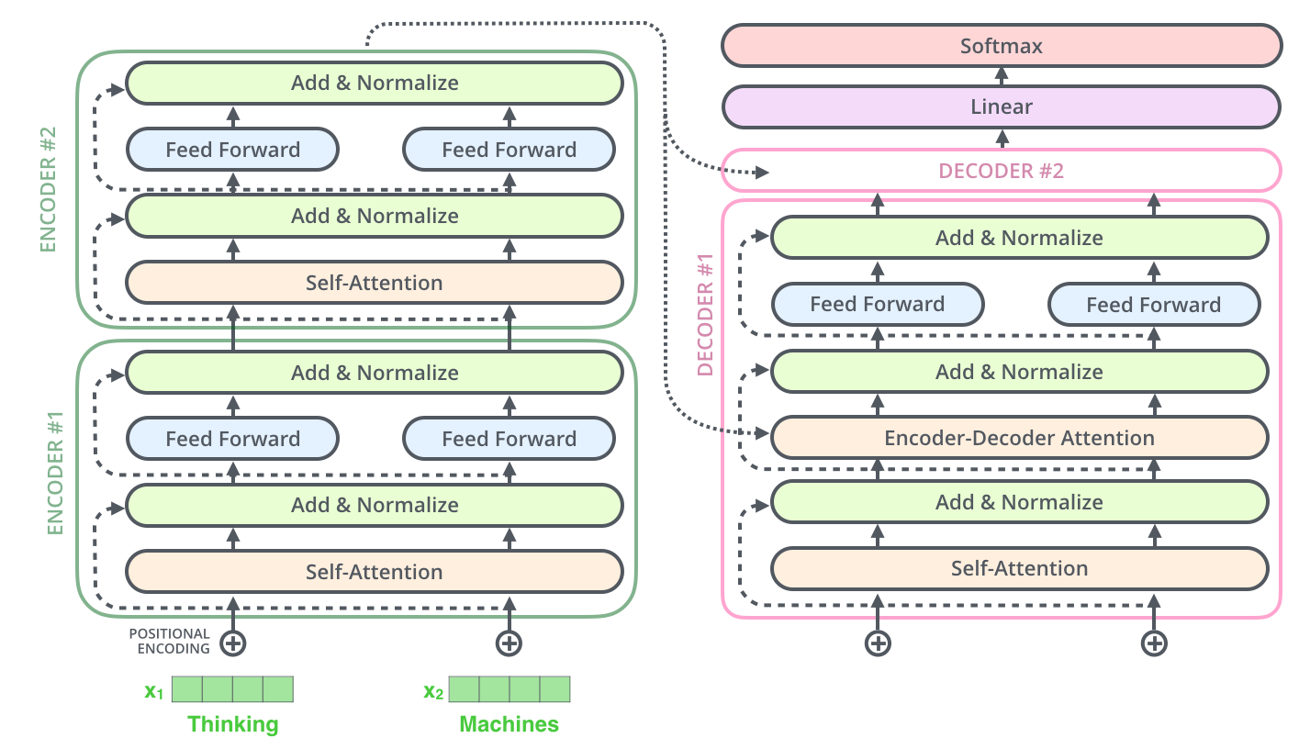

Slide 19
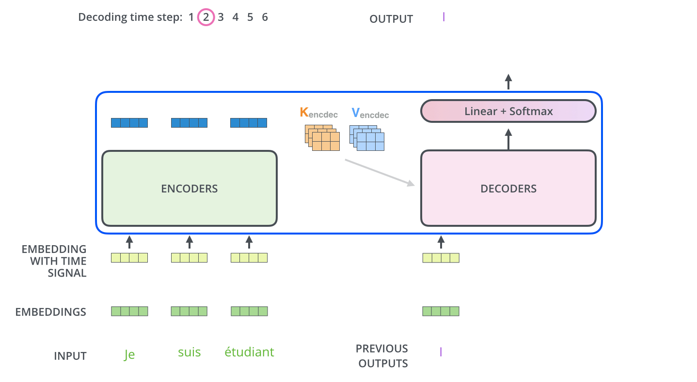

Slide 20
The self-attention layers in the decoder operate in a slightly different way than the one in the encoder:
In the decoder, the self-attention layer is only allowed to attend to earlier positions in the output sequence. This is done by masking future positions (setting them to -inf) before the softmax step in the self-attention calculation.
The Encoder-Decoder Attention layer,
now called cross-attention, works just like multiheaded self-attention, except it creates its Queries matrix from the layer below it, and takes the Keys and Values matrix from the output of the encoder stack.

Slide 21
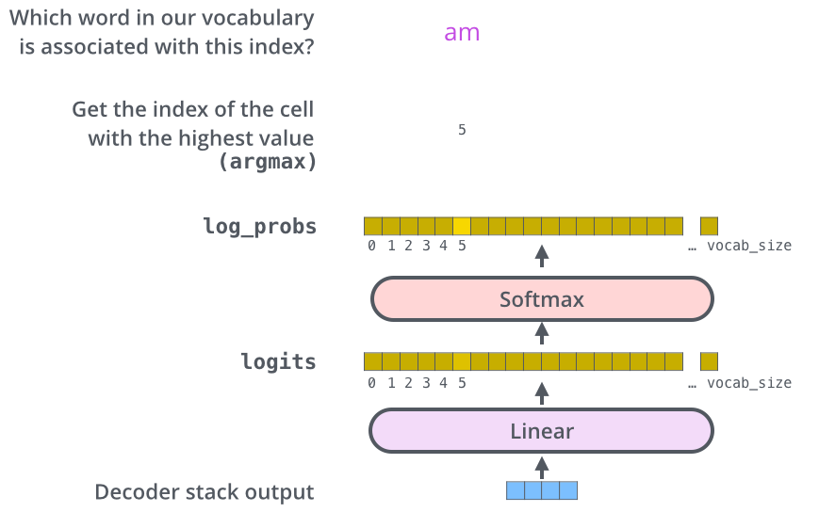
The Final Linear and Softmax Layer

Slide 22
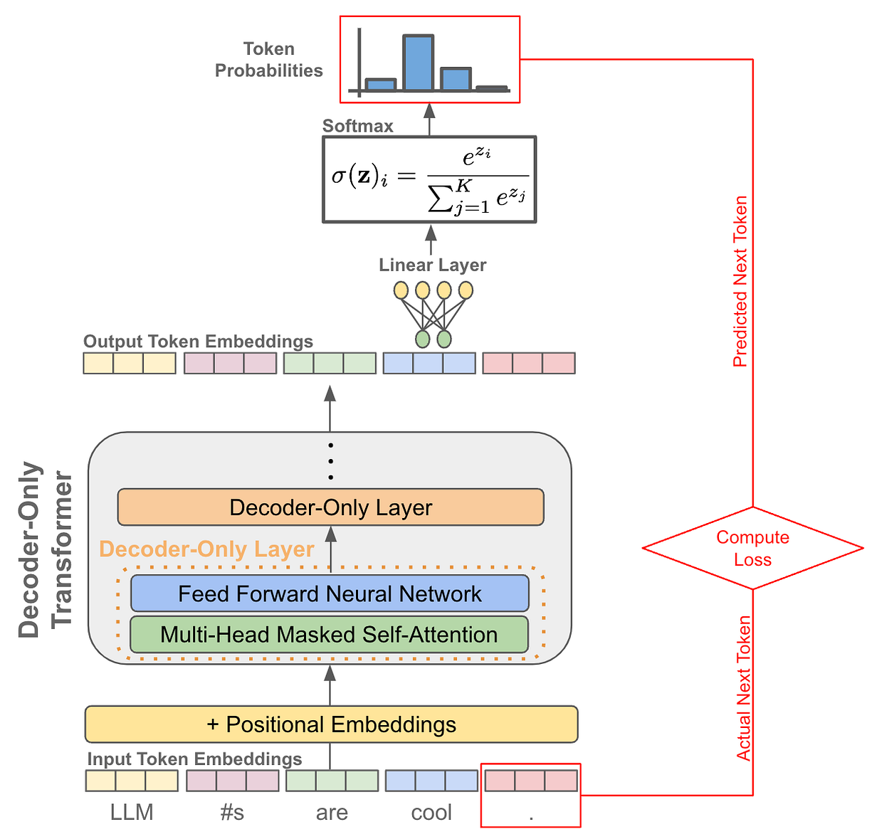
GPT style decoder only,
autoregressive LLM

Slide 23
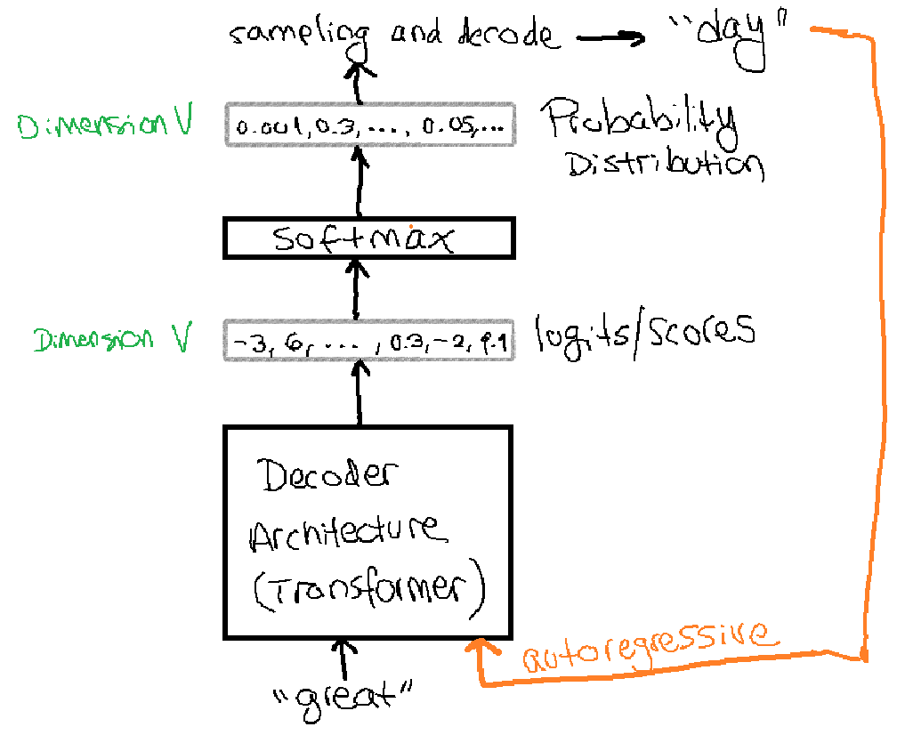
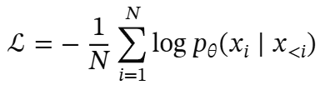
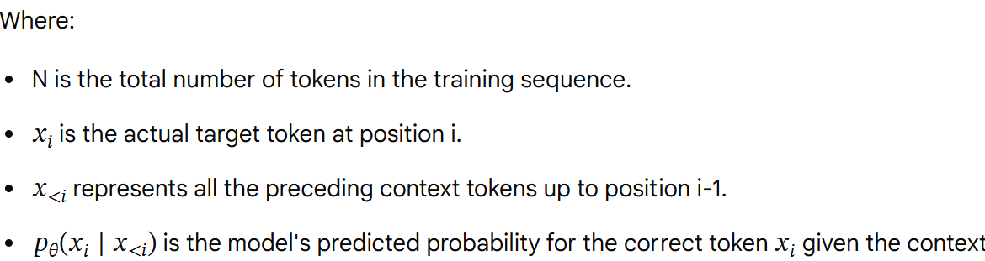
Next token prediction loss (cross-entropy loss)

Slide 24
Suggest next steps:
Read the Attention Is All You Need paper, the Transformer blog post (Transformer: A Novel Neural Network Architecture for Language Understanding), and the Tensor2Tensor announcement.
Watch Łukasz Kaiser’s talk walking through the model and its details

