Slide 1
ADVANCED COMPUTER VISION
Vision–Language Models
with an adapter
Longin Jan Latecki, latecki@temple.edu
From ViT features to LLM tokens • LLaVA, RoPE, and Qwen‑VL
Notes:
Teaching cue: Vision–Language Models through the adapter lens
[Sources]
- https://arxiv.org/abs/2304.08485
- https://arxiv.org/abs/2308.12966
- https://arxiv.org/abs/2309.16609
- https://arxiv.org/abs/2104.09864

Slide 2
ADAPTER-STYLE VLMS
By the end, you can trace an image through a VLM
Locate the adapter between a familiar ViT and a decoder-only LLM
Explain why visual features must become language-space tokens
Derive RoPE’s relative-position effect inside attention
Follow Qwen‑VL’s 1024 → 256 visual-token compression
Read the tensor operations behind Qwen attention
02
Notes:
Teaching cue: By the end, you can trace an image through a VLM
[Sources]
- https://arxiv.org/abs/2304.08485
- https://arxiv.org/abs/2308.12966
- https://arxiv.org/abs/2309.16609
- https://arxiv.org/abs/2104.09864

Slide 3
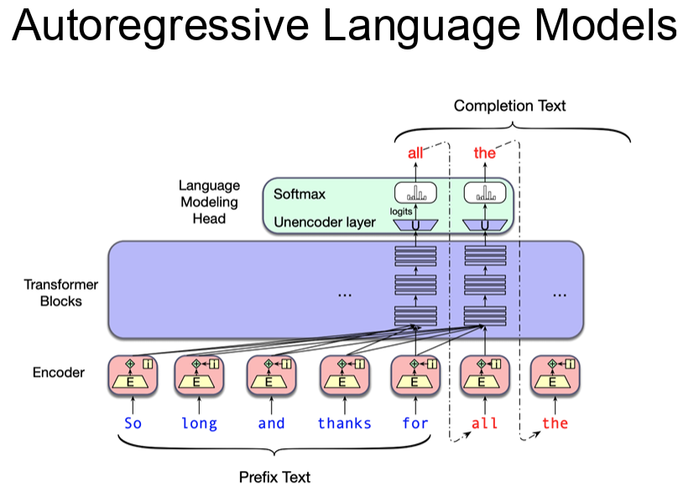

Slide 4
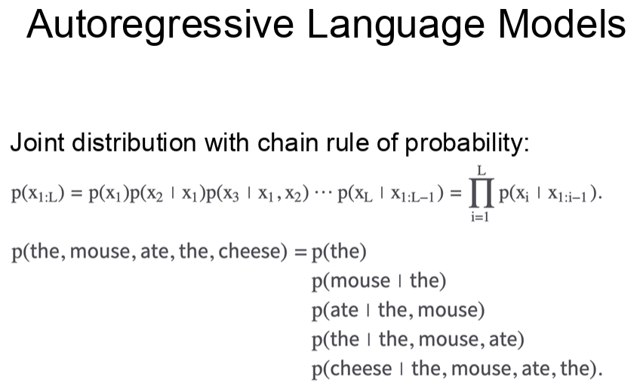

Slide 5
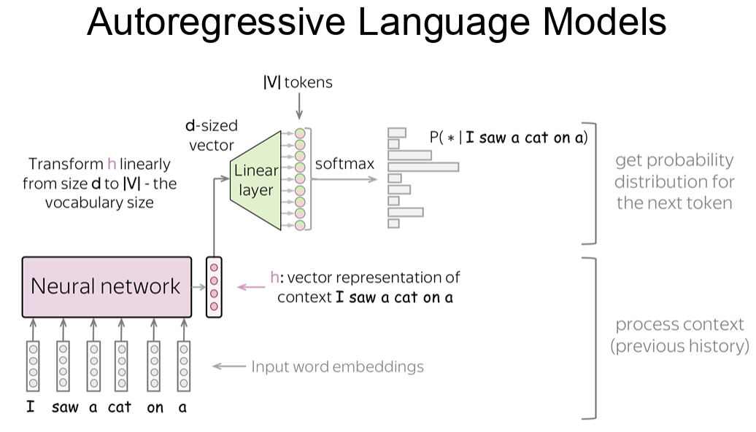

Slide 6
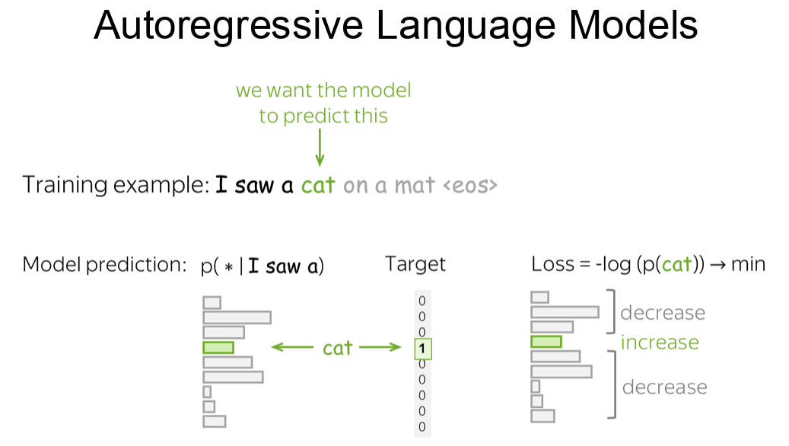

Slide 7
ADAPTER-STYLE VLMS
A ViT already gives us the right raw material
ViT output
What the LLM needs
A sequence of patch features
A sequence of token embeddings
Spatially organized evidence
Ordered context for causal attention
Embeddings of dim dᵥ set by the ViT
Embeddings of dim dₗ set by the language model
03
Notes:
Teaching cue: A ViT already gives us the right raw material
[Sources]
- https://arxiv.org/abs/2304.08485

Slide 8
ADAPTER-STYLE VLMS
Adapter-style VLMs keep the two pretrained models visible
vision encoder → adapter → autoregressive LLM
We focus on models that translate visual features into the LLM’s token interface—not unified-from-scratch multimodal transformers.
04
Notes:
Teaching cue: Adapter-style VLMs keep the two pretrained towers visible
[Sources]
- https://arxiv.org/abs/2304.08485
- https://arxiv.org/abs/2308.12966

Slide 9
ADAPTER-STYLE VLMS
The minimal recipe is surprisingly small
1
2
3
4
Encode patches
Adapt width / length
Insert visual tokens
Predict text tokens
The architectural novelty is often concentrated in step 2; the learning signal still comes from next-token prediction.
05
Notes:
Teaching cue: The minimal recipe is surprisingly small
[Sources]
- https://arxiv.org/abs/2304.08485
- https://arxiv.org/abs/2308.12966

Slide 10
ADAPTER-STYLE VLMS
The adapter turns an image into a prefix the LLM can consume
<BOS>
<img>
v₁
v₂
…
vₘ
</img>
User:
What…?
Assistant:
one ordered sequence presented to the decoder
06
Notes:
Teaching cue: The adapter turns an image into a prefix the LLM can consume
[Sources]
- https://arxiv.org/abs/2308.12966

Slide 11
ADAPTER-STYLE VLMS
Every adapter answers three engineering questions
Width
Length
Position
How do dᵥ-dimensional vision features become dₗ-dimensional LLM embeddings?
Do we preserve every patch token or compress the sequence?
How is 2D image location preserved after tokens enter a 1D sequence?
07
Notes:
Teaching cue: Every adapter answers three engineering questions
[Sources]
- https://arxiv.org/abs/2304.08485
- https://arxiv.org/abs/2308.12966

Slide 12
ADAPTER-STYLE VLMS
A projector preserves tokens; a resampler chooses evidence
Linear projector
Query resampler
One output per input patch
Fixed number of learned queries
Cheap and transparent
Content-selective compression
Longer LLM prefix
Extra cross-attention
08
Notes:
Teaching cue: A projector preserves tokens; a resampler chooses evidence
[Sources]
- https://arxiv.org/abs/2304.08485
- https://arxiv.org/abs/2308.12966

Slide 13
ADAPTER-STYLE VLMS
The adapter changes where cross-modal mixing happens
Projector-style
Resampler-style
ViT
Linear
LLM
ViT
Cross-attn
LLM
mixing happens later inside the decoder
mixing begins in the adapter
09
Notes:
Teaching cue: The adapter changes where cross-modal mixing happens
[Sources]
- https://arxiv.org/abs/2304.08485
- https://arxiv.org/abs/2308.12966

Slide 14
ADAPTER-STYLE VLMS
Checkpoint: identify the adapter contract
Given Zᵥ ∈ ℝᴺ×ᵈᵥ and an LLM width dₗ, what must be true before Zᵥ can enter the decoder?
ANSWER
The adapter must output a sequence Hᵥ ∈ ℝᴹ×ᵈₗ; M may equal N or be compressed.
10
Notes:
Teaching cue: Checkpoint: identify the adapter contract
[Sources]
- https://arxiv.org/abs/2304.08485
- https://arxiv.org/abs/2308.12966

Slide 15
01
LLaVA
The adapter as a learned linear translation
11
Notes:
Teaching cue: LLaVA
[Sources]
- https://arxiv.org/abs/2304.08485

Slide 16
ADAPTER-STYLE VLMS
LLaVA connects CLIP ViT‑L/14 to Vicuna with one matrix
image
CLIP ViT‑L/14
linear W
Vicuna
N patch tokens remain N visual tokens
12
Notes:
Teaching cue: LLaVA connects CLIP ViT‑L/14 to Vicuna with one matrix
[Sources]
- https://arxiv.org/abs/2304.08485

Slide 17

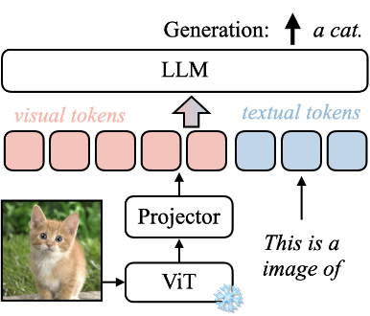
Architecture of LLaVA (Liu et al. 2023)

Slide 18
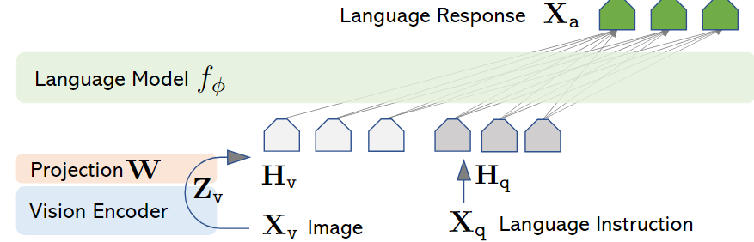
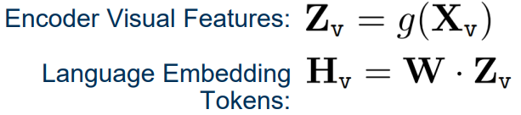

Architecture of LLaVA
Vicuna
Clip

Slide 19
ADAPTER-STYLE VLMS
LLaVA preserves the visual sequence and changes only its width
The LLaVA adapter is a single learned projection
CLIP grid features
Zᵥ ∈ ℝᴺ×ᵈᵥ
W ∈ ℝᵈᵥ×ᵈₗ
Hᵥ ∈ ℝᴺ×ᵈₗ
Vicuna token space
Hᵥ = Zᵥ W
Each patch feature is independently mapped into the language embedding space; token count N is unchanged.
13
Notes:
Teaching cue: LLaVA preserves the visual sequence and changes only its width
[Sources]
- https://arxiv.org/abs/2304.08485

Slide 20
LLAVA TRAINING
Stage 1: No instruction tuning - alignment only
The model predicts captions, update only W
image I
frozen CLIP
train W
frozen Vicuna
Worked caption-alignment example
Caption loss
Prompt q
Describe the image briefly.
Lalign = −Σₜ log p(cₜ | I, q, c<ₜ)
Caption c
A child holds a yellow umbrella.
∇CLIP = 0 • ∇W ≠ 0 • ∇Vicuna = 0
Loss: caption tokens only
595K filtered CC3M pairs • 1 epoch • LR 2×10⁻³ • batch 128
replaces 22
Notes:
'No instruction tuning' in the ablation means the model completed Stage 1 feature alignment only. It still uses autoregressive cross-entropy on caption tokens, but only W is updated.
[Sources]
- https://arxiv.org/abs/2304.08485

Slide 21
LLAVA TRAINING
Stage 2: Instruction tuning: visual-dialogue training
Train on (image, user instruction, assistant response) examples; update both W and Vicuna.
User
What color is the umbrella?
context only
Assistant
The umbrella is yellow.
LOSS ✓
User
Why might the child be carrying it?
context only
Assistant
It likely provides protection from rain.
LOSS ✓
Linst = −Σₜ∈assistant log p(aₜ | I, instructions, earlier tokens)
∇CLIP = 0 • ∇W ≠ 0 • ∇Vicuna ≠ 0
158K instruction examples • 3 epochs • LR 2×10⁻⁵ • batch 32
replaces 23
Notes:
Stage 2 is instruction tuning: diverse image-conditioned instructions and assistant responses are used to update W and Vicuna, while CLIP remains frozen. Loss is applied to assistant tokens.
[Sources]
- https://arxiv.org/abs/2304.08485

Slide 22
Instruction tuning teaches responses to image-conditioned requests
DEFINITION
Conversation
User: What color is the umbrella?
Instruction tuning
Assistant: The umbrella is yellow.
Fine-tune on examples where the user instruction specifies the task and the assistant demonstrates the desired response.
Description
User: Describe the image in detail.
Assistant: A child in a red coat holds a yellow umbrella…
Training tuple
(image I, instruction u, answer a)
Reasoning
User: Why might the child be carrying it?
Linst = −Σₜ log p(aₜ | I, u, a<ₜ)
Assistant: It likely provides protection from rain.
The instruction changes the requested behavior;
the image remains shared evidence.
Notes:
Instruction tuning is supervised fine-tuning on image, instruction, and assistant-response tuples. LLaVA's Stage 2 applies autoregressive cross-entropy to assistant answer tokens.
[Sources]
- https://arxiv.org/abs/2304.08485

Slide 23
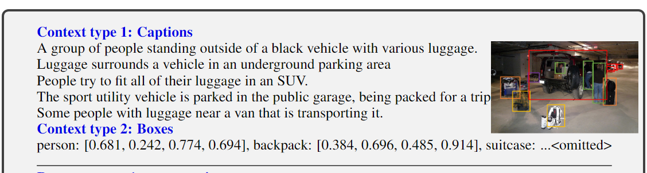
Instruction-Tuning Data Generation
Human Captions: Detailed descriptions of what is in an image.
Bounding Boxes: Exact coordinates showing where objects are located.
The original LLaVA’s visual instruction data was generated using language-only GPT-4, but it was based on both: image captions + object bounding boxes.

Slide 24
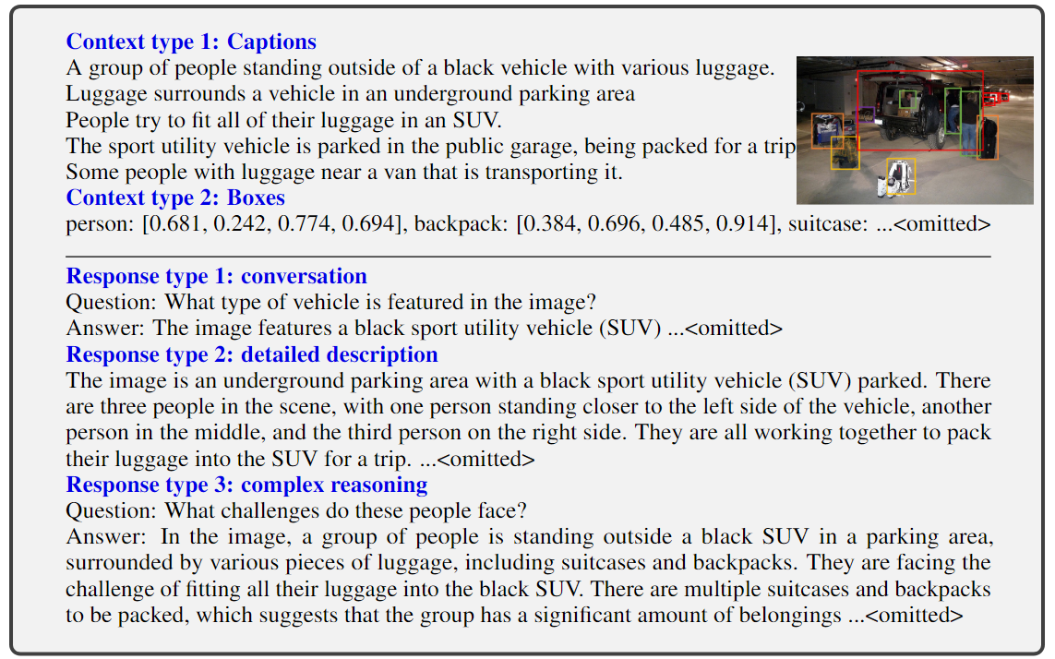
Instruction-Tuning Data Generation

Slide 25
Instruction-Tuning Data Generation
The LLaVA-Instruct-158K Mixture
Data Category | Sample Size | Strategic Goal
Conversations | 58,000 | Teaches natural multi-turn dialogue flow. The model learns context retention
Detailed Descriptions | 23,000 | Forces rich scene analyses beyond simple object naming
Complex Reasoning | 77,000 | Requires the model to explain "why" things happen, necessitating logic

Slide 26
Ablation: instruction diversity drives visual behavior
Full mixture
85.1
conversation + detail + reasoning
4×
Conversation only
73.8
Full training scores nearly four times the no-instruction baseline.
less description and reasoning diversity
No instruction tuning
21.5
alignment stage only
21.5 means the visual interface was aligned, but general instruction-following behavior was not taught.
LLaVA-Bench (COCO) relative scores
replaces 25
Notes:
Reported overall relative scores from LLaVA Table 4: full data 85.1, conversation-only 73.8, and no instruction tuning 21.5. The 4× callout is 85.1/21.5 ≈ 3.96.
[Sources]
- https://arxiv.org/abs/2304.08485

Slide 27
The loss family is the same; targets and gradients change
Both stages use teacher-forced next-token cross-entropy.
NO INSTRUCTION TUNING
INSTRUCTION TUNING
Stage 1 • feature alignment
Stage 2 • visual instruction following
Target
caption tokens c₁…cT
Target
assistant answer tokens a₁…aT
Loss
Lalign = −Σ log p(cₜ | I,q,c<ₜ)
Loss
Linst = −Σ log p(aₜ | I,u,a<ₜ)
Train
W only
Train
W + Vicuna
Learns
How visual features enter the LLM
Learns
How to use vision to satisfy user intent
∇CLIP=0 ∇W≠0 ∇Vicuna=0
∇CLIP=0 ∇W≠0 ∇Vicuna≠0
Image and prompt tokens condition predictions but are masked from the target-token loss.
replaces 24
Notes:
The loss family does not fundamentally change between stages. The target sequences, data diversity, and trainable parameters change: captions and W in Stage 1; assistant responses and W+Vicuna in Stage 2.
[Sources]
- https://arxiv.org/abs/2304.08485

Slide 28
ADAPTER-STYLE VLMS
Training loss is applied to generated tokens—not the prompt
<img>
user
question
assistant
the
answer
</s>
masked
masked
masked
masked
loss ✓
loss ✓
loss ✓
19
Notes:
Teaching cue: Training loss is applied to assistant tokens—not the prompt
[Sources]
- https://arxiv.org/abs/2304.08485

Slide 29
ADAPTER-STYLE VLMS
A causal mask lets answer tokens read the entire image prefix
query position →
blue = visible
gray = masked
image
user
answer
16
Notes:
Teaching cue: A causal mask lets answer tokens read the entire image prefix
[Sources]
- https://arxiv.org/abs/2304.08485

Slide 30
ADAPTER-STYLE VLMS
The connector is tiny; the behavior change comes from data and tuning
1
595K
158K
linear projection
alignment pairs
instruction samples
22
Notes:
Teaching cue: The connector is tiny; the behavior change comes from data and tuning
[Sources]
- https://arxiv.org/abs/2304.08485

Slide 31
ADAPTER-STYLE VLMS
LLaVA’s simplicity exposes its main trade-offs
Strengths
Costs
Fast to train and easy to ablate
Prefix length grows with image resolution
Preserves all patch evidence
No content-aware compression in the adapter
Uses a standard causal LLM interface
Spatial structure is only implicit in patch order/features
23
Notes:
Teaching cue: LLaVA’s simplicity exposes its main trade-offs
[Sources]
- https://arxiv.org/abs/2304.08485

Slide 32
ADAPTER-STYLE VLMS
LLaVA design takeaway
Why can one linear layer be enough to unlock multimodal dialogue?
ANSWER
Both models are already pretrained. The projector only has to align interfaces; instruction tuning teaches the LLM how to use the aligned evidence.
24
Notes:
Teaching cue: LLaVA design takeaway
[Sources]
- https://arxiv.org/abs/2304.08485

Slide 33
Problem: token mixing in LLM

Slide 34
ALIBABA CLOUD · QWEN TEAM · 2025
IMAGE
Qwen2.5-VL
VIDEO
TEXT
Vision-Language Model Architecture
Dynamic visual tokens, efficient ViT attention, multimodal position, and scale-aware outputs
~7B
32
28
3
Total Parameters
ViT Layers
LLM Layers
Model Sizes
State-of-the-art Multimodal Intelligence

Slide 35

Overview of Qwen2.5-VL
What is Qwen2.5-VL?
Visual Understanding
OCR & Documents
Qwen2.5-VL is a state-of-the-art multimodal large language model developed by Alibaba Cloud's Qwen Team, released in January 2025.
Objects, scenes, charts, icons, layouts
Tables, invoices, forms, handwriting
It processes text, images, and video together — combining a powerful Vision Transformer encoder with the Qwen2.5 language decoder.
Long Video (1hr+)
Agentic Tasks
The model family includes three sizes: 3B (edge AI), 7B (production), and 72B (flagship), all open-weight under Apache-2.0.
Temporal reasoning, event localization
GUI control, computer & phone use
FOCUS: Qwen2.5-VL-7B
Released Jan 2025 · Outperforms GPT-4o-mini at 7B scale · Multilingual: Chinese & English

Slide 36
Architecture Overview — Qwen2.5-VL-7B
Vision Encoder (ViT)
LLM Decoder (Qwen2.5)
INPUTS
Image
14×14 Patch Embed
28 Grouped Query Attention
(4 KV heads)
VL Merger (MLP)
2D-RoPE Pos. Embed
M-RoPE (1D + 2D + Time)
OUT
2×2 Pool → 5120-dim
MLP: 5120→3584
Video
28× Window Attention
SwiGLU FFN
4× Full Attention
RMSNorm
Text
RMSNorm + SwiGLU
151,646 Vocab Tokens
32 Transformer Layers | 1280 Hidden
28 Transformer Layers | 3584 Hidden
Vision Encoder
VL Merger
LLM Decoder

Slide 37
Vision Encoder — Dynamic ViT
Technical Specifications
Key Innovations
Architecture
Vision Transformer (ViT)
Native Dynamic Resolution
Parameters
~0.4B
Qwen2.5-VL preserves each image’s aspect ratio and uses a variable-size patch grid instead of resizing every image to one fixed square. Images outside a configured pixel budget are proportionally resized, and their dimensions are rounded to multiples of 28.
Transformer Layers
32
Attention Heads
16
Hidden Size
1280
Windowed Attention (28/32 layers)
MLP Inner Size
3456
Most layers use local window attention (8×8 max) to cut computation from O(n²) to near-linear, without losing global context.
Patch Size
14 × 14 pixels
Full Attn Layers
4 (idx: 7, 15, 23, 31)
LLM-Aligned Design
Window Attn Layers
28 (all others)
ViT adopts the same RMSNorm + SwiGLU building blocks as the Qwen2.5 LLM decoder, enabling tighter integration.
Window Size (max)
8 × 8 patches
Normalization
RMSNorm
Activation
SwiGLU
2D Rotary Position Embedding
Position Encoding
2D-RoPE (spatial)
Spatial positions encoded via 2D-RoPE, enabling accurate localization of objects and regions in any aspect ratio.

Slide 38
Dynamic resolution allocates tokens according to image area
Small image
Large document
A thumbnail is resized within processor bounds and produces a short patch grid. Decoder cost stays low because fewer visual tokens are inserted.
A high-resolution receipt or page produces a larger grid, preserving more text and layout detail instead of forcing everything into 448×448.
03
Notes:
Qwen2.5-VL dynamically converts images of different sizes into token sequences of different lengths.
[Sources]
- https://arxiv.org/abs/2502.13923
- https://qwenlm.github.io/blog/qwen2.5-vl/

Slide 39
LLM Decoder — Qwen2.5 Backbone
LLM Specifications
M-RoPE: Multimodal Position Encoding
Total LLM Params
~6.6B
Time Axis (T)
Height (H)
Width (W)
Transformer Layers
28
Hidden Size
3584
Temporal position for video frames
Vertical spatial coordinate
Horizontal spatial coordinate
MLP Inner Size
18,944
KV Attention Heads
4 (128-dim each)
Attention Type
Grouped Query Attention (GQA)
Decomposed rotation applied independently across each dimension
Vocabulary Size
151,646 tokens
Position Encoding
M-RoPE (1D + 2D + Temporal)
Normalization
RMSNorm (pre-norm)
Activation
SwiGLU
Context Length
Up to 32K tokens
Pretraining Tokens
4.1 Trillion

Slide 40
Parameter Breakdown & Training Pipeline
~7B Total Parameters
ViT
~0.4B
(5.7%)
LLM Decoder ~6.6B (94.3%)
3-Stage Training Pipeline
STAGE 1
STAGE 2
STAGE 3
ViT Pretraining
Multimodal Pretraining
Instruction Tuning (SFT)
1.5T tokens
2.0T tokens
ChatML format
ViT-only training on image-caption pairs, CLIP contrastive learning, OCR data. Builds visual-linguistic alignment.
Full ViT + LLM training on text, VQA, video grounding, agent tasks. Includes long-context up to 32K.
Fine-tuning on annotated conversations. Specialises for document parsing, multi-image, video Q&A, GUI control.

Slide 41
Core Capabilities & Positioning
Visual Understanding
OCR & Document Parsing
Long Video (1hr+)
Objects, scenes, landmarks
Invoices, tables, forms
Dynamic FPS training
Film/TV IPs, products
Handwriting recognition
Absolute time encoding
Expanded category coverage
Structured HTML output
Second-level localization
Agentic Capabilities
Multilingual Support
Production Readiness
Computer use (GUI)
Chinese & English primary
Apache-2.0 open-weight
Phone use automation
Multi-language OCR
3B / 7B / 72B variants
Tool-use pipelines
Cross-lingual reasoning
Edge to cloud deployment
Qwen2.5-VL-7B outperforms GPT-4o-mini at comparable scale — practical, production-oriented multimodal AI

Slide 42
Summary
Qwen2.5-VL-7B Key Takeaways
Vision Encoder:
32-layer ViT · 1280 hidden · 14×14 patches · 28 window + 4 full attn
LLM Decoder:
28-layer Qwen2.5 · 3584 hidden · GQA · 151K vocab · 4.1T tokens pretrained
VL Merger:
MLP connector: 5120→3584 · Compresses ViT patches 4× · Bridges modalities
M-RoPE:
Temporal + 2D spatial position encoding enabling image & video understanding
Dynamic Resolution:
No forced resize — native patching at original image size, any aspect ratio

Slide 43
Vision Encoder — Windowed vs Full Attention
Why Mixed Attention?
32-Layer Attention Map
Pure full self-attention (each token attends to every other) costs O(n²) in both time and memory. For high-res images this is prohibitive — a 1344×1344 image yields ~9,216 patches, making full attention require ~85M attention scores per layer.
1
2
3
4
5
6
7
8
9
10
11
12
13
14
15
16
Qwen2.5-VL ViT solves this with a 28/4 split: 28 layers use local window attention (max 8×8 = 64 patches per window), reserving only 4 evenly-spaced layers for global full attention. This provides near-linear scaling while keeping global context.
17
18
19
20
21
22
23
24
25
26
27
28
29
30
31
32
Attention Type
Complexity
Memory
Layers Used
Full Self-Attention
O(n²)
High
4 (idx 7,15,23,31)
Full Attention (4 layers)
Window Attention (28 layers)
Windowed (8×8)
O(n · w²)
Low
28 (all others)
~87.5% compute savings vs full attention on large images

Slide 44
Video Understanding — Long-Context Temporal Reasoning
How Qwen2.5-VL Processes Video
Supported Video Tasks
Dynamic FPS Sampling
Video Q&A
Frame rate varies per video (1–2 FPS for long, higher for short). Keeps token count manageable without missing key moments.
"What sport is being played in the first minute?"
Event Localization
Absolute Time Encoding
"At what time does the speaker mention pricing?"
Each frame's timestamp (in seconds) encoded directly into M-RoPE's temporal axis — not just relative frame index.
Video Captioning
Visual Token Injection
Generate detailed description of a 1-hour lecture
Frame patches merged via VL Merger, then interleaved with text tokens in the LLM's context window.
Temporal Grounding
"Find all scenes where a red car appears"
Second-Level Localization
Model can output timestamps ("event starts at 3m 42s") because absolute time is baked into position encoding.
Multi-shot Analysis
Summarize 10 short clips as a single narrative
Tested on videos up to 1 hour · Video-MME benchmark: 65.1% (7B model) · Supports MP4, AVI, MOV

Slide 45
Agentic Capabilities — Computer & Phone Use
Qwen2.5-VL as an Autonomous Agent
Beyond passive Q&A, Qwen2.5-VL is trained specifically for agentic use cases — it can perceive a screen, reason about the state, and output structured action commands (click, type, scroll, swipe) that an automation framework can execute.
🖥 Computer Use
📱 Phone Use
Perceive
Full desktop screenshot as input; bounding boxes for interactive elements
Perceive
Mobile UI screenshot; identifies buttons, text fields, navigation
Reason
Chain-of-thought planning: "I need to open Settings → Network"
Reason
Understands iOS/Android conventions and app-specific layouts
Act
Outputs: click(x,y) · type("text") · scroll(dir) · hotkey(keys)
Act
Outputs: tap(x,y) · swipe(dir) · type("text") · back()
Verify
Screenshot after action confirms success or triggers retry
Verify
Tracks app state across multi-step tasks (e.g., booking a flight)
Evaluated on OSWorld, AndroidWorld benchmarks · Enables no-code automation pipelines · Works with Playwright, ADB, PyAutoGUI

Slide 46
Model Family, Deployment & Resources
Qwen2.5-VL Model Family
Qwen2.5-VL-3B
Qwen2.5-VL-7B
Qwen2.5-VL-72B
Edge / Mobile
★ Production Focus
Flagship
• 3B params
• 7B params
• 72B params
• ViT: 32L / 1280H
• ViT: 32L / 1280H
• ViT: 32L / 1280H
• LLM: 36L / 2048H
• LLM: 28L / 3584H
• LLM: 80L / 8192H
• 4K context
• 32K context
• 128K context
On-device inference, IoT, mobile apps
Server deployment, enterprise APIs, this talk
Research, maximum accuracy, multi-GPU
Deployment & Access
HuggingFace
Qwen/Qwen2.5-VL-7B-Instruct
License
Apache 2.0 (free commercial use)
Inference
vLLM, SGLang, Transformers, llama.cpp (GGUF)
API
Alibaba Cloud DashScope (hosted)
Qwen2.5-VL Technical Report · Bai et al., Feb 2025 · github.com/QwenLM/Qwen2.5-VL

Slide 47
The model is one decoder fed by a variable-length visual tokenizer
vision encoder
image / video
PatchMerger/Adapter
LLM
3D patch embed + mostly windowed ViT
native resolution and dynamic FPS
2×2 spatial grouping + MLP
Qwen2.5
M‑RoPE supplies temporal, height, and width position IDs across the combined sequence.
02
Notes:
Qwen2.5-VL uses a native dynamic-resolution ViT, a spatial PatchMerger, and a Qwen2.5 decoder. It does not use the learned-query resampler of original Qwen-VL.
[Sources]
- https://arxiv.org/abs/2502.13923
- https://github.com/huggingface/transformers/blob/main/src/transformers/models/qwen2_5_vl/modeling_qwen2_5_vl.py

Slide 48
Qwen2.5-VL’s PatchMerger merges four tokens, then projects to 3584D
z1
z2
2×2 spatial merge
two-layer projector
m = Concat(RMSNorm(z₁), …, RMSNorm(z₄))
4 × 1280 = 5120
W₁: 5120 × 5120
W₂: 3584 × 5120
output v ∈ ℝ³⁵⁸⁴
z3
z4
h = GELU(W₁m + b₁), v = W₂h + b₂
1
Notes:
The Qwen2.5-VL PatchMerger first RMS-normalizes four neighboring 1280-D ViT features and concatenates them into m ∈ R^5120. A two-layer GELU MLP maps 5120 → 5120 → 3584, reducing the spatial token count by four while matching the 7B language model’s embedding dimension. It uses no learned resampling queries.
[Sources]
- https://github.com/huggingface/transformers/blob/main/src/transformers/models/qwen2_5_vl/modeling_qwen2_5_vl.py
- https://huggingface.co/Qwen/Qwen2.5-VL-7B-Instruct/raw/main/config.json

Slide 49
Worked example: 560×840 pixels become 600 visual tokens
patch grid = (560/14) × (840/14) = 40 × 60
before merge: 40 × 60 = 2,400 tokens
after 2×2 merge: 20 × 30 = 600 tokens
illustrative 10×15 thumbnail
One merged token represents a 28×28-pixel spatial region before resizing effects.
11
Notes:
With patch size 14 and merge size 2, each merged token covers 28×28 input pixels. The numerical example assumes dimensions already divisible by 28; processors resize other inputs to valid bounds.
[Sources]
- https://github.com/huggingface/transformers/blob/main/src/transformers/models/qwen2_5_vl/modeling_qwen2_5_vl.py

Slide 50
A 14×14 spatial patch and two-frame temporal patch form one ViT input token
frame 0
frame 1
Conv3D patch projection
kernel = stride = (2,14,14)
3×2×14×14 values → one 1152-d vector
z = Conv3D(x; kernel=(2,14,14), stride=(2,14,14))
04
Notes:
The released implementation uses spatial patch size 14, temporal patch size 2, three input channels, and vision hidden size 1152.
[Sources]
- https://github.com/huggingface/transformers/blob/main/src/transformers/models/qwen2_5_vl/modeling_qwen2_5_vl.py

Slide 51
The visual encoder mixes local detail with four global-attention checkpoints
window-attention blocks
full attention checkpoint
32 ViT blocks
window-attention blocks
full attention checkpoint
window-attention blocks
full attention checkpoint
full-attention indices: 7, 15, 23, 31
05
Notes:
The default vision encoder has 32 blocks. Only layers indexed 7, 15, 23, and 31 use full attention; the remaining layers use window attention.
[Sources]
- https://arxiv.org/abs/2502.13923
- https://qwenlm.github.io/blog/qwen2.5-vl/
- https://github.com/huggingface/transformers/blob/main/src/transformers/models/qwen2_5_vl/modeling_qwen2_5_vl.py

Slide 52
Window attention keeps the formula but restricts which keys each query can see
FULL ATTENTION
WINDOW ATTENTION
key set = all N tokens
key set = tokens in one window
06
Notes:
Window attention applies ordinary scaled dot-product attention within local windows; full-attention blocks periodically mix information globally.
[Sources]
- https://arxiv.org/abs/2502.13923
- https://github.com/huggingface/transformers/blob/main/src/transformers/models/qwen2_5_vl/modeling_qwen2_5_vl.py

Slide 53
Window attention keeps the formula but restricts which tokens keys each query can see.
An 8×8-patch window caps local attention at 64 tokens
window size on the original imge = 112 pixels = 8 × 14-pixel patches
For N visual patches:
full attention ≈ O(N²)
window attention ≈ O(N·64)
64 patch tokens
07
Notes:
Qwen2.5-VL uses a maximum 112×112-pixel window, corresponding to 8×8 patches at patch size 14.
[Sources]
- https://arxiv.org/abs/2502.13923
- https://qwenlm.github.io/blog/qwen2.5-vl/
- https://github.com/huggingface/transformers/blob/main/src/transformers/models/qwen2_5_vl/modeling_qwen2_5_vl.py

Slide 54
Image and text embeddings become one causal decoder sequence
<vision_start>
v₁
…
vN
<vision_end>
Question
Answer
conditioning context
predicted tokens
L = −Σt∈assistant log p(yₜ | visual tokens, prompt, y<ₜ)
Visual and user tokens condition the answer; supervised loss is applied to target assistant tokens.
12
Notes:
The decoder operates autoregressively over a combined multimodal sequence. Standard supervised fine-tuning uses next-token cross-entropy on assistant target tokens.
[Sources]
- https://arxiv.org/abs/2502.13923
- https://github.com/huggingface/transformers/blob/main/src/transformers/models/qwen2_5_vl/modeling_qwen2_5_vl.py

Slide 55
M‑RoPE gives every token temporal, height, and width coordinates
modality
temporal
height
width
text
p
p
p
image
constant
row
column
video
time
row
column
13
Notes:
Multimodal RoPE decomposes rotary position into temporal, height, and width components. Text positions advance equally across all components.
[Sources]
- https://arxiv.org/abs/2502.13923
- https://arxiv.org/abs/2409.12191
- https://github.com/huggingface/transformers/blob/main/src/transformers/models/qwen2_5_vl/modeling_qwen2_5_vl.py

Slide 56
Spatial RoPE distinguishes horizontal from vertical displacement
Δh=0, Δw=1
(h=2,w=3)
(2,4)
score(i,j) depends on Δt, Δh, Δw
Δh=1, Δw=0
Flattened sequence distance alone cannot preserve both directions; M‑RoPE can.
(3,3)
14
Notes:
This pedagogical example shows why separate height and width rotary coordinates preserve 2D relationships.
[Sources]
- https://arxiv.org/abs/2502.13923
- https://arxiv.org/abs/2409.12191

Slide 57
Absolute-time encoding makes unequal video gaps unequal in phase
frame 0
frame 1
frame 2
frame 3
0.0 s
0.5 s
2.0 s
2.5 s
0.5 s
1.5 s
0.5 s
temporal position step ∝ seconds elapsed
Dynamic-FPS training exposes the model to different sampling rates while preserving real time.
15
Notes:
Qwen2.5-VL aligns the temporal component of M-RoPE with absolute time and uses dynamic-FPS training.
[Sources]
- https://arxiv.org/abs/2502.13923
- https://qwenlm.github.io/blog/qwen2.5-vl/

Slide 58
Native-scale coordinates replace the old 0–1000 normalization
Locate the invoice total.
invoice total
{"bbox_2d":[240,510,815,760],
"label":"invoice total"}
Coordinates are expressed on the actual processed image scale.
image = 1200×1600 px
Downstream tools can map the result directly to pixels—after validating bounds and preprocessing scale.
16
Notes:
Qwen2.5-VL uses actual image-scale coordinates for boxes and points rather than traditional normalization and supports stable structured outputs.
[Sources]
- https://arxiv.org/abs/2502.13923
- https://qwenlm.github.io/blog/qwen2.5-vl/

Slide 59
Training combines broad pretraining with task-focused supervision
The curriculum teaches perception first, then multimodal knowledge, then controllable behavior.
VISION PRETRAIN
MULTIMODAL PRETRAIN
POST-TRAIN
native dynamic-resolution ViT
CLIP-style visual learning
image, document, grounding, video
4.1T multimodal tokens reported
instruction following
structured outputs and agent data
17
Notes:
The report describes training a native dynamic-resolution ViT from scratch, scaling multimodal pretraining to 4.1 trillion tokens, and using supervised/post-training data for task behavior.
[Sources]
- https://arxiv.org/abs/2502.13923
- https://qwenlm.github.io/blog/qwen2.5-vl/

Slide 60
Pretraining data teaches five distinct kinds of visual evidence
natural images
documents
objects, scenes, attributes
OCR, tables, formulas, layout
grounding
video
boxes, points, descriptions
events, timing, long context
18
Notes:
Qwen2.5-VL curates general image, document parsing, grounding, video, and visual-agent data. The report emphasizes both pretraining and supervised fine-tuning quality.
[Sources]
- https://arxiv.org/abs/2502.13923
- https://qwenlm.github.io/blog/qwen2.5-vl/

Slide 61
One supervised example can train language, grounding, and structure together
USER
Read the total and return its bounding box as JSON.
ASSISTANT TARGET
{"text":"$3,000","bbox_2d":[471,682,529,704]}
L = −Σt log p(yₜ | image, instruction, y<ₜ)
The same next-token loss trains semantic content and the exact output schema.
19
Notes:
This is a pedagogical example modeled on the Qwen team's structured document outputs. Supervised next-token loss trains the assistant response tokens.
[Sources]
- https://qwenlm.github.io/blog/qwen2.5-vl/
- https://arxiv.org/abs/2502.13923

Slide 62
The model’s strongest interfaces are structured, temporal, and actionable
DOCUMENT
GROUNDING
VIDEO
AGENT
JSON
x,y
t
→
extract tables, forms, and fields
boxes and points at native scale
locate events in elapsed time
reason about screens and actions
20
Notes:
The Qwen2.5-VL report highlights document parsing, visual localization, long-video understanding, and visual-agent behavior.
[Sources]
- https://arxiv.org/abs/2502.13923
- https://qwenlm.github.io/blog/qwen2.5-vl/

Slide 63
Implementation checkpoints prevent the most common misconceptions
✓
Dynamic resolution means variable visual-token length—not arbitrary unbounded input.
✓
PatchMerger means local 2×2 grouping—not learned-query cross-attention.
✓
Window attention lives in the ViT; four blocks still provide global vision mixing.
✓
M‑RoPE positions the combined multimodal sequence; 2D RoPE also operates inside the ViT.
✓
Native coordinates refer to the processed image scale; preprocessing must be tracked.
21
Notes:
Use this slide as an implementation and teaching checklist. It synthesizes the architecture and preprocessing details in the paper and released code.
[Sources]
- https://arxiv.org/abs/2502.13923
- https://github.com/huggingface/transformers/blob/main/src/transformers/models/qwen2_5_vl/modeling_qwen2_5_vl.py

Slide 64
The design is a sequence of controlled information bottlenecks
PATCH
ATTEND
MERGE
DECODE
14×14×2 local measurement
mostly local; four global layers
2×2 neighbors → one token
M‑RoPE + causal prediction
Dynamic scale preserves evidence; window attention controls compute; PatchMerger controls decoder length; M‑RoPE preserves space and time.
22
Notes:
Final synthesis: Qwen2.5-VL balances native-scale visual evidence with computational bottlenecks and multimodal positional structure.
[Sources]
- https://arxiv.org/abs/2502.13923
- https://github.com/huggingface/transformers/blob/main/src/transformers/models/qwen2_5_vl/modeling_qwen2_5_vl.py

Slide 65
03
Rotary position embedding
Position enters attention by rotating Q and K
25
Notes:
Teaching cue: Rotary position embedding
[Sources]
- https://arxiv.org/abs/2104.09864
- https://arxiv.org/abs/2309.16609

Slide 66
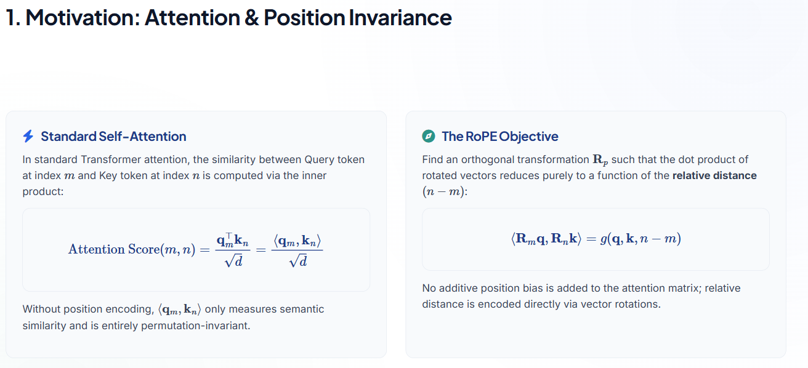

Slide 67
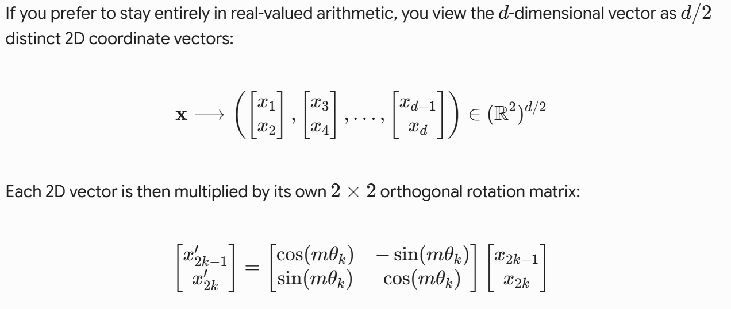
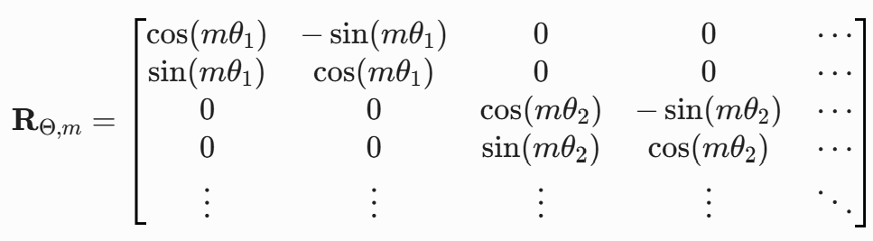

Slide 68
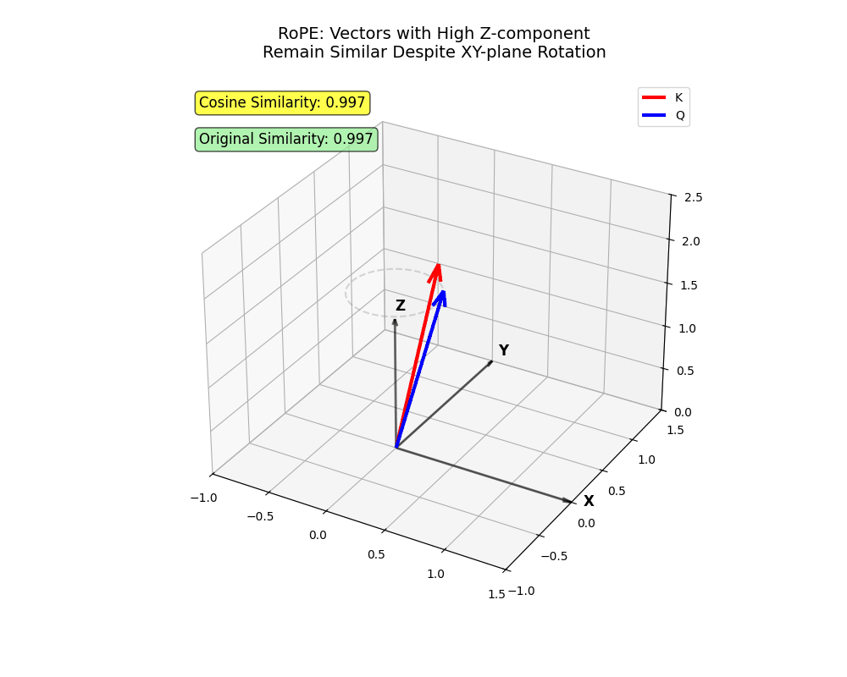
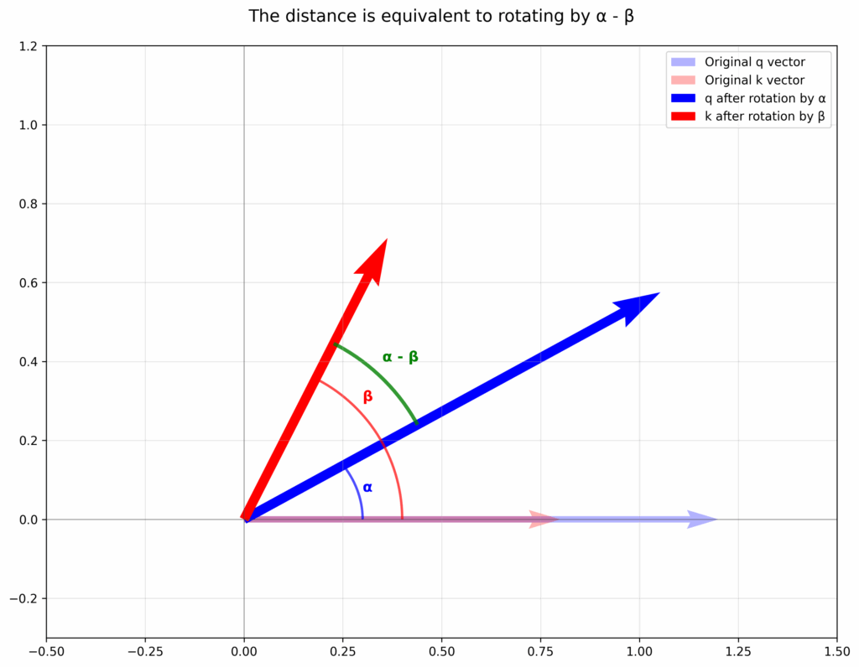
https://towardsdatascience.com/rope-clearly-explained/

Slide 69
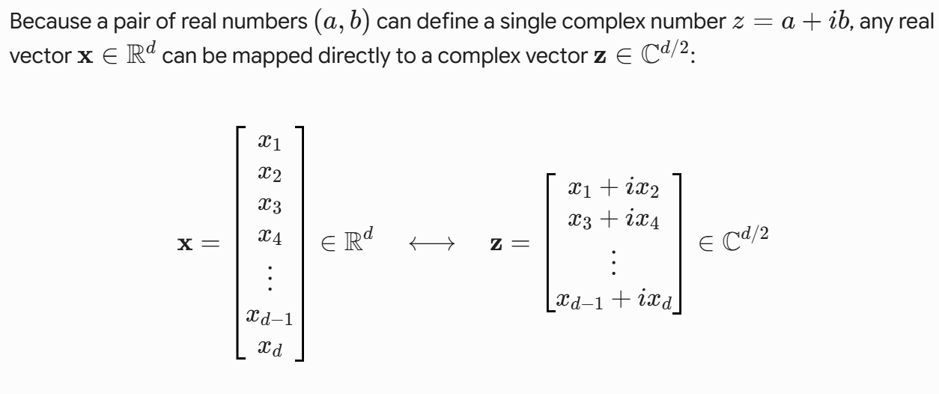
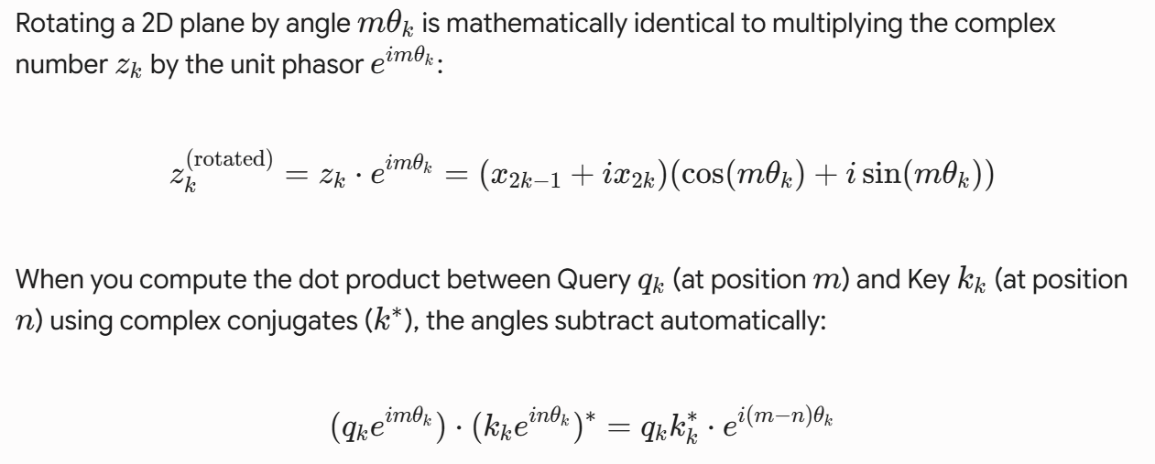
Complex number
interpretation

Slide 70
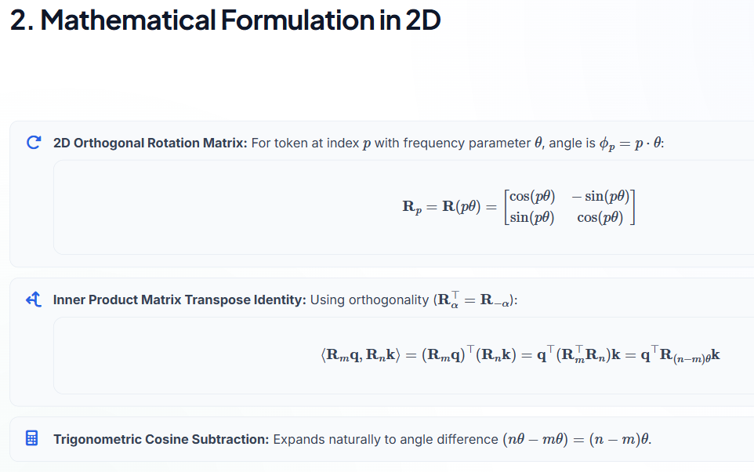

Slide 71
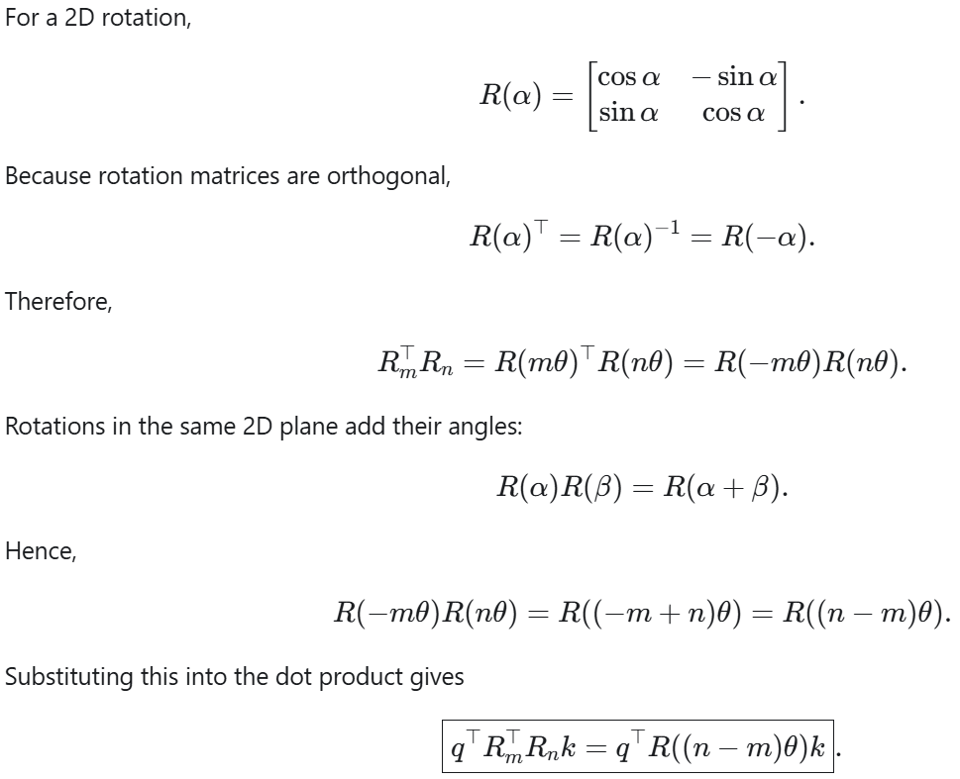

Slide 72
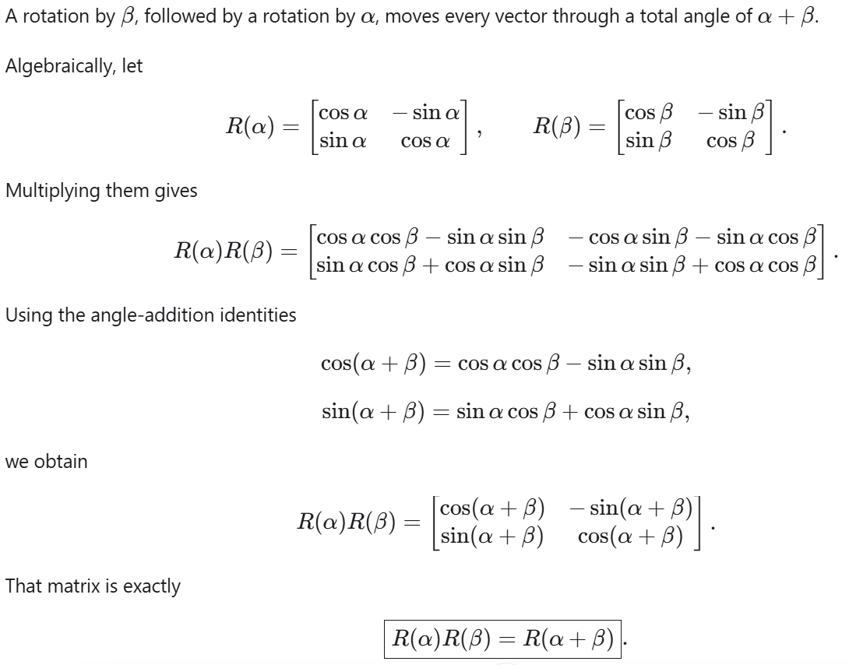

Slide 73
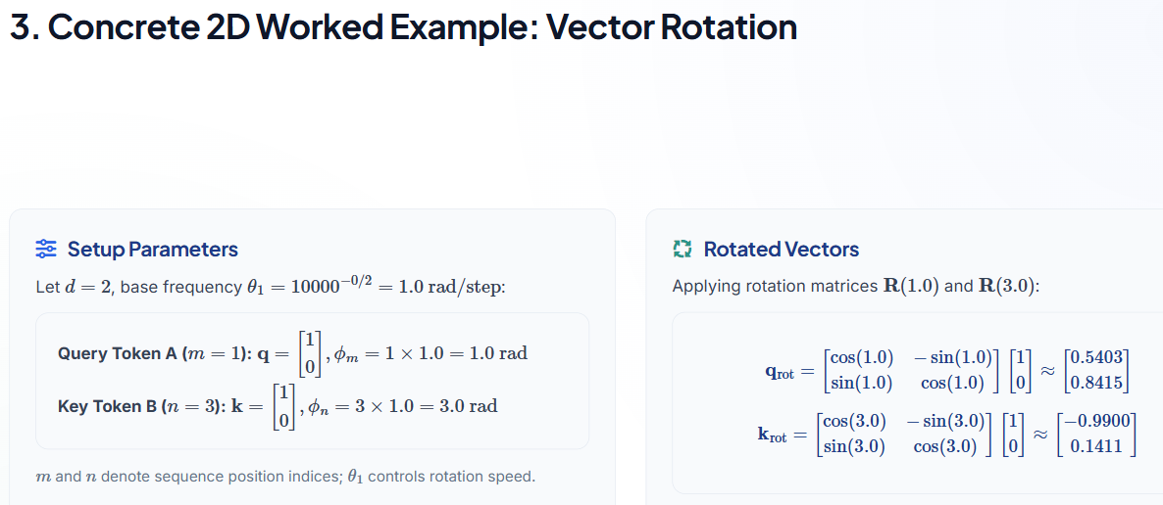


Slide 74
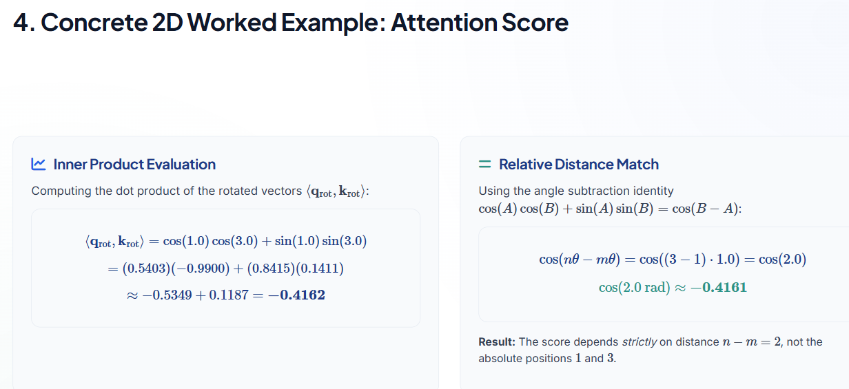

Slide 75
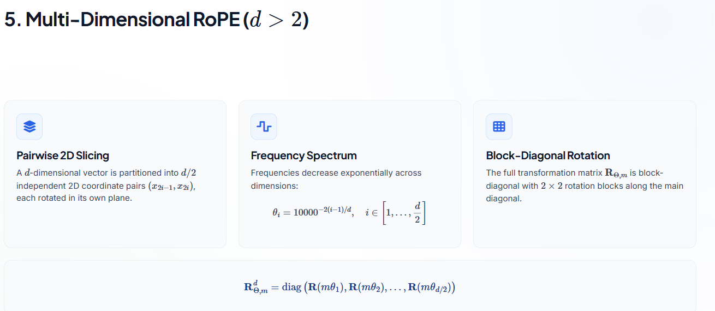

Slide 76
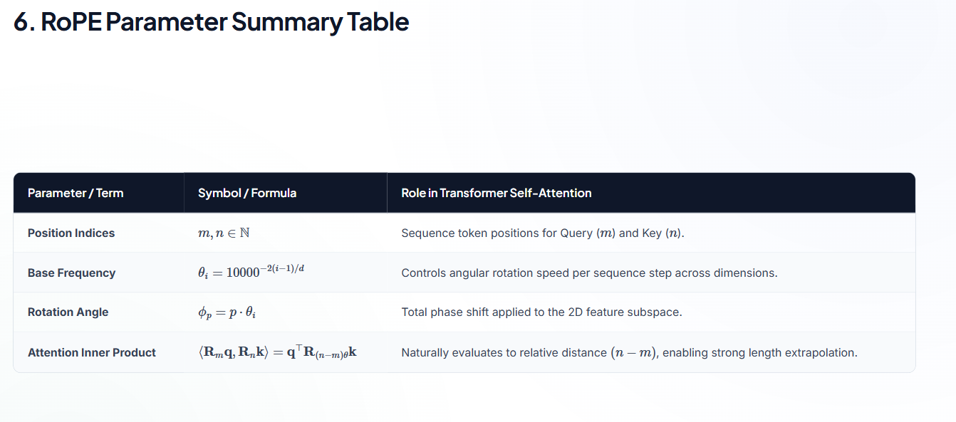

Slide 77
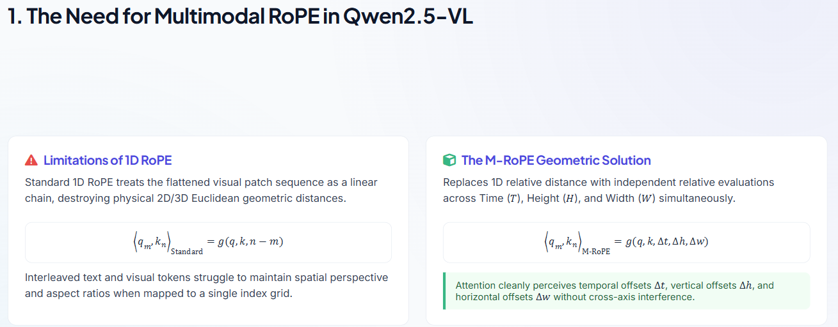

Slide 78
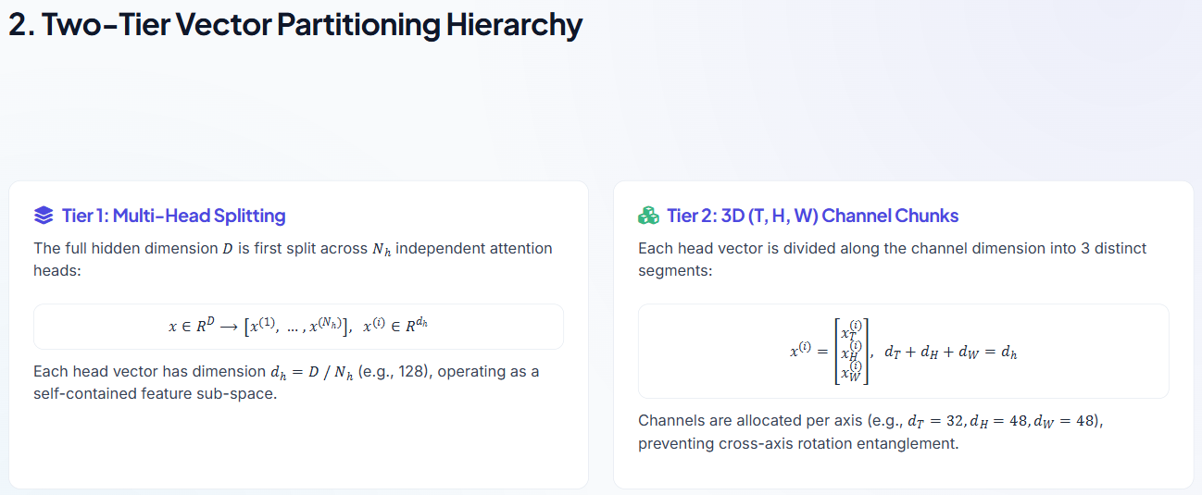

Slide 79
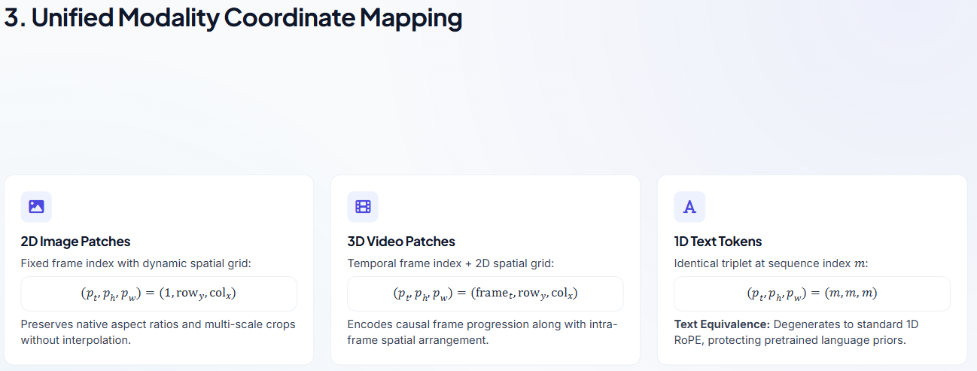

Slide 80
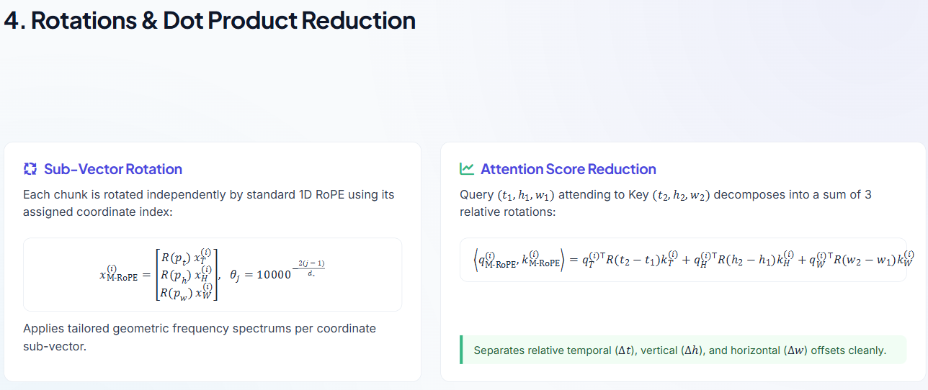

Slide 81
