Slide 1
Multi-layer networks, hyperparameter search, validation
Collected from the Internet and modified by
Longin Jan Latecki
latecki@temple.edu
Sources:
Stanford CS 231. Deep Learning for CV: https://cs231n.stanford.edu/
Computer Vision Lectures by Svetlana Lazebnik
Other Internet Sources

Slide 2
From linear to nonlinear classifiers
To achieve good accuracy on challenging problems, we need to be able to train nonlinear models
Deep learning approach: stack simple feature transformations in multiple layers
Contrast with historical “shallow” approach: complicated hand-crafted feature transformation (nonlinear, non-trainable) followed by simple trainable classifier
Layer 1
Layer 2
…
Layer L
Input
Output
Hand-crafted feature transformation
Trainable
classifier
Input
Output

Slide 3
Overview
Multi-layer networks
  Linear layers
  Activation function

Slide 4


From linear classifiers to multi-layer networks
$$x$$
$$y=w^{T}x$$

Slide 5



From linear classifiers to multi-layer networks
$$y^{(1)}=w^{(1)}∙x$$
$$y^{(2)}=w^{(2)}∙x$$
$$x$$
$$⋮$$

Slide 6
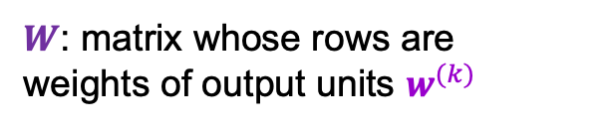

From linear classifiers to multi-layer networks
Linear layer
$$x$$
$$y=Wx$$
$W$: matrix whose rows are weights of output units $w^{(k)}$

Slide 7

From linear classifiers to multi-layer networks
Linear layer
$$x$$
Let’s add more layers!

Slide 8


From linear classifiers to multi-layer networks
Linear layer
$$y=Wx$$
$$x$$
$$z=UWx$$
Still linear!

Slide 9
From linear classifiers to multi-layer networks
Linear layer
Nonlinearity
Linear layer
$$x$$

Slide 10



Element-wise nonlinearities (activation functions)
Linear layer
Nonlinearity
$$y$$
$$x$$
$$z=g(y)$$
$$y=Wx$$

Slide 11
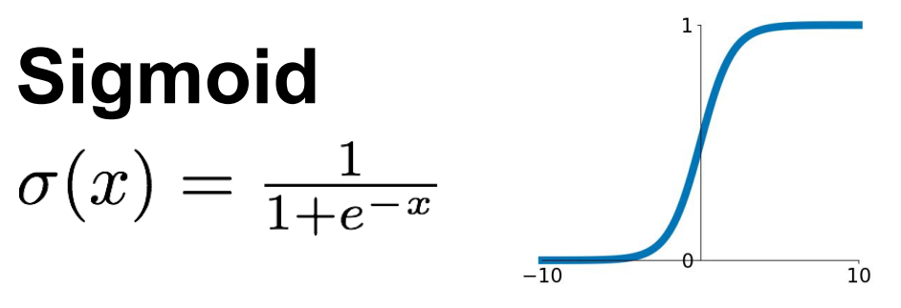
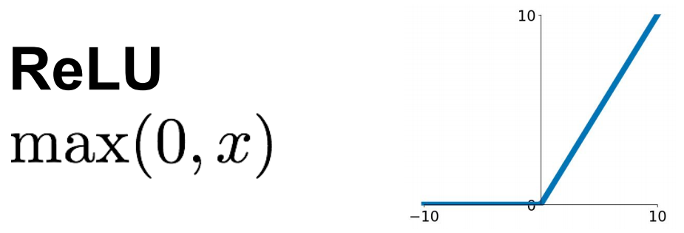
Element-wise nonlinearities (activation functions)
Source: Stanford 231n

Slide 12
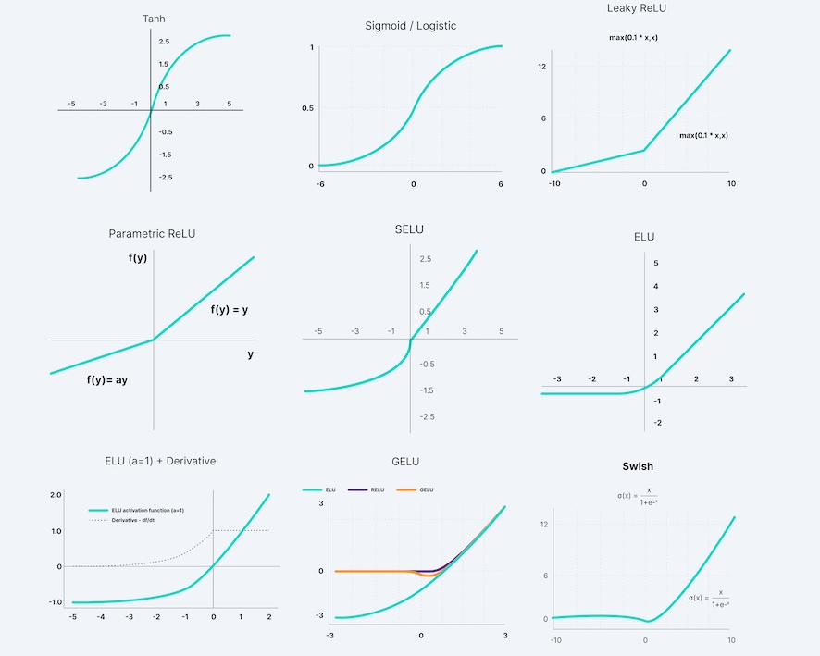
Element-wise nonlinearities (activation functions)
Source: V7labs

Slide 13


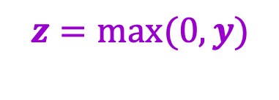

Element-wise nonlinearities
Linear layer
Nonlinearity
$$y$$
$$x$$
$$z=g(y)$$
$$y=Wx$$
$$z=max(0,y)$$

Slide 14


The power of ReLU
Points not linearly separable in original space
$$x^{(2)}$$
$$x^{(1)}$$
Source: J. Johnson

Slide 15

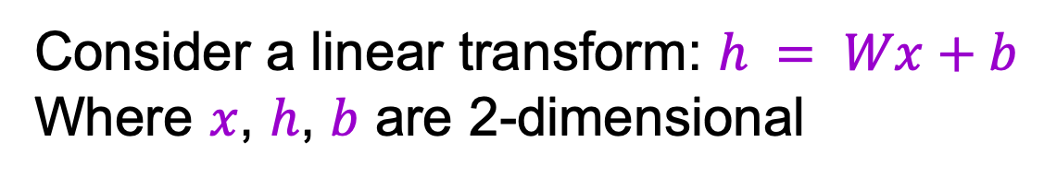

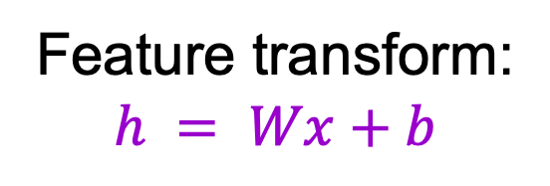
The power of ReLU
Points not linearly separable in original space
Consider a linear transform: $h = Wx+b$
Where $x$, $h$, $b$ are 2-dimensional
$$x^{(2)}$$
$$h^{(2)}$$
Feature transform:
$$h = Wx+b$$
$$x^{(1)}$$
$$h^{(1)}$$
Still not linearly separable!
Source: J. Johnson

Slide 16
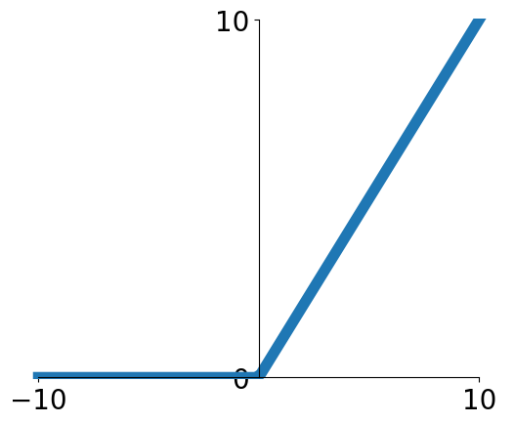
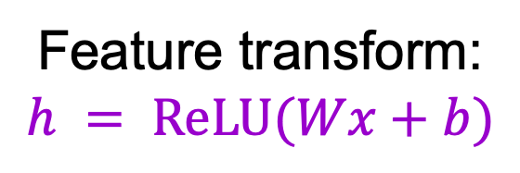
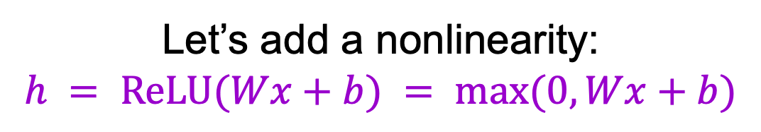
The power of ReLU
Points not linearly separable in original space
Let’s add a nonlinearity:
$$h = ReLU(Wx+b) = max⁡(0, Wx+b)$$
$$x^{(2)}$$
$$h^{(2)}$$
Feature transform:
$$h = ReLU(Wx+b)$$
$$x^{(1)}$$
$$h^{(1)}$$
Source: J. Johnson

Slide 17
The power of ReLU
Points not linearly separable in original space
Let’s add a nonlinearity:
$$h = ReLU(Wx+b) = max⁡(0, Wx+b)$$
$$x^{(2)}$$
$$h^{(2)}$$
Feature transform:
$$h = ReLU(Wx+b)$$
$$x^{(1)}$$
$$h^{(1)}$$
Source: J. Johnson

Slide 18
The power of ReLU
Points not linearly separable in original space
Let’s add a nonlinearity:
$$h = ReLU(Wx+b) = max⁡(0, Wx+b)$$
$$x^{(2)}$$
$$h^{(2)}$$
Feature transform:
$$h = ReLU(Wx+b)$$
$$x^{(1)}$$
$$h^{(1)}$$
Points are linearly separable in feature space!
Source: J. Johnson

Slide 19
The power of ReLU
Let’s add a nonlinearity:
$$h = ReLU(Wx+b) = max⁡(0, Wx+b)$$
$$x^{(2)}$$
$$h^{(2)}$$
Feature transform:
$$h = ReLU(Wx+b)$$
$$x^{(1)}$$
$$h^{(1)}$$
Source: J. Johnson

Slide 20
The power of ReLU
Let’s add a nonlinearity:
$$h = ReLU(Wx+b) = max⁡(0, Wx+b)$$
$$x^{(2)}$$
$$h^{(2)}$$
A
Feature transform:
$$h = ReLU(Wx+b)$$
A
$$x^{(1)}$$
$$h^{(1)}$$
Source: J. Johnson

Slide 21
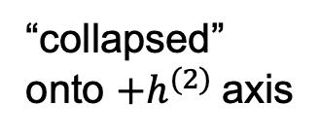
The power of ReLU
Let’s add a nonlinearity:
$$h = ReLU(Wx+b) = max⁡(0, Wx+b)$$
$$x^{(2)}$$
$$h^{(2)}$$
A
Feature transform:
$$h = ReLU(Wx+b)$$
B
B
A
“collapsed” onto ${+h}^{(2)}$axis
$$x^{(1)}$$
$$h^{(1)}$$
Source: J. Johnson

Slide 22
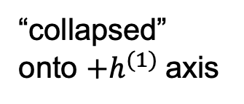
The power of ReLU
Let’s add a nonlinearity:
$$h = ReLU(Wx+b) = max⁡(0, Wx+b)$$
$$x^{(2)}$$
$$h^{(2)}$$
A
Feature transform:
$$h = ReLU(Wx+b)$$
B
B
A
D
“collapsed” onto ${+h}^{(2)}$axis
$$x^{(1)}$$
$$h^{(1)}$$
D
“collapsed” onto ${+h}^{(1)}$axis
Source: J. Johnson

Slide 23
The power of ReLU
Let’s add a nonlinearity:
$$h = ReLU(Wx+b) = max⁡(0, Wx+b)$$
$$x^{(2)}$$
$$h^{(2)}$$
A
Feature transform:
$$h = ReLU(Wx+b)$$
B
B
A
D
“collapsed” onto ${+h}^{(2)}$axis
$$x^{(1)}$$
$$h^{(1)}$$
C
C
D
“collapsed” onto origin
“collapsed” onto ${+h}^{(1)}$axis
Source: J. Johnson

Slide 24
The power of ReLU
Points not linearly separable in original space
Let’s add a nonlinearity:
$$h = ReLU(Wx+b) = max⁡(0, Wx+b)$$
$$x^{(2)}$$
$$h^{(2)}$$
Feature transform:
$$h = ReLU(Wx+b)$$
$$x^{(1)}$$
$$h^{(1)}$$
Source: J. Johnson

Slide 25
The power of ReLU
Points not linearly separable in original space
Let’s add a nonlinearity:
$$h = ReLU(Wx+b) = max⁡(0, Wx+b)$$
$$x^{(2)}$$
$$h^{(2)}$$
Feature transform:
$$h = ReLU(Wx+b)$$
$$x^{(1)}$$
$$h^{(1)}$$
Source: J. Johnson

Slide 26
The power of ReLU
Points not linearly separable in original space
Let’s add a nonlinearity:
$$h = ReLU(Wx+b) = max⁡(0, Wx+b)$$
$$x^{(2)}$$
$$h^{(2)}$$
Feature transform:
$$h = ReLU(Wx+b)$$
$$x^{(1)}$$
$$h^{(1)}$$
Transformed points are linearly separable!
Source: J. Johnson

Slide 27




The power of ReLU
Points not linearly separable in original space
Let’s trace the boundary back to the original space
$$x^{(2)}$$
$$h^{(2)}$$
$$x^{(1)}$$
$$h^{(1)}$$
Source: J. Johnson

Slide 28
The power of ReLU
Points not linearly separable in original space
Let’s trace the boundary back to the original space
$$x^{(2)}$$
$$h^{(2)}$$
$$x^{(1)}$$
$$h^{(1)}$$
Linear boundary in transformed space gives nonlinear boundary in original space!
Source: J. Johnson

Slide 29
Two-layer neural network (for binary classification)
Hidden layer
Input layer
Output layer
.
.
.
.
.
.
Units in hidden and output layer have nonlinear activations

Slide 30

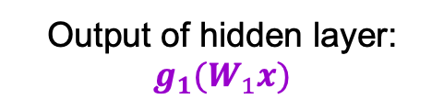
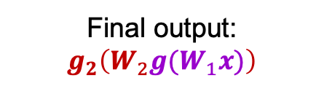
Two-layer neural network
Input layer: $x$
Output of hidden layer: $g_{1}(W_{1}x)$
Final output: $g_{2}\left(W_{2}g(W_{1}x)\right)$
Image source

Slide 31
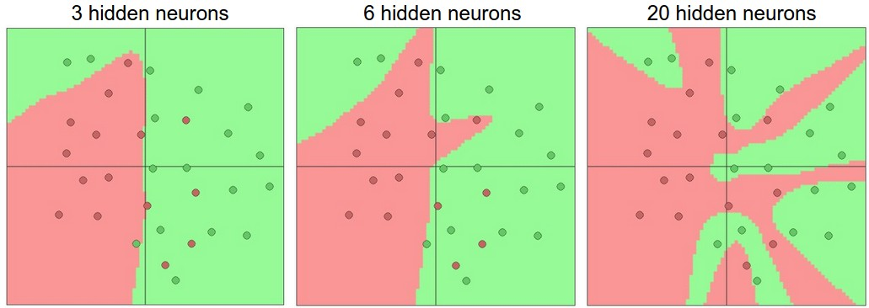
Expressiveness of two-layer networks
How complex can we make the decision boundary in a two-layer network?
  The bigger the hidden layer, the more complex the model
A two-layer network is a universal function approximator
  But the hidden layer may need to be huge
Figure source

Slide 32
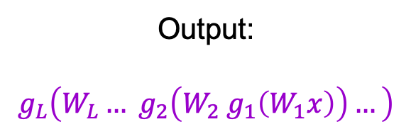

Neural networks beyond two layers
Output:
$$g_{L}\left(W_{L}… g_{2}\left(W_{2}{ g}_{1}\left(W_{1}x\right)\right)…\right)$$
Individual dimensions of $x$
Image source

Slide 33
“Deep” pipeline
Layer 1
Layer 2
…
Layer L
Input
Output
  Learn a feature hierarchy
  Each layer extracts features from the output of previous layer
  All layers are trained jointly

