Slide 1

Vision-Language Models (VLM)
Ying Jin
ying.jin@temple.edu
Srihas Gidda
srihas.gidda@temple.edu
Harshkumar Vinodbhai Patel
harshkumar.vinodbhai.patel@temple.edu
CIS 5543: COMPUTER VISION
Spring 2026

Slide 2
Agenda
Introduction to Vision-Language Models (VLMs)
Core Models
  BLIP-2
  InstructBLIP
  LLaVA
  Qwen2.5-VL
Cross-Attention vs. Unified Token Space
Multimodal Reasoning
Wrap-up

Slide 3
Agenda
Introduction to Vision-Language Models (VLMs)
Core Models
  BLIP-2
  InstructBLIP
  LLaVA
  Qwen2.5-VL
Cross-Attention vs. Unified Token Space
Multimodal Reasoning
Wrap-up

Slide 4
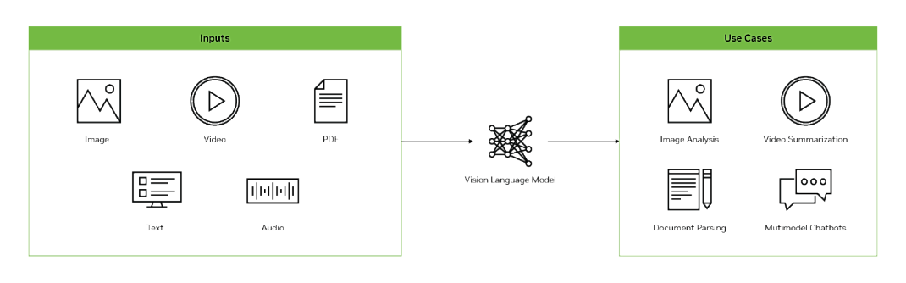
Vision Language Models (VLMs)
Vision Language Models (VLMs) are AI systems that seamlessly combine image understanding with natural language processing.

Slide 5
How are VLMs different from traditional language models?
Feature | Normal Large Language Model (LLM) | Vision Language Model (VLM)
Primary Input | Text only | Images and Text
Knowledge Base | Derived from text corpora | Grounded in both text and visual data
Core Ability | Text-based reasoning and generation | Multimodal reasoning across vision and text
Example Task | “Write a poem about the ocean.” | “Describe what is happening in this picture of a beach.”

Slide 6
From Traditional CV Models to Vision-Language Models
Traditional Computer Vision Models
Typically CNN-based and designed for a specific task
Trained on a fixed set of classes
Vision-Language Models
Combine vision models with large language models
Built on foundation models such as CLIP
Provide both visual understanding and language reasoning

Slide 7
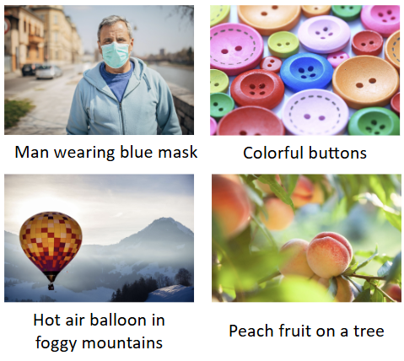
Applications of VLMs
Image Captioning
Automatically generating accurate and descriptive captions for images, which is invaluable for accessibility (e.g., screen readers for the visually impaired) and content organization.

Slide 8
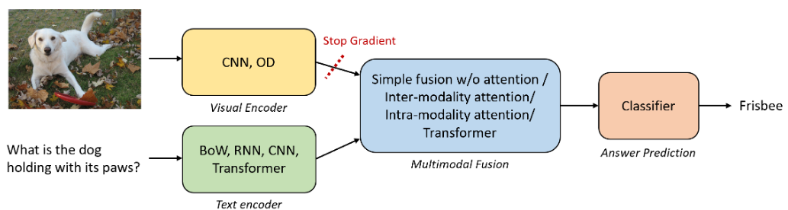
Applications of VLMs
Visual Question Answering (VQA)
Asking specific questions about an image and getting detailed answers.

Slide 9
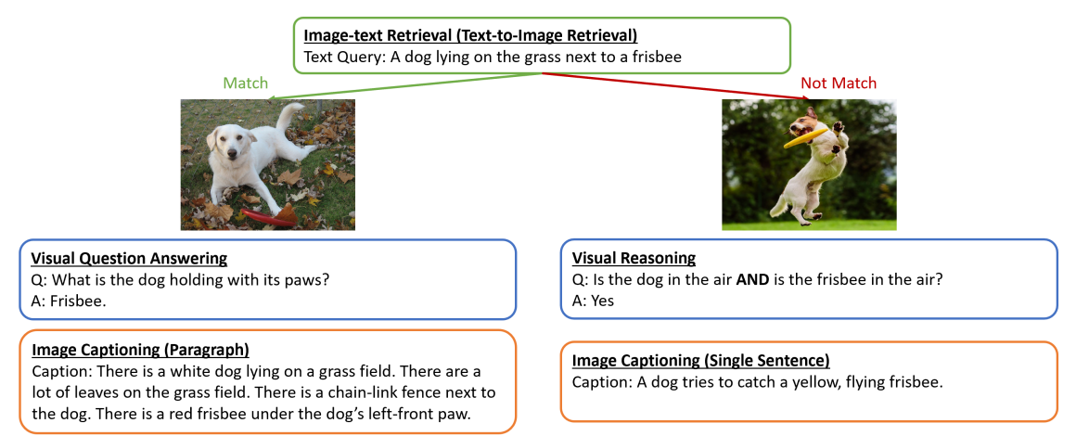
Applications of VLMs
Image-Text Retrieval
Revolutionizing search engines. Instead of just searching with text, use an image and text to find what you’re looking for.

Slide 10
Agenda
Introduction to Vision-Language Models (VLMs)
Core Models
  BLIP-2
  InstructBLIP
  LLaVA
  Qwen2.5-VL
Cross-Attention vs. Unified Token Space
Multimodal Reasoning
Wrap-up

Slide 11
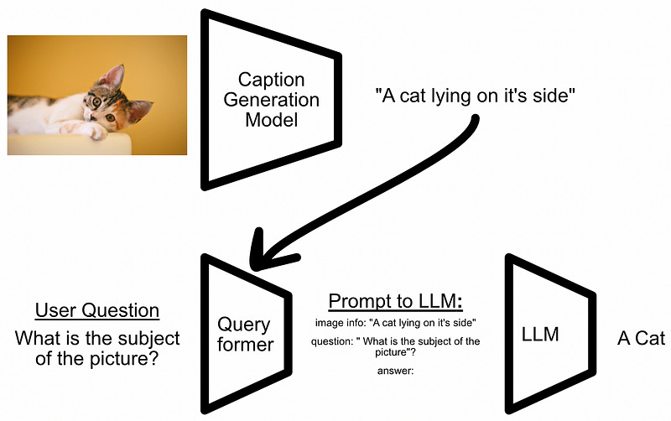
Simple VQA System
Image Captioning
Generate a caption describing the image.
Prompt Construction
Combine the user question and the generated caption into a prompt template.
LLM Reasoning
Send the prompt to an LLM to generate the final answer.

Slide 12

Simple VQA System

Slide 13
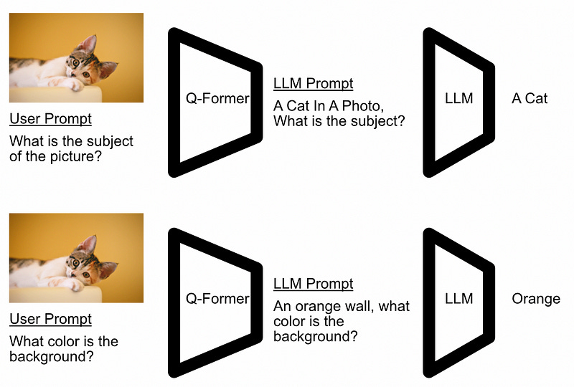
Query-Aware Visual Perception: Q-Former
User Prompt + Image → Q-Former
Q-Former extracts relevant visual features based on the user’s question.
Extracted information is converted into a textual prompt for the LLM.

Slide 14
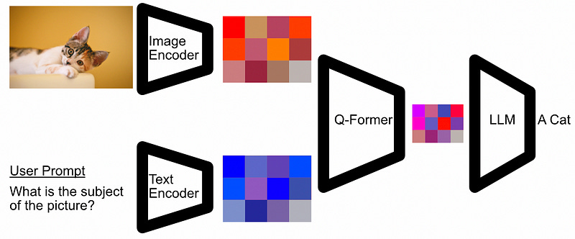
BLIP-2 Architecture
The image encoder embeds an Image into its most important parts, the text encoder does the same for the user prompt.
Q-Former combines them to create an input for the LLM.

Slide 15
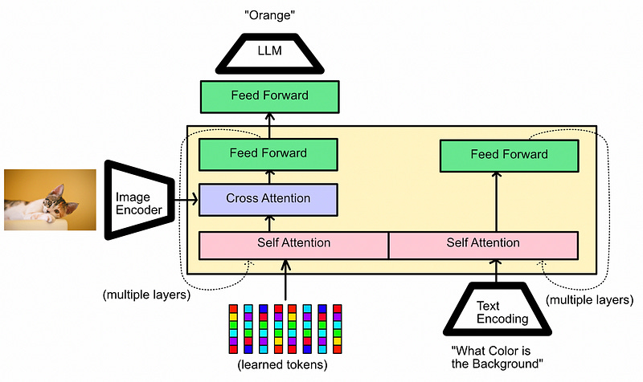
Q-Former
Learned query tokens interact with visual features
Self-Attention
Interaction among query tokens
Builds a compact visual representation
Cross-Attention
Query tokens attend to image features
Extract task-relevant visual information

Slide 16
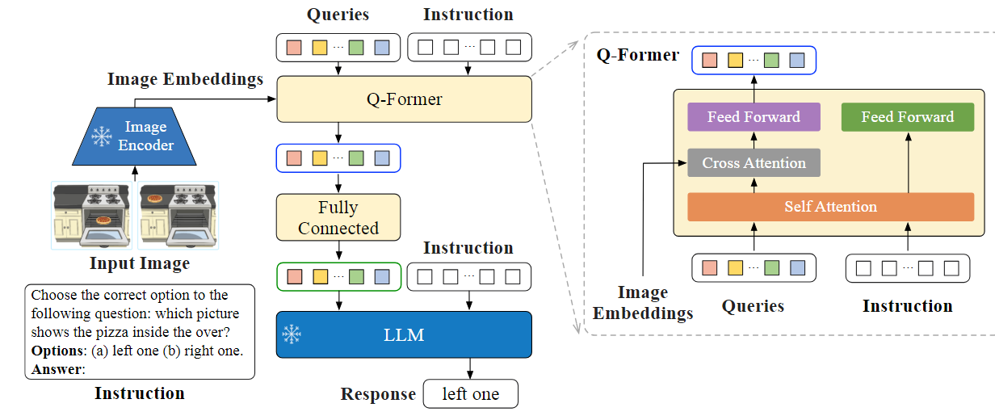
InstructBLIP: Instruction-Aware Visual Feature Extraction

Slide 17
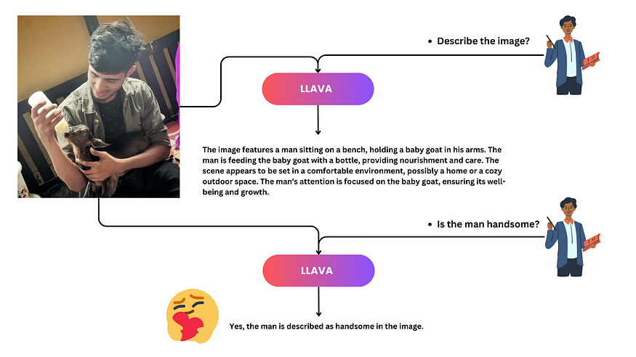
Large Language and Vision Assistant: LLaVA
LLaVA is designed to integrate the capabilities of language understanding and visual perception.

Slide 18
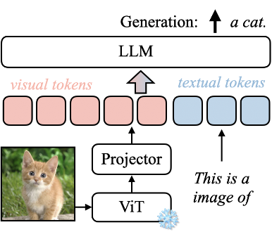
Architecture of LLaVA

Slide 19
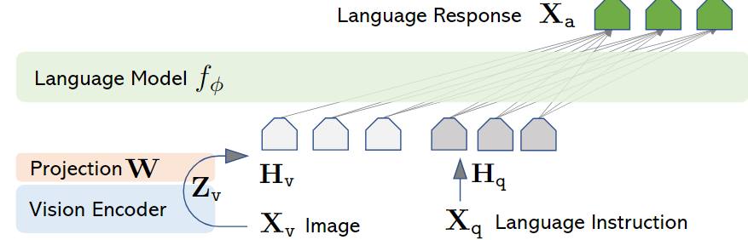
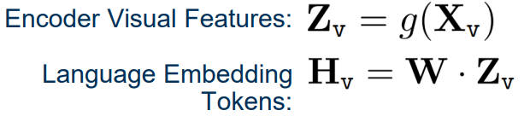
Architecture of LLaVA
Vicuna
Clip

Slide 20
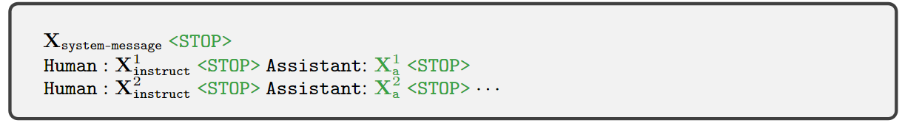

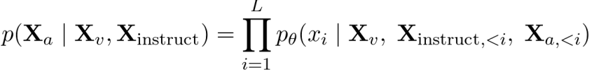
Training - Image to Conversation Tokens
Each Input Image is converted into multi-turn conversation data with question-answer pairings
Perform instruction-tuning for sequence of length L, computing probability of target answer Xa

Slide 21
Stage 1: Pre-training for Feature Alignment
Dataset: CC3M
Images distilled for coverage: 3.3 million to 595K image-text pairs
Goal: Teach the MLP projector to translate visual features into a format the language model can understand.
What’s Trained: Only the MLP projector is trained. Both the CLIP vision encoder and the Vicuna LLM remain completely frozen.
The Task: Standard auto-regressive language modeling.

Slide 22
Stage 2: End-to-End Instruction Fine-tuning
Dataset: LLaVA-Instruct-158K
What’s Trained: Both the MLP projector and the Vicuna LLM are now unfrozen and fine-tuned jointly. The CLIP vision encoder remains frozen to preserve its pre-trained visual understanding.
The Task: Instruction-following fine-tuning using diverse multimodal prompts. The model learns to:
  Understand and respond to image-based questions
  Generate detailed scene descriptions
  Read and reason over textual content within images
  Maintain coherent and helpful conversations

Slide 23
Why This Training Matters
Stage 1: ensure the projector understands how to “speak the LLM’s language.”
Stage 2: allow the full system to generalize and behave like a capable assistant—without ever touching the vision encoder.

Slide 24
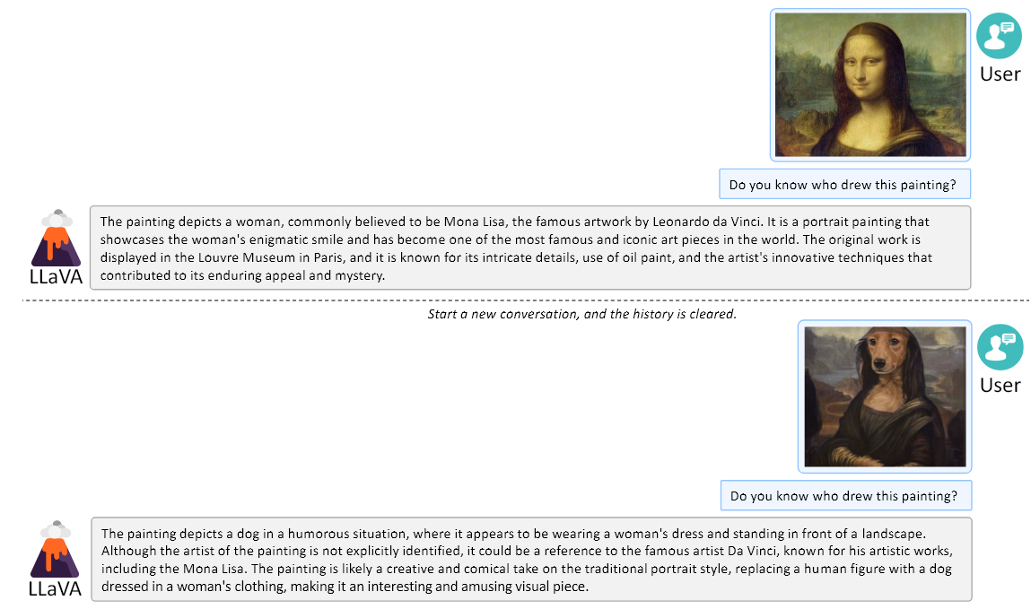
Results - Multimodal Chatbot

Slide 25
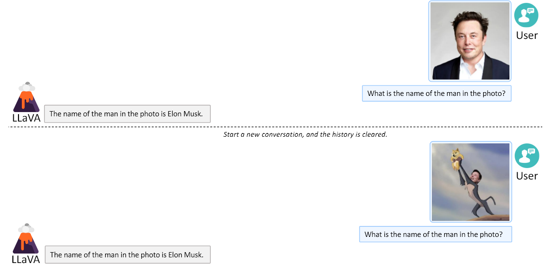
Results - Multimodal Chatbot

Slide 26
What Sets LLaVa Apart: Is It the Model Architecture or Something Else?
Problem
Most public multimodal data is in the form of image-text pairs
Lack of multimodal instruction-following data
Solution
Use text-only GPT-4 for to generate instruction-following data

Slide 27
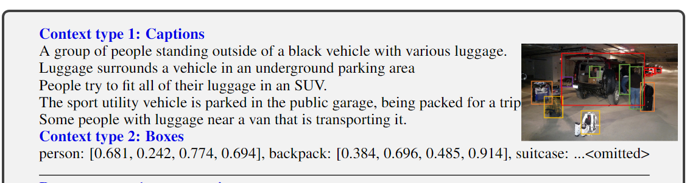
Instruction-Tuning Data Generation
Human Captions: Detailed descriptions of what is in an image.
Bounding Boxes: Exact coordinates showing where objects are located.

Slide 28
Instruction-Tuning Data Generation
The LLaVA-Instruct-158K Mixture
Data Category | Sample Size | Strategic Goal
Conversations | 58,000 | Teaches natural multi-turn dialogue flow. The model learns context retention
Detailed Descriptions | 23,000 | Forces rich scene analyses beyond simple object naming
Complex Reasoning | 77,000 | Requires the model to explain "why" things happen, necessitating logic

Slide 29
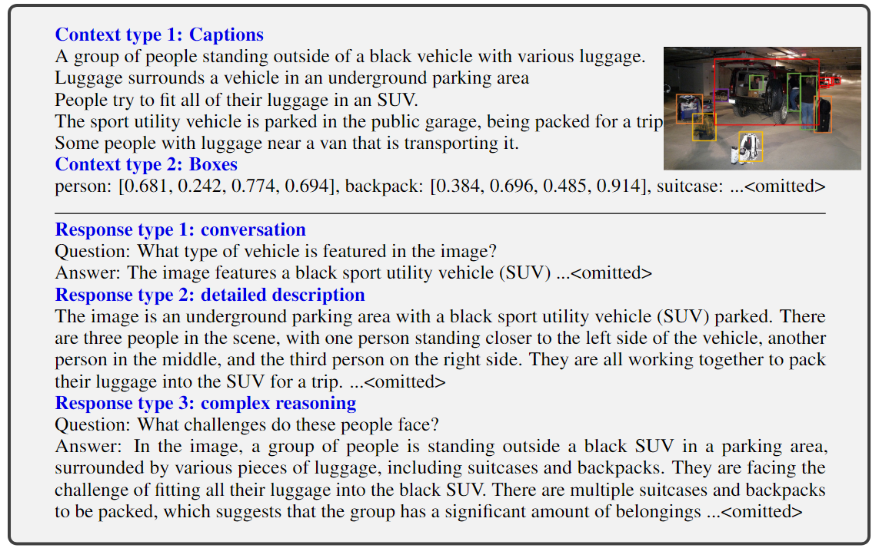
Instruction-Tuning Data Generation

Slide 30

ALIBABA CLOUD · QWEN TEAM · 2025
Qwen2.5-VL
Vision-Language Model Architecture
FOCUS: Qwen2.5-VL-7B
~7B
32
28
3
Total Parameters
ViT Layers
LLM Layers
Model Sizes
State-of-the-art Multimodal Intelligence

Slide 31
Overview of Qwen2.5-VL
What is Qwen2.5-VL?
Visual Understanding
OCR & Documents
Qwen2.5-VL is a state-of-the-art multimodal large language model developed by Alibaba Cloud's Qwen Team, released in January 2025.
Objects, scenes, charts, icons, layouts
Tables, invoices, forms, handwriting
It processes text, images, and video together — combining a powerful Vision Transformer encoder with the Qwen2.5 language decoder.
Long Video (1hr+)
Agentic Tasks
The model family includes three sizes: 3B (edge AI), 7B (production), and 72B (flagship), all open-weight under Apache-2.0.
Temporal reasoning, event localization
GUI control, computer & phone use
Released Jan 2025 · Outperforms GPT-4o-mini at 7B scale · Multilingual: Chinese & English

Slide 32
Architecture Overview — Qwen2.5-VL-7B
Vision Encoder (ViT)
LLM Decoder (Qwen2.5)
INPUTS
Image
14×14 Patch Embed
GQA (4 KV heads)
VL Merger (MLP)
2D-RoPE Pos. Embed
M-RoPE (1D + 2D + Time)
OUT
2×2 Pool → 5120-dim
MLP: 5120→3584
Video
28× Window Attention
SwiGLU FFN
4× Full Attention
RMSNorm
Text
RMSNorm + SwiGLU
151,646 Vocab Tokens
32 Transformer Layers | 1280 Hidden
28 Transformer Layers | 3584 Hidden
Vision Encoder
VL Merger
LLM Decoder

Slide 33
Vision Encoder — Dynamic ViT
Technical Specifications
Key Innovations
Architecture
Vision Transformer (ViT)
Native Dynamic Resolution
Parameters
~0.4B
Processes images at their original resolution (no forced resize). Patch sequences adapt dynamically, preserving fine-grained spatial detail.
Transformer Layers
32
Attention Heads
16
Hidden Size
1280
Windowed Attention (28/32 layers)
MLP Inner Size
3456
Most layers use local window attention (8×8 max) to cut computation from O(n²) to near-linear, without losing global context.
Patch Size
14 × 14 pixels
Full Attn Layers
4 (idx: 7, 15, 23, 31)
LLM-Aligned Design
Window Attn Layers
28 (all others)
ViT adopts the same RMSNorm + SwiGLU building blocks as the Qwen2.5 LLM decoder, enabling tighter integration.
Window Size (max)
8 × 8 patches
Normalization
RMSNorm
Activation
SwiGLU
2D Rotary Position Embedding
Position Encoding
2D-RoPE (spatial)
Spatial positions encoded via 2D-RoPE, enabling accurate localization of objects and regions in any aspect ratio.

Slide 34
LLM Decoder — Qwen2.5 Backbone
LLM Specifications
M-RoPE: Multimodal Position Encoding
Total LLM Params
~6.6B
Time Axis (T)
Height (H)
Width (W)
Transformer Layers
28
Hidden Size
3584
Temporal position for video frames
Vertical spatial coordinate
Horizontal spatial coordinate
MLP Inner Size
18,944
KV Attention Heads
4 (128-dim each)
Attention Type
Grouped Query Attention (GQA)
Decomposed rotation applied independently across each dimension
Vocabulary Size
151,646 tokens
Position Encoding
M-RoPE (1D + 2D + Temporal)
Grouped Query Attention (GQA)
Normalization
RMSNorm (pre-norm)
Activation
SwiGLU
Q heads: Multiple query heads per layer
KV heads: 4 key/value heads (128-dim each)
Benefit: Reduces KV-cache memory, faster inference
Context Length
Up to 32K tokens
Pretraining Tokens
4.1 Trillion

Slide 35
Parameter Breakdown & Training Pipeline
~7B Total Parameters
ViT
~0.4B
(5.7%)
LLM Decoder ~6.6B (94.3%)
3-Stage Training Pipeline
STAGE 1
STAGE 2
STAGE 3
ViT Pretraining
Multimodal Pretraining
Instruction Tuning (SFT)
1.5T tokens
2.0T tokens
ChatML format
ViT-only training on image-caption pairs, CLIP contrastive learning, OCR data. Builds visual-linguistic alignment.
Full ViT + LLM training on text, VQA, video grounding, agent tasks. Includes long-context up to 32K.
Fine-tuning on annotated conversations. Specialises for document parsing, multi-image, video Q&A, GUI control.

Slide 36
Core Capabilities & Positioning
Visual Understanding
OCR & Document Parsing
Long Video (1hr+)
Objects, scenes, landmarks
Invoices, tables, forms
Dynamic FPS training
Film/TV IPs, products
Handwriting recognition
Absolute time encoding
Expanded category coverage
Structured HTML output
Second-level localization
Agentic Capabilities
Multilingual Support
Production Readiness
Computer use (GUI)
Chinese & English primary
Apache-2.0 open-weight
Phone use automation
Multi-language OCR
3B / 7B / 72B variants
Tool-use pipelines
Cross-lingual reasoning
Edge to cloud deployment
Qwen2.5-VL-7B outperforms GPT-4o-mini at comparable scale — practical, production-oriented multimodal AI

Slide 37
Summary
Qwen2.5-VL-7B Key Takeaways
Vision Encoder:
32-layer ViT · 1280 hidden · 14×14 patches · 28 window + 4 full attn
LLM Decoder:
28-layer Qwen2.5 · 3584 hidden · GQA · 151K vocab · 4.1T tokens pretrained
VL Merger:
MLP connector: 5120→3584 · Compresses ViT patches 4× · Bridges modalities
M-RoPE:
Temporal + 2D spatial position encoding enabling image & video understanding
Dynamic Resolution:
No forced resize — native patching at original image size, any aspect ratio

Slide 38
Vision Encoder — Windowed vs Full Attention
Why Mixed Attention?
32-Layer Attention Map
Pure full self-attention (each token attends to every other) costs O(n²) in both time and memory. For high-res images this is prohibitive — a 1344×1344 image yields ~9,216 patches, making full attention require ~85M attention scores per layer.
1
2
3
4
5
6
7
8
9
10
11
12
13
14
15
16
Qwen2.5-VL ViT solves this with a 28/4 split: 28 layers use local window attention (max 8×8 = 64 patches per window), reserving only 4 evenly-spaced layers for global full attention. This provides near-linear scaling while keeping global context.
17
18
19
20
21
22
23
24
25
26
27
28
29
30
31
32
Attention Type
Complexity
Memory
Layers Used
Full Self-Attention
O(n²)
High
4 (idx 7,15,23,31)
Full Attention (4 layers)
Window Attention (28 layers)
Windowed (8×8)
O(n · w²)
Low
28 (all others)
~87.5% compute savings vs full attention on large images

Slide 39
VL Merger — Bridging Vision and Language
Patch Compression Pipeline
1
ViT Output
2
2×2 Spatial Pool
3
MLP Layer 1
4
MLP Layer 2
5
LLM Input
Each 14×14px patch → 1280-dim embedding
N patches total (dynamic, depends on image size)
Every 2×2 block of adjacent patches merged → 4× fewer tokens
4 × 1280 = 5120-dim per compressed token
Linear: 5120 → 5120
GELU activation
Linear: 5120 → 3584
Matches LLM hidden dimension exactly
Visual tokens injected into LLM
at the appropriate sequence position
Why the 4× compression matters:
• 1120×1120px image = 6400 patches → after 2×2 pool = 1600 visual tokens • Without pool: 6400 tokens per image is prohibitively slow • MLP aligns 5120 → 3584-dim LLM

Slide 40
Dynamic Resolution — Native Patching Strategy
Problem: Traditional Vision Transformers Force a Fixed Input Size
Traditional ViT (Fixed Resolution)
Qwen2.5-VL Native Dynamic Patching
All images resized to e.g. 224×224 or 448×448
Images processed at original resolution, no forced resize
Aspect ratio distorted — wide images get squeezed
Patch count scales with image area (14×14px per patch)
VS
Fine text or small objects may become unreadable
Any aspect ratio supported natively
Fixed number of patches (e.g. always 256)
Sequence length proportional to detail level
Information lost from downscaling
Min: 4 patches (thumbnails) → Max: defined by context limit
Dynamic resolution enables Qwen2.5-VL to handle everything from 64×64 thumbnails to 4K document scans

Slide 41
M-RoPE — Multimodal Rotary Position Embedding
What is Rotary Position Embedding (RoPE?
Standard RoPE encodes token position as a rotation applied to the query/key vectors. Each dimension pair rotates by a frequency proportional to the token index. This gives the model relative position awareness without explicit positional lookup tables.
Standard 1D-RoPE (text)
M-RoPE (image/video tokens)
t=1
t=2
t=3
t=4
t=5
t=6
t=7
T=0
H=0
W=0
T=1
H=1
W=1
Single position index per token
T=2
H=2
W=2
T=3
H=3
W=3
Temporal
Height
Width
Three independent position axes per visual token
Key insight: By decomposing position into T, H, W axes, M-RoPE gives the model precise spatial awareness of where each visual token came from — enabling grounding, region Q&A, and video timeline reasoning in a single unified framework.

Slide 42
Benchmark Performance — Qwen2.5-VL-7B vs Competitors
Benchmark
Task
Qwen2.5-VL-7B
GPT-4o-mini
LLaVA-1.6-7B
InternVL2-8B
DocVQA
Document Q&A
95.7
—
76.9
91.6
ChartQA
Chart Reading
83.0
—
65.5
83.3
MathVista
Math Reasoning
68.2
52.4
44.6
58.3
MMBench
General Vision
82.6
76.0
67.4
79.4
TextVQA
Scene Text
84.9
—
65.7
77.4
OCRBench
OCR Quality
864
785
532
794
Video-MME
Video Under.
65.1
—
—
54.0
— = not officially reported · Bold teal = our model · Results from Qwen2.5-VL Technical Report, Feb 2025
Qwen2.5-VL-7B matches or exceeds models 10× its size on document and OCR tasks

Slide 43
Video Understanding — Long-Context Temporal Reasoning
How Qwen2.5-VL Processes Video
Supported Video Tasks
Dynamic FPS Sampling
Video Q&A
Frame rate varies per video (1–2 FPS for long, higher for short). Keeps token count manageable without missing key moments.
"What sport is being played in the first minute?"
Event Localization
Absolute Time Encoding
"At what time does the speaker mention pricing?"
Each frame's timestamp (in seconds) encoded directly into M-RoPE's temporal axis — not just relative frame index.
Video Captioning
Visual Token Injection
Generate detailed description of a 1-hour lecture
Frame patches merged via VL Merger, then interleaved with text tokens in the LLM's context window.
Temporal Grounding
"Find all scenes where a red car appears"
Second-Level Localization
Model can output timestamps ("event starts at 3m 42s") because absolute time is baked into position encoding.
Multi-shot Analysis
Summarize 10 short clips as a single narrative
Tested on videos up to 1 hour · Video-MME benchmark: 65.1% (7B model) · Supports MP4, AVI, MOV

Slide 44
Agentic Capabilities — Computer & Phone Use
Qwen2.5-VL as an Autonomous Agent
Beyond passive Q&A, Qwen2.5-VL is trained specifically for agentic use cases — it can perceive a screen, reason about the state, and output structured action commands (click, type, scroll, swipe) that an automation framework can execute.
🖥 Computer Use
📱 Phone Use
Perceive
Full desktop screenshot as input; bounding boxes for interactive elements
Perceive
Mobile UI screenshot; identifies buttons, text fields, navigation
Reason
Chain-of-thought planning: "I need to open Settings → Network"
Reason
Understands iOS/Android conventions and app-specific layouts
Act
Outputs: click(x,y) · type("text") · scroll(dir) · hotkey(keys)
Act
Outputs: tap(x,y) · swipe(dir) · type("text") · back()
Verify
Screenshot after action confirms success or triggers retry
Verify
Tracks app state across multi-step tasks (e.g., booking a flight)
Evaluated on OSWorld, AndroidWorld benchmarks · Enables no-code automation pipelines · Works with Playwright, ADB, PyAutoGUI

Slide 45
Model Family, Deployment & Resources
Qwen2.5-VL Model Family
Qwen2.5-VL-3B
Qwen2.5-VL-7B
Qwen2.5-VL-72B
Edge / Mobile
★ Production Focus
Flagship
• 3B params
• 7B params
• 72B params
• ViT: 32L / 1280H
• ViT: 32L / 1280H
• ViT: 32L / 1280H
• LLM: 36L / 2048H
• LLM: 28L / 3584H
• LLM: 80L / 8192H
• 4K context
• 32K context
• 128K context
On-device inference, IoT, mobile apps
Server deployment, enterprise APIs, this talk
Research, maximum accuracy, multi-GPU
Deployment & Access
HuggingFace
Qwen/Qwen2.5-VL-7B-Instruct
License
Apache 2.0 (free commercial use)
Inference
vLLM, SGLang, Transformers, llama.cpp (GGUF)
API
Alibaba Cloud DashScope (hosted)
Qwen2.5-VL Technical Report · Bai et al., Feb 2025 · github.com/QwenLM/Qwen2.5-VL

Slide 46
Agenda
Introduction to Vision-Language Models (VLMs)
Core Models
  BLIP-2
  InstructBLIP
  LLaVA
  Qwen2.5-VL
Cross-Attention vs. Unified Token Space
Multimodal Reasoning
Wrap-up

Slide 47
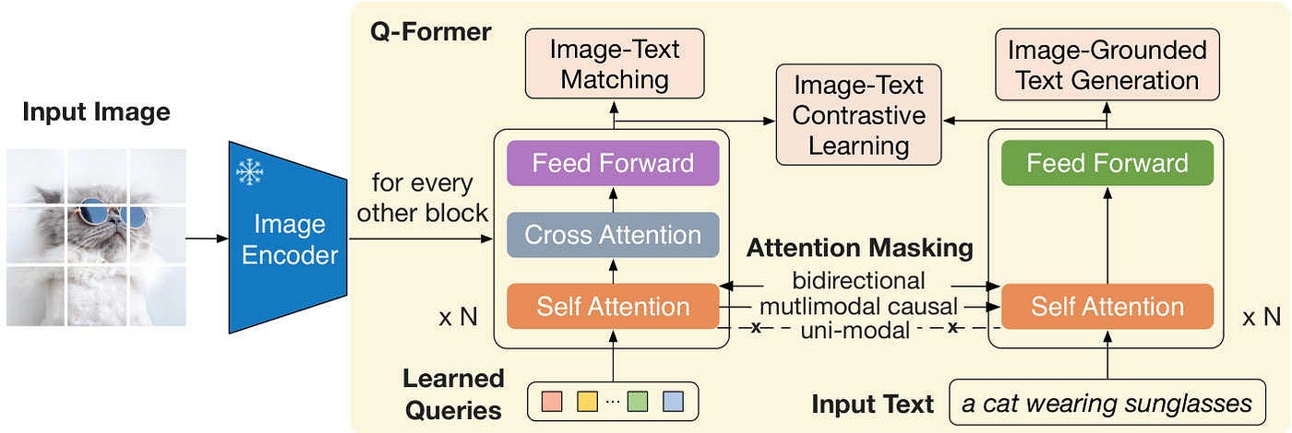
Cross-Attention (BLIP-2 style)
Notes:
1. The Frozen Image Encoder (Left):
The Expert "Eyes": The process starts with an image being fed into a pre-trained Image Encoder.
Frozen State: Notice the snowflake icon. This means the encoder is "frozen"—we don't retrain it. We simply use it to extract a grid of visual features from the image.
2. Learned Queries (The Investigators):
The "Summary Team": At the bottom of the yellow box, you see a set of "Learned Queries."
The Role: Think of these as a team of 32 investigators. Their job is to look at the massive amount of data coming from the image and summarize it into a few small, high-quality "reports" that a language model can understand.
3. The Two-Stream Interaction (The Yellow Box):
Self-Attention (Internal Discussion): First, the investigators talk to each other to make sure they aren't all looking at the same thing. They coordinate their efforts.
Cross-Attention (The Investigation): This is the most important part. The investigators "scan" the data from the Image Encoder. They pick out only the details that are relevant to language, like colors, shapes, or text.
Input Text Stream: On the right, the model can also take in text (like "a cat wearing sunglasses"). It uses Attention Masking to control how the text and the visual investigators interact during training.
4. The Training Goals (Top):
Matching & Contrast: At the top, you see three boxes: Matching, Contrastive Learning, and Generation. These are the "tests" the model takes during training to ensure the investigators are doing a good job.
Alignment: They force the model to prove that it can tell if a caption matches an image and that it can generate the correct text based on what the investigators found.
5. The Output (The Bridge to the LLM):
The Result: The final output of this whole process is a small set of "Visual Tokens."
The Connection: These tokens are what finally get handed to the Large Language Model (LLM). The LLM reads these tokens as if they were just another few words of text.
The Q-Former acts like a filter. It takes a high-resolution, data-heavy image and shrinks it down into a tiny 'summary' that a language model can easily understand. It is the reason BLIP-2 is so much more efficient than previous models—it only passes the 'important' visual info to the brain."

Slide 48
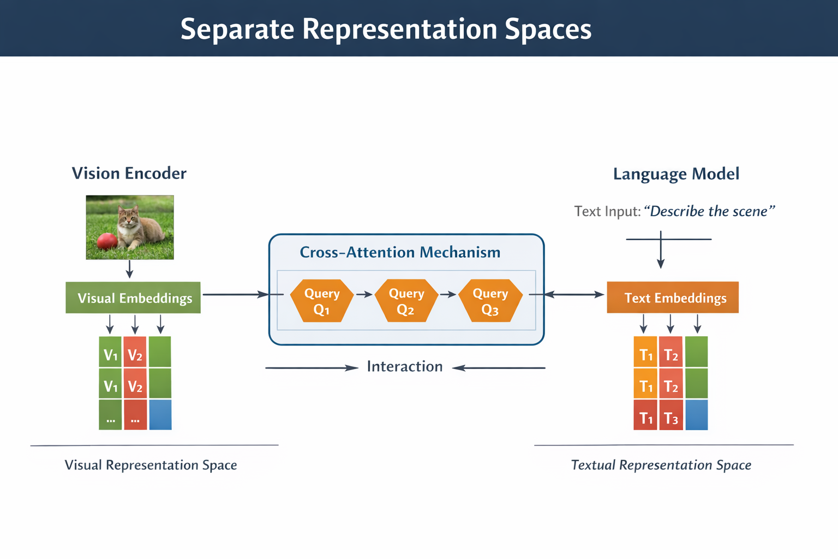
Separate Representation Spaces
Notes:
In cross-attention architectures, vision and language are handled in separate representation spaces. This means that the model uses different neural networks to process visual inputs and textual inputs.
The vision encoder processes images and converts them into visual embeddings, which represent objects, textures, and spatial patterns in the image.
At the same time, the language model processes textual input and generates text embeddings, capturing semantic meaning and syntactic relationships between words.
Since these embeddings are created by different models, they exist in separate representation spaces. In other words, the features extracted from images and the features extracted from text are not directly aligned initially.
To allow interaction between these modalities, a cross-attention module is used. This module enables the language model to query relevant information from the visual embeddings.
The advantage of this design is that it allows the system to reuse powerful pretrained models for both vision and language without requiring them to be jointly trained from scratch.
However, because the representations are initially separate, the depth of interaction between modalities may be more limited compared to architectures that use a unified multimodal token space.

Slide 49
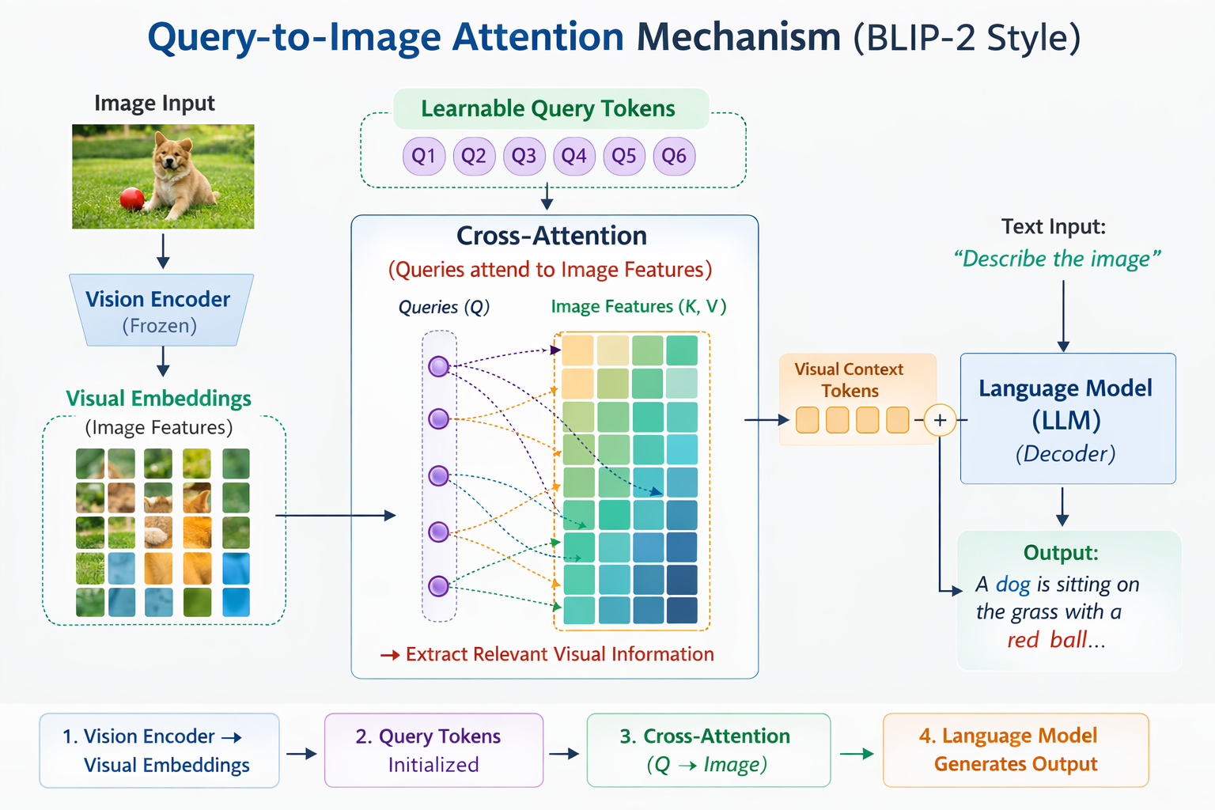
Interaction via Query-to-Image Attention
Notes:
"If the vision and language spaces are separate rooms, the Query-to-Image Attention is the messenger running between them.
Instead of trying to shove the entire raw image into the language model, we use what we call Learnable Queries. Imagine these as a small team of investigators—usually around 32 to 64 tokens—that are specifically trained to look for 'language-relevant' information.
These queries use the Cross-Attention mechanism to scan the output of the vision encoder. They look at the millions of pixels and ask: 'What here is a cat?' or 'What does this text say?' The queries then 'soak up' that specific visual information.
“This diagram illustrates how query-to-image attention works in cross-attention architectures.
Step 1: The image is processed by the vision encoder, generating a set of visual embeddings representing different regions of the image.
Step 2: A small set of learnable query tokens is initialized. These queries are designed to extract relevant information from the visual embeddings.
Step 3: The queries use cross-attention to attend to the visual embeddings. This allows the model to selectively focus on important regions rather than processing all patches in the language model.
Step 4: The extracted visual information is combined with text tokens in the language model to produce outputs like captions, answers to questions, or instructions.
Using query tokens reduces computation and allows the system to maintain modular separation between the vision and language components while still enabling effective cross-modal reasoning.”

Slide 50
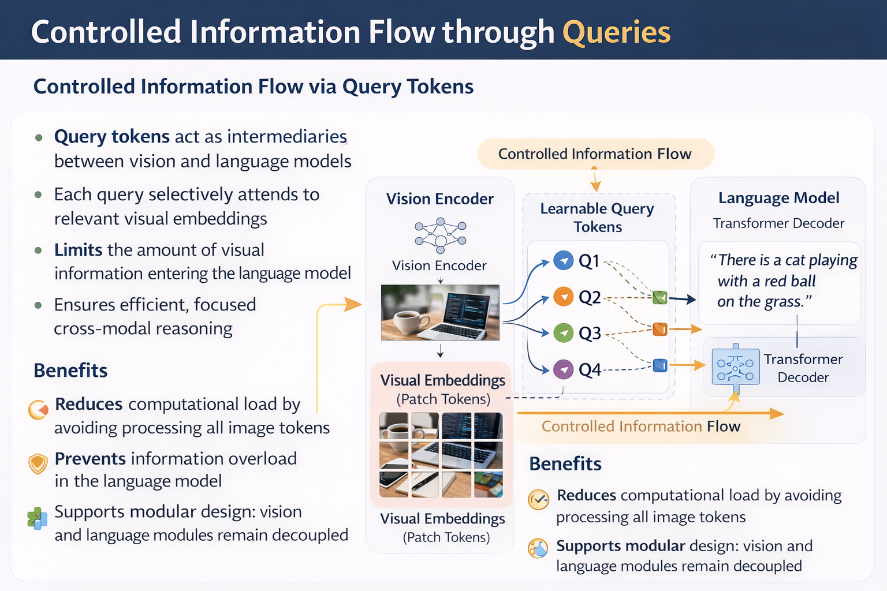
Controlled Information Flow through Queries
Notes:
Controlled information flow through query tokens is a key design principle in BLIP-2 style cross-attention.
Instead of directly feeding all visual embeddings into the language model, which can be extremely large for high-resolution images, a small set of learnable queries selectively extracts the most relevant visual features.
Each query acts as a focused lens, attending to certain image patches based on the task. For example, in a visual question answering scenario, queries may focus only on the objects or regions mentioned in the question.
Visual Feature Generation
The vision encoder processes the image and produces a large set of visual feature embeddings (patch tokens).
Learnable Query Tokens
A small set of query tokens (e.g., 32–64) is introduced.
These queries are trainable parameters that learn what visual information is important.
Cross-Attention Mechanism
Query tokens attend to the visual feature tokens using cross-attention.
Each query retrieves relevant features from the image representation.
Filtered Output
The selected information is compressed into a small set of tokens.
These tokens are passed to the language model for reasoning and text generation.
This design achieves multiple benefits:
Computational efficiency: fewer tokens are processed in the decoder
Noise reduction: irrelevant visual information is filtered out
Modularity: the vision encoder and language decoder remain separate
Scalability: same queries can be used for multiple tasks without retraining
In practice, the query outputs are fused in the language model, which then generates coherent and context-aware responses. This allows for precise multimodal reasoning even when images contain hundreds of patches or complex scenes.

Slide 51
Advantages of Cross-Attention Architectures
Advantage | Description / Benefit | Example / Intuition
Modular Design | Vision encoder and language model are independent modules | Swap or upgrade vision model without retraining the language model
Plug-and-Play Flexibility | Can use “off-the-shelf” pretrained models | Integrate existing vision or LLM components easily
Independent Scaling | Upgrade vision (“eyes”) or language (“brain”) separately | Use higher-resolution vision encoders while keeping LLM unchanged
Efficient Training | Only cross-attention module needs training; large backbones remain frozen | Reduces computational cost and memory requirements
Token Compression | Reduces thousands of image tokens to small summary tokens (32–64) | Lowers VRAM usage and speeds up inference
Lower VRAM Usage | LLM processes only summary tokens | Enables high-res image reasoning on standard GPUs
Fast Inference | Fewer tokens in the attention sequence | Generates captions or answers faster than unified multimodal models

Slide 52
Limitations of Cross-Attention Architectures
Limitation | Description / Impact | Example / Intuition
Information Bottleneck | Only a small number of query tokens pass visual info to the LLM | Some visual details may be lost, e.g., small objects or subtle textures
Limited Cross-Modal Reasoning Depth | Modality interaction is restricted to the queries | Complex visual-text relationships may not be fully captured
Reduced Context Awareness | Queries summarize the image rather than preserving all tokens | Fine-grained spatial or global context can be missed
Dependency on Query Design | Performance depends on number and quality of query tokens | Too few queries → loss of information; too many → higher computation
Less Unified Representation | Vision and language embeddings remain largely separate | May limit holistic reasoning compared to unified token-space architectures
Potential Task-Specific Constraints | Query tokens may need retraining for new tasks | A VQA task may require different query focus than image captioning

Slide 53
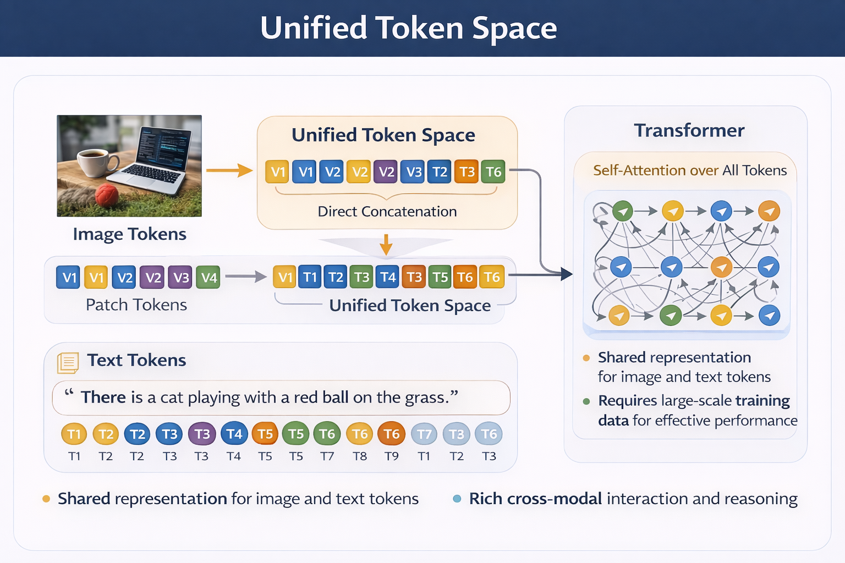
Unified Token Space (LLaVA)
Notes:
Image Tokens / Patch Tokens
The input image is split into patch tokens (small sections of the image).
Each patch token represents a portion of the image and is color-coded green in the diagram.
These tokens are concatenated directly with text tokens to form a single sequence.
Text Tokens
The input text (e.g., “There is a cat playing with a red ball on the grass.”) is tokenized into text tokens, color-coded blue.
Text tokens are combined in the same sequence as the image patch tokens.
Unified Token Space
Image and text tokens are merged into one unified sequence.
Every token, whether visual or textual, exists in a shared embedding space.
Transformer with Self-Attention
The transformer performs self-attention over all tokens.
This allows bidirectional interaction:
Text tokens can attend to image tokens to gather visual context.
Image tokens can attend to text tokens to understand linguistic context.
The arrows in the diagram illustrate the full connectivity between tokens.

Slide 54
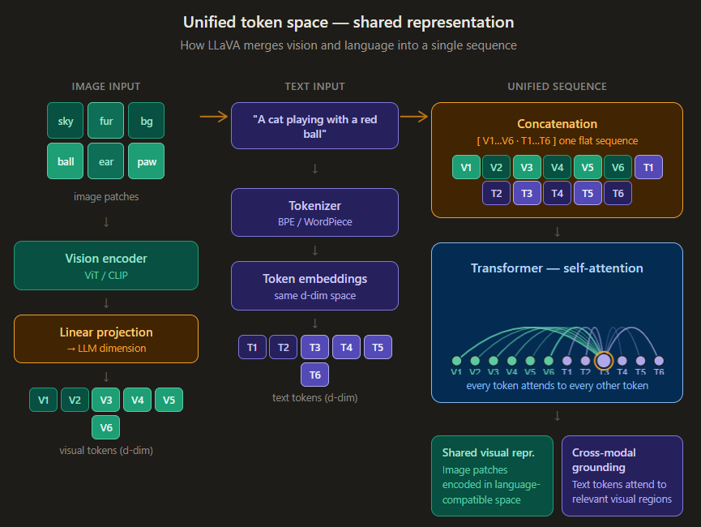
Shared Representation for Image and Text
Notes:
What the diagram shows
The diagram illustrates how LLaVA (Large Language and Vision Assistant) bridges vision and language by converting both into a single shared sequence of tokens that a transformer can process uniformly.
Left column — Image input
The image is first split into fixed-size patches (sky, fur, ball, ear, paw, bg). These patches are fed into a vision encoder (typically ViT or CLIP's image tower), which produces high-dimensional visual embeddings. Because those embeddings live in a different vector space than the language model's token embeddings, a linear projection layer (an MLP in later LLaVA versions) maps them down into the exact same d-dimensional space the LLM uses. The result is a row of visual tokens V1–V6 that look, dimensionally, identical to word tokens.
Middle column — Text input
The caption or prompt is processed through the LLM's standard tokenizer (BPE or WordPiece), then looked up in the token embedding table to produce vectors of the same d dimensions. The result is a row of text tokens T1–T6.
Center — Concatenation into unified space
Both token rows are simply concatenated into one flat sequence: [V1, V2, V3, V4, V5, V6, T1, T2, T3, T4, T5, T6]. There is no separate vision branch at this point — it's just one long list of d-dimensional vectors. The amber box highlights this as the core architectural decision: treat everything as tokens.
Right — Transformer self-attention
The unified sequence is passed into the transformer. The attention canvas shows the key mechanic: token T3 (highlighted with an orange ring) sends attention arcs of varying thickness to every other token in the sequence. Thicker arcs mean stronger attention weights. Notice that T3 (a text token like "ball") attends strongly to the visual patch tokens representing the ball in the image — that's cross-modal grounding happening inside the attention mechanism. No special routing is needed; it emerges naturally because both token types share the same space.
Bottom result cards
Shared visual representation — after training, the linear projection has learned to place visual patch embeddings near their semantically corresponding text embeddings in the same vector space. "Ball patch" and the word "ball" end up geometrically close.
Cross-modal grounding — the model learns which visual regions matter for which words, entirely through the attention mechanism over the unified sequence.
The key insight
The elegance of this design is its simplicity: by forcing visual features through a projection that matches the LLM's embedding dimension, the entire architecture collapses to "it's all just tokens." The transformer doesn't need to know whether a token came from an image or text — it just runs attention over all of them equally.

Slide 55
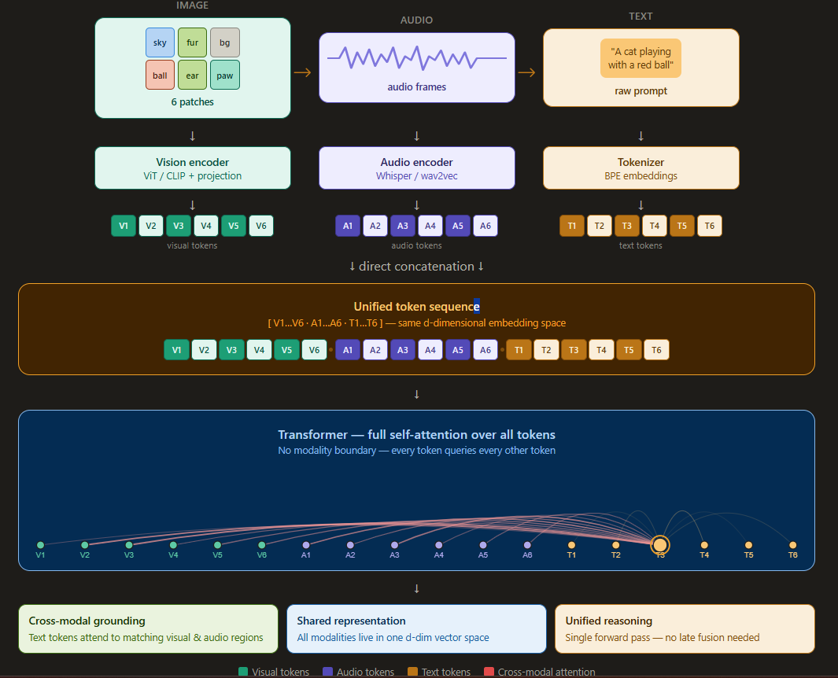
Direct Concatenation of Multimodal Inputs
Notes:
What the diagram shows
The diagram illustrates how a multimodal model (like a vision-language-audio model) takes three completely different input types — an image, an audio clip, and a text prompt — and fuses them into a single flat token sequence before passing everything into one transformer. No separate processing branches, no late fusion — just one unified sequence.
Top row — Three raw inputs
The pipeline starts with three modalities arriving simultaneously:
Image is divided into 6 fixed-size patches (sky, fur, bg, ball, ear, paw). Each patch is a small crop of the original image, color-coded by content region.
Audio arrives as a raw waveform — the jagged signal shown in the purple card represents frame-level audio features (e.g. mel spectrograms sliced into time windows).
Text is the natural language prompt — "A cat playing with a red ball" — which will be broken into subword tokens.
These three inputs are fundamentally incompatible in their raw form. Images are pixel grids, audio is a time-series signal, text is discrete symbols. The entire point of the pipeline is to resolve this incompatibility.
Encoder row — Modality-specific processing
Each input is routed through its own dedicated encoder:
Vision encoder (ViT / CLIP + projection) — The image patches are fed into a Vision Transformer. Each patch becomes a high-dimensional embedding vector. A linear projection layer then maps those vectors down into the LLM's d-dimensional space.
Audio encoder (Whisper / wav2vec) — The audio waveform is converted into frame-level feature vectors via a pretrained audio encoder. A similar projection maps these into the same d-dimensional space.
Tokenizer (BPE embeddings) — The text is split into subword tokens, each looked up in the embedding table to produce d-dimensional vectors. No projection needed — text embeddings already live in the LLM's native space.
The critical outcome of this step: all three encoders produce vectors of identical dimension d. This is what makes concatenation possible.
Token rows — All modalities now look the same
After encoding and projection:
Visual tokens V1–V6 — teal, each a d-dim vector representing one image patch
Audio tokens A1–A6 — purple, each a d-dim vector representing one audio frame window
Text tokens T1–T6 — amber, each a d-dim vector representing one subword token
From the transformer's perspective, these are now indistinguishable in format. They are just vectors of the same size.
Direct concatenation — The core operation
The three token sequences are simply appended end-to-end:
[ V1, V2, V3, V4, V5, V6 · A1, A2, A3, A4, A5, A6 · T1, T2, T3, T4, T5, T6 ]
The amber dots between groups are separators for readability — in practice, a special separator token or positional encoding marks modality boundaries. This flat sequence of 18 tokens (or however many the inputs produce) is the full input to the transformer. There is no branching, no routing, no modality-specific attention mask — just one long sequence.
Transformer — Full self-attention
The attention canvas shows what happens inside the transformer. Token T3 (highlighted with an orange ring) is attending to every other token in the sequence. The arcs represent attention weights:
Red arcs = cross-modal attention — T3 reaching across the modality boundary to attend to visual token V4 or audio token A2. These are the most important connections: they allow the model to link "ball" in the text to the ball patch in the image and the bouncing sound in the audio.
Thinner same-color arcs = within-modality attention — T3 also attends to other text tokens, though with lower weight in this example.
The transformer has no knowledge of which tokens came from which modality. It treats the entire sequence symmetrically, and the cross-modal grounding emerges purely from training on paired multimodal data.
Output cards — What this architecture achieves
Cross-modal grounding — the model learns to link semantically related tokens across modality boundaries (e.g. the word "ball" attending to both the red-patch visual token and the bouncing-sound audio token).
Shared representation — after passing through multiple transformer layers, all tokens exist in a common semantic space. "Ball" the word, the ball patch, and the ball-bounce audio frame all end up geometrically nearby in that space.
Unified reasoning — because everything runs in a single forward pass with no modality-specific heads or late fusion stages, the model can reason across all three modalities simultaneously, making it far more powerful than architectures that process each modality separately and combine outputs at the end.
The key insight
Direct concatenation works because of one elegant trick: force every modality through a projection that matches the LLM's embedding dimension. Once you've done that, the transformer's attention mechanism handles the rest — it naturally discovers which tokens from different modalities are related to each other, without any hand-engineered cross-modal routing logic.

Slide 56
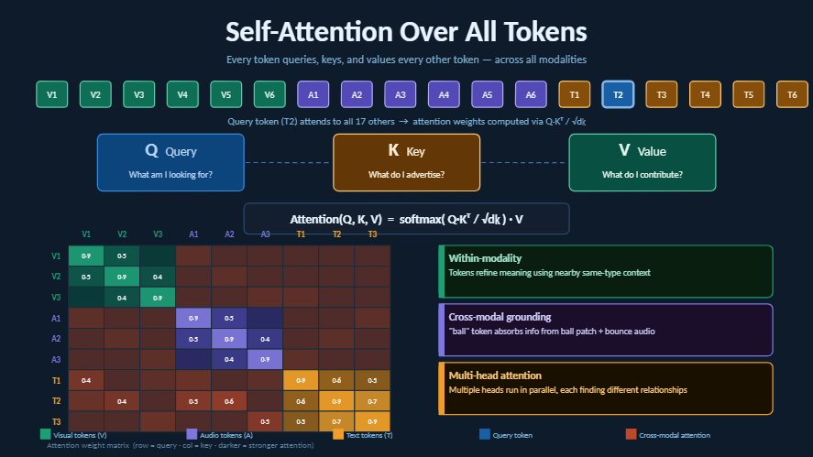
Self-Attention Over All Tokens
Notes:
What the diagram shows
The diagram walks through the complete self-attention mechanism — from a flat unified token sequence, through the Q/K/V projections, to the attention weight matrix and final output. It shows how every token simultaneously interacts with every other token, regardless of which modality it came from.
Top row — The unified token sequence
The 18 tokens across the top represent the full input sequence after direct concatenation:
V1–V6 (teal) — visual tokens from image patches
A1–A6 (purple) — audio tokens from waveform frames
T1–T6 (amber) — text tokens from the prompt
Token T2 is highlighted in blue — this is the designated query token for this example. Every other token in the sequence becomes either a Key (something T2 compares against) or a Value (something T2 absorbs information from).
The caption confirms: T2 will compute an attention weight against all 17 other tokens using the formula Q·Kᵀ / √dₖ.
Q / K / V cards — Three projections per token
For every token in the sequence, three separate linear projections are computed using learned weight matrices:
Q (Query) — "What am I looking for?" The query vector encodes what kind of information this token wants to gather from others. T2's query vector is what gets compared to every other token's key.
K (Key) — "What do I advertise?" Every token broadcasts a key vector that describes what kind of information it contains. Other tokens' queries are matched against this.
V (Value) — "What do I contribute?" If a key matches a query well, the corresponding value vector is what actually gets passed to the querying token. It carries the actual content.
The same token plays all three roles simultaneously — T2 has its own Q (to ask questions), its own K (to answer other tokens' questions), and its own V (to share its content with others).
The attention formula
Attention(Q, K, V) = softmax( Q·Kᵀ / √dₖ ) · V
Breaking this down step by step:
Q·Kᵀ — compute the dot product between T2's query vector and every token's key vector. High dot product = high compatibility.
/ √dₖ — divide by the square root of the key dimension. This prevents dot products from growing too large in high-dimensional spaces, which would cause softmax to produce near-zero gradients (the "vanishing gradient" problem in attention).
softmax(...) — convert the raw scores into a probability distribution that sums to 1. These are the attention weights — how much T2 "pays attention" to each token.
· V — take a weighted sum of all value vectors, weighted by those softmax scores. The result is T2's new contextually-enriched representation.
The 9×9 attention weight matrix
The heatmap shows the full attention weight matrix for a 9-token subset (V1–V3, A1–A3, T1–T3). Each cell shows how strongly the row token (query) attends to the column token (key).
Key observations:
Diagonal cells are darkest — every token attends most strongly to itself (high self-attention weight of 0.9), which is expected since a token's own key perfectly matches its own query.
Within-modality blocks (teal for visual, purple for audio, amber for text) — tokens attend moderately to others of the same type. V1 attending to V2 (0.5) reflects shared visual context.
Cross-modal cells (shown in orange-red) — these are the most interesting. T1 attending to V1 (0.4), T2 attending to A2 (0.6), A1 attending to T1 (0.3) — these represent the model discovering relationships across modality boundaries. The word "ball" in text attending to the ball patch in vision, or a speech token aligning with a visual mouth movement in audio.
Each row sums to 1 after softmax — the weights represent a complete probability distribution over all tokens for each query.
Right side — Three types of output
Within-modality — text tokens use nearby text tokens to refine meaning (e.g. "red" and "ball" reinforce each other). Visual patches group with related patches. This is standard language model self-attention behavior.
Cross-modal grounding — the critical capability: the word "ball" can attend to the ball image patch and the bouncing sound simultaneously. The model learns these alignments purely through training on paired data — no hand-crafted rules.
Multi-head attention — in practice, this entire Q/K/V computation runs in parallel across multiple heads (typically 8, 16, or 32). Each head learns to attend to a different type of relationship — one head might focus on spatial proximity in the image, another on semantic similarity in text, another on temporal alignment in audio.
Legend
The five color codes at the bottom map to: visual tokens (teal), audio tokens (purple), text tokens (amber), the query token (blue), and cross-modal attention (red-orange). The cross-modal color is deliberately distinct to make those inter-modality connections stand out in the matrix.
The key insight
Self-attention over all tokens is what makes multimodal transformers powerful. By treating visual patches, audio frames, and text subwords as identical objects in the same vector space — and running full attention over all of them simultaneously — the model can discover arbitrary relationships between modalities without any explicit guidance about which tokens should relate to which. The alignment emerges from the data.

Slide 57
Advantages of Unified Token Space
Advantage | Description / Benefit | Example / Intuition
Rich Bidirectional Interaction | Every token (text or image) can attend to all others | Text can refer to image patches, image patches can “attend” to words
Stronger Multimodal Reasoning | Unified representation allows nuanced reasoning over visual-text relationships | Understand spatial relationships, actions, and attributes in images
Direct Semantic Alignment | Visual tokens and text tokens share the same embedding space | “Apple” token is close to visual feature of an apple
Fine-Grained Context Understanding | Preserves all tokens for self-attention | Captures subtle visual cues and detailed textual context simultaneously
Unified Training | Model learns visual-language reasoning jointly | No need for separate query mechanisms or bridges
Better Task Adaptability | Works well for diverse multimodal tasks | Captioning, VQA, diagram reasoning, visual instruction following
Notes:
1. Rich Bidirectional Interaction: Every token interacts with every other token, allowing detailed reasoning between text and image patches.
2. Stronger Multimodal Reasoning: By sharing a unified embedding space, the model can capture complex relationships, like understanding that “the red ball is next to the cat” and reasoning about both text and image simultaneously.
3. Direct Semantic Alignment: Visual features and textual tokens occupy the same semantic space, so concepts are naturally aligned, enabling more accurate multimodal understanding.
4. Fine-Grained Context Understanding: All tokens are available for self-attention, preserving detailed context from both modalities.
5. Unified Training: The model learns both visual and language representations together, without needing separate query mechanisms or intermediate bridges.
6. Better Task Adaptability: Because the embeddings are fully shared, the model is flexible across tasks such as captioning, VQA, diagram reasoning, and visual instruction following.

Slide 58
Limitations of Unified Token Space
Limitation | Description / Impact | Example / Intuition
High Computational Cost | Self-attention over all image and text tokens grows quadratically with token count | Processing high-resolution images with many patches is resource-intensive
Large-Scale Training Data Required | Needs massive multimodal datasets to learn effective joint representations | Smaller datasets may lead to poor visual-language alignment
Memory Intensive | Requires large VRAM for high-resolution images and long text sequences | May limit deployment on standard GPUs without optimization
Less Modular | Vision and language modules are tightly coupled | Upgrading one component requires retraining or fine-tuning the entire model
Slower Inference | More tokens → longer attention computation → slower output generation | Real-time applications may be challenging without optimization
Potential Overfitting | High model complexity may overfit to training distributions | Model may struggle on unseen visual contexts or rare word-image combinations
Notes:
. High Computational Cost: Self-attention over all tokens is expensive, especially with high-resolution images producing thousands of patch tokens.
2. Large-Scale Training Data Required: The model must jointly learn visual and textual reasoning. Without massive multimodal datasets, semantic alignment may be poor.
3. Memory Intensive: All tokens must be kept in memory, which can exceed typical GPU VRAM for large images or long text sequences.
4. Less Modular: Vision and language modules are tightly coupled. Upgrading the vision encoder or language model usually requires retraining the unified system.
5. Slower Inference: More tokens mean attention computation takes longer, which can impact latency in interactive tasks.
6. Potential Overfitting: With high model complexity, the model may overfit to training distributions, struggling with rare visual or textual combinations.

Slide 59
Cross-Attention — Indirect Interaction via Intermediaries
The "Broker" Philosophy: Vision and language never meet directly; they communicate through a specialized "middleman" (the intermediary).
Intermediary Mechanism: Typically, a Q-Former or a set of Learnable Queries that act as the interface.
Information Filtering: The intermediary "scans" the vision features and only extracts what is relevant to the linguistic task, filtering out the rest.
Notes:
Imagine two world-class experts: a Vision Expert who understands every pixel of an image, and a Language Expert who understands every nuance of human conversation. In this architecture, these two experts are never allowed to sit in the same room. Instead, they communicate through a messenger—an intermediary known as 'Learnable Queries.'
The Language Expert sends a set of queries to the messenger. The messenger goes into the vision room, 'scans' the image, and pulls out only the information that answers those specific queries. It then brings a summary back to the Language Expert. This is highly efficient, but because it is indirect, the interaction is only as good as the messenger. If the messenger doesn't know to look for a specific detail, that information is lost in transition. It is a controlled, filtered, and modular way of 'connecting' two different worlds."
The Intermediary: In models like BLIP-2, this is the Q-Former. It uses a fixed number of tokens (usually 32) to 'probe' the image.
Why "Indirect"?: The term 'Indirect' is used because the raw visual features never enter the Large Language Model's (LLM) internal layers. Only the "summary" provided by the queries reaches the brain.
Analogy for Audience: It’s like a CEO (the LLM) who never visits the factory floor (the pixels) but instead relies on a single page of bullet points from a manager (the queries).
The Consequence: This setup is great for speed and modularity, but it inherently creates a bottleneck that limits the model's ability to see "fine-grained" details that weren't captured by the initial queries.

Slide 60
Unified Token Space — Direct Joint Modeling
The "Shared Workspace" Philosophy: Removes the middleman. Vision and language live and work in the exact same mathematical environment.
Direct Interaction: There are no "queries" or messengers; image patches are treated exactly like text tokens.
Fusion: The mechanism by which visual features (images/videos) and linguistic features (text tokens) are combined within a neural network to enable joint processing, interaction, and reasoning across modalities.
End-to-End Fusion: Every single layer of the transformer processes both modalities simultaneously, allowing them to influence each other deeply.
Notes:
Returning to our analogy of the two experts, this architecture breaks down the walls between their rooms. We take the 'Visual Patches' and the 'Text Words,' translate them into the same language, and put them at the exact same table. They are no longer separate entities; they are now part of a single, continuous stream of data.
This is 'Direct' because there is no filtering bottleneck. Every layer of the model's brain is looking at both the pixels and the words at the same time. This allows for a much higher level of synergy. The model doesn't just 'get a report' about the image; it experiences the image as if it were a part of the sentence itself. This lack of boundaries is what allows for the advanced reasoning we see in modern models like Qwen2.5-VL."
Mathematical Definition: In Direct Joint Modeling, the self-attention mechanism is applied to the concatenated sequence of both visual and text embeddings $[V, T]$.
The "Zero Bottleneck" Benefit: Because the interaction is direct, the model can perform Visual Grounding. It can link a specific word (like "Submit button") to the exact visual tokens that represent those pixels.
Analogy for Audience: It’s like a person reading a graphic novel where the text and the illustrations are part of the same storytelling flow, rather than reading a book and occasionally looking at a separate appendix of photos.
The Cost: While this is smarter, remind the audience that this "Direct" approach is computationally "Heavy" because the model has to process many more tokens in its internal layers compared to the "Indirect" query approach.

Slide 61
Fusion as the Engine of Reasoning
Aspect | Low Fusion (Modular Architecture) | High Fusion (Unified Architecture)
Interaction Style | Limited interaction between vision and language | Direct and continuous interaction between modalities
Representation | Separate visual and textual representations | Shared embedding space for image and text tokens
Information Flow | Indirect communication via intermediaries (e.g., query tokens) | Full self-attention across all tokens
Reasoning Capability | Moderate reasoning; limited cross-modal logic | Strong reasoning with deeper multimodal understanding
Visual Grounding | Less precise linking of words to image regions | Accurate grounding of text in visual elements
Task Strengths | Recognition, classification, retrieval tasks | Complex reasoning, VQA, scene understanding
Computational Cost | Lower computational and memory requirements | Higher computational and VRAM requirements
Architecture Examples | Query-based cross-attention systems | Unified token-space multimodal transformers
Notes:
"The most critical takeaway from this entire architectural comparison is a simple rule: The degree of fusion determines the reasoning capability.
In the AI world, we’ve learned that simply having 'eyes' and a 'brain' isn't enough for high-level tasks. If you keep those modalities separate—what we call Low Fusion—the model behaves like a translator. It can tell you what is in an image, but it struggles to understand why it matters or how to interact with it.
However, when you move to High Fusion—where the pixels and words live in the same mathematical 'sentence'—something transformative happens. The model gains Spatial Intelligence. It doesn't just see a button on a screen; it understands the linguistic context of that button's label and can reason through the logic of clicking it. As we move toward 2026 and the era of 'Agentic AI,' the industry is choosing deeper fusion because that is the only way to build models that can truly reason through the complexities of the physical and digital worlds."
The "So What?": Explain that "Reasoning" in this context refers to the model's ability to solve problems that require a deep understanding of the relationship between visual cues and linguistic logic (e.g., reading a map, following a diagram, or using a complex software UI).
The Trade-off: High fusion is smarter but significantly more "computationally expensive" because the LLM has to do all the heavy lifting for both modalities.
Final Takeaway: Architecture is a deliberate choice. You choose the "degree of fusion" based on whether you need a fast captioner (Low Fusion) or a smart autonomous agent (High Fusion).

Slide 62
Agenda
Introduction to Vision-Language Models (VLMs)
Core Models
  BLIP-2
  InstructBLIP
  LLaVA
  Qwen2.5-VL
Cross-Attention vs. Unified Token Space
Multimodal Reasoning
Wrap-up

Slide 63

Multimodal Reasoning

Slide 64
What is Multimodal Reasoning?
Joint reasoning over visual and textual information,
combining perception with high-level cognition.
Perception (Low-Level)
Cognition (High-Level)
Edge & colour detection
Object localisation
Depth estimation
Pattern recognition
Counting & comparing
Spatial relationships
Cause & effect inference
Logical reasoning
CIS 5543 | Spring 2026 | Temple University
3 / 22

Slide 65
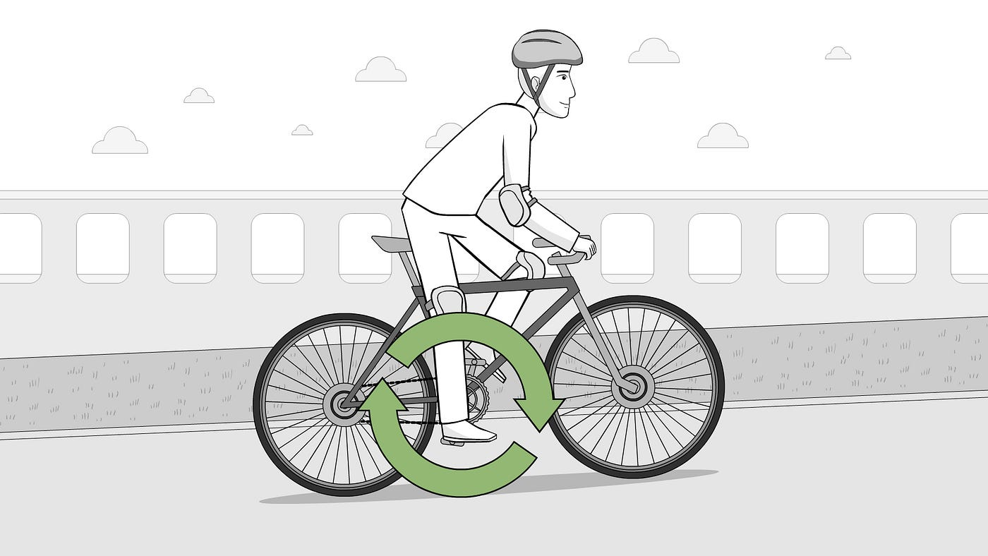
Example of Perception & Cognition

Slide 66
Joint vs Sequential Processing
Sequential (Old Approach)
Joint (Modern VLMs)
1. Vision model produces caption
2. Language model reasons on caption
Problem: Converting image to text
LOSES visual detail that may be
relevant to the question
Visual & textual features interact
simultaneously at every layer
Question shapes WHICH visual
features the model attends to.
Visual features shape the output.
>>>
CIS 5543 | Spring 2026 | Temple University
4 / 22

Slide 67
Visual Question
Answering (VQA)
Input: image + question | Output: answer grounded in visual content
CIS 5543 | Spring 2026 | Temple University
5 / 22

Slide 68
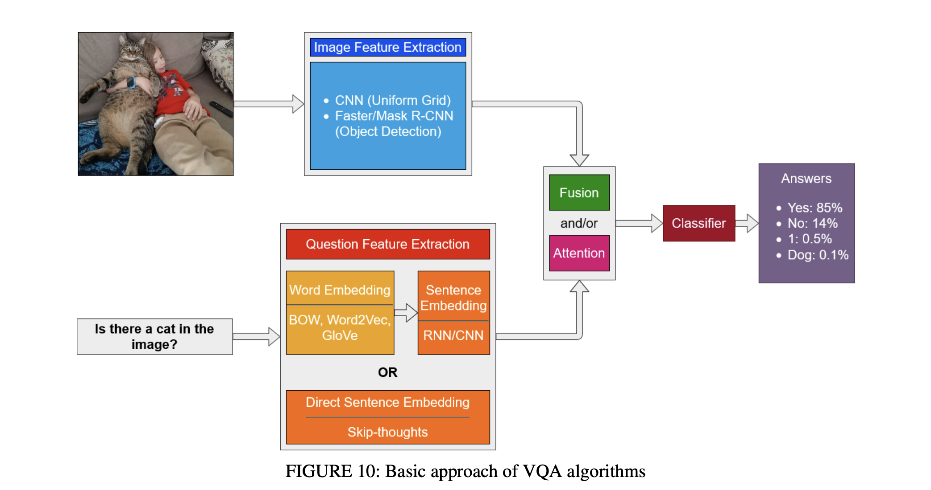
VQA Algorithm

Slide 69
VQA: Three Requirements
Object Recognition
Example: "What colour is the car on the left?"
Localise & identify objects across viewpoints, lighting, occlusion
Spatial Understanding
Example: "What is between the two chairs?"
Reason about relationships: left/right, behind, between, closer
Logical Reasoning
Example: "If carrying an umbrella, is it raining?"
Draw inferences using commonsense world knowledge
CIS 5543 | Spring 2026 | Temple University
6 / 22

Slide 70
VQA: Object Recognition
The most basic VQA requirement: identify what's in the image.
Modern VLMs handle this well because they inherit strong visual
representations from their vision encoder (ViT, CLIP).
These encoders are trained on hundreds of millions of image-text
pairs, learning generalised visual concepts that cluster similar
objects together in embedding space.
Must Handle
Different viewpoints
Varying lighting conditions
Partial occlusion
Diverse object styles
CIS 5543 | Spring 2026 | Temple University
7 / 22

Slide 71
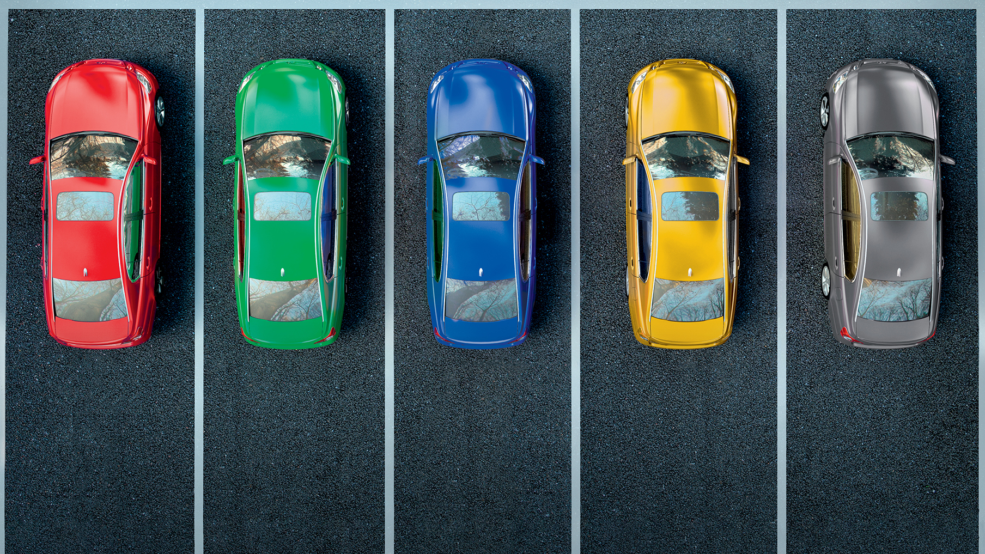
Example

Slide 72
VQA: Spatial Understanding
Questions about relationships between objects are significantly harder.
Spatial relationships are encoded implicitly in attention patterns,
not explicitly — no built-in coordinate geometry or 3D representation.
Current VLMs still struggle with compositional spatial queries
like "How many objects are to the left of the red cube?"
Hard Spatial Questions
"Is the cat left or right of the dog?"
"What is between the two chairs?"
"Which object is closer?"
Benchmark: CLEVR — tests compositional spatial & counting reasoning on synthetic scenes
CIS 5543 | Spring 2026 | Temple University
8 / 22

Slide 73
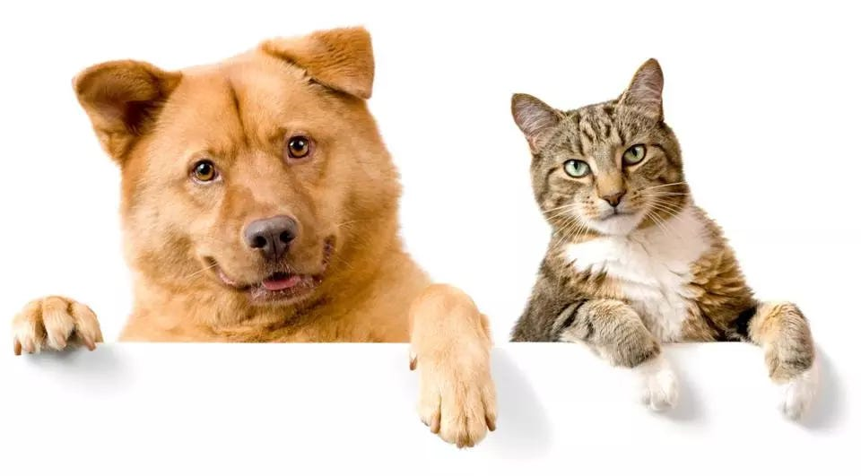
Example

Slide 74
VQA: Logical Reasoning
The most complex requirement — requires commonsense world knowledge beyond what is visible.
Detect
Associate
Infer
Person holding
umbrella
>>>
Umbrella =
rain protection
>>>
Likely raining
or about to rain
The pretrained LLM backbone provides this commonsense knowledge. Larger LLMs = better reasoning,
even with the same vision encoder.
CIS 5543 | Spring 2026 | Temple University
9 / 22

Slide 75

Example

Slide 76
Question-Conditioned Visual Attention
The question dynamically steers which image regions the model focuses on.
Image
Question
Cross-Attention
Decoder
ViT encoder
>>> patch tokens
>>>
Tokenizer
>>> embeddings
>>>
Q tokens attend
to visual tokens
>>>
Generate answer
token by token
"What colour is the hat?"
>>> attention concentrates on hat region
"How many people in the background?"
>>> attention shifts to background regions
CIS 5543 | Spring 2026 | Temple University
10 / 22

Slide 77
Image-Conditioned
Text Generation
Generating extended, coherent text based on visual input
CIS 5543 | Spring 2026 | Temple University
11 / 22

Slide 78
Three Subtypes of Visual Text Generation
Image Captioning
Produce a natural language description of an image
"An elderly woman reads a book in a sunlit garden"
Visual Explanation
Produce a REASONED account of what's happening
"The person is likely a doctor because of the white coat and stethoscope"
Story Generation
Construct a coherent narrative from image sequences
Given 3 birthday photos: construct a narrative with temporal flow
CIS 5543 | Spring 2026 | Temple University
12 / 22

Slide 79

Image Captioning

Slide 80

Visual Explanation

Slide 81

Story Generation

Slide 82
Coherence vs Faithfulness
Two critical properties — in slight tension with each other:
Coherence
Faithfulness
Text is internally consistent,
grammatically correct, and flows
naturally.
Risk: A model can produce
perfectly coherent text that is
completely wrong about the image.
Every claim is supported by
something actually present in the
image.
Requires: Strong visual grounding
— outputs anchored to specific
visual features, not language priors.
CIS 5543 | Spring 2026 | Temple University
13 / 22

Slide 83
Sources of Reasoning Ability
Pretrained LLM
Knowledge
LLMs absorb world knowledge & reasoning patterns from trillions of tokens.
Larger LLM backbone = better multimodal reasoning.
Instruction
Tuning
Fine-tuning on human-written image + instruction pairs (LLaVA-Instruct,
InstructBLIP). Teaches the model to follow multimodal commands.
Large-Scale
Multimodal Data
CLIP: 400M pairs | OpenCLIP: 1B+ pairs. Scale of exposure teaches
which visual concepts correspond to which linguistic concepts.
CIS 5543 | Spring 2026 | Temple University
14 / 22

Slide 84
Challenges in
Multimodal Reasoning
Hallucination | Weak Grounding | Inconsistency | Prompt Sensitivity
CIS 5543 | Spring 2026 | Temple University
15 / 22

Slide 85
Challenge 1: Hallucination
Generating plausible-sounding content not actually present in the image.
More insidious than text-only hallucination — VLMs contradict
what is literally visible in the input image.
Root cause: The language prior overrides visual evidence.
A kitchen image + "Is there a microwave?" >>> model says "yes"
because kitchens statistically have microwaves — even if this one doesn't.
HallusionBench
Show model: empty table
Ask: "How many apples?"
Model: "2" or "3"
Language prior > visual evidence
Active research: RLHF with faithful vs unfaithful comparisons, Visual Contrastive Decoding
CIS 5543 | Spring 2026 | Temple University
16 / 22

Slide 86
Challenge 2: Weak Visual Grounding
The model may produce the right answer for the WRONG reasons.
Grounding = pointing to specific image regions that support a claim.
Weakly grounded models rely on statistical shortcuts from the
language prior rather than genuine visual understanding.
This makes them fragile to adversarial or unusual images
(e.g., a cat in an atypical pose or context).
Well-Grounded
"Why is this a dog?"
>>> Highlights ears, snout,
fur texture, body shape
Poorly Grounded
"Why is this a dog?"
>>> Correct answer but from
language statistics, not vision
CIS 5543 | Spring 2026 | Temple University
17 / 22

Slide 87
Challenge 3 & 4: Inconsistency & Prompt Sensitivity
Logical Inconsistency
Prompt Sensitivity
"How many chairs?" >>> "3"
"More chairs or tables?" >>> "Tables"
"Exactly 3 chairs?" >>> "Yes"
Each answered independently —
no persistent scene model.
"What colour is the hat?" >>> "Blue"
"Tell me the hat's colour" >>> "Dark blue"
"Is the hat red?" >>> "Yes"
Same question, different phrasing =
radically different answers.
CIS 5543 | Spring 2026 | Temple University
18 / 22

Slide 88
Agenda
Introduction to Vision-Language Models (VLMs)
Core Models
  BLIP-2
  InstructBLIP
  LLaVA
  Qwen2.5-VL
Cross-Attention vs. Unified Token Space
Multimodal Reasoning
Wrap-up

Slide 89
Wrap-Up
VLMs | Two Paradigms | Modern Trends | Open Questions
CIS 5543 | Spring 2026 | Temple University
19 / 22

Slide 90
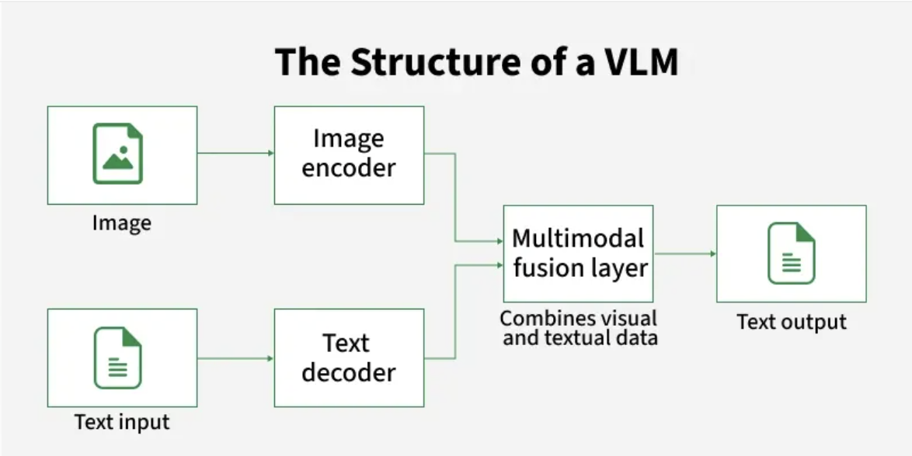
VLM Framework

Slide 91
Two Dominant Paradigms
Cross-Attention
Unified Token Space
Example: Flamingo
Example: GPT-4V, LLaVA
Modular & efficient
Vision & language stay separate
Visual features injected via cross-attention layers
Can swap encoders independently
Trade-off: Depth of integration limited by number of cross-attention layers
Powerful & expressive
Visual info converted to tokens
Same self-attention across both modalities
Deepest possible integration
Trade-off: Visual tokens consume context window space
CIS 5543 | Spring 2026 | Temple University
20 / 22

Slide 92
Modern Trend: Deeper Fusion
The field is moving toward end-to-end natively multimodal architectures.
Pipeline Era
Adapter Era
Native Multimodal
Separate vision +
language models.
Caption as bridge.
>>>
Frozen LLM +
vision encoder +
learned projector.
>>>
Trained from scratch
on vision + text + audio
simultaneously.
Gemini 1.5, GPT-4o — trained natively multimodal from the ground up.
Not adapted from a language model, but built to process vision + text + audio simultaneously.
CIS 5543 | Spring 2026 | Temple University
21 / 22

Slide 93
Key Takeaways
1
VLMs combine vision encoders with LLMs to reason jointly over images and text — a fundamental advance over text-only models.
2
Two fusion paradigms exist: cross-attention (BLIP-2) uses query intermediaries for efficiency; unified token space (LLaVA) enables richer reasoning through direct token interaction.
3
Qwen2.5-VL pushes the frontier with dynamic resolution, window attention, MLP token merging, and M-RoPE — matching GPT-4o on key benchmarks as an open-source model.
4
Multimodal reasoning requires object recognition, spatial understanding, and logical inference — enabled by question-conditioned visual attention.
5
The field is moving toward agentic capabilities — VLMs that can perceive, reason about, and interact with computer and phone interfaces autonomously.
CIS 5543: Computer Vision | Spring 2026 | Temple University

Slide 94
Open Questions & Conclusion
How to improve reliability
and grounding?
Calibrated confidence in multimodal outputs
remains an open problem.
How to scale multimodal
reasoning further?
Chinchilla-optimal ratio for image-text data?
Vision encoder vs LLM scale interaction?
Pattern matching vs genuine
visual understanding?
Current VLMs are sophisticated interpolation machines.
Closing this gap is the central research challenge.
CIS 5543 | Spring 2026 | Temple University
22 / 22

