Slide 1

Understanding Large Language Models
A Natural Language Processing Lecture
Darlin Kola
tun32955@temple.edu
Varshil Patel
tuu73592@temple.edu
Omkar Brahmbhatt
tuu62443@temple.edu
MS Computer Science student
MS Computer Science student
MS Computer Science student
CIS 5543: COMPUTER VISION
Spring 2026

Slide 2
Part 1:
How LLMs Work: The Power of Token Prediction
From Text to Probabilities
Notes:
Let's begin Part 2. The raw model — fresh out of pre-training — is just a next-token predictor. But the magic lies in HOW you talk to it. The same model can write poetry, debug code, or act as a medical consultant — all depending on how you prompt it.

Slide 3
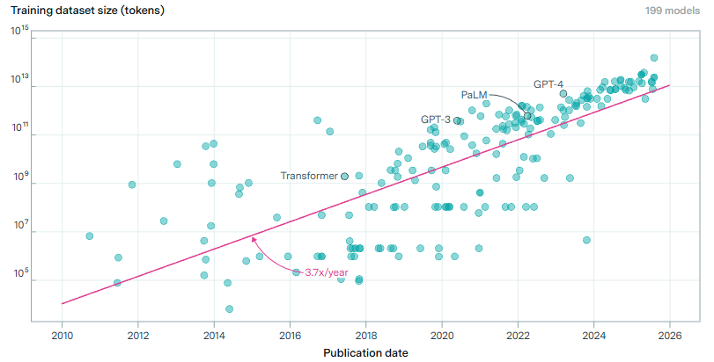
What is an LLM?
Computer Program that is really good at working with text
  Reading, summarizing, answering questions, continuing sentences, translating, etc.
It learns by analyzing massive amounts of text
  Hundreds of billions to trillions of words — far more than any human could read.
It discovers patterns in how language is used
  Grammar, facts, style, reasoning patterns, common phrases.
At its core, it works like autocomplete on steroids
  You type: “The cat sat on the…”
  It predicts the next likely word: “mat”
  Then it predicts the next one, and the next, and the next…
Everything an LLM does — from writing essays to solving problems — comes from predicting one token at a time.
Notes:
When we say ‘LLM,’ we’re really talking about a system that’s extremely good at working with text. It doesn’t think like a human — it models patterns.
During training, it reads an unimaginable amount of text. Think of every book in your library… then multiply that by millions.
The key idea is prediction. It’s always asking: Given everything so far, what comes next?
That simple mechanism — next‑token prediction — is the foundation for everything else we’ll talk about today.

Slide 4
What is a Token
A token is a small chunk of text the model works with
  not always a full word — could be subwords, punctuation, or whitespace markers
A tokenizer converts raw text → tokens → token IDs
Tokens are the atomic units of prediction
  LLMs don’t predict whole sentences — they predict one token ID at a time.
Good tokenization = better language representation
  Fewer tokens, more meaningful chunks, more efficient training
Output quality depends on how well tokenization represents language
Notes:
Before we talk about how LLMs generate text, we need to understand what they actually see.
A token is just a small chunk of text — not necessarily a full word. It might be a whole word, but it could also be a subword like ‘ing’, a punctuation mark, or even a whitespace symbol.
The tokenizer is the component that takes raw text and breaks it into these pieces. It maps text → tokens → token IDs, which are just integers. Those IDs are the atomic units the model predicts.
This is important: LLMs never predict whole sentences or paragraphs. They predict one token ID at a time, over and over, thousands of times per response.
Good tokenization really matters. If the tokenizer splits text into meaningful chunks, the model learns better representations and needs fewer steps to process the same sentence.
Fewer tokens means faster training, cheaper inference, and often better output quality. A well‑designed tokenizer captures the structure of language in a way the model can use.
So tokens are the bridge between raw text and the model’s internal world. Everything the model does — training, prediction, decoding — happens at the token level.

Slide 5
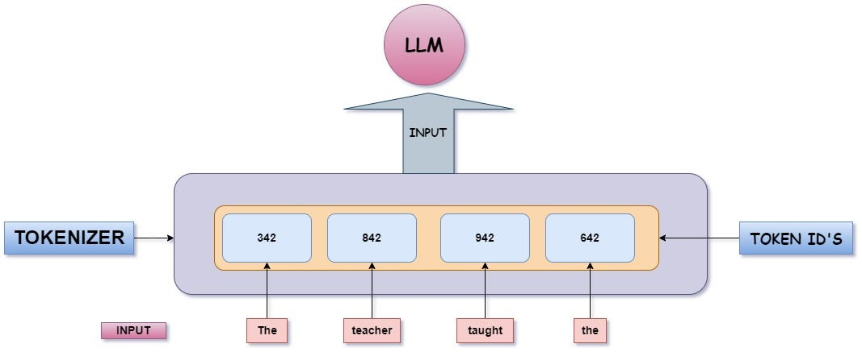
Tokenization Example
Text: “The cat sat on the mat”
Might tokenize as:
  “The”
  “ cat”
  “ sat”
  “ on”
  “ the”
  “ mat”
  “.”
Each becomes an integer ID like:
  [1212, 4003, 912, 320, 1212, 7894, 13]

Slide 6
How LLMs get their data
Public web text
  Websites, articles, forums, documentation, FAQs
Books & long-form writing
  Digitized books, essays, public-domain collections
Academic & technical sources
  Research papers, textbooks, lecture notes, standards (“when accessible/allowed”)
Code & developer text
  Public code repositories, code docs, issues, comments (varies by model/provider)
Licensed & partner datasets
  Data purchased or accessed via agreements
Human-created data for alignment (later stage)
  Example Q&A, preference comparisons, safety demos, “good answer vs bad answer” pairs
Notes:
LLMs don’t invent knowledge out of thin air — they learn patterns from huge amounts of text.
A major source is public web text: everything from documentation to forum discussions.
Books and long‑form writing help models learn structure, style, and reasoning.
Academic and technical text gives them exposure to more formal language and domain‑specific knowledge.
Many models also learn from public code, which is why they’re surprisingly good at programming tasks.
Some data is licensed or provided through partnerships — this varies by company.
And finally, there’s human‑created data used later in training. This is where alignment comes in: humans rate answers, compare responses, and teach the model what ‘good’ looks like.

Slide 7
How LLMs generate text
LLMs operate on tokens, not words
  Everything is processed as token IDs.
Core mechanism: next-token prediction
  Given previous tokens, predict the most likely next one.
Autoregressive Generation loop
  Predict → append the token → feed it back in → repeat.
Training objective: cross‑entropy / maximum likelihood
  The model learns to assign high probability to the correct next token.
Logits + softmax produce -> probabilities
  Raw scores (logits) are converted into a probability distribution.
Decoding selects the next token
  Greedy, sampling, top‑k, nucleus sampling, etc.
Notes:
Now that we know what tokens are, let’s talk about how LLMs actually generate text.
The model doesn’t think in words or sentences — it thinks in token IDs.
The core idea is next‑token prediction. Given everything so far, what token is most likely to come next?
During generation, this becomes a loop: predict a token, add it to the sequence, and use that new sequence to predict the next one.
During training, the model learns this behavior by minimizing cross‑entropy loss — essentially learning to be less ‘surprised’ by the correct next token.
Before the model outputs probabilities, it produces logits — raw scores. Softmax turns those into a probability distribution.
Finally, decoding decides which token to actually output. Different decoding strategies lead to different styles of text — deterministic, creative, diverse, etc.

Slide 8

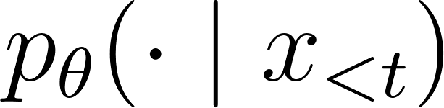
From Data to Predictions
Input = context tokens
  The prompt plus everything generated so far →
Output = a probability distribution over the vocabulary
Multiple continuations can be valid
  Probability mass spreads across several plausible next tokens.
Generation = repeat next‑token prediction
  Predict → append → feedback in → repeat to build sentences, paragraphs, or code.
Chat formats simply structure the context
  System / user / assistant tokens guide the model, but the underlying mechanism is unchanged.
Notes:
So the entire behavior of an LLM — reasoning, style, creativity — emerges from repeatedly predicting one token at a time.
1. Input = context tokens → x<t
How to say it:
“x less‑than t.”
What it means:
“This symbol x<t means all tokens before time t — the entire context the model sees.”
“It includes the prompt plus everything the model has generated so far.”
“The model never sees raw text — only token IDs arranged in a sequence.”
2. Output = a probability distribution → pθ(⋅∣x<t)
How to say it:
“p theta of dot given x less‑than t.”
What it means:
“This is the model’s predicted probability distribution over the entire vocabulary.”
“The dot means ‘any possible next token.’ We’re talking about the whole distribution, not a single token.”
“θ represents the model’s parameters — all the weights learned during training.”
“So this expression means: Given the context so far, what is the probability of every possible next token?”
3. Multiple continuations can be valid
“Because language is ambiguous, the probability mass spreads across several plausible next tokens.”
“The model isn’t choosing yet — it’s just telling us what’s likely.”
4. Generation loop: predict → append → feed back → repeat
You can gesture a loop with your hand here.
“Generation is just repeating next‑token prediction.”
“We sample or select a token from the distribution, append it to the context, feed it back in as part of x<t+1, and run the model again.”
“This loop builds sentences, paragraphs, code — everything.”
5. Chat formats simply structure the context
“System, user, and assistant messages are just tokens in the context.”
“They guide the model’s behavior, but the underlying mechanism is unchanged.”
“It’s still just computing pθ(⋅∣x<t) over and over.”

Slide 9
Tokens: What the Model Actually sees
Tokens = subword units
  Produced by a tokenizer (e.g., BPE, unigram). Not words — pieces of words.
Tokens include many kinds of text fragments
  Word pieces, whole words, punctuation, whitespace markers.
Text → token IDs → embeddings
  Raw text is mapped to integer IDs; embeddings turn IDs into vectors the model can process.
Tokenization shapes the sequence
  Affects sequence length T and vocabulary size ∣V∣.
These choices impact model behavior
  Compute cost, memory usage, and even how well the model handles spacing, repetition, and copying.
Notes:
Before the model can do anything with text, it has to break it into tokens.
Tokens are small pieces of text — not always full words. They might be word fragments, punctuation, or even whitespace.
A tokenizer is the tool that takes raw text and turns it into these pieces. Then it maps each piece to an integer ID the model can understand.
Those token IDs get turned into vectors through embeddings, and that is what the model actually processes.
How we tokenize text matters a lot. It affects how long the sequence is and how big the vocabulary needs to be.
These choices influence compute cost, memory usage, and even how well the model handles things like spacing, repetition, or copying text.
So tokenization is the foundation — it shapes everything the model sees and everything it can generate.

Slide 10
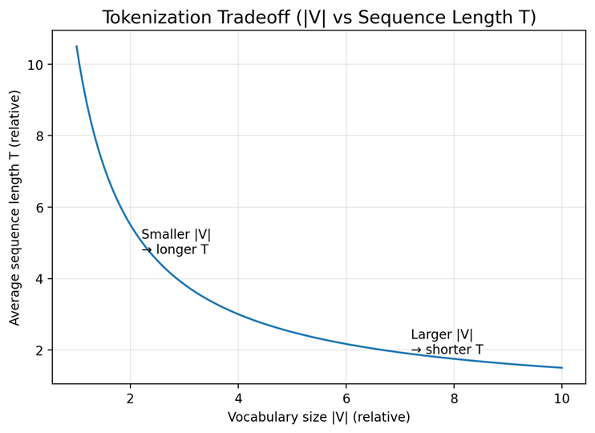
Tokenization Tradeoffs
Smaller vocabulary ∣V∣
  More splitting into subwords
  Longer sequences T → more steps, more attention compute
Larger vocabulary ∣V∣
  Fewer tokens per sentence
  Shorter sequences, but a much larger output layer / softmax to compute
Subword tokenization = middle ground
  Balances rare‑word coverage, vocabulary size, and efficiency
Tokenization changes the loss scale
  More tokens per sentence → more prediction steps → different per‑token loss dynamics
Practical impacts
  Speed, memory footprint, training cost, and sometimes generation quality
Notes:
Tokenization isn’t just a preprocessing detail — it affects almost everything the model does.
If we use a smaller vocabulary, the tokenizer has to break words into more pieces. That means sequences get longer, and longer sequences cost more compute.
If we use a larger vocabulary, we get shorter sequences, but now the model has to deal with a much bigger output layer — which is expensive during training and inference.
Subword tokenization is the compromise. It keeps the vocabulary manageable while still representing most words in just one or two pieces.
Tokenization also affects the loss. More tokens per sentence means more prediction steps, which changes the scale of the training objective.
All of these choices impact speed, memory, and sometimes even the quality of the generated text.
So the tokenizer sets the stage — it determines how efficiently the model can learn and how well it can express language.

Slide 11
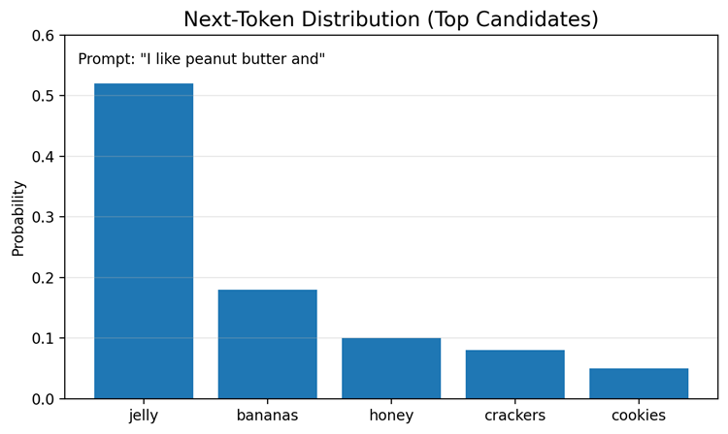
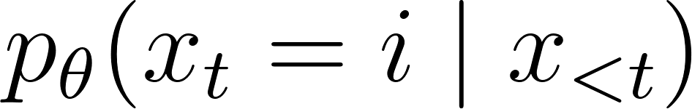
Next-Token Prediction = Multiclass Classification
At each position t, the model chooses 1 token out of ∣V∣ classes
  The vocabulary is the set of possible “labels.”
The output is a categorical distribution
  — probability of each token being next.
Top‑probability tokens are plausible continuations
  The model spreads probability across multiple reasonable next tokens.
There’s always a long tail of low‑probability tokens
  Decoding often trims this tail (top‑k, top‑p, temperature).
Repeating this local classification step yields global coherence
  One classification per token → sentences → paragraphs → full conversations.
Notes:
“This slide explains what the model is actually doing at every single step of generation.”
1. At each position t, the model chooses 1 token out of ∣V∣ classes
“Think of the vocabulary as the set of possible labels.
If the vocabulary has ∣V∣ tokens, then at position t the model is doing a ∣V∣-way classification problem.
It must pick exactly one token as the next output.”
2. The output is a categorical distribution
3. Top‑probability tokens are plausible continuations
“The model usually spreads probability across several reasonable next tokens.
The highest‑probability ones are the most likely continuations under the training distribution.”
4. There’s always a long tail of low‑probability tokens
“Most tokens get tiny probabilities — the long tail.
Decoding strategies like top‑k, top‑p, or temperature often trim or reshape this tail so we don’t sample extremely unlikely tokens.”
5. Repeating this local classification step yields global coherence
“This is the key idea:
the model only ever does local next‑token classification.
But when you repeat that step hundreds or thousands of times, you get coherent sentences, paragraphs, and full conversations.”
“One classification per token → coherent long‑form text.”

Slide 12
Next-Token Prediction Example
Suppose the context is:
“The cat sat on the”
Then:
x_{<t} = “The cat sat on the”
i might be “mat”
p_{θ}(x_{t}=“mat”∣“The cat sat on the”)
is the probability the model assigns to “mat” being the next token.

Slide 13
Autoregressive Modeling (Core Idea)
LLMs generate text left‑to‑right
  Standard setup: each position depends on all earlier tokens.
Each new token is predicted from the full context
  “Given everything so far, what comes next?”
Generated tokens are fed back into the model
  Predict → append → use as new context → repeat.
Decisions are path‑dependent
  Early tokens influence all later predictions.
Autoregression enables streaming and long‑form generation
  The model can produce text one token at a time, indefinitely.
Notes:
Autoregressive just means: the model generates text one token at a time, always conditioning on everything it has already written.
At each step, the model asks: Given the entire context so far, what is the most likely next token?
Once it predicts a token, that token becomes part of the context. The model then predicts the next one, and the next, and so on.
This makes the process path‑dependent. If the model makes a strange choice early on, the rest of the generation will follow that path.
Because the model only needs the previous tokens to continue, it can stream output — which is why chatbots can start responding before they’ve ‘finished thinking.’
This simple loop is the foundation for everything LLMs do: essays, code, reasoning, conversations — all built one token at a time.

Slide 14
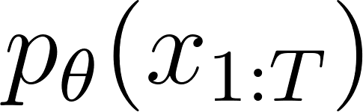
Why Autoregressive Factorization is needed
  This is the probability of the entire sequence of tokens. It’s the quantity we ultimately want the model to assign to a full sentence or text span.
Example:
Sequence: “The cat sat”
Tokens: [x1=“The”, x2=“cat”, x3=“sat”]
p_{θ}(‘The cat sat’)
  Just means: How likely does the model think this whole sentence is?
Notes:
This slide explains how an LLM assigns a probability to an entire sequence of tokens — not all at once, but one token at a time
1. Full‑sequence probability
pθ(x1:T)
This expression means: What is the probability of the whole sequence of tokens from position 1 to T?
The model has parameters θ, and we want to know how likely it thinks this entire sequence is.
On its own, this equation doesn’t tell you how to compute that probability. It just states the goal:
“We want the model to assign a probability to the whole sequence of tokens.”
But computing this directly is impossible — the space of all possible sequences is astronomically large.
That’s where autoregressive factorization comes in.

Slide 15
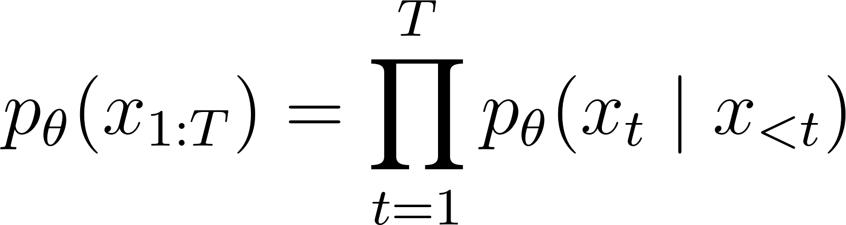
Autoregressive Factorization (Formal View)
Autoregressive factorization
This equation shows how we compute the probability of the whole sequence.
We break it into a chain of next‑token predictions.
At each step, the model predicts the next token based on all previous tokens.
This is what makes the model autoregressive:
  Each token depends on the tokens before it
Notes:
This slide explains how an LLM assigns a probability to an entire sequence of tokens — not all at once, but one token at a time
2. Autoregressive factorization
This equation says that the probability of the entire sequence is built by multiplying together the probabilities of each individual token, one step at a time.”
“At each position t, the model predicts the next token xt based on all the previous tokens x<t.”
“So instead of trying to model a whole sentence at once — which is impossibly complex — we break it into a chain of simpler predictions.”
“This is the core idea of an autoregressive model:
each token depends on the tokens before it, and the whole sequence probability is the product of these conditional probabilities.”
“This factorization is what makes generation possible: the model can produce text left‑to‑right, one token at a time.”
It’s like building a sentence by asking: ‘Given everything so far, what’s the next most likely token?’ and repeating that until you’re done.

Slide 16
Autoregressive Factorization Example
Autoregressive factorization
For “The cat sat”:
  p(‘The cat sat’)=p(‘The’)⋅p(‘cat’∣‘The’)⋅p(‘sat’∣‘The cat’)
You can look at it as:
“How likely is ‘The’?”
“Given ‘The’, how likely is ‘cat’?”
“Given ‘The cat’, how likely is ‘sat’?”
Multiply them → probability of the whole sentence.

Slide 17
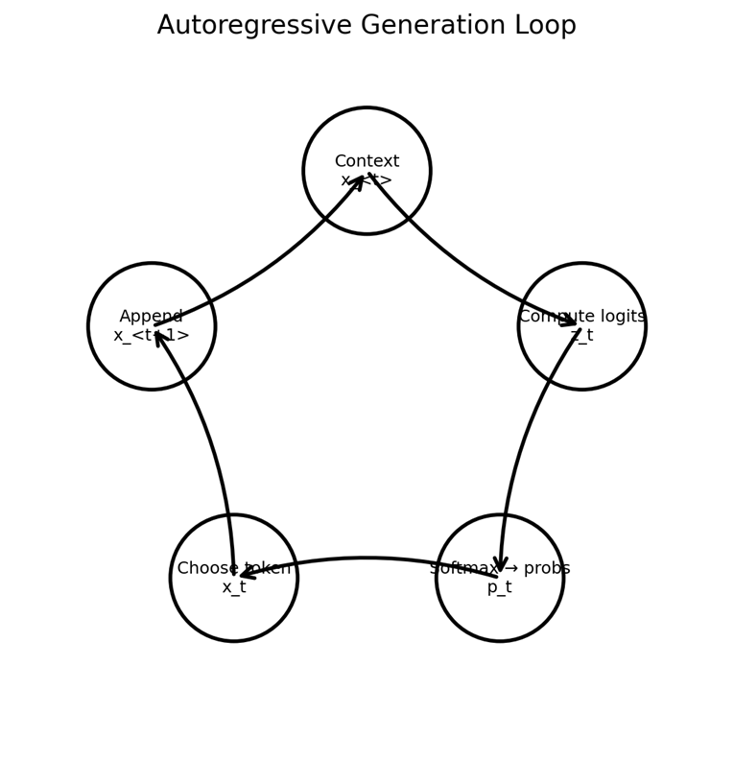

Autoregressive Generation Loop (Inference)
Start with a prompt / context x<t
  The model reads all previous tokens.
Compute logits over the vocabulary
  One raw score per token in ∣V∣.
Apply softmax to get probabilities
Select the next token using a decoding rule
  Greedy, sampling, top‑k, top‑p, etc.
Append the token and repeat
  Continue until EOS, max tokens, or a stop condition.
Notes:
“This slide walks through one full step of generation: how the model picks the next token.”
“We start with a prompt or context, written as x<t.”
x<t means “all tokens before position t” — everything the model has already seen.
“The model reads all those previous tokens and produces a vector of logits, zt.”
zt is a vector of raw scores, one score for each token in the vocabulary.
The vocabulary size is ∣V∣, so zt∈R∣V∣.
These scores are not probabilities yet; they’re just unnormalized preferences.
“To turn those scores into probabilities, we apply softmax.”
We write this as:
pθ(⋅∣x<t)=softmax(zt)
This means:
The probability distribution over the next token, given the context x<t, is the softmax of the logits vector zt.
More explicitly, for each token i in the vocabulary:
softmax equation**
zt,i: the logit (raw score) for token i at position t
Numerator: exponentiate that score
Denominator: sum over all tokens to normalize
Result: a proper probability distribution over all tokens.
“Once we have probabilities, we choose the next token using a decoding rule.”
That could be:
Greedy: pick the highest‑probability token
Sampling: sample according to the distribution
Top‑k / top‑p: restrict to the most likely tokens, then sample
“We then append that chosen token to the sequence and repeat the whole process.”
Now the context becomes x≤t, and we move on to predicting token t+1.
We keep going until we hit an end‑of‑sequence token, a max token limit, or some other stop condition.
“So each step is: context → logits → softmax → probabilities → pick a token → repeat.”

Slide 18
Training vs Inference: Teacher Forcing & Exposure Bias
Training uses ground‑truth prefixes (teacher forcing)
  The model conditions on real prefixes x_{<t} from the dataset.
Targets are known during training
  The next token x_{t} comes directly from real text.
Inference uses model‑generated prefixes
  The model conditions on its own predictions
This mismatch can cause error compounding (exposure bias)
  Small mistakes early on can snowball into larger deviations.
Long‑horizon generation is more vulnerable
  Drift, instability, and off‑distribution behavior become more likely.
Notes:
During training, the model always gets the correct prefix — the real text from the dataset. This is called teacher forcing.
Because the next token is known, the model learns to predict it under ideal conditions.
But at inference time, the model doesn’t get perfect prefixes anymore. It gets its own previous predictions.
If it makes a small mistake early on, that mistake becomes part of the context — and the model has to condition on it. This is exposure bias.
The longer the generation, the more these small deviations can accumulate, leading to drift or instability.

Slide 19
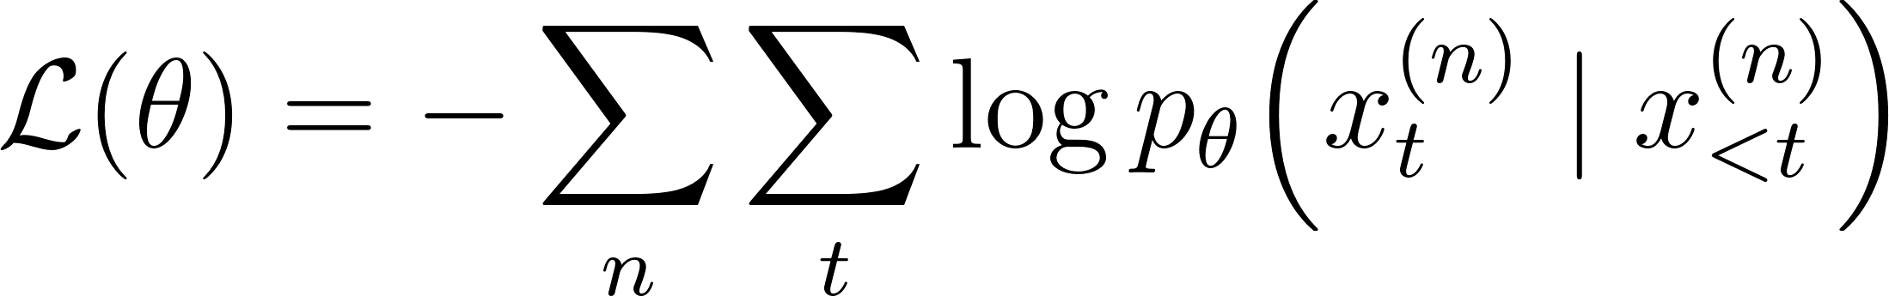
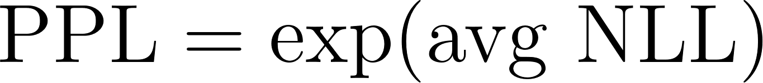
Training Objective: NLL / Cross-Entropy (MLE)
Goal: maximize the likelihood of the training data
  Fit p_{θ} so real text is assigned high probability.
Equivalent view: minimize negative log‑likelihood (NLL)
  Same objective, different sign.
Dataset‑level loss
This is exactly cross‑entropy
  Because targets are categorical one‑hot labels.
Perplexity =
  Negative Log‑Likelihood (NLL)
  Interpretable as the model’s “effective branching factor.”
Notes:
The goal of training is maximum likelihood: we want the model pθ to assign high probability to real text from the dataset.”
“Instead of maximizing likelihood directly, we minimize negative log‑likelihood — NLL.
It’s the same objective, just flipped so it works with gradient descent.”
⭐ Dataset‑level loss
“This equation shows the total loss over the whole dataset.”
L(θ)=−∑n∑tlog⁡pθ(xt(n)∣x<t(n))
n: index over training examples
t: index over tokens
xt(n): the correct next token
x<t(n): all previous tokens (the context)
“We add up the negative log‑probability of the correct token at every position in every sequence.
If the model is surprised, the log‑probability is low and the loss is high.”
⭐ Cross‑entropy equivalence
“Because the target is a one‑hot vector — only one token is correct —
this NLL is exactly the same as cross‑entropy loss.”
“So next‑token prediction is just a giant multiclass classification problem.”
⭐ Perplexity
PPL=exp⁡(average NLL)
“Perplexity is just the exponential of the average NLL. -
It gives an interpretable number: the model’s effective branching factor.”
PPL ≈ 1 → model is extremely confident
PPL ≈ 10 → model is choosing among ~10 plausible next tokens
“Lower perplexity means the model is better at predicting the next token.
It measures how surprised the model is by the correct next token

Slide 20
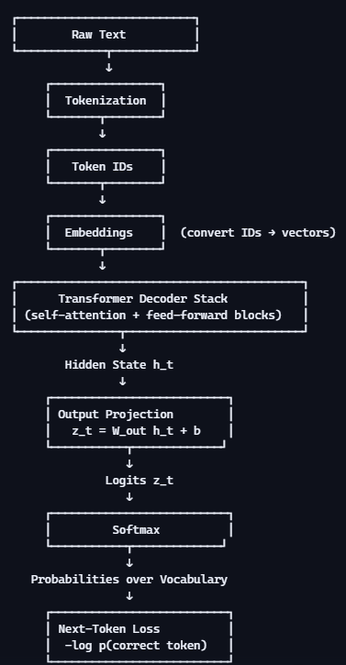
LLM Overview
Text is tokenized into discrete IDs
IDs are mapped to embeddings
The transformer processes embeddings into hidden states
Hidden states are mapped to logits
Softmax turns logits into probabilities
Loss compares predicted probability to the correct next token
Notes:
Let me walk through this from top to bottom.
We start with raw text and tokenize it into discrete IDs.
Those IDs go through an embedding lookup to get dense vectors.
The transformer stack processes those vectors using self‑attention and feed‑forward layers, producing a hidden state at each position.
That hidden state is mapped through the output projection to produce logits — one score per token in the vocabulary.
Softmax turns those logits into a probability distribution.
Finally, we compute the next‑token prediction loss by taking the negative log‑probability of the correct token.
This entire chain runs for every token in every sequence during training

Slide 21
Intro to Logits
What are logits?
  Raw, unnormalized scores the model produces before applying softmax.
Where do they come from?
  The decoder outputs a hidden state h_{t}, which is mapped to logits through the output projection:
What do they represent?
  A score for every token in the vocabulary — one score per possible next token.
Why aren’t they probabilities?
  Logits can be any real numbers (positive, negative, large, small).
  They don’t sum to 1 and aren’t constrained to [0,1].
How do we turn them into probabilities?
  Softmax transforms logits into a valid probability distribution over the vocabulary.
Why do logits matter?
  They are the model’s raw preferences — softmax simply normalizes them.
Notes:
Before the model can decide what the next token should be, it produces something called logits. Logits are just raw scores — they’re the model’s unnormalized preferences for every token in the vocabulary.
They come from taking the decoder’s hidden state at time t, which summarizes everything the model has seen so far, and passing it through a linear layer called the output projection. That’s what the equation zt=Woutht+b represents.
The result is a vector of length ∣V∣, one score per possible next token. These scores aren’t probabilities yet — they can be positive or negative, large or small. Softmax is what we apply next to turn these raw scores into a real probability distribution.
So logits are the bridge between the model’s internal representation and the probabilities we use to pick the next token

Slide 22
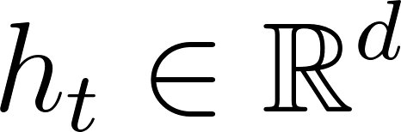
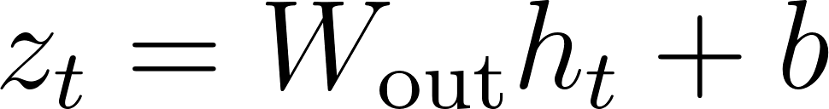
Logits: Raw Scores Before Probabilities
Decoder produces hidden state
  A vector summarizing all context up to time t.
Output projection (“unembedding”)
z_{t} are logits
  Unnormalized scores — can be positive, negative, large, small.
Only relative differences matter
  Softmax converts logits into a probability distribution.
Compute note
  Large ∣V∣ makes this layer expensive — the softmax bottleneck.

Slide 23
Intro to Softmax
What does softmax do?
  Turns logits into a valid probability distribution.
Why do we need it?
  Logits can be any real numbers — softmax normalizes them so probabilities are between 0 and 1 and sum to 1.
Intuition
  Exponentials amplify differences in logits: higher logits → much higher probabilities.
What we get
  A categorical distribution over the vocabulary — one probability per possible next token.
Why it matters
  This is the distribution the model samples from to choose the next token.
Notes:
Once the model has produced logits — those raw, unnormalized scores — we need a way to turn them into actual probabilities. That’s exactly what softmax does.
Softmax takes the entire logits vector and converts it into a valid probability distribution: every value is between 0 and 1, and they all sum to 1. The formula looks a little intimidating, but the idea is simple: we exponentiate each logit, which makes bigger scores grow faster, and then we normalize by the sum so everything fits into a proper distribution.
The result is one probability for every token in the vocabulary. This is the distribution the model uses to decide what the next token should be. Softmax is the final step that turns the model’s raw preferences into something we can actually sample from

Slide 24
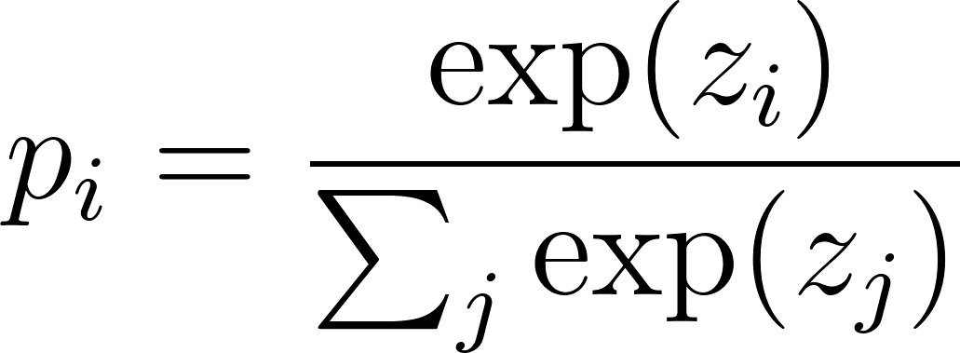
Softmax + Numerical Stability
Softmax converts logits to probabilities
This is the definition of softmax.
  It tells us how to turn the raw logit z_{t,i} into a probability.
The numerator:
  exp⁡(z_{t,i}) Exponentiating makes bigger logits grow much faster than smaller ones. This is why softmax “amplifies gaps.”
The denominator:
  ∑_{j}exp⁡(z_{t,j}) This adds up the exponentials for every token in the vocabulary. Dividing by this sum ensures the probabilities add up to 1.
The whole fraction:
  “How big is token i’s exponential compared to all the others?”
Notes:
Softmax is the final step that turns logits into actual probabilities.
Up to this point, the model has only produced logits — raw, unnormalized scores that can be positive, negative, or huge in magnitude.
Softmax exponentiates those scores and normalizes them so they form a proper probability distribution.
The problem is: exponentials can blow up.
If a logit is large — say 50 or 100 — exp⁡(z) becomes astronomically big.
That’s why we rarely compute softmax directly. Instead, we use the log‑softmax form.
Log‑softmax is numerically stable.
It rewrites the expression so we never exponentiate giant numbers.
The key trick is subtracting the maximum logit before exponentiating — the classic log‑sum‑exp trick.
This doesn’t change the probabilities at all, because softmax is shift‑invariant.
Softmax amplifies differences.
Even small differences in logits can turn into big differences in probabilities.
This is why the model can be extremely confident even when the logits are only slightly different.
This step is also a computational bottleneck.
Because the vocabulary is huge — tens or hundreds of thousands of tokens — we have to compute one logit and one exponential per token.
That’s why softmax is one of the most expensive layers during inference.

Slide 25
Softmax Example
Logits: [2, 1, 0]
Exponentials: [e², e¹, e⁰]≈[7.39, 2.72, 1]
Normalized:
  [0.67, 0.24, 0.09]
Interpretation:
Even though the logits differ by only 1, the probabilities differ by a lot — that’s the amplification effect.
Notes:
Softmax is the final step that turns logits into actual probabilities.
Up to this point, the model has only produced logits — raw, unnormalized scores that can be positive, negative, or huge in magnitude.
Softmax exponentiates those scores and normalizes them so they form a proper probability distribution.
The problem is: exponentials can blow up.
If a logit is large — say 50 or 100 — exp⁡(z) becomes astronomically big.
That’s why we rarely compute softmax directly. Instead, we use the log‑softmax form.
Log‑softmax is numerically stable.
It rewrites the expression so we never exponentiate giant numbers.
The key trick is subtracting the maximum logit before exponentiating — the classic log‑sum‑exp trick.
This doesn’t change the probabilities at all, because softmax is shift‑invariant.
Softmax amplifies differences.
Even small differences in logits can turn into big differences in probabilities.
This is why the model can be extremely confident even when the logits are only slightly different.
This step is also a computational bottleneck.
Because the vocabulary is huge — tens or hundreds of thousands of tokens — we have to compute one logit and one exponential per token.
That’s why softmax is one of the most expensive layers during inference.

Slide 26
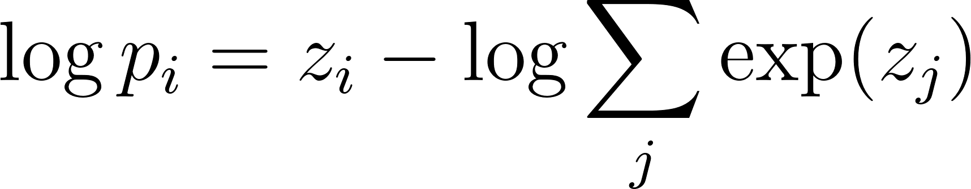
Softmax + Numerical Stability
Log‑softmax (more stable)
  This is the log of the softmax probability.
  It’s mathematically equivalent to softmax, but avoids computing huge exponentials directly.
  Training uses log‑probabilities, so this form is essential.
Notes:
Log‑softmax is numerically stable.
It rewrites the expression so we never exponentiate giant numbers.
The key trick is subtracting the maximum logit before exponentiating — the classic log‑sum‑exp trick.
This doesn’t change the probabilities at all, because softmax is shift‑invariant.
Softmax amplifies differences.
Even small differences in logits can turn into big differences in probabilities.
This is why the model can be extremely confident even when the logits are only slightly different.
This step is also a computational bottleneck.
Because the vocabulary is huge — tens or hundreds of thousands of tokens — we have to compute one logit and one exponential per token.
That’s why softmax is one of the most expensive layers during inference.

Slide 27
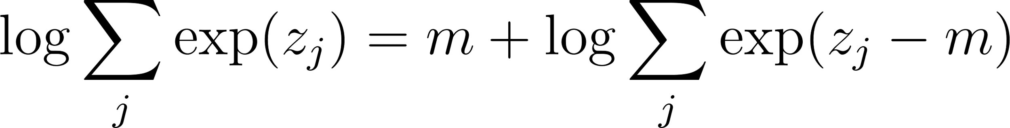
Softmax + Numerical Stability
Stability trick: subtract max logit m
Subtracting the max logit shifts all logits so the largest becomes 0.
This keeps all exponentials ≤ 1, preventing overflow.
Softmax is shift‑invariant, so subtracting a constant doesn’t change the final probabilities.
Example:
Logits: [1000, 999]
Direct exponentials: exp⁡(1000) → overflow
Subtract max (1000): [0, −1]
Exponentials now safe: [1, e−1]
Same probabilities, but numerically stable.
Notes:
Softmax is the final step that turns logits into actual probabilities.
Up to this point, the model has only produced logits — raw, unnormalized scores that can be positive, negative, or huge in magnitude.
Softmax exponentiates those scores and normalizes them so they form a proper probability distribution.
The problem is: exponentials can blow up.
If a logit is large — say 50 or 100 — exp⁡(z) becomes astronomically big.
That’s why we rarely compute softmax directly. Instead, we use the log‑softmax form.
Log‑softmax is numerically stable.
It rewrites the expression so we never exponentiate giant numbers.
The key trick is subtracting the maximum logit before exponentiating — the classic log‑sum‑exp trick.
This doesn’t change the probabilities at all, because softmax is shift‑invariant.
Softmax amplifies differences.
Even small differences in logits can turn into big differences in probabilities.
This is why the model can be extremely confident even when the logits are only slightly different.
This step is also a computational bottleneck.
Because the vocabulary is huge — tens or hundreds of thousands of tokens — we have to compute one logit and one exponential per token.
That’s why softmax is one of the most expensive layers during inference.

Slide 28
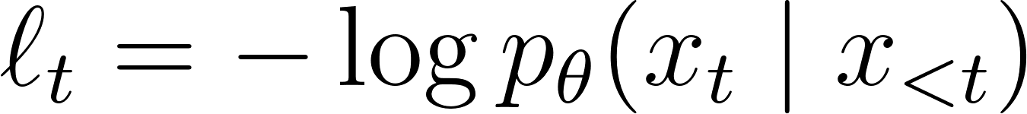
Next-Token Prediction Loss(Token-Level)
Goal is to increase the probability of the correct next token
Loss for a single position t:
If the model assigns high probability to the correct token → low loss
If the model assigns low probability → high loss
Example:
Correct next token = “cat”
Model predicts:
p(cat)=0.40 → loss = −log⁡0.40=0.92
p(cat)=0.01 → loss = −log⁡0.01=4.60
Notes:
This is the core idea: at each position, the model predicts a probability distribution over the vocabulary. The loss is simply the negative log‑probability of the correct token. If the model is confident and correct, the loss is small. If it’s surprised, the loss is large. This is the basic building block of training

Slide 29
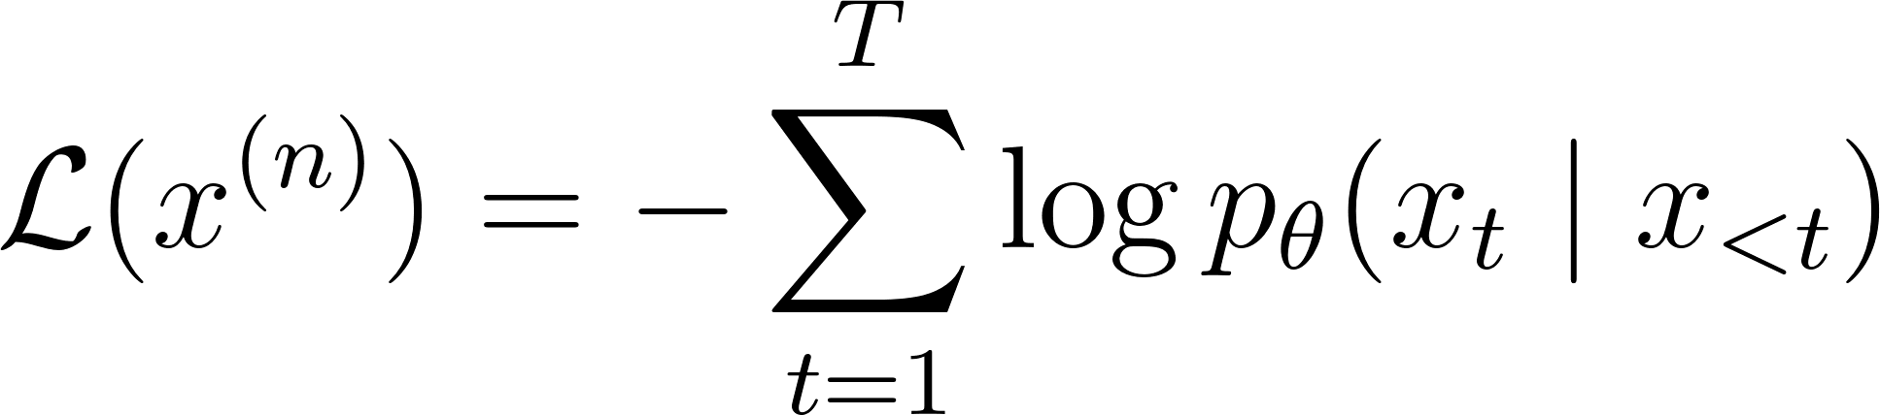
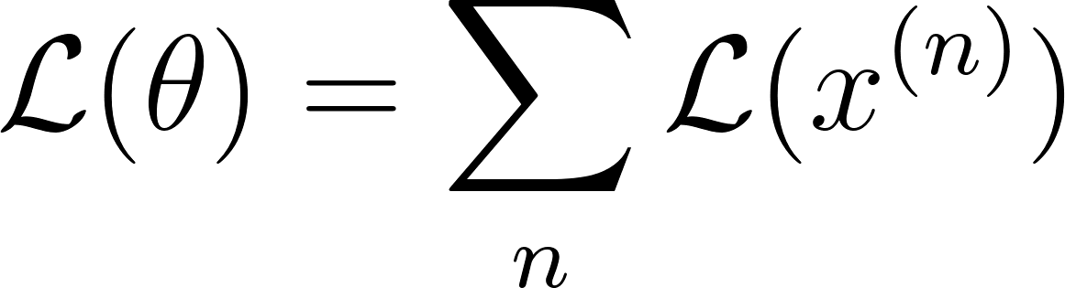
Next-Token Prediction Loss (Sequence Level)
Sequence loss:
This equation computes the total loss for one training example (one sequence).
At each position t, the model predicts a probability distribution over the vocabulary.
We look at the probability the model assigned to the correct next token xt.
We take the negative log of that probability.
Then we sum these values across all tokens in the sequence.
Dataset loss:
Sum of token‑level losses across the whole sequence and dataset.
Notes:
Softmax is the final step that turns logits into actual probabilities.
Up to this point, the model has only produced logits — raw, unnormalized scores that can be positive, negative, or huge in magnitude.
Softmax exponentiates those scores and normalizes them so they form a proper probability distribution.
The problem is: exponentials can blow up.
If a logit is large — say 50 or 100 — exp⁡(z) becomes astronomically big.
That’s why we rarely compute softmax directly. Instead, we use the log‑softmax form.
Log‑softmax is numerically stable.
It rewrites the expression so we never exponentiate giant numbers.
The key trick is subtracting the maximum logit before exponentiating — the classic log‑sum‑exp trick.
This doesn’t change the probabilities at all, because softmax is shift‑invariant.
Softmax amplifies differences.
Even small differences in logits can turn into big differences in probabilities.
This is why the model can be extremely confident even when the logits are only slightly different.
This step is also a computational bottleneck.
Because the vocabulary is huge — tens or hundreds of thousands of tokens — we have to compute one logit and one exponential per token.
That’s why softmax is one of the most expensive layers during inference.

Slide 30

Next-Token Prediction Loss (Dataset Level)
Dataset loss:
  This is the loss over the entire dataset.
  For each training example x^{(n)}, we compute its sequence loss.
  Then we add all those sequence losses together.
Big Picture:
  The model isn’t trained on one sentence — it’s trained on millions or billions.
  So the total loss is the sum of how surprised the model is across all sequences.
  Training tries to minimize this total surprise.
Summing across the data because maximum likelihood training wants the model to assign high probability to the entire training corpus, not just individual examples.
Notes:
This equation represents the loss over the entire dataset.
For each training example, we compute its sequence loss — basically how surprised the model was by that sequence.
Then we add all those sequence losses together.
The big idea is that the model isn’t trained on one sentence — it’s trained on millions or billions.
So the dataset loss measures the model’s total surprise across all sequences.
Training simply tries to reduce that total surprise, which is equivalent to maximizing the likelihood of the entire corpus.

Slide 31
Part 2:
Prompting and
Conditioning
How we communicate with LLMs and steer their behavior
Notes:
Let's begin Part 2. The raw model — fresh out of pre-training — is just a next-token predictor. But the magic lies in HOW you talk to it. The same model can write poetry, debug code, or act as a medical consultant — all depending on how you prompt it.

Slide 32
The Power of a Good Prompt
Same Model, Different Results
Prompt A: "Tell me about Python"
Response: Generic overview of Python programming...
Prompt B: "You are a senior software architect. Explain Python's GIL and its impact on multi-threaded apps."
Response: Deep technical analysis with concurrency patterns...
Key Insight
The model's weights don't change between prompts. What changes is the context — and context is everything.
Why This Matters
Prompting is the primary interface between humans and LLMs. Understanding it is essential for effectively using and building AI applications.
Notes:
Imagine you have one single model — say GPT-4. You type: 'Tell me about Python.' You get a generic overview. Now type: 'You are a senior software architect. Explain Python's GIL and its impact on multi-threaded applications.' Suddenly, the same model gives you a deep, nuanced answer. The weights didn't change. Not a single parameter was updated. The CONTEXT changed. That's the entire premise of prompting and conditioning.

Slide 33
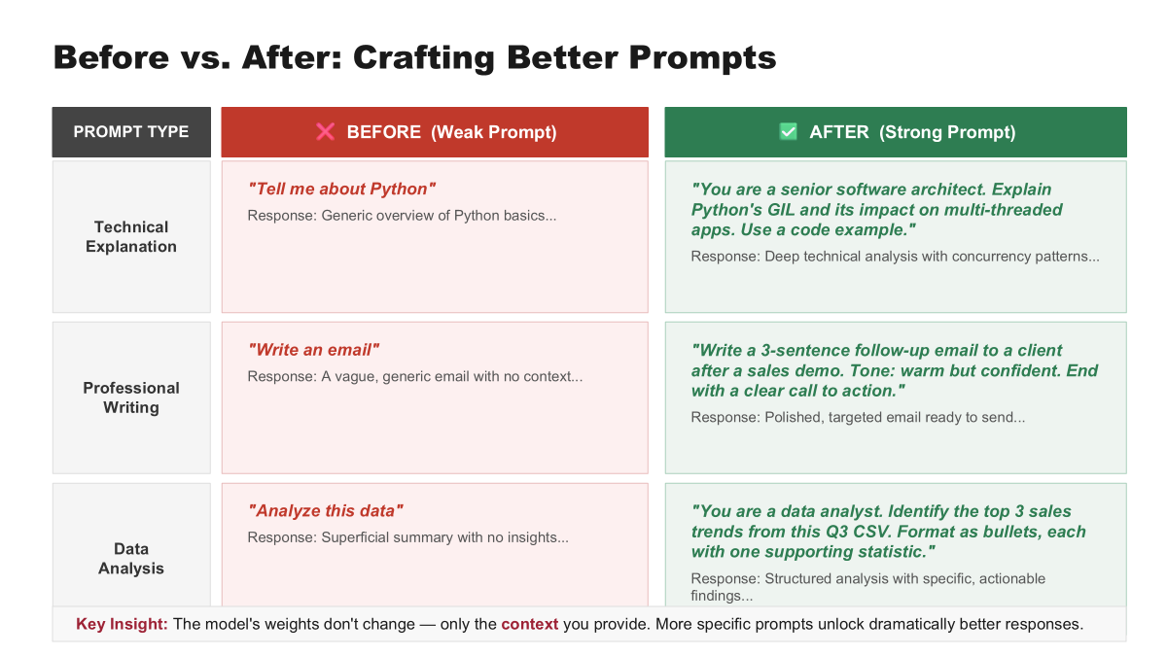

Slide 34
What is In-Context Learning?
Definition
In-context learning (ICL) is the ability of LLMs to learn and perform tasks purely from examples or instructions in the prompt — without updating any model parameters.
No Gradient Updates
Emergent Ability
Flexible & Instant
Unlike fine-tuning, the model does not update weights. It 'learns' from prompt context alone.
ICL emerges in large models (100B+ params). Smaller models struggle with this capability.
Switch tasks instantly by changing the prompt. No retraining, no new data pipeline needed.
Notes:
In-context learning is arguably the most surprising emergent property of large language models. You don't need to retrain a model for every new task. You simply show the model what you want — through examples or instructions — right there in the prompt. First documented in the GPT-3 paper by Brown et al. in 2020, it shocked the community. No one explicitly designed this capability. It emerged from scale.

Slide 35
Zero-Shot Prompting
Give the model a task description with no examples — rely entirely on pre-trained knowledge.
Example: Zero-Shot
When It Works Best
Well-known tasks (translation, sentiment)
Clear, unambiguous instructions
Large, capable models
Limitation: May fail on novel or ambiguous task formats.
Prompt: "Classify the sentiment of this review as positive, negative, or neutral: The food was cold and the service was terrible."
Model Output: "Negative"
Notes:
Zero-shot is the simplest form. You describe the task, provide the input, and ask for the output — no examples. The model relies entirely on its pre-trained knowledge. Works remarkably well for well-defined tasks — translation, classification, summarization — especially with larger models. But for unusual tasks, it can fail.

Slide 36
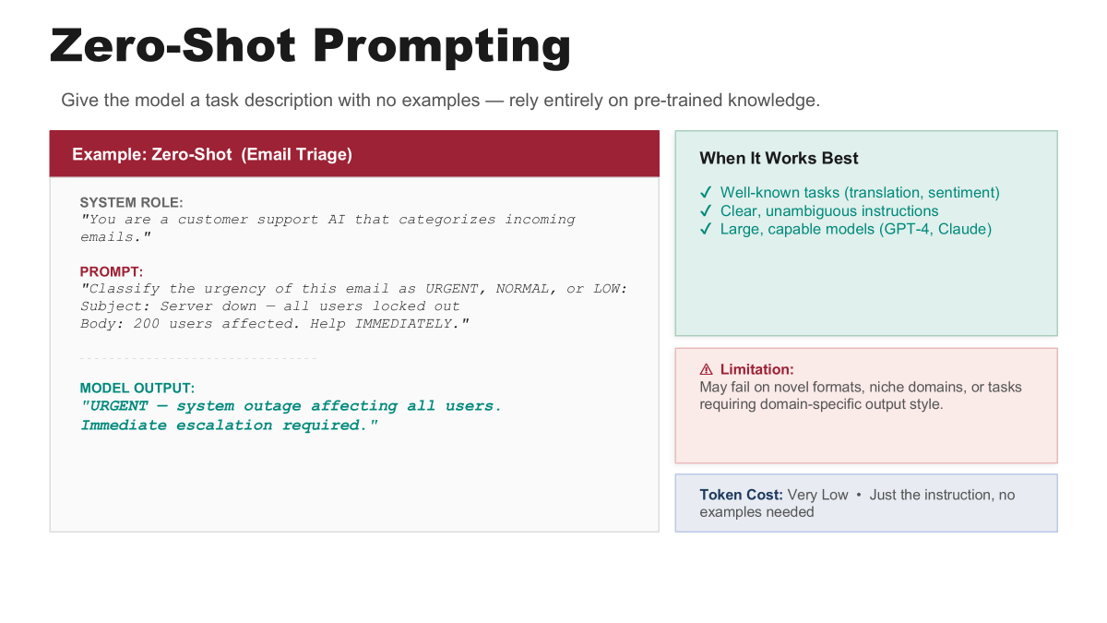
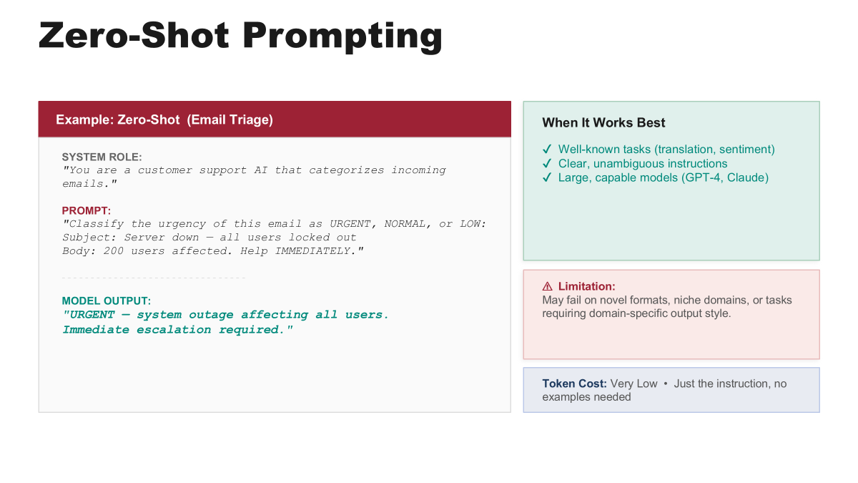

Slide 37
Few-Shot Prompting
Provide a few demonstration examples in the prompt to guide the model's behavior.
Example: Few-Shot (2 demonstrations)
Why It Works
The model identifies the pattern from demonstrations and applies it to the new input.
Key Factors:
Format consistency matters
Label diversity helps
Order of examples affects output
More examples = more token cost
Review: "Loved the ambiance!" -> Positive
Review: "Worst meal ever." -> Negative
Review: "The pasta was decent but nothing special." -> ???
Model Output: Neutral
Notes:
Few-shot prompting takes in-context learning further. You show the model actual input-output pairs. Research shows format matters more than actual labels — if you keep the format consistent, even random labels can sometimes guide the model. The order of examples affects performance. Label diversity matters — showing only positive examples biases the model.

Slide 38
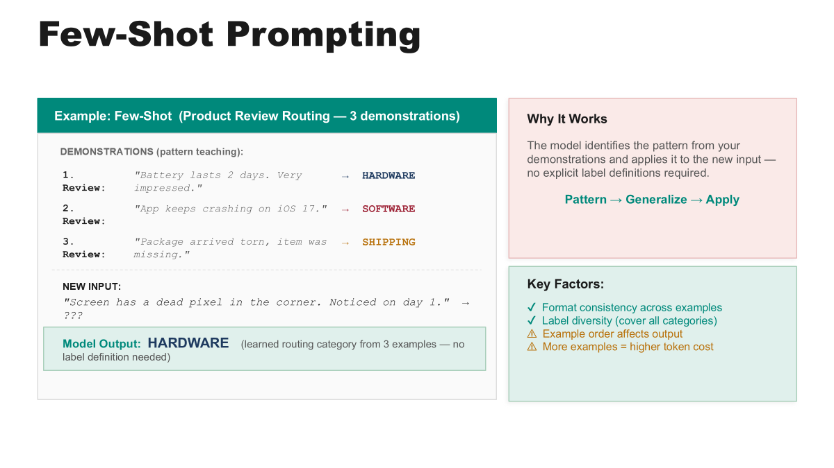

Slide 39
Zero-Shot vs. Few-Shot: A Comparison
Aspect | Zero-Shot | Few-Shot
Examples in Prompt | None | 1-10 demonstrations
Token Cost | Low | Higher (scales with examples)
Task Clarity | Relies on instruction alone | Pattern demonstrated explicitly
Performance | Good for common tasks | Better for novel/ambiguous tasks
Best For | Standardized tasks, large models | Custom formats, edge cases
Key Takeaway: As models grow larger, zero-shot performance improves dramatically. GPT-4 zero-shot often matches GPT-3 few-shot.
Notes:
The key tradeoff is token efficiency vs. task clarity. Zero-shot is cheap but relies on the model already understanding the task. Few-shot costs more tokens but provides explicit demonstrations. As models scale up, zero-shot improves faster than few-shot.

Slide 40
Chain-of-Thought Prompting
Encourage the model to reason step-by-step before producing a final answer.
Without CoT
Q: Roger has 5 tennis balls. He buys 2 cans of 3. How many?
A: 11
Jumps straight to the answer. Works for simple problems, fails on complex reasoning.
With CoT
Q: Same question... Let's think step by step.
A: Roger starts with 5. He buys 2 cans of 3 = 6. 5 + 6 = 11
Reasoning is visible, errors are catchable, outputs are more reliable.
Notes:
Introduced by Wei et al. in 2022. Instead of asking for an answer directly, ask the model to show its work. On GSM8K math benchmark, CoT improved GPT-3's accuracy from 18% to over 57%. The magic phrase 'Let's think step by step' is zero-shot CoT.

Slide 41
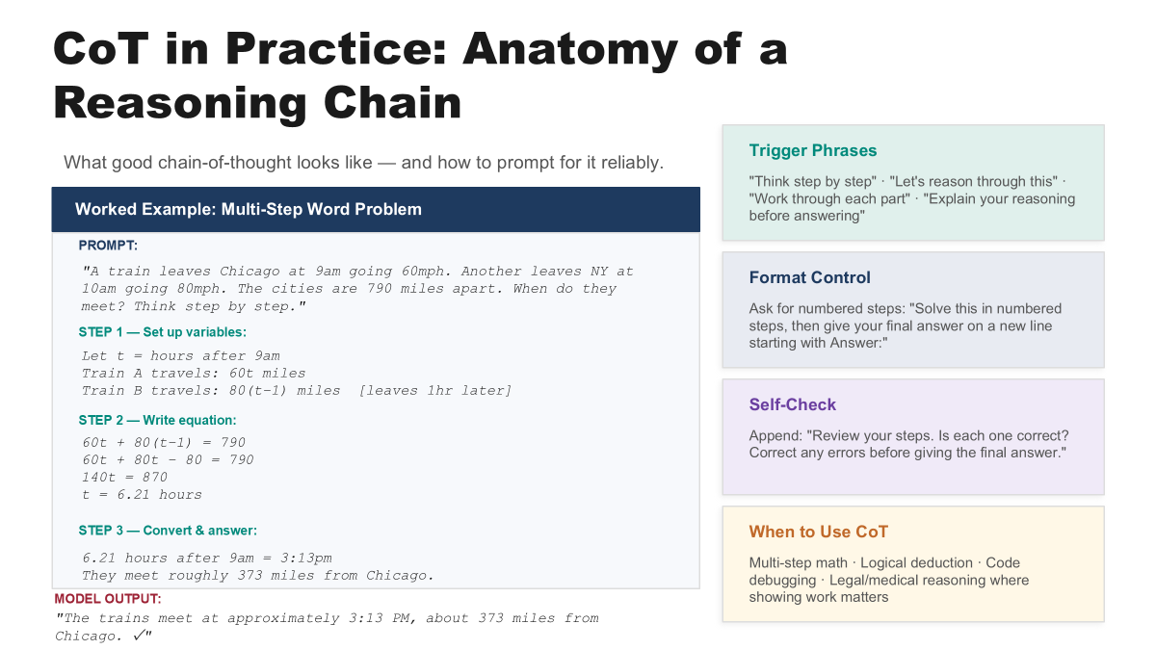

Slide 42
Advanced Prompting Strategies
Beyond basic CoT — more sophisticated techniques for complex reasoning.
Self-Consistency
Tree of Thought (ToT)
ReAct (Reason + Act)
Sample multiple CoT reasoning paths, then take a majority vote on the final answer. Reduces variance and improves accuracy by 5-15% over single CoT.
Explore multiple reasoning branches in parallel, evaluate each, and backtrack if needed. Enables deliberate planning for complex problems like puzzles.
Interleave reasoning traces with actions (search, code execution). The model thinks, acts, observes results, then thinks again. Powers modern AI agents.
Notes:
Let me show you three cutting-edge strategies that build on CoT. Self-Consistency, proposed by Wang et al. 2022, generates multiple reasoning paths and takes a majority vote. It's like asking a panel of experts instead of one person. Tree of Thought, by Yao et al. 2023, creates a branching search over reasoning paths. Instead of a single chain, the model explores a tree — evaluating and pruning branches. ReAct, by Yao et al. 2022, interleaves reasoning with actions. The model thinks, takes an action (like searching the web), observes the result, and reasons again. This is the foundation of modern AI agents like ChatGPT plugins.

Slide 43
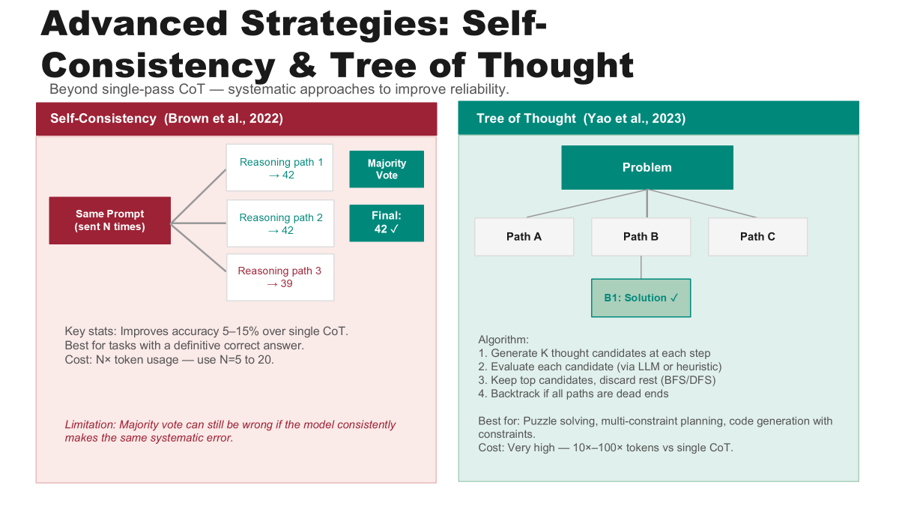

Slide 44
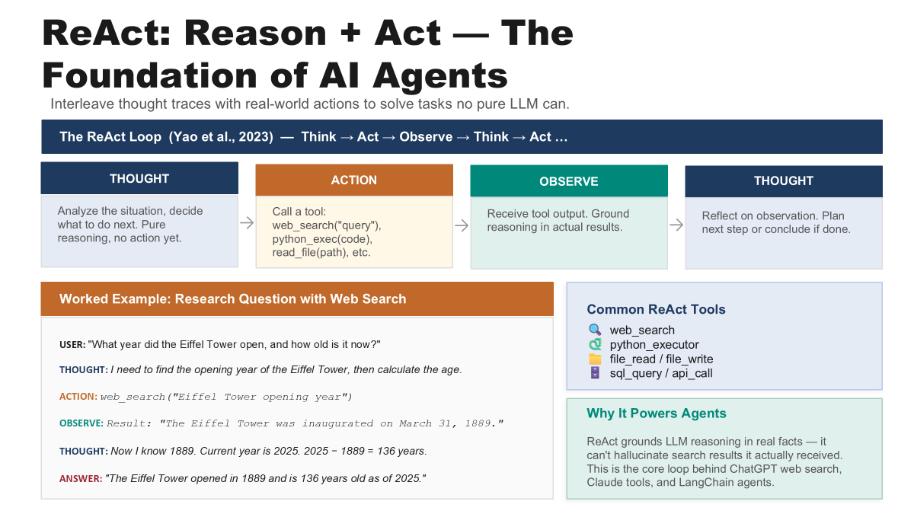

Slide 45
System, User & Instruction Prompts
Modern LLM APIs structure conversations using distinct prompt roles.
System Prompt
User Prompt
Instruction Prompt
Sets the model's persona, behavior rules, and constraints.
"You are a helpful medical assistant. Always recommend consulting a doctor for serious symptoms."
The actual question or request from the end user.
"I have a persistent headache for 3 days. What should I do?"
Explicit task directives embedded in the system or user message.
"Respond in bullet points. Keep each point under 20 words. Use simple language."
Notes:
Modern LLM APIs use structured message formats with distinct roles. The system prompt sets the stage — who the model is, what rules it follows. The user prompt is the actual question. Instruction prompts are specific directives. Technically, the system prompt is not fundamentally different at the token level — it's all just tokens. But the model has been trained through RLHF to treat system messages as higher-priority guidance.

Slide 46
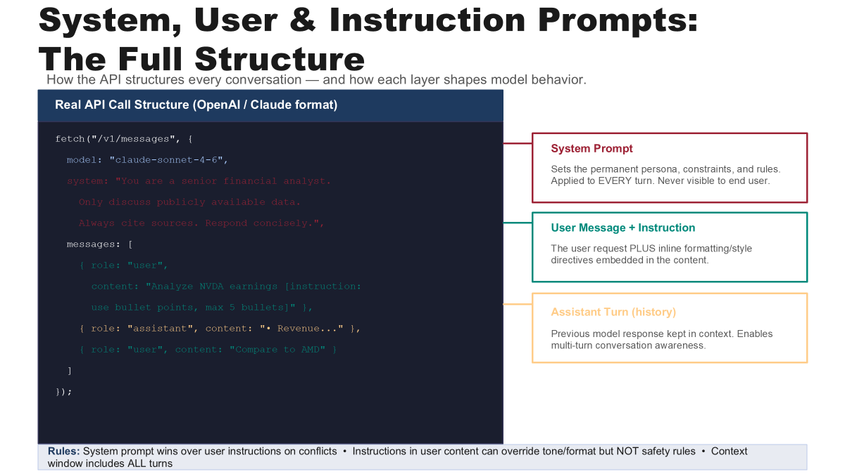

Slide 47
Anatomy of an LLM Conversation
SYSTEM
You are a Python tutor for beginners. Explain concepts with code examples.
Context Window
All messages are concatenated into one token sequence. The model sees the entire history at once.
USER
What is a list comprehension?
ASSISTANT
A list comprehension is a concise way to create lists... [x**2 for x in range(10)]
USER
Can you show a filtering example?
Notes:
At the API level, every message is a role-content pair. Everything gets concatenated into one long token sequence. The model processes this entire sequence through its attention mechanism. When generating the next token, it attends to ALL previous tokens. This is why conversation history matters.

Slide 48
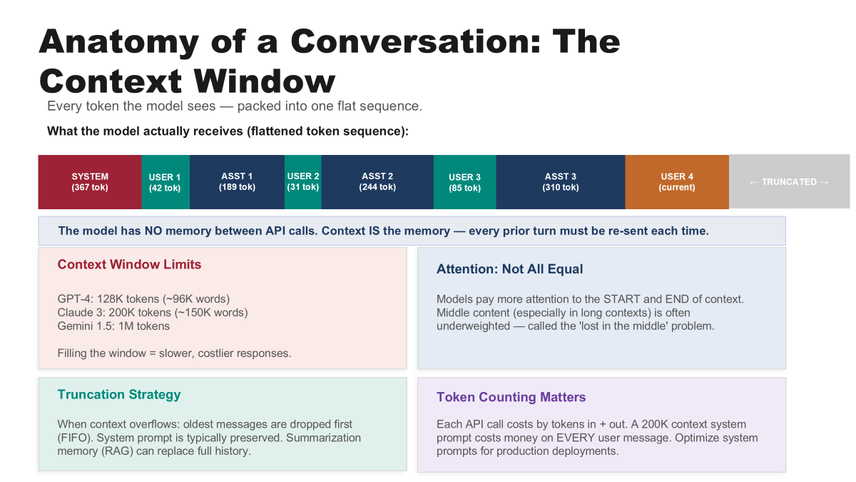

Slide 49
Instruction Tuning & RLHF
How models learn to follow prompts and align with human preferences.
Pre-training
(Next-token prediction on internet text)
Supervised Fine-Tuning
(Human-written instruction-response pairs)
RLHF
(Reward model + PPO from human preferences)
->
->
Why Base Models Aren't Enough
A base model trained only on next-token prediction will try to complete your text, not answer your question. Ask it 'What is the capital of France?' and it might continue with 'What is the capital of Germany? What is the capital of...'
RLHF in Practice
1. Train a reward model from human rankings of responses
2. Use PPO (Proximal Policy Optimization) to fine-tune the LLM to maximize reward
3. Balance helpfulness with safety constraints
This is what makes ChatGPT different from GPT-3.
Notes:
This is crucial for understanding why prompting works so well with modern models. A base model — trained only on next-token prediction — is a text completer, not a question answerer. If you ask 'What is the capital of France?', it might continue the pattern with more questions rather than giving an answer. Instruction tuning fixes this by training on human-written instruction-response pairs. The model learns that when given an instruction, it should follow it. RLHF goes further — training from human preference rankings using reinforcement learning. This three-stage pipeline is what turned GPT-3 into ChatGPT.

Slide 50
Part 3:
Architectural
Components
Inside the Transformer Decoder — embeddings, attention, and the path from tokens to predictions
Notes:
Now we open the hood of an LLM and look at every major component. We'll trace a token's journey from the moment it enters as an integer, through the embedding matrix, through decoder layers, and out through the unembedding matrix as a probability distribution.

Slide 51
Tokenization: From Text to Numbers
Before tokens enter the model, raw text must be converted into integer IDs.
Example: "Understanding LLMs" -> ["Under", "standing", " LL", "Ms"] -> [16397, 8449, 27624, 10128]
Byte-Pair Encoding
(BPE)
WordPiece
SentencePiece
Start with characters, iteratively merge the most frequent pairs. Used by GPT-2, GPT-3, GPT-4.
Vocab: 50K-100K tokens
Similar to BPE but maximizes likelihood of training data when merging. Used by BERT.
Uses ## prefix for sub-words
Language-agnostic, treats input as raw bytes. Used by LLaMA, T5, PaLM.
Handles any language without pre-tokenization
Notes:
Before any neural network processing happens, we need to convert text into numbers. This is tokenization — and it's more nuanced than it sounds. Modern LLMs don't tokenize at the word level or character level. They use subword tokenization. BPE, used by most GPT models, starts with individual characters and iteratively merges the most common pairs. After training, common words like 'the' become single tokens, while rare words get split into subwords. This is why 'Understanding' might become 'Under' + 'standing'. The vocabulary size matters — larger vocabularies mean fewer tokens per input but bigger embedding matrices. GPT-2 uses 50,257 tokens. LLaMA uses SentencePiece with 32,000 tokens. The tokenizer's choices directly affect model performance, efficiency, and even multilingual capability.

Slide 52
Example: BPE Tokenization Step-by-Step
Walking through how Byte-Pair Encoding tokenizes the word "lowest"
Step 1: Start with characters
Input: "lowest"
Initial tokens: l o w e s t
Step 2: Find most frequent pair
Most frequent bigram: (e, s) -> merge!
Tokens: l o w es t
Step 3: Continue merging
Next frequent pair: (es, t) -> merge!
Tokens: l o w est
Step 4: Next merge
Next frequent pair: (l, o) -> merge!
Tokens: lo w est
Final Result
"lowest" -> ["low", "est"]
Token IDs: [4253, 395]
Common words stay whole; rare words split
into known subwords.
Key Insight
BPE vocabulary is built by iteratively
merging the most frequent character
pairs in the training corpus.
Common words become single tokens;
rare words decompose into subwords.

Slide 53
The Embedding Matrix
Converting discrete tokens into continuous vector representations.
How It Works
1. Tokenizer: "The cat sat" -> [464, 3797, 3332]
2. Lookup: Each ID indexes into matrix E [V x d_model]
3. Result: Each token becomes a dense d_model vector
Vocabulary Sizes:
GPT-2: 50,257 | GPT-3: 50,257 | LLaMA-2: 32,000
The Intuition
Token IDs are meaningless integers. The embedding matrix translates them into a rich geometric space where:
Similar words cluster together ("king" near "queen")
Relationships are directions ("king" - "man" + "woman" ~ "queen")
Learned during training via backpropagation
Notes:
The embedding matrix is a learnable lookup table of shape V by d_model. Each token ID indexes a row. For GPT-3, the embedding matrix alone has over 617 million parameters. It learns to encode semantic meaning as geometric position in a high-dimensional space.

Slide 54
Example: Embedding Lookup
How token IDs become vectors through matrix indexing
Step-by-Step Lookup
Input sentence: "The cat"
1. Tokenize:
"The" -> token ID 464
"cat" -> token ID 3797
2. Index into E [50,257 x 768]:
E[464] = [0.12, -0.34, 0.56, ...]
E[3797] = [0.78, 0.23, -0.91, ...]
3. Output: 2 vectors, each 768-dim
Shape: [2 x 768]
Why This Matters
Token 464 ("The") is just an integer.
It has no meaning. The embedding vector
[0.12, -0.34, 0.56, ...] encodes semantic
meaning in geometric space.
Similar words -> nearby vectors.
Parameter Count
GPT-2: 50,257 x 768 = 38.6M
GPT-3: 50,257 x 12,288 = 617M
LLaMA: 32,000 x 4,096 = 131M
This single matrix = 1-5% of total!

Slide 55
Positional Encoding in LLMs
Adding position information since attention is inherently order-agnostic.
Learned Positional
Embeddings
Sinusoidal
Encoding
Rotary Position
Embedding (RoPE)
Separate learned matrix P [max_seq x d_model]. Added to token embeddings.
Used by: GPT-2, GPT-3
Fixed sine/cosine functions at different frequencies. Unique per position.
Used by: Original Transformer
Rotates Q and K vectors by position. Captures relative distances naturally.
Used by: LLaMA, PaLM, Mistral, modern LLMs
Notes:
Attention is permutation-invariant — without position information, 'The cat sat on the mat' is the same as 'The mat sat on the cat.' Three main approaches: learned embeddings (GPT), sinusoidal (original Transformer), and RoPE (modern models). RoPE is now dominant — it elegantly encodes relative position by rotating query and key vectors.

Slide 56
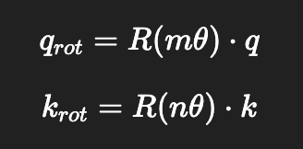
Example: How RoPE Works
Rotary Position Embedding encodes position by rotating Q and K vectors
The Problem: Why Position Matters
"The cat sat on the mat"
"The mat sat on the cat"
Without position info, attention treats
these as identical (same tokens).
RoPE: Rotation = Position
For position m, rotate Q and K by
angle m * theta:
q_rot = R(m * theta) * q
k_rot = R(n * theta) * k
Worked Example (2D simplified)
Position 0: rotate by 0 deg
q=[1, 0] -> q_rot=[1.0, 0.0]
Position 1: rotate by theta
q=[1, 0] -> q_rot=[cos t, sin t]
Position 5: rotate by 5*theta
q=[1, 0] -> q_rot=[cos 5t, sin 5t]
Why RoPE is Elegant
Dot product of rotated Q and K:
q_rot(m) . k_rot(n) depends on (m-n)
Relative position encoded automatically!
No absolute position matrix needed.
Generalizes to unseen lengths.
Used by: LLaMA, PaLM, Mistral

Slide 57
The Transformer Decoder Stack
LLMs like GPT are built on the decoder-only transformer architecture.
Input
Tokens
Embedding
Matrix
Positional
Encoding
Decoder
Block x N
Layer
Norm
Unembed
Matrix
Softmax
Logits
->
->
->
->
->
->
Key Differences from Encoder-Only Models:
Causal (masked) self-attention: Each token can only attend to previous tokens, not future ones
Autoregressive generation: Tokens are produced one at a time, each conditioned on all previous tokens
No encoder-decoder cross-attention: The decoder attends only to its own previous outputs
Notes:
Modern LLMs use a decoder-only transformer. This is different from the original Transformer which had both encoder and decoder. The key innovation is causal self-attention — each token can only attend to tokens before it. This creates the autoregressive property: tokens are generated one at a time, left to right.

Slide 58
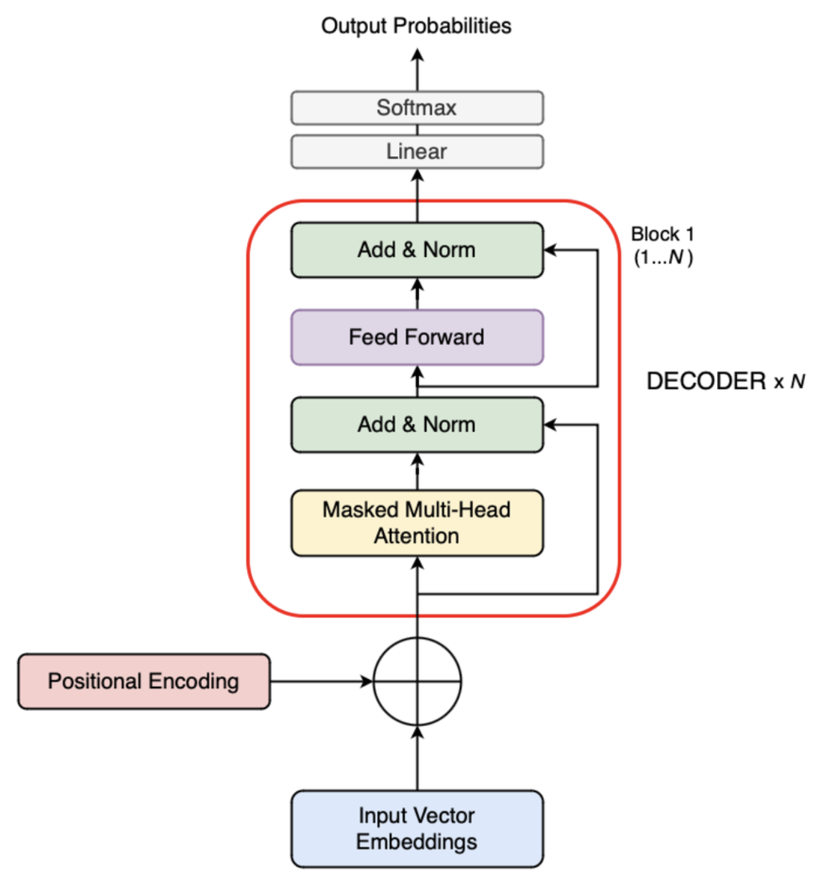
Inside a Decoder Block
Each decoder block has two sub-layers with residual connections and layer normalization.
Input (from previous layer)
Pre-LayerNorm Architecture
Modern LLMs use Pre-LN (normalize before attention), improving training stability.
Residual Connections
x + SubLayer(x) prevents vanishing gradients in deep networks.
Stacking: GPT-3 = 96 layers, LLaMA-2 70B = 80 layers.
Layer Norm
Masked Multi-Head Self-Attention
Residual Connection (Add)
Layer Norm
Feed-Forward Network (MLP)
Notes:
Each decoder block follows the Pre-LayerNorm pattern: normalize inputs, then masked multi-head self-attention, then residual connection, then another normalize, feed-forward network, and another residual. This is repeated N times — 96 in GPT-3, 80 in LLaMA-2 70B.

Slide 59
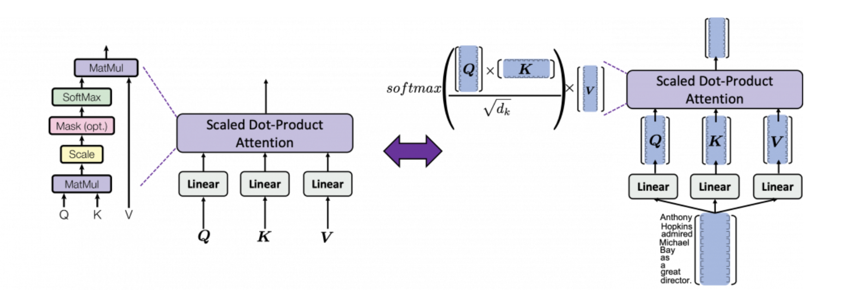
Self-Attention Diagram
Notes:
Causal masking is what makes autoregressive generation work. Each token can only attend to tokens before it — never future tokens. Implemented by adding a mask matrix M to attention scores before softmax: 0 for allowed positions, -inf for blocked ones. The triangular pattern ensures left-to-right generation.

Slide 60
Masked (Causal) Self-Attention
The key mechanism that enforces the autoregressive property.
Causal Attention Mask
How Masking Works
Future positions are set to -inf before softmax, becoming 0 after.
Attention(Q,K,V) = softmax(QK^T / (d_k) + M) * V
 | The | cat | sat | on
The | 1.0 | 0 | 0 | 0
cat | 0.3 | 0.7 | 0 | 0
sat | 0.1 | 0.4 | 0.5 | 0
on | 0.1 | 0.2 | 0.3 | 0.4
Can attend
Masked (blocked)
Notes:
Causal masking is what makes autoregressive generation work. Each token can only attend to tokens before it — never future tokens. Implemented by adding a mask matrix M to attention scores before softmax: 0 for allowed positions, -inf for blocked ones. The triangular pattern ensures left-to-right generation.

Slide 61
Multi-Head Attention & Interpretability
Different attention heads specialize in different patterns — making LLMs partially interpretable.
Induction Heads
Positional Heads
Semantic Heads
Detect and copy patterns. If 'A B ... A' appeared, predict B next. This is the foundation of in-context learning at the mechanistic level.
Attend to specific relative positions (e.g., always look at the previous token or token 2 positions back). Handle local syntax.
Attend to semantically related tokens regardless of position. One head might always connect subjects to verbs.
Mechanistic Interpretability: A growing field that reverse-engineers neural networks to understand what individual neurons, heads, and circuits compute. Research by Anthropic, DeepMind, and others is making LLMs more transparent.
Notes:
One of the most exciting developments in AI is mechanistic interpretability — reverse-engineering what individual components of neural networks actually do. Induction heads are a key discovery — they implement a simple but powerful algorithm: if the sequence 'A B ... A' appears, predict B. This is how in-context learning works mechanistically. Different heads specialize: some attend to previous positions (local syntax), others attend to semantically related tokens (long-range meaning). This research makes LLMs less of a black box.

Slide 62
Example: Multi-Head Attention in Action
How different heads capture different patterns in "The cat sat on the mat"
Head 1: Previous Token
(Positional / Syntactic)
When processing "sat":
"The" : 0.05
"cat" : 0.85 <- prev token
"sat" : 0.10
Always looks one position back.
Handles local word order.
Head 2: Subject-Verb
(Semantic)
When processing "sat":
"The" : 0.05
"cat" : 0.80 <- subject!
"sat" : 0.15
Connects verbs to subjects
regardless of distance.
Head 3: Induction
(Pattern Matching)
Sequence: "A B ... A ?"
Predicts: B (copies pattern)
Example:
"The cat... The ?" -> "cat"
Foundation of in-context learning!
How Multi-Head Outputs Combine
MultiHead(Q,K,V) = Concat(head_1, ..., head_h) * W_O
Each head uses d_k = d_model / h. GPT-3: 12,288 / 96 = 128 dims per head.
Output projection W_O combines all heads back to d_model dimensions.

Slide 63
The Feed-Forward Network (MLP)
After attention mixes information across tokens, the FFN processes each token independently.
Mathematical Formulation
FFN(x) = W2 * GELU(W1 * x + b1) + b2
where W1,W2- layers,x1=input vector,b1- bias vector
Why the Expansion?
The 4x expansion creates a higher-dimensional space for more complex feature representations.
Think of it as: attention decides WHICH tokens matter, the FFN decides WHAT to do with that information.
d_model
(768)
->
4 * d_model
(3072)
->
d_model
(768)
Notes:
The feed-forward network processes each token independently with an expand-and-contract design. First, project from d_model to 4*d_model. Apply non-linearity (GELU). Then contract back. Research shows FFN layers store factual knowledge — they act like key-value memories. Attention routes information, FFN transforms it.

Slide 64
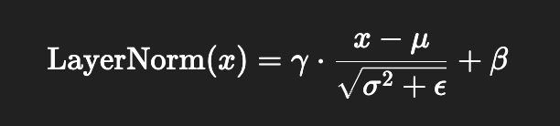
Layer Normalization & Residual Connections
Layer Normalization
Why not Batch Norm?
Batch norm depends on batch statistics — problematic for variable-length sequences. Layer norm is independent of batch size.
RMSNorm: Many modern LLMs (LLaMA, PaLM) use this simpler variant for efficiency.
Residual Connections
output = x + SubLayer(LayerNorm(x))
Why Critical?
Without residuals, gradients must pass through every layer sequentially. In 96 layers, they would vanish to zero.
With residuals, gradients have a 'highway' — direct flow from loss to early layers without degradation.
Notes:
Layer norm ensures inputs to each sub-layer have consistent statistics. Residual connections create 'gradient highways' — gradients flow directly from output to any layer, bypassing intermediate transformations. Without these two techniques, training 96+ layer models would be impossible.

Slide 65
The Unembedding Matrix
Converting hidden states back into vocabulary probabilities.
Hidden State
h (d_model)
->
Unembedding
->
Raw Logits
(V-dim)
->
Softmax /
Temperature
->
Probability
Distribution
Weight Tying
Many models share embedding and unembedding matrices (W_e = W_u):
Reduces parameters significantly
Creates a consistent token space
Improves generalization
Temperature & Sampling-Hyperparameter
logits / T -> softmax -> probabilities
T = 0: Greedy (always pick highest)
T = 1: Standard sampling
T > 1: More random/creative
T < 1: More focused/deterministic
Notes:
The unembedding matrix mirrors embedding. Hidden state vector multiplied by W_u gives V-dimensional logits. Softmax converts to probabilities. Weight tying shares embedding and unembedding matrices. Temperature controls randomness in sampling.

Slide 66
KV Cache & Efficient Inference
How LLMs generate tokens quickly despite massive model sizes.
The Problem
Without caching, generating token N requires recomputing attention over all N-1 previous tokens from scratch.
For a 1000-token response, that means:
Token 1: process 1 token
Token 2: process 2 tokens
...
Token 1000: process 1000 tokens
Total: ~500,000 redundant computations!
The Solution: KV Cache
Cache the Key (K) and Value (V) tensors from all previous tokens. When generating token N:
1. Compute Q, K, V only for the NEW token
2. Append new K, V to the cache
3. Attend new Q against ALL cached K, V
Trade-off: Uses more GPU memory but dramatically reduces computation time. For GPT-3, KV cache for 2048 tokens = ~3GB per batch item.
Notes:
KV caching is one of the most important optimizations in LLM inference. Without it, generating each new token requires recomputing attention over the entire sequence from scratch — quadratic cost. With KV caching, we store the Key and Value projections from all previous tokens. For each new token, we only compute its Q, K, V — and attend the new Q against all cached K and V values. This makes inference linear instead of quadratic. The tradeoff is memory: for GPT-3 with 2048 tokens, the KV cache requires about 3GB per batch item. This is why GPU memory is the primary bottleneck for long-context generation.

Slide 67
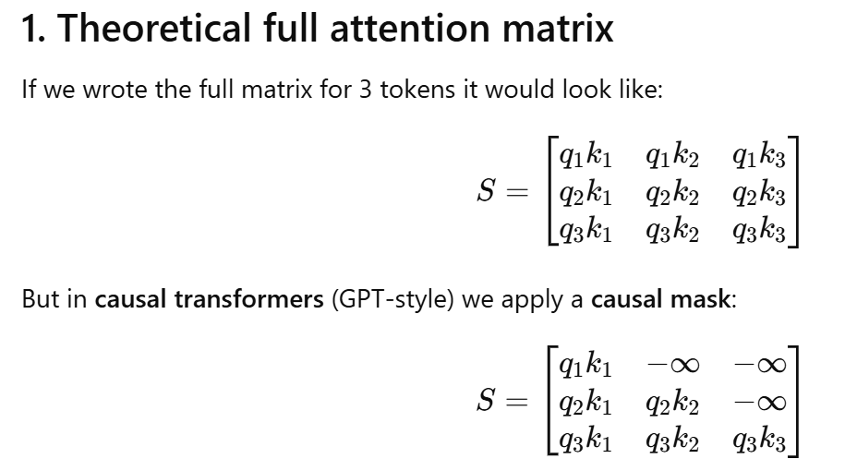
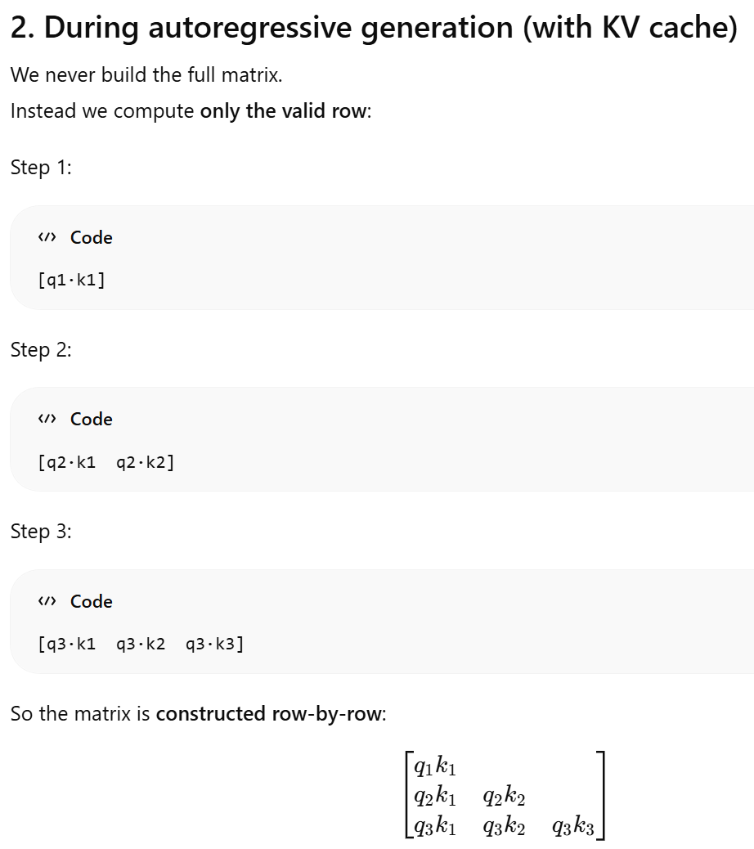


Slide 68
The LLM Training Pipeline
From raw text to a deployed model — the complete lifecycle.
1
Data Collection
Curate trillions of tokens from books, websites, code, papers. Filter quality, deduplicate, remove PII.
2
Pre-training
Train next-token prediction on massive GPU clusters (1000s of GPUs). Takes weeks/months. Cost: $2M-$100M+.
3
Supervised Fine-Tuning
Train on human-written instruction-response pairs. Teaches the model to follow instructions.
4
RLHF / DPO
Align with human preferences using reward models. Makes outputs helpful, harmless, and honest.
5
Evaluation & Safety
Benchmark on standard tests (MMLU, GSM8K, HumanEval). Red-team for safety. Deploy with guardrails.
Notes:
Let me walk you through the entire lifecycle of building an LLM. Step 1: Data collection — curating trillions of tokens from diverse sources, deduplicating, filtering for quality. Step 2: Pre-training — the expensive part. GPT-4 reportedly cost over $100 million to train. Step 3: SFT — supervised fine-tuning on instruction-response pairs. Step 4: RLHF or newer methods like DPO. Step 5: Evaluation and deployment with safety guardrails.

Slide 69
Context Window & Long-Context Models
How much text can an LLM process at once, and why it matters.
Model | Context Length | Approx. Pages
GPT-2 | 1,024 tokens | ~2 pages
GPT-3 | 2,048 tokens | ~4 pages
GPT-4 | 8K / 32K / 128K | ~16 / 64 / 256 pages
Claude 3 | 200K tokens | ~400 pages (a full novel)
Gemini 1.5 | 1M+ tokens | ~2000 pages
Key Challenges
Quadratic attention cost: O(n^2) makes long contexts expensive
KV cache memory: grows linearly with context
'Lost in the middle' problem: models attend poorly to middle of long contexts
Solutions:
Flash Attention, RoPE scaling, sliding window attention, ring attention
Notes:
Context window is one of the most rapidly evolving aspects of LLMs. GPT-2 could handle 1,024 tokens — about 2 pages. Gemini 1.5 handles over 1 million tokens — entire books. The key challenge is the quadratic cost of attention. Flash Attention optimizes memory access patterns on GPUs. RoPE scaling extends position embeddings to longer sequences. The 'lost in the middle' problem is fascinating — models attend well to the beginning and end of long contexts but poorly to the middle.

Slide 70
The Complete Pipeline: Token to Prediction
1
Tokenize
"The cat sat" -> [464, 3797, 3332]
Autoregressive Loop
After sampling token N, append it and repeat steps 1-7 for token N+1.
Continues until a stop token or max length.
2
Embed
Token IDs -> dense vectors via embedding matrix lookup
3
Add Position
Inject positional info (learned embeddings or RoPE)
4
Decode (x N)
N decoder blocks: masked attention + FFN + residuals
5
Final Norm
Apply final layer normalization
6
Unembed
Project to vocabulary logits via unembedding matrix
7
Sample
Apply temperature, top-p/top-k, sample next token
Notes:
The complete journey: Tokenize -> Embed -> Add Position -> N Decoder Blocks -> Final Norm -> Unembed -> Sample. Then append the new token and repeat. This autoregressive loop continues until a stop token is generated.

Slide 71
LLM Model Variants & Scale
Model | Params | Layers | d_model | Heads | Context
GPT-2 | 1.5B | 48 | 1600 | 25 | 1,024
GPT-3 | 175B | 96 | 12,288 | 96 | 2,048
LLaMA-2 7B | 7B | 32 | 4,096 | 32 | 4,096
LLaMA-2 70B | 70B | 80 | 8,192 | 64 | 4,096
Mistral 7B | 7B | 32 | 4,096 | 32 | 8,192
Scaling Laws (Kaplan et al., 2020)
Performance follows predictable power laws when scaling parameters, data, and compute. The Chinchilla law (Hoffmann et al., 2022) showed most models were undertrained — roughly 20 tokens per parameter are needed for optimal efficiency.
Notes:
GPT-2 was 1.5B params with 48 layers. GPT-3 jumped to 175B with 96 layers. LLaMA-2 showed that smaller models trained longer can rival larger ones. Scaling laws predict performance improvements from increasing model size, data, and compute.

Slide 72
Key Takeaways
Prompting Is Programming
Structure Enables Scale
Zero-shot, few-shot, and chain-of-thought are your tools for steering LLM behavior without retraining.
System, user, and instruction prompts create a layered interface. RLHF teaches models to follow them.
Decoder Architecture
Embeddings Bridge Worlds
Masked attention enforces autoregressive generation. Residuals and layer norms enable extreme depth.
Embedding maps tokens to vectors. Unembedding maps vectors back to probabilities. KV cache makes it fast.
Notes:
Four major themes: Prompting is the new programming. Structured prompts with RLHF create powerful interfaces. The decoder architecture with masked attention enables autoregressive generation. And embedding/unembedding matrices bridge discrete tokens and continuous neural computation.

Slide 73
References & Further Reading
Foundational Papers:
Vaswani et al. (2017) — "Attention Is All You Need" — The original Transformer
Brown et al. (2020) — "Language Models are Few-Shot Learners" — GPT-3 and in-context learning
Wei et al. (2022) — "Chain-of-Thought Prompting" — Step-by-step reasoning
Ouyang et al. (2022) — "Training language models to follow instructions with human feedback" — InstructGPT/RLHF
Touvron et al. (2023) — "LLaMA 2: Open Foundation Models" — Open-source LLMs
Kaplan et al. (2020) — "Scaling Laws for Neural Language Models"
Recommended Resources:
Andrej Karpathy — "Let's build GPT from scratch" (YouTube)
Jay Alammar — The Illustrated Transformer (blog)
Anthropic — Mechanistic Interpretability research
Notes:
Here are the key papers and resources for further study. The Vaswani 2017 paper introduced the Transformer. Brown 2020 showed GPT-3's in-context learning ability. Wei 2022 introduced chain-of-thought. Ouyang 2022 described InstructGPT and RLHF. For hands-on learning, Karpathy's YouTube series is excellent.

Slide 74
Conclusion
In this lecture, we explored two foundational aspects of Large Language Models.
We examined how Tokenization, prompting and conditioning serve as the primary interface for communicating with LLMs — from zero-shot and few-shot learning to chain-of-thought reasoning, advanced strategies like self-consistency and ReAct, the structured prompt system of system/user/instruction roles, instruction tuning with RLHF, retrieval-augmented generation, and the emerging challenges of prompt safety.
In Part 3, we dissected the architectural components — tokenization, the transformer decoder stack with masked self-attention, feed-forward networks, residual connections, layer normalization, embedding and unembedding matrices, positional encodings, KV caching for efficient inference, the training pipeline, multi-head attention interpretability, and long-context scaling.
Together, these concepts form the foundation for understanding how modern LLMs work — from the interface we use to interact with them, to the machinery that generates every token of their responses.
Notes:
And that brings us to the end. We covered a tremendous amount of ground. From prompting — how a simple change in words alters behavior — to the architecture — every component from embedding to unembedding. I hope this gives you a solid foundation for understanding not just how to use LLMs, but how they actually work. Thank you.

