Slide 1

Contrastive Models (CLIP, BLIP)
Vivek Solanki
vivek.solanki@temple.edu
MS in Computational Data Science
Ying Jin
ying.jin@temple.edu
PhD in in Computer & information Science
Nitin Vadnala
nitin.vadnala@temple.edu
MS in Computer Science
CIS 5543: COMPUTER VISION
Spring 2026

Slide 2
Agenda
Motivation & Big Picture
Foundations
CLIP
BLIP
Conceptual Takeaways

Slide 3
Agenda
Motivation & Big Picture
Foundations
CLIP
BLIP
Conceptual Takeaways

Slide 4
Motivation & Big Picture

Slide 5
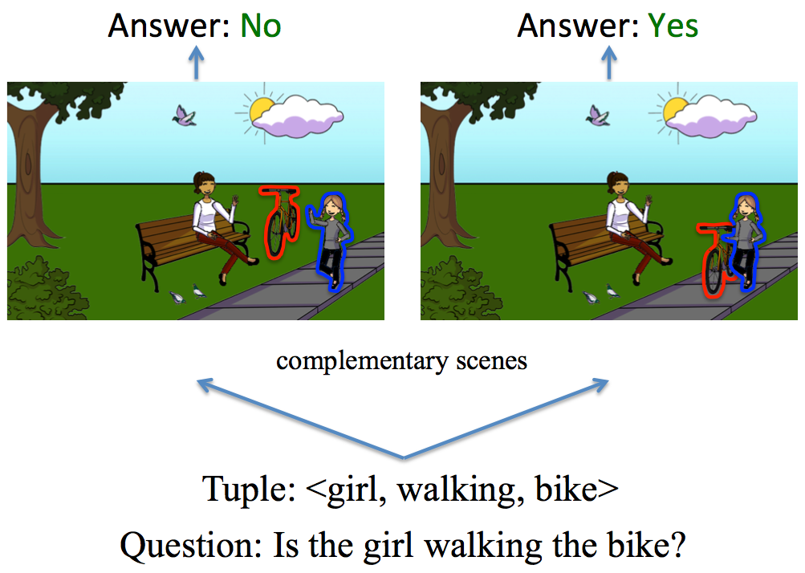
Why Visual Language Models?
Traditional Vision Models Focus On:
  Image classification (e.g., ImageNet)
  Object detection (bounding boxes)
  Semantic and instance segmentation
Traditional Language Models Focus On:
  Next-token prediction
  Text generation
  Question answering
However, Many Real-World Tasks Require Both Modalities:
  Image captioning
  Visual question answering (VQA)
  Image–text retrieval
  Zero-shot image classification using text prompts
Vision and language must be represented in a unified semantic space.

Slide 6
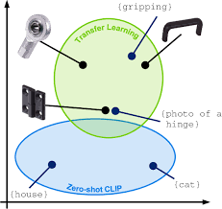
The Core Problem
Images → Continuous pixel space
Text → Discrete token space
How can we map both into a shared semantic space?
Goal: Learn a joint embedding space where:
  Matching image-text pairs are close
  Non-matching pairs are far apart

Slide 7
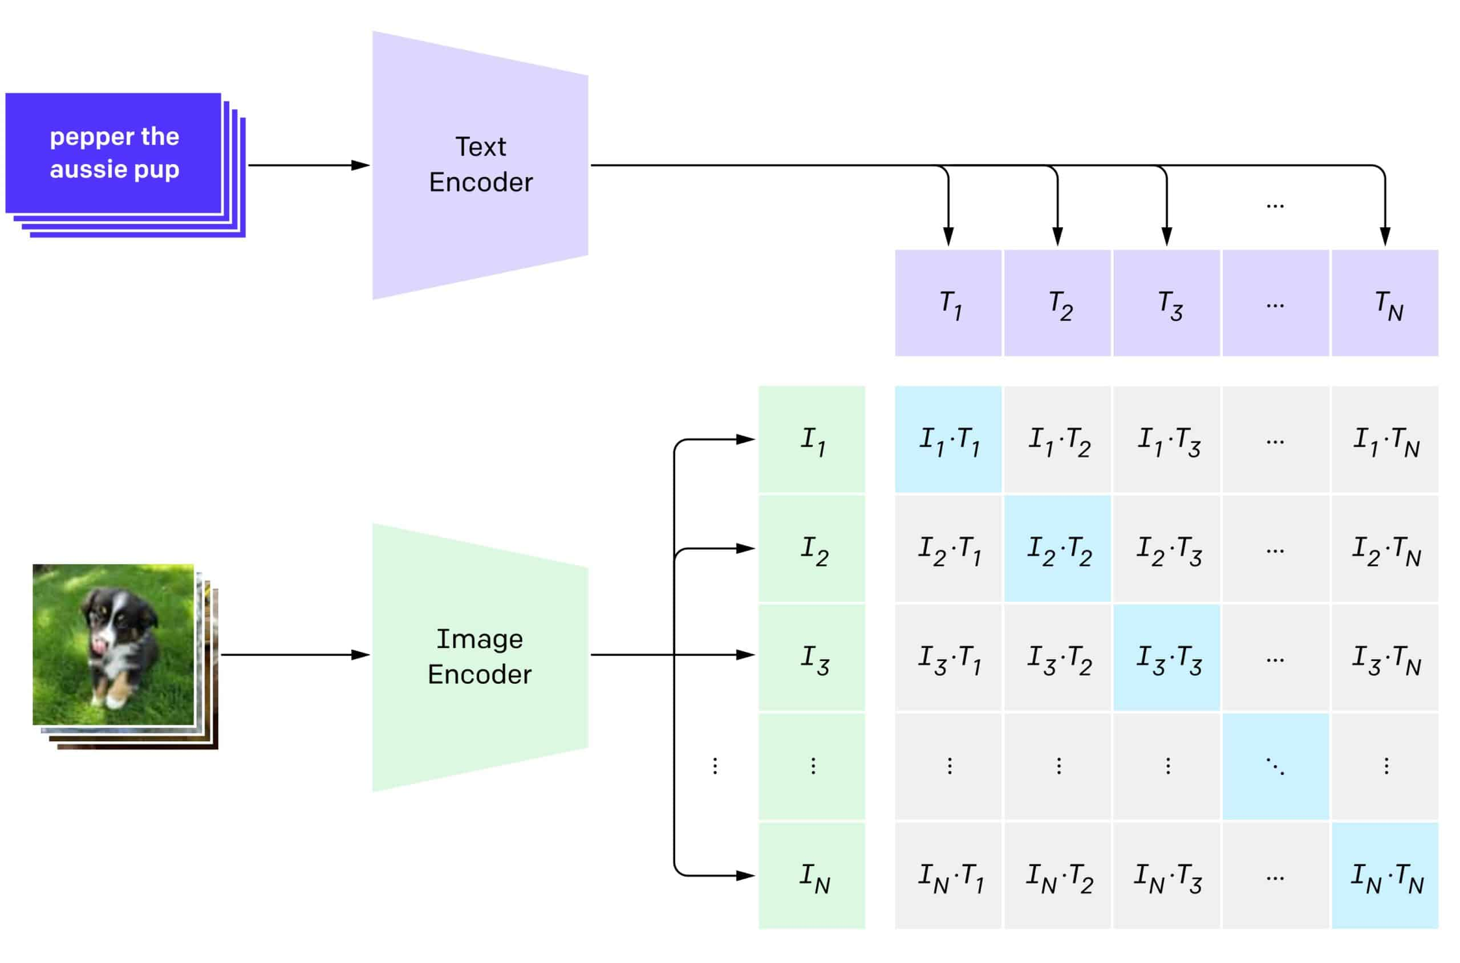
Where CLIP and BLIP Fit
Contrastive Learning provides the alignment mechanism.
CLIP:
  Uses large-scale image-text contrastive learning
  Learns joint embedding space
  Enables zero-shot classification
BLIP:
  Combines contrastive alignment with generative objectives
  Adds captioning and language modeling components
  Improves robustness to noisy captions
These models form the foundation of modern Vision–Language Models (VLMs).

Slide 8
Agenda
Motivation & Big Picture
Foundations
CLIP
BLIP
Conceptual Takeaways

Slide 9
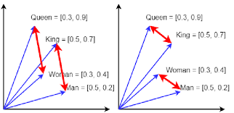
What is an Embedding ?
An embedding is a learned vector representation of data in a high-dimensional space.
Key principle:
  Semantic similarity ↔ Geometric proximity
  If two objects are similar in meaning, their embeddings should be close in vector space.
Embeddings enable:
  Similarity search
  Retrieval
  Transfer learning across tasks

Slide 10
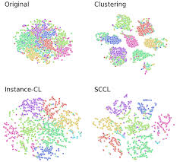
Geometry of Embeddings
Embedding spaces are:
  High-dimensional (often 512–1024 dimensions)
  Structured through training objectives
  Learned end-to-end
Distance metrics measure:
  Similarity (cosine similarity)
  Alignment between modalities
  Semantic relationships
Contrastive learning explicitly shapes this geometry.

Slide 11
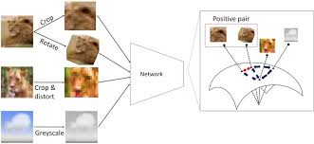
Instance Discrimination
Core idea:
  Treat each instance as its own class.
Positive pair:
  Two augmented views of the same image.
Negative pairs:
  All other images in the batch.
This transforms representation learning into a classification problem.

Slide 12
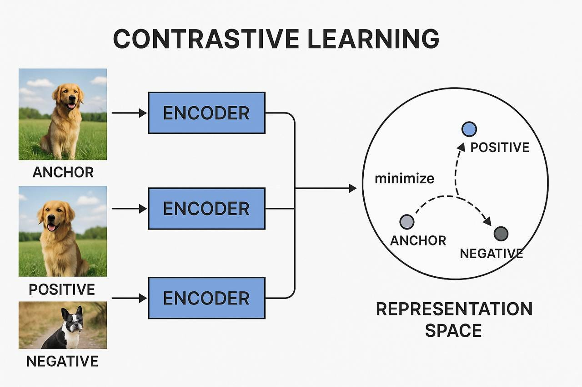
Core Idea
Contrastive learning shapes embedding geometry by:
  Pulling positive pairs together
  Pushing negative pairs apart
Objective:
  Maximize similarity of matched pairs while minimizing similarity of mismatched pairs.
This creates structured clusters in embedding space.

Slide 13
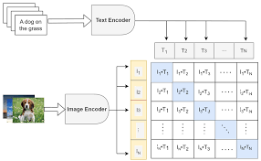
Image Text Contrastive Learning
Given a batch of N image-text pairs:
  Each image has one matching caption (positive)
  All other captions in the batch are negatives
Construct similarity matrix:
  N × N matrix of image-text similarities
Diagonal elements → positive pairs
Off-diagonal elements → negative pairs
Training objective is symmetric:
  Image → Text
  Text → Image

Slide 14
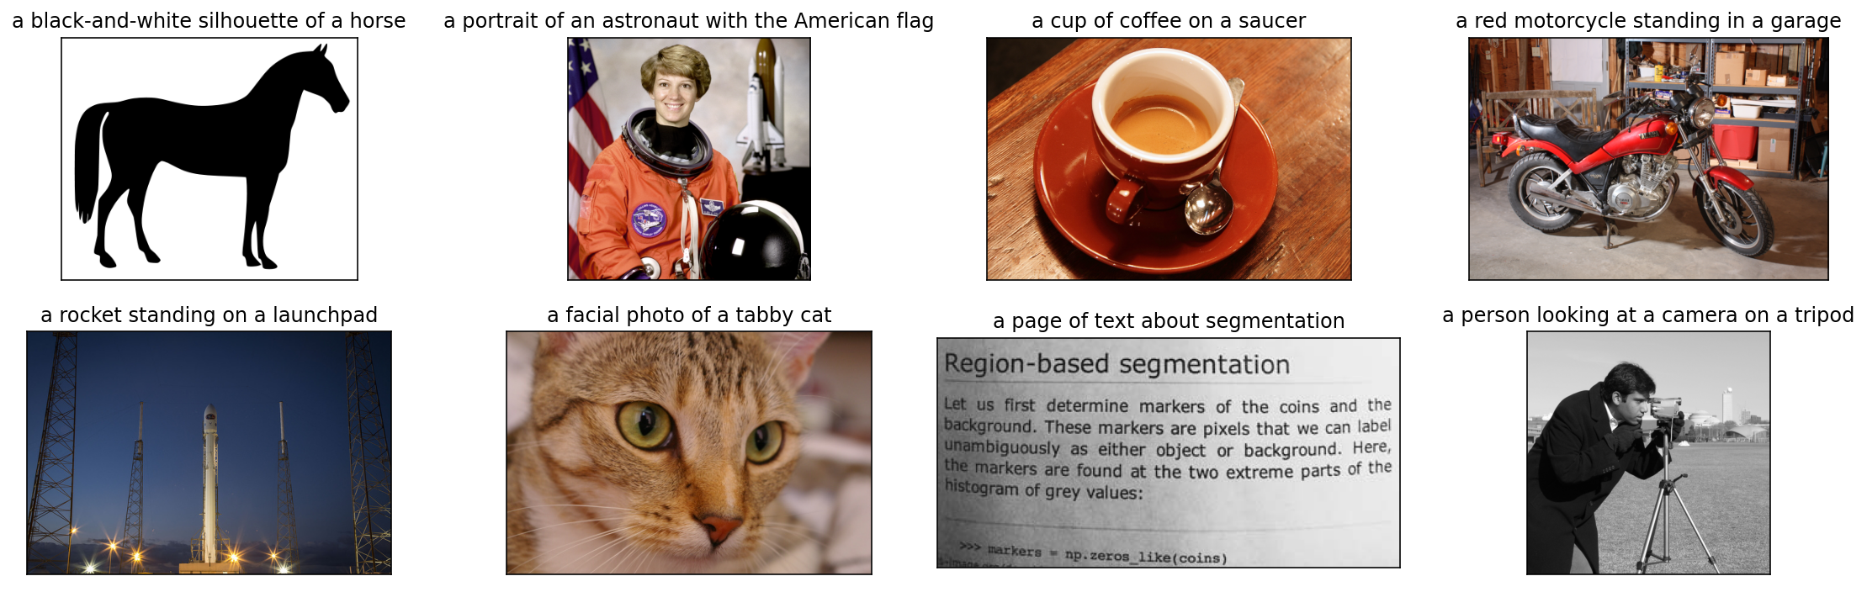
Joint Multimodal Embedding Space

Slide 15
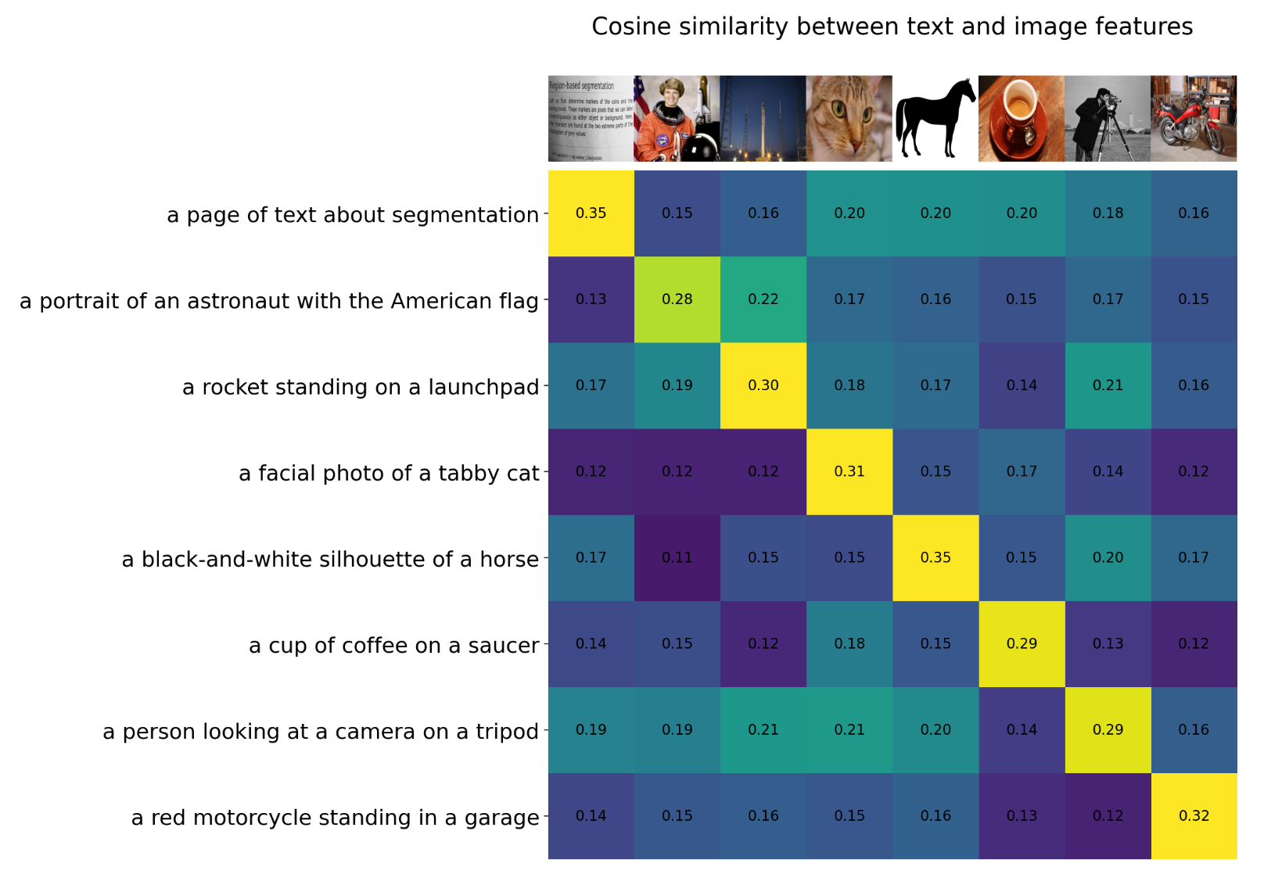
Joint Multimodal Embedding Space

Slide 16
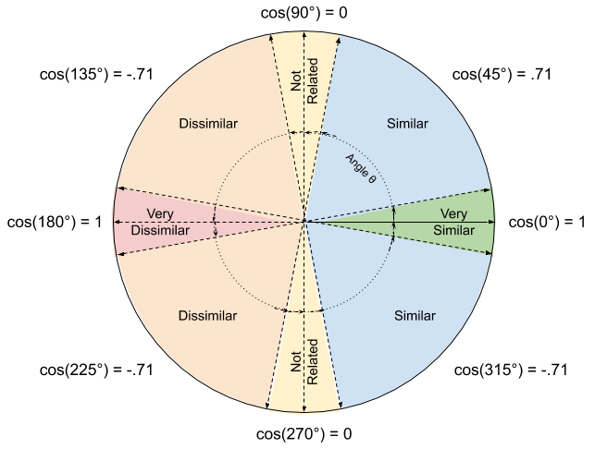
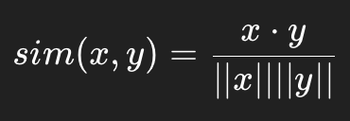
Similarity Function
Similarity is computed using cosine similarity:
Embeddings are L2-normalized.
Why normalization matters:
  Prevents magnitude from dominating similarity
  Forces model to learn directional alignment
  Stabilizes training dynamics

Slide 17
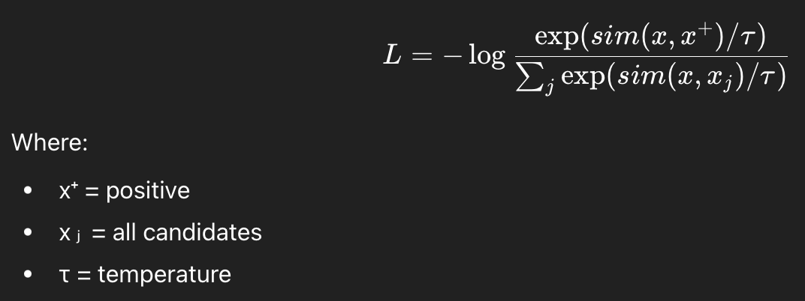
InfoNCE Loss

Slide 18
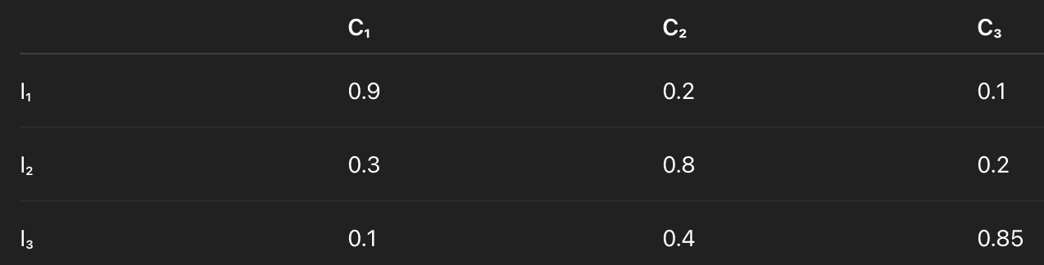
Example: Image–Text Contrastive Learning (Batch of 3)
Suppose we have a batch of 3 image–text pairs:
  Image₁ ↔ Caption₁
  Image₂ ↔ Caption₂
  Image₃ ↔ Caption₃
We compute all pairwise similarities:
Diagonal entries → correct matches (positives)
Off-diagonal entries → incorrect matches (negatives)
For each image, we apply softmax over its row.
We want the diagonal value to dominate.

Slide 19
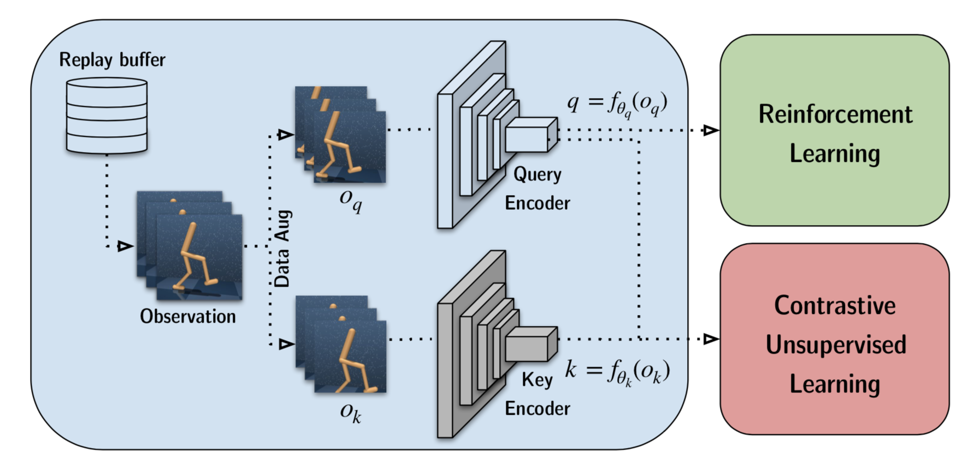
Why Negatives Prevent Collapse
Without negatives:
  Minimizing distance between positives → trivial collapse solution.
Collapse:
  All embeddings map to identical vector.
Negatives introduce repulsion force:
  Enforce separation and structure.
Contrastive learning balances attraction and repulsion.

Slide 20
Agenda
Motivation & Big Picture
Foundations
CLIP
BLIP
Conceptual Takeaways

Slide 21
CLIP

Slide 22
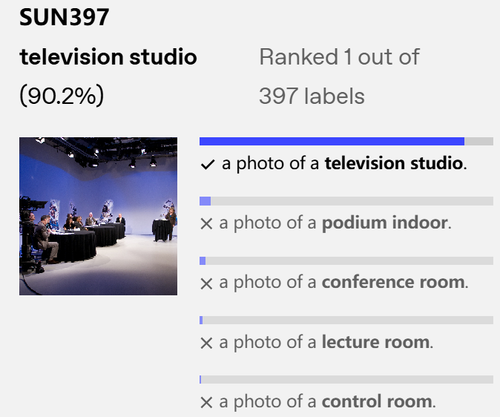
What makes CLIP different ?
CLIP learns the relationship between images and text
It does not generate captions
Instead, it measures how well a text description matches an image
CLIP matches images with relevant text descriptions

Slide 23
Traditional Image Classification vs CLIP
Traditional models
clip
Trained on fixed categories
Can only classify into predefined labels
New category → need fine-tuning
Requires:
  Labeled datasets
  Computational resources
Learns from image-text pairs
Flexible classification
No need to retrain for new categories

Slide 24
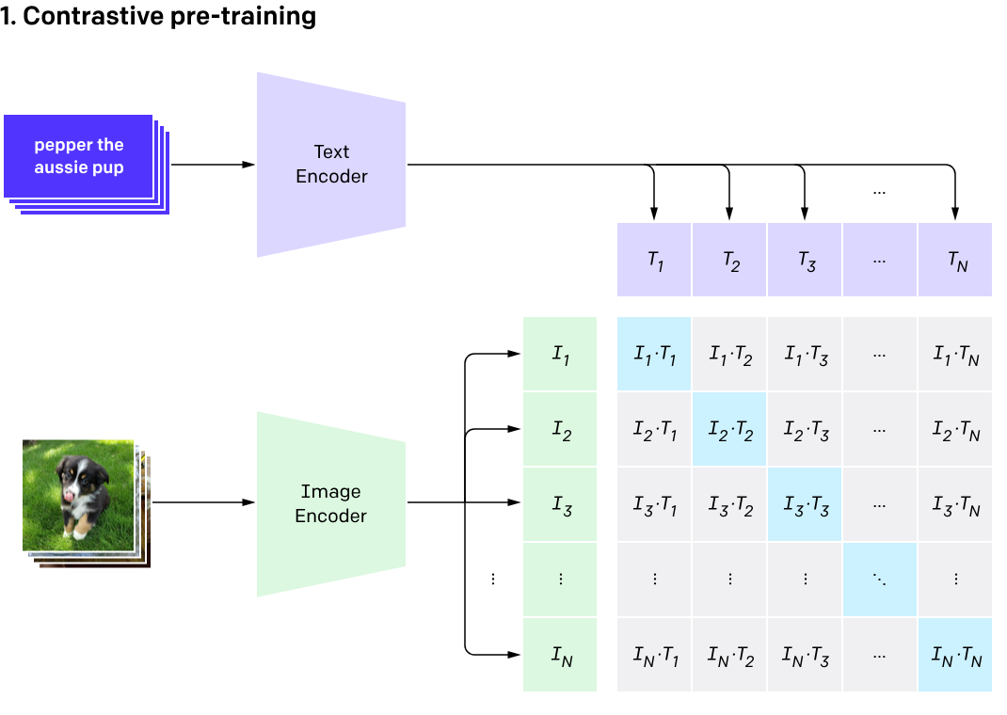
CLIP Working

Slide 25

Model Input Architecture

Slide 26
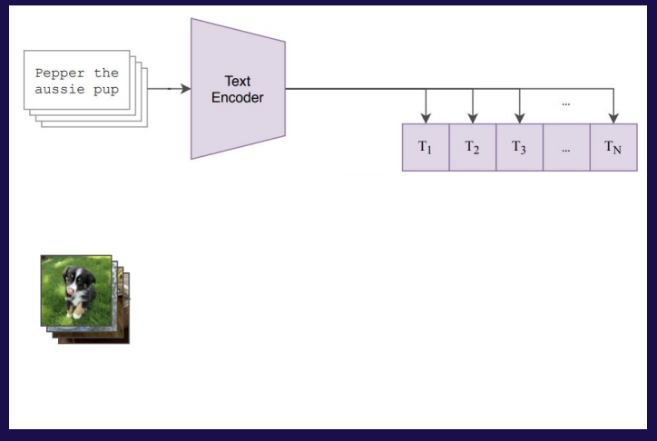
CLIP Text Encoder
ARCHITECTURE
Transformer-based model (63M parameters)
12 layers, 512 hidden size, 8 attention heads

Slide 27
CLIP Text Encoder
INPUT REPRESENTATION
Lower-cased Byte Pair Encoding (BPE)
Vocabulary size: 49,152
Max sequence length: 76
Special tokens: [SOS] and [EOS]

Slide 28
Byte Pair Encoding (BPE)
BPE Solution
  Start with characters
  Merge most frequent character pairs
  Repeat merging to form sub words
Simple Example
  Original word: “playing”
  Step 1 – Character tokens: p l a y i n g
  Step 2 – Frequent merges: play + ing
  Final tokens: ["play", "ing"]

Slide 29
CLIP Text Encoder
TEXT FEATURE EXTRACTION
Use final-layer activation of [EOS] token
Apply LayerNorm + Linear Projection
Project into shared image-text embedding space
Masked self-attention is used

Slide 30
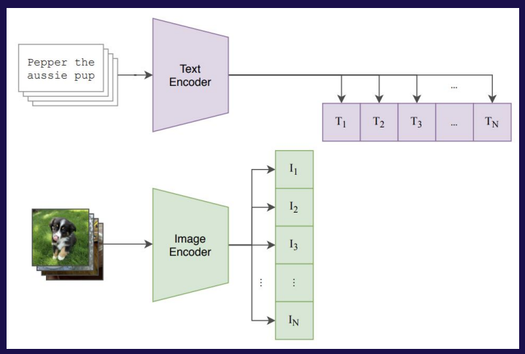
CLIP Image Encoder
ARCHITECTURE
Modified ResNet or Vision Transformer (ViT)

Slide 31
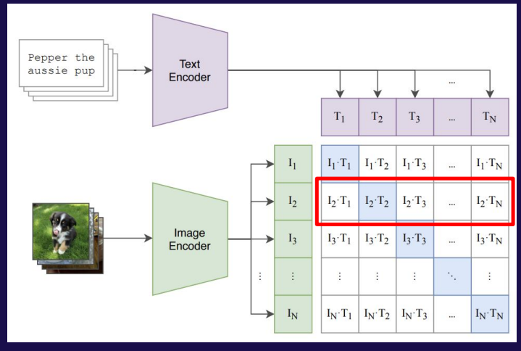
Joint Multimodal Embedding Space

Slide 32
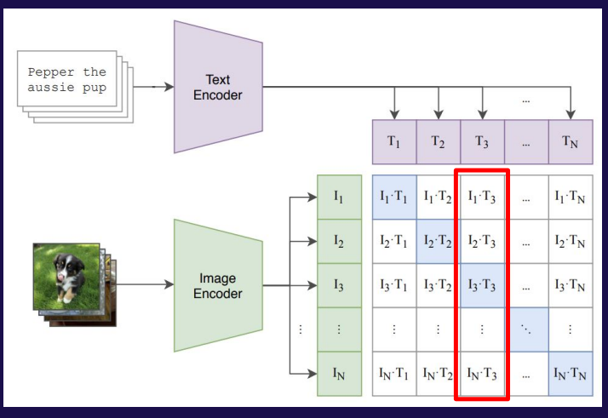
Joint Multimodal Embedding Space

Slide 33
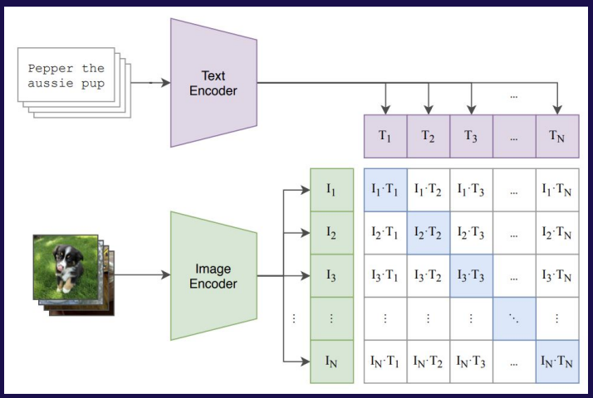
Architecture

Slide 34

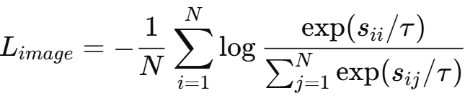
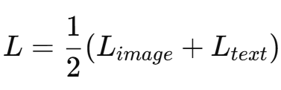
Contrastive Pre-Training
Similarity Computation
Contrastive Loss (InfoNCE)
Final Loss

Slide 35
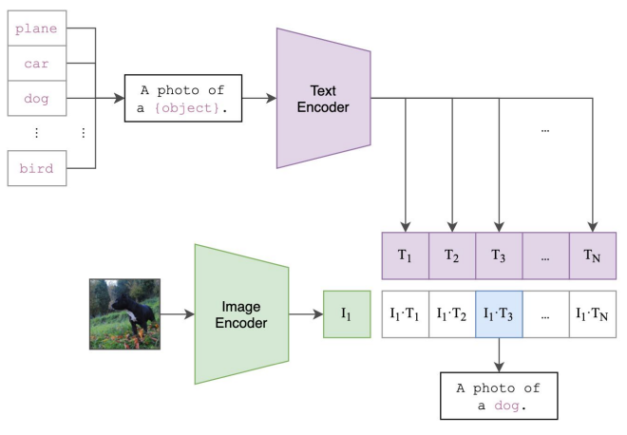
Zero-Shot Classification

Slide 36
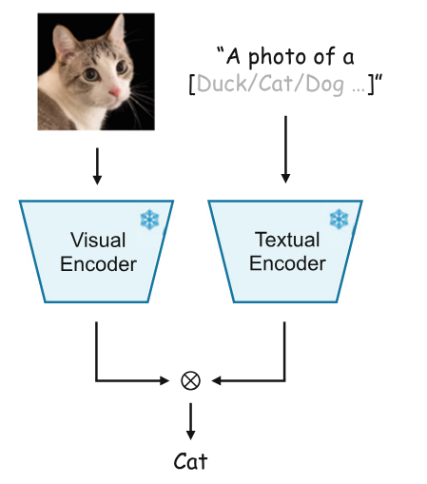
Prompt Engineering & Ensembling
Prompt
  A photo of a {label}
  A satellite photo of a {label}
Ensembling
  A photo of a big {label}
  A photo of a small {label}

Slide 37
Beyond Classification - Retrieval
Image-to-Text (Caption Retrieval):
  Given an image, find the best matching caption from a text database. The image and all candidate texts are encoded, and then similarity scores determine the optimal match.
Text-to-Image (Image Search)
  Query with natural language (e.g., "red sports car on racetrack") to find matching images in a database. This powers search engines with descriptive queries instead of keywords.

Slide 38
Agenda
Motivation & Big Picture
Foundations
CLIP
BLIP
Conceptual Takeaways

Slide 39
Text Generation and Cross-Modal Reasoning in BLIP

Slide 40
Introduction to BLIP: Bridging Vision and Language
BLIP = Bootstrapping Language-Image Pretraining
Consists of Vision Encoder (ViT), Text Encoder, and Multimodal Decoder
Vision Encoder extracts image patch embeddings
Multimodal Decoder generates text using cross-attention with image embeddings
Used for image captioning, visual question answering, and multimodal tasks

Slide 41
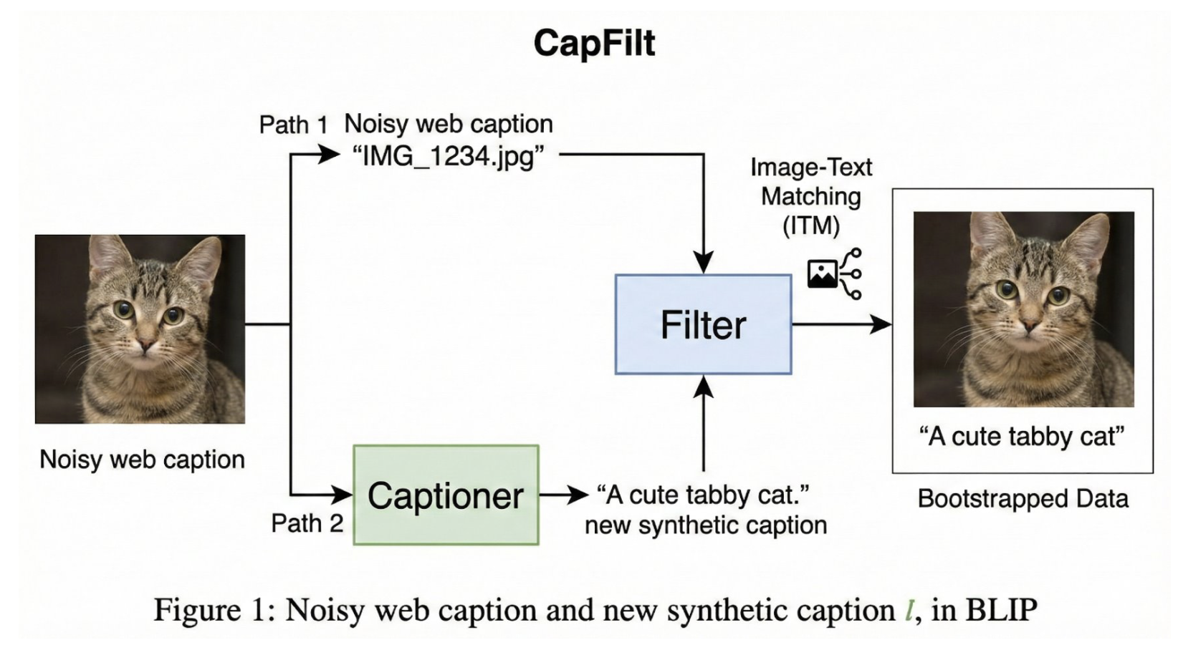
Problem -> Solution

Slide 42

The Three Pillars of BLIP Architecture​
Vision Encoder (ViT): Converts the image into a sequence of patch embeddings.​
Text Encoder: Used for understanding and matching (Bi-directional).​
Text Decoder: A Causal Transformer used specifically for generation.​ ​

Slide 43
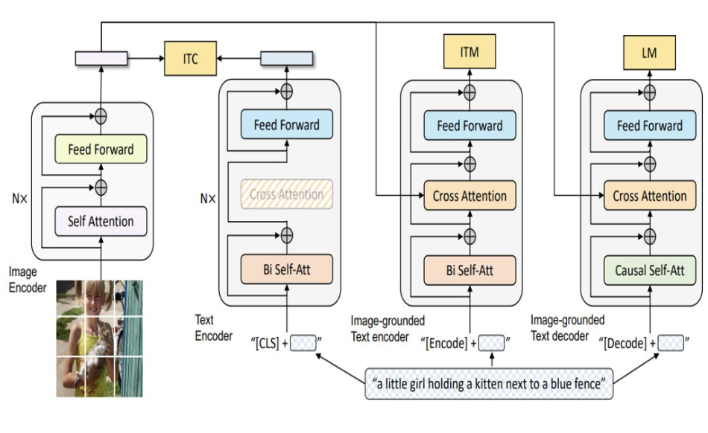
The BLIP Multimodal Architecture​
Unified Vision-Language Framework: A single architecture that performs Image-Text Contrastive learning (ITC), Image-Text Matching (ITM), and Language Modeling (LM) simultaneously.​
Modular Flexibility: Features a Vision Encoder (ViT), a Bidirectional Text Encoder for understanding, and a Causal Text Decoder for generation.​
Cross-Modal Integration: Every text-based module utilizes Cross-Attention layers to physically bridge the gap between image patches and text tokens.​ ​

Slide 44
Generation Process: Encode the Image
Input image is split into patches​
Vision Transformer converts patches into embeddings​
Mathematically: V = {v1, v2, ..., vN}​
Each vi ∈ R^d represents visual features​
These embeddings act as Keys and Values in cross-attention​
These remain fixed during decoding​ ​

Slide 45
Initialize Text Tokens​
Generation starts with special token <BOS>​
Token converted into embedding vector​
Embedding passed into Transformer Decoder​
Provides initial context for generation​
Decoder generates one token at a time​ ​

Slide 46
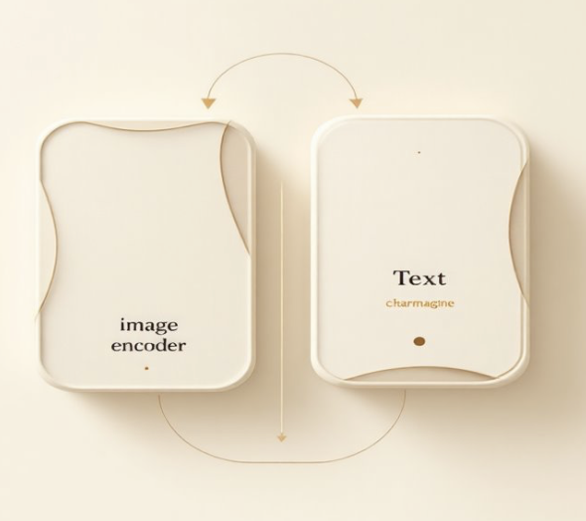
The Cross-Attention Mechanism: Connecting Text and Images in Transformers​
How does the text decoder know what is in the image?​
  Concise visual overview: how a text decoder “looks at an image using cross-attention so generated words match visual content. This deck explains the intuition, math, and a classroom-friendly explanation you can copy into comments.​ ​

Slide 47
Deconstructing Cross-Attention​ ​
Cross-attention allows a language model to "look at" specific parts of an image that are relevant to a given text input. Here's how it works in a simplified sequence:​
The Search Warrant (Text Query)​
  When user type "dog," the model doesn't just see letters. It turns that word into a Query Vector (Q). This vector is like a mathematical description of "dog-ness"—it's looking for floppy ears, fur, and four legs.​
Scanning the Grid (Query-Key Comparison)​
  The image is chopped into a grid of small squares (patches). Each square has a Key Vector (K) that describes what’s inside that specific patch (e.g., "blue sky," "green grass," or "furry ear"). The model compares your Q (dog) against every K (image patch).​
Finding the Matches (Attention Scores)​
  The comparison is done using a Dot Product. If the Query and Key point in the same direction—meaning the math for "dog" matches the math for "furry ear"—you get a high Attention Score.​
Narrowing the Focus (Softmax Normalization)​
  The model might find many "okay" matches, but it needs to know what is most important. The Softmax function turns those raw scores into percentages (weights) that sum to 100%.​
  Ear patch: 0.7 (70%)​
  Grass patch: 0.1 (10%)​
  Sky patch: 0.05 (5%)​
Creating the Final "Mental Image" (Context Vector)​
  Now, the model takes the Value Vectors ($V$)—the actual visual content of the patches—and multiplies them by those Softmax weights. It ignores the sky and grass and pulls all the "dog" information together into one Context Vector. This vector is the model's final refined understanding: "Here is the 'dog' part of the image."​ ​ ​ ​ ​ ​

Slide 48
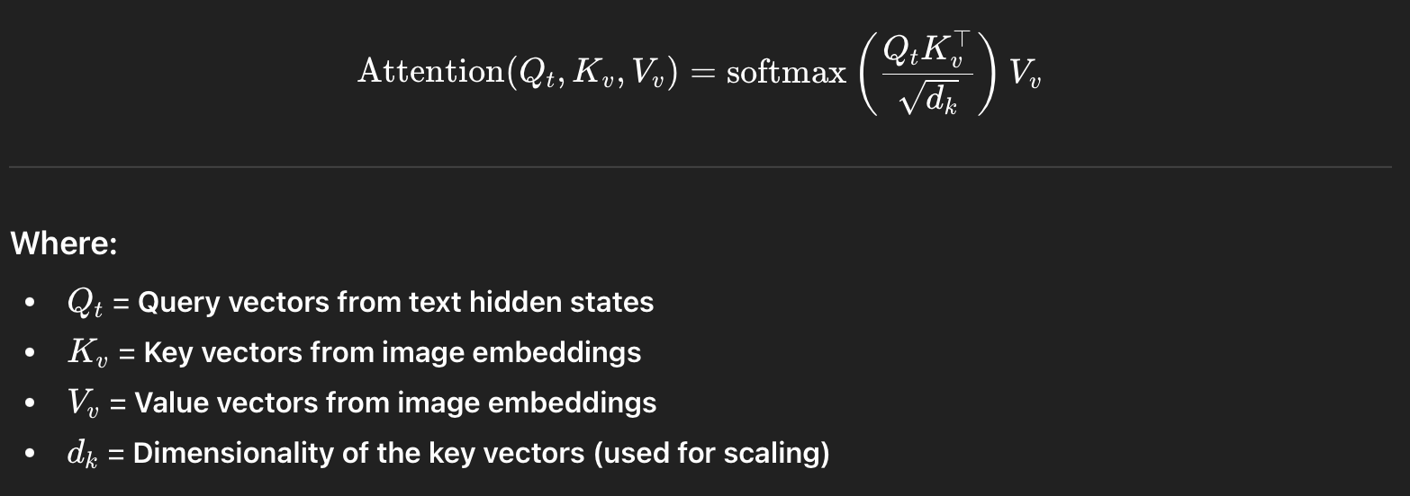
Cross-Attention: Inject Visual Information​ ​

Slide 49

Next Token Prediction​
Decoder outputs hidden state ht​
Converted into probabilities using softmax​
Formula:
Model selects next word using greedy, sampling, or beam search​
  Greedy decoding: pick the highest probability token every time​
  Sampling: randomly select next token based on probability distribution​
  Beam search: keep multiple candidate sequences to find best overall output​
This produces meaningful captions​ ​

Slide 50
Autoregressive Generation Loop​
Generated token is appended to input sequence​
<BOS> → 'a' → 'dog' → 'running’​
Process repeats step-by-step​
Each step uses image information via cross-attention​
Stops when <EOS> token is generated​
Produces complete caption​ ​

Slide 51
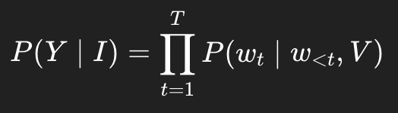
Complete BLIP Generation Formula​
Image Encoding: V = VisionEncoder(Image)​
Caption Generation:
Uses Transformer Decoder with Cross-Attention​
Combines visual and textual information​
Generates human-like descriptions​ ​

Slide 52
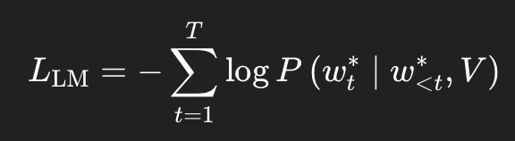
Training Objective (Language Modeling)​
BLIP trains the decoder using cross-entropy loss:​
Where:​
w_t* = ground-truth token at time t​
w_<t* = previous ground-truth tokens​
V = visual embeddings from image encoder​ ​

Slide 53
Understanding Each Component​
Language Modeling Loss (L_LM):​
Measures how well the model predicts the correct next word.​
Ground Truth Token (w_t*):​
The correct word at position t.​
Visual Embeddings (V):​
Encoded representation of the image used by the decoder.​ ​

Slide 54
Teacher Forcing During Training​
During training, the decoder receives:​
The correct previous words (not its own predictions)​
The image embeddings​
This stabilizes training and improves convergence.​
Goal: Learn P(Text | Image)​ ​

Slide 55
Cross-Attention in BLIP​
Decoder uses Cross-Attention:​
Queries (Q): Text hidden states​
Keys (K) & Values (V): Image embeddings​
CrossAttn(Q_t, K_v, V_v)​
This allows the decoder to attend to image features when predicting each word.​ ​

Slide 56
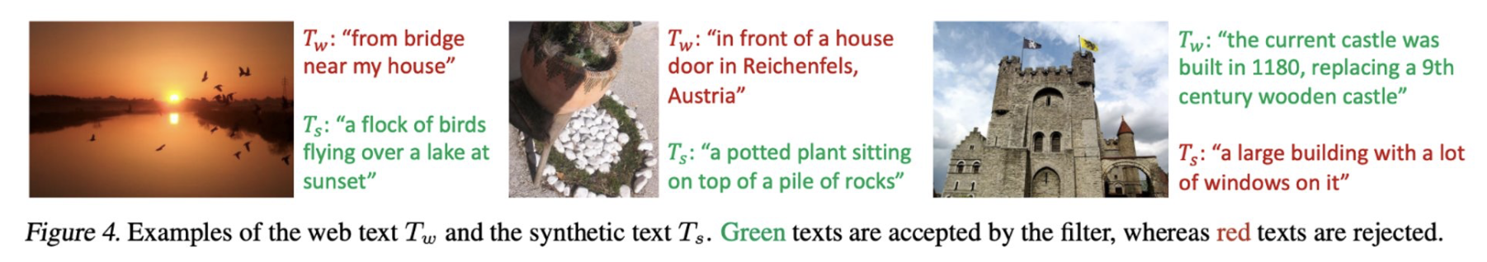
Example
Tw = the original web text scraped from the internet (often noisy/irrelevant)​
Ts = the new synthetic caption generated by BLIP's Captioner ​
Web captions are often about context/history, not what's visually in the image. BLIP's Captioner creates better descriptions, and the Filter removes anything still not good enough — leaving only clean, image-relevant text for training.​ ​

Slide 57
Summary
BLIP uses autoregressive language modeling.​
Cross-entropy loss trains next-word prediction.​
Cross-attention injects image information into the decoder.​
Teacher forcing improves training stability.​
Final Objective: Learn conditional generation P(Text | Image).​ ​

Slide 58
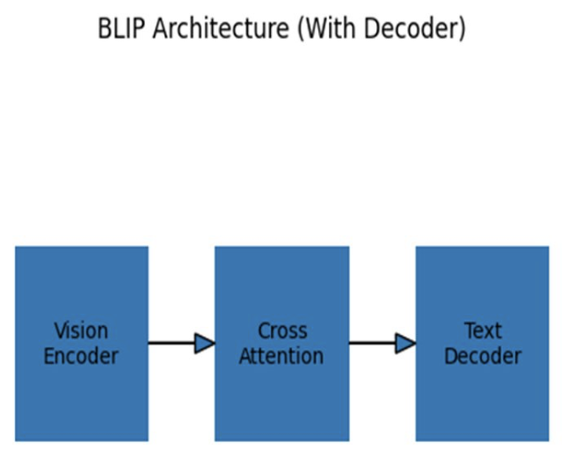
Why BLIP Generates Better Captions Than CLIP​
BLIP uses Vision Encoder and Text Decoder​
Uses Cross-Attention​
Decoder generates captions word by word​
Can generate natural sentences​ ​

Slide 59
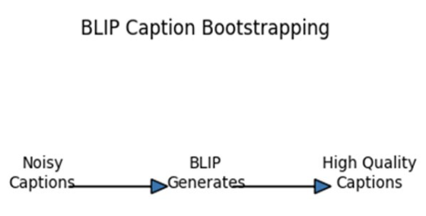
BLIP Caption Bootstrapping​
Starts with noisy captions​
Generates synthetic captions​
Filters high-quality captions​
Retrains model using better data​ ​

Slide 60
Why BLIP is Better​
BLIP has a decoder for caption generation​
Trained using causal language modeling​
Improves training data using bootstrapping​
Produces fluent and accurate captions​ ​

Slide 61
BLIP - 2 Key Points​
Uses a frozen Vision Encoder and Frozen Large Language Model (LLM)​
Introduces Q-Former (Query Transformer) to extract visual features​
Enables image-to-text generation using powerful LLMs​
Much more efficient than BLIP (only Q-Former is trained)​
Improves multimodal understanding and reasoning​ ​

Slide 62
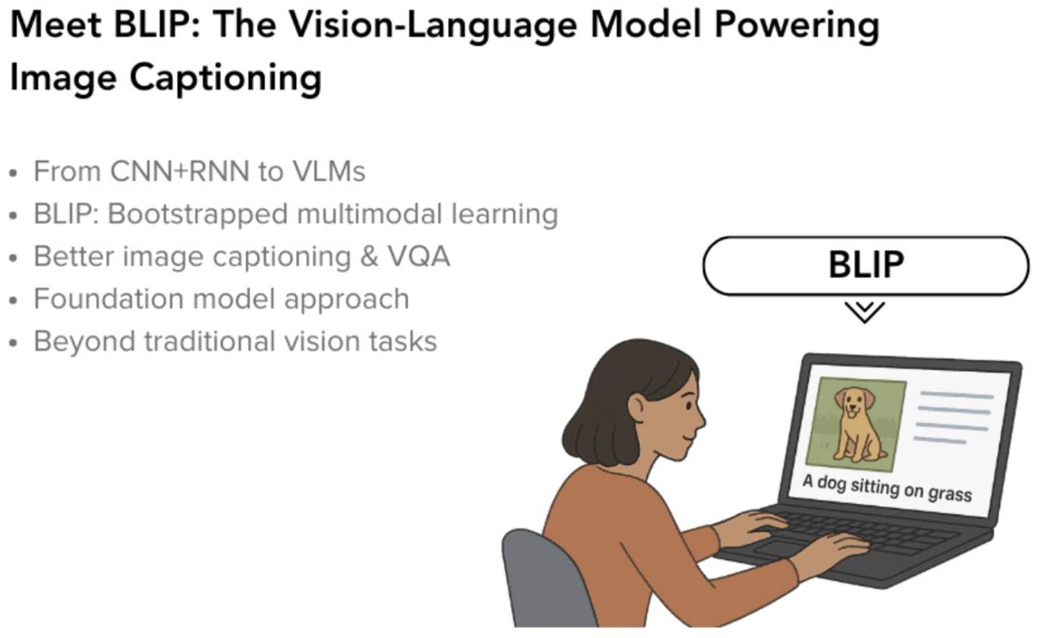

Slide 63
Agenda
Motivation & Big Picture
Foundations
CLIP
BLIP
Conceptual Takeaways

Slide 64
Conceptual Takeaways
Contrastive learning aligns modalities
CLIP enables zero-shot learning
BLIP unifies alignment + generation

