Slide 1
Question
What are the inputs and outputs of CLIP during inference?

Slide 2
Answer
Input: images and text descriptions
Most similar images or text descriptions

Slide 3
Question
What are the main components of CLIP?

Slide 4
Answer
Text encoder
Image encoder
Matching function (cosine similarity)

Slide 5
Question
What loss function is used to train CLIP, and what is its purpose?

Slide 6
Answer
Contrastive loss
Purpose: Train the model to align matching image–text pairs.

Slide 7
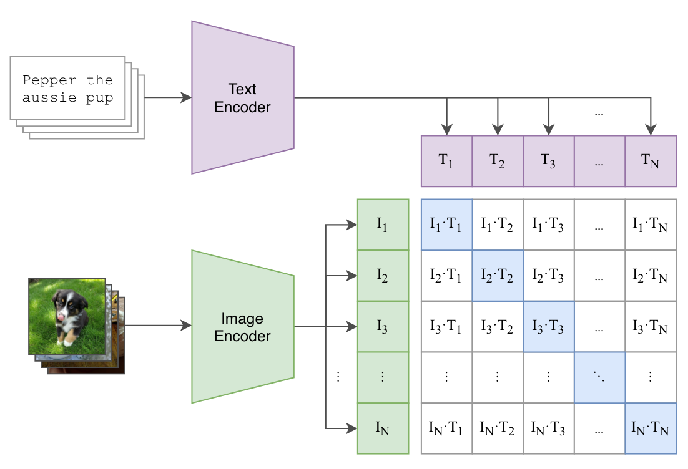
Question
What are the two main components of CLIP contrastive loss?

Slide 8
Answer
Image-to-Text Loss
Text-to-Image Loss

Slide 9
Question
What is the main goal of contrastive learning in vision-language models?
A. To generate captions from scratch
B. To map images and text into separate embedding spaces
C. To align matching image-text pairs and separate non-matching pairs
D. To classify images into fixed categories

Slide 10
Answer
What is the main goal of contrastive learning in vision-language models?
Correct Answer: C. To align matching image-text pairs and separate non-matching pairs

Slide 11
Question
In image-text contrastive learning, what do diagonal elements of the similarity matrix represent?
A. Negative pairs
B. Random pairs
C. Augmented image pairs
D. Correct matching image-text pairs

Slide 12
Answer
In image-text contrastive learning, what do diagonal elements of the similarity matrix represent?
Correct Answer: D. Correct matching image-text pairs

Slide 13
Question
Why are embeddings L2-normalized before computing cosine similarity?
A. To increase embedding dimensionality
B. To prevent magnitude from dominating similarity
C. To reduce training time
D. To remove negative samples

Slide 14
Answer
Why are embeddings L2-normalized before computing cosine similarity?
Correct Answer: B. To prevent magnitude from dominating similarity

Slide 15
Question
What problem do negative samples prevent in contrastive learning?
A. Overfitting
B. Slow convergence
C. Trivial collapse (all embeddings becoming identical)
D. Tokenization errors

Slide 16
Answer
What problem do negative samples prevent in contrastive learning?
Correct Answer: C. Trivial collapse (all embeddings becoming identical)

Slide 17
Question
What makes CLIP different from traditional image classification models?
A. CLIP generates captions directly
B. CLIP uses only images for training
C. CLIP can classify new categories without retraining (zero-shot)
D. CLIP requires bounding box annotations

Slide 18
Answer
What makes CLIP different from traditional image classification models?
Correct Answer: C. CLIP can classify new categories without retraining (zero-shot)

Slide 19
Question
What architecture is used in the CLIP text encoder?
A. CNN
B. RNN
C. Transformer
D. LSTM

Slide 20
Answer
What architecture is used in the CLIP text encoder?
Correct Answer: C. Transformer

Slide 21
Question
What is the role of cross-attention in BLIP?
A. To remove irrelevant image patches
B. To inject visual information into the text decoder
C. To replace the vision encoder
D. To tokenize text inputs

Slide 22
Answer
What is the role of cross-attention in BLIP?
Correct Answer: B. To inject visual information into the text decoder

Slide 23
Question
What is BLIP’s main advantage over CLIP?
A. Faster inference time
B. Better zero-shot classification
C. Ability to generate fluent captions using a decoder
D. Smaller model size

Slide 24
Answer
What is BLIP’s main advantage over CLIP?
Correct Answer: C. Ability to generate fluent captions using a decoder

Slide 25
Question
What does BLIP caption bootstrapping do?
A. Removes the vision encoder
B. Starts with clean captions only
C. Generates and filters synthetic captions to improve training data
D. Uses only human-annotated captions

Slide 26
Answer
What does BLIP caption bootstrapping do?
Correct Answer: C. Generates and filters synthetic captions to improve training data

