Slide 1

Understanding Vision Transformers:
Tokens, Attention and Architecture
A Computer Vision Lecture
Iman Qaiser
iman.qaiser@temple.edu
PhD Computer & Information Science student
Zuzanna Bąk
zuzanna.bak@temple.edu
MS Computational Data Science student
Charmi Pokal
charmi.babulal.pokal@temple.edu
MS Computer Science student
CIS 5543: COMPUTER VISION
Spring 2026

Slide 2
Agenda
Introduction & History
Basic Architecture
Patch Tokenization
Self Attention
ViT Architecture
Conclusion

Slide 3
Agenda
Introduction & History
Basic Architecture
Patch Tokenization
Self Attention
ViT Architecture
Conclusion

Slide 4

Introduction & History of
Vision Transformers

Slide 5
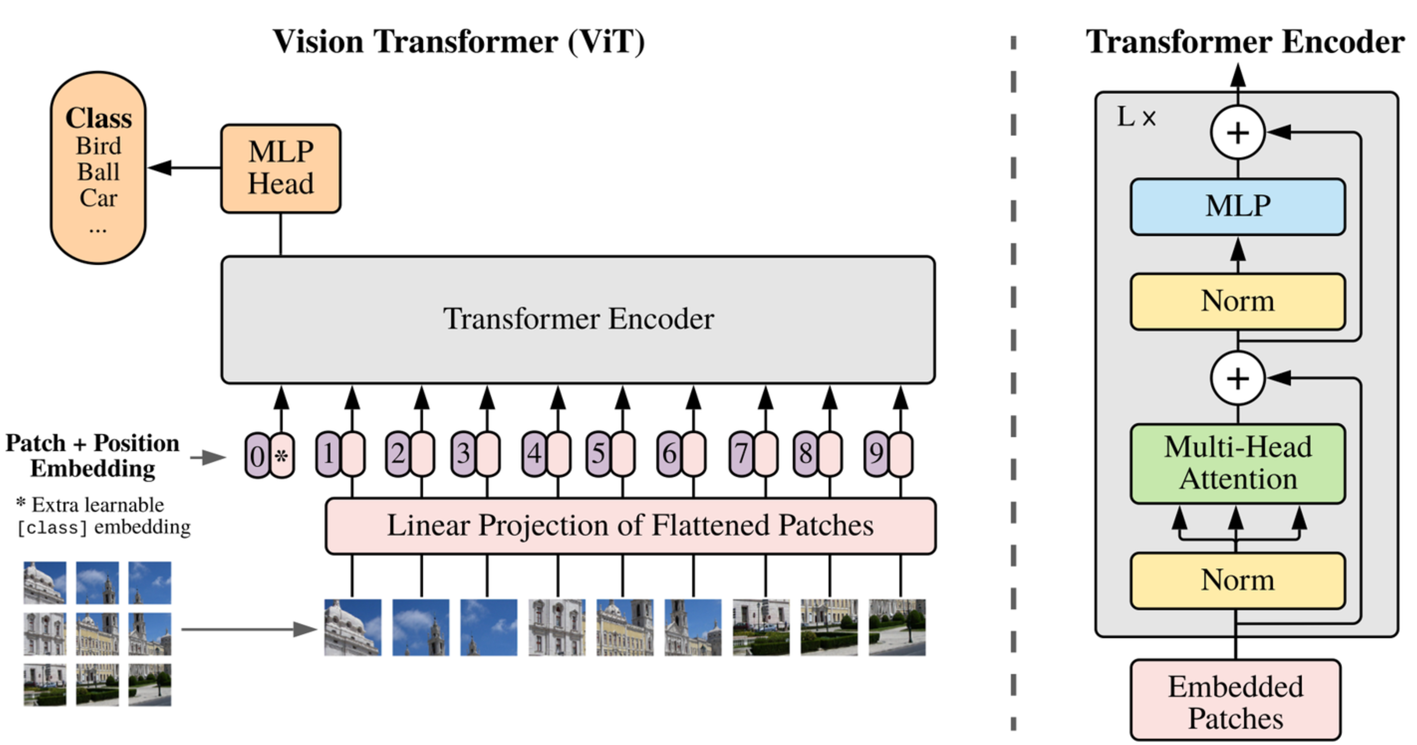
History of Vision Transformers
Transformers
BERT
GPT
Notes:
The story really begins in 2017 with the introduction of the transformer architecture, introduced in Attention Is All You Need.
Originally, transformers weren’t designed for images at all — they were built for machine translation, like translating English to French.

Slide 6
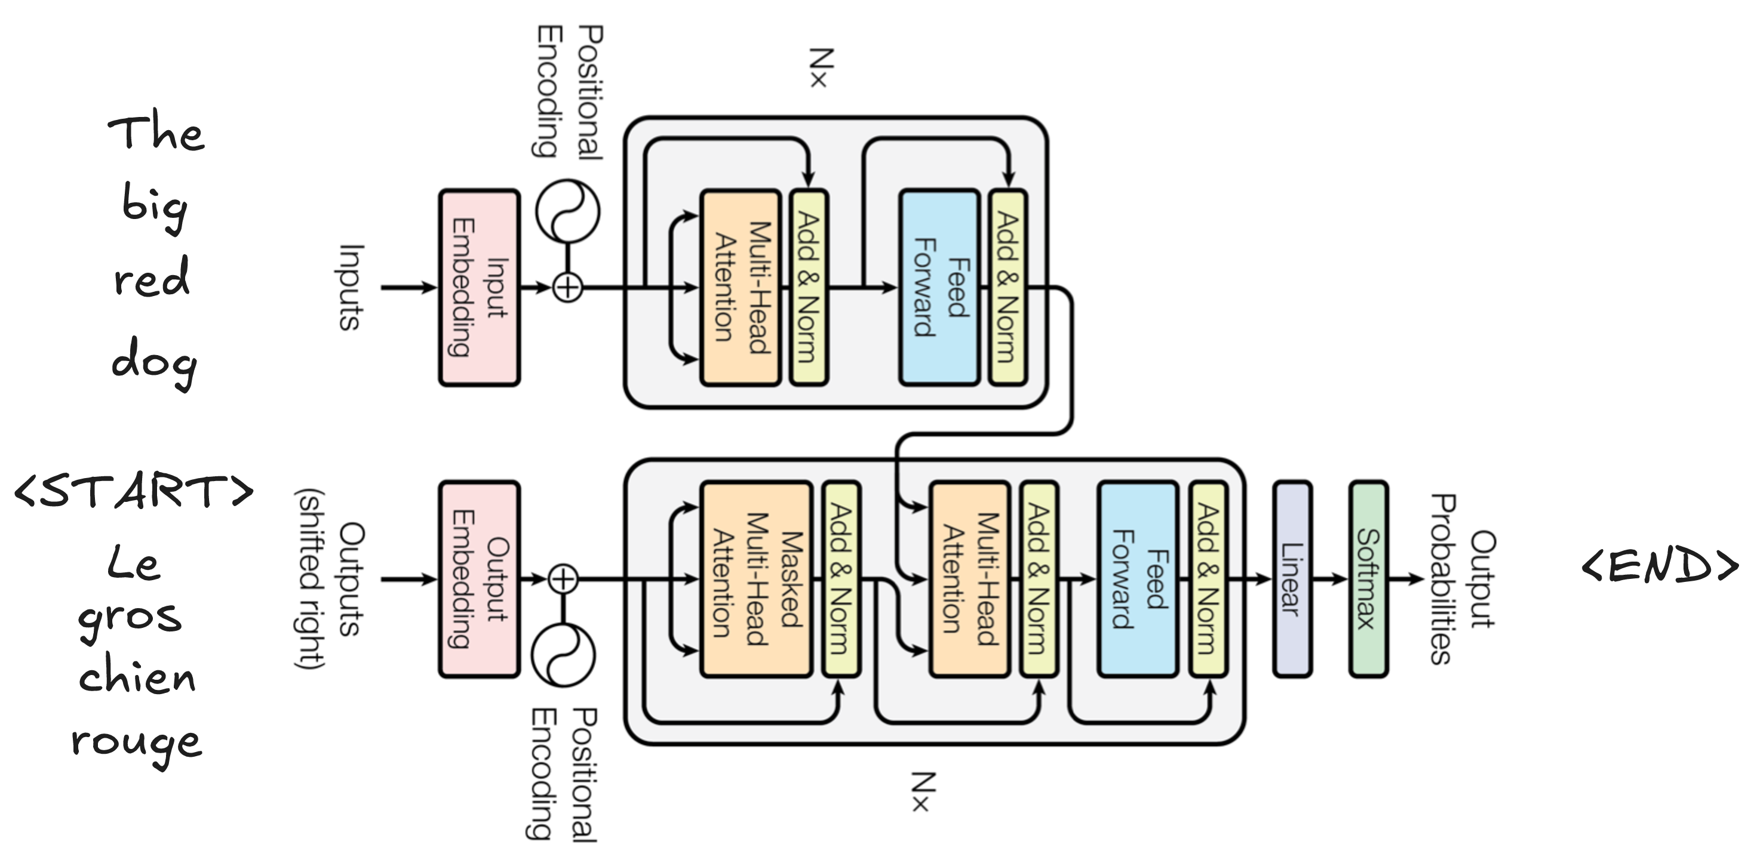
History of Vision Transformers
Transformers
BERT
GPT
Notes:
But what made them groundbreaking was the idea of self-attention, which allowed the model to look at an entire sequence at once, instead of processing information step-by-step like older models. We’ll talk about this more later but the main takeaway is that this turned out to be incredibly powerful! Very quickly, transformers became the state-of-the-art architecture.

Slide 7
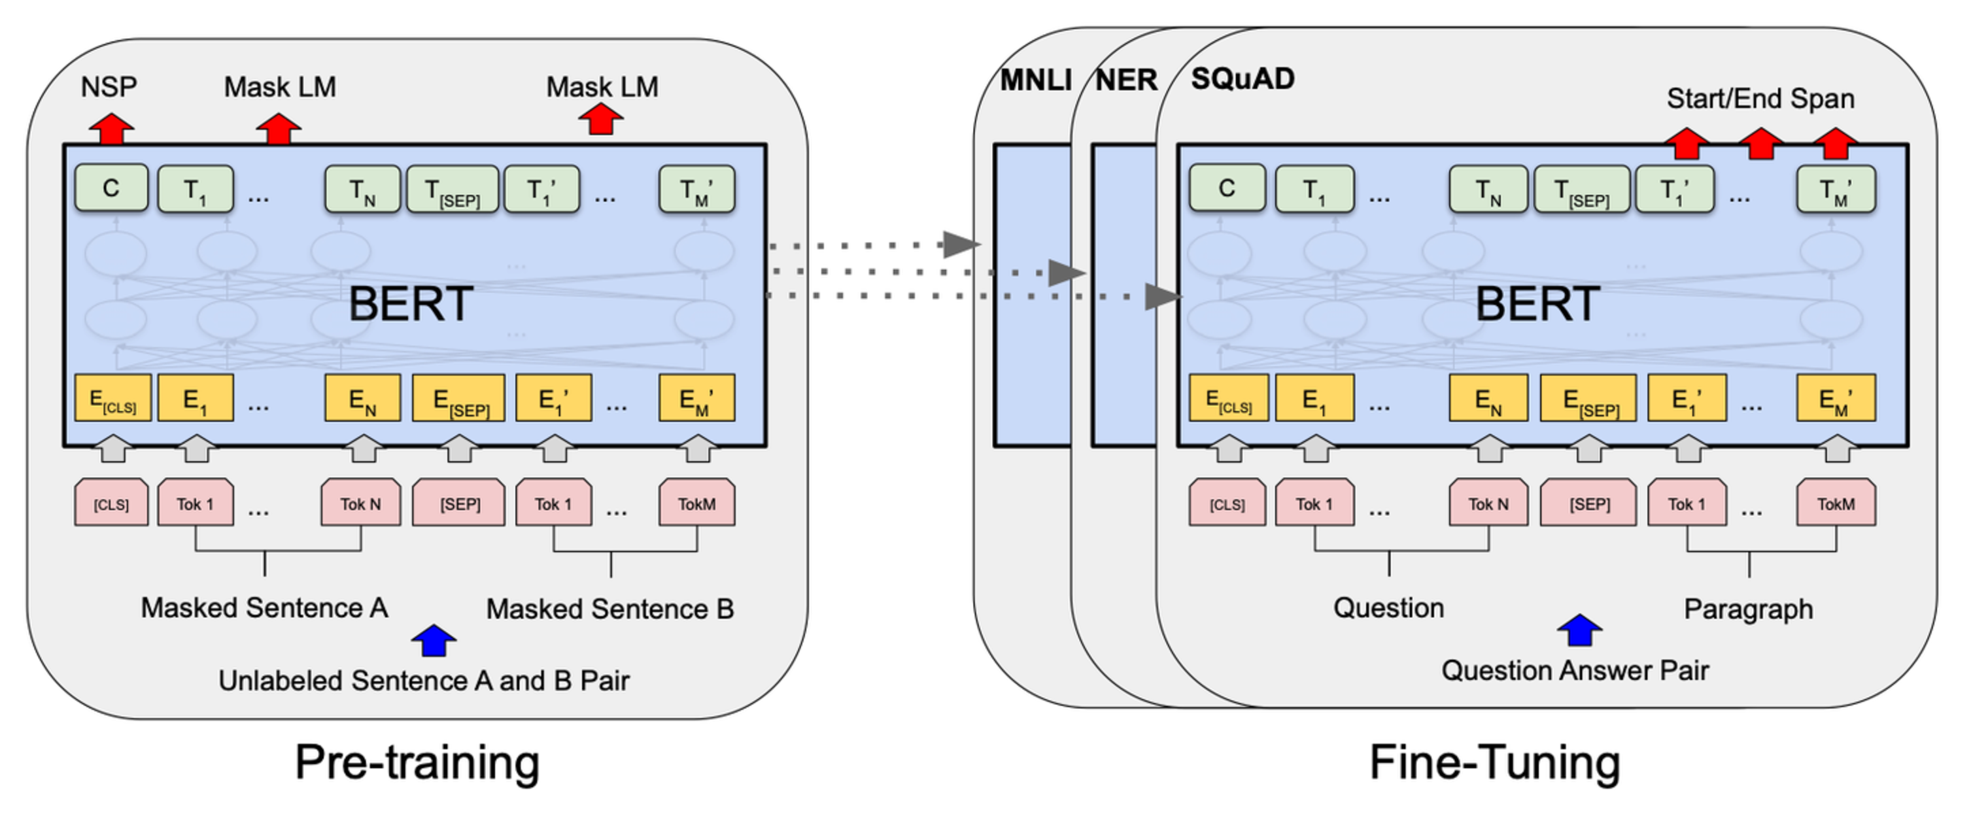
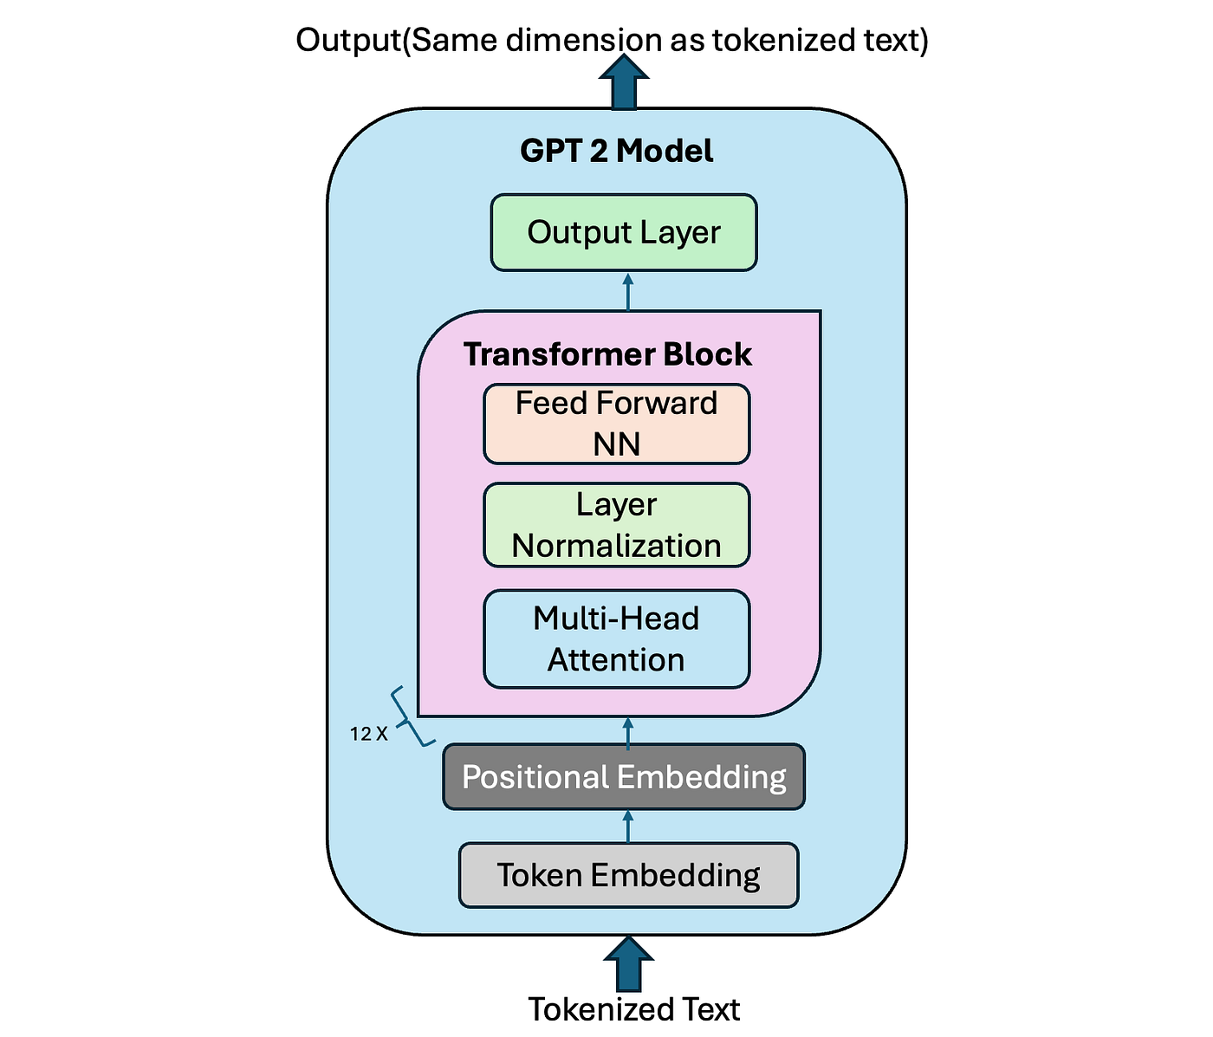
History of Vision Transformers
Transformers
Transformers
BERT
BERT
GPT
GPT
Notes:
They directly led to models like BERT and GPT, which are models that are familiar to us today!
Most importantly, they popularized a new training paradigm: Pre-train a model on massive amounts of data and then fine-tune it for a specific task.

Slide 8
Transition to ViT
Inspired by the success, researchers were interested in applying transformers to computer vision problems.
Notes:
Once transformers completely reshaped language modeling, researchers started asking a natural question: “If attention works so well for text…could it work for images too?”

Slide 9

Transition to ViT
Inspired by the success, researchers were interested in applying transformers to computer vision problems.
Image Classification
Notes:
Once transformers completely reshaped language modeling, researchers started asking a natural question: “If attention works so well for text…could it work for images too?”

Slide 10
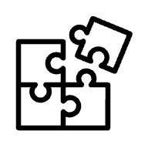
Transition to ViT
Inspired by the success, researchers were interested in applying transformers to computer vision problems.
Image Classification
Image Segmentation
Notes:
Once transformers completely reshaped language modeling, researchers started asking a natural question: “If attention works so well for text…could it work for images too?”
Reference: https://www.youtube.com/watch?v=Hnsrm1ezI3g&t=295s

Slide 11

Transition to ViT
Inspired by the success, researchers were interested in applying transformers to computer vision problems.
Image Classification
Image Segmentation
Object
Detection
Notes:
Once transformers completely reshaped language modeling, researchers started asking a natural question: “If attention works so well for text…could it work for images too?”
Reference: https://www.youtube.com/watch?v=Hnsrm1ezI3g&t=295s

Slide 12
Agenda
Introduction & History
Basic Architecture
Patch Tokenization
Self Attention
ViT Architecture
Conclusion

Slide 13
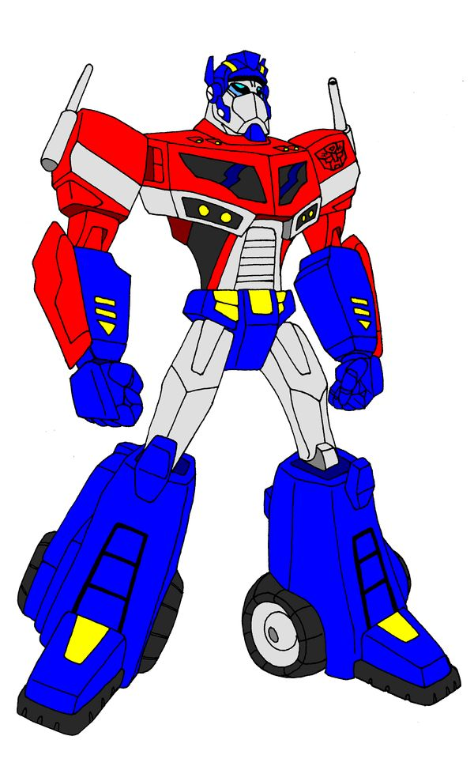
Basic Architecture of Vision Transformers

Slide 14
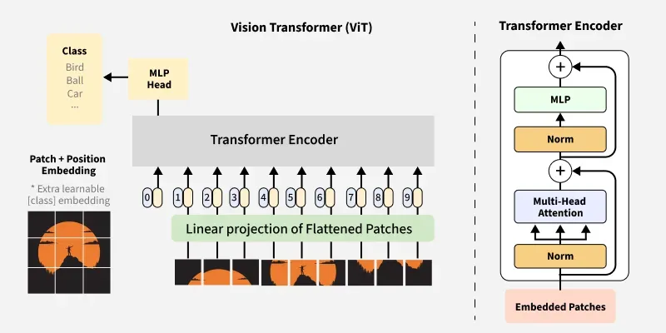
Basic Architecture - intuition
ViT = image → patches → Transformer encoder → class.
Notes:
Here's the fundamental shift. CNNs scan an image with small windows that slide around. ViT takes a different approach: chop the entire image into a grid of equal-sized squares—say, sixteen-by-sixteen patches. Flatten each square into a list of numbers. Now you have a sequence, just like words in a sentence. Feed that sequence into a Transformer encoder where every patch can attend to every other patch simultaneously. Finally, a small classifier reads the combined information and predicts the label.

Slide 15
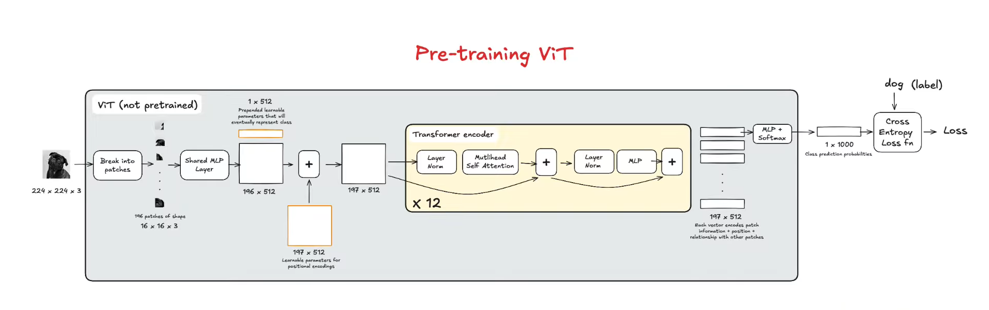

Basic Architecture - process
Notes:
Let's walk through the pipeline.
First, patch tokenization: we slice the image into sixteen-by-sixteen squares, embed each into a vector, and
+ add positional encodings so the model knows this patch came from the top-left versus bottom-right.
Second, the encoder: twelve or twenty-four repeated blocks.
The encoder block is a little different here but Iman will explain it in depth later. Each block has self-attention—where patches exchange information—plus an MLP to mix features.
Residual connections let gradients flow back cleanly during training. Third, the MLP head: a small classifier, often reading from a special classification token, outputs the final category.

Slide 16
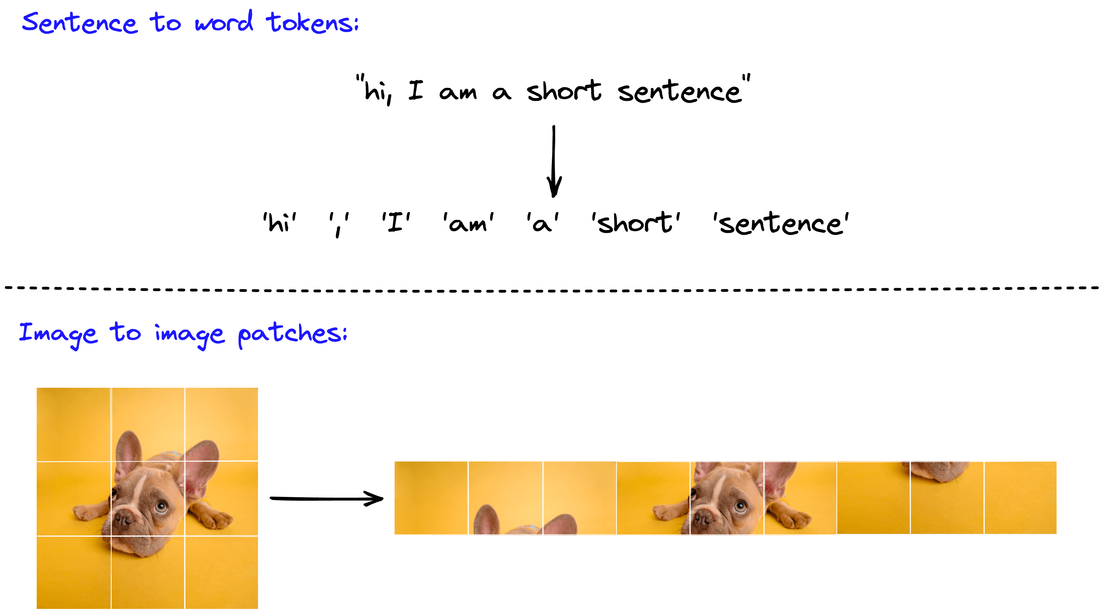
Key components of ViT
Patch tokenization - converts pixels into a sequence of data.
Notes:
Why do we need patch tokenization? Standard Transformers expect a sequence of tokens, like words in a sentence.
An image is a two-D grid of pixels—not a sequence.
So we cut the image into equal patches, say sixteen-by-sixteen squares. Flatten each square into a single vector. Then linearly project it to a standard dimension, like seven-sixty-eight. Now our image is a sequence of tokens the Transformer can process.
Think of it like splitting a sentence: 'hi, I am a short sentence' becomes seven words. Here, a photo becomes nine patches.
1. Patch Tokenization
Standard Transformers were built for text (sequences of words). To make an image fit that mold, we use Patch Tokenization.
* The Concept: Imagine taking a printed photo and cutting it into a grid of equal-sized squares (e.g., 3 \times 3 pixels).
* The Goal: Each square (patch) is flattened into a single vector (a list of numbers) called a Token. This turns a 2D image into a 1D sequence that the Transformer can actually "read."

Slide 17
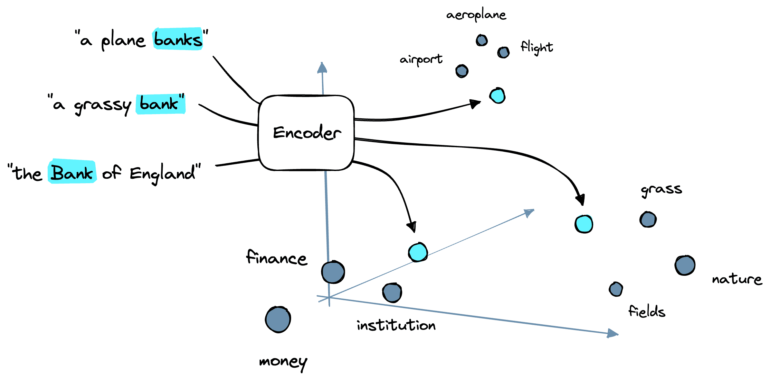
Key components of ViT
Patch tokenization – converts pixels into a sequence of data.
Encoder – Learns global patterns and relationships.
Notes:
The encoder is where the magic happens. It's a stack of layers—twelve in ViT-Base, twenty-four in ViT-Large. Each layer uses self-attention, which means every patch can look at every other patch and decide how much to listen. Imagine patch twelve contains a beak. Self-attention lets it attend strongly to patch one-eighty-seven, which has talons, and patch ninety-four, which has a wing. The model isn’t hard-coded; it learns these relationships from data. That's how it builds a global understanding of the image.
2. The Encoder
The Encoder is the "brain" where the actual learning happens. It’s a stack of layers that processes the tokens you just created.
* The Secret Sauce: It uses Self-Attention. This allows every patch to "talk" to every other patch.
* The Intuition: If the Transformer sees a patch containing a "beak" in the top-left, Self-Attention helps it look at a patch in the bottom-right to see if there are "talons," helping it conclude the image is an eagle.

Slide 18
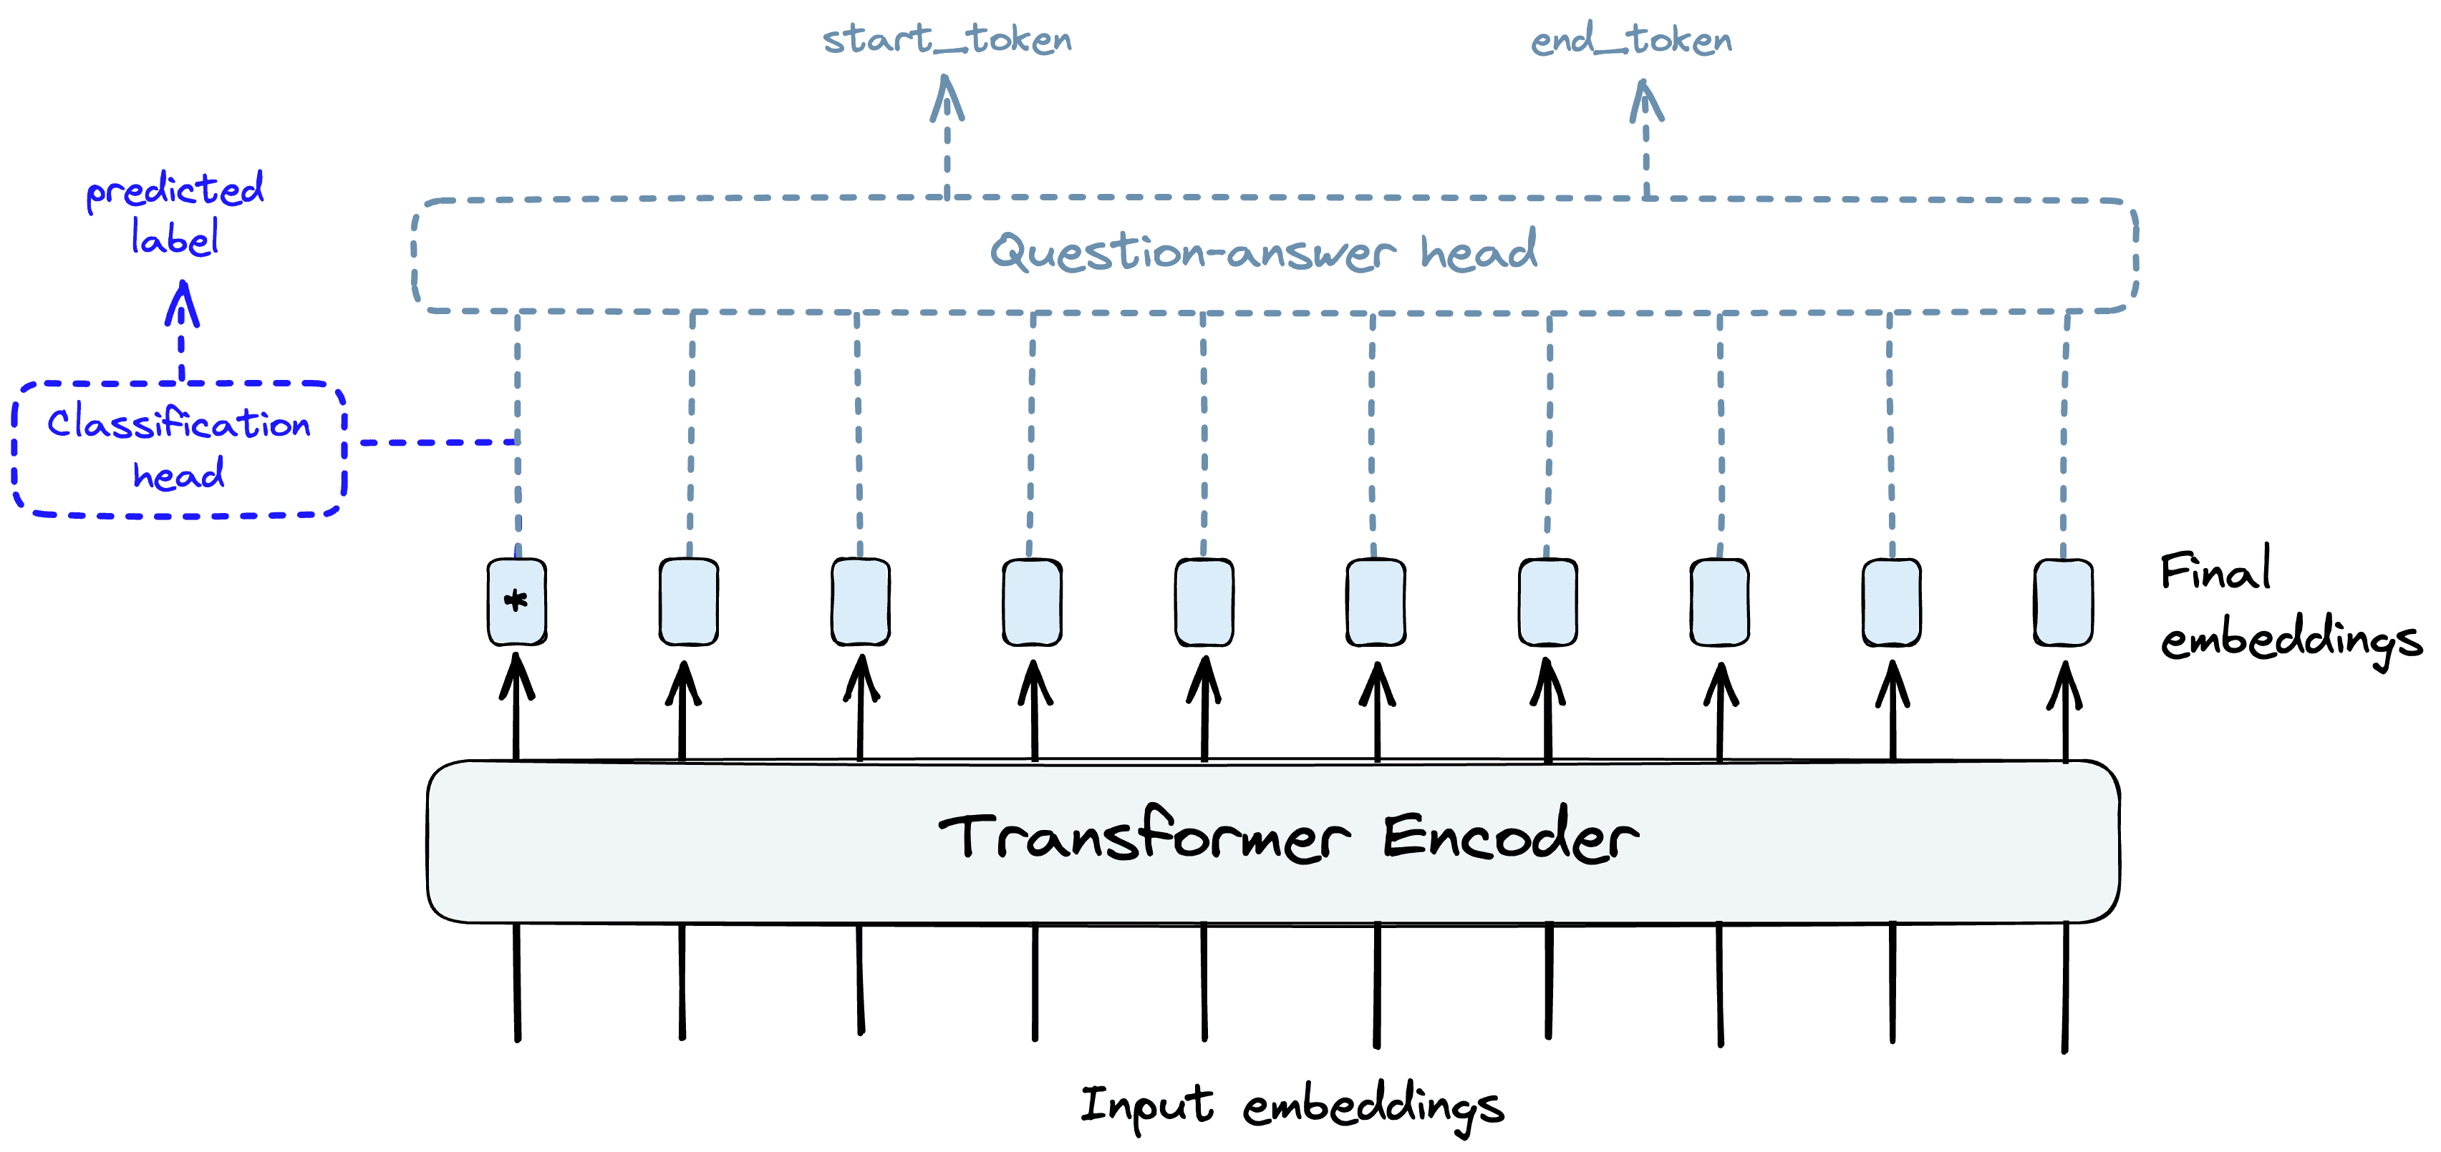
Key components of ViT
Patch tokenization – converts pixels into a sequence of data.
Encoder – Learns global patterns and relationships.
MLP head – Predicts the final category/class.
Notes:
3. MLP Head (Multilayer Perceptron)
Once the tokens have passed through the Encoder, they are rich with information. The MLP Head is the final decision-maker sitting at the very end of the pipeline.
The Role: It takes the processed representation (usually from a special "classification token") and maps it to a final label.
The Output: It’s a simple neural network that says, "Based on all the relationships the Encoder found, there is a 98% chance this is a cat."
After twelve layers of attention, each token is rich with global information. The MLP head is the final classifier—usually a small feed-forward network. It reads from a special token called the classification token, or [CLS], which we prepend to the sequence. Think of [CLS] as a summary token that attends to all patches. The head maps that summary to class probabilities. For instance: ninety-eight percent cat, one percent dog, one percent other. During fine-tuning, we often swap the head to match the new task's number of classes.

Slide 19
Agenda
Introduction & History
Basic Architecture
Patch Tokenization
Self Attention
ViT Architecture
Conclusion

Slide 20

Patch Tokenization in Vision Transformers
Breaking down images into manageable pieces for deep learning models
Notes:
2

Slide 21
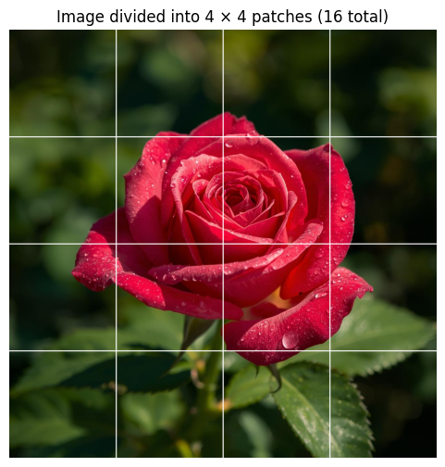
The Basic Idea Behind Patch Tokenization
Definition and Overview
Patch tokenization is the process of dividing an image into smaller, fixed-size patches or squares. Each patch is then treated as a single token, similar to how words function in language models.
Think of it like cutting a photograph into equal-sized tiles—each tile becomes a unit of information that the model can process independently.
Notes:
3

Slide 22
Why Do We Need Patch Tokenization?
Computational Efficiency
Learning Contextual Relationships
Adapting Transformers to Vision
Processing pixel-by-pixel would be extremely expensive. A 224×224 image has 50,176 pixels! Breaking it into 16×16 patches reduces this to just 196 tokens.
Patches capture local patterns like edges and textures, while the transformer learns how these patches relate to each other globally across the image.
Transformers were designed for sequences (like text). Patches convert 2D images into 1D sequences that transformers can process effectively.
Notes:
4

Slide 23
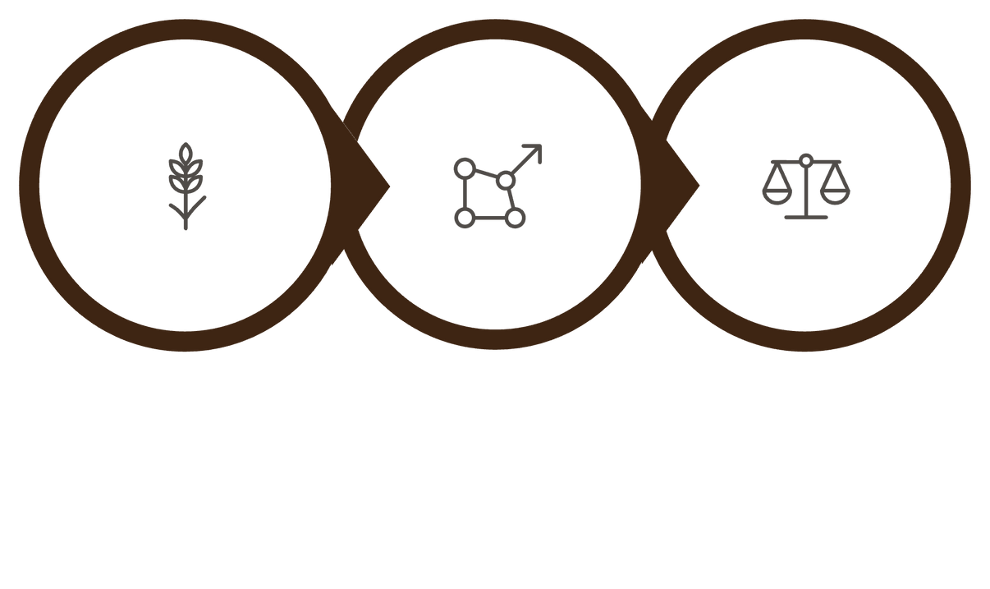

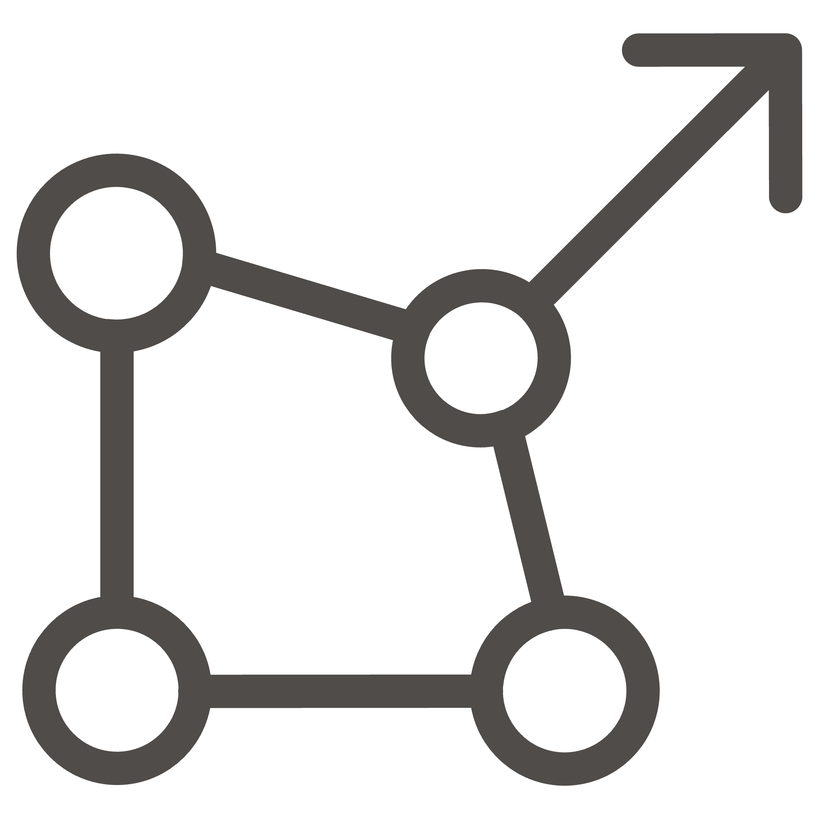

Linear Patch Embeddings: Step-by-Step
Linear Projection
Extract Patch
Flatten Patch
The standard approach involves three clear stages that transform image patches into vectors the transformer can understand.
Notes:
6

Slide 24
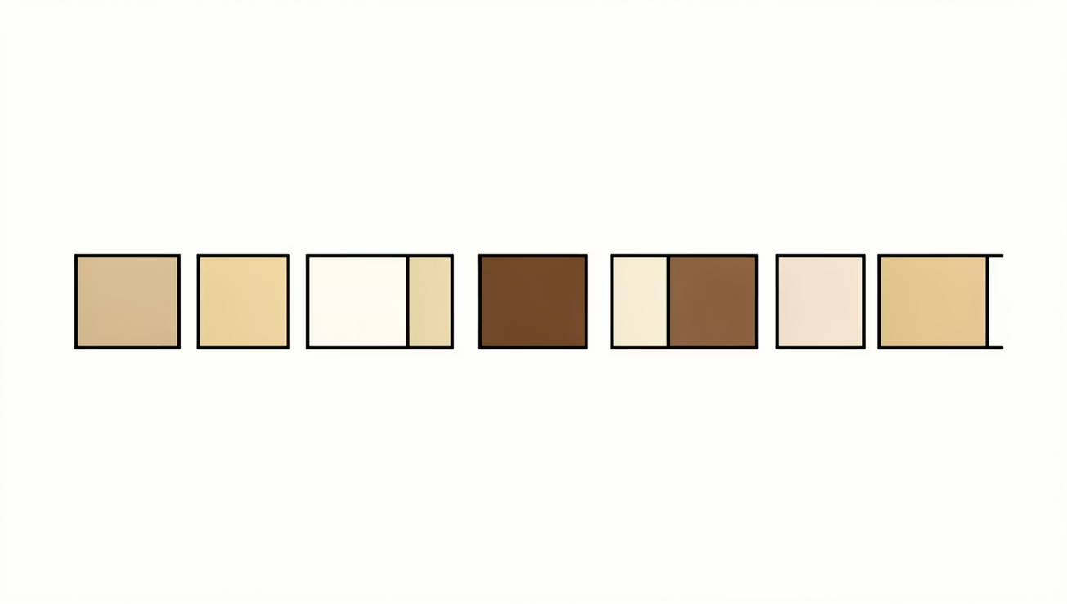
Understanding Each Stage
Step 1: Extract Patch
Extract a square patch (e.g., 16×16 pixels) from the image. If the image is RGB, this patch contains 16×16×3 = 768 values.
Step 2: Flatten the Patch
Reshape the 3D patch into a 1D vector. Our 16×16×3 patch becomes a flat vector of 768 numbers arranged sequentially.
Notes:
7

Slide 25

Step 3: Linear Projection
Linear projection converts raw image patch values into meaningful feature vectors that the transformer can process.
The flattened vector is passed through a learnable linear layer (matrix multiplication) to project it into the model's embedding dimension (typically 768 or 1024).
Real-world analogy: Imagine summarizing a paragraph into key bullet points. The linear projection extracts the most important features from the raw pixel data and represents them in a compressed, meaningful format.
Notes:
8

Slide 26
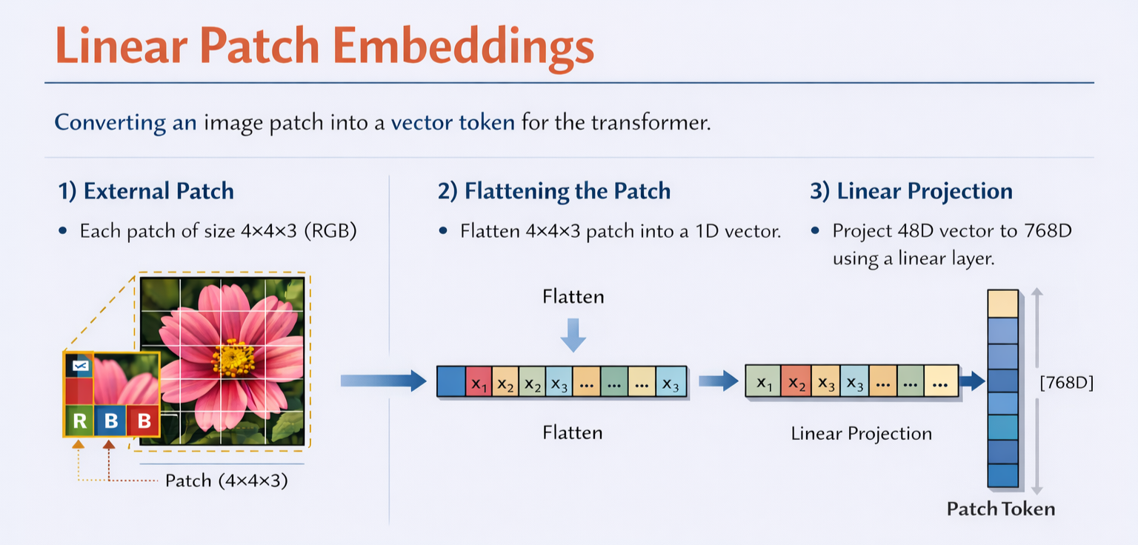

Slide 27
Convolutional Stem: An Alternative Approach
How It Differs
Key Advantage
Instead of cutting an image into patches right away, a convolutional stem first processes the image using convolution layers to:
Reduce the image size gradually (downsampling).
Extract useful local features like edges, colors, and textures.
The key advantage of a convolutional stem is its ability to capture local spatial features early, providing better visual representations for the transformer.
Models like Early Convolutions (in hybrid ViTs) combine the best of both CNNs and transformers.
Notes:
10

Slide 28
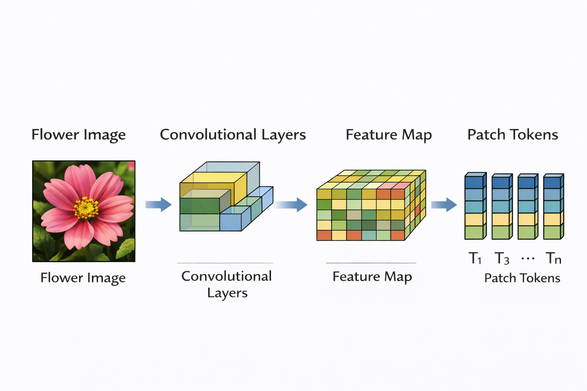
Feature Map
A feature map is the output image produced by a convolution filter that shows where a specific feature appears in the input.
The feature map is basically:
“a map showing where vertical edges are in the image”

Slide 29

Positional Encoding: Adding Spatial Awareness
The Problem
2.Fixed Positional Encodings
Transformers process patches as a set, without inherent understanding of their spatial positions. A patch from the top-left is treated the same as one from the bottom-right.
Use predefined sinusoidal functions (like in original Transformers) to encode position. These don't require learning but may be less flexible for vision tasks.
1.Learned Positional Encodings
Formula
Positional encoding is a vector representing the position of each patch in the image.
It is added to the patch embedding:
$$z_{i}=E\left(x_{i}\right)+P_{i}$$
Where:
$E\left(x_{i}\right)$= patch embedding
$P_{i}$= positional encoding
$z_{i}$= final input to Transformer
Add a learnable position vector to each patch embedding. The model learns during training which positions are important (e.g., objects usually appear in the center).
Notes:
11

Slide 30
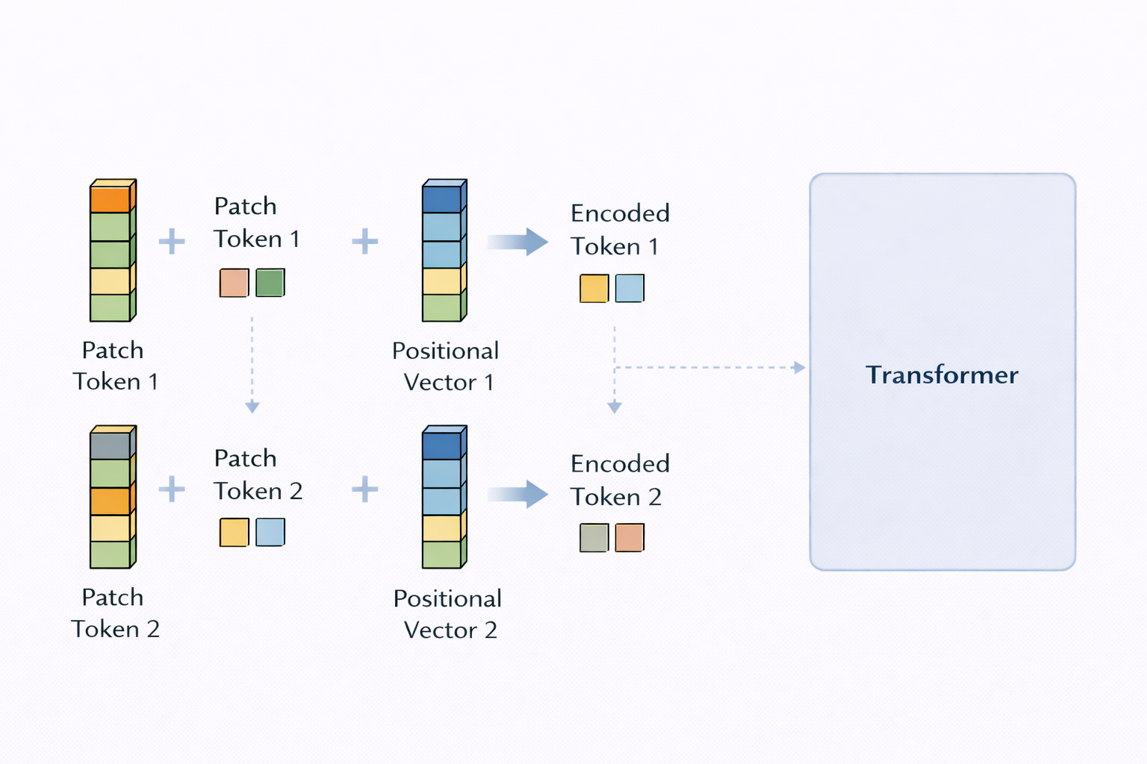

Slide 31
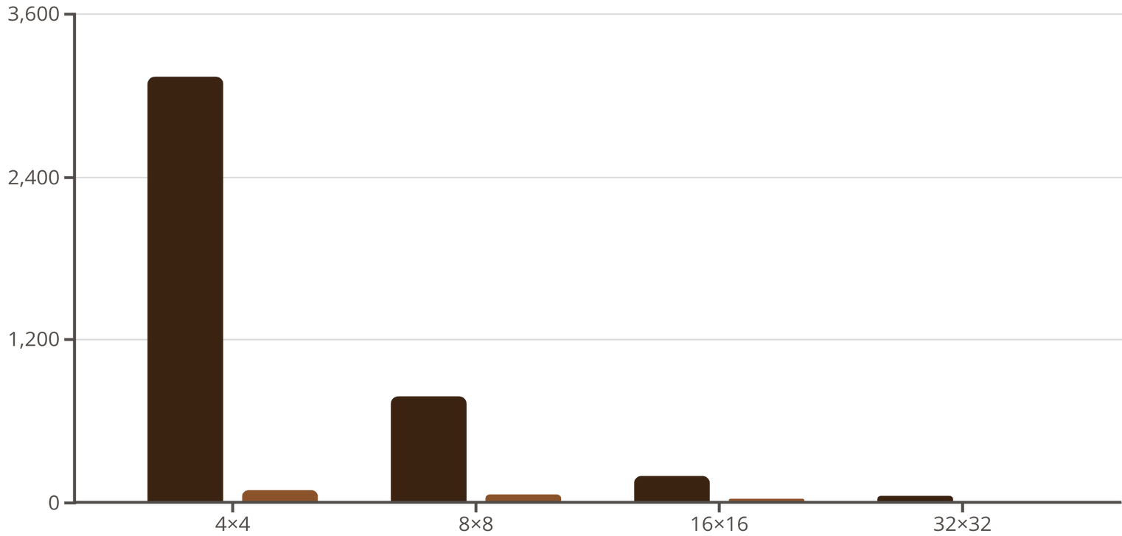
Comparison of Different Patch Sizes
For a 224×224 image, smaller patches capture fine details but create many tokens, increasing computational cost quadratically.
Formula: Number of patches = (H/P) × (W/P), where H and W are image dimensions and P is patch size.
Trade-off: 16×16 patches balance detail and efficiency, which is why they're most common in practice.
Number of Tokens
Computation Cost
Notes:
12

Slide 32
Key Takeaways
Patch tokenization converts images into sequences
Linear embeddings and convolutional stems offer different approaches
Making them compatible with transformer architectures while maintaining computational efficiency.
Linear projections are simple and effective; convolutional stems add useful inductive biases.
Positional encodings are essential
Patch size is a critical hyperparameter
They provide spatial awareness that transformers lack inherently, enabling models to understand image structure.
It determines the trade-off between capturing fine-grained details and computational efficiency.
Notes:
13

Slide 33
Agenda
Introduction & History
Basic Architecture
Patch Tokenization
Self Attention
ViT Architecture
Conclusion
Notes:
Now that the parts are on the table, let’s open the hood on self-attention—what it is and why it’s so effective for images.

Slide 34
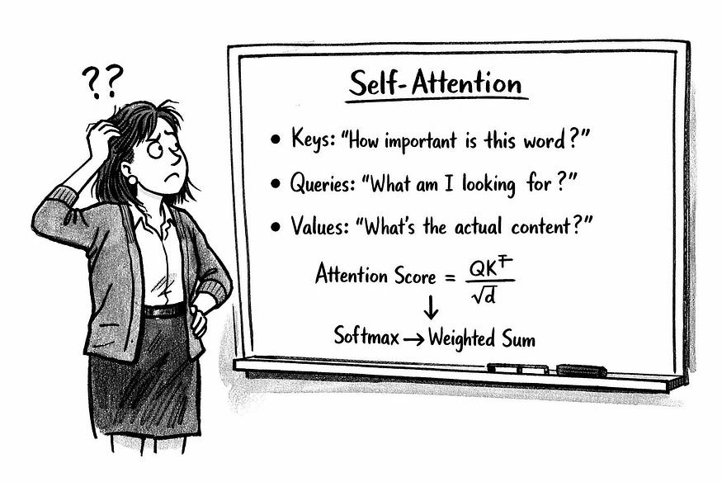
Notes:
The most difficult part of the Transformer architecture to get an intuitive understanding of self-attention.
So here’s my attempt to explains things a little more clearly. I’m assuming most people have an intuitive understanding of the old RNNs, embeddings and positional encodings.

Slide 35
What problem does attention solve?
American shrew mole
One mole of carbon dioxide
Take a biopsy of the mole
Notes:
Let's start with a puzzle. I say the word 'mole.' What do you picture?
It could be an American shrew mole.
Or a mole of carbon dioxide
Or a skin mole that needs a biopsy.
Same word, totally different meanings.

Slide 36

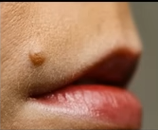
What problem does attention solve?
American shrew mole
One mole of carbon dioxide
Take a biopsy of the mole
Use context to decide what each token should ‘listen to’.
6.02 x 10²³
Notes:
How do you know which one I mean? You use context—the words around it. Attention does exactly that for images: it uses surrounding patches to decide what each patch represents.
Here's the reveal.
If I say 'American shrew mole,' the word 'American' tells you it's the animal. If I say 'one mole of carbon dioxide,' tTHE number - irt screams chemistry.
If I say 'biopsy,' you know I'm talking about skin.
In images, the same logic applies. A patch showing orange fur needs to check nearby patches: do they have stripes? Then it's a tiger. No stripes but a mane? Lion.
Attention lets each patch query its neighbors to resolve ambiguity.

Slide 37
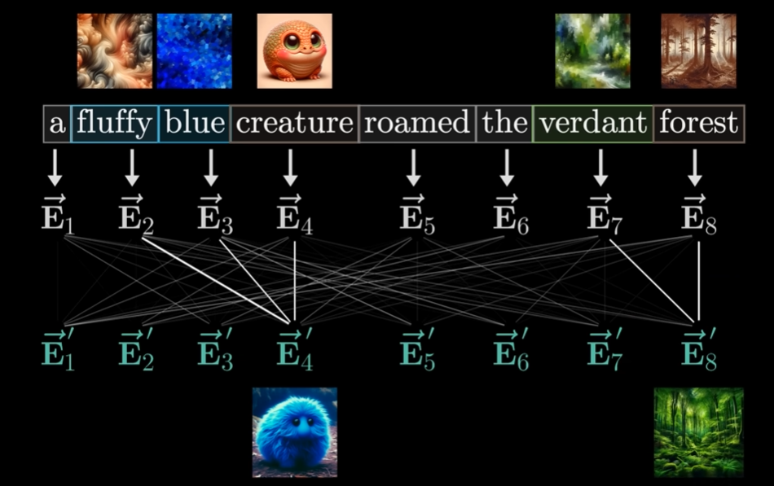
What is attention intuitively?
In ViT: Replace ‘words’ with ‘image patches’
Notes:
Alright, let's build intuition before we hit the math. Look at this sentence: 'a fluffy blue creature roamed the verdant forest.'
Imagine you're reading the word 'blue.' What does it mean? Is it a blue forest? A blue sky? You don't know yet. So your brain looks at the surrounding words.
You see 'creature' right after 'blue'—aha! The creature is blue, not the forest.
That's exactly what attention does. Each word starts with an embedding—these Ē vectors. Then attention lets 'blue' look at all other words and decide: 'creature' is relevant, 'forest' is not. It computes a weighted average. The output—Ē-prime—is now context-aware.
'Blue' knows it's describing the creature.
In Vision Transformers, replace 'words' with 'image patches.' A patch showing orange pixels asks: 'Am I part of a basketball? A tiger? A sunset?' Attention looks at neighboring patches. If it sees stripes nearby, boom—it's a tiger. That's the power of global context.

Slide 38
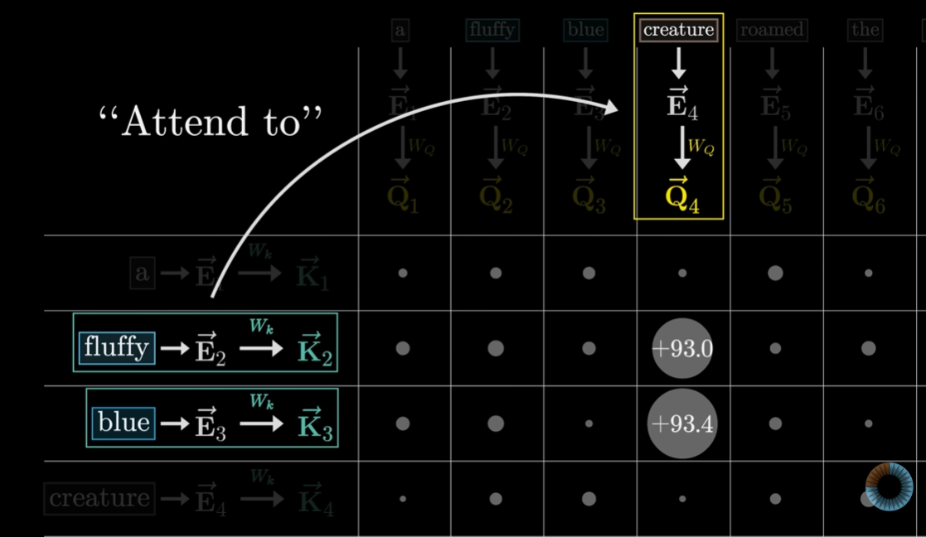
The attention mathematically (Q, K, V)
+93.0 and +93.4 -> High relevant scores.
Notes:
Now let's formalize this with math—but I promise it's simpler than it looks.
To implement attention, we project each word embedding into three different spaces: Query, Key, and Value. Think of a library:
Query is what you're searching for. Here, the word 'creature' generates Q₄—its query vector.
Key is what each book advertises. 'Fluffy' generates K₂, 'blue' generates K₃, and so on. These are like book titles on a shelf.
Value is the actual content inside each book—the information you retrieve.
Now, how do we find relevant books? We compute similarity: take Q₄ and dot it with every key. Q₄ dot K₂, Q₄ dot K₃, et cetera. High scores mean high relevance.
Look at the matrix. 'Creature' scores ninety-three-point-zero with one key and ninety-three-point-four with another. Those are huge scores—likely matching 'blue' and other descriptive words. Low scores get ignored.
These numbers tell us exactly how much 'creature' should pay attention to each word.

Slide 39
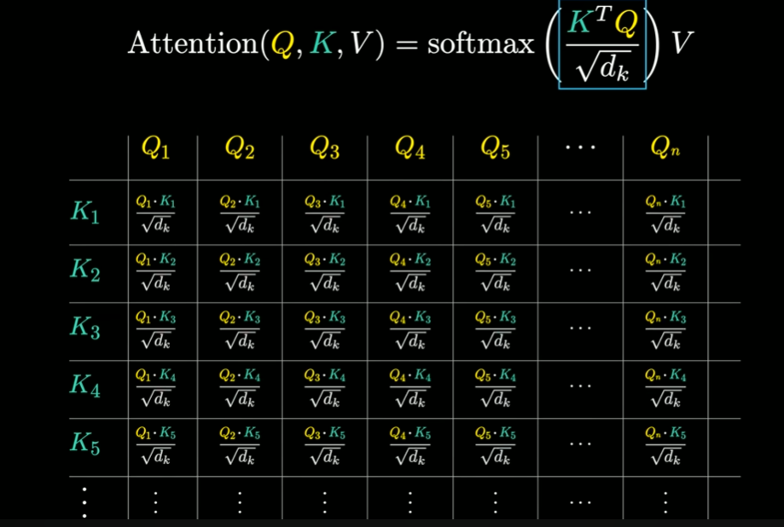
The attention mathematically (Q, K, V)
Weights = softmax(QKᵀ/√d) → how much one patch listens to another
Output = weighted sum of Vs
Notes:
Here's the complete picture. Let me walk you through this step-by-step.
Step 1: Compute similarity scores.
We organize all queries into a matrix Q and all keys into matrix K. Multiply K-transpose times Q. This gives an N-by-N matrix where every query is compared to every key. In our example, N is eight words, so it's eight-by-eight. In ViT with one-ninety-six patches, it's one-ninety-six by one-ninety-six.
Step 2: Scale the scores.
Here's the problem: if your embedding dimension d is large—say, seven-sixty-eight—these dot products explode. You get scores of three hundred, five hundred, a thousand. That breaks the next step. So we divide by the square root of d. Look at the formula: every cell is Q_i dot K_j divided by root-d. This keeps scores moderate—typically between minus-five and plus-five.
Step 3: Apply softmax.
Softmax converts raw scores into probabilities. Each row sums to one. These are our attention weights—literally how much each patch listens to every other patch. If patch five's row has point-six for patch twelve and point-three for patch eight, patch five cares mostly about those two.
Step 4: Weighted sum of values.
Finally, multiply the weight matrix by V—the value matrix. Each value vector is the actual information from that patch. The output is a weighted combination. Patch five's new representation is point-six times V-twelve plus point-three times V-eight plus tiny bits from others.
Every patch does this simultaneously. That's self-attention.

Slide 40
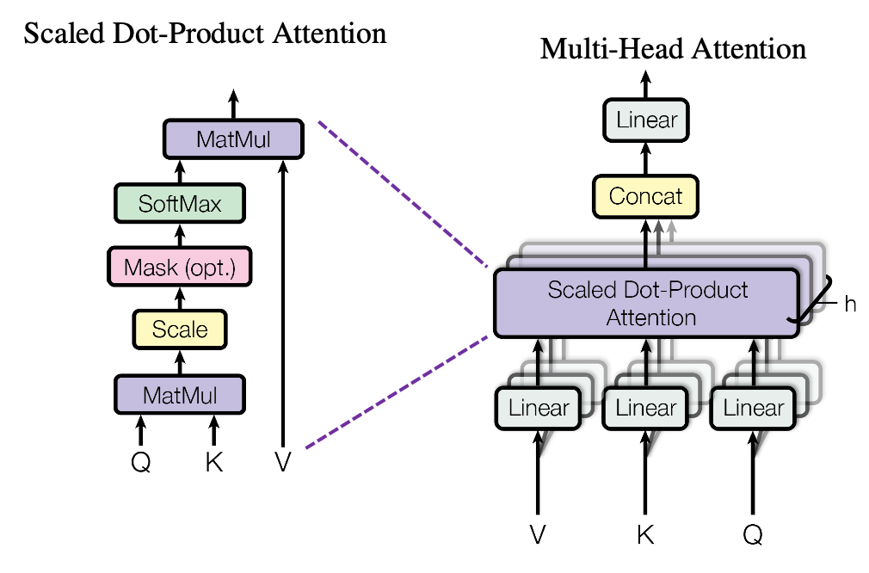
Multi-head attention (why many heads?)
Repeating same attention many times in parallel (h times - different “views”)
Notes:
Quick question: if one set of attention weights works, why run it multiple times? .....
Because one perspective isn't enough. Multi-head attention runs h parallel attention functions—say, twelve heads in ViT-Base. Each head gets its own Q, K, V projections and learns independently.
Why is this powerful? Different heads specialize. One head might focus on edges in the image. Another on textures—like fur versus scales. Another on spatial layout—which patches are close together. They learn this from data, not because we programmed it.
Here's how it works mechanically. Your embedding dimension d—say, seven-sixty-eight—is split across heads. Twelve heads means each head operates on sixty-four dimensions. Seven-sixty-eight divided by twelve equals sixty-four. After each head computes attention, we concatenate their outputs back together. Twelve times sixty-four equals seven-sixty-eight again.
So the model doesn't just see the image one way—it sees it through twelve different lenses simultaneously. That's why multi-head attention is so effective.

Slide 41
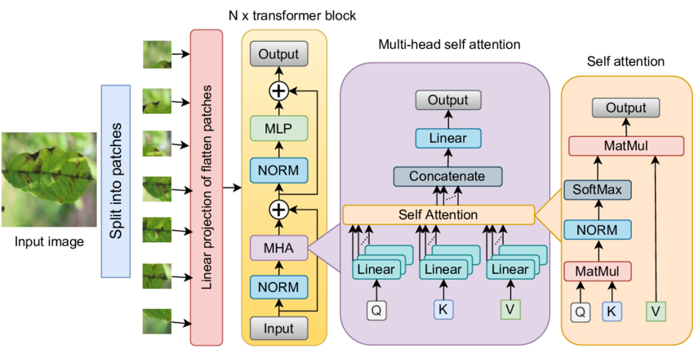
Where attention lives in the ViT block
Encoder block (Pre-LayerNorm → MHA → residual) → (Pre-LN → MLP → residual)
Notes:
Let's see where attention fits in the architecture. Each encoder block has two main sub-layers. First, layer normalization to stabilize inputs, then multi-head attention, then a residual connection that adds the original input back. Second, another layer norm, then an MLP—a small feed-forward network that typically expands dimensions by four-x then contracts back—then another residual. These residuals are critical. They create skip connections, letting gradients flow directly backward during training without weakening. Without residuals, stacking twelve or twenty-four blocks would cause vanishing gradients. ViT stacks these blocks: ViT-Base uses twelve, ViT-Large uses twenty-four, ViT-Huge uses thirty-two.

Slide 42
Cost & why patch size matters
#tokens: N = H*W/P^2 (image HxW, patch PxP)
Attention cost Ó(n^2) (We build an NxN weight matrix per head)
Example 224x224:
Patch Size | N (tokens) | N² (cost) | Trade-off
P = 16 | 196 | ~38,400 | ✅ Fast, standard
P = 8 | 784 | ~614,656 | ⚠️ Slow, finer detail
P = 4 | 3,136 | ~9,834,496 | ❌ Prohibitive!
Notes:
Here's the brutal truth about computational cost.
For an H-by-W image with P-by-P patches, the number of tokens is N equals H times W divided by P-squared. Simple formula, huge implications.
Attention builds an N-by-N weight matrix. That's quadratic complexity—O of N-squared. More tokens means exponentially more computation.
Let's use real numbers. Standard ImageNet images are two-twenty-four by two-twenty-four pixels.
With sixteen-by-sixteen patches:
N equals one-ninety-six tokens. N-squared is about thirty-eight thousand. Totally manageable. Your GPU is happy. Training is fast.
Cut patches to eight-by-eight:
Now N jumps to seven-eighty-four tokens. N-squared is six-hundred-fourteen thousand—over fifteen times heavier. Every matrix multiplication costs fifteen-x more. Memory usage explodes. Your GPU might run out of RAM.
And it's not just attention. Every softmax, every layer norm—everything scales with N or N-squared.
Here's the trade-off. Smaller patches capture finer details—like individual whiskers on a cat. Bigger patches are coarser but way faster. Most ViT models use P equals sixteen as the sweet spot. ViT-Huge uses P equals fourteen to balance detail and speed.
Bottom line: patch size is not just an architecture choice—it's a computational constraint."

Slide 43
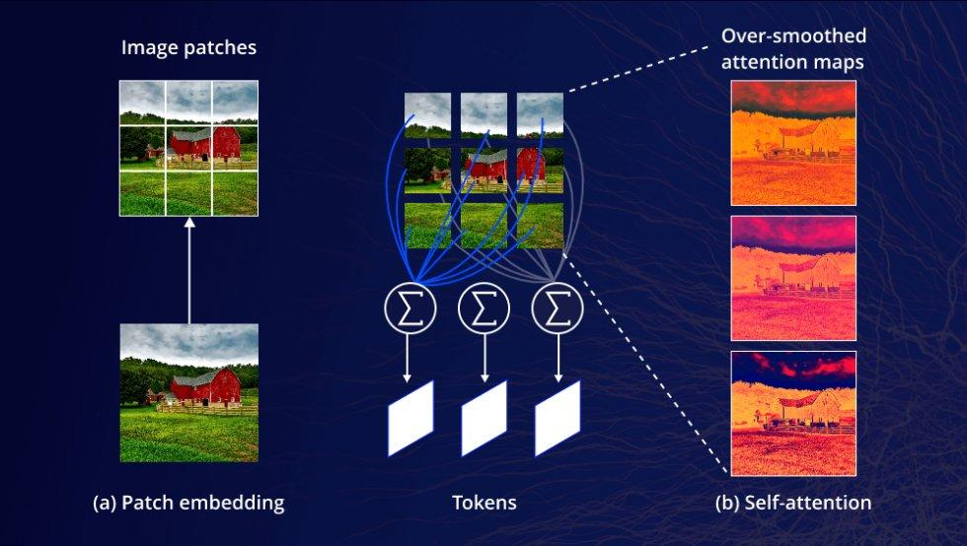
Image with CLS attention maps for intuition
Legend
Red = high attention
Orange = medium
Blue = low attention
Notes:
Let's make this concrete with a real example.
Here's a photo of a landscape with a red barn. We've split it into patches—see the three-by-three grid on the left. Each patch becomes a token.
Now look at the right side. These are attention maps. The heatmaps show where the classification token—[CLS]—is paying attention. Bright red and orange mean high attention. Dark blue means low attention.
Notice what happens. The [CLS] token focuses strongly on the barn—the main object. It mostly ignores the sky and grass. This wasn't hand-coded. The model learned this from millions of labeled images. It discovered that foreground objects matter for classification. Background clutter doesn't.
Different attention heads specialize. Some focus on edges—the outline of the barn. Others on textures—wood grain versus grass. Others on spatial groupings—which patches form a cohesive object.
By the final layer, [CLS] has aggregated information from all the relevant patches. It knows: red building, green field, trees, sky. That's how it classifies the image correctly.
This visualization proves attention isn't just math—it's learning meaningful visual relationships.

Slide 44
Agenda
Introduction & History
Basic Architecture
Patch Tokenization
Self Attention
ViT Architecture
Conclusion

Slide 45
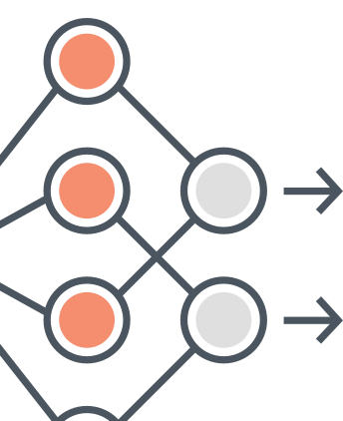
The Architecture of Vision Transformers

Slide 46
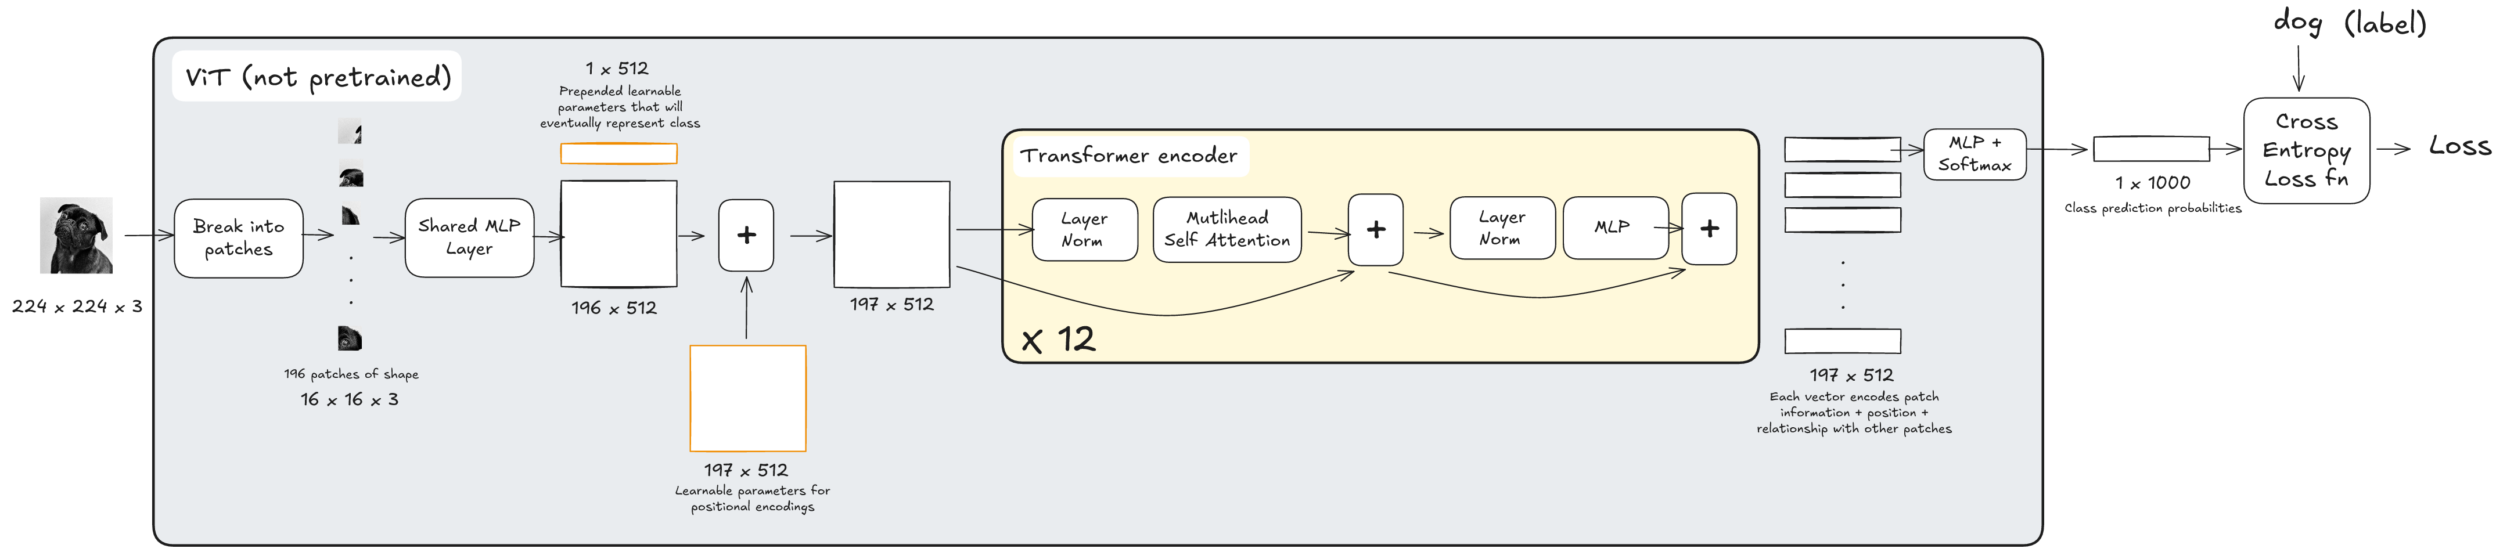
Pre-Training Pipeline
Notes:
Let’s take a closer look at how the components we’ve discussed actually come together during the pre-training. The input is a image, and the output is a label which is used to calculate a loss. This can be done since ourtraining dataset has pairs of images and their labels.
We’ll start by initializing all learnable parameters including the transformer weights, the positional embeddings, and the CLS token, which I’ll revisit in just a minute.

Slide 47
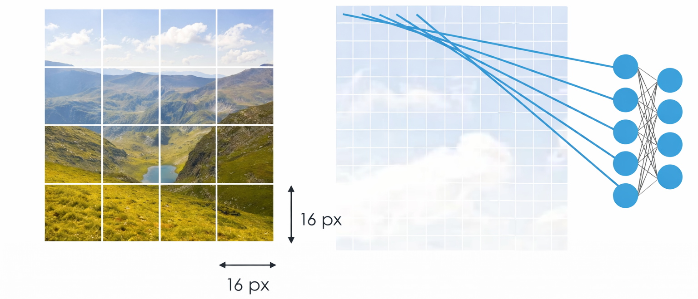
Pre-Training Pipeline
Notes:
For ease, let’s focus on a single example from the dataset. The image is first broken down into a set of fixed-size patches.
Each patch is then flattened and passed through a linear projection, which is essentially a shared feed-forward or MLP layer. This maps each patch into a fixed-dimensional embedding vector.

Slide 48
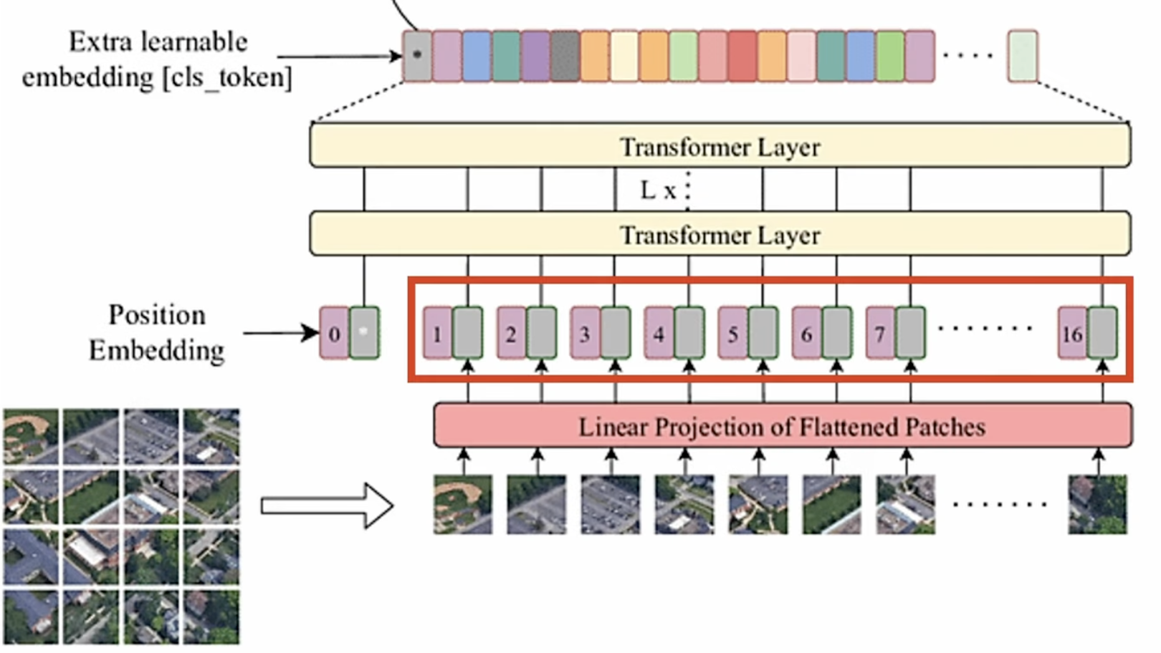
Pre-Training Pipeline
Notes:
The CLS or classification token is then appended to the embeddings matrix. This token is designed to gather information from all of the image patches.
It starts off as a dummy input but through self-attention, it starts to collect global information.
By the end of the pipeline, this one token represents the whole image and is what will help us make the classification prediction at the end.

Slide 49
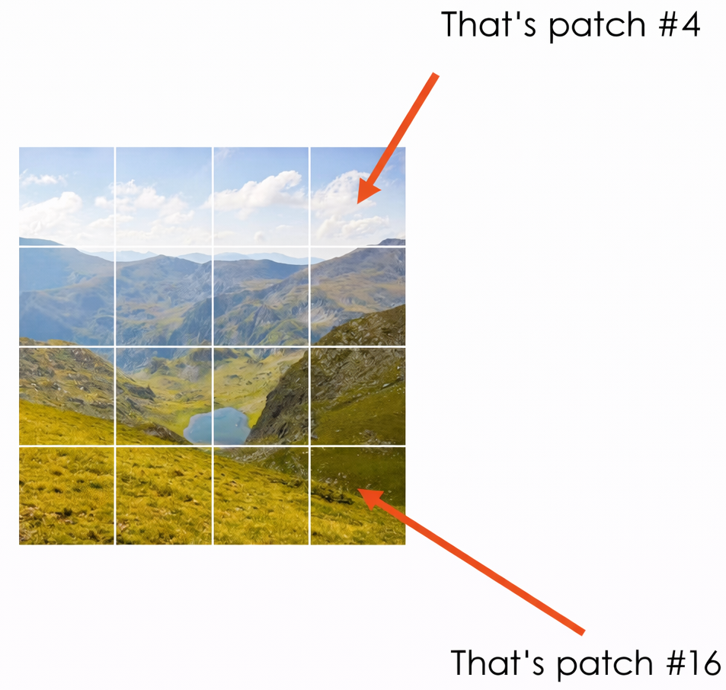
Pre-Training Pipeline
Notes:
To the patch embedding matrix, we add positional encodings, which give the network a sense of where each patch is located within the image.
These positional encodings are learnable parameters and are optimized through backpropagation during training. After this step, we end up with a single matrix where the image patch embeddings and positional information are combined.
This matrix is then processed by the transformer encoder.

Slide 50
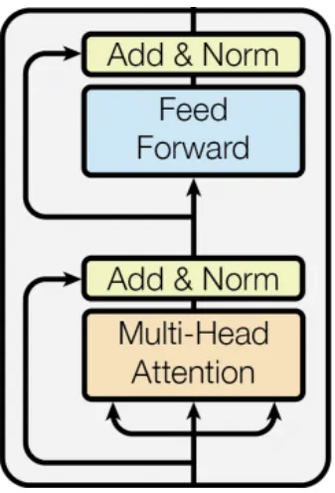
Pre-Training Pipeline
Notes:
First, the embeddings go through multi-head self-attention, which captures relationships between different image patches. In the diagram, the three inputs represent the Query, Key, and Value vectors.
The output is then combined with the original input using a skip connection, and followed by layer normalization — this is the Add & Norm step.
Layer normalization is done to ensure stable and faster training. It’s chosen over batch normalization as by normalizing per sample instead of per batch, its independent of batch size.
These skip connections help make training deep networks more stable and avoid problems like vanishing gradient.
Next, the result passes through a feed-forward network, which adds non-linearity which helps the embeddings become rich in representation.
Again, we apply a skip connection and layer normalization.
This entire block is repeated multiple times which in ViT Base is 12 times.

Slide 51
Pre-Training Pipeline
Notes:
After the encoder blocks, the output has the same shape as the input matrix and at this point, each vector encodes patch content, positional information, and relationships with all other patches.
For classification, we only focus on the first CLS token. This CLS vector is passed through a classification head, which is typically a simple linear MLP.
If we’re working with 1000 classes, this layer maps the CLS embedding to a 1000-dimensional vector of logits or unnormalized prediction scores.
Softmax is applied to convert these logits into class probabilities.

Slide 52
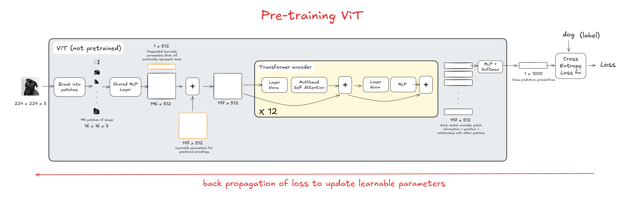
Pre-Training Pipeline
Notes:
Since we have both the predicted probabilities and the ground-truth label, we can compute a loss — most commonly cross-entropy loss.
This loss is backpropagated through the entire network, updating allll the learnable parameters.

Slide 53
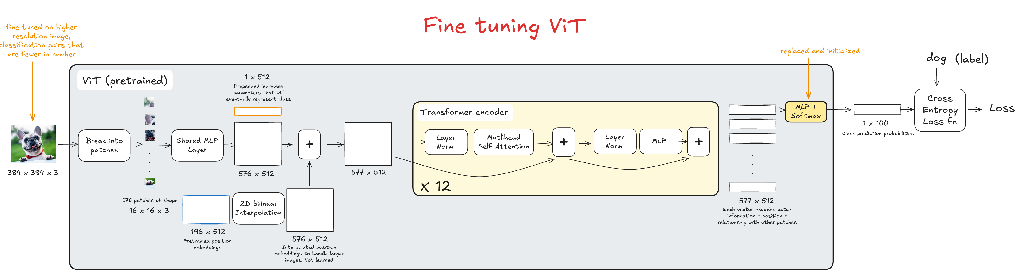
Finetuning Pipeline
Notes:
During fine-tuning, we tweak this same model for image classification tasks using a new dataset, with much higher resolution images.
In this example, instead of predicting 1000 classes, we only have about 100 classes.
Because of that, we simply replace the final classification head while keeping the rest of the transformer intact.

Slide 54
Finetuning Pipeline
Notes:
The key difference during fine-tuning happens at the step where we add the positional encodings.
Instead of learning them from scratch, we reuse the pretrained positional embeddings. However, because these images are higher resolution and result in more patches, we use 2D bilinear interpolation to resize the positional embeddings to these new dimensions.

Slide 55
Finetuning Pipeline
Notes:
After that, the process remains the same.
The positional encodings are added to the CLS token and patch embeddings, passed through the transformer encoder blocks, and then fed into the newly replaced linear classification head.
Softmax produces class probabilities, a loss is computed, and this loss is backpropagated to update the model.

Slide 56
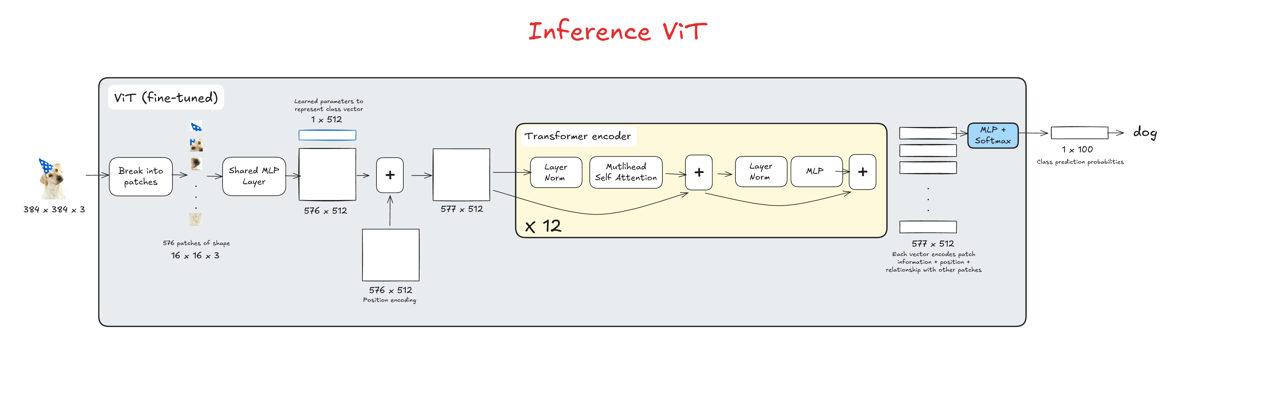
Inference Pipeline
Notes:
At inference time, the learned class token and positional embeddings are processed by the transformer encoder to produce rich vector representations of the input image, and the class token representation is then used to make the final prediction.

Slide 57
Model Variants
Model | Layers | Hidden Size D | MLP Size | Heads | Params
ViT-Base | 12 | 768 | 3072 | 12 | 86M
ViT-Large | 24 | 1024 | 4096 | 16 | 307M
ViT-Huge | 32 | 1280 | 5120 | 16 | 632M
Notes:
Vision Transformers come in several model variants, most commonly referred to as Tiny, Base, and Large.
These variants all share the same overall architecture, but differ in a few key parameters.
The number of layers corresponds to how many transformer encoder blocks are stacked,
The hidden size, or embedding dimension D refers to the length of each patch embedding vector. Essentially the width of the matrix flowing through the model. In our examples, it was 512!
The MLP size refers to the width of the feed-forward network inside each transformer block.
The number of heads corresponds to how many parallel attention mechanisms are used inside the multi-head self-attention block.
Finally, the parameter count reflects the total number of learnable parameters across the entire transformer.

Slide 58
Why Choose ViT Over CNNs?
CNNs were structured for the purpose of working on images. This design advantage is referred to as inductive bias.
Notes:
CNNs were so successful because they were explicitly designed for images. This built-in design advantage is what we refer to as inductive bias

Slide 59
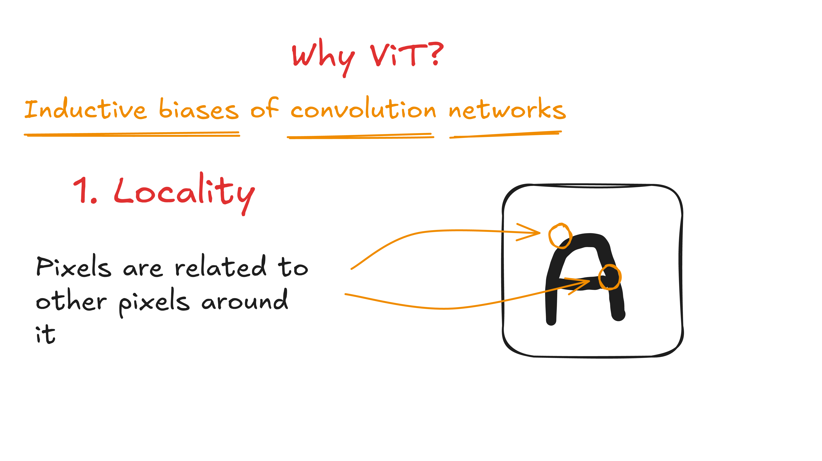
Why Choose ViT Over CNNs?
CNNs were structured for the purpose of working on images. This design advantage is referred to as inductive bias.
Notes:
One of the key inductive biases in CNNs is locality.
Nearby pixels are usually related, and CNNs exploit this by using small 2D convolutional filters that focus on local neighborhoods.
In Vision Transformers, this locality is not built in and instead, spatial relationships must be learned explicitly through positional embeddings and attention.

Slide 60
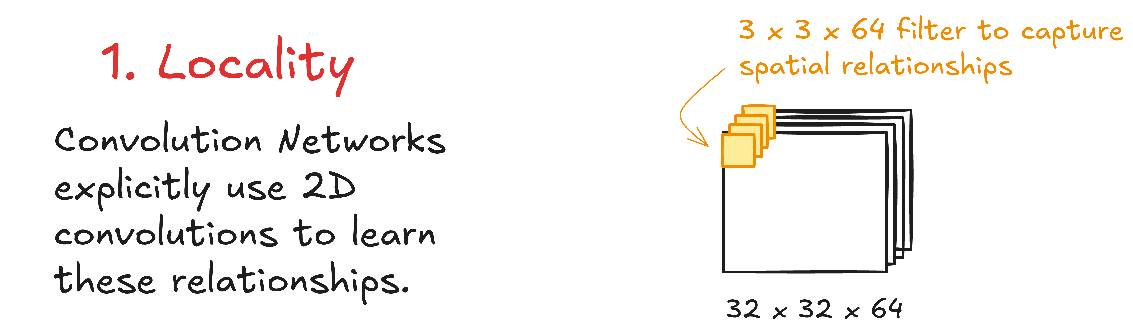
Why Choose ViT Over CNNs?
CNNs were structured for the purpose of working on images. This design advantage is referred to as inductive bias.
Notes:
One of the key inductive biases in CNNs is locality.
Nearby pixels are usually related, and CNNs exploit this by using small 2D convolutional filters that focus on local neighborhoods.
In Vision Transformers, this locality is not built in and instead, spatial relationships must be learned explicitly through positional embeddings and attention.

Slide 61
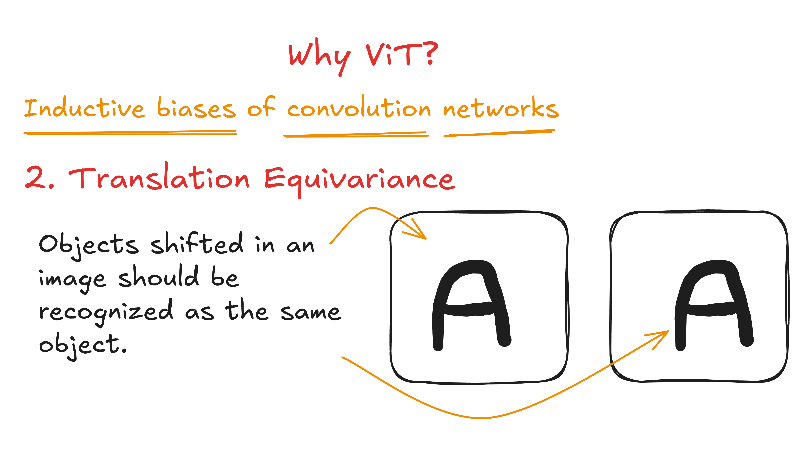
Why Choose ViT Over CNNs?
CNNs were structured for the purpose of working on images. This design advantage is referred to as inductive bias.
Notes:
Another important property is translation invariance.
CNNs recognize objects even if they shift slightly within the image because the same convolutional filters are applied across the entire spatial grid.
ViTs do not naturally have this property — they rely on training data to learn it.

Slide 62
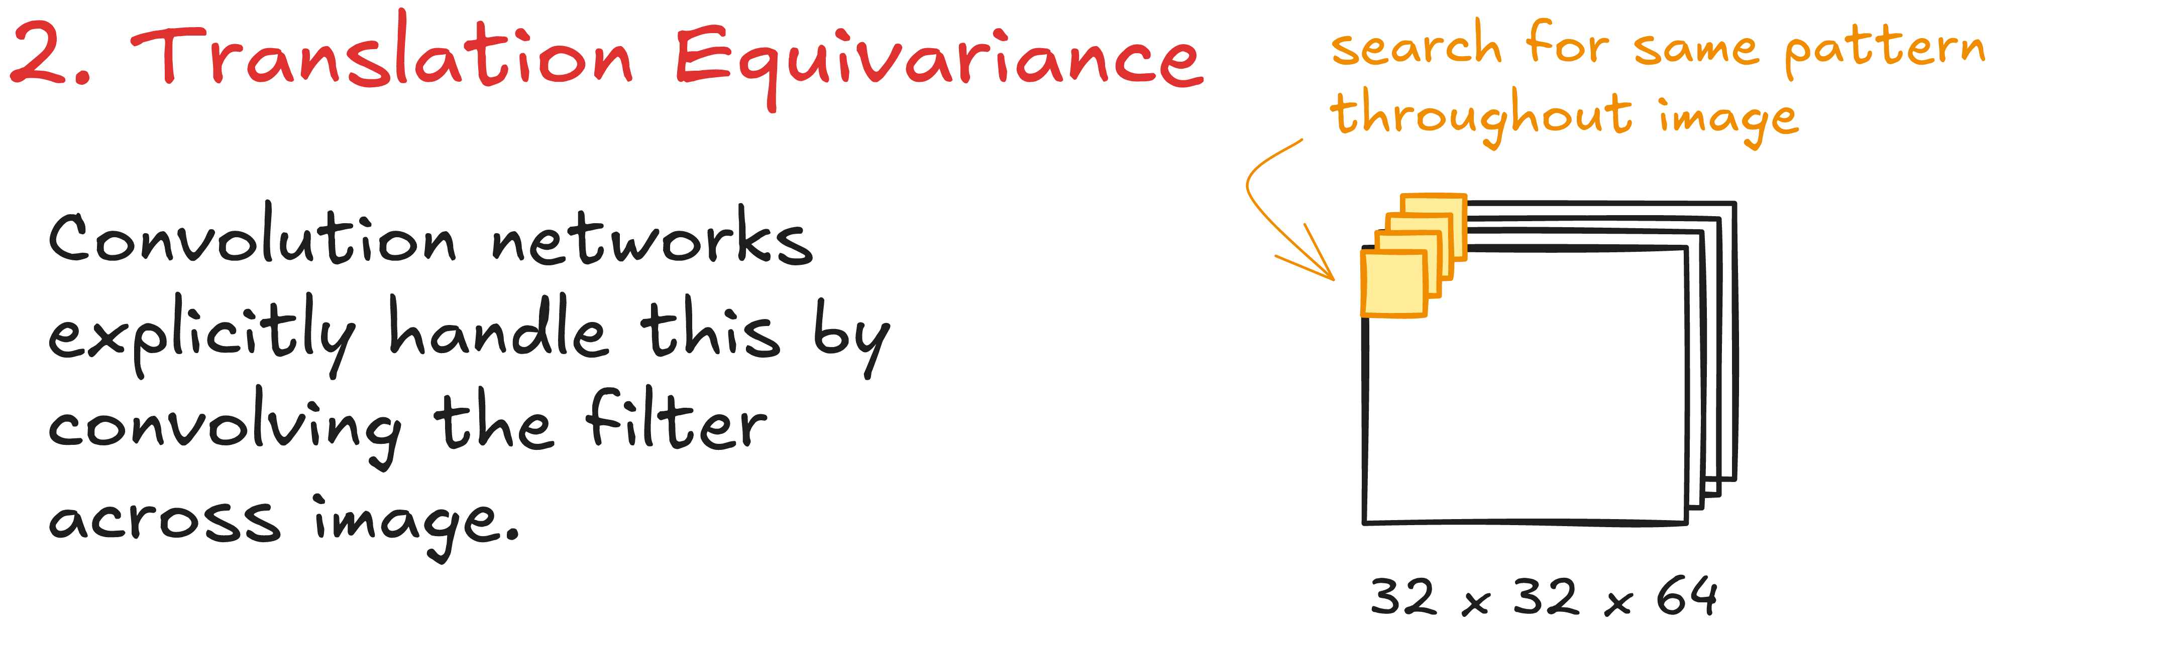
Why Choose ViT Over CNNs?
CNNs were structured for the purpose of working on images. This design advantage is referred to as inductive bias.
Notes:
Another important property is translation invariance.
CNNs recognize objects even if they shift slightly within the image because the same convolutional filters are applied across the entire spatial grid.
ViTs do not naturally have this property — they rely on training data to learn it.

Slide 63
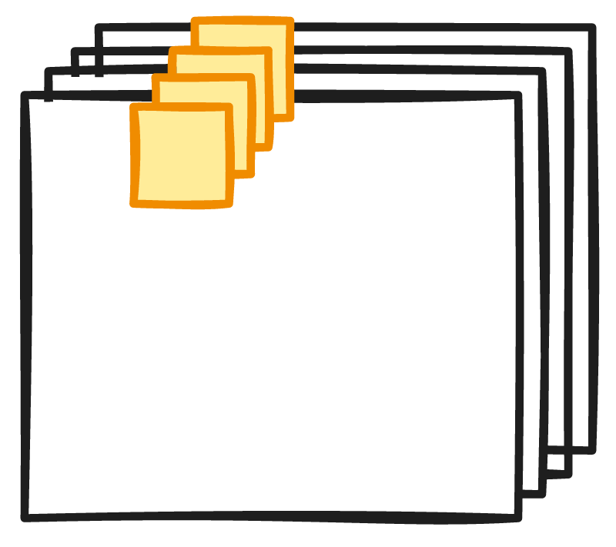
Why Choose ViT Over CNNs?
CNNs were structured for the purpose of working on images. This design advantage is referred to as inductive bias.
Notes:
Another important property is translation invariance.
CNNs recognize objects even if they shift slightly within the image because the same convolutional filters are applied across the entire spatial grid.
ViTs do not naturally have this property — they rely on training data to learn it.

Slide 64
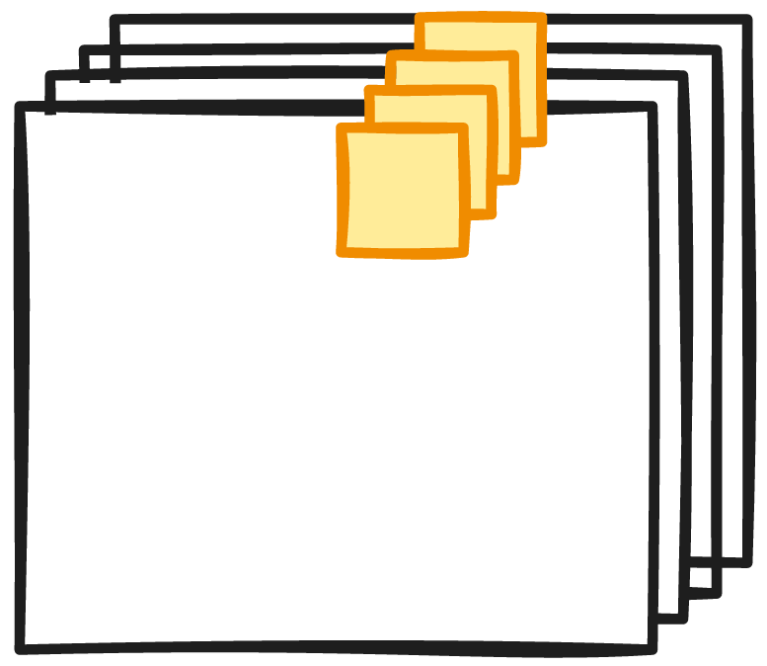
Why Choose ViT Over CNNs?
CNNs were structured for the purpose of working on images. This design advantage is referred to as inductive bias.
Notes:
Another important property is translation invariance.
CNNs recognize objects even if they shift slightly within the image because the same convolutional filters are applied across the entire spatial grid.
ViTs do not naturally have this property — they rely on training data to learn it.

Slide 65
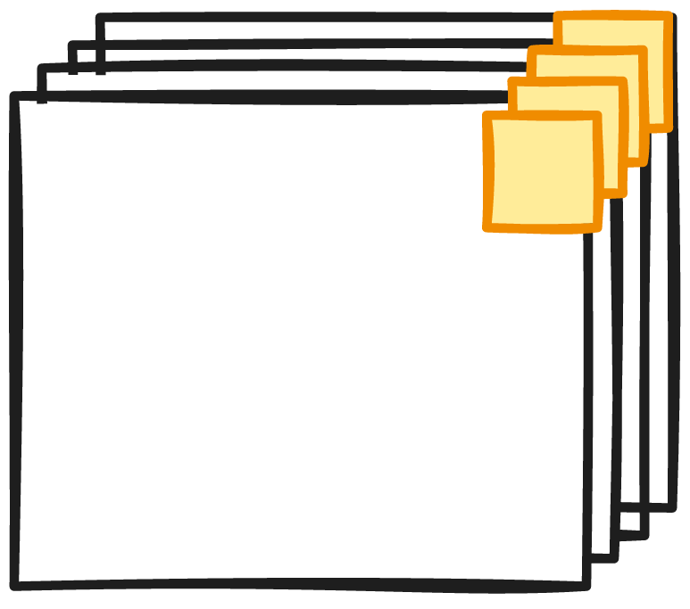
Why Choose ViT Over CNNs?
CNNs were structured for the purpose of working on images. This design advantage is referred to as inductive bias.
Notes:
Another important property is translation invariance.
CNNs recognize objects even if they shift slightly within the image because the same convolutional filters are applied across the entire spatial grid.
ViTs do not naturally have this property — they rely on training data to learn it.

Slide 66
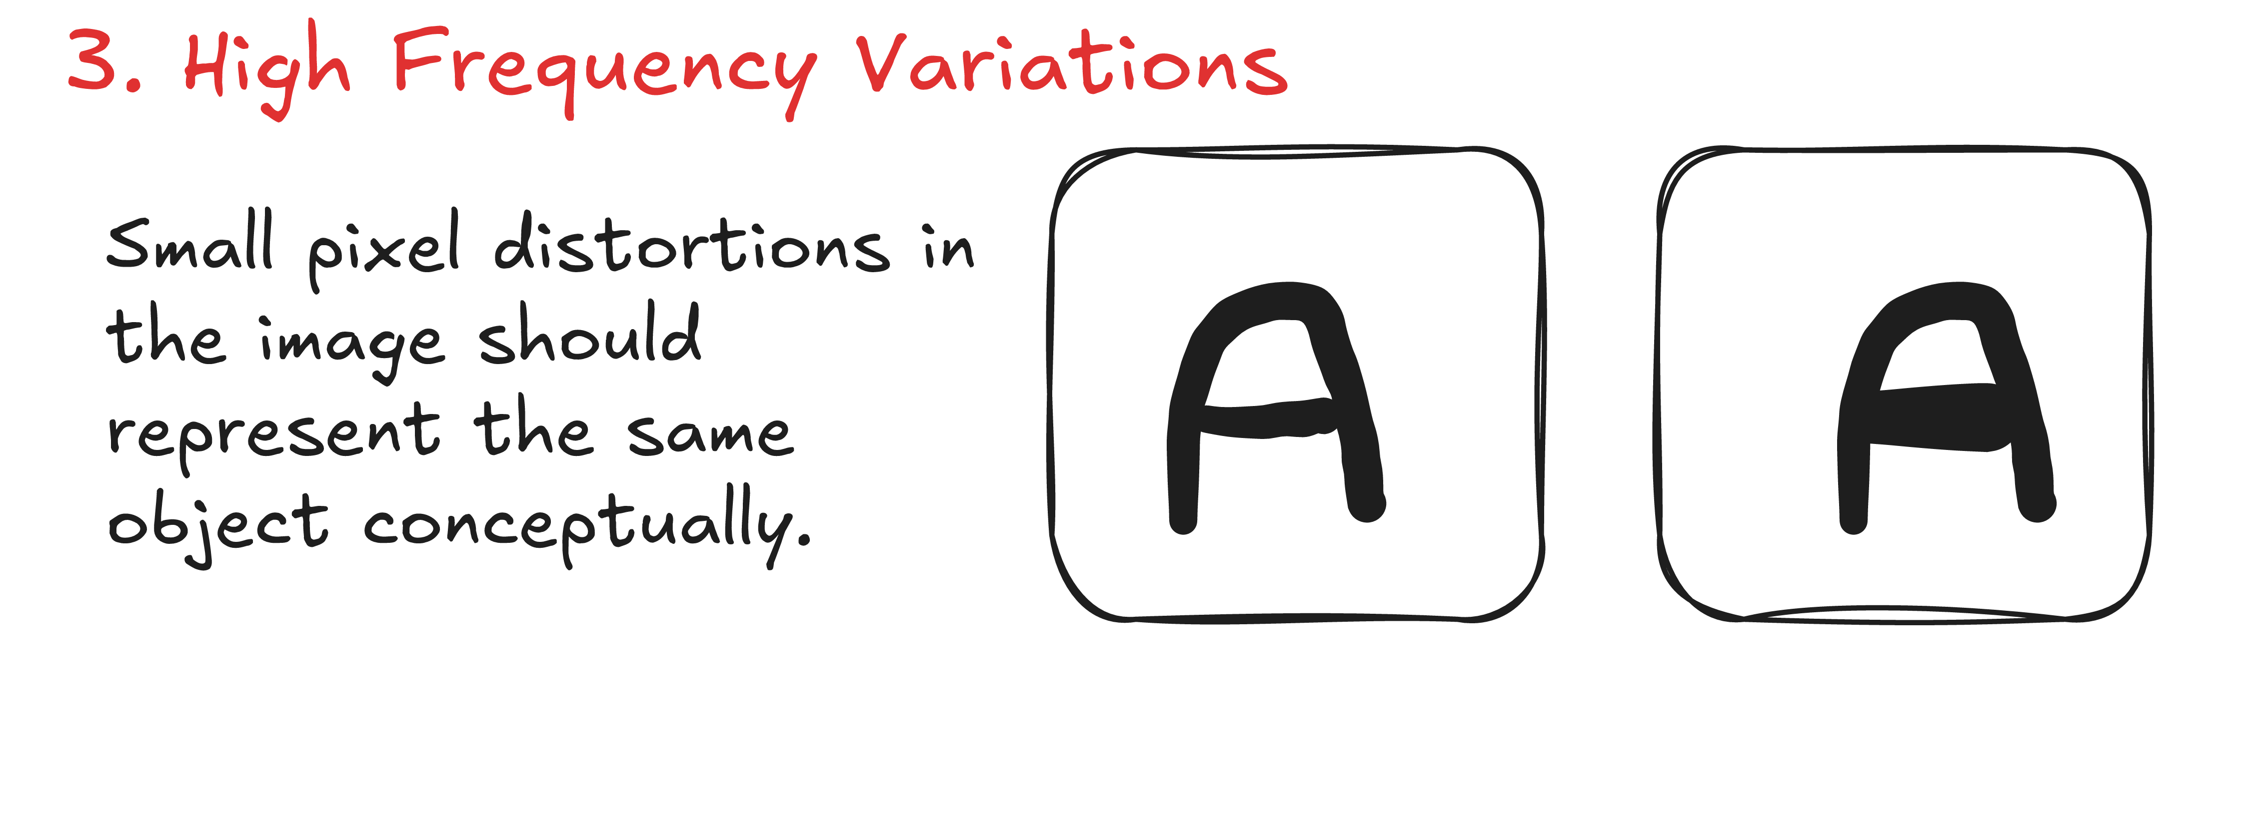
Why Choose ViT Over CNNs?
CNNs were structured for the purpose of working on images. This design advantage is referred to as inductive bias.
Notes:
CNNs also handle small pixel-level variations, such as noise or minor distortions, through operations like pooling, which reduce sensitivity to high-frequency changes.

Slide 67
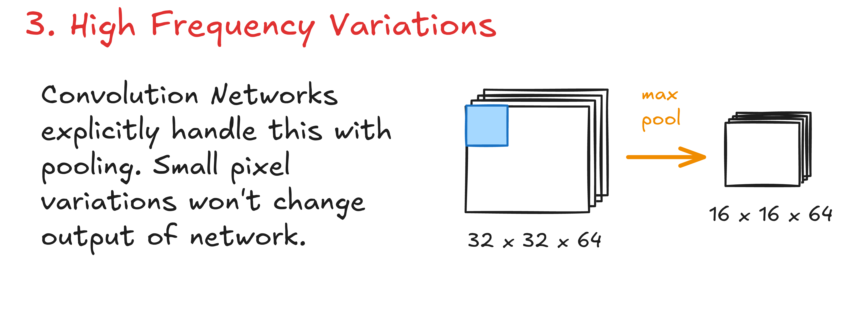
Why Choose ViT Over CNNs?
CNNs were structured for the purpose of working on images. This design advantage is referred to as inductive bias.
Notes:
Another important property is translation invariance.
CNNs recognize objects even if they shift slightly within the image because the same convolutional filters are applied across the entire spatial grid.
ViTs do not naturally have this property — they rely on training data to learn it.

Slide 68
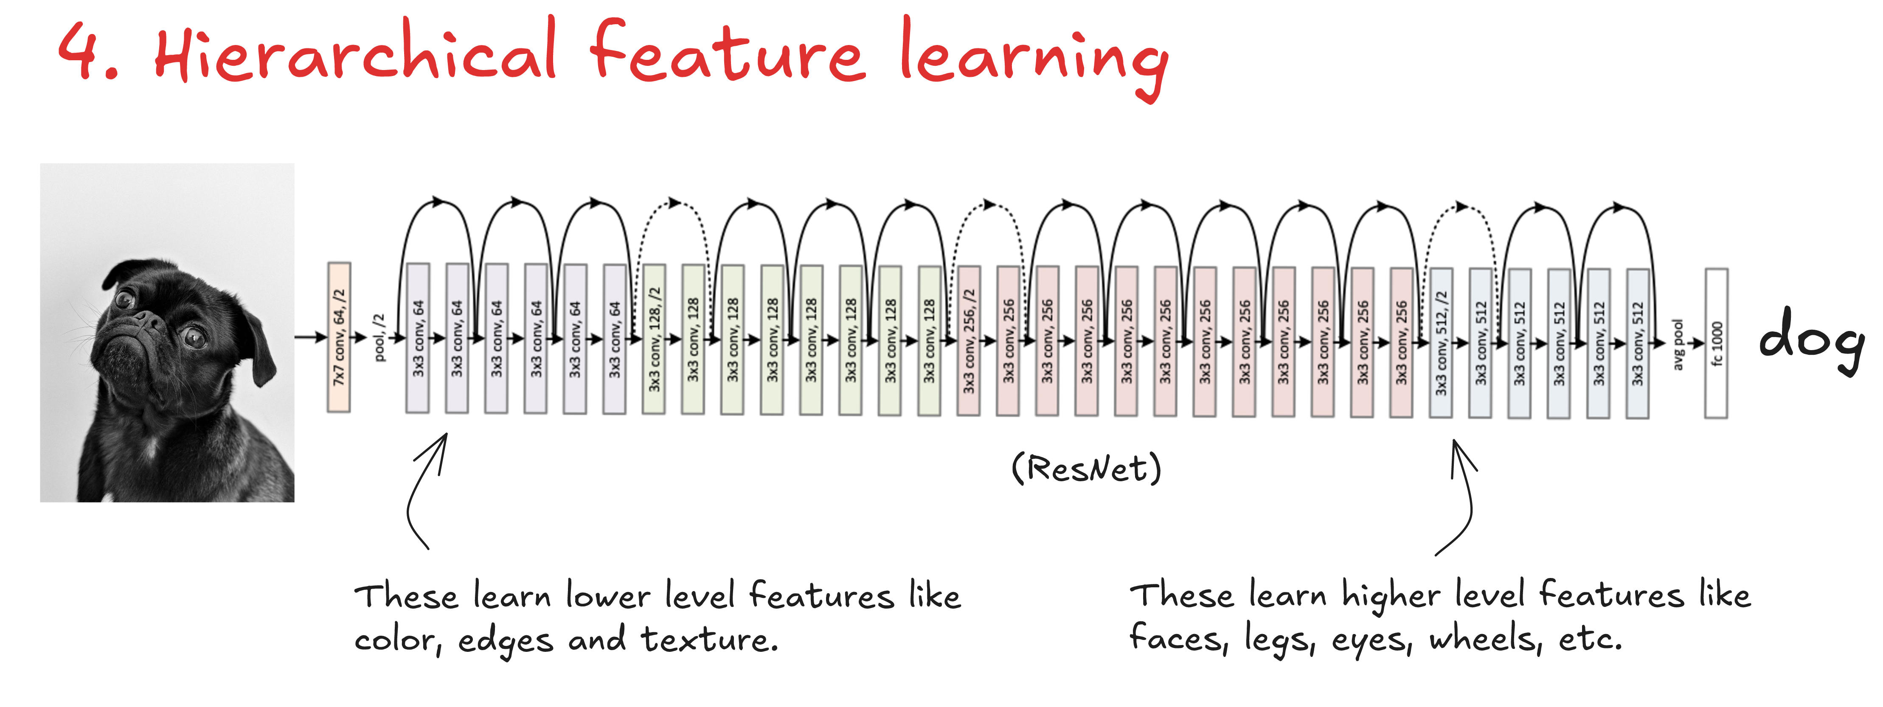
Why Choose ViT Over CNNs?
CNNs were structured for the purpose of working on images. This design advantage is referred to as inductive bias.
Notes:
Finally, CNNs learn features in a hierarchical manner.
Early layers detect low-level features, while deeper layers build up to higher-level semantic concepts.
Vision Transformers differ fundamentally here — self-attention allows them to model global relationships from the very first layer, rather than building features stage by stage.

Slide 69
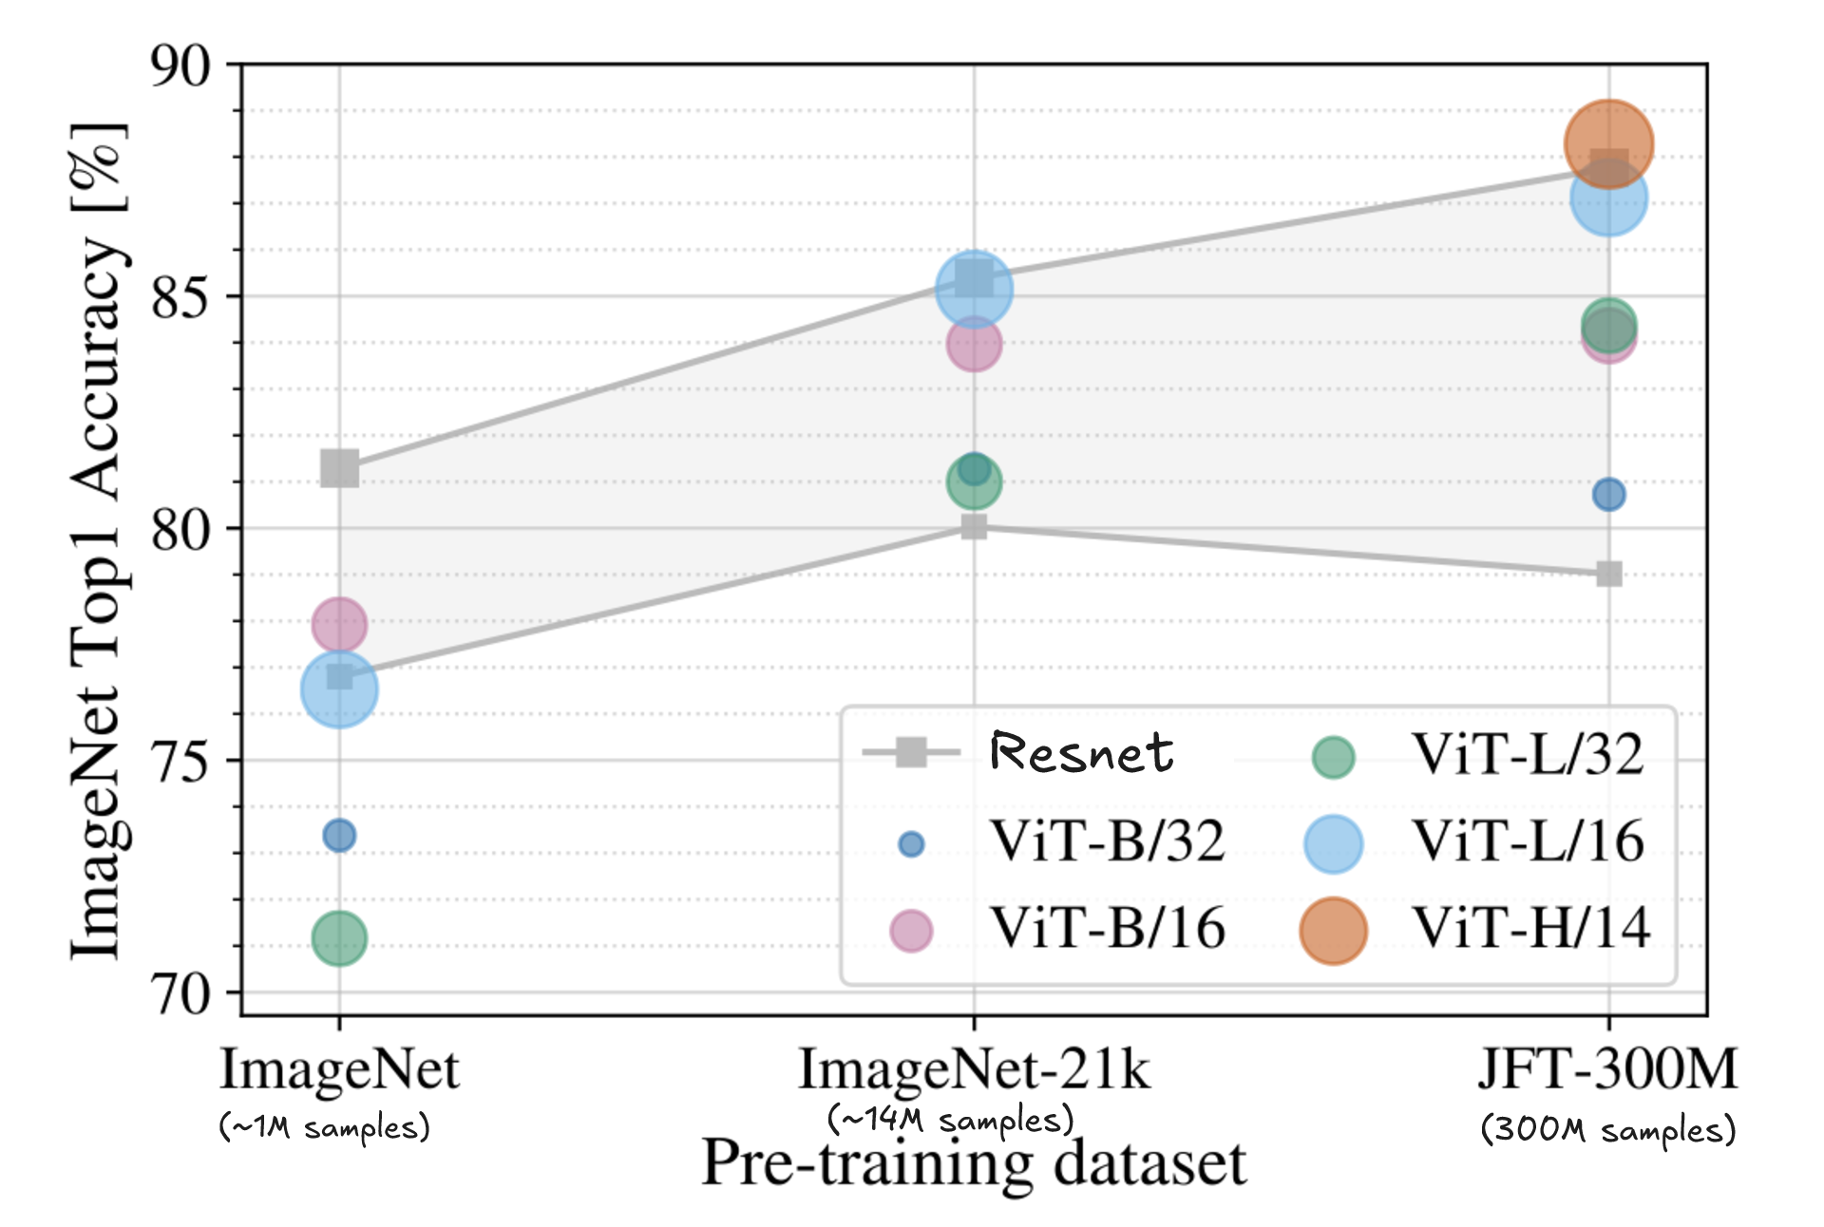
Why Choose ViT Over CNNs?
Scaling the training data of ViT outweighs the inductive biases of the convolutional networks.
Notes:
Because of their inductive biases, CNNs are more data-efficient on smaller datasets, but at large scale, Vision Transformers outperform them as data scaling outweighs those built-in assumptions.

Slide 70
Training at Scale
Vision Transformers achieve their best performance at scale, but this higher accuracy requires much more computation and longer training times.
Notes:
Training ViTs at scale, means scaling the model size, the amount of data, and using strong augmentation and regularization, often referred to as AugReg.
The result is higher accuracy, but at the cost of significantly increased computation and training time.

Slide 71

Training at Scale
Vision Transformers achieve their best performance at scale, but this higher accuracy requires much more computation and longer training times.
Large
Models
Notes:
Training ViTs at scale, means scaling the model size, the amount of data, and using strong augmentation and regularization, often referred to as AugReg.
The result is higher accuracy, but at the cost of significantly increased computation and training time.

Slide 72

Training at Scale
Vision Transformers achieve their best performance at scale, but this higher accuracy requires much more computation and longer training times.
Large
Models
Large
Data
Notes:
Training ViTs at scale, means scaling the model size, the amount of data, and using strong augmentation and regularization, often referred to as AugReg.
The result is higher accuracy, but at the cost of significantly increased computation and training time.

Slide 73

Training at Scale
Vision Transformers achieve their best performance at scale, but this higher accuracy requires much more computation and longer training times.
Large
Models
Large
Data
Augmentation
+
Regularization
(AugReg)
Notes:
Training ViTs at scale, means scaling the model size, the amount of data, and using strong augmentation and regularization, often referred to as AugReg.
Data augmentation artificially increases dataset diversity through techniques like random cropping, while regularization helps reduce overfitting in large models.
The result is higher accuracy, but at the cost of significantly increased computation and training time.

Slide 74
Agenda
Introduction & History
Basic Architecture
Patch Tokenization
Self Attention
ViT Architecture
6. Conclusion

Slide 75
Conclusion
  In conclusion, Vision Transformers introduce a new way of analyzing images by using self-attention to capture global relationships instead of only local patterns. By converting images into patch tokens, they process visual data similarly to language sequences and learn long-range dependencies effectively. Although they require large datasets and higher computational resources, they achieve strong performance on complex vision tasks. With improvements like hybrid models and efficient architectures, Vision Transformers are becoming an important and rapidly growing direction in modern computer vision.

