Slide 1
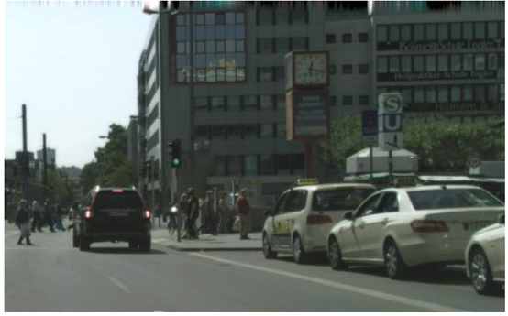
Q1. Match the segmentation type with the correct description for the given reference image
Description
Each car is labeled separately (Car 1, Car 2, Car 3), each pedestrian separately (Person 1, Person 2), and the background is also labeled with classes such as road, sidewalk, building, and sky.
2. All cars in the image (Car 1, Car 2, Car 3…) are labeled simply as “car”, all pedestrians as “person”, the road as “road”, and buildings as “building”, with no distinction between individual cars or people.
3. Each visible car is labeled separately as Car 1, Car 2, Car 3, each pedestrian as Person 1, Person 2, but the road, sky, and buildings are not individually identified as objects.
Segmentation type
Semantic Segmentation
B. Instance Segmentation
C. Panoptic Segmentation
Notes:
A2,B3,C1

Slide 2
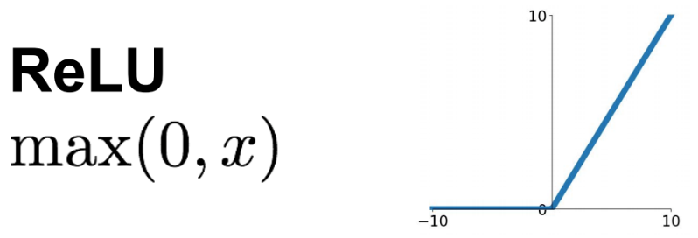


Q2. Why is a convolutional layer always followed by an activation function? What would be the effect of adding multiple convolutional layers without adding an activation function?
$K$ feature maps
Almost always directly followed by a ReLU (or similar activation function)
$K$ filters
image
convolutional layer
Source: Stanford 231n

Slide 3
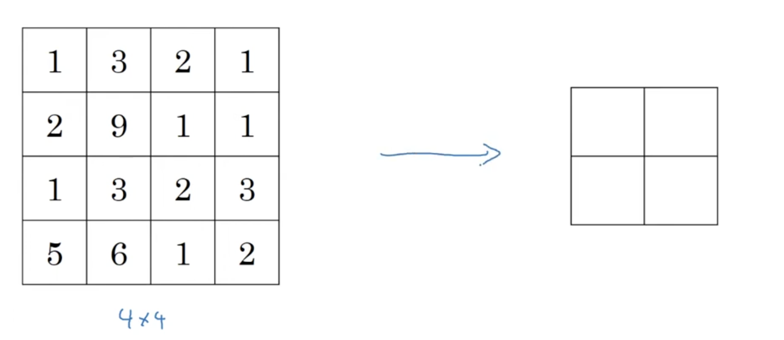
Q3. Given the following input, find the max pooled output for filter (kernel) size 2 and stride 2.
Source: Stanford 231n

Slide 4
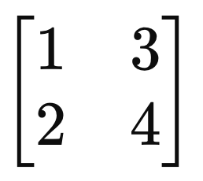
Q4. Given the following input matrix, upsample it using bilinear interpolation.
1 | p | 3
q | r | s
2 | t | 4
Source: Stanford 231n

Slide 5
Q5. You are building a vision system to analyze millions of satellite images collected daily. Only a very small fraction of the images are labeled, and obtaining pixel-level annotations is expensive and slow. However, you have access to massive amounts of unlabeled data.
Which training strategy is most appropriate, and why?
A. Fully supervised training from scratch
B. Transfer learning using a supervised ImageNet model only
C. Self-supervised pre-training on unlabeled data followed by supervised fine-tuning
D. Training a shallow classifier on handcrafted features

Slide 6
Q6. A student argues that self-supervised learning will always outperform supervised learning because it uses more data.
Which scenario contradicts this claim?
A. Large unlabeled dataset with no labels
B. Abundant labeled data for the exact target task
C. Domain shift between pretraining and downstream task
D. Pretext task unrelated to downstream semantics

