Slide 1
Repurposing pre-trained networks
Fully supervised training:
  Train on large dataset, test on the same task
Test on
learned task
Figure source

Slide 2
Repurposing pre-trained networks
Transfer learning:
  Pre-train on large dataset
  Fine-tune for a different task on a smaller dataset
Fine-tune on new task
Figure source

Slide 3
Repurposing pre-trained networks
Self-supervised pre-training:
  Pre-train on large dataset without labels using a pretext task objective
  Fine-tune for a different task on a smaller dataset (with labels)
Fine-tune on new task
Pretext task
Figure source

Slide 4
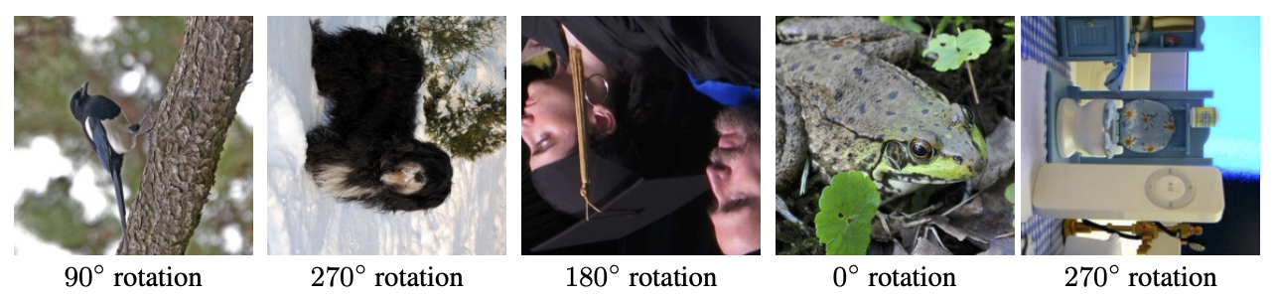
Pretext task: Rotation prediction (MP3)
Can you recognize the image rotation (0, 90, 180, 270 degrees)?
S. Gidaris, P. Singh, and N. Komodakis. Unsupervised representation learning by predicting image rotations. ICLR 2018

Slide 5
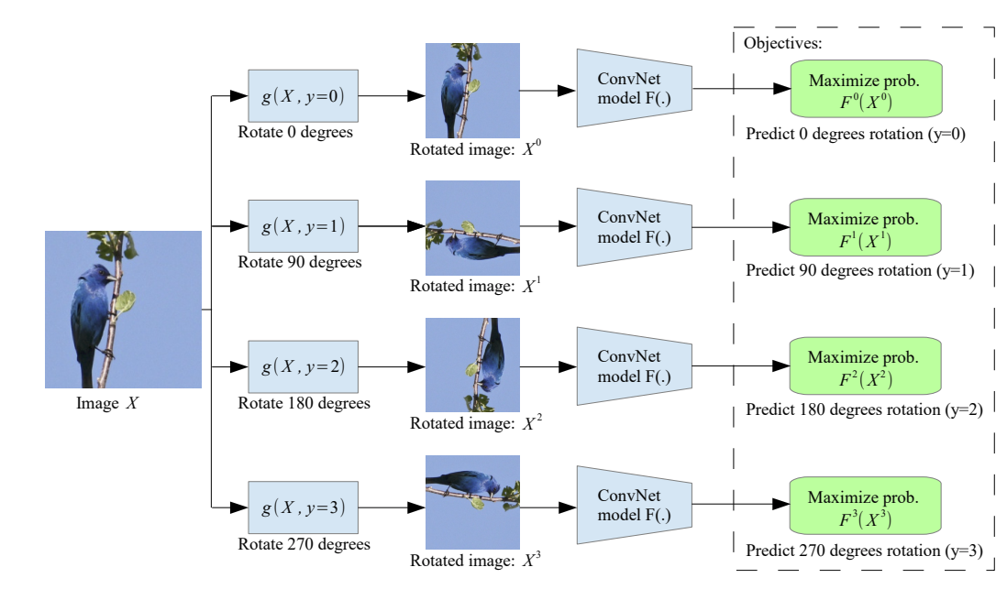
Pretext task: Rotation prediction (MP3)
During training, feed in all four rotated versions of an image in the same mini-batch
S. Gidaris, P. Singh, and N. Komodakis. Unsupervised representation learning by predicting image rotations. ICLR 2018

Slide 6
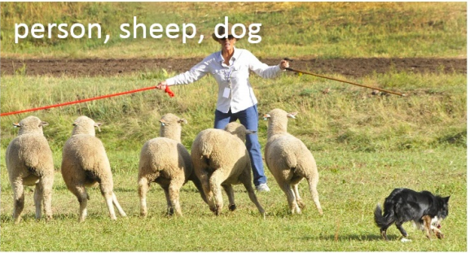
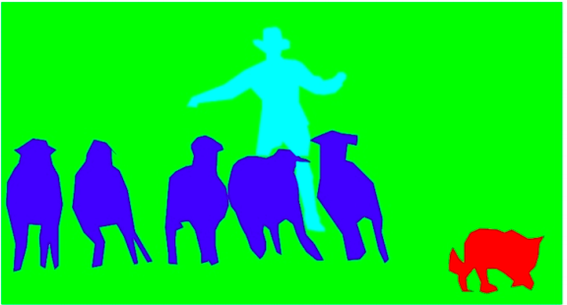
CNNs for dense prediction
Image classification
Semantic segmentation

Slide 7
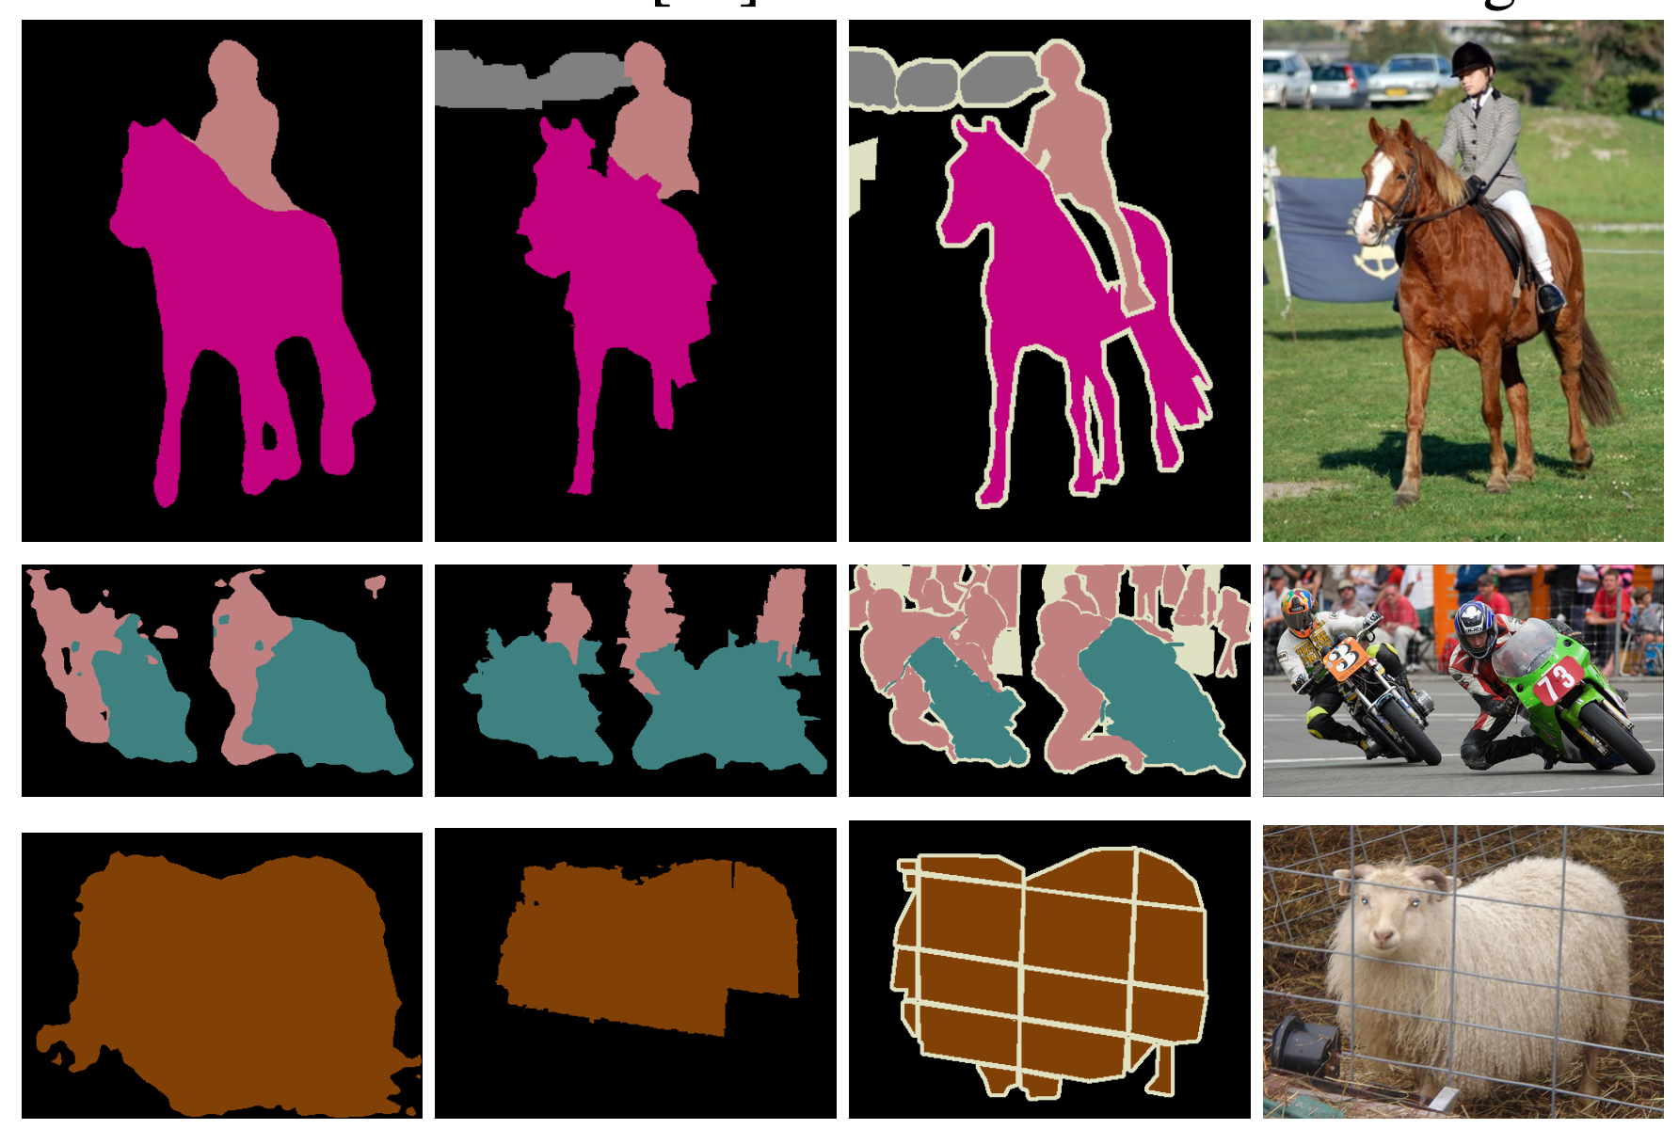
Semantic segmentation
Image
Ground truth
Predicted labeling
Figure source

Slide 8
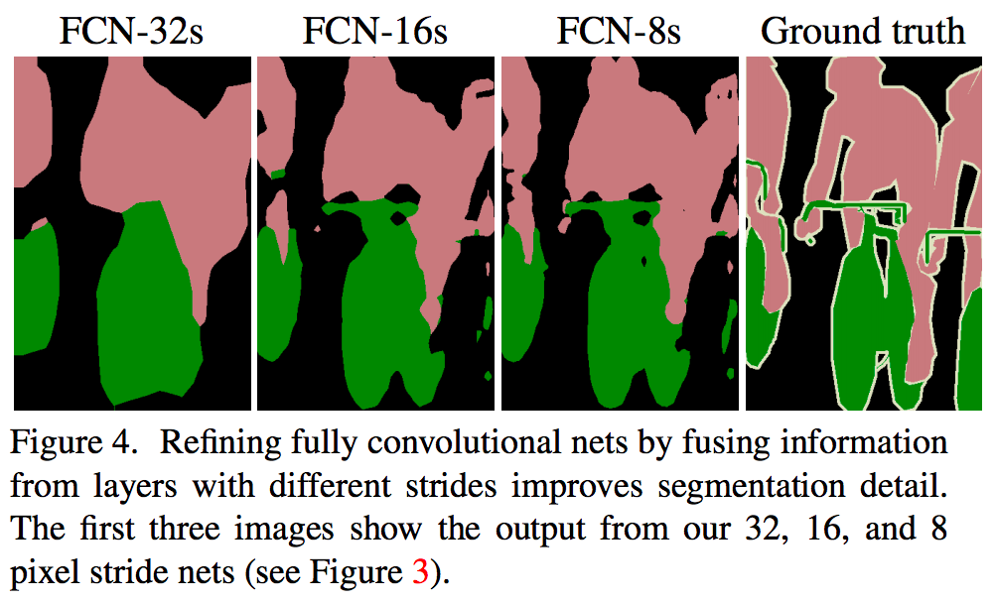
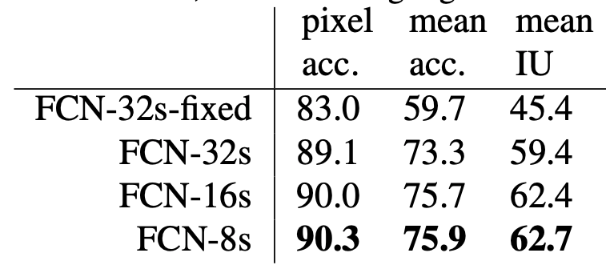
Semantic segmentation
Example evaluation:
Comparison on a subset of PASCAL 2011 validation data
J. Long et al. Fully Convolutional Networks for Semantic Segmentation. CVPR 2015

Slide 9
Outline
Dense prediction architectures
Feature map upsampling
U-Net
A tour of dense prediction problems

Slide 10
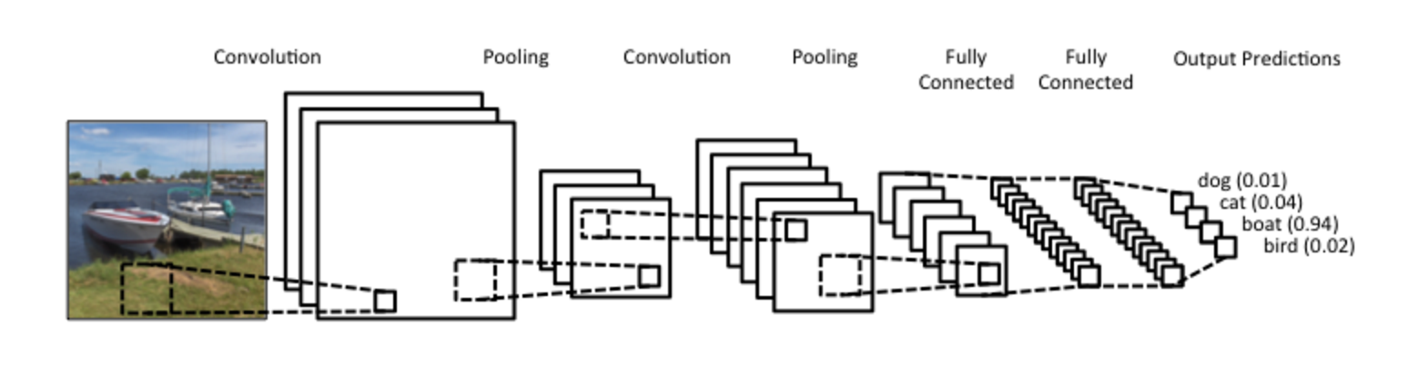
Convolutional architectures so far
Stem/
backbone
Head

Slide 11
Convolutional architectures so far
How do we repurpose
this architecture for other tasks, like semantic segmentation?
VGG19
Image source

Slide 12
Convolutional architectures so far
How do we repurpose
this architecture for other tasks, like semantic segmentation?
VGG19
Retain the stem, build some new layers on top of the output feature maps: e.g., 1x1 conv, elementwise softmax
How to deal with the loss of spatial resolution?
Image source

Slide 13
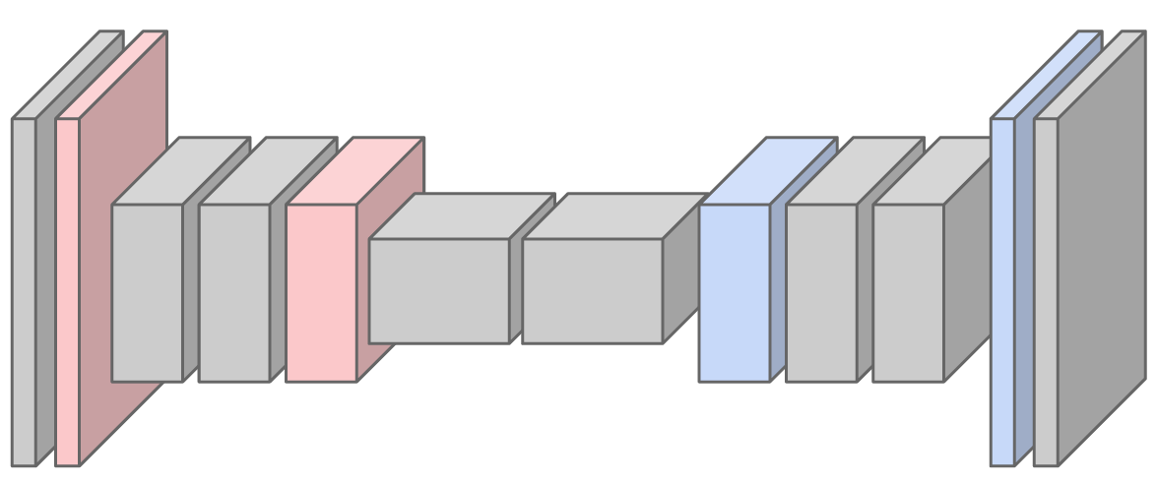
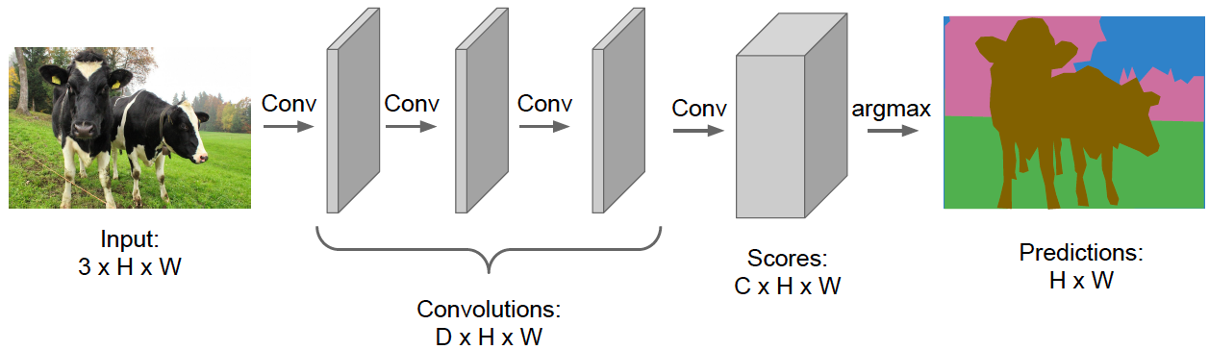
Dense prediction architecture
Idea 1: need to upsample the intermediate feature maps to produce full-resolution predictions
Idea 2: need to fuse encoder and decoder feature maps to avoid loss of spatial information
Encoder
Decoder
Source: Stanford CS231n

Slide 14
Dense prediction architecture
Why not a network with only stride-1 convolutions and element-wise operations?
Source: Stanford CS231n

Slide 15
Outline
Dense prediction architectures
Feature map upsampling

Slide 16
How to upsample a feature map by a factor of 2?
Step 1: increase the resolution of the feature grid

Slide 17
How to upsample a feature map by a factor of 2?
Step 2: interpolate to get the missing values

Slide 18
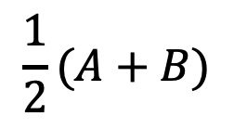
How to upsample a feature map by a factor of 2?
A
B
$$\frac{1}{2}(A+B)$$
C
D

Slide 19
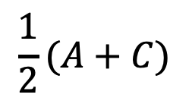
How to upsample a feature map by a factor of 2?
A
B
$$\frac{1}{2}(A+C)$$
C
D

Slide 20
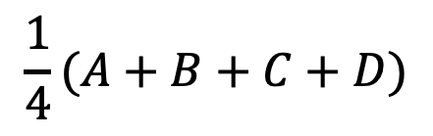
How to upsample a feature map by a factor of 2?
A
B
$$\frac{1}{4}(A+B+C+D)$$
C
D

Slide 21
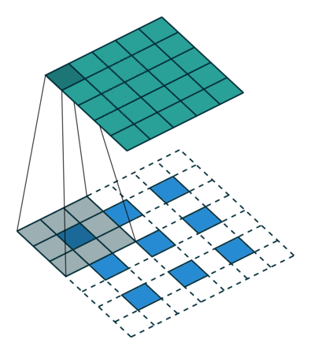
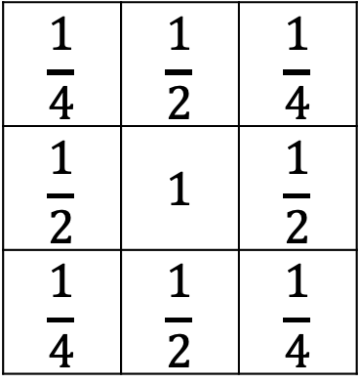
Upsampling by filtering
For 2x upsampling, dilate the input by inserting rows and columns of zeros between adjacent entries, convolve with upsampling filter
Upsampling filter:
$$\frac{1}{4}$$ | $$\frac{1}{2}$$ | $$\frac{1}{4}$$
$$\frac{1}{2}$$ | $$1$$ | $$\frac{1}{2}$$
$$\frac{1}{4}$$ | $$\frac{1}{2}$$ | $$\frac{1}{4}$$
output
input
A learned upsampling filter can be used as well
V. Dumoulin and F. Visin, A guide to convolution arithmetic for deep learning, arXiv 2018

Slide 22
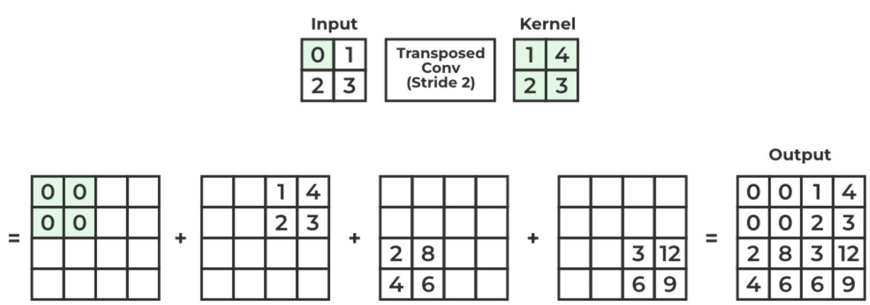
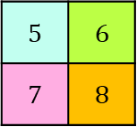
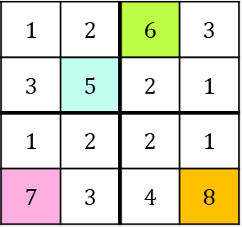

Upsampling by max unpooling
“Reversing” a max pooling operation:
Max pooling
Max unpooling
$$1$$ | $$2$$ | $$6$$ | $$3$$
$$3$$ | $$5$$ | $$2$$ | $$1$$
$$1$$ | $$2$$ | $$2$$ | $$1$$
$$7$$ | $$3$$ | $$4$$ | $$8$$
$$0$$ | $$0$$ | $$6$$ | $$0$$
$$0$$ | $$5$$ | $$0$$ | $$0$$
$$0$$ | $$0$$ | $$0$$ | $$0$$
$$7$$ | $$0$$ | $$0$$ | $$8$$
$$5$$ | $$6$$
$$7$$ | $$8$$
Output is sparse, so unpooling is typically followed by a transposed convolution layer
Remember pooling indices (which element was max)
An example of
a transposed convolution

Slide 23
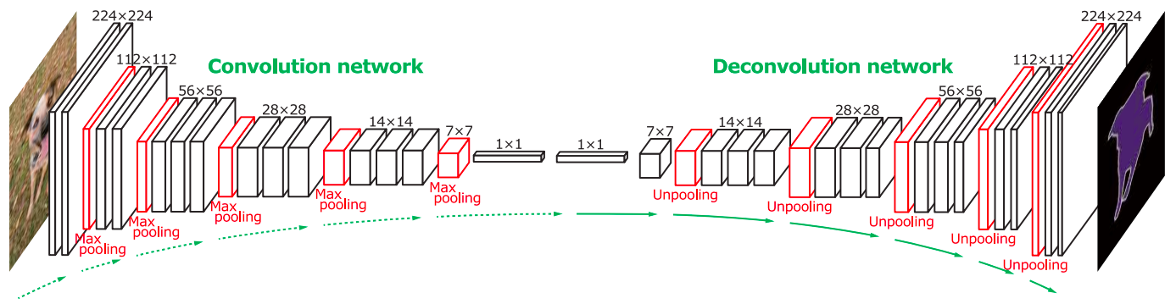
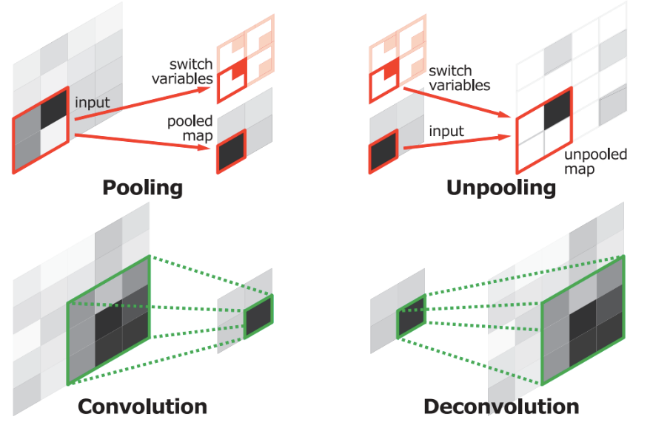
Early dense prediction architecture: DeconvNet
A learned upsampling operation that increases spatial resolution is called deconvolution (or transposed convolution).
It is not inverse convolution. A confusing jargon.
H. Noh et al. Learning Deconvolution Network for Semantic Segmentation. ICCV 2015

Slide 24
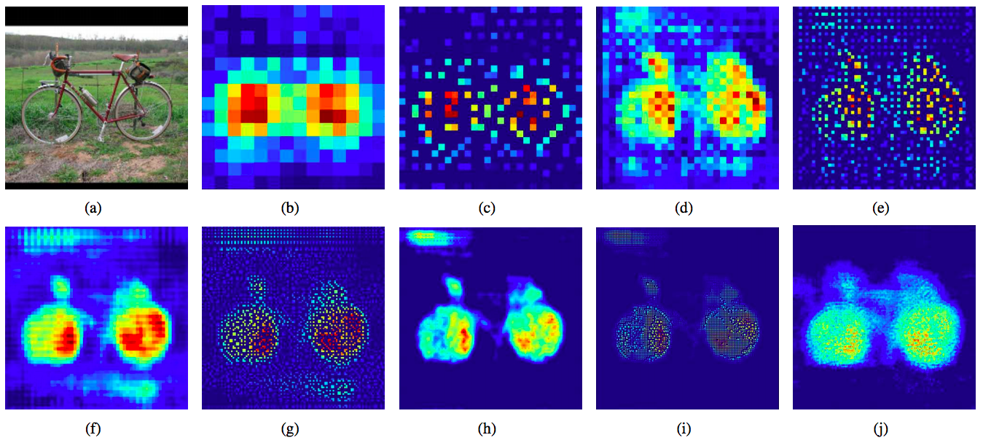
Early dense prediction architecture: DeconvNet
Original image
14x14 deconv
28x28 unpooling
28x28 deconv
54x54 unpooling
54x54 deconv
112x112 unpooling
112x112 deconv
224x224 unpooling
224x224 deconv
H. Noh et al. Learning Deconvolution Network for Semantic Segmentation. ICCV 2015

Slide 25
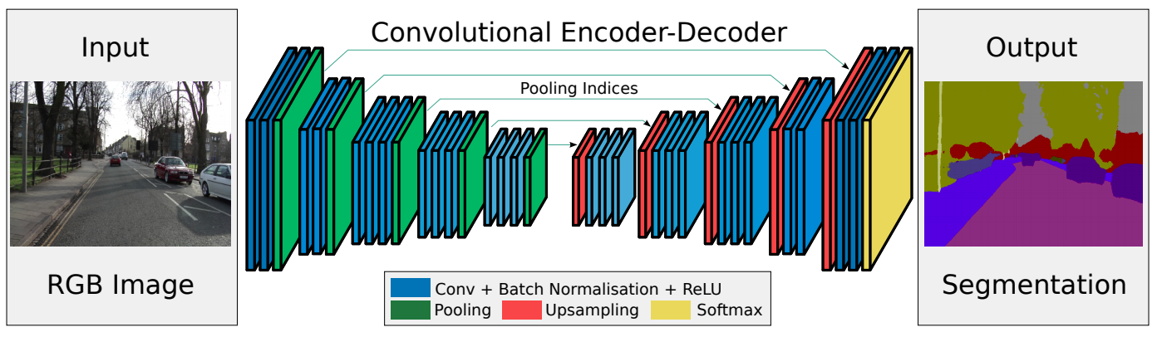
Another early architecture: SegNet
Drop the FC layers,
get better results
V. Badrinarayanan et al. SegNet: A Deep Convolutional Encoder-Decoder Architecture for Image Segmentation. PAMI 2017

Slide 26
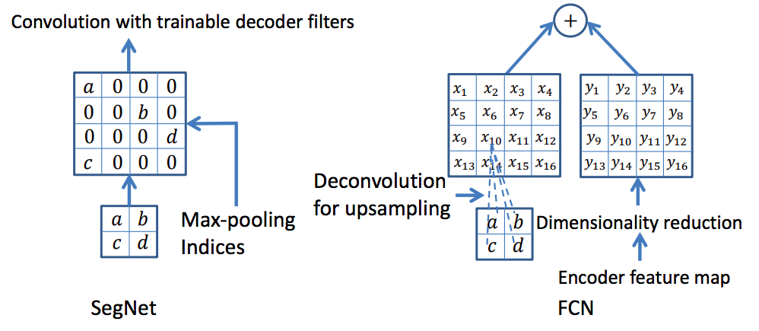
Another early architecture: SegNet
V. Badrinarayanan et al. SegNet: A Deep Convolutional Encoder-Decoder Architecture for Image Segmentation. PAMI 2017

Slide 27
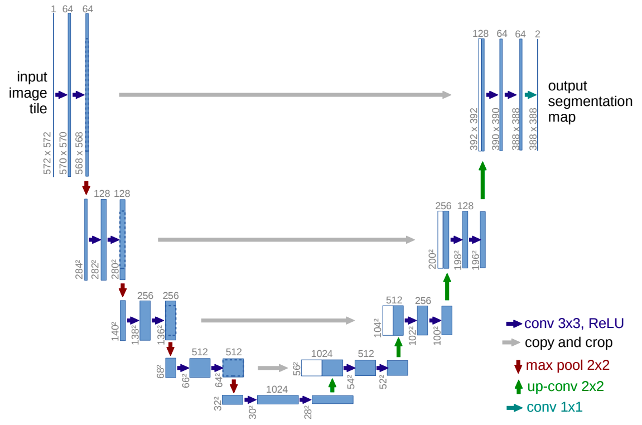
U-Net
copy-and-concatenate skip connections
Cropping in skip connections was needed since no padding was
used in U-net
O. Ronneberger et al. U-Net: Convolutional Networks for Biomedical Image Segmentation. MICCAI 2015

Slide 28
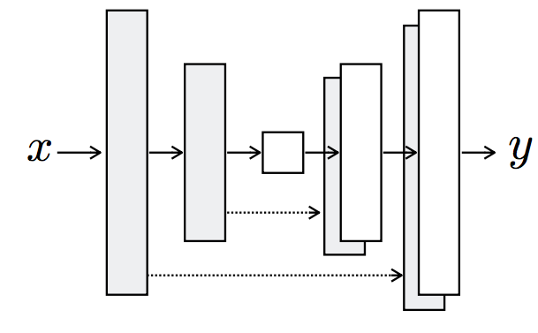
A more typical representation of U-Net
Figure source

Slide 29
Outline
Dense prediction architectures
Feature map upsampling
U-Net
A tour of dense prediction problems

Slide 30
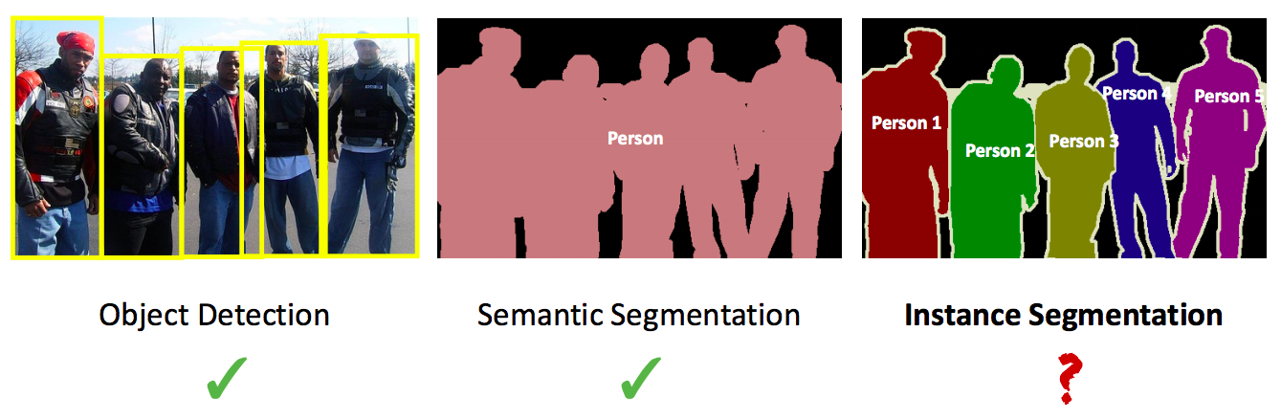
Instance segmentation
Source: Kaiming He

Slide 31
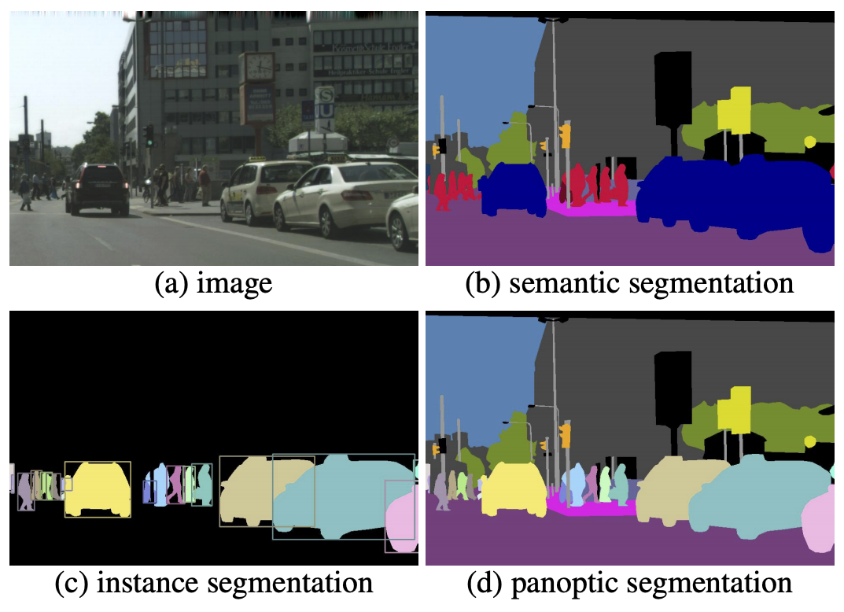
Instance and panoptic segmentation
A. Kirillov et al. Panoptic segmentation. CVPR 2019
Notes:
Each pixel of an image must be assigned a semantic label and an instance id. Pixels with the same label and id belong to the same object; for stuff labels the instance id is ignored.

Slide 32
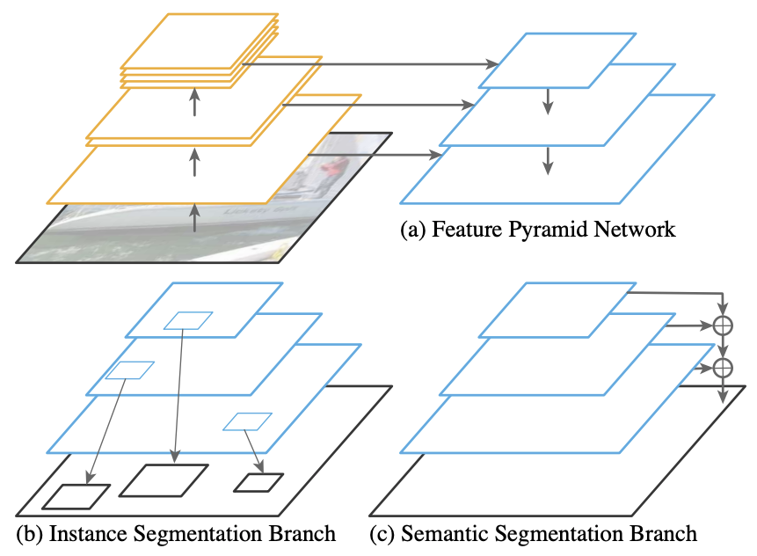
Panoptic feature pyramid networks
A. Kirillov et al. Panoptic feature pyramid networks. CVPR 2019
Notes:
We start with an FPN backbone [36], widely used in object detection, for extracting rich multi-scale features. (b) As in Mask R-CNN [24], we use a region-based branch on top of FPN for instance segmentation. (c) In parallel, we add a lightweight denseprediction branch on top of the same FPN features for semantic segmentation. This simple extension of Mask RCNN with FPN is a fast and accurate baseline for both tasks

Slide 33
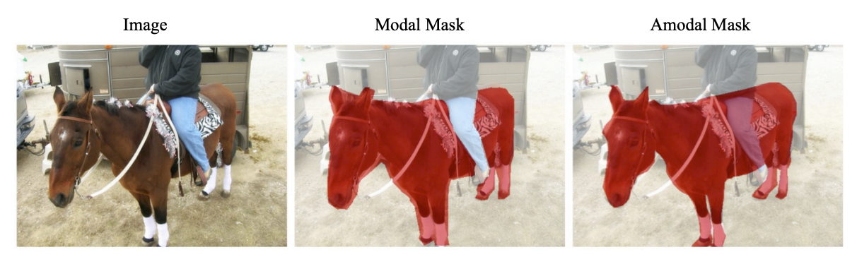
Amodal segmentation
K. Li and J. Malik. Amodal instance segmentation. ECCV 2016

Slide 34
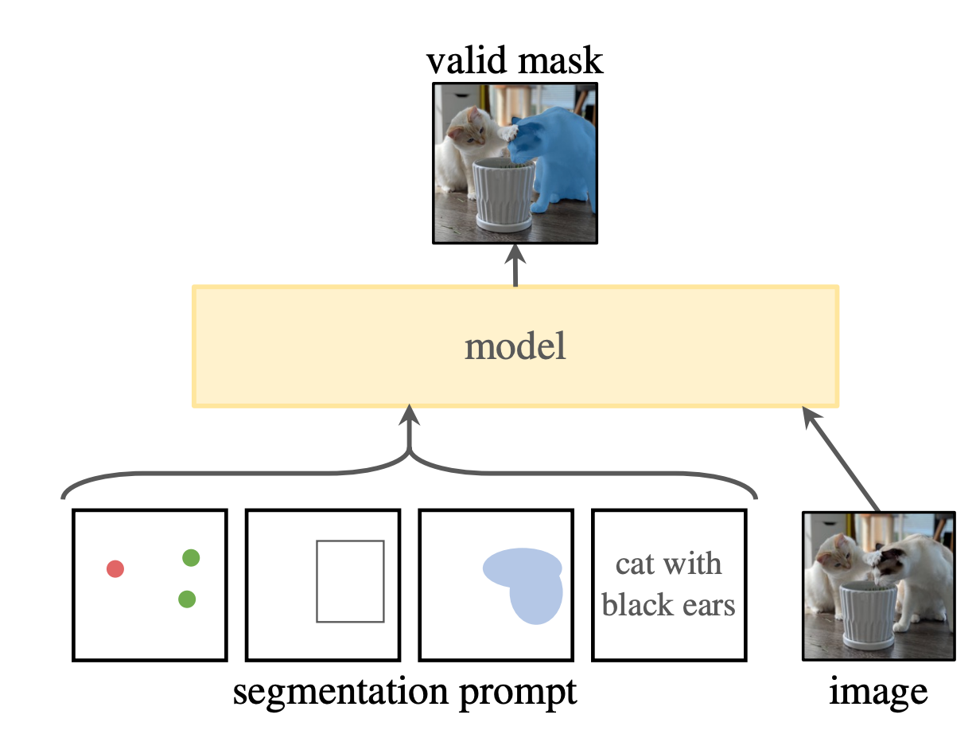
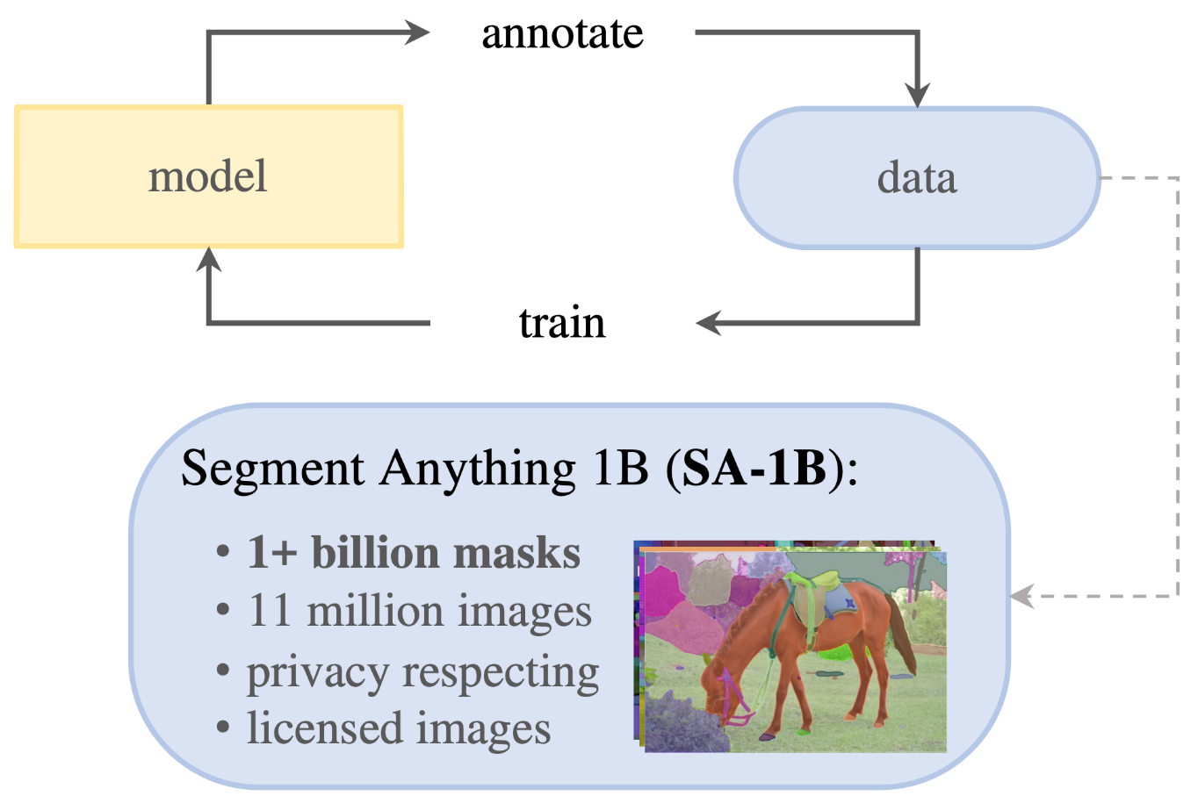
Promptable segmentation
A. Kirilllov et al. Segment anything. ICCV 2023

Slide 35
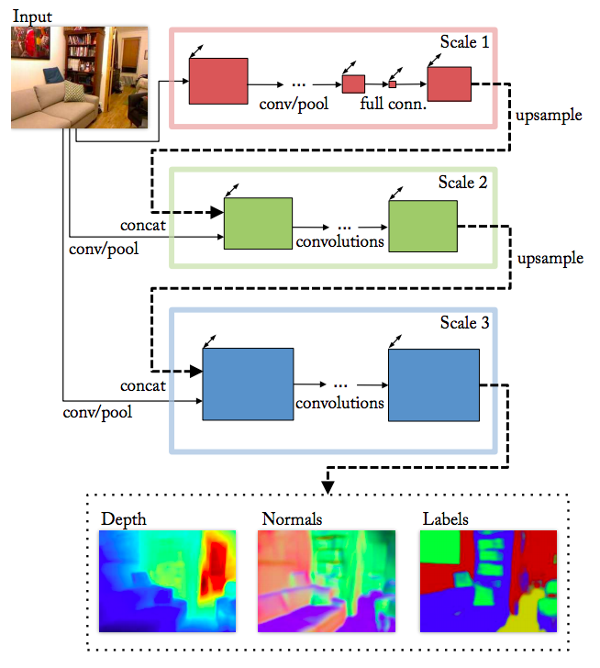
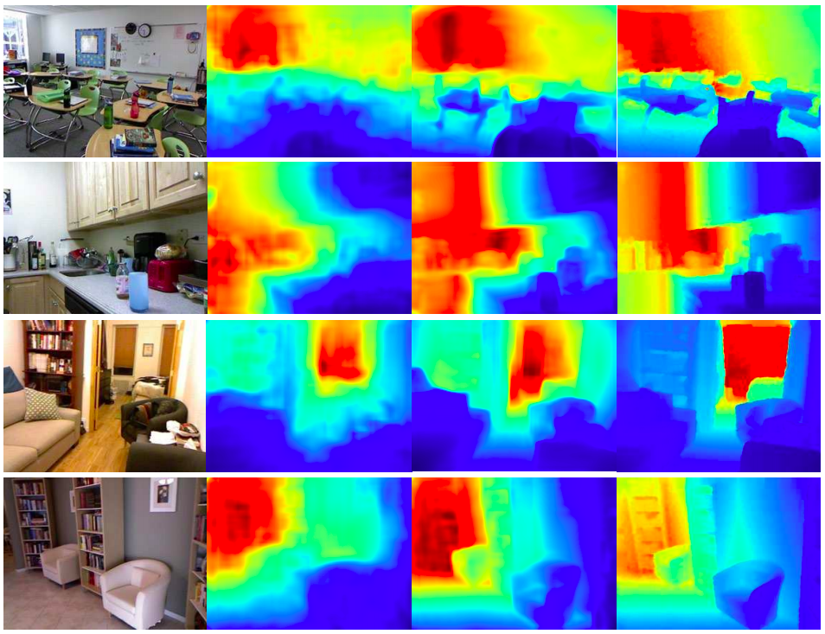
Depth and normal estimation
Predicted depth
Ground truth
D. Eigen and R. Fergus, Predicting Depth, Surface Normals and Semantic Labels with a Common Multi-Scale Convolutional Architecture, ICCV 2015

Slide 36
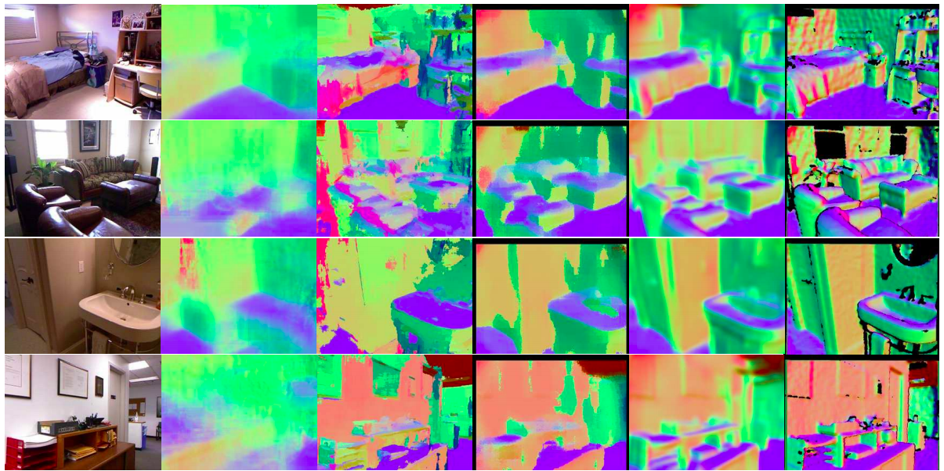
Depth and normal estimation
Predicted normals
Ground truth
D. Eigen and R. Fergus, Predicting Depth, Surface Normals and Semantic Labels with a Common Multi-Scale Convolutional Architecture, ICCV 2015

Slide 37
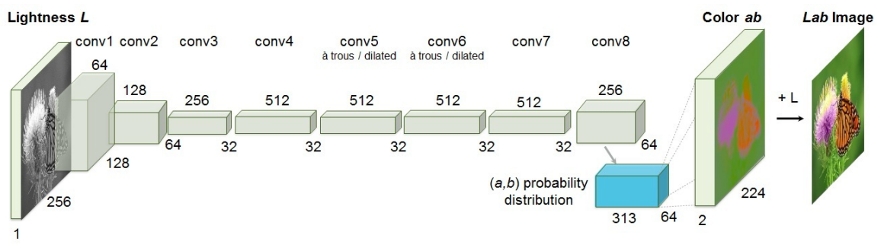
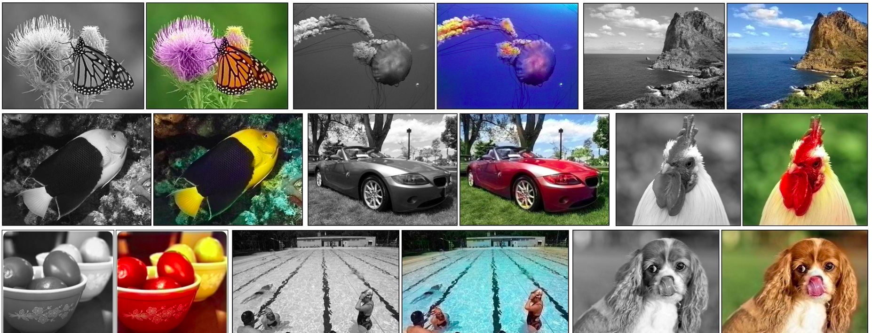
Colorization
R. Zhang, P. Isola, and A. Efros, Colorful Image Colorization, ECCV 2016

Slide 38
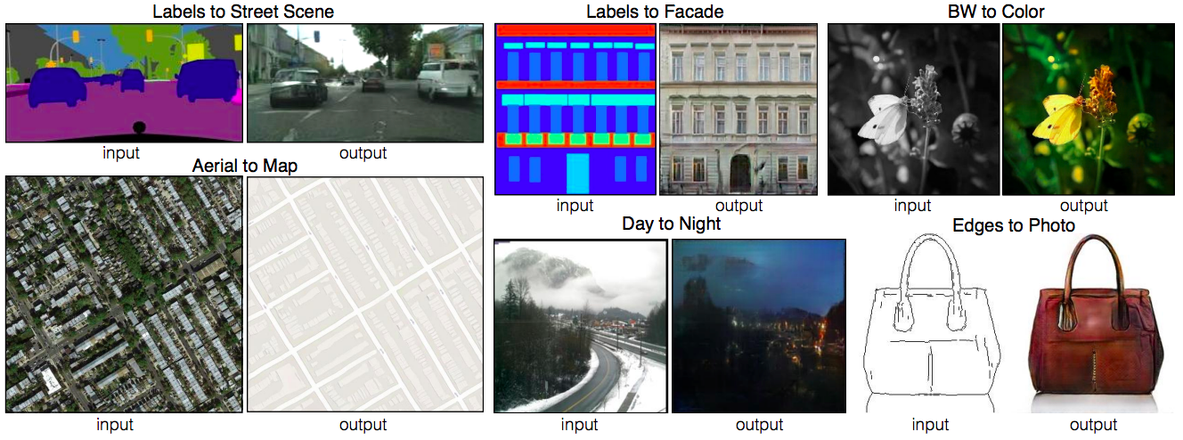
Image-to-image translation (paired)
P. Isola, J.-Y. Zhu, T. Zhou, A. Efros, Image-to-Image Translation with Conditional Adversarial Networks, CVPR 2017

