Slide 1

Video Language Models
CIS 5543 — Computer Vision
Dr. Longin Jan Latecki
Di Liu, Nahom Lulseged Tamene, Srihas Gidda
Notes:
Good afternoon. Our presentation is on video language models. I’ll begin with Part A, which focuses on video representation: how we move from raw frames to representations that later support captioning, question answering, and temporal reasoning.

Slide 2
Part A. Video Representation
From frames to tokens: sampling, tokenization, and temporal attention
Notes:
In this first part, I’ll focus on a basic but important question: what changes when we move from images to video? The short answer is that video adds time, and that creates both a representational challenge and a computational one. I’ll organize this around three ideas: frame sampling, tokenization, and temporal attention.

Slide 3
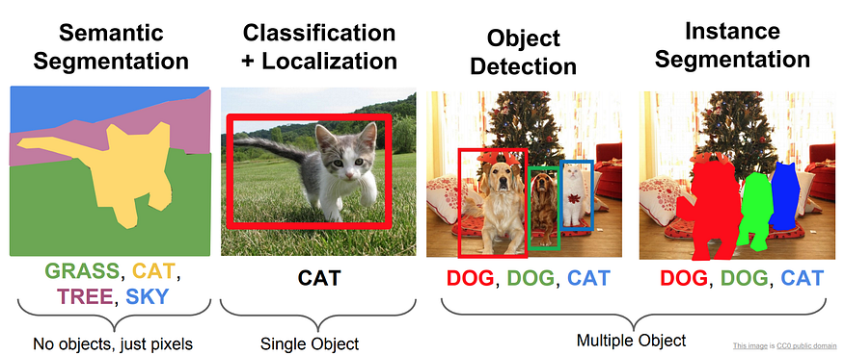
What image models already do well
Notes:
Let’s begin with the image case. Modern vision models already do a great deal within a single frame. They can classify an image, detect objects, segment regions, and separate individual instances. So the issue is not that visual understanding is impossible. The issue is that most image models are fundamentally designed around spatial structure in one moment.

Slide 4

What is a video?
An image is a binary, two-dimensional (2D) representation of visual data.
A video is a multimedia format that sequentially displays these images (frames).
Notes:
Technically speaking, the frames are separate pictures. As a result, storing and playing these frames sequentially at a conventional speed results in the creation of a video, thus giving the illusion of motion (just like a flipbook).

Slide 5
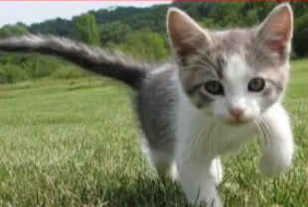
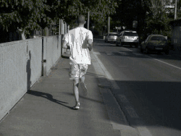
Why video is different from image processing
Output:
Object category
Scene
attributes
Image: static appearance
Output:
Action
Event
Before/after relation
Video: appearance + motion+ temporal structure
Notes:
This is where video becomes fundamentally different. In an image, the model mainly reasons about static appearance: what objects are present, what scene we are looking at, or where things are located. In video, the model also has to reason about motion, change, and temporal order. It is not just what is in the frame, but what is happening across frames.

Slide 6
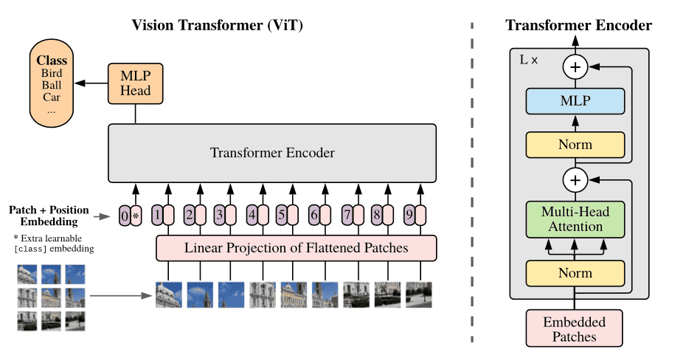
How ViT processes an image
Split image into patches
Convert patches into tokens
Self-attention models spatial relations
Notes:
Before moving to video, let’s quickly review ViT. A vision transformer splits one image into patches, turns those patches into tokens, and uses self-attention to model spatial relationships within that image. This works extremely well for still-image tasks, but the key assumption is that the input is one static frame.

Slide 7
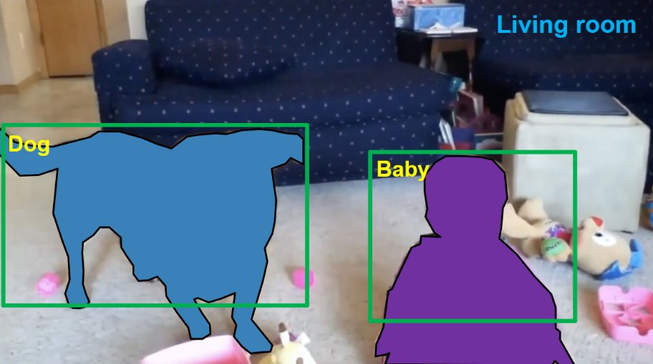
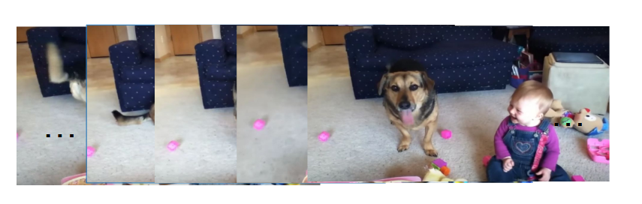
Moving from image to video
A video can be represented as: H × W × C × T
It adds one more dimension: time (T)
But more importantly, frame order matters: A video is an ordered sequence, not a collection of independent images.
Notes:
If we take a video and treat it as separate images, we can still run image-style understanding on each frame. But that is not yet real video understanding. A video adds a temporal dimension, and these frames are ordered. If we shuffle them, we may preserve the content of individual frames, but we destroy motion and temporal meaning.

Slide 8
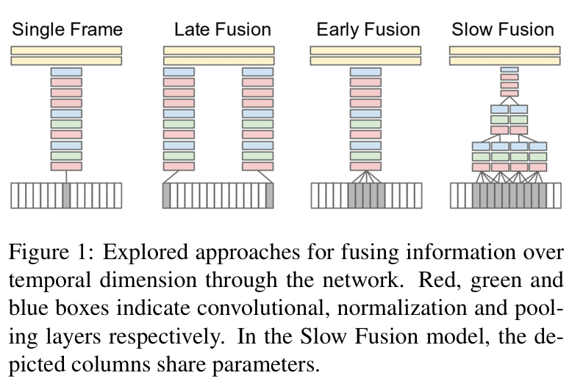
Early CNN approach: Karpathy et al. (2014)
Treat video as short clips, not full long sequences
Explore when to fuse temporal information in a CNN: early, late, or gradually through the network.
Important early step toward deep video classification at scale
Large-scale Video Classification with Convolutional Neural Networks (CVPR 2014)
Notes:
One early milestone was Karpathy and colleagues’ large-scale CNN approach to video classification. This line of work was important because it showed that deep learning could scale to video, especially with datasets like Sports-1M. In particular, Karpathy et al. treat a video as short clips and ask where temporal fusion should happen — early, late, or gradually through the network. But temporally, these models were still relatively shallow. They captured short-range patterns, but they did not yet give us a strong general mechanism for modeling long-range temporal structure.

Slide 9
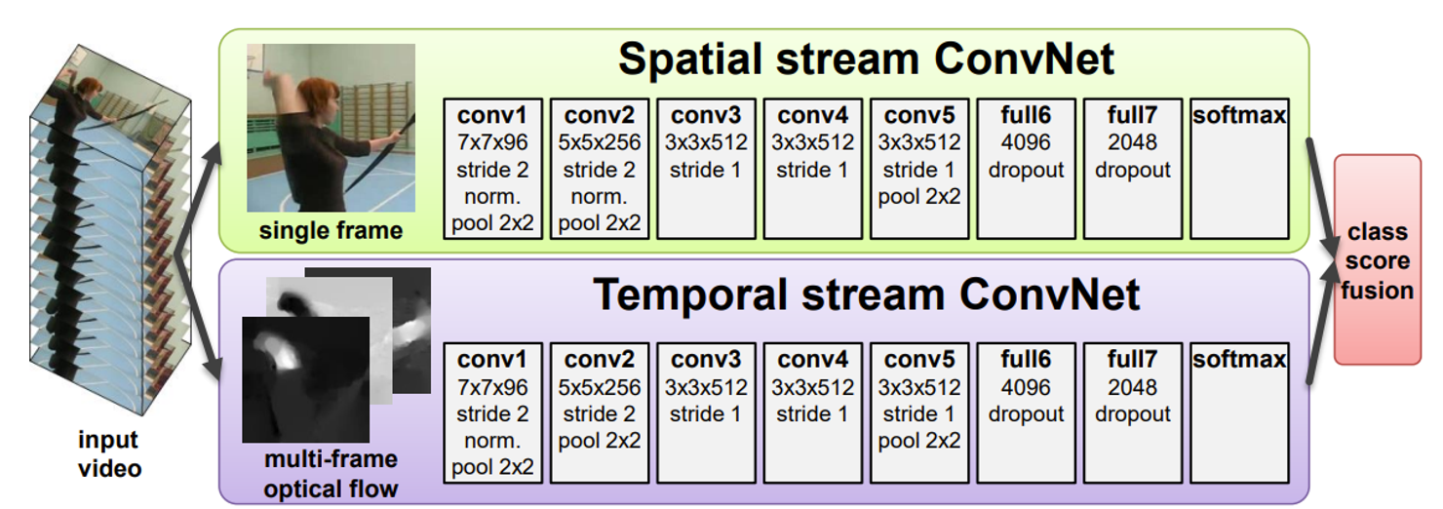
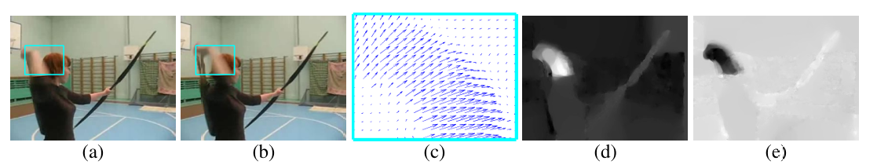
Two-Stream Networks
Notes:
A second major step was the two-stream network. Instead of relying only on RGB appearance, it explicitly separated appearance from motion by using one stream for raw frames and another for optical flow. This was a very influential idea because it recognized that video understanding needs more than static spatial features. But it still required hand-designed motion input, and it was not yet the flexible end-to-end paradigm we see in transformer models.
Optical flow is the apparent motion of objects, surfaces, and edges in a visual scene, represented as a vector field showing the direction and magnitude of movement between consecutive frames.

Slide 10
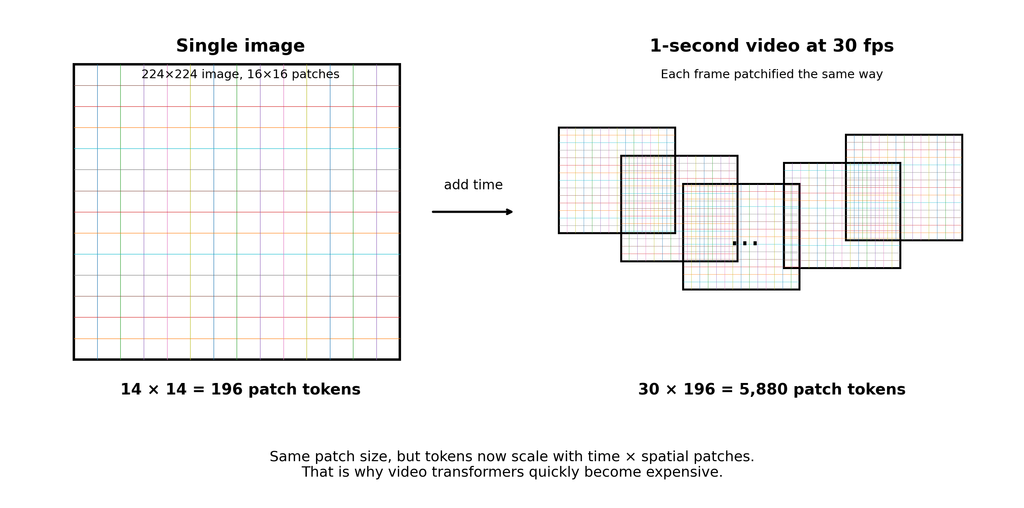
The core challenge: token explosion
Notes:
SD (640 × 480): 1,200 tokens/frame → 2.16M tokens/min
HD (1920 × 1080): ~8,100 tokens/frame → ~14.58M tokens/min
Here is the central bottleneck. A transformer already turns one image into many patch tokens. Video multiplies that token sequence across time. So the challenge is not just that videos are large in pixels, but that they become very large in tokens. That is exactly why the next question is: if we cannot process every frame equally, which moments should we keep?
Example
For your 1-second, 30 fps example:
5,880 tokens
attention interactions are about 5,880² ≈ 34.6 million
That is already a lot for just one second of video.
For 1 minute of SD video:
2.16 million tokens
pairwise attention would be about
(2.16M)² ≈ 4.7 trillion interactions
For 1 minute of HD video:
14.58 million tokens
pairwise attention would be about
(14.58M)² ≈ 212 trillion interactions
That is why naive full attention over raw video is basically impractical.

Slide 11
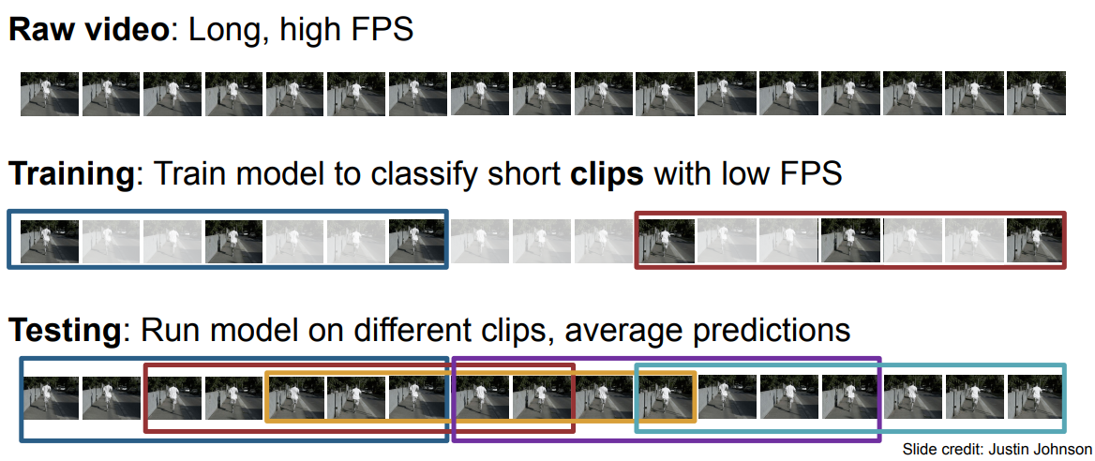
Instead of full videos, train on short clips
Notes:
Once we see how quickly token counts grow, the standard workaround becomes intuitive: instead of feeding an entire video into the model, we usually train on short clips. That means using fewer frames, often at lower resolution and sometimes lower frame rate as well. For example, a model might only see a 16-frame clip at 5 frames per second. This makes training much more feasible, but it introduces a new problem: if the model only sees part of the video, then which part we sample becomes very important.

Slide 12
Frame Sampling Strategies
Video models rarely process every frame equally
Sampling decides which temporal evidence the model gets to see.
Notes:
Now that we have seen why full video processing is expensive, the next question is straightforward: if we cannot treat every frame equally, which frames should we keep?
This is the problem of frame sampling. In practice, video models rarely process every moment in the video with the same attention. Instead, they sample frames or clips to preserve the most useful temporal evidence under a limited compute budget.
So in this next section, I’ll focus on different sampling strategies and the design tradeoffs behind them.

Slide 13
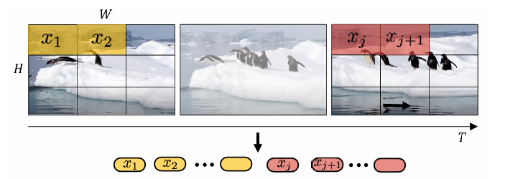
Uniform Sparse Sampling
Arnab et al., 2021, ICCV (ViViT), DOI: 10.1109/ICCV48922.2021.00676
We uniformly sample x_{t} frames from the input video clip, embed each 2D frame independently using the same method as used in image processing, and concatenate all these tokens together.
If x_{h}∗x_{w} non-overlapping image patches are extracted from each frame, then a total of x_{t}∗x_{h}∗x_{w} tokens will be forwarded through the transformer encoder.
Notes:
The simplest sampling strategy is uniform sparse sampling. The idea is straightforward: instead of processing every frame, we keep evenly spaced frames across the clip. This gives us broad temporal coverage at relatively low cost, which is why it is a strong and very common baseline. The tradeoff, however, is that uniform sampling may miss short but important events that happen between sampled frames.

Slide 14
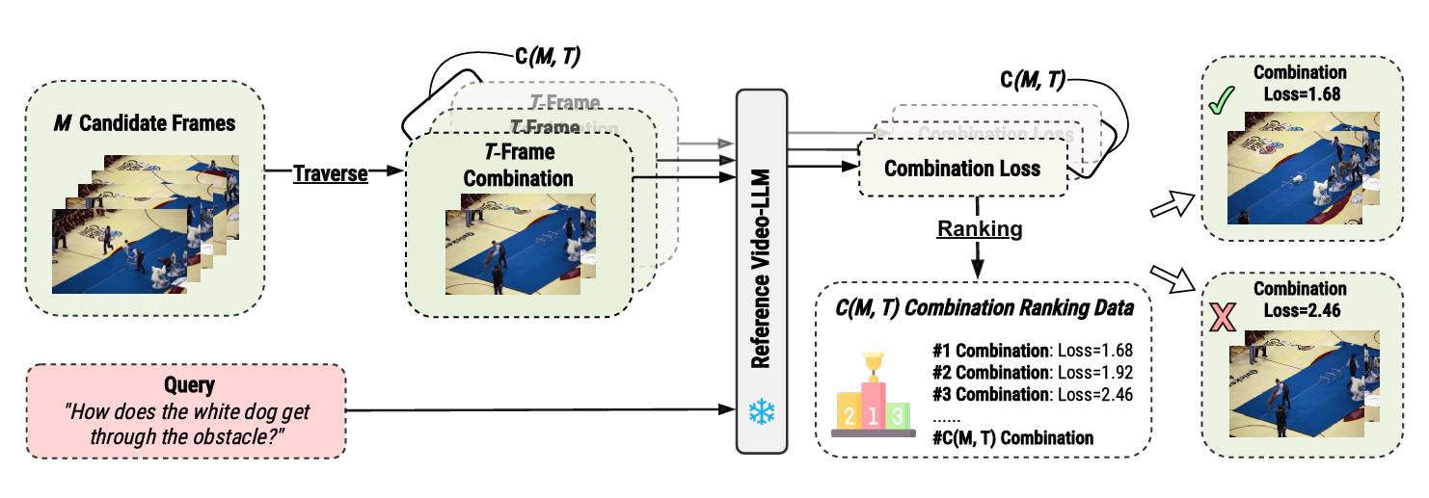
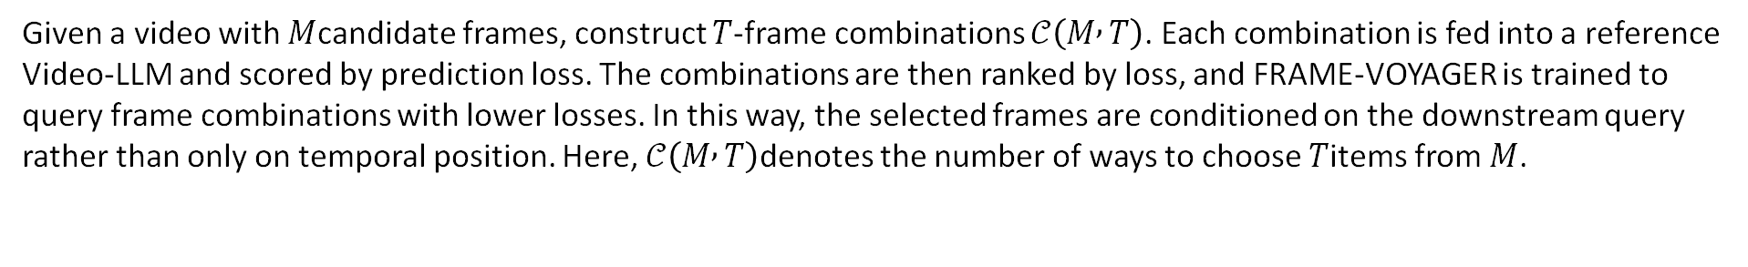
2. Query-aware adaptive sampling
Yu et al., 2024/2025, Frame-Voyager: Learning to Query Frames for Video Large Language Models.
Given a video with $M$candidate frames, construct $T$-frame combinations $𝒞\left(M , T\right)$. Each combination is fed into a reference Video-LLM and scored by prediction loss. The combinations are then ranked by loss, and FRAME-VOYAGER is trained to query frame combinations with lower losses. In this way, the selected frames are conditioned on the downstream query rather than only on temporal position. Here, $𝒞\left(M , T\right)$denotes the number of ways to choose $T$items from $M$.
Notes:
This final strategy is query-aware adaptive sampling. Instead of choosing frames only by time, segment, or shot structure, the model conditions frame selection on the actual downstream query.
In FRAME-VOYAGER, we start with M candidate frames from the video and construct T-frame combinations. Each combination is fed into a reference Video-LLM, which gives a prediction loss for that particular frame subset. The combinations are then ranked by loss, and FRAME-VOYAGER is trained to query the combinations with lower losses.
So the key idea is that frame importance is no longer defined only by where the frame appears in the video. It is defined relative to the task. If the query asks about a specific event, object, or relation, the model tries to preserve the frame subset that is most useful for answering that query.

Slide 15
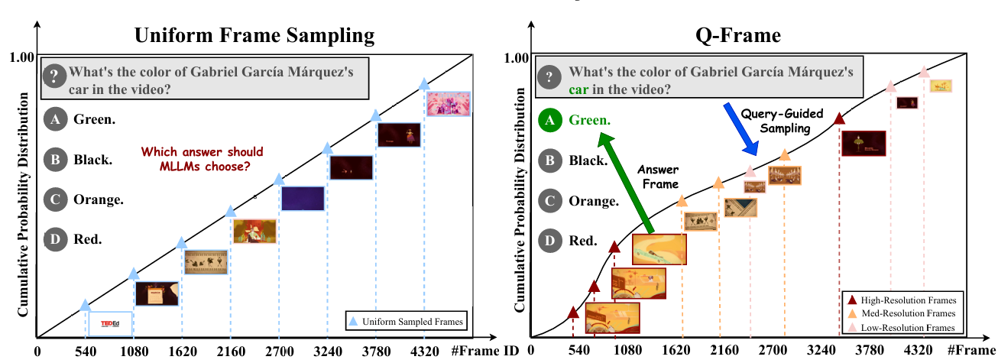
3. Q-Frame
Zhang, S. et al. (2025). Q-Frame: Query-aware Frame Selection and Multi-Resolution Adaptation for Video-LLMs. ICCV 2025 / arXiv:2506.22139.
Q-Frame is composed of Cross-modal Query Retrieval (CQR), Query-Aware Frame Selection (QFS), and Multi-Resolution Adaptation (MRA). CQR retrieves frames relevant to the query, QFS selects the most useful temporal subset, and MRA assigns higher resolution to important frames while reducing cost on less critical ones. The method is training-free and plug-and-play.
Notes:
Q-Frame can be seen as a newer extension of query-aware sampling. Like Frame-Voyager, it conditions frame selection on the actual question, rather than only on time or video structure. But Q-Frame adds a second idea: not all selected frames need to be processed at the same resolution.
More specifically, the method has three parts. First, cross-modal query retrieval identifies candidate frames that are semantically relevant to the query. Second, query-aware frame selection chooses the most useful temporal subset. Third, multi-resolution adaptation assigns higher resolution to more important frames while reducing cost on less important ones.
So compared with uniform sampling, Q-Frame is both more task-aware and more compute-aware. It tries to preserve the frames that matter for the query, and it also preserves fine-grained detail where resolution matters most.

Slide 16
Summary: Comparing Frame Sampling Strategies
Strategy | Unit sampled | Selection basis | Main advantage | Main limitation
Uniform sparse | Frames | Even temporal spacing | Simple, efficient baseline | May miss brief events
Query-aware adaptive (Frame-Voyager) | Frame combinations | Query-conditioned ranking via Video-LLM loss | Task-relevant frame selection | More complex selection pipeline
Q-Frame | Frames at adaptive resolutions | Query-aware frame selection + multi-resolution adaptation | Preserves both relevance and detail under budget | Adds resolution selection complexity
Notes:
To summarize, these strategies differ mainly in what they sample and how they decide what to keep. Uniform sampling uses time alone. Segment-based sampling enforces broader temporal coverage. Random short-clip sampling is mainly about making training feasible. Shot-aware methods use the internal structure of the video. Query-aware methods go one step further and select frames based on the actual task. And Q-Frame extends that idea by adapting not only which frames to keep, but also the resolution used for each frame.

Slide 17
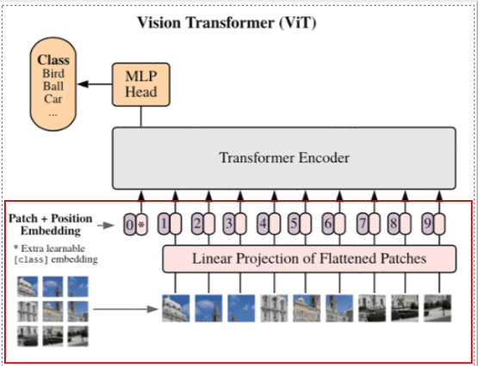
From sampled frames to video tokens
Sampling = which moments do we keep?
Tokenization / representation = what unit do we feed into the model?
Notes:
Up to this point, we have been talking about which frames or clips to keep. But sampling only solves the first half of the problem. Once we have those sampled frames, we still need to decide how to turn them into tokens for the model.
In image transformers like ViT, the process is straightforward: take one image, split it into non-overlapping patches, embed each patch, and treat those patch embeddings as tokens. For video, we can start from the same idea, but now we have multiple sampled frames rather than one image.
That raises a new design question: do we tokenize each sampled frame independently, just like ViT? Do we group neighboring patches across space and time into tubelets? Or do we build a hierarchical representation that becomes coarser across layers?
So the next few slides are really about the second design decision after sampling: not what moments to keep, but what the basic unit of video representation should be.

Slide 18
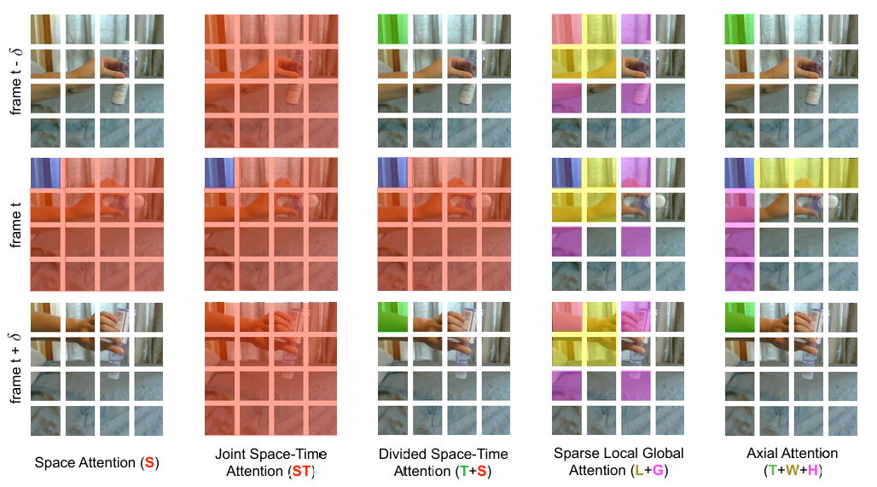
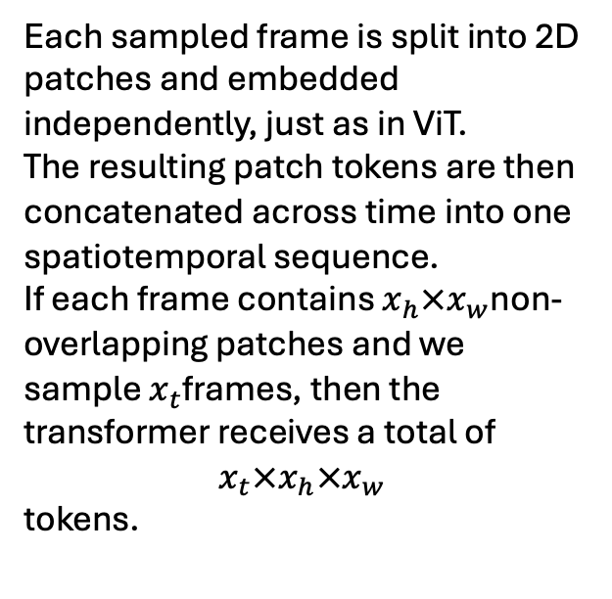
1. Frame-wise patch tokens
Each sampled frame is split into 2D patches and embedded independently, just as in ViT.
The resulting patch tokens are then concatenated across time into one spatiotemporal sequence.
If each frame contains $x_{h}×x_{w}$non-overlapping patches and we sample $x_{t}$frames, then the transformer receives a total of
$$x_{t}×x_{h}×x_{w}$$
tokens.
Bertasius et al., 2021 (TimeSformer); Arnab et al., 2021 (ViViT)
Notes:
Here, the basic unit is still the familiar ViT patch. We take each sampled frame, split it into 2D patches, embed those patches independently, and then concatenate the patch tokens across time. So this is the most direct extension of image tokenization to video. The advantage is conceptual simplicity: we reuse the ViT patching idea almost unchanged. The limitation is that time is not built into the token itself; temporal structure has to be learned later by the transformer.

Slide 19
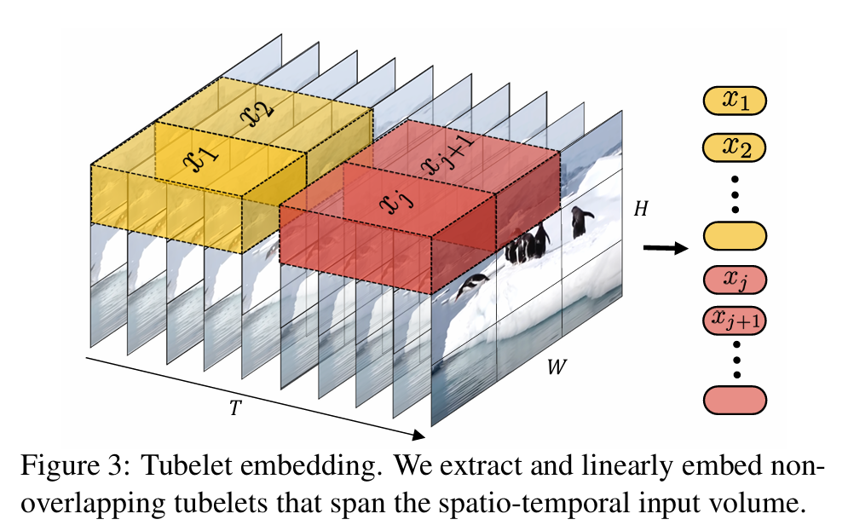
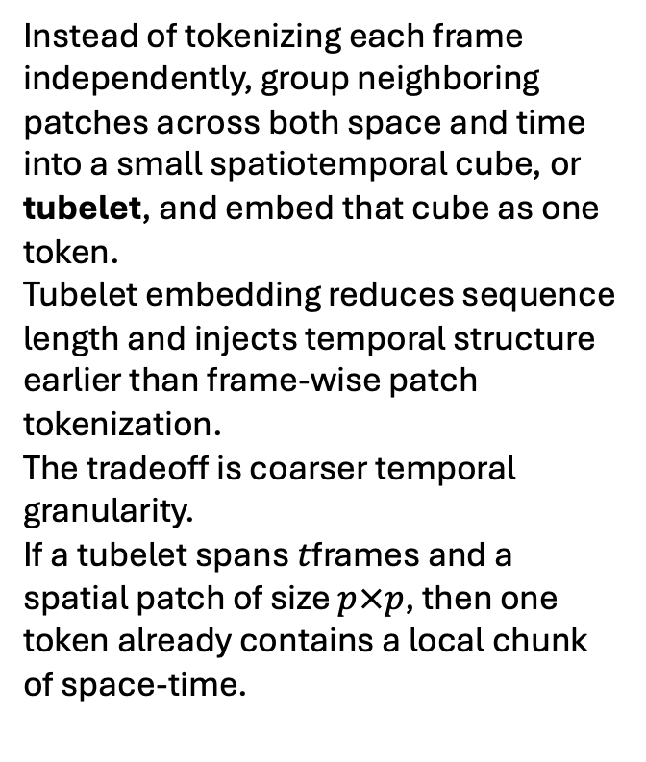
2. Tubelet tokens
Instead of tokenizing each frame independently, group neighboring patches across both space and time into a small spatiotemporal cube, or tubelet, and embed that cube as one token.
Tubelet embedding reduces sequence length and injects temporal structure earlier than frame-wise patch tokenization.
The tradeoff is coarser temporal granularity.
If a tubelet spans $t$frames and a spatial patch of size $p×p$, then one token already contains a local chunk of space-time.
Arnab et al., 2021 (ViViT)
Notes:
Tubelet tokens change the basic unit. Instead of treating each frame as a separate image and patchifying it independently, we group neighboring patches across space and time into a small spatiotemporal cube. That cube becomes one token. So compared with frame-wise patches, tubelets fuse temporal information earlier and also reduce the total sequence length. But the tradeoff is that the representation becomes coarser, because one token now summarizes multiple frames rather than just one local region in one frame.

Slide 20
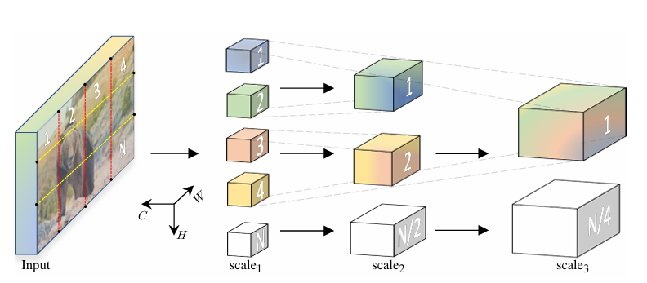
3. Hierarchical / multiscale tokens
Fan et al., 2021 (MViT); Liu et al., 2022 (Video Swin Transformer)
Rather than keeping one flat token grid throughout the network, hierarchical video transformers progressively reduce spatial or spatiotemporal resolution while increasing channel capacity.
Early layers operate on fine-grained visual detail. Later layers operate on coarser, higher-level spatiotemporal summaries. This creates a multiscale feature hierarchy that is better matched to the dense and structured nature of video.
Notes:
The previous two approaches still assume a relatively flat token sequence. Hierarchical or multiscale tokenization takes a different path. Instead of maintaining the same resolution throughout the network, it progressively reduces resolution and increases representational capacity across layers. So early layers preserve fine visual detail, while deeper layers operate on coarser but more semantically rich spatiotemporal summaries. This is appealing for video because video contains information at multiple scales: local motion, short actions, and longer events

Slide 21
Summary of Tokenization Strategies
Strategy | Basic unit | Time fused | Token count / compute | Main strength | Main tradeoff
Frame-wise patch tokens | 2D patch from each frame | Later in the transformer | Highest | Most direct extension of ViT; simple and interpretable | Long token sequence; time not built into token
Tubelet tokens | Local space-time cube | Earlier at tokenization | Lower | Injects temporal structure earlier; fewer tokens | Coarser temporal granularity
Hierarchical / multiscale | Features at multiple resolutions | Progressively across layers | Reduced as depth increases | Captures local detail and higher-level structure | More complex architecture
Notes:
To summarize this section, these three approaches mainly differ in what they treat as the basic token and when temporal information enters the representation.
Frame-wise patch tokens are the closest to standard ViT: each sampled frame is patchified independently, and temporal fusion happens later in the transformer. That makes the method simple, but it also produces the longest token sequence.
Tubelet tokens change the basic unit from a 2D patch to a small space-time cube. This reduces the number of tokens and introduces temporal structure earlier, but at the cost of coarser temporal detail.
Hierarchical or multiscale models take a different route: instead of keeping one flat token sequence, they progressively build coarser and more semantic representations across layers. So the key tradeoff across these methods is simplicity versus early temporal fusion versus multiscale efficiency.

Slide 22
Temporal attention
how the model links events across frames
Notes:
Once we have sampled frames and turned them into tokens, one major question still remains: how do those tokens communicate across time? That is the role of temporal attention. In general, temporal attention allows visual tokens from one frame to attend to tokens in other frames, so the model can link information across time. The remaining slides compare different ways of doing that, from global attention, to local windows, to motion-aware attention.

Slide 23
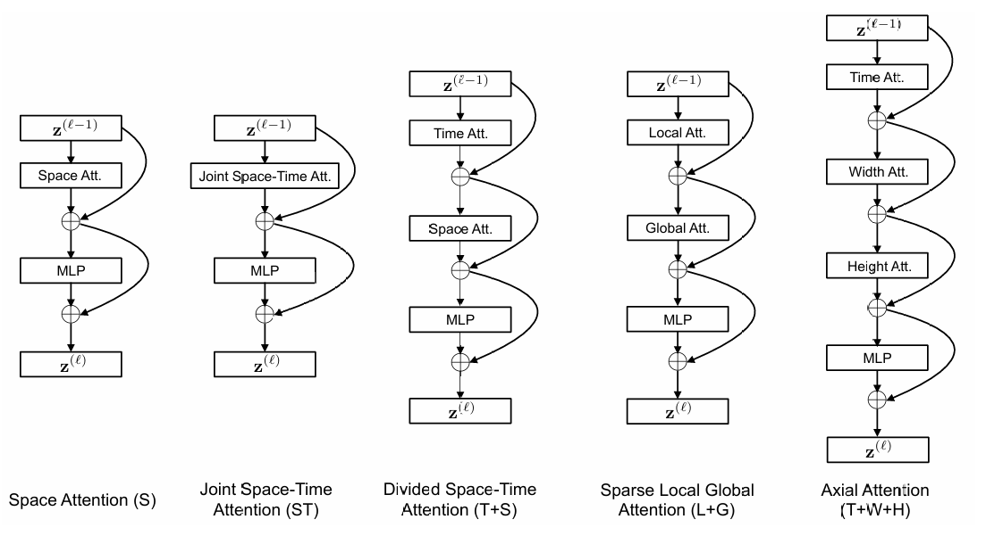
Full/Divided space-time attention
Full space-time attention lets each token attend jointly to tokens across both space and time.
Divided space-time attention factorizes this process into two steps: temporal attention across frames, followed by spatial attention within each frame.
Compared with fully joint attention, divided attention preserves global temporal interaction while reducing complexity and improving optimization in practice.
Bertasius, Wang, & Torresani, 2021. Is Space-Time Attention All You Need for Video Understanding? ICML 2021.
Notes:
The most direct approach is full space-time attention: every token can, in principle, attend to every other token across both space and time. That is expressive, but expensive. TimeSformer showed that a better design is often divided space-time attention, where temporal attention is applied first across frames, and spatial attention is then applied within each frame. So the model still captures global temporal interaction, but in a more structured and efficient way.

Slide 24
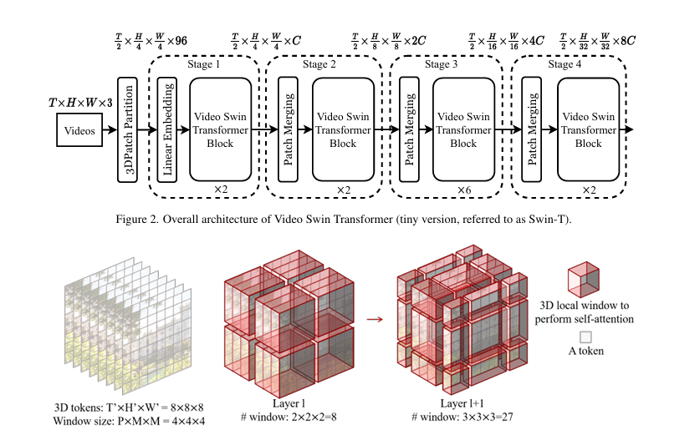
2. Local / windowed temporal attention
Local / windowed temporal attention restricts self-attention to nearby spatiotemporal neighborhoods rather than the full sequence.
Information is propagated globally by shifting the window partition across layers.
This introduces a useful locality bias and yields a better speed–accuracy tradeoff than globally connected video transformers.
Liu et al., 2022. Video Swin Transformer. CVPR 2022.
Notes:
If full or divided global attention is still too expensive, one alternative is to restrict attention to local spatiotemporal windows. That is the core idea in Video Swin Transformer. Instead of connecting everything to everything, the model attends within local windows and then shifts those windows across layers so information can still propagate more broadly. This makes the model much more efficient and also introduces a useful inductive bias: nearby content in video is often more related than distant content.

Slide 25
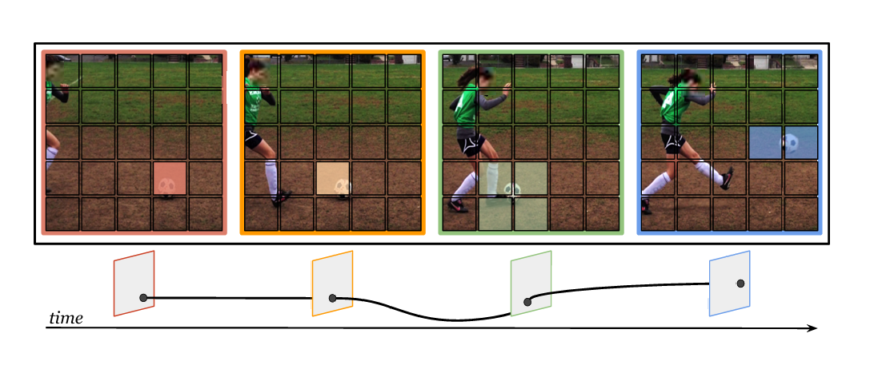
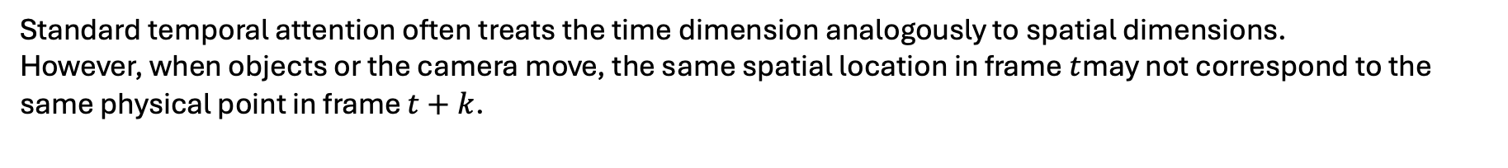
3. Motion-aware / trajectory attention
Patrick et al., 2021. Keeping Your Eye on the Ball: Trajectory Attention in Video Transformers. NeurIPS 2021.
Standard temporal attention often treats the time dimension analogously to spatial dimensions.
However, when objects or the camera move, the same spatial location in frame $t$may not correspond to the same physical point in frame $t+k$.
Trajectory attention instead aggregates information along implicitly estimated motion paths, making temporal interaction better aligned with real visual dynamics.
Notes:
This last approach asks a deeper question: even if we allow tokens to attend across time, are we attending along the right correspondences? Motionformer argues that in video, the same pixel location across frames may correspond to completely different physical points if the object or the camera moves. So instead of aggregating information along fixed spatial coordinates, trajectory attention tries to follow implicit motion paths. In that sense, it is more aligned with how dynamic scenes actually evolve.

Slide 26
Summary: Temporal Attention Strategies
Strategy | Attention scope | Main idea | Main strength | Main tradeoff
Full / divided space-time | Global across frames | Attend across time for all tokens; divided attention factorizes temporal and spatial attention | Strong global temporal interaction | Expensive; divided attention is still heavier than local methods
Local / windowed temporal | Local spatiotemporal windows | Restrict attention to nearby windows and shift windows across layers | Better efficiency and locality bias | Long-range interaction is less direct
Motion-aware / trajectory | Motion-aligned across frames | Aggregate information along moving object trajectories rather than fixed locations | Better temporal correspondence under motion | More complex mechanism and motion reasoning
Notes:
To summarize this section, temporal attention methods mainly differ in how broadly and how intelligently they connect information across frames. Full or divided space-time attention provides the broadest temporal interaction, but it is also the most computationally expensive. Local or windowed attention improves efficiency by restricting interaction to nearby spatiotemporal neighborhoods and letting information propagate across layers. Motion-aware or trajectory attention goes one step further by trying to align attention with moving objects rather than fixed spatial coordinates. So the key tradeoff in this section is between global coverage, computational efficiency, and motion-sensitive correspondence.

Slide 27
Part A Take Away
Video adds time, and time makes representation both harder and more expensive.
Sampling decides which temporal evidence the model ever gets to see.
Tokenization decides whether video is represented as patches, tubelets, or multiscale features.
Temporal attention decides how information is linked across frames.
Video architecture is ultimately a tradeoff among coverage, efficiency, and temporal fidelity.
Notes:
Let me close Part A by pulling the big picture together.
The first key point is that video representation begins with a bottleneck. A video is not just a larger image. It is an ordered sequence of frames, and once we patchify video, the number of tokens grows very quickly.
Second, sampling becomes the first major design decision. Because we usually cannot process every frame equally, the model has to decide what temporal evidence it will actually keep. That is why we looked at strategies ranging from uniform sampling, to segment-based sampling, to shot-aware and query-aware methods.
Third, once frames are sampled, we still need to decide what the basic unit of representation should be. Do we tokenize each frame independently, do we build tubelets that already contain a small chunk of space and time, or do we build a hierarchical multiscale representation?
Fourth, temporal attention determines how those representations communicate across time. Some models do this globally, some restrict attention locally for efficiency, and some try to follow motion trajectories more explicitly.
So overall, the architecture is always a tradeoff: temporal coverage, computational cost, locality, motion sensitivity, and representational richness.
Now, at this point, you may be wondering: Di, when you talked about sampling, you showed us some very recent work from 2025 and 2026, but for tokenization and temporal attention, a lot of the foundational models you discussed were from around 2021 and 2022, and you did not go deeply into the newest developments there.
That is a very fair question. The reason is that, in this part, I wanted to establish the core design logic first: what to sample, how to tokenize, and how to connect information across frames. Many of the most influential formulations of those ideas were established in that 2021–2022 period.
But the story definitely does not stop there. In the next part, Nahom is going to go much deeper into temporal reasoning and long-context video understanding, and he will bring in more of the latest state-of-the-art models and recent work. So if Part A gave us the representational foundations, the next part will show us how those foundations are being pushed toward more advanced reasoning over time.

Slide 28
Video Language Models for
Temporal Reasoning
Nahom Tamene
Focus: Event understanding & long-context temporal reasoning in Video-LMs
Builds on: Part A (video representation, tokenization, temporal attention) and Part B (captioning, VQA, cross-modal fusion)
CIS 5543 — Computer Vision
1

Slide 29
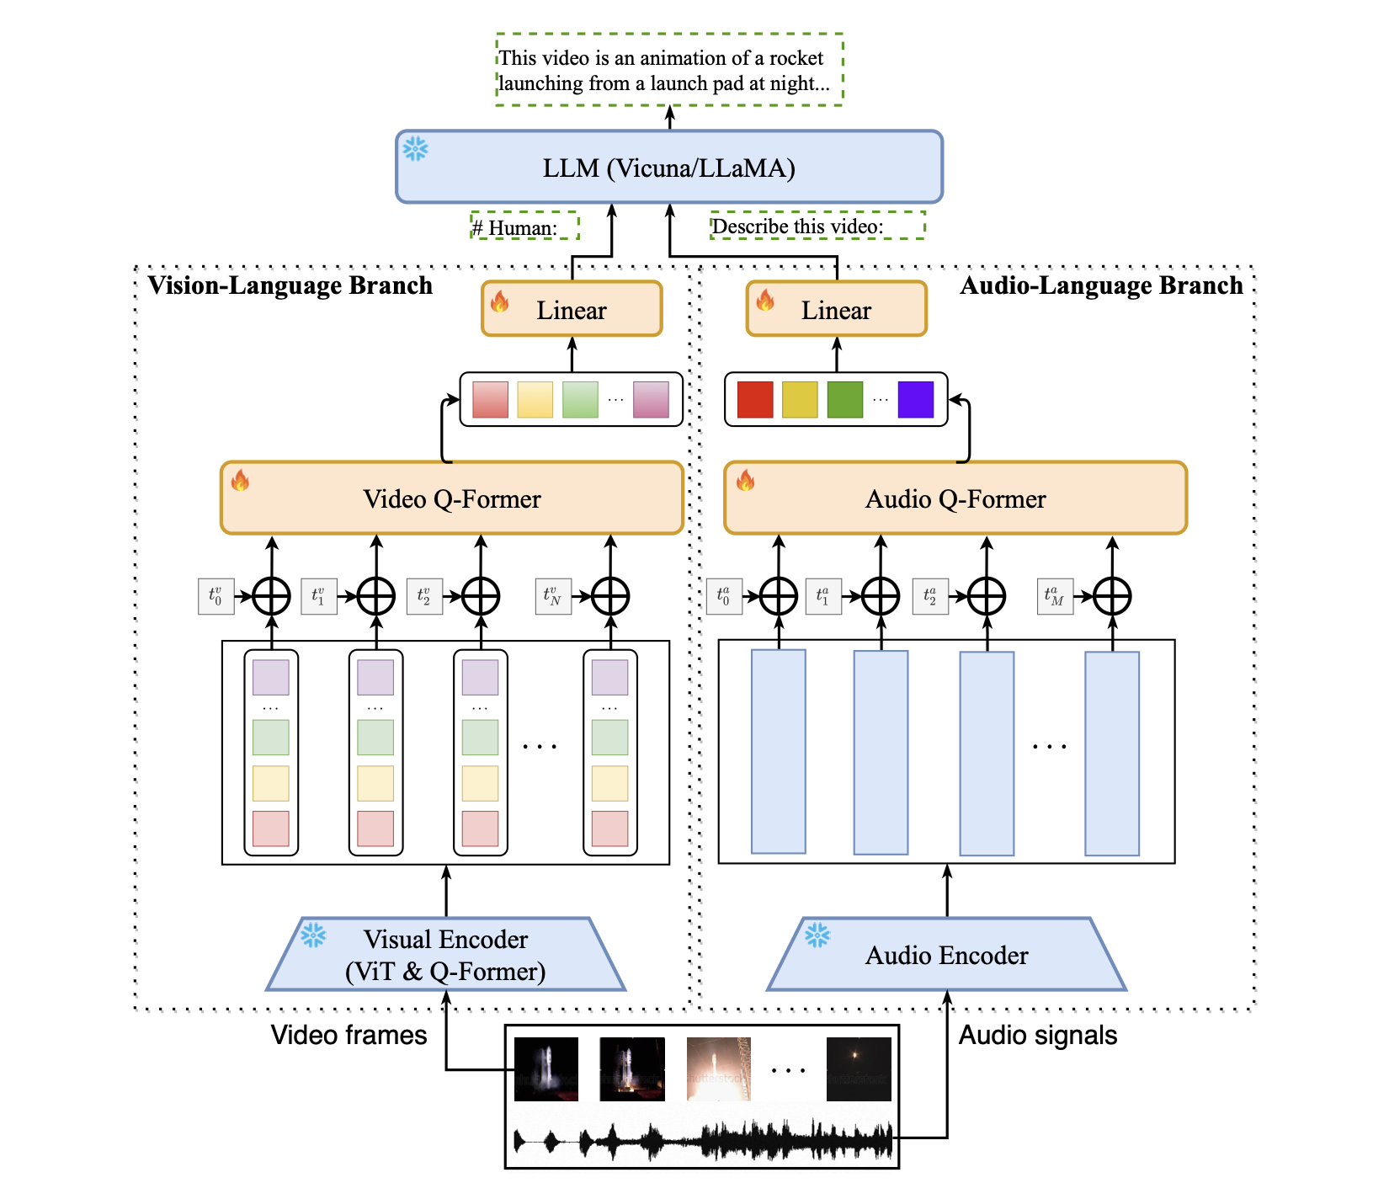
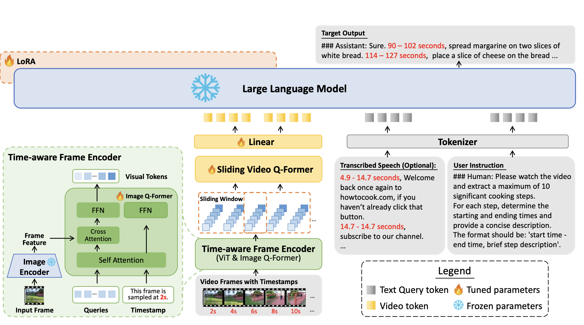
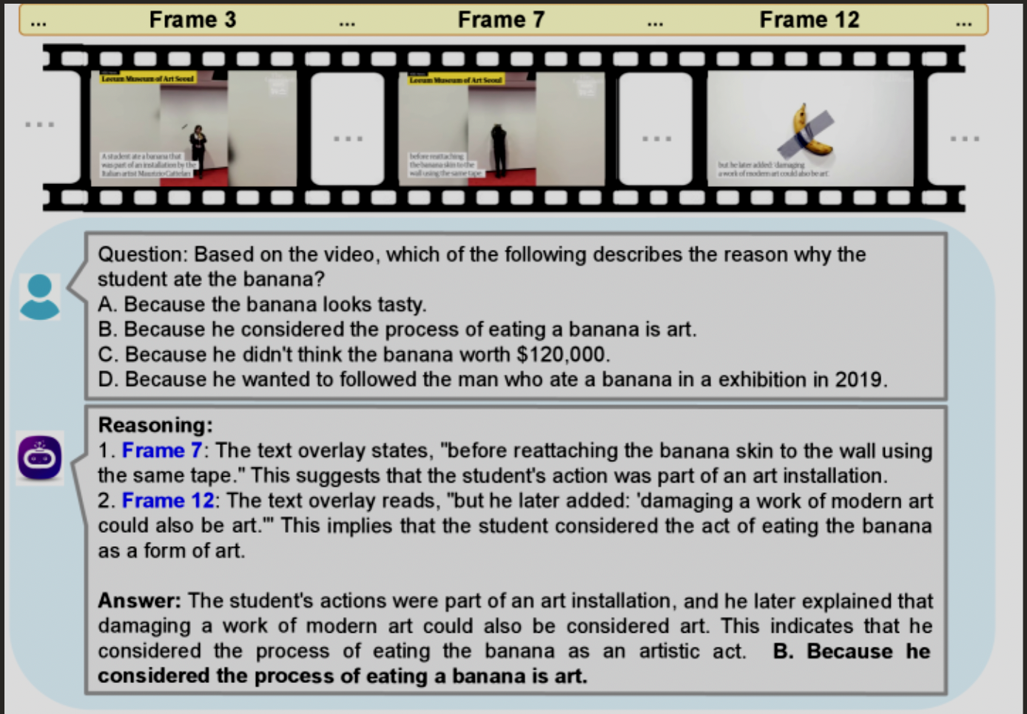
What Multimodal Temporal Reasoning
We can break the phrase into three parts:
Multimodal: combining different data types
Temporal: reasoning across time
Reasoning: going beyond recognition
Goal: learning to read videos over time as narratives using vision, audio, and language together.

Slide 30
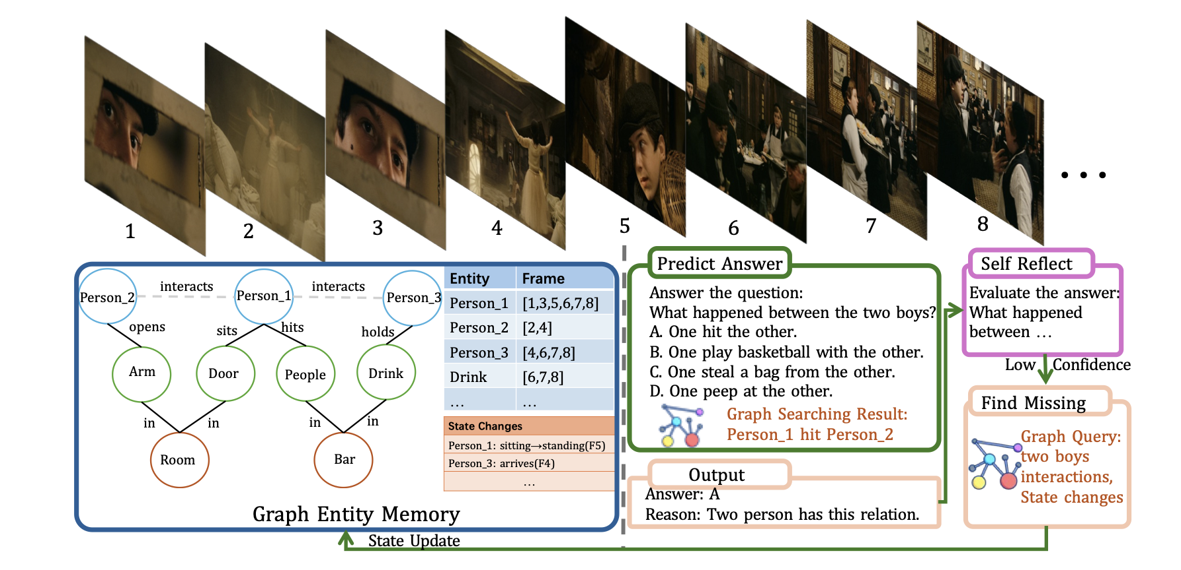
Why it’s Hard
Video adds challenges that images don’t have:
Long-range dependencies, Temporal ambiguity, Multi-event overlap
And most importantly: Long context limits
2

Slide 31
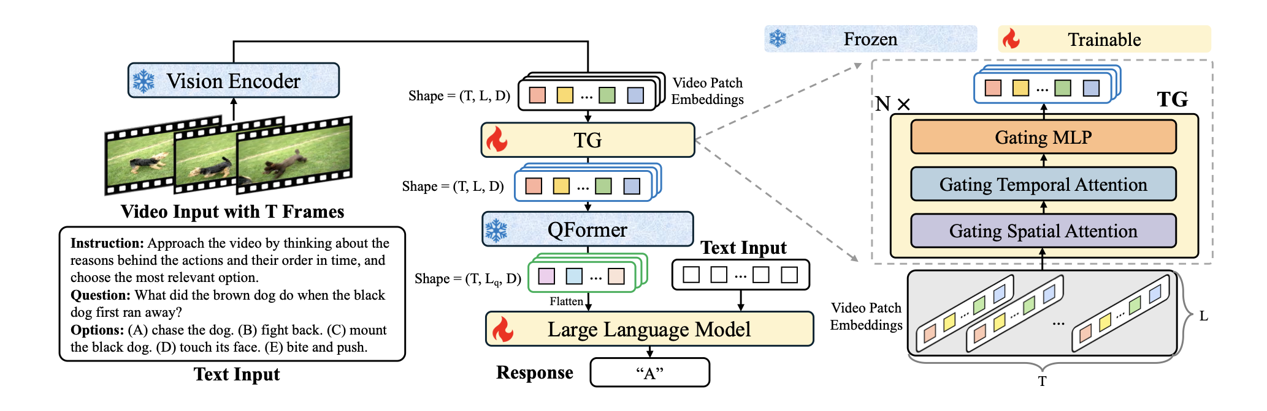
How VideoLMs Handle it
A. Temporal encoding (time modeling)

Slide 32
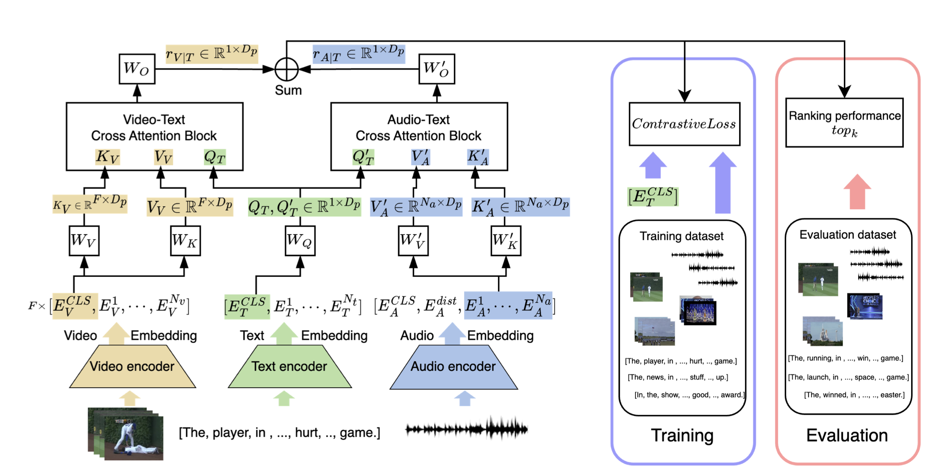
B. Cross-modal fusion

Slide 33
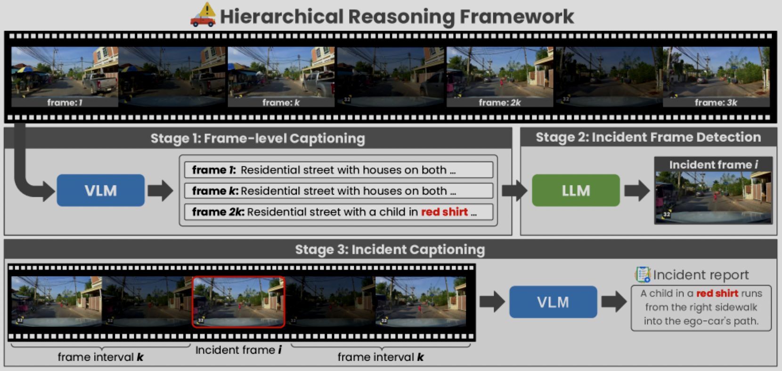
C. Hierarchical reasoning

Slide 34
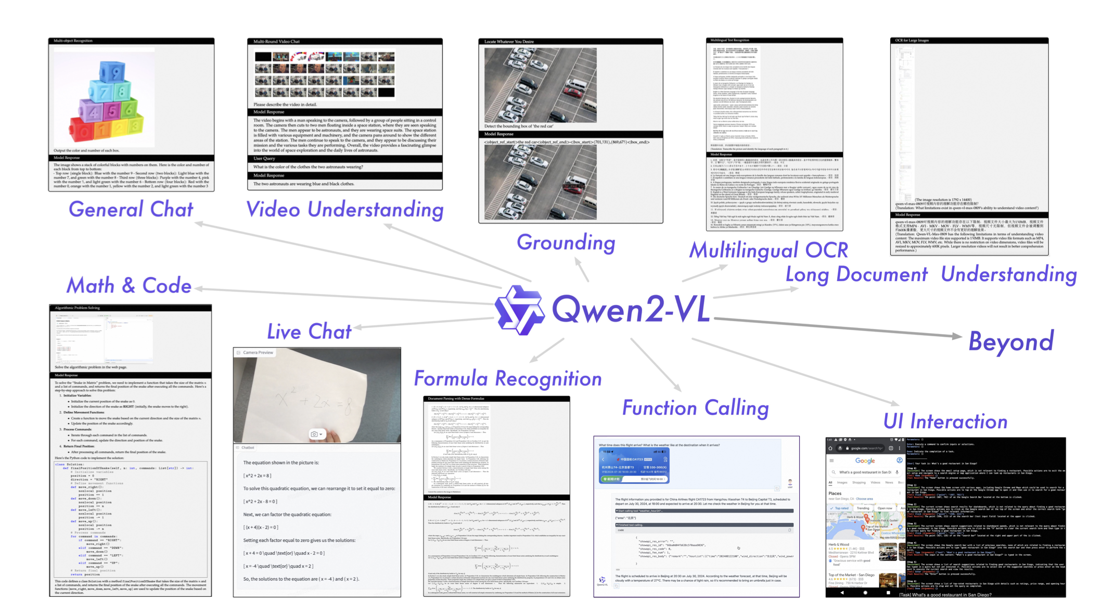
Model Case Study: Qwen2.5 - VL

Slide 35
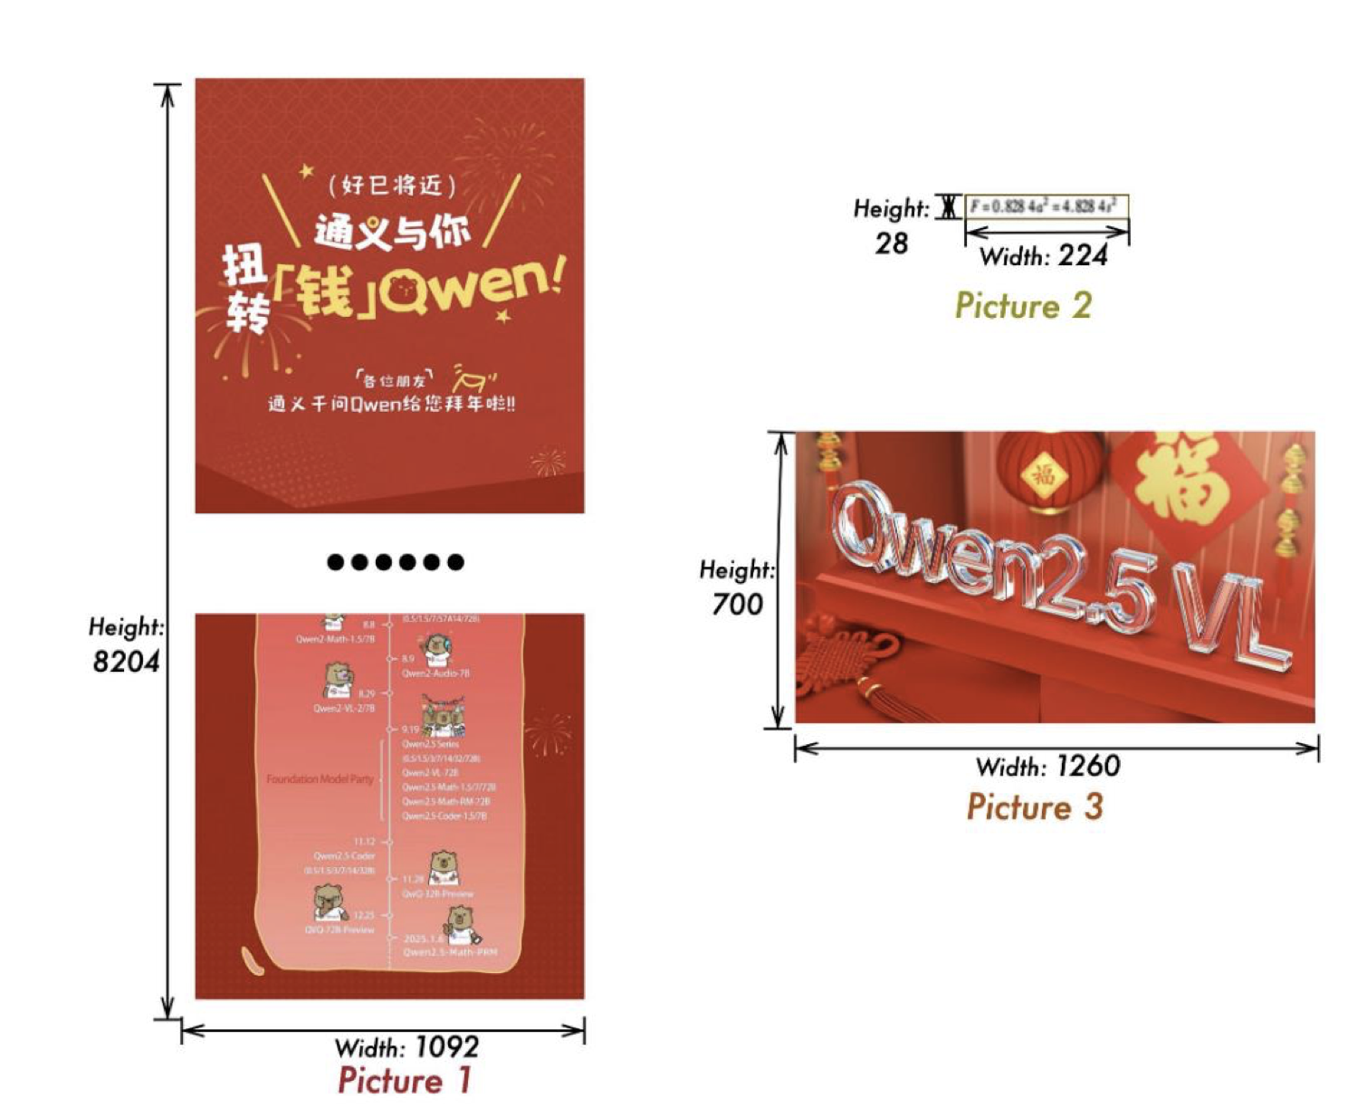
How Qwen2.5 VL Processes Images
Image Encoding:
Image resizing: multiples of 28
Support for dynamic resolution
  Vanilla ViT: fixed resolution only

Slide 36
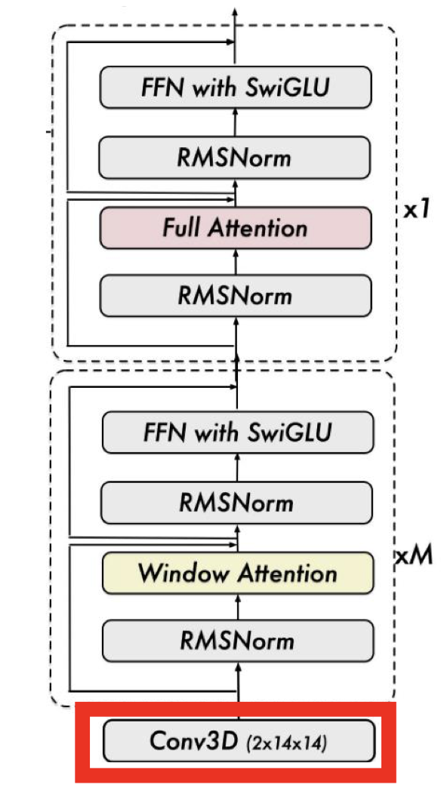
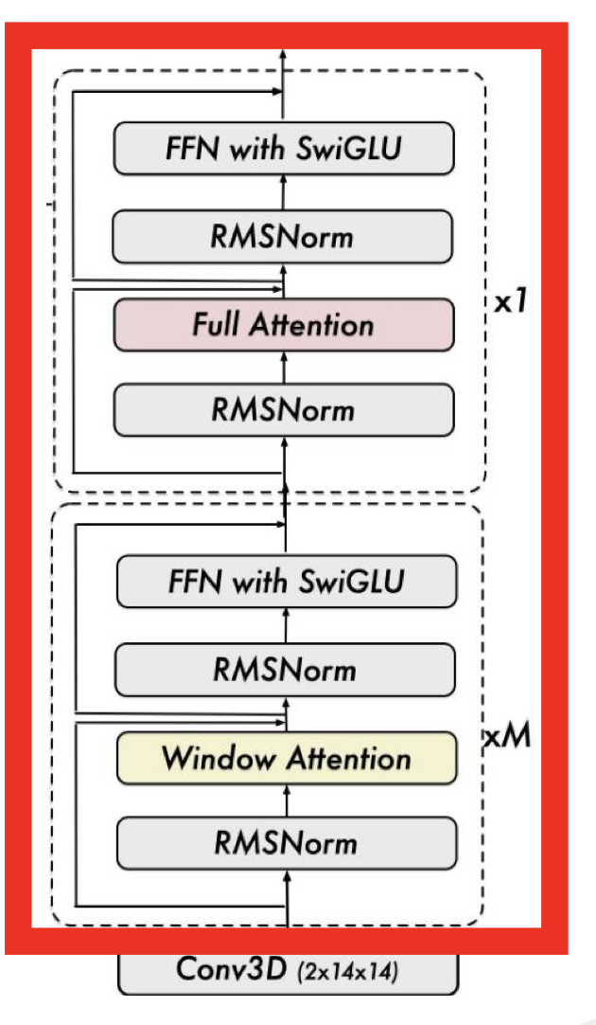
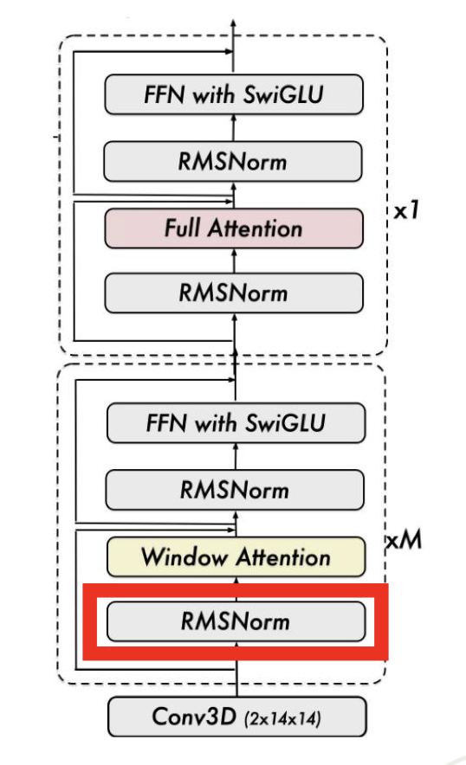
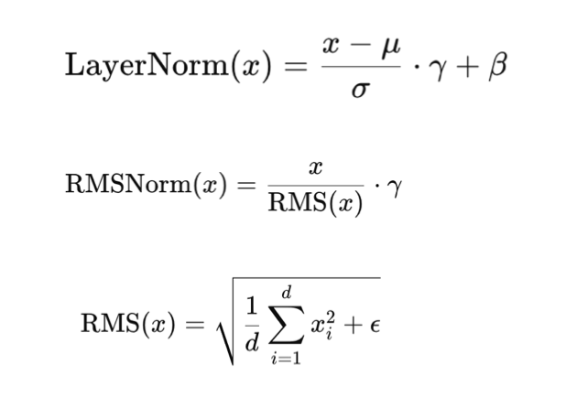
Continued Image Encoding:
• Patch size: 14 x 14
  Even number of patches in both width and height
• Each patch is passed to Conv3D
• Vision Encoder: ViT
• Several modifications are applied
• After ViT: Vision-Language Merger
  Merge 4 adjacent patch features into one token
  Two-layer MLP
• RMSNorm
  Cheap & competitive alternative to vanilla LayerNorm
  Employed in modern Transformers
    • T5, LLaMA, Mistral, etc.

Slide 37
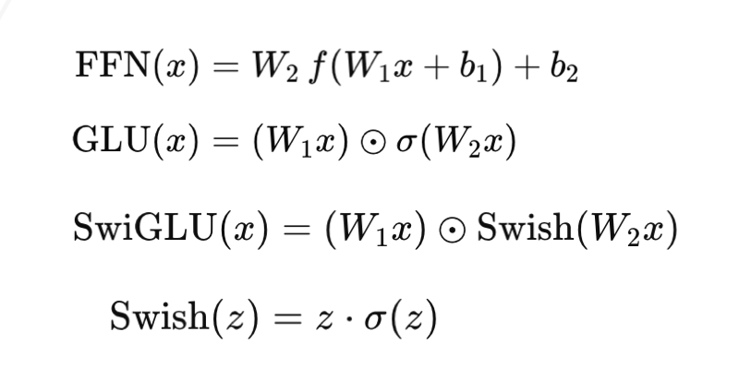
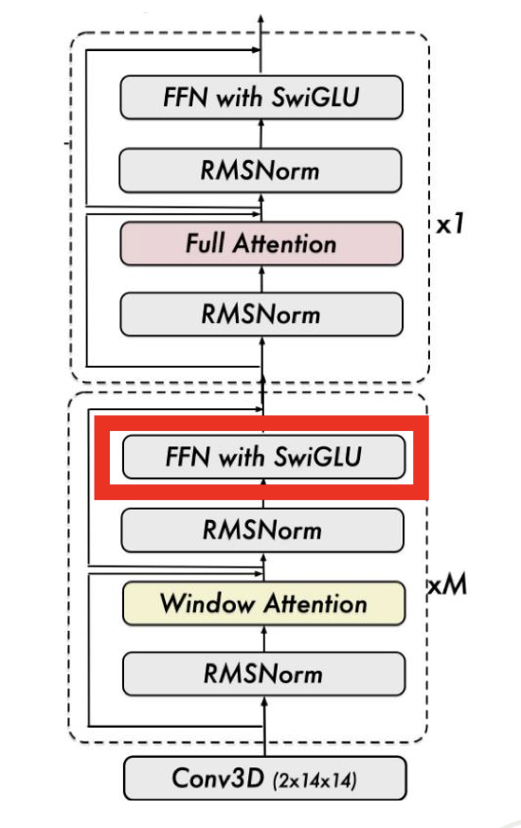
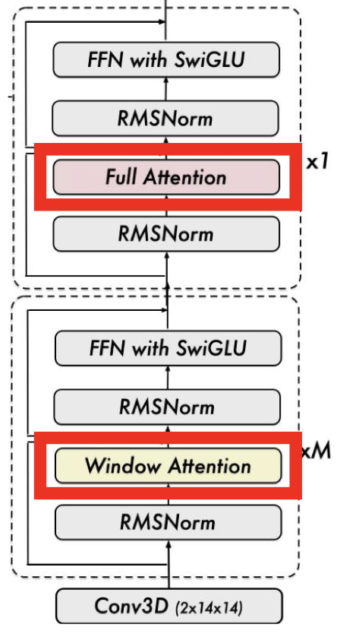
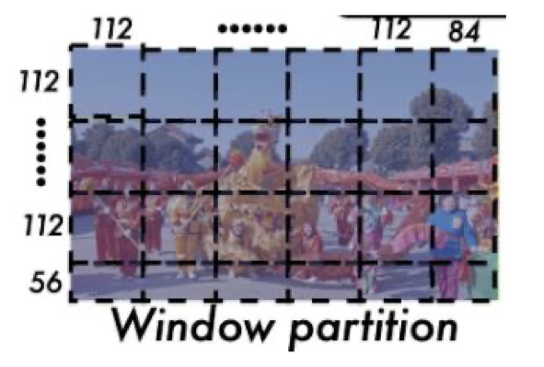
Continued Image Encoding:
• Window Attention
  Patch token attends only to adjacent 8×8 patches
    8x8 patches = 112x112 pixels
  Linear complexity in the number of input tokens
• Full Attention is only used in 4 blocks
• FFN with SwiGLU
  Better expressivity than ReLU/GELU
  Employed in modern Transformers
    PaLM, LLaMA, Mistral, etc.

Slide 38
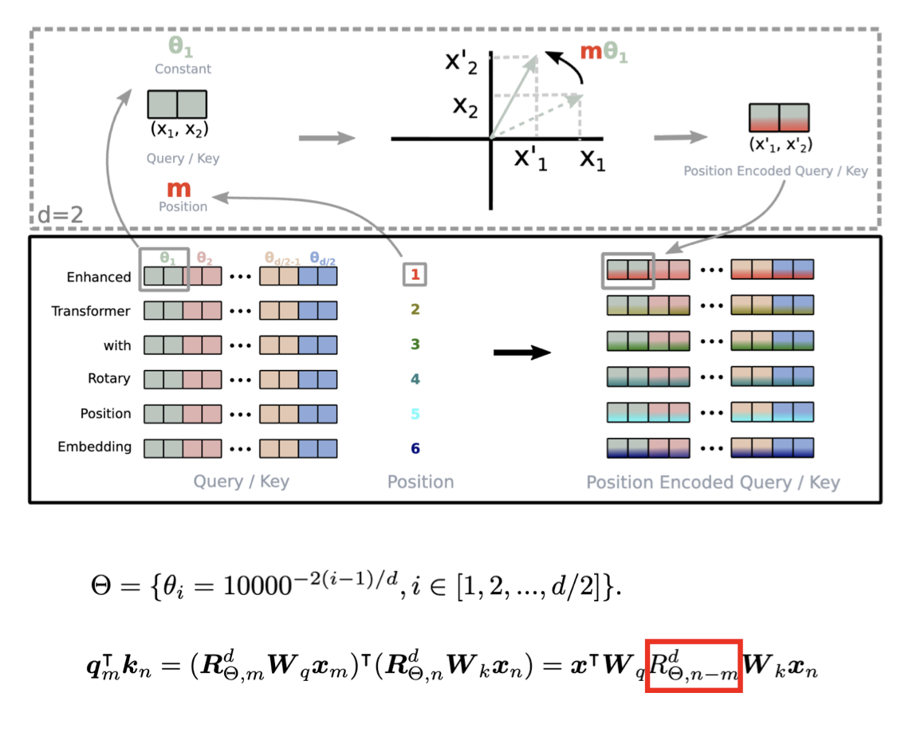
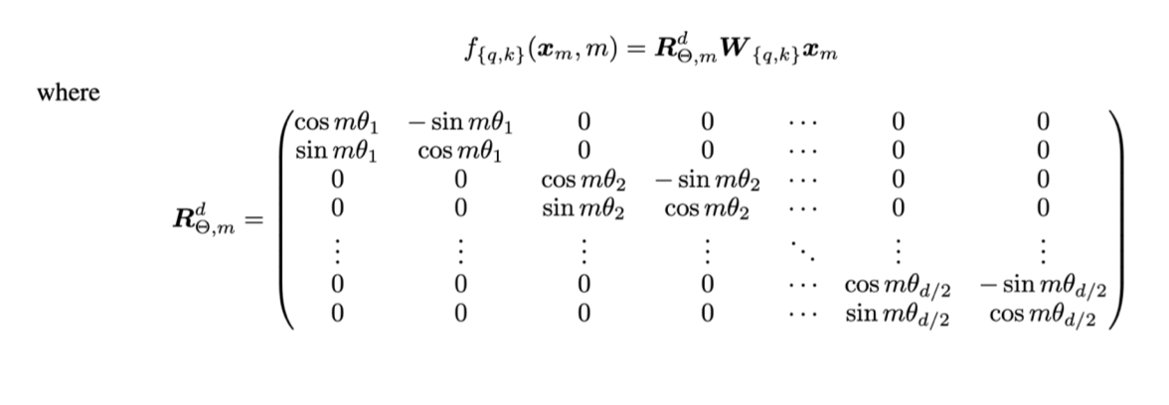
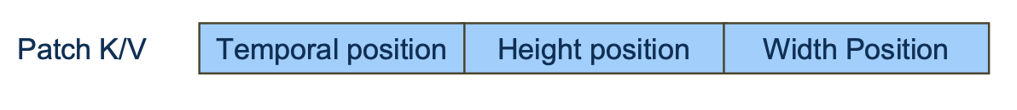
Rotary Positional Embedding (RoPE)
Applies rotary transformations to Q/K
  in each Attention layer
  not to input embeddings
Encodes relative distance directly in the
dot product
• Preserves original token meaning
through V
Image patch: 2D-RoPE
  Halve the feature dimension
  Encode row and column indices separately
Video patch: Multimodal RoPE (MRoPE)

Slide 39




Dynamic FPS Sampling
SLOW-PACED — 1 FPS
FAST ACTION — 4 FPS
f1
f2
f3
f4
f5
f6
f7
f8
→
t=0s
t=2s
t=4s
t=5.0s
t=5.25s
t=5.5s
t=5.75s
t=6.0s
Content-Adaptive
Slow Content → Low FPS
Fast Action → High FPS
Images = 1 Frame
Sample rate varies based on
scene complexity & motion
Lectures, static scenes:
1 FPS is sufficient
Sports, action sequences:
higher FPS preserves motion
Still images processed as
a single frame, no FPS needed

Slide 40
Absolute Time MRoPE
3D Positional Encoding
Image MRoPE
H
Height
Width
2 axes only
Video MRoPE
NEW
W
Height
Width
Time
0.0s
3 axes — T uses real seconds
0.5s
T
1.0s
Real Timestamps
Learns Speed & Duration
Precise Event Grounding
T axis encodes seconds (0.5s, 1.0s...),
not frame indices (1, 2, 3...)
Model understands temporal
relationships between events
Pinpoint moments:
'00:45 — man picks up phone'

Slide 41
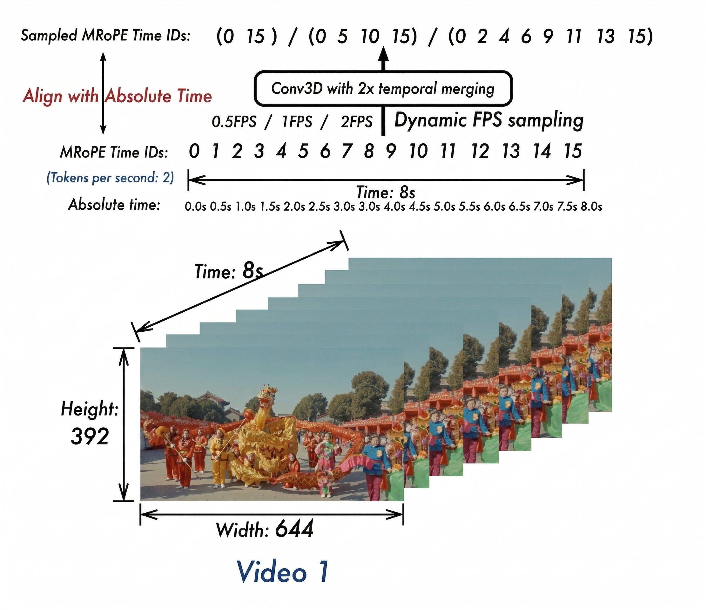
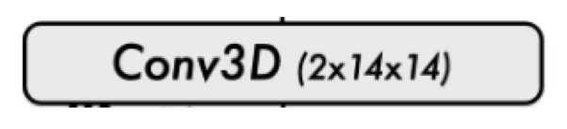
Video Encoding:
- How Qwen2.5 VL Processes Videos
Patch size: 2 x 14 x 14
  Bind two consecutive timesteps
Dynamic FPS sampling
  Vision Encoder handles various FPS
Temporal position
  aligned with absolute time
  Qwen2-VL: simple frame index

Slide 42
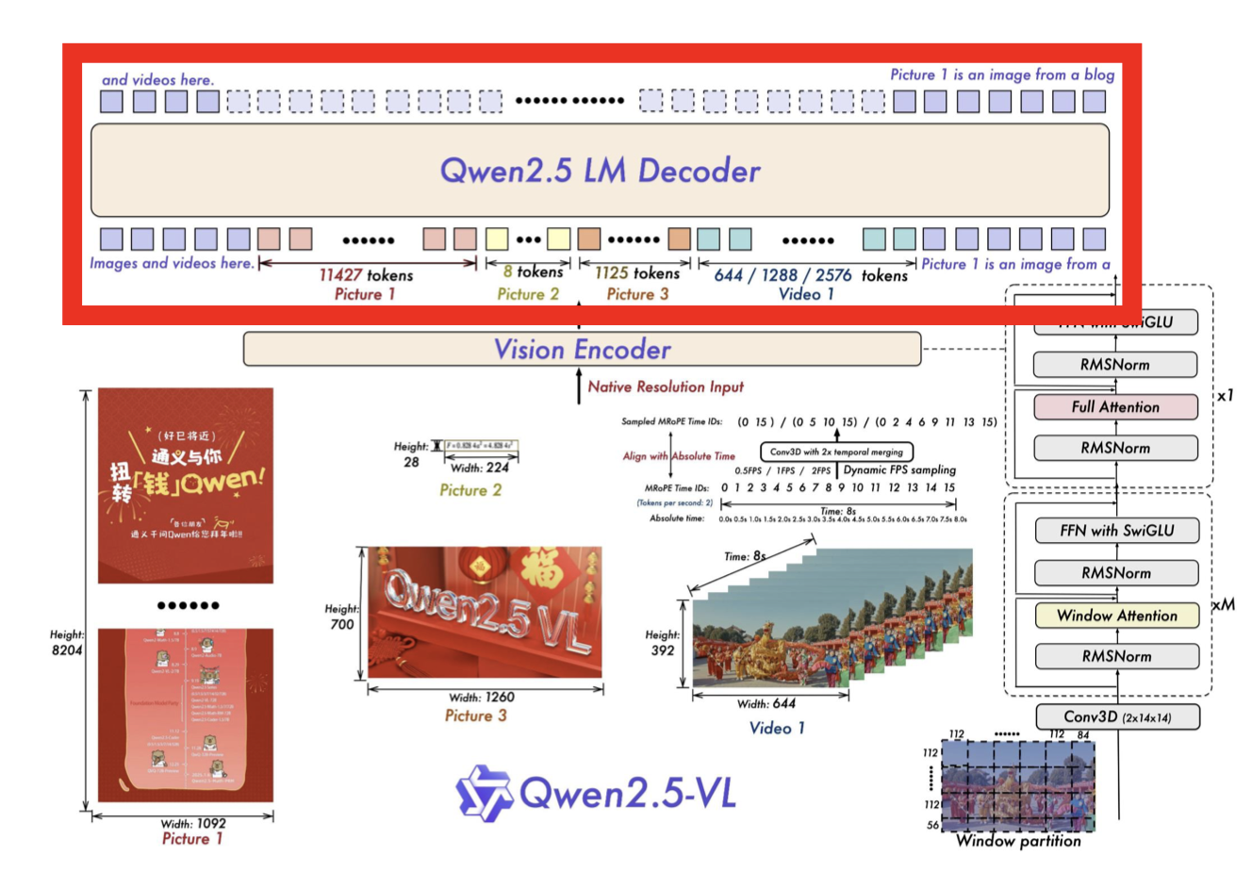
LLM and Full Model Architecture
• Initialized with Qwen2.5[1]
• We omit the details of LLM

Slide 43
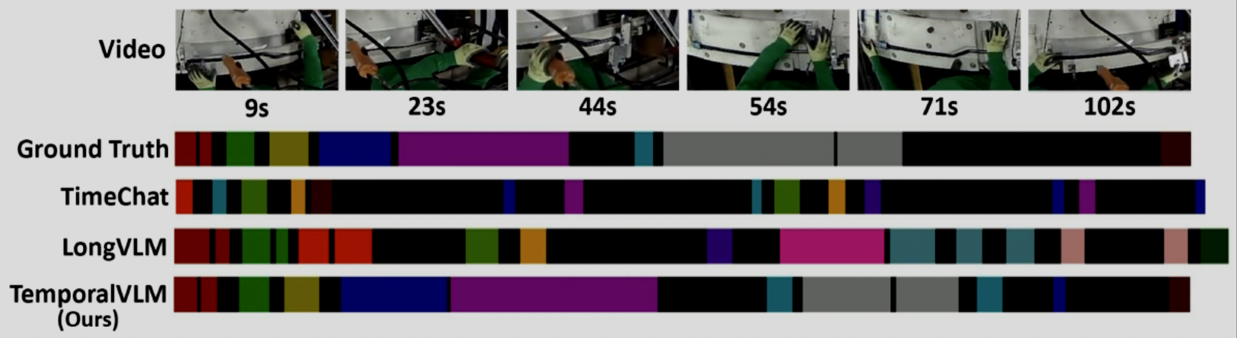
How are these differences useful in video understanding?
Temporal video models can segment actions and preserve event order across time, while weaker models miss boundaries and hallucinate actions.

Slide 44
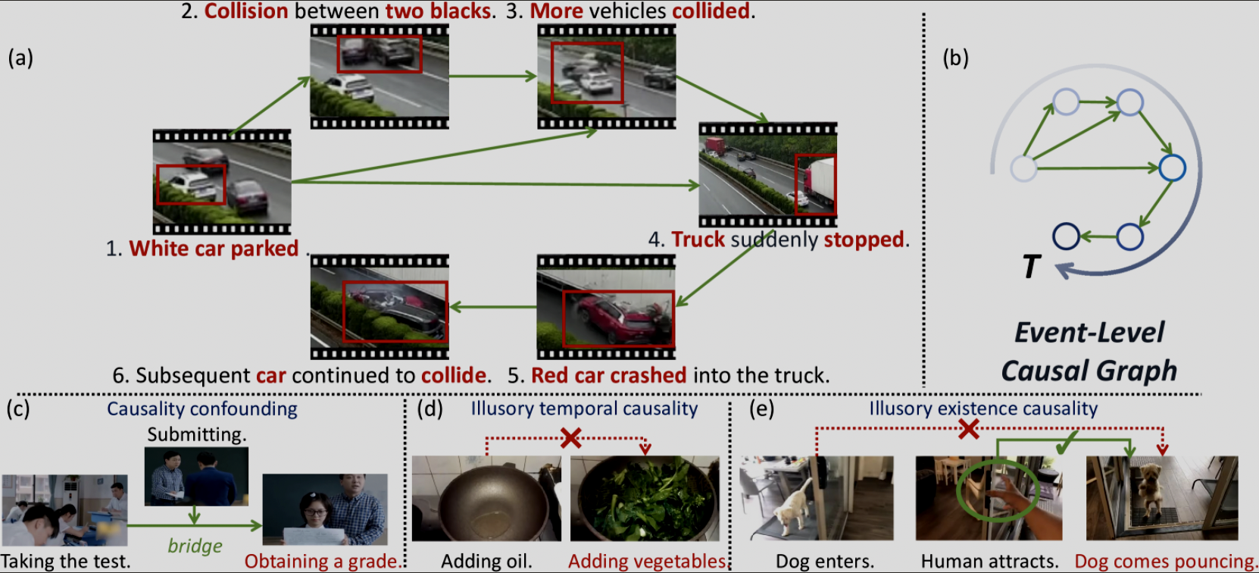
Example

Slide 45
Event Understanding
We can extend previous example to see how event understanding works
What “event” means for Qwen2.5-VL

Slide 46

Qwen2.5-VL: Video Understanding
Processes video as temporally ordered token sequences
Encodes real time (seconds), not frame indices
Segments events implicitly from token patterns
Enables temporal grounding, VideoQA, and captioning

Slide 47

How Qwen2.5-VL understands events
A. Temporal tokenization (video as sequences)

Slide 48


B. Event segmentation (implicit grouping)

Slide 49

C. Attention over time (temporal reasoning)
Using transformer-based attention, Qwen2.5-VL:
focuses on key frames where events change
reduces noise from redundant frames
links early and late parts of an event chain

Slide 50




What event understanding enables
1. Temporal grounding
2. Video Question Answering
3. Video captioning
Output:
Code:

Slide 51
Long-context Challenges
The Core Problem: 1 hour of video at 2 FPS = 7,200 frames. At 256 tokens/frame = 1.8 MILLION tokens before compression.
1
2
3
Token Budget Explosion
Temporal Locality vs. Global Context
Variable-Speed Content
Raw video produces far more tokens than any LLM context window can handle. Image VLMs face this with just one frame — videos multiply the problem ×1000.
Events at t=1s and t=3600s may be causally related ('the character picks up the gun... 59 mins later, the gun fires'). The model must hold long-range dependencies.
A fixed FPS misaligns fast and slow content. 2 FPS is wasteful on static scenes; too slow for sport action. Models must balance detail vs. context length.

Slide 52



How models like Qwen 2.5-VL Succeed
1.
✓ MLP merger compresses 2×2 adjacent patches into 1 token. Window Attention makes ViT linear not quadratic.
2.
✓ MRoPE's temporal axis + large positional ID space (up to 64k positions) maintains long-range structure.
3.
✓ Dynamic FPS sampling adapts the sampling rate to content. Slower scenes use fewer tokens; action uses more.

Slide 53



How models like Qwen 2.5-VL Fail
While Qwen2.5-VL is strong at video understanding, it still faces fundamental long-context challenges when dealing with extended videos (minutes → hours). These challenges come from both transformer limitations and the nature of video data.
2. Attention scaling bottleneck
1. Context length vs video length mismatch
3. Frame sampling trade-offs
Vanilla self‑attention has time and memory cost quadratic in the number of tokens nn; for long video sequences (frames × patches), this makes full attention impractical, forcing models like Qwen2.5‑VL to cap context length or aggressively downsample.
only part of the video resides in the active context at any moment; earlier content is progressively compressed or dropped to keep the token budget bounded.

Slide 54
Key Takeaways
1. Video understanding ≠ frame understanding
A model can describe every frame correctly and still miss what happened.
Temporal structure — order, duration, causality — is the key differentiator.
2. Encoding real time is the breakthrough
Absolute time MRoPE + dynamic FPS + temporal gating let Qwen2.5-VL reason about duration, speed, and event ordering — not just frame indices.
3. Long-context is the unsolved frontier
Every solution trades completeness for tractability. 1 hr of video = 1.8M tokens before compression. Key events can vanish between samples.
4. From “what’s in the video” to “what happened and why”
Spatial → Temporal → Causal → Narrative understanding. Qwen2.5-VL is strong on 1–2, starting on 3. Step 4 is still ahead of us.

Slide 55
t-3
t-2
t-1
t
t+1
t+2
t+3
Video-Language Alignment
From Contrastive Learning to Temporal Understanding
How modern AI bridges the gap between what we see in video and what we say in language
Notes:
Welcome. 30-minute presentation on video-language alignment. 30 slides across 4 phases: foundations, architecture, applications, synthesis.

Slide 56

The Core Challenge: Why Video Is Harder Than Images
Notes:
Hat ON vs OFF — 92% pixel overlap, opposite meaning. Three challenges: temporal redundancy, motion vs appearance, alignment granularity. [~2 min]

Slide 57

How Video Is Embedded into Vectors
Notes:
4-step pipeline: Frame Sampling → Spatial Encoding (CNN/ViT) → Temporal Modeling (TimeSformer) → Aggregation (CLS/pool → 512-dim). Example: 10s cooking clip → 16 frames → 512-dim vector. [~2.5 min]

Slide 58

Contrastive Learning: The CLIP Paradigm for Video
Notes:
NCE loss: matched pair / all pairs. N-1 negatives per sample. Larger batches = stronger signal. Temperature tau. [~2 min]

Slide 59

The Text Encoder: Language to Vectors for Alignment
Notes:
Pipeline: Tokenize (BPE) → Embed (lookup 768-dim) → Transformer layers (12 layers BERT-base) → Pooling + Projection (CLS→512-dim). Encoder choices: BERT (bidirectional, best for understanding), GPT (autoregressive, doubles as decoder), T5 (encoder-decoder). Prompt engineering: temporal prompts improve retrieval 3-5%. Learned prompts (CoOp). Key insight: text encoder defines semantic structure of shared space. If BERT can't distinguish 'putting on' vs 'taking off,' visual training can't fix it. This explains negation failure. [~2 min]

Slide 60

NCE Loss: Mathematical Intuition & Gradient Dynamics
Notes:
Gradient: dL/dv_i = (1/tau)*sum p(j|i)(t_j-t_i). Hard negatives = strong gradients. Temperature, batch size effects. NCE vs triplet: N-1x more info/step. InfoNCE = MI lower bound. [~2 min]

Slide 61

Visual Backbone: 2D CNNs → 3D CNNs → TimeSformer
Notes:
Three generations: 2D CNN (per-frame), 3D CNN (SlowFast), TimeSformer (divided space-time attention). [~2 min]

Slide 62

Divided Space-Time Attention: TimeSformer Deep Dive
Notes:
8 frames × 196 patches = 1568 tokens. Full attention: 2.46M. Divided: temporal (196×8) + spatial (8×196) = 3136. 785x reduction, within 1% accuracy. [~2 min]

Slide 63

Alignment Strategy: Dual Encoders vs. Fusion
Notes:
Dual: O(N+M), scalable. Fusion: O(N×M), accurate. Modern: dual for coarse retrieval, fusion for re-ranking. [~1.5 min]

Slide 64

Multimodal Fusion: How Video and Text Interact
Notes:
Four fusion types: Late (cosine sim, O(N+M), best for retrieval), Cross-Attention (Q=text K,V=video, O(N×M), best for QA), Early/Unified (interleaved tokens, O((N+M)2), deepest interaction, best for captioning/LLMs), Gated (learned modality weighting, O(N+M), element-wise). Modern trend: hybrid — Stage 1 late fusion for candidate selection, Stage 2 cross-attention for re-ranking. Fundamental trade-off: fusion depth vs computational efficiency. [~2 min]

Slide 65

MIL-NCE: Handling Misalignment in Narrated Video
Notes:
Narration ±3s off. Bag of clips, numerator sums over bag. Best clip dominates. HowTo100M: 136M pairs. [~2 min]

Slide 66

From Global Alignment to Spatio-Temporal Grounding
Notes:
Global insufficient for WHERE/WHEN. Temporal + spatial grounding. Cross-attention: 'bag'→0.89 on bag region. [~1.5 min]

Slide 67

Cross-Modal Attention: What the Model 'Sees'
Notes:
Per-word attention. 'dog'→spatial focus. 'catches'→temporal spread. 'frisbee'→object tracking. Nouns=spatial, verbs=temporal. Only 15% patches significant. [~2 min]

Slide 68

Cycle Consistency: Captioning as Alignment Test
Notes:
V→Caption→Retrieve V'. V'=V = faithful. Kitchen cleaning→'cooking'→wrong retrieval→cycle broken. Training objective too. [~1.5 min]

Slide 69

Case Study: Zero-Shot Video Retrieval
Notes:
'Golden retriever + hoop + rain' — compositional generalization. Components composed at test time. sim=0.91. [~1.5 min]

Slide 70

Video Captioning: Encoder-Decoder Architecture
Notes:
Visual encoder → cross-attention → language decoder. PDVC, Vid2Seq, VideoLLaMA. Dense vs paragraph. [~1.5 min]

Slide 71

Dense Video Captioning: Localizing Events in Time
Notes:
Dense captioning: 1 video → N events with timestamps. Two-stage: event proposal (temporal boundaries) + captioning (per-event description). End-to-end: Vid2Seq with timestamp tokens. Event proposal analogous to object detection but temporal. Evaluation: ActivityNet Captions, METEOR per event at IoU thresholds. SOTA: 8.5 METEOR vs human 12.0. Challenges: boundary ambiguity, long-range dependencies, redundancy suppression, granularity control. [~2 min]

Slide 72

Captioning Metrics & Temporal Hallucinations
Notes:
BLEU/METEOR/CIDEr/BERTScore/CLIPScore. Hallucination taxonomy. Reversed captions still score high. [~1.5 min]

Slide 73

Video-LLM Architectures: Adapters to Native Models
Notes:
Type 1: Frozen+Adapter (10M params). Type 2: LoRA (200M). Type 3: Native (1T+). Visual tokens in LLM context. [~2 min]

Slide 74

Video Question Answering: Reasoning Over Time
Notes:
'Why did glass break?' — causal chain. Four types: descriptive, temporal, causal, counterfactual. [~1.5 min]

Slide 75

Retrieval-Augmented VideoQA with External Knowledge
Input: Video + subtitles + question + MCQ options feed into Query Formulation to generate retrieval queries.
Triple Retrieval: Three parallel retrievers (subtitle, video, captioning) search external knowledge bases for evidence.
Reader: Fuses retrieved knowledge with original context — RAG architecture adapted for video understanding.
Key Insight: Some questions need knowledge outside the clip. Retrieval bridges this gap.
Notes:
RAG for video. 3 parallel retrievers → reader fuses → answer. [~1.5 min]

Slide 76

VideoQA: Benchmarks, Methods & Open Challenges
Notes:
MSRVTT-QA, NExT-QA, EgoSchema, Video-MME. 2020 ClipBERT → 2024 LongVA. Challenges: long-form, multi-hop, grounded, robustness. [~1.5 min]

Slide 77

Limitations: Negation, Compositionality & Hallucination
Notes:
Negation (cos≈0.85), spatial compositionality (bag-of-words), temporal hallucination (scene prior). Open problems. [~1.5 min]

Slide 78

Future Directions: World Models & Predictive Alignment
Notes:
World models: predict next frame = understand physics. Predictive alignment. Embodied AI, long-form, multi-modal, efficient architectures. [~1.5 min]

Slide 79
Key Takeaways
1
2
3
Contrastive Learning
is the Engine
Temporal Context
is the Fuel
Fine-Grained Alignment
is the Goal
NCE loss aligns video and text in shared space. Hard negatives and large batches drive learning.
Static features can't distinguish opposite actions. TimeSformer's divided attention is efficient and powerful.
Grounding, captioning, and QA need spatial + temporal precision. Compositional reasoning remains the frontier.
The Evolution: From Tags to Understanding
Image
Classification
Video
Tagging
Global
Alignment
Spatio-Temporal
Grounding
VideoQA +
Captioning
World
Models
Notes:
Three takeaways: Engine, Fuel, Goal. From tags to understanding. [~1 min]

Slide 80
Additional Slides for References

Slide 81

4. Segment-based sparse sampling
Wang, L et al. (2016). Temporal segment networks: Towards good practices for deep action recognition.
Temporal segment network: One input video is divided into K segments and a short snippet is randomly selected from each segment. The class scores of different snippets are fused by an the segmental consensus function to yield segmental consensus, which is a video-level prediction. Predictions from all modalities are then fused to produce the final prediction.
Notes:
A second strategy is segment-based sparse sampling. Instead of sampling evenly across the clip, we first divide the video into several temporal segments, and then sample one short snippet from each segment.
Uniform sparse sampling
You sample frames at fixed regular intervals across the video.
Example:
if the video has 100 frames and you want 5 frames, you might take:
frame 1
frame 21
frame 41
frame 61
frame 81
That is evenly spaced frame selection.
Segment-based sparse sampling
You first divide the video into 5 segments, then sample one frame or short snippet from each segment.
Example:
segments might be:
frames 1–20
frames 21–40
frames 41–60
frames 61–80
frames 81–100
Then from each segment you randomly pick one snippet, such as:
frame 13
frame 27
frame 52
frame 68
frame 90
So the difference is:
uniform sampling fixes the sampling positions more rigidly
segment-based sampling guarantees broad coverage, but allows some randomness or flexibility within each segment
The main advantage is broader whole-video coverage. Rather than risking that all sampled frames come from a similar part of the video, this approach encourages the model to look across the entire temporal span.
At the same time, the limitation is that each segment is still represented only sparsely, so short but important events can still be missed inside a segment. In other words, it improves coverage, but it is still a sparse approximation of the full video.

Slide 82


5. Random short-clip sampling
Earlier methods
CLIPBERT
Lei, J. et al. (2021). Less Is More: CLIPBERT for Video-and-Language Learning via Sparse Sampling. CVPR. DOI: 10.1109/CVPR46437.2021.00725.
Notes:
This third strategy shifts the sampling unit from individual frames to short clips. In CLIPBERT, the full video is viewed as a sequence of equal-duration clips, V=[c1 ,c2 ,…,cN ]. Instead of using all clips during training, the model randomly samples only one or a few clips, where Ntrain≪NN, and pairs each sampled clip with the text input to produce a prediction. These clip-level predictions are then aggregated into a video-level prediction.
So compared with uniform frame sampling, this preserves local temporal continuity inside each sampled clip. And compared with segment-based sparse sampling, it does not try to guarantee full temporal coverage in every training example. Its main goal is to make end-to-end training computationally feasible. Then, at inference time, more clips are sampled—more densely or uniformly—to recover broader video coverage.

Slide 83


6. Shot-aware / keyframe-aware sampling
Zhao et al., 2026, InfoShot: Shot-Aware Frame Sampling for Video Understanding
Given a video $V$, first partition it into semantically consistent shots ${\left\{s_{k}\right\}}_{k=1}^{K}$. For each shot, select two complementary keyframes: one common frame to represent the dominant content, and one unique frame to capture unusual within-shot deviation. The sampled frame set is then passed to the downstream VLM under a fixed frame budget.
Notes:
The previous strategies assumed fixed temporal spacing, either globally or by segment. This fourth strategy is different: it first tries to understand the structure of the video itself. In InfoShot, the video is partitioned into semantically consistent shots, and then two complementary keyframes are selected from each shot—one that represents the main content of the shot, and one that captures unusual within-shot change.
The advantage is that sampling is now guided by video structure rather than by equal temporal spacing alone. So compared with uniform or segment-based sampling, this method has a better chance of preserving both broad context and brief but important events under a limited frame budget.

