Slide 1
Computer Vision Course Summary
A joint work of all CIS 5543 students
Spring 2026

Slide 2
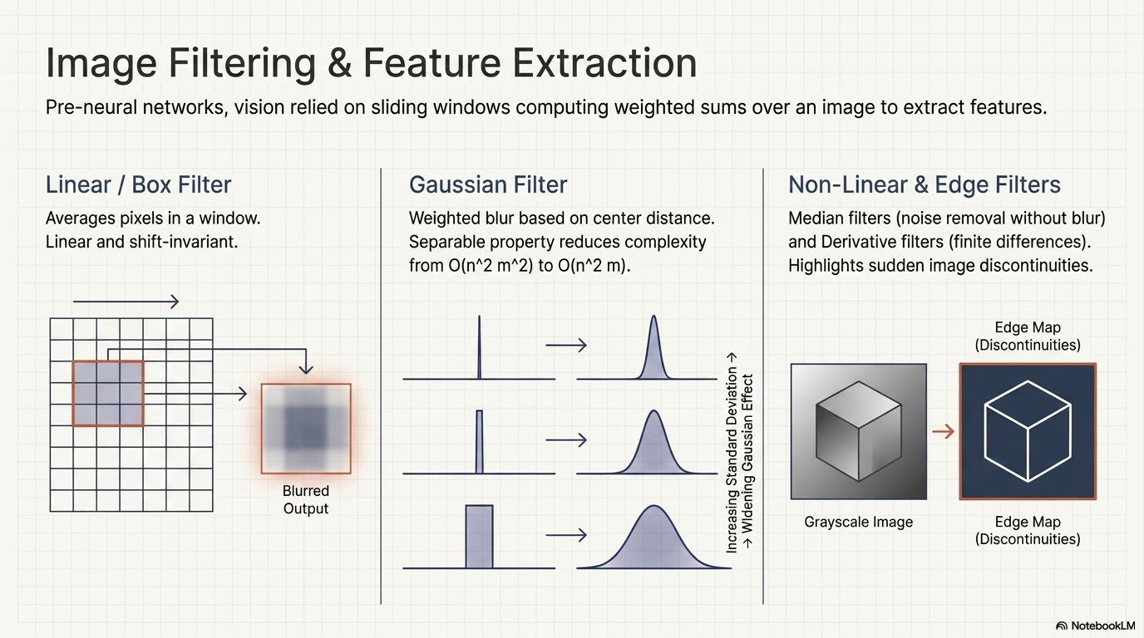

Slide 3
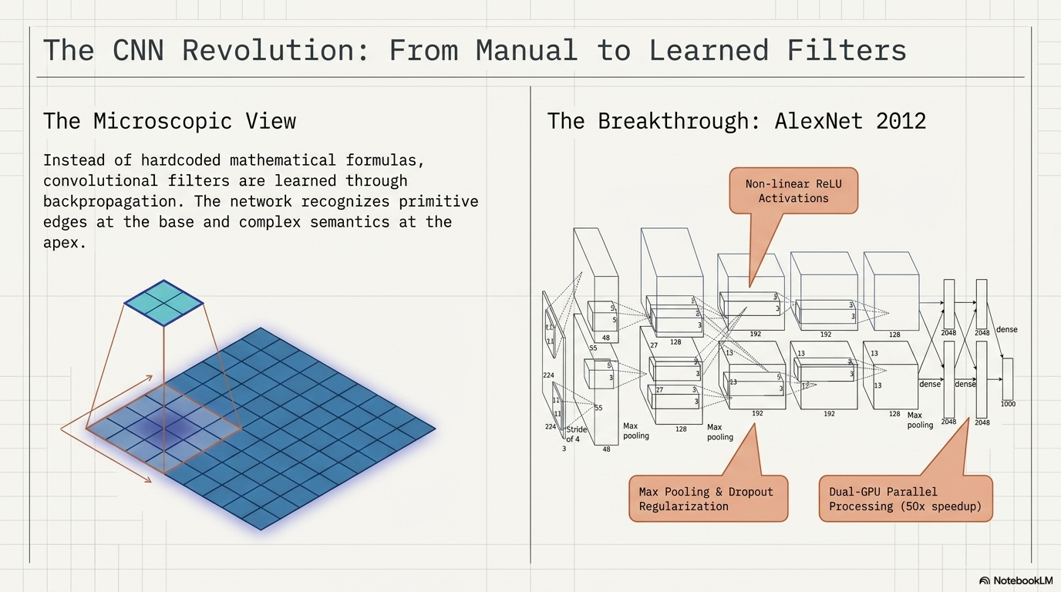

Slide 4
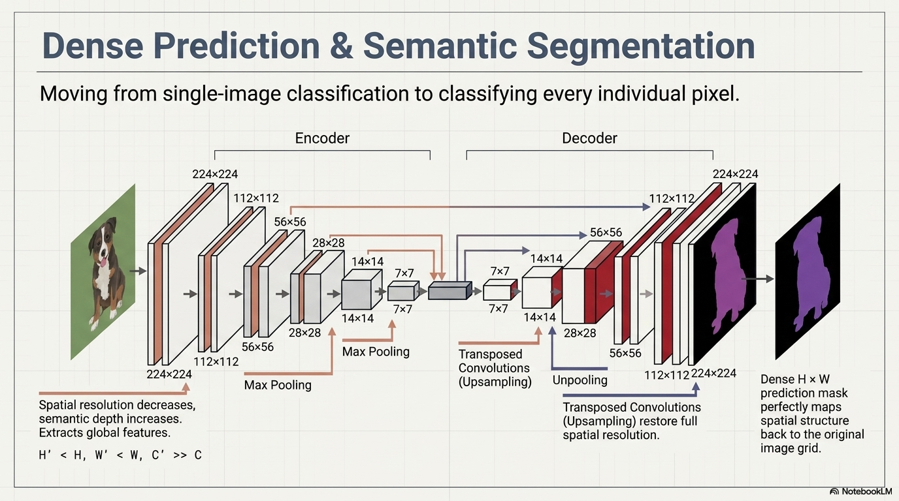

Slide 5
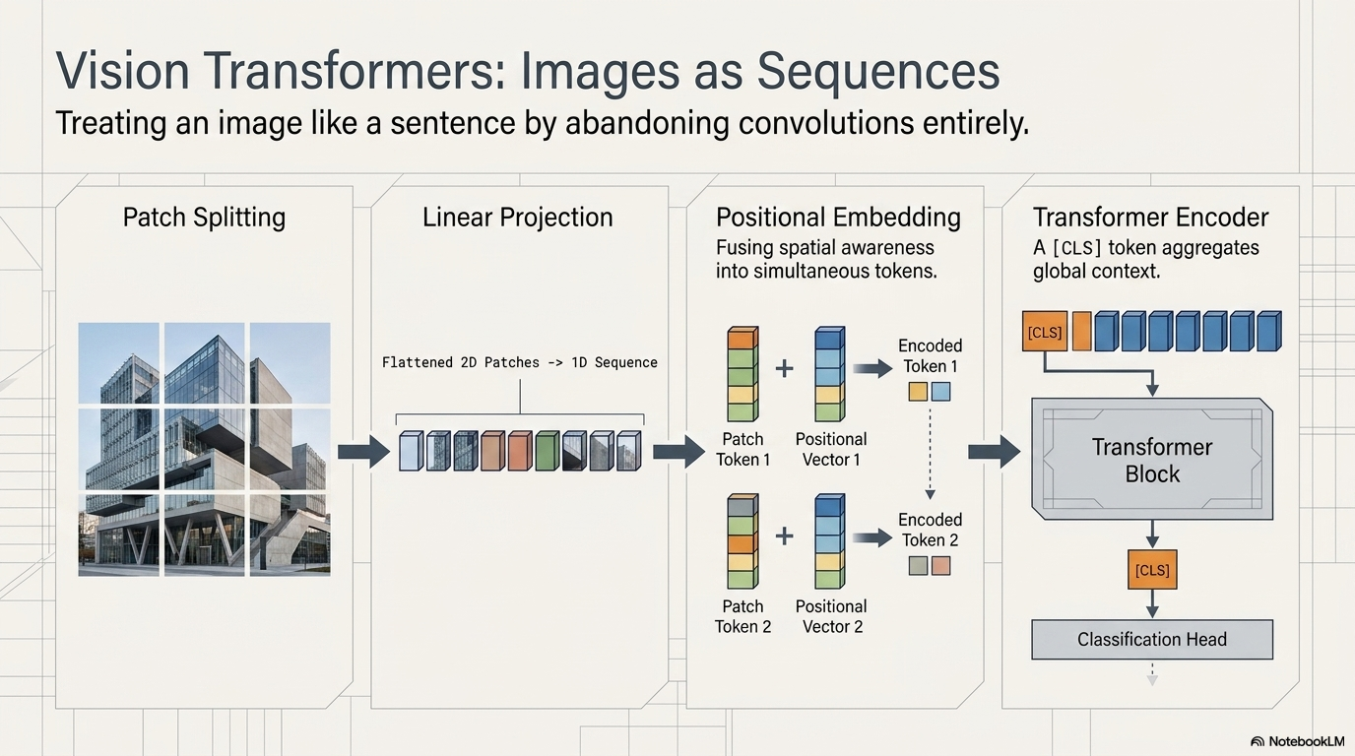

Slide 6
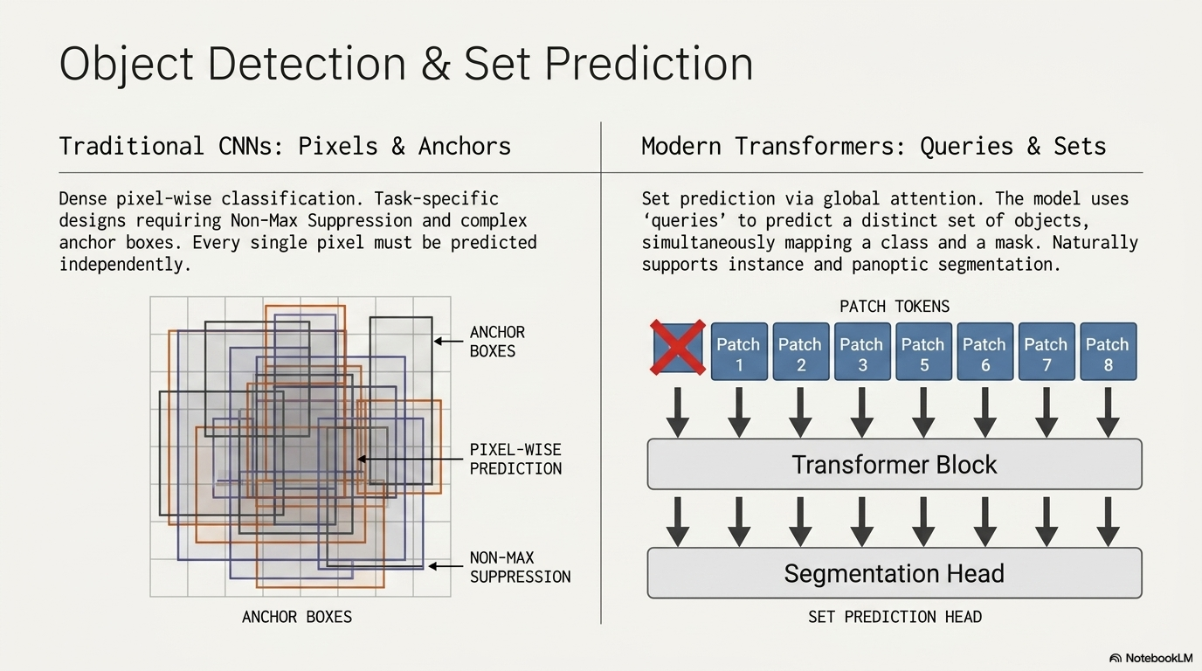

Slide 7
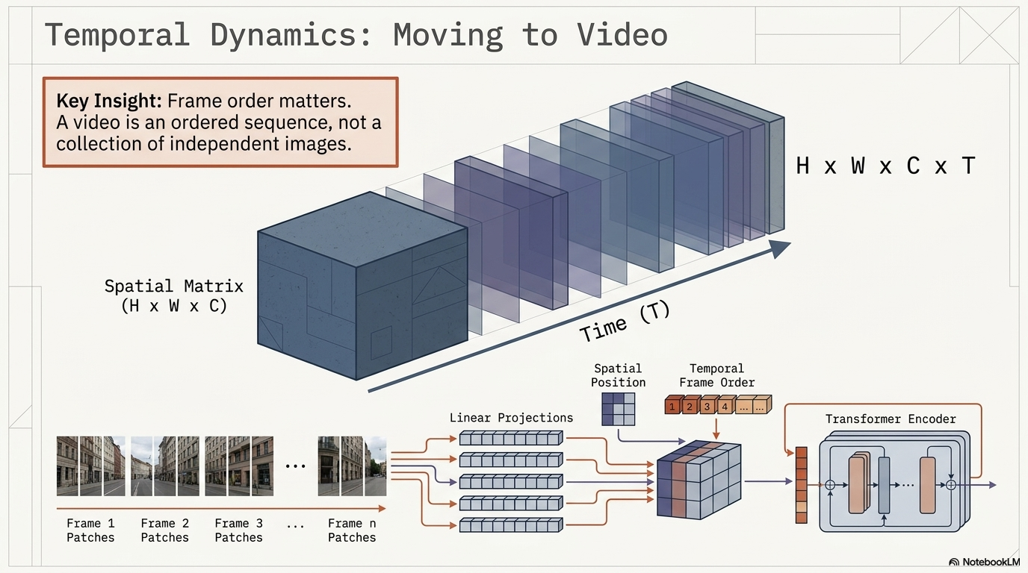

Slide 8
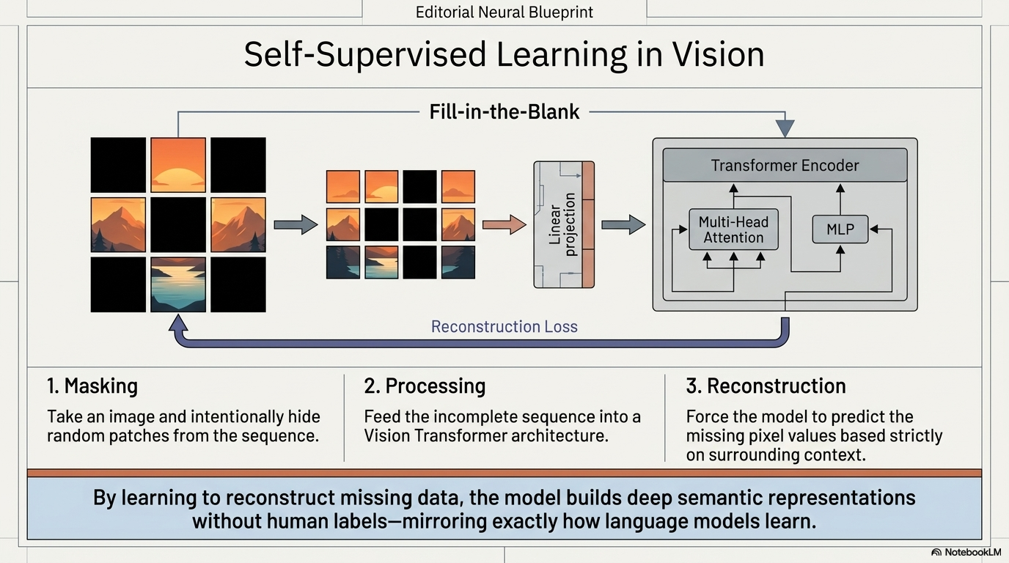

Slide 9
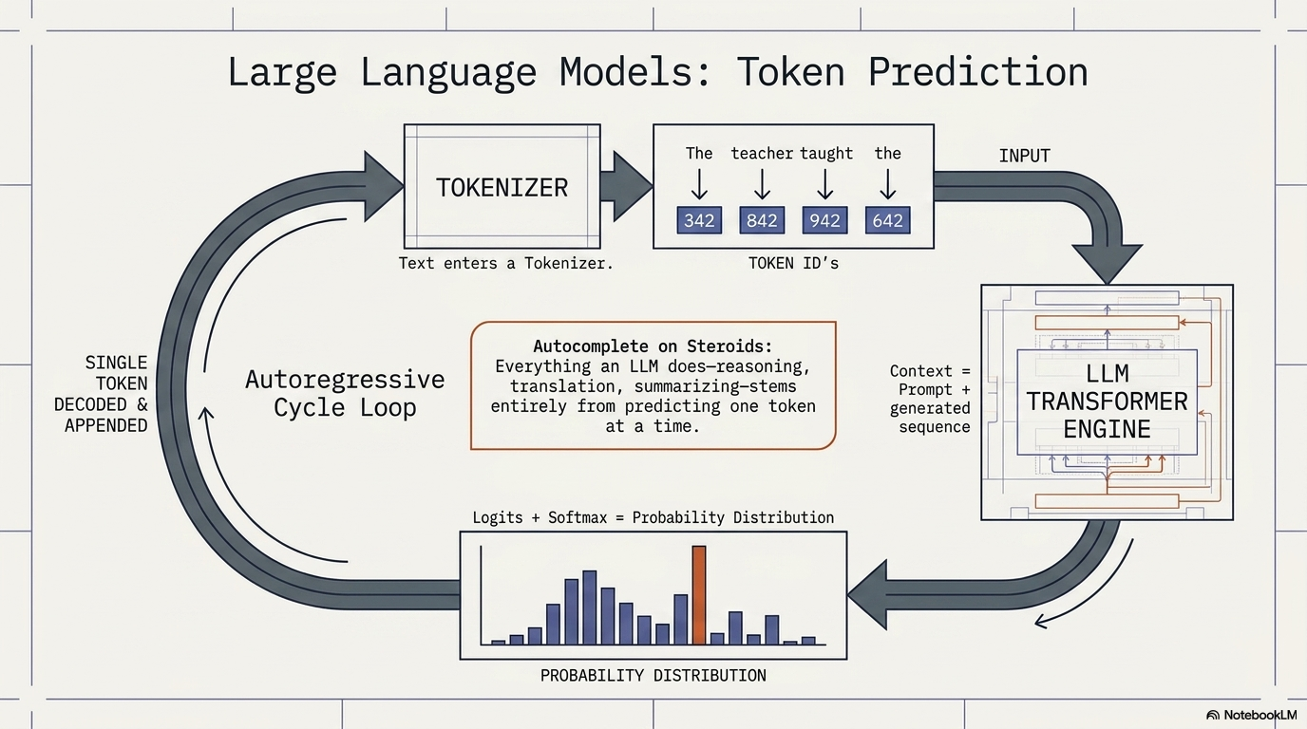

Slide 10
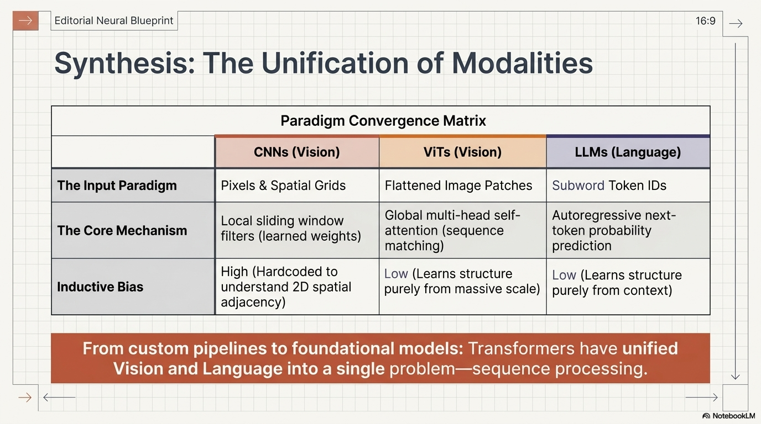

Slide 11
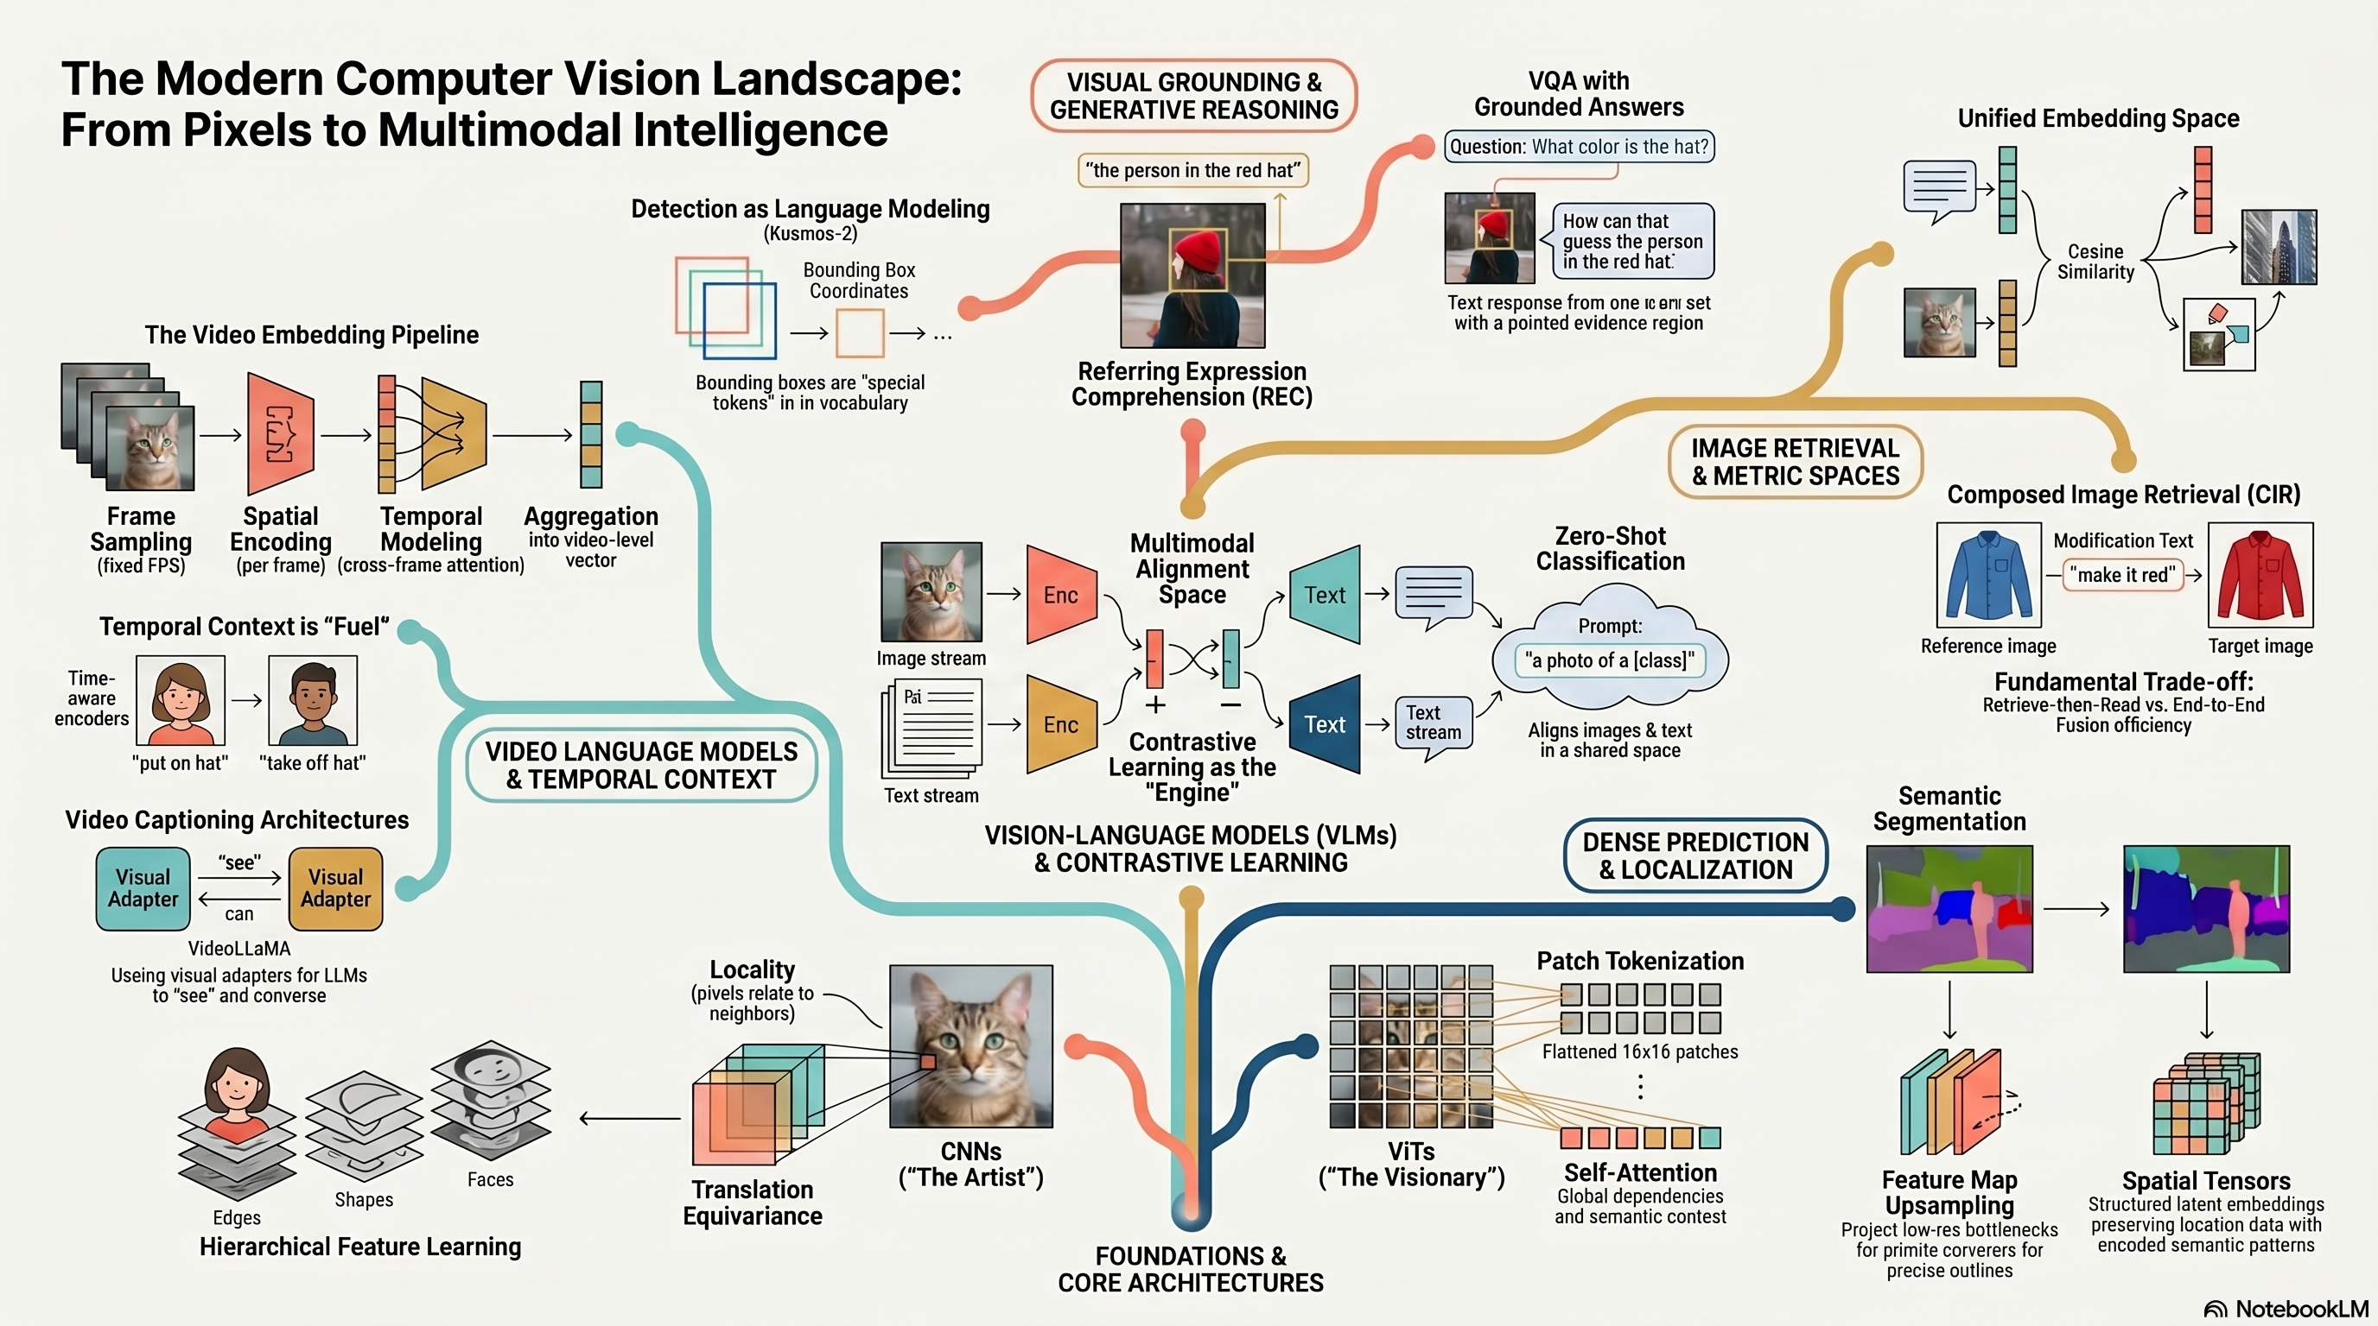

Slide 12
CV topics not covered
Object tracking and detection
Depth estimation
3D reconstruction

Slide 13
New course in Fall 2026
Covers foundations, architectures, and applications of AI systems that reason over images and text.
Introduces multimodal learning, CLIP-style contrastive pretraining, and LLM-based VLMs such as LLaVA and Qwen.
Explores key tasks such as image captioning, visual question answering, text-to-image generation, retrieval, and grounding.
Examines training methods, including alignment objectives, instruction tuning, RLHF, and large-scale multimodal pretraining.
Emphasizes model design, evaluation, bias, robustness, deployment challenges, paper discussions, and course projects.

Slide 14
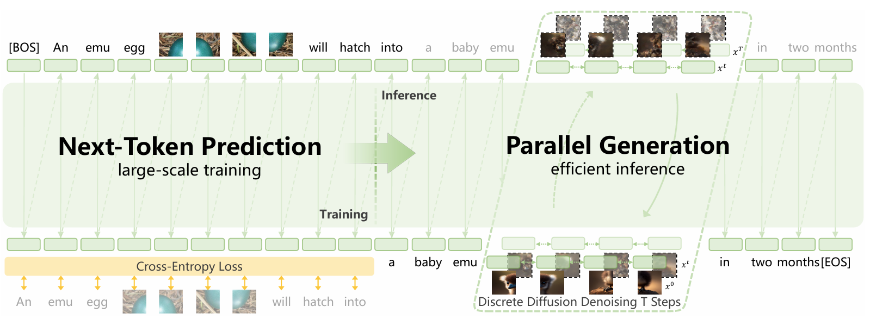
Future: VLMs that generate both text and images, e.g., Emu3.5

