Slide 1
Chapter 2
Fundamentals of Matrix Algebra By Gregory Hartman

Slide 2
2.1 Matrix Addition and Scalar Multiplication

Slide 3
Definitions

Slide 4
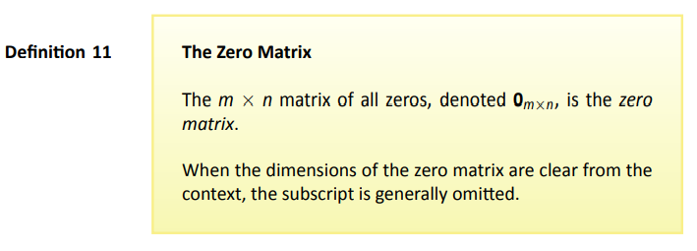
Definitions
Page 4

Slide 5
Theorem
Page 5

Slide 6
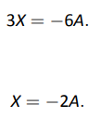

Slide 7
2.2 Matrix Multiplation

Slide 8
Definitions

Slide 9
Example 24

Slide 10
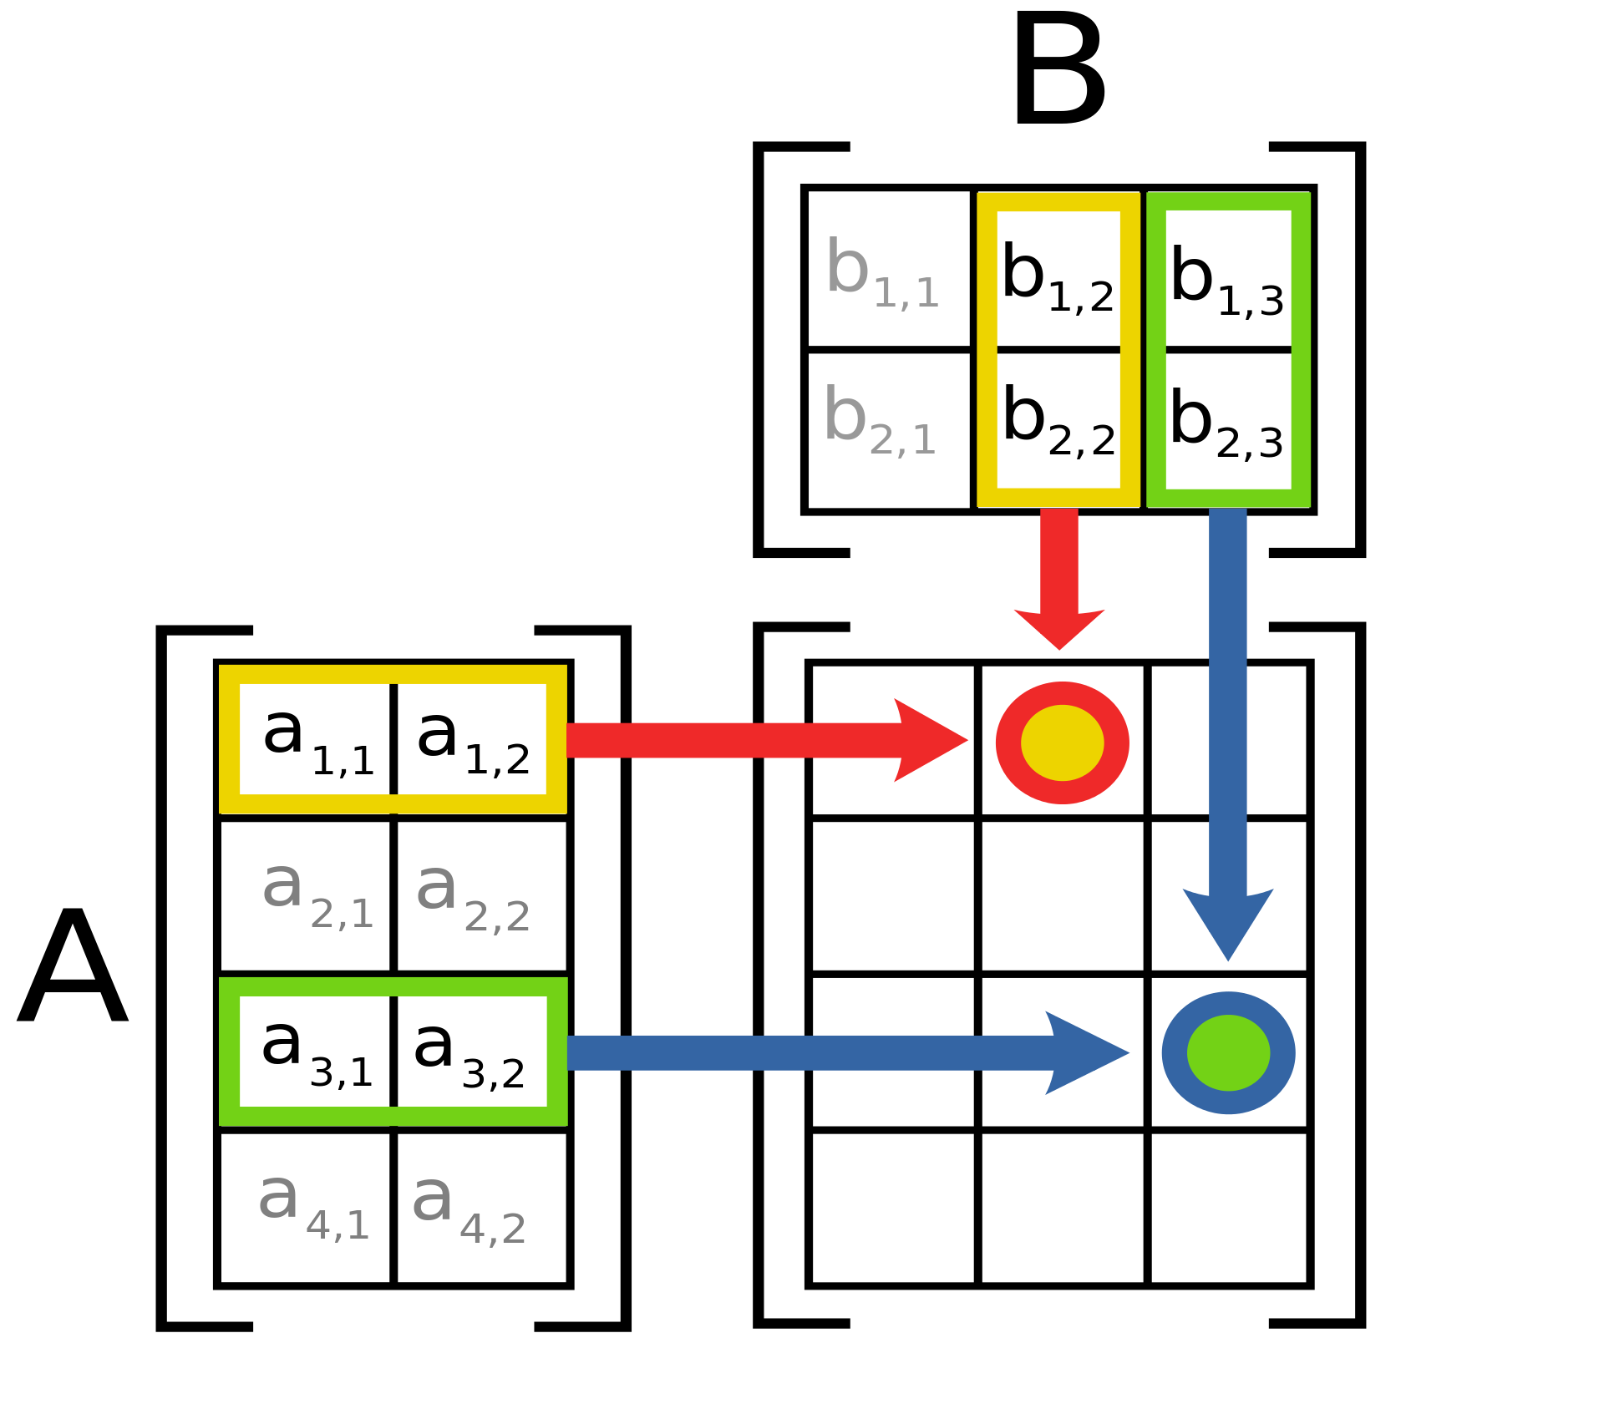
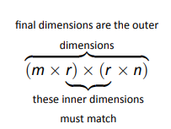
Important

Slide 11
Example 25
……….

Slide 12
Definition
Examples

Slide 13
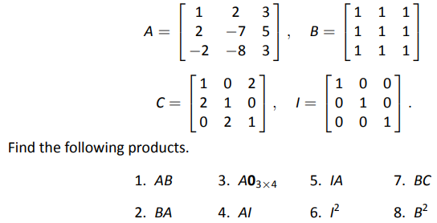
Example 29

Slide 14
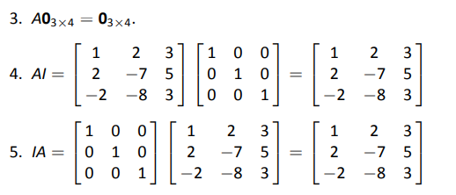
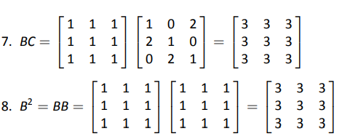
Example 29 : Solution (cont)

Slide 15
Theorem

Slide 16
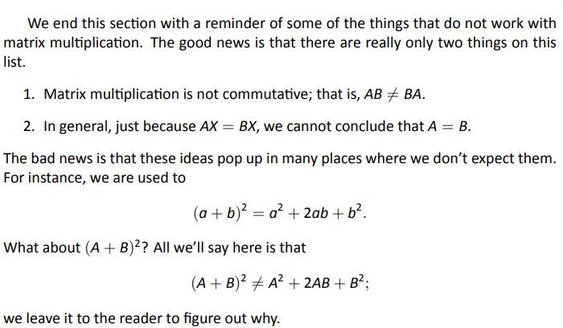
Final Thoughts

Slide 17
2.3 Visualizing Matrix Arithmetic in 2D

Slide 18
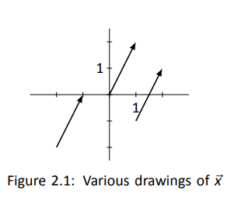
Graphing a Vector

Slide 19
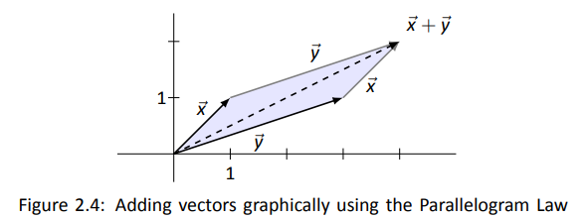
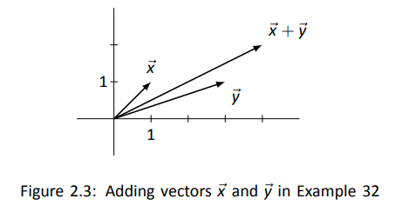
Example 32
Problem
Solution

Slide 20
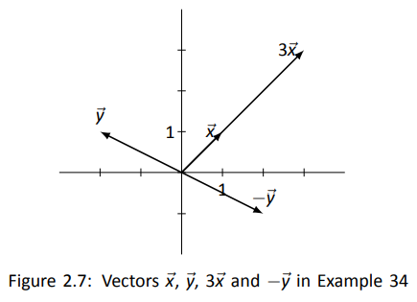
Example 34
Problem
Solution

Slide 21
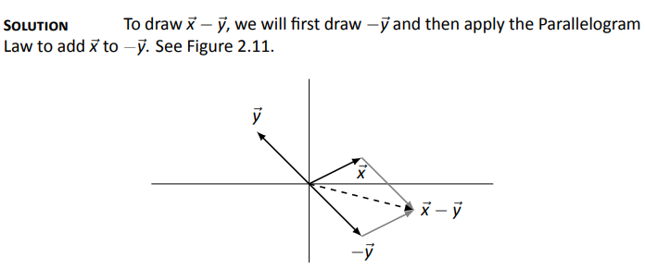
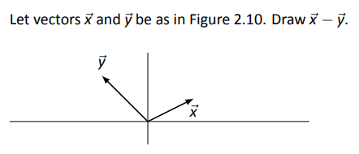
Example 36
Problem

Slide 22
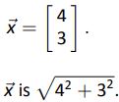

Slide 23
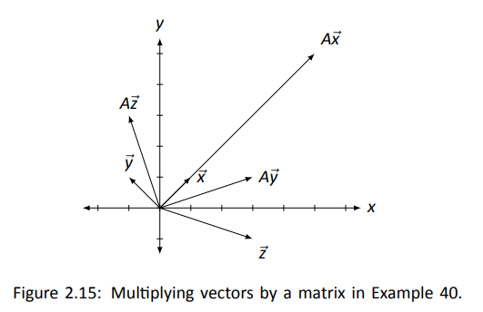
Example 40
Problem
Solution

Slide 24
2.4 Vector Solutions to Linear Systems

Slide 25
Example 44
Problem
Solution

Slide 26
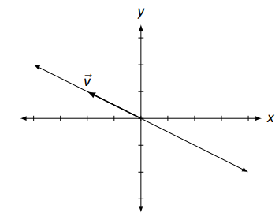
Example 44 (cont)

Slide 27
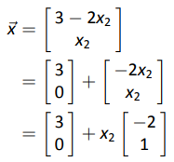
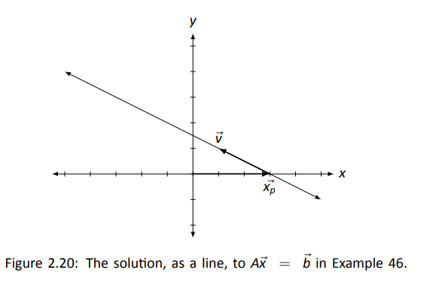
Example 46
Problem
Solution
1.
2.

Slide 28
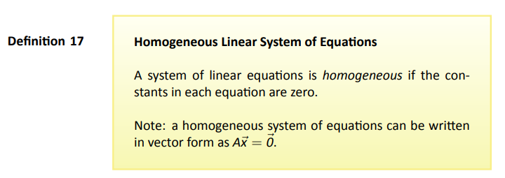
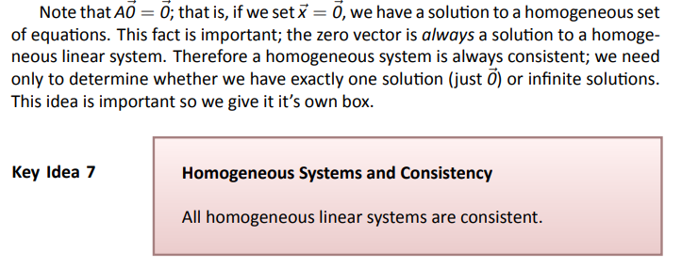
The term homogeneous comes from two Greek words; homo meaning “same” and genus meaning “type.”

Slide 29
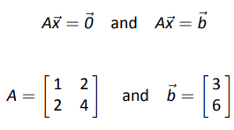
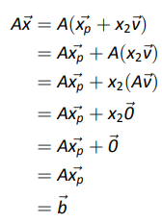
Determining How Many Solutions
Recall earlier example
Solutions
Recall earlier notation

Slide 30
Key Idea

Slide 31
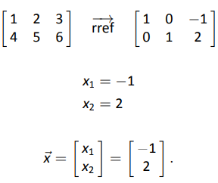
Example 49
Problem
Solution
First, we solve for

Slide 32
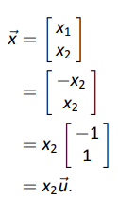
Example 50
Problem
Solution
Next we solve for
First, we solve for

Slide 33
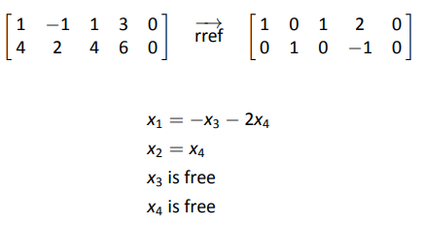
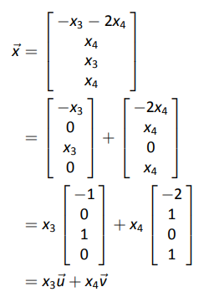
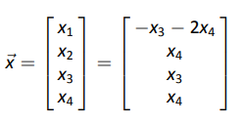
Example 47
Problem
Solution
First, we solve for
Again, we pull apart this
vector, but this time we
break it into three
vectors: one with “x₃”
stuff, one with “x₄” stuff,
and one with just
constants.

Slide 34
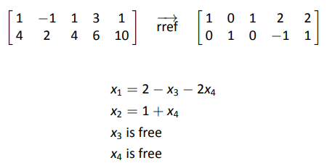
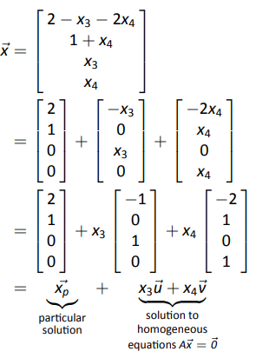
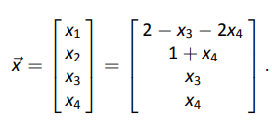
Example 47 (cont)
Problem
Solution
Next we solve for
Again, we pull apart this
vector, but this time we
break it into three
vectors: one with “x₃”
stuff, one with “x₄” stuff,
and one with just
constants.

Slide 35
2.5 Solving Matrix Equations AX = B

Slide 36
Overview of (new) Problem Solving Method

Slide 37
Example 51

Slide 38
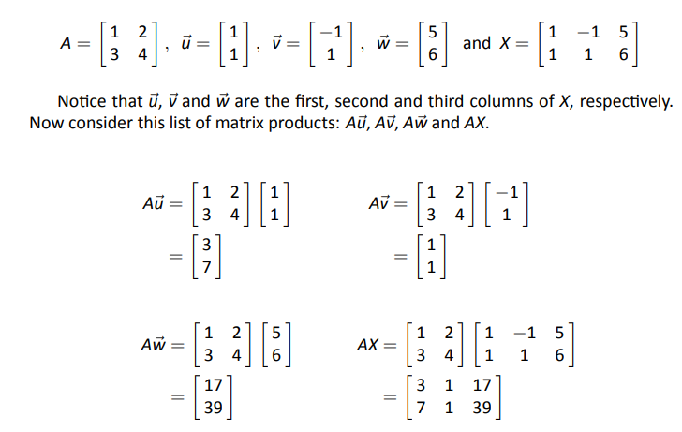
Why Does This Work?

Slide 39
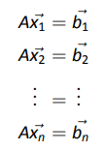
Why Does This Work? (cont)

Slide 40
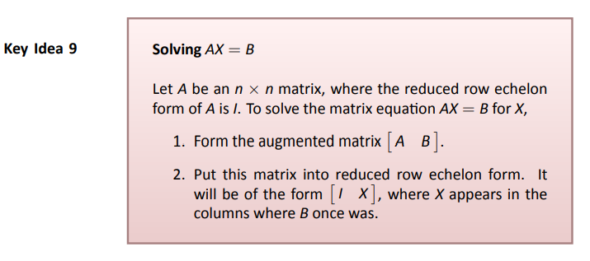
Key Idea

Slide 41
2.6 The Matrix Inverse

Slide 42
Inverse 101

Slide 43
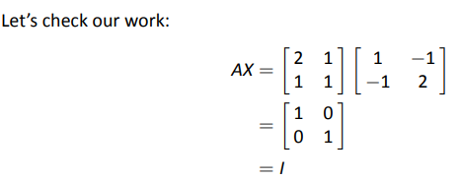
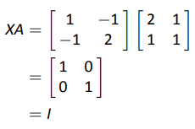
Example 53
Problem
Solution
We also have:
This means that AX = I = XA

Slide 44
Example 54

Slide 45
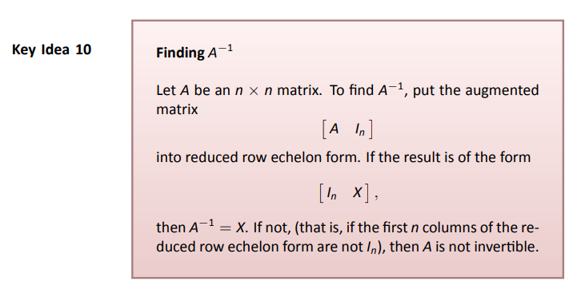
Key Idea

Slide 46
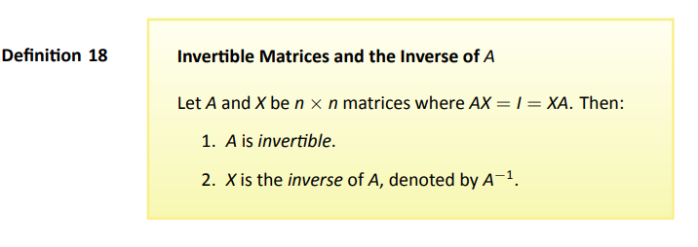

Slide 47
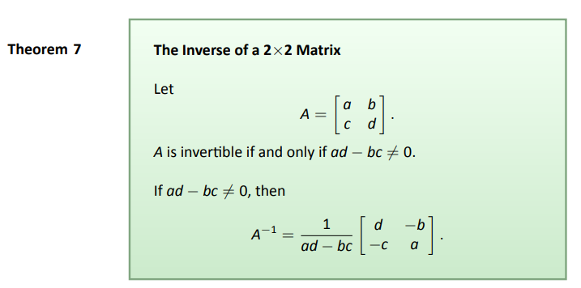
Theorem

Slide 48
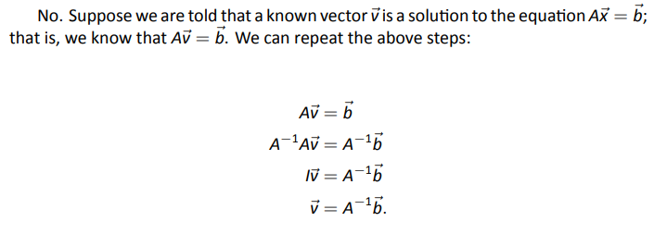
What if A⁻¹ exists?
Can more than one solution exist?

Slide 49
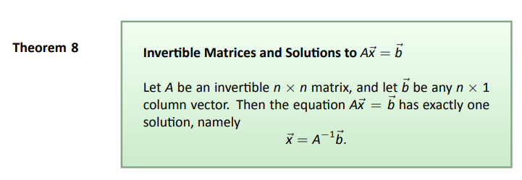
Theorem (we just proved)

Slide 50
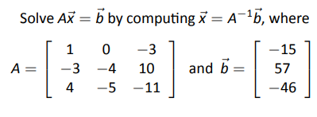
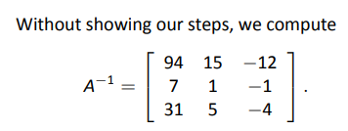
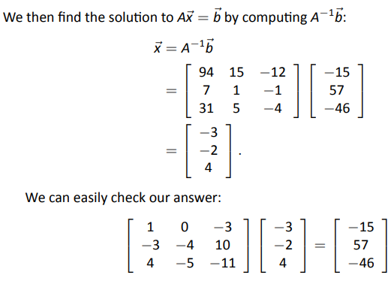
Example 57
Problem
Solution

Slide 51
2.7 Properties of Matrix Inverse

Slide 52
