Slide 1
Math for Neural Networks
Longin Jan Latecki
latecki@temple.edu

Slide 2
Based on
Deep Learning Course by Mitesh M. Khapra, Indian Institute of Technology, Madras, http://www.cse.iitm.ac.in/~miteshk/CS6910.html
Akshay L Chandra. Perceptron Learning Algorithm: A Graphical Explanation Of Why It Works. Towards Data Science
https://pabloinsente.github.io/the-multilayer-perceptron
Other Internet sources

Slide 3
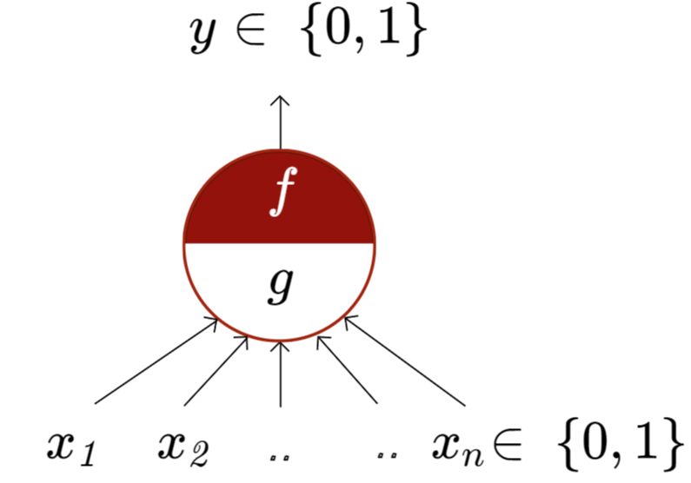
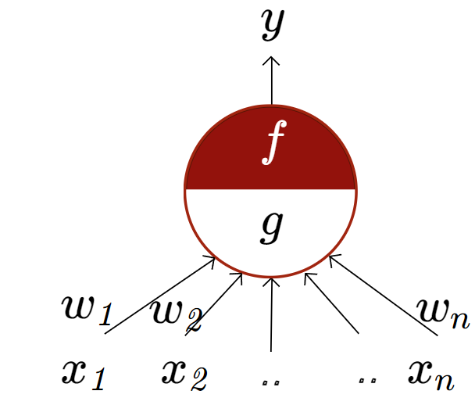
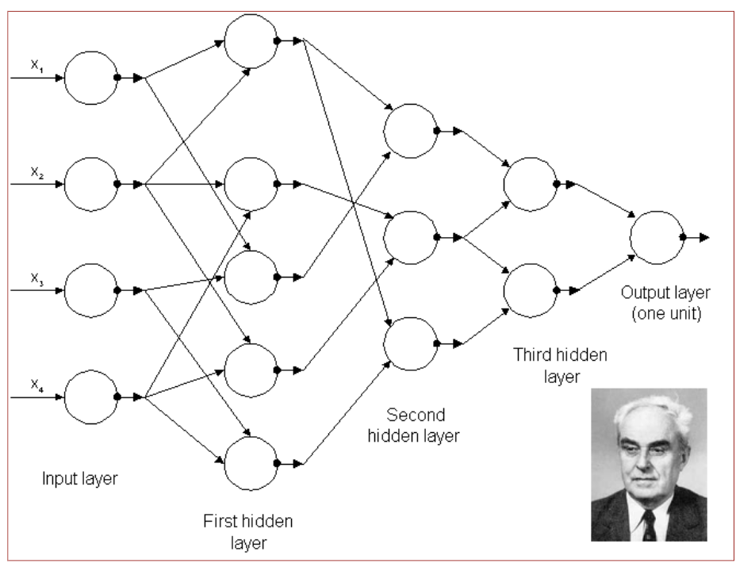
McCulloch Pitts Neuron
McCulloch (neuroscientist) and Pitts (logician) proposed a highly simplified model of the neuron (1943).
the perceptron may eventually be able to learn, make decisions, and translate languages” -Frank Rosenblatt, 1957-8
First generation Multilayer Perceptrons published by A. Ivakhnenko and V. G. Lapa,
CYBERNETIC PREDICTING DEVICES, 1966.

Slide 4
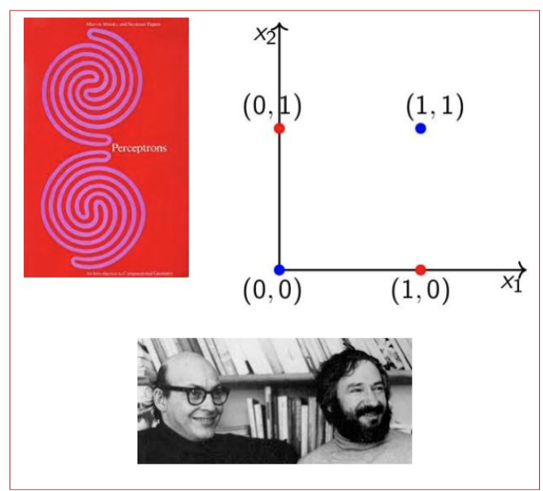
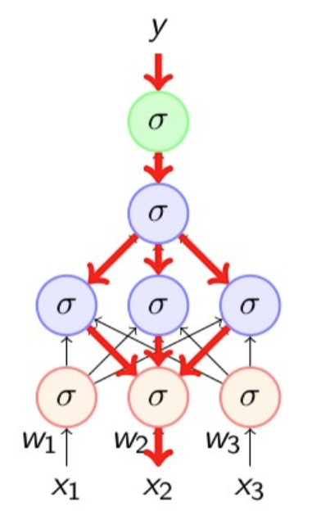
Perceptron Limitations
In book “Perceptrons” 1969, Minsky and Papert outlined the limits of what perceptrons could do and killed them.
Backpropagation
Discovered and rediscovered several times throughout 1960’s and 1970’s
Werbos(1982) first used it in the context of artificial neural networks
Eventually popularized by the work of Rumelhart et. al. in 1986

Slide 5
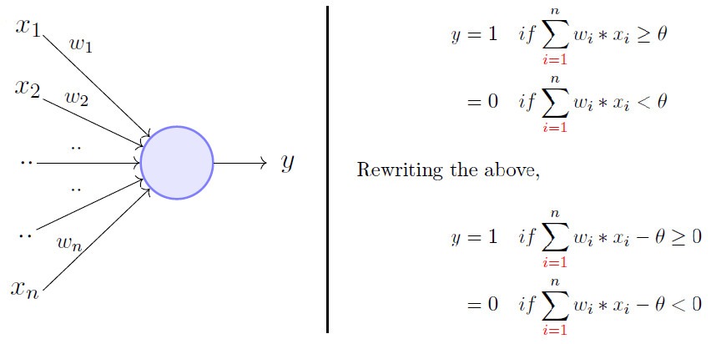
Perceptron
The perceptron model is a more general computational model than McCulloch-Pitts neuron.
It takes an input, aggregates it (weighted sum), and returns 1 only if the aggregated sum is more than some threshold otherwise, it returns 0.

Slide 6
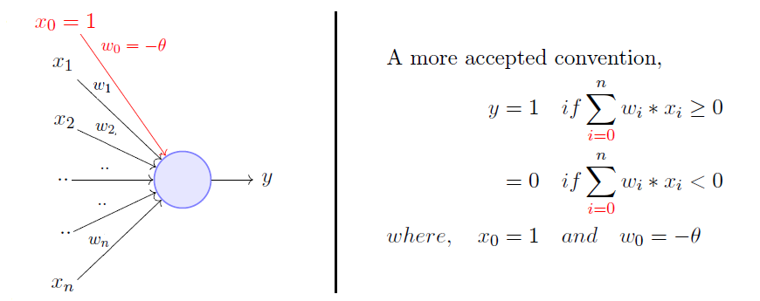
Rewriting the threshold (called bias) and making it a constant input with a variable weight, we get:
A single perceptron can only be used to implement linearly separable functions. It takes both real and Boolean inputs and associates a set of weights to them. After weights are learned, we get the function. A perceptron will fire if the weighted sum of its inputs is greater than the threshold (−w₀). Minsky and Papert proposed a more principled way of learning the weights using a set of examples (data). It was NOT a Sigmoid neuron and it did not use the Gradient Descent.

Slide 7
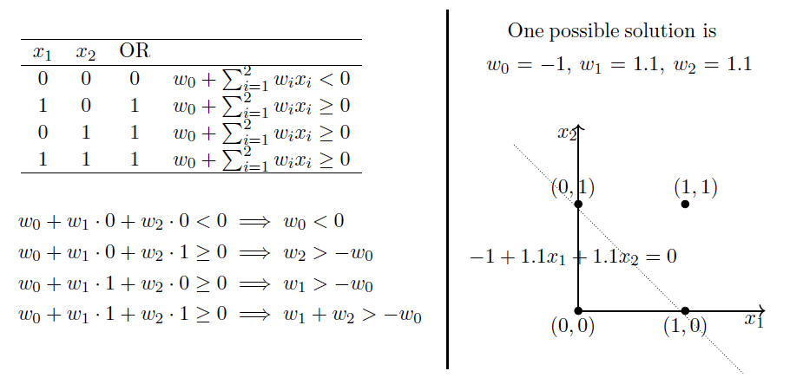
OR Function Using A Perceptron

Slide 8
Predicting whether one would like to watch a movie or not: binary decision
The weights (including the bias w₀) are learned from data:
Here it is viewer history. For perceptron, we assume that the data is linearly separable and we want a perceptron to learn how to make this decision.
A movie buff may have a very low threshold and may watch any movie irrespective of the genre, actor, or director, e.g. θ=0.
On the other hand, a selective viewer may only watch thrillers starring Matt Damon and directed by Nolan, e.g., θ=3.

Slide 9
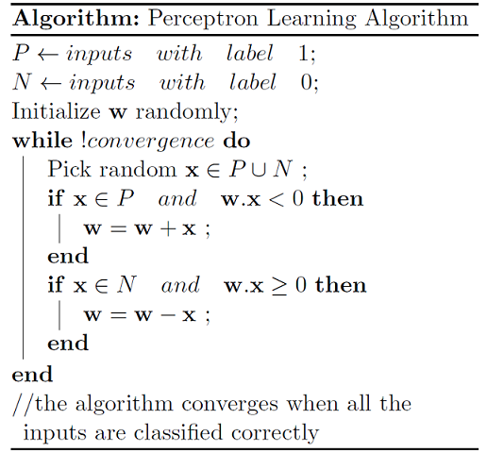
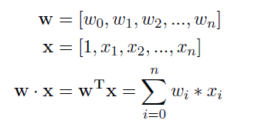
Stochastic Gradient Descent Version
-1;
1. Initialize weights (and bias) randomly
2. For each training example:
a. Calculate the predicted output:
ŷ = sign(w · x)
b. Update weights if the prediction is incorrect:
w = w + β (y – ŷ) · x
3. Repeat step 2 until convergence
or max iterations are reached,
where y is 1 or -1, ŷ predicted the label,
and β learning rate, which we set to β = ½.
We switched the labels from 1 and 0 to 1 or -1.
The perceptron learning algorithm is a simple supervised learning algorithm for binary classification.

Slide 10
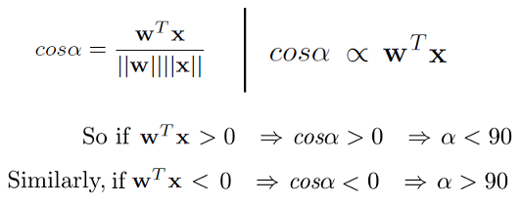
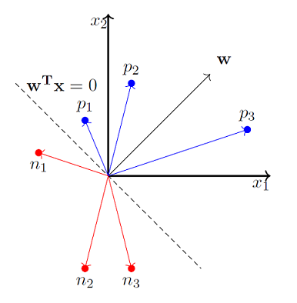
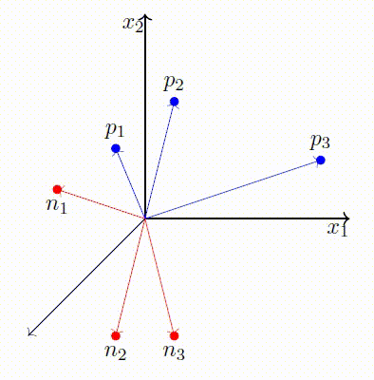
Perceptron Learning Algorithm: Geometry

Slide 11
Perceptron Learning Algorithm
1. Initialize weights (and bias) randomly
2. For each training example:
a. Calculate the predicted output: ŷ = sign(w · x)
b. Update weights if the prediction is incorrect: w = w + β (y – ŷ) · x
3. Repeat step 2 until convergence or max iterations are reached,
where y is the true label (1 or -1), ŷ predicted the label, and β learning rate.
The perceptron update rule can be viewed as a stochastic gradient descent algorithm instance.
The gradient descent update rule: w = w – η ∂L/∂wL(w)
The implicit loss function that the perceptron algorithm is minimizing is
L(w) = max(0, -y(w · x))
∂L/∂w = {
0, if y(w · x) > 0 (correct classification)
-y · x, if y(w · x) ≤ 0 (incorrect classification)
}
Observe that if y(w · x) ≤ 0, then w = w – η ∂L/∂wL(w) = w - η(-y · x) = w + η(y · x), where β = ½ η.

Slide 12
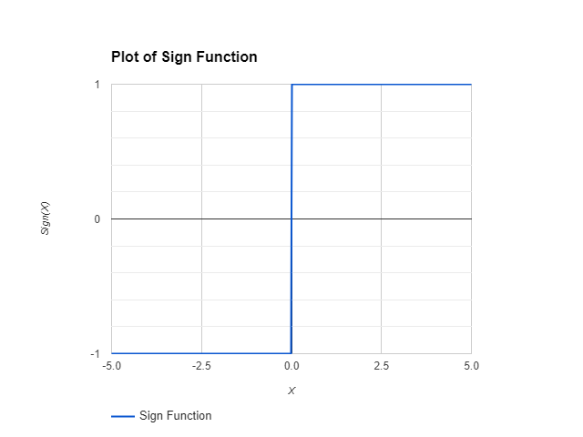
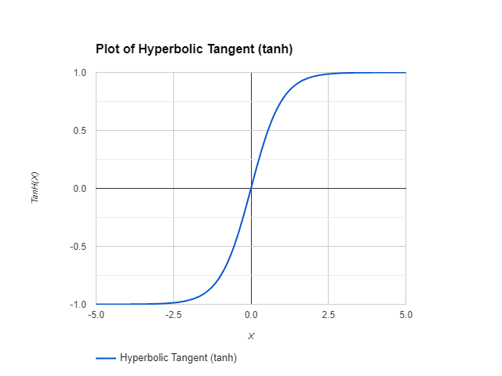
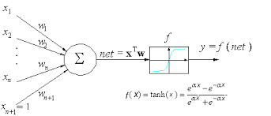
Perceptron Learning Algorithm → Single Layer Neural Network (NN)
If we replace the sign function with tanh
(or other nonlinear function)
as an activation function,
we obtain a single-layer neural network
from the perceptron.
Or replace the step function
with the sigmoid.

Slide 13
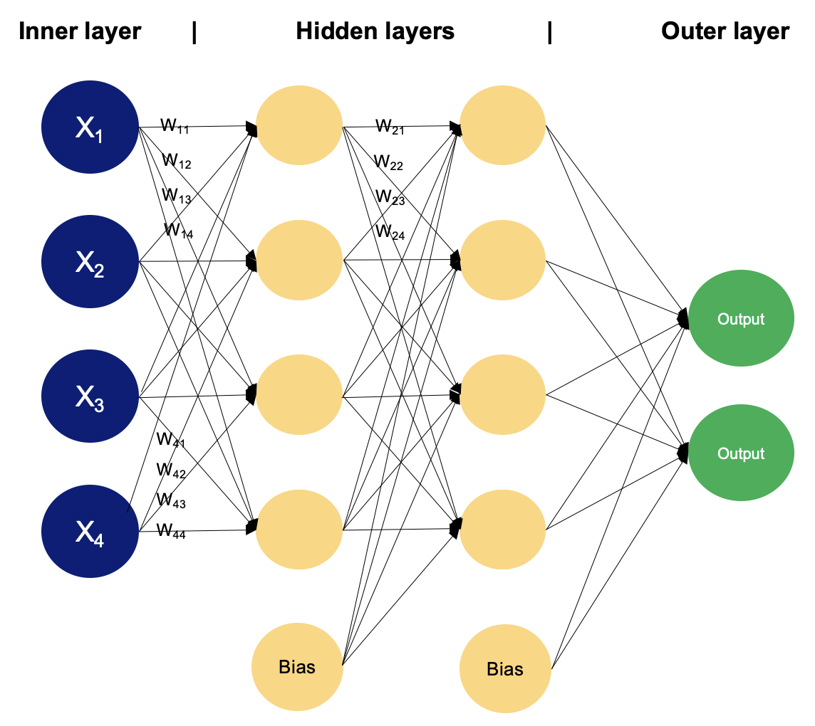
Multilayer Perceptron or Neural Network (NN)

Slide 15
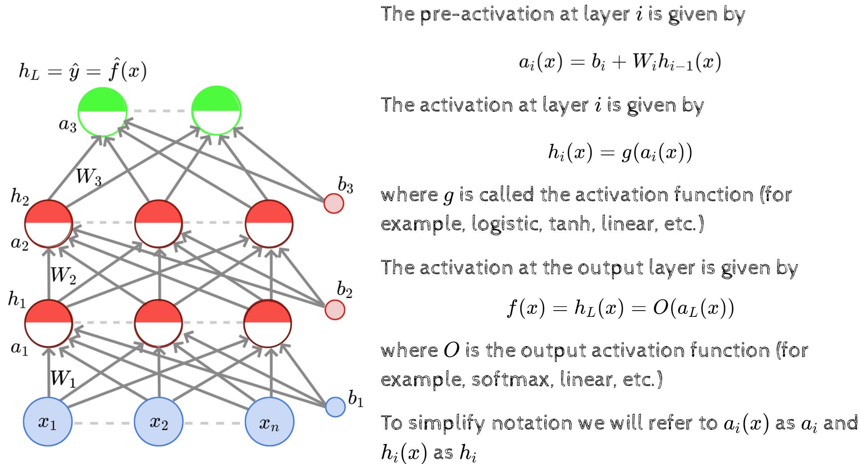

Slide 16
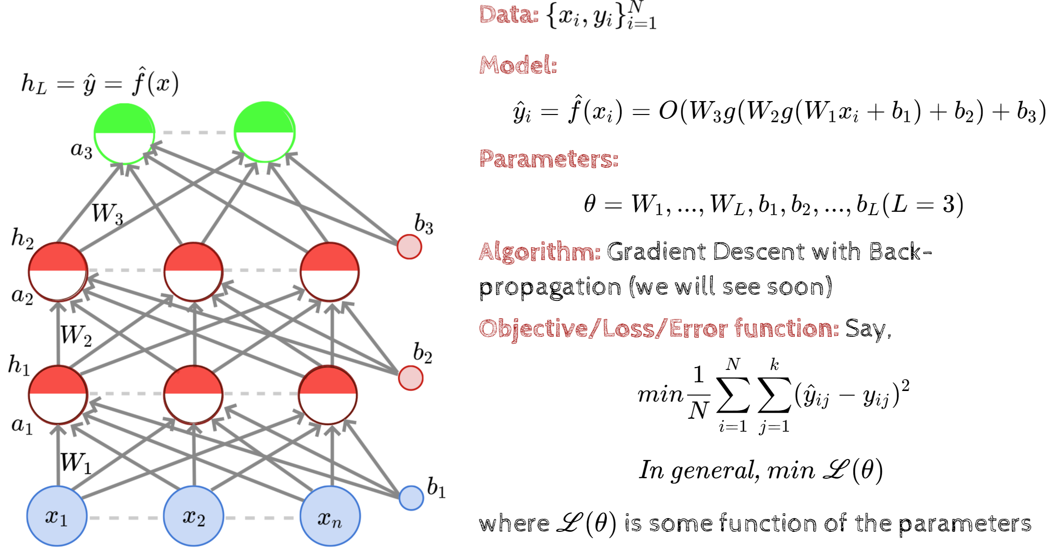

Slide 17
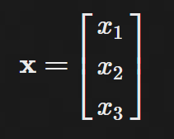
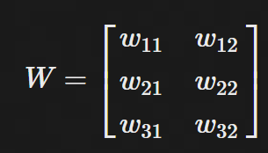
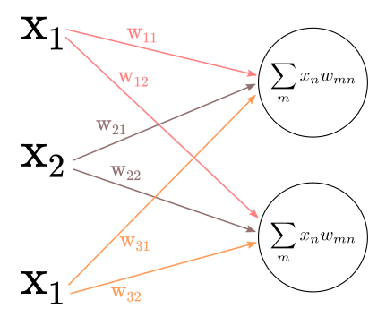
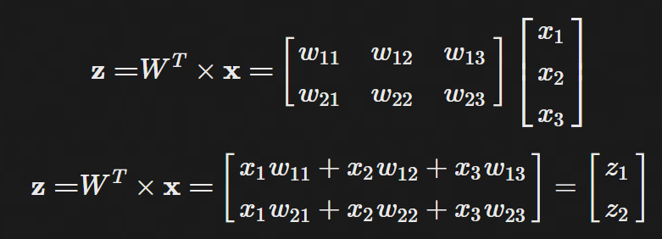
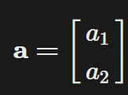
we have 3 input units connecting to hidden 2 units we have 3x2 weight matrix:
$$σ\left(z\right)=a$$
$$σ\left(z\right)=ReLU or \frac{1}{1+e^{−z}}$$

Slide 18
