Slide 1
Finite-State Machines with No Output Longin Jan Latecki Temple University
Some slides by Elsa L Gunter, NJIT,
and by Costas Busch

Slide 2
Big Picture: Three Equivalent Representations
Regular
expressions
Each
can
describe
the others
Regular
languages
Finite
automata
Kleene’s Theorem:
For every regular expression, there is a deterministic finite-state automaton that defines the same language, and vice versa.
More in Ch. 13.4

Slide 3
Kleene closure
A and B are subsets of V*, where V is a vocabulary The concatenation of A and B is AB={xy: x string in A and y string in B}
Example: A={0, 11} and B={1, 10, 110} AB={01,010,0110,111,1110,11110}
What is BA?
A⁰={λ} A^{n+1}=A^{n}A for n=0,1,2,…

Slide 4
Let A be any subset of V*.
Kleene closure of A, denoted by A*, is
Examples:
If C={11}, then C*={1^{2n}: n=0,1,2,…}
If B={0,1}, then B*=V*.

Slide 5
Example
Regular expression

Slide 6
Example
Regular expression
= { all strings with at least
two consecutive 0 }

Slide 7
Implementing Regular Expressions
Regular expressions, regular grammars reasonable way to generates strings in language
Not so good for recognizing when a string is in language
Regular expressions: which option to choose, how many repetitions to make
Answer: finite state automata

Slide 8
Finite (State) Automata
A FA is similar to a compiler in that:
A compiler recognizes legal programs in some (source) language.
A finite-state machine recognizes legal strings in some language.
Example: Pascal Identifiers
sequences of one or more letters or digits, starting with a letter:
letter | digit
letter
S
A

Slide 9
Finite Automaton
Input
String
Output
“Accept”
or
“Reject”
Finite
Automaton

Slide 10
Finite State Automata
A finite state automation over an alphabet is illustrated by a state diagram:
a directed graph
edges are labeled with elements of alphabet,
some nodes (or states), marked as final
one node marked as start state

Slide 11
Transition Graph
initial
state
accepting
state
transition
state

Slide 12
Initial Configuration
Input String

Slide 13
Reading the Input

Slide 17
Input finished
accept

Slide 18
Rejection

Slide 22
Input finished
reject

Slide 23
Another Rejection

Slide 24
reject

Slide 25
Another Example

Slide 29
Input finished
accept

Slide 30
Rejection Example

Slide 34
Input finished
reject

Slide 35
Finite State Automata
A finite state automation M=(S,Σ,δ,s₀,F) consists of
a finite set S of states,
a finite input alphabet Σ,
a state transition function δ: S x Σ → S,
an initial state s₀,
F subset of S that represent the final states.

Slide 36
Finite Automata
Transition
s₁ →ª s₂
Is read ‘In state s₁ on input “a” go to state s₂’
If end of input
If in accepting state => accept
Otherwise => reject
If no transition possible (got stuck) => reject
FSA = Finite State Automata

Slide 37
Input Alphabet

Slide 38
Set of States

Slide 39
Initial State

Slide 40
Set of Accepting States

Slide 41
Transition Function

Slide 45
Transition Function

Slide 46
Exercise
Construct the state diagram
for M=(S,Σ,δ,s₀,F),where
S={s₀, s₁, s₂, s₃},
Σ={0,1}, F={s₀, s₃} and transition function δ:
state | Input: 0 | Input: 1
s₀ | s₀ | s₁
s₁ | s₀ | s₂
s₂ | s₀ | s₀
s₃ | s₂ | s₁

Slide 47
Language accepted by FSA
The language accepted by a FSA is the set of strings accepted by the FSA.
in the language of the FSM shown below: x, tmp2, XyZzy, position27.
not in the language of the FSM shown below:
123, a?, 13apples.
letter | digit
letter
S
A

Slide 48
Example
accept

Slide 49
Example
accept
accept
accept

Slide 50
Example
accept
trap state
Provide a regular grammar G so that L(G)=L(M).

Slide 51
Extended Transition Function

Slide 55
Observation: if there is a path from to
with label then

Slide 56
Example: There is a walk from to
with label

Slide 57
Recursive Definition

Slide 59
Language Accepted by FAs
For a FA
Language accepted by :

Slide 60
Observation
Language rejected by :

Slide 61
Example
= { all strings with prefix }
accept

Slide 62
Example
= { all strings without
substring }

Slide 63
Example

Slide 64
Kleene’s Theorem: For every regular expression, there is a deterministic finite-state automaton that defines the same language, and vice versa.
An equivalent regular expression:

Slide 65
Deterministic FSA’s
If FSA has for every state exactly one edge for each letter in alphabet then FSA is deterministic
In general FSA in non-deterministic.
Deterministic FSA is a special kind of non-deterministic FSA

Slide 66
Example FSA
Regular expression: (0 ∨ 1)* 1
Deterministic FSA
0
1
1
0

Slide 67
Example DFSA
Regular expression: (0 ∨ 1)* 1
Accepts string 0 1 1 0 1
0
1
1
0

Slide 68
Example DFSA
Regular expression: (0 ∨ 1)* 1
Accepts string 0 1 1 0 1
0
1
1
0

Slide 69
Example DFSA
Regular expression: (0 ∨ 1)* 1
Accepts string 0 1 1 0 1
0
1
1
0

Slide 70
Example DFSA
Regular expression: (0 ∨ 1)* 1
Accepts string 0 1 1 0 1
0
1
1
0

Slide 71
Example DFSA
Regular expression: (0 ∨ 1)* 1
Accepts string 0 1 1 0 1
0
1
1
0

Slide 72
Example DFSA
Regular expression: (0 ∨ 1)* 1
Accepts string 0 1 1 0 1
0
1
1
0

Slide 73
Example DFSA
Regular expression: (0 ∨ 1)* 1
Accepts string 0 1 1 0 1
0
1
1
0

Slide 74
Example NFSA
Regular expression: (0 ∨ 1)* 1
Non-deterministic FSA
0
1
1

Slide 75
Example NFSA
Regular expression: (0 ∨ 1)* 1
Accepts string 0 1 1 0 1
Regular expression: (0 + 1)* 1
Accepts string 0 1 1 0 1
0
1
1

Slide 76
Example NFSA
Regular expression: (0 ∨ 1)* 1
Accepts string 0 1 1 0 1
Regular expression: (0 + 1)* 1
Accepts string 0 1 1 0 1
0
1
1

Slide 77
Example NFSA
Regular expression: (0 ∨ 1)* 1
Accepts string 0 1 1 0 1
Regular expression: (0 + 1)* 1
Accepts string 0 1 1 0 1
0
1
1

Slide 78
Example NFSA
Regular expression: (0 ∨ 1)* 1
Accepts string 0 1 1 0 1
Guess
Regular expression: (0 + 1)* 1
Accepts string 0 1 1 0 1
0
1
1

Slide 79
Example NFSA
Regular expression: (0 ∨ 1)* 1
Accepts string 0 1 1 0 1
Backtrack
Regular expression: (0 + 1)* 1
Accepts string 0 1 1 0 1
0
1
1

Slide 80
Example NFSA
Regular expression: (0 ∨ 1)* 1
Accepts string 0 1 1 0 1
Guess again
Regular expression: (0 + 1)* 1
Accepts string 0 1 1 0 1
0
1
1

Slide 81
Example NFSA
Regular expression: (0 + 1)* 1
Accepts string 0 1 1 0 1
Guess
Regular expression: (0 + 1)* 1
Accepts string 0 1 1 0 1
0
1
1

Slide 82
Example NFSA
Regular expression: (0 ∨ 1)* 1
Accepts string 0 1 1 0 1
Backtrack
Regular expression: (0 + 1)* 1
Accepts string 0 1 1 0 1
0
1
1

Slide 83
Example NFSA
Regular expression: (0 ∨ 1)* 1
Accepts string 0 1 1 0 1
Guess again
Regular expression: (0 + 1)* 1
Accepts string 0 1 1 0 1
0
1
1

Slide 84
Example NFSA
Regular expression: (0 ∨ 1)* 1
Accepts string 0 1 1 0 1
Regular expression: (0 + 1)* 1
Accepts string 0 1 1 0 1
0
1
1

Slide 85
Example NFSA
Regular expression: (0 ∨ 1)* 1
Accepts string 0 1 1 0 1
Guess (Hurray!!)
Regular expression: (0 + 1)* 1
Accepts string 0 1 1 0 1
0
1
1

Slide 86
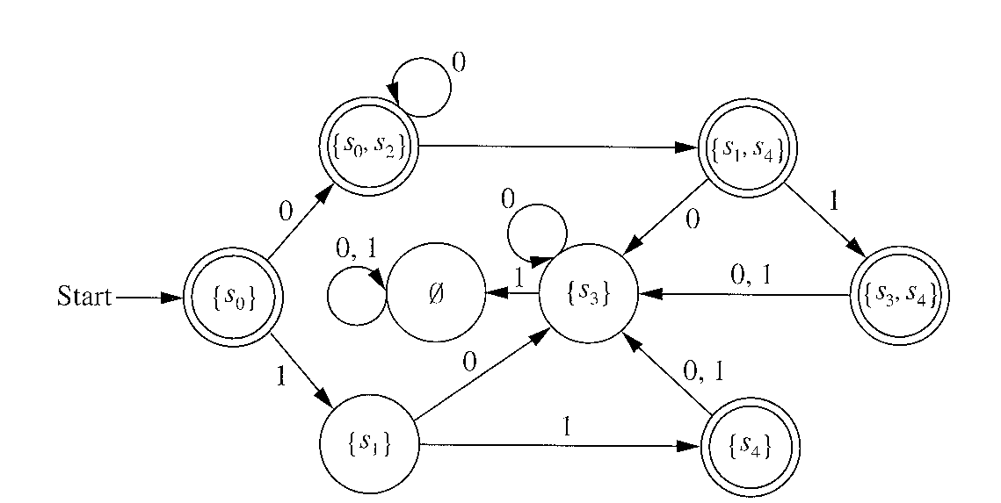
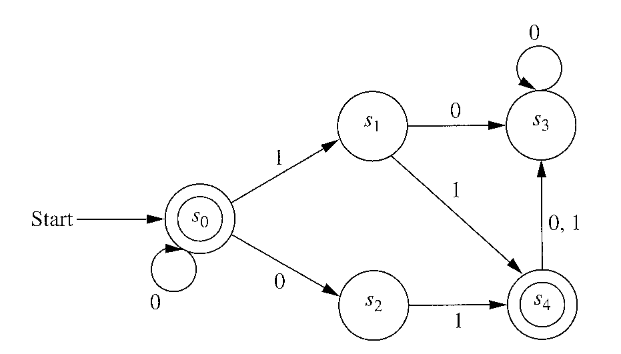
If a language L is recognized by
a nondeterministic FSA,
then L is recognized by a deterministic FSA
Example 10, p. 812
NFSA
FSA

Slide 87
How to Implement an FSA
A table-driven approach:
table:
one row for each state in the machine, and
one column for each possible character.
Table[j][k]
which state to go to from state j on character k,
an empty entry corresponds to the machine getting stuck.

Slide 88
The table-driven program for a Deterministic FSA
state = S // S is the start state
repeat {
k = next character from the input
if (k == EOF) // the end of input
if state is a final state then accept
else reject
state = T[state,k]
if state = empty then reject // got stuck
}

