Slide 1
Point Matching Evaluation Report
Motaz
Semir
Howard

Slide 2
Grading Strategy
5 data sets: A,B,C,D,E
For each data set: run 20 tests and average the acc rates
Final grade: average acc rate of 5 data sets
Tiebreaker is Average Time

Slide 3
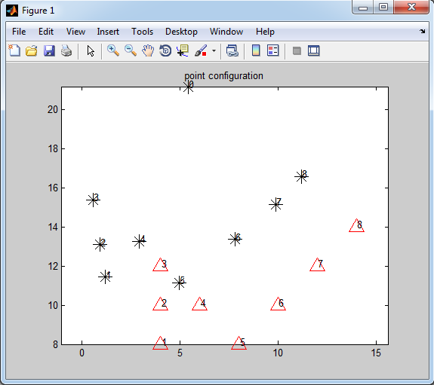
Experiment 1 PointMatchingA

Slide 4
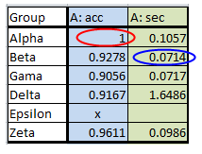
Table: A
Red circle: highest accuracy rate
Blue circle: shortest running time when acc > 0.9

Slide 5
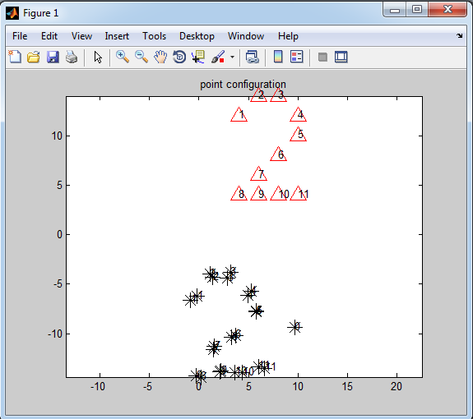
Experiment 2 PointMatchingB

Slide 6
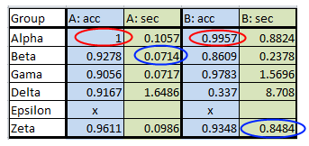
Table: A,B

Slide 7
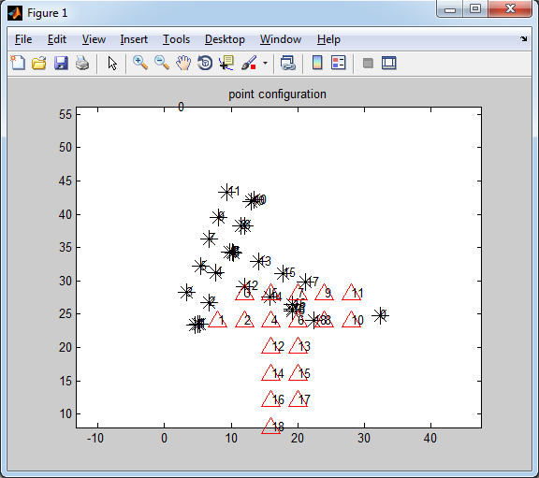
Experiment 3 PointMatchingC

Slide 8
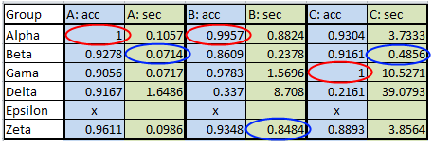
Table: A,B,C

Slide 9
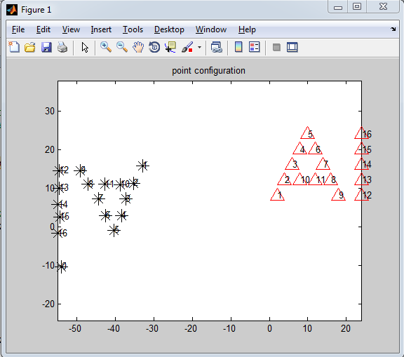
Experiment 4 PointMatchingD

Slide 10
Table: A,B,C,D

Slide 11
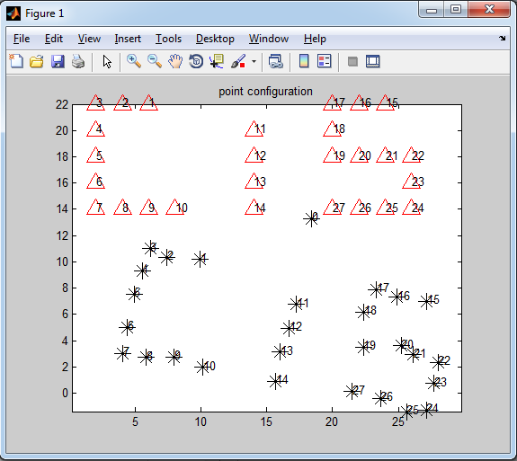
Experiment 5 PointMatchingE

Slide 12
Table: A,B,C,D,E

Slide 13
Table: A,B,C,D,E,Avg
Acc Table:
Group | A | B | C | D | E | Avg
Alpha | 1 | 0.9957 | 0.93 | 1 | 0.995 | 0.9841
Beta | 0.9278 | 0.8609 | 0.916 | 0.8588 | 0.927 | 0.8981
Gama | 0.9056 | 0.9783 | 1 | 0.9912 | 0.998 | 0.9747
Delta | 0.9167 | 0.337 | 0.216 | 0.6471 | 0.434 | 0.5102
Epsilon | x | x | x | x | x | x
Zeta | 0.9611 | 0.9348 | 0.889 | 0.9647 | 0.884 | 0.9268

Slide 14
Winners:
Alpha:
Feipeng Zhao
Bernardo F. Juncal
An Dang

Slide 15
Thank You

